Slide 1
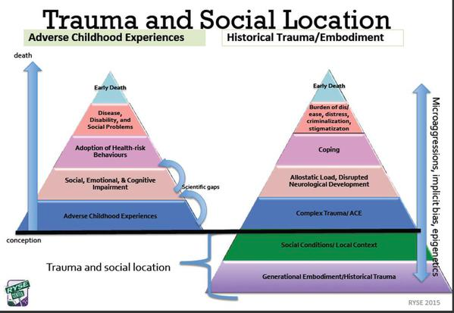
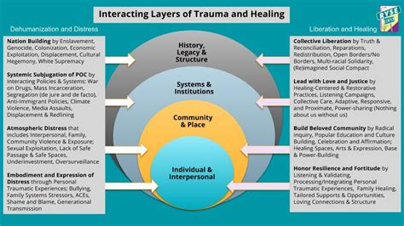
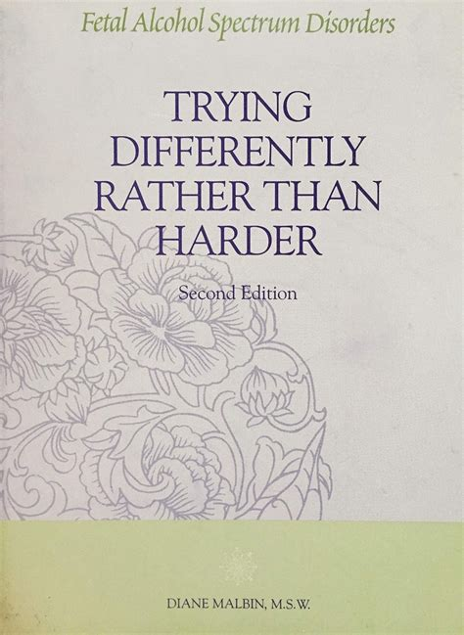
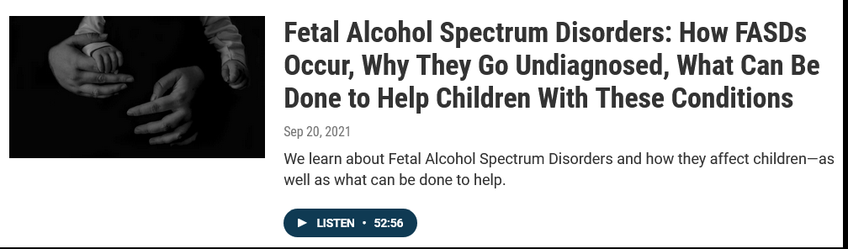


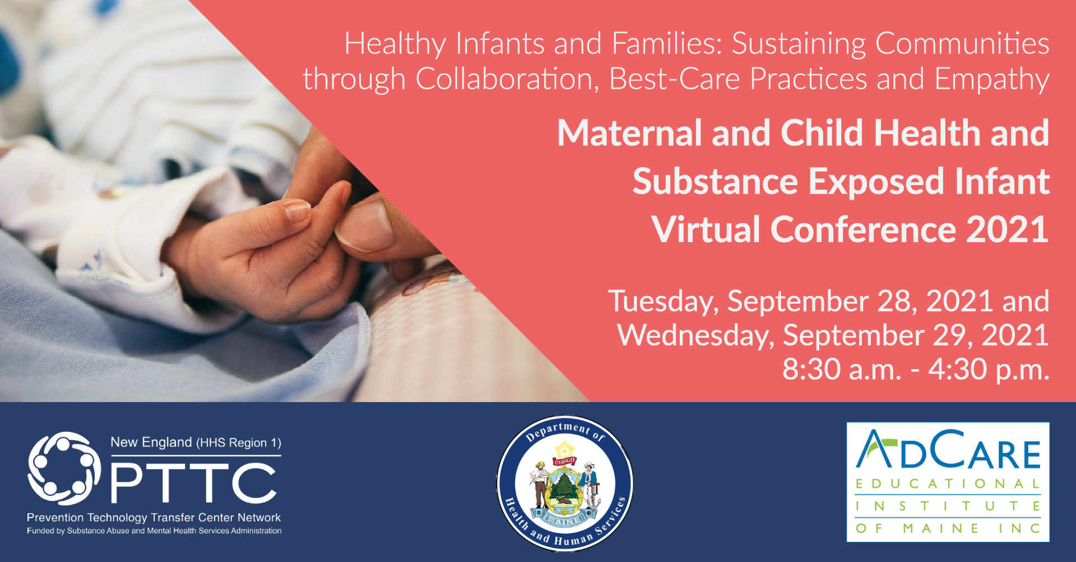


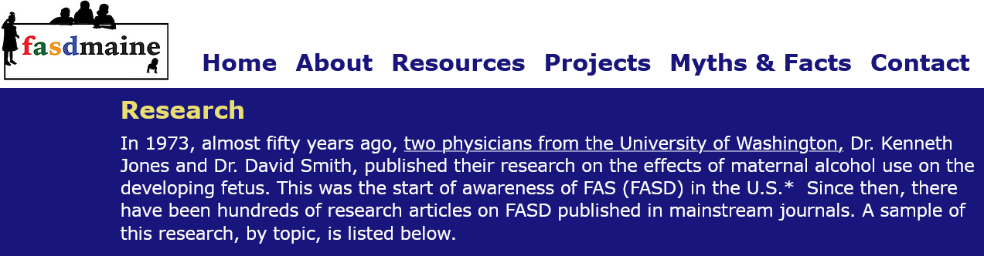
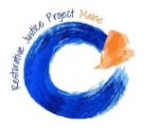
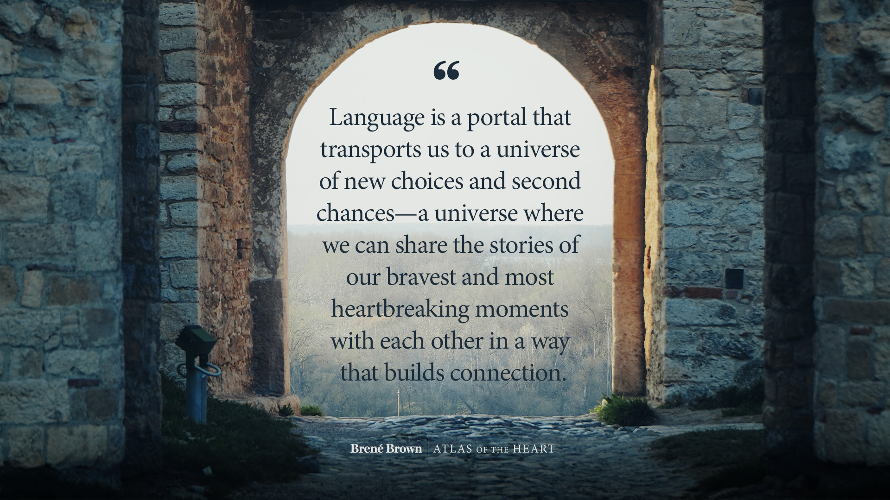
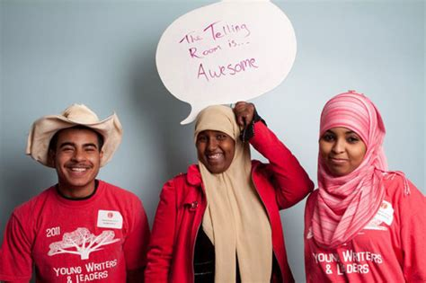

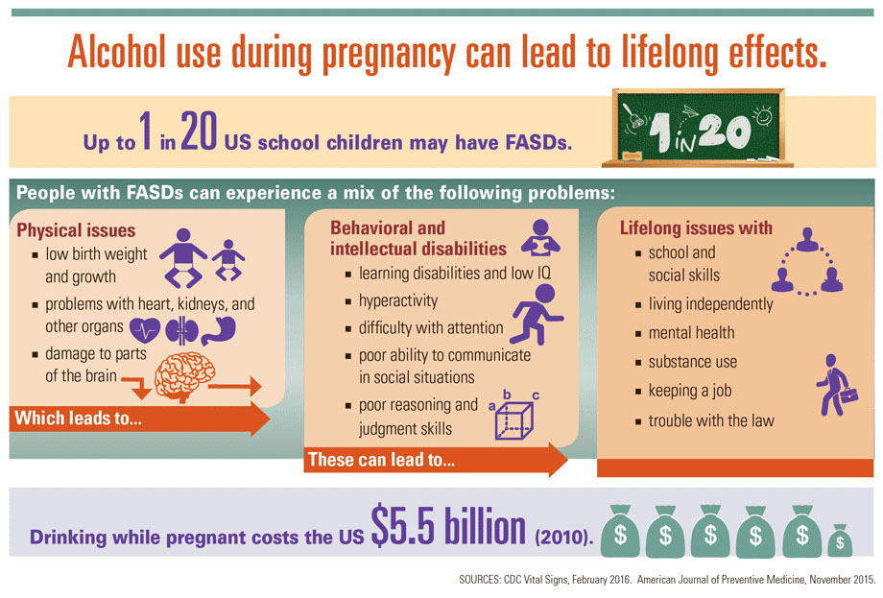

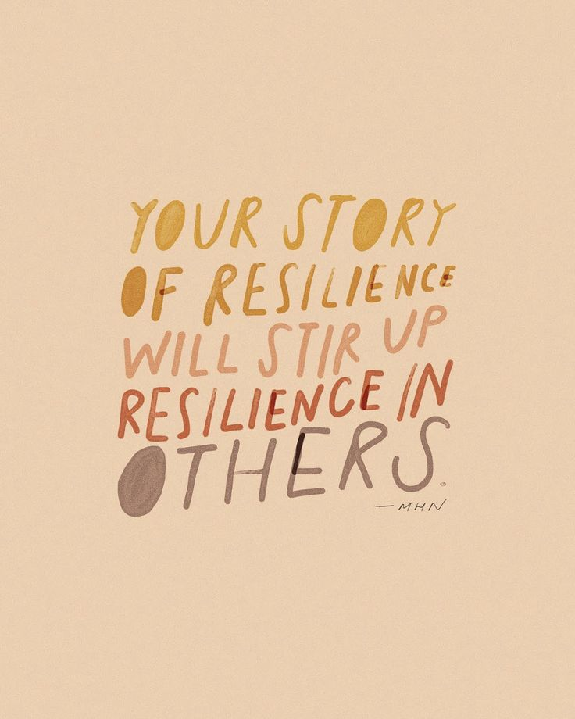
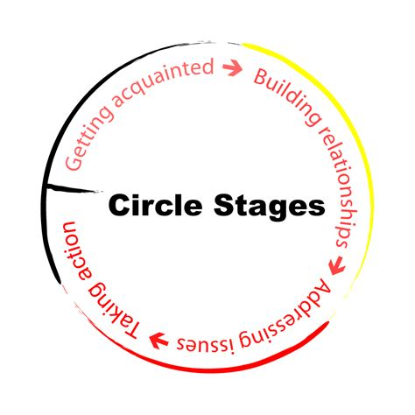
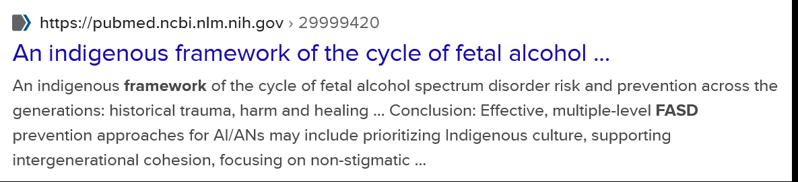

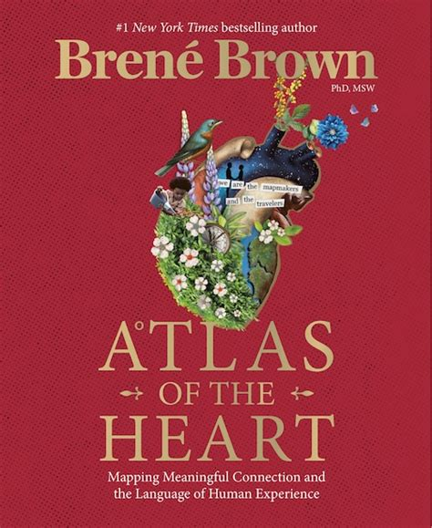

Restoring caregiver health through story stewardship
Peer listening for immediate support and long-term system improvement
.”
Andrea Dole, BA, Family and Social Work Trainee, NH-ME LEND, Center for Community Inclusion & Disability Studies, UMaine
Project: ‘Reclaiming our Stories’
Create ethical frameworks and processes for leveraging the collective wisdom, resources, and social analysis inherent in stories:
Open-access to peer support and social learning
Culturally-humble application of universal design principles
Resilience-oriented frameworks that center lived-experience
Personal and collective healing, leadership and transformation
Process:
inclusive multi-media learning and mentoring
Results: Peer-Listening Pilot & Reflection
LEND Trainee collaborated with FASD Maine to create and pilot a successful storytelling process utilizing informed peer-listening:
Storytelling as a healing art that leverages peer-support
Respectful evidence-based Story Stewardship practices
Align with FASD-informed best-practices for caregiver support ^{5,4}
Grounded in Restorative Practitioner Core Competencies ⁶
Working with principles of Grounded Theory Research ⁵
This process can be extended or repeated one-on-one or in groups, and/or as part of a peer-led Grounded Theory research project.
FASD Maine provided access to high quality, inclusive, multi-media materials, in-depth opportunities for Trainee to learn about FASD, and mentorship in developing FASD-informed systems of care.
FASDMaine.org provides up-to-date research on best practices. “Caregiver supports should emphasize self-care, provide support for grief and loss, offer respite, promote social connection, enhance advocacy, and consider the multi-generational impacts of FASD.”
Leadership Partner - FASD Maine:
Madonna Mooney, Connie Mazelsky, Shannon Coray
“By being seen, I then see myself”
Grounded theory research validates life
FASD Maine is a grassroots educational and advocacy organization of family members affected by FASD and professionals who care for them. Since 2019, FASD Maine has worked diligently to increase awareness, public support, diagnostic capacity, and policy change.
Grounded theory (GT) research methods offer an opportunity for caregivers to experience validation of powerful lived-experiences and strengths. “The Basic Social Process (Bigus et al., 1982; Glaser, 1978) that arose is grounded in data, conceptualizing experiences of parents for parents.”
“I didn’t have to take care of your reaction to my exhaustion. You already know, ‘of course you’re dead-meat because you’re doing this!’ I felt really heard - with no interruptions (that’s not easy to do!) – no getting out of the heart into the head. Support is what keeps us alive; the heart; deep listening. There’s a loss and grief about the reality of the pervasiveness of FASD. And with cultural denial, there’s often a fear of going into these places.”
“…Sharing more of my experience yesterday lightened a load I was not completely aware I was carrying until I had a listener, you, to prompt my share and acknowledge my hard work. Your making space for my story was like the traveler who did not realize how thirsty and tired they were until someone offered them water and rest; and was not aware of their own strength or the challenges of their journey until they were given a moment to pause to see the many obstacles they had overcome and how far they had traveled.”
-Caregiver Storyteller reflections on peer-listening process pilot
Fetal Alcohol Spectrum Disorder (FASD)
FASD is the most common cause of intellectual disability and birth defects in the U.S. and covers a range of diagnoses.
Those more likely to use alcohol during pregnancy are white, 35 and older, with higher education and higher income.¹
FASD-informed systems of care use evidence-based practices to adapt the environment to create conditions for success for people with brain injury and their caregivers without shame or stigma.^{2,3,4}
5
research on ethical story-gathering practices
LEND Trainee pursued research and experiences related to stories:
Interview with Nick Whiston at Portland nonprofit The Telling Room: story as a healing art; ethical storytelling and use of stories
Support from Sandra Horne, Marnie Marnault, and Jen Maeverde of CCIDS at U Maine: consent, collaborative workflow, leadership
Online journal search: ethical and culturally humble FASD research methods and implications for ‘reclaiming our stories’
Collaboration with Restorative Justice Project Maine: Trauma-Informed Harm Repair Process related to Systems of Care
Online and print review of Grounded Theory Research methods and findings related to story, disability, caregiving, and healing
Conclusion: Peer-led processes heal & transform
Peer-led Restorative Practices and Grounded Theory research offer:
Connection-building frameworks that disarm shame and stigma
Culturally-humble centering of powerful lived-experiences
Healing, agency, sustainability: universal and ecological design
A sense of wholeness amidst struggle and clarity for action
1.May PA, et al. (2018) Prevalence of Fetal Alcohol Spectrum Disorders in 4 US Communities. JAMA.
2.Corrigan, P. W., Lara, J. L., Shah, B. B., Mitchell, K. T., Simmes, D., & Jones, K. L. (2017). The Public Stigma of Birth Mothers of Children with Fetal Alcohol Spectrum Disorders. Alcoholism, clinical and experimental research, 41(6), 1166–1173. https://doi.org/10.1111/acer.13381
3.Flannigan K, Pei J, McLachlan K, Harding K, Mela M, Cook J, Badry D and McFarlane A (2022) Responding to the Unique Complexities of Fetal Alcohol Spectrum Disorder. Front. Psychol. 12:778471. doi: 10.3389/fpsyg.2021.778471
4.Petrenko C. L. (2015). Positive Behavioral Interventions and Family Support for Fetal Alcohol Spectrum Disorders. Current developmental disorders reports, 2(3), 199–209. https://doi.org/10.1007/s40474-015-0052-8
5.Brown, B (2021) Atlas of the Heart: Mapping the Language of Meaningful Human Connection “A Grounded Theory on Cultivating Meaningful Connection: Developing Grounded Confidence, Practicing the Courage to Walk Alongside, Practicing Story Stewardship”
6.Restorative Justice Project Maine, Restorative Practitioner Harm Repair Series (2021 Training): “Restorative Justice Practitioner Core Competencies: Growing Equity, Development & Trauma-Informed, Self-Care, Preserves Restorative Practitioner Role, Balances Power Dynamics, Respects Dignity of all Participants, Promotes Voluntariness, Invites Holistic Dialogue, Practices Restorative Mindset, Balances Flexibility with Guiding, Demonstrates Groundedness, Actively Self Reflects”
Trauma-informed, Culturally-inclusive, Accessible, Equity Promoting, Power-Balacing, Stress-Relieving, Unburdening, Awareness-Building, Physiologically Sound, Turning the tide on cycles of abuse and shame. Sustainable, Aesthetic, Efficient: appealing to multiple needs of busy, overtaxed caregivers and professionals

