Slide 1
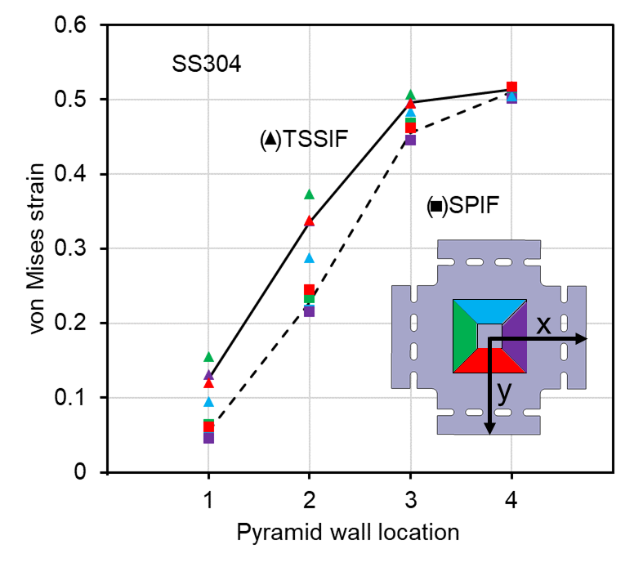
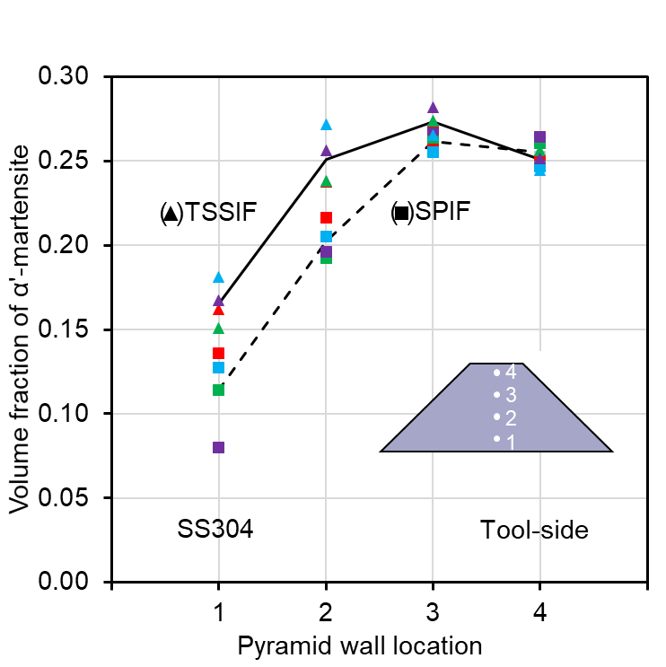
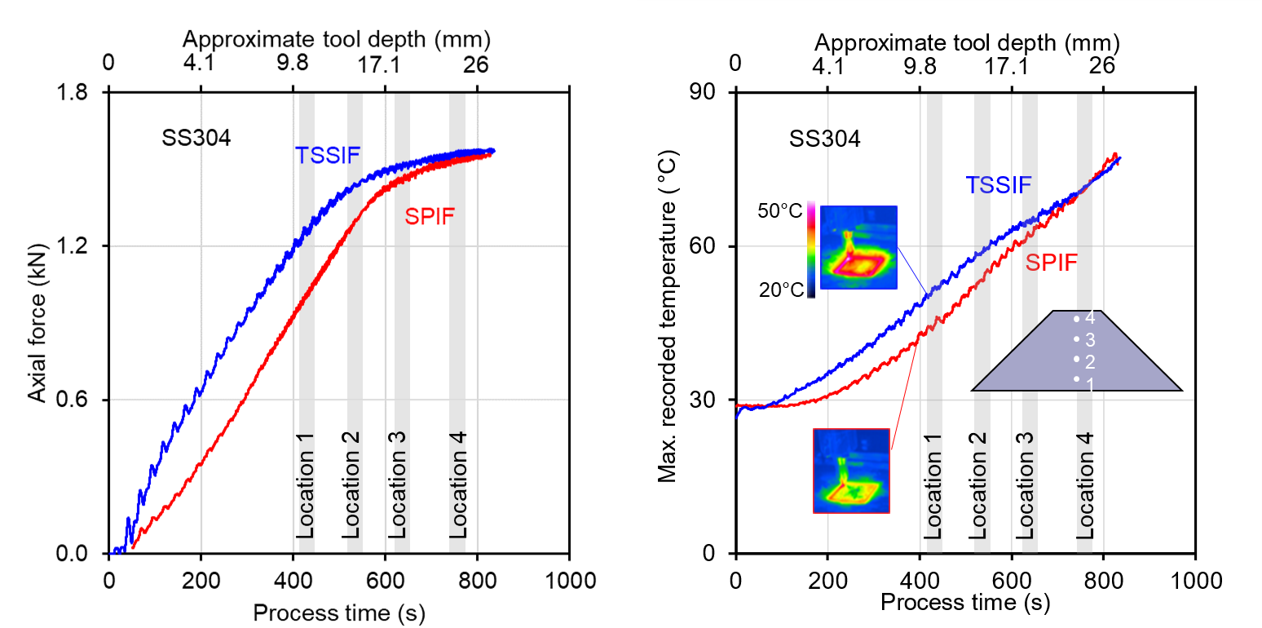
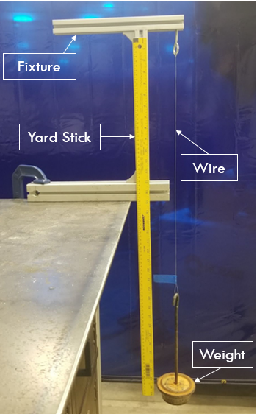
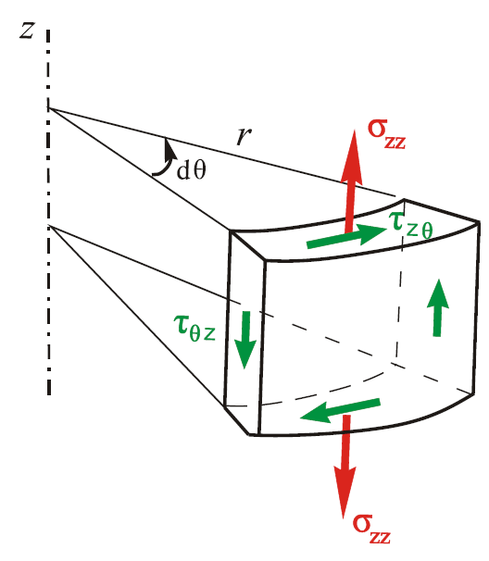
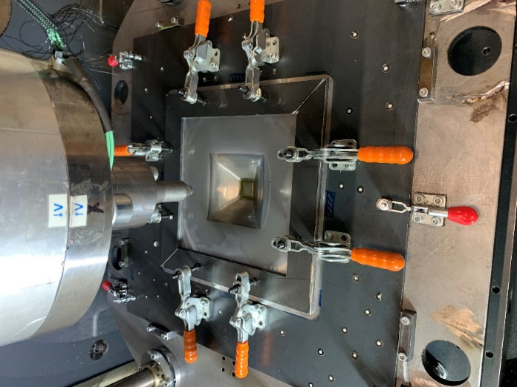
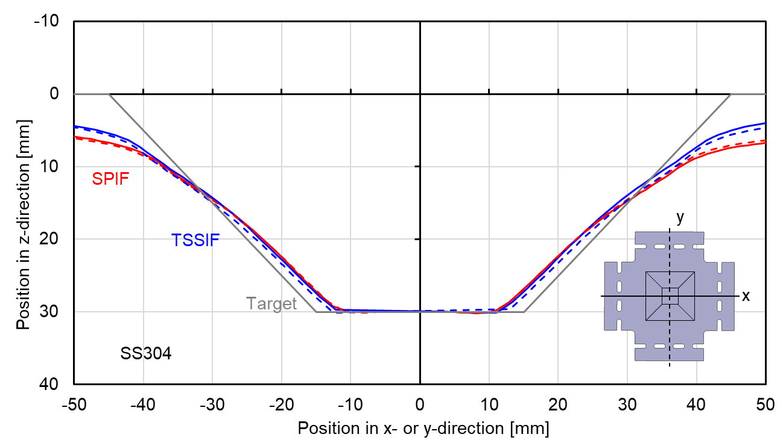
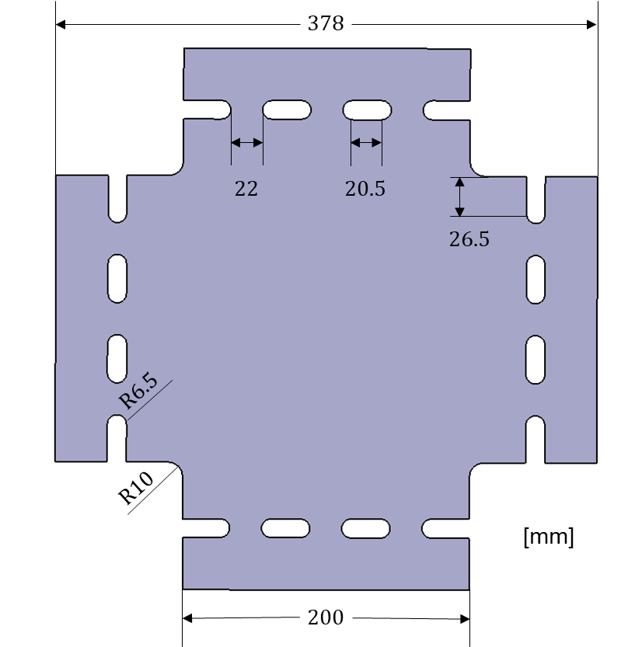
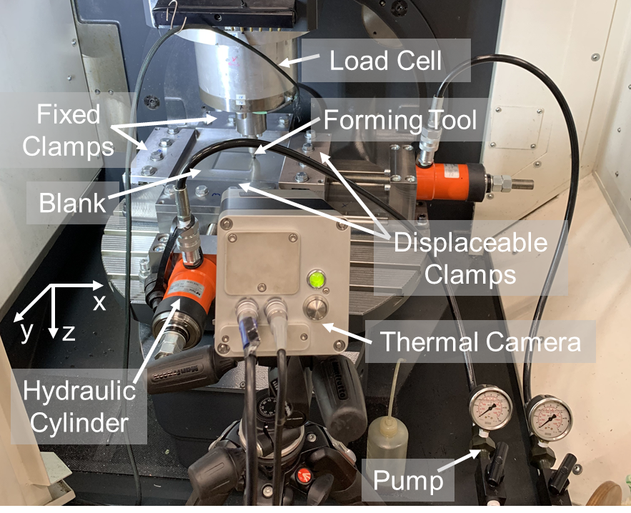
Effects of tensile stress superposition in incremental forming on martensitic transformation and springback of SS304 truncated square pyramids
Elizabeth M. Mamros¹, Fabian Maaß², Marlon Hahn ², A. Erman Tekkaya ², Jinjin Ha¹, Brad L. Kinsey¹
¹Mechanical Engineering Department, University of New Hampshire
²Institute of Forming Technology and Lightweight Components, TU Dortmund University
Introduction
Hypothesis
Martensitic Transformation
Patient-specific, metallic trauma fixation hardware, e.g., plates that hold severely fractured bones together during healing, have conflicting requirements, i.e., high strength in regions
Superposing additional stresses into single point incremental forming, e.g., stress-superposed incremental forming, increases the phase transformation in specific regions leading to heterogeneous material properties and characteristics.
where screws are located yet low weight in the remainder of the component. Like natural biomaterials, a heterogeneous structure is required, but how to design and manufacture such a biomaterial is a challenging, state-of-the-art research area.
Process Force and Temperature
Trauma hardware example [1].
TSSIF (triangles) and SPIF (squares) square pyramidal frustums:
(left) von Mises strain and (right) volume fraction of α’-martensite measured on tool-side. Average values are shown as solid (TSSIF) and dashed (SPIF) lines.
Stress Superposition
Objective
Develop accurate models to determine deformation paths, i.e., tension pre-stress and toolpaths in incremental forming, that exploit stress superposition to achieve the desired final part properties
TSSIF resulted in increased phase transformation and equivalent strain at Locations 1, 2, and 3 in pyramid walls
Consistent with force and temperature results, the largest differences between the processes were observed at Locations 1 and 2
No discernible patterns were evident with respect to the different faces
Electron backscatter results were collected for select locations to validate trends evident in Ferritescope measurements (not shown)
Stress Superposition
The incorporation of additional stresses into an existing manufacturing process during a single operation
Incremental forming process: (left) axial force (z-force) and (right) maximum temperature recorded by infrared camera.
TSSIF initially required higher forming forces, due to lower susceptibility to bending than SPIF, and subjected the blank to increased temperatures
Near the end of the forming process, the forces and temperatures for the two processes were approximately equal
Conclusions
Reduces required forming forces
Increases material formability
Allows for customization
Stress superposition experiment: lengthening of wire by twisting (torsion).
Geometry and Strain Contours
TSSIF compared to conventional SPIF results in:
Initially increased process temperatures and axial forces
Greater geometrical accuracy, particularly in part height
Larger uniform strain area along pyramid walls
Increased phase transformation at Locations 1, 2, and 3
Methodology of using tensile stress superposition in IF successfully enhances the martensitic transformation kinetics and improves the geometrical accuracy of the final part
Tensile Frame
TSSIF – Tensile Stress-Superposed IF
Tool(s)
DSIF – Double-Sided IF
SPIF – Single Point Incremental Forming (IF)
MTIF – Multi-Tool IF
Next Steps
Die
CSSIF – Compressive Stress-Superposed IF
y
Conduct numerical simulations of TSSIF and SPIF processes with phase transformation user material subroutine (UMAT) for comparison with experimental results
Establish fundamental understanding of dominating effects in phase transformation kinetics at varying points throughout the toolpath
Measure and compare residual stresses in TSSIF and SPIF parts
*Combination
Profiles along the center of pyramidal frustums in the x- (solid) and y- (dashed) directions for target geometry and parts manufactured by SPIF and TSSIF.
Examples of process variations that use stress superposition in incremental forming.
TSSIF Experimental Setup
Overall, TSSIF showed increased geometrical accuracy compared to SPIF in particular with respect to the part height
Material: SS304 ($t=0.8$ mm)
During forming:
Temperature
Thermal camera
X, Y, Z forces
Load cell
After forming:
Final strain state
Geometry profile
Photogrammetry camera (ARGUS)
Phase transformation
Magnetic induction (Ferritescope)
SPIF
TSSIF
0.60
0.45
Acknowledgements
Pyramidal frustum target geometry.
von Mises strain
0.30
Supported by the US National Science Foundation EPSCoR award (#1757371), Institute of International Education – Graduate International Research Experiences (NSF #1829436), the German-American Fulbright Commission, and the Germanistic Society of America.
x
4
0.15
y
3
0
References
Specimen blank geometry.
2
4
3
2
1
x
10 mm
1
10 mm
y
Final strain state for unclamped parts manufactured by SPIF and TSSIF.
*Poster based on: Mamros, E.M., Maaß, F., Hahn, M., Tekkaya, A.E., Ha, J., and Kinsey, B.L. (2022) Superposing tensile stresses into single point incremental forming to affect martensitic transformation of SS304. International Deep Drawing Research Group Conference. IOP Conf. Ser.: Mater. Sci. Eng., 1238(1), p. 012085.
Photo credit: Adams, M. and Marcoux, E.
TSSIF created larger uniform strain areas on the pyramid walls
Relatively uniform sheet thickness, i.e., consistent thinning, is expected along the pyramid walls for parts formed by both processes.
IF experimental setup.
Notes:
Patient-specific, metallic trauma fixation hardware, e.g., plates that hold severely fractured bones together during healing, have conflicting requirements, i.e., high strength in regions where screws are located yet low weight in the remainder of the component. Like natural biomaterials, a heterogeneous structure is required, but how to design and manufacture such a biomaterial is a challenging, state-of-the-art research area. In this work, the metal forming deformation paths were intentionally manipulated to promote the transformation of stainless steel 316L to a stronger martensite phase while assuring more ductility elsewhere. Material characterization was performed on a custom-fabricated biaxial loading machine to probe unique deformation paths. A novel biaxial specimen geometry was designed in collaboration with the National Institute of Standards and Technology (NIST) to achieve large strain values in the gauge region and as a result, enhance martensitic transformations. Digital Image Correlation and thermal imaging were utilized to measure surface strains and temperature, respectively, in-situ. The martensitic transformation of specimens was measured by electron backscatter diffraction. These results were also compared with the martensite volume fractions resulting from uniaxial experiments reported in previous research. Finite element analyses were conducted to investigate the stress states resulting from the varying deformation paths. Future work will include incorporating phase transformations into the numerical simulations to allow for volume fraction predictions to determine optimal deformation paths for a rapid prototyping, incremental forming machine to produce custom, biocompatible components with the desired final heterogeneous part properties.

