Slide 1
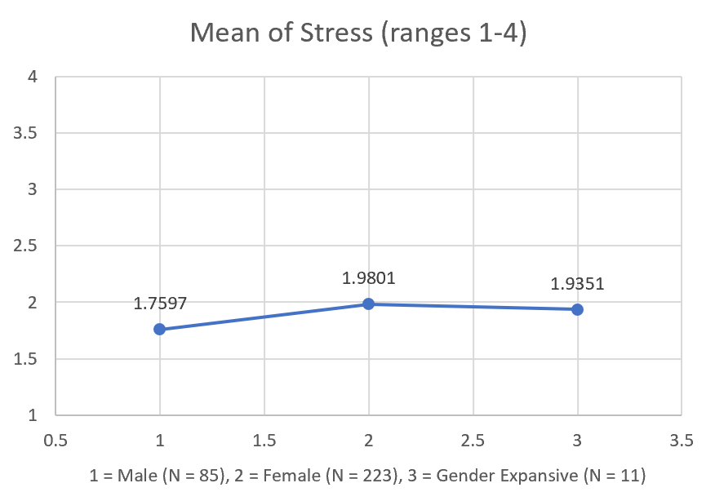
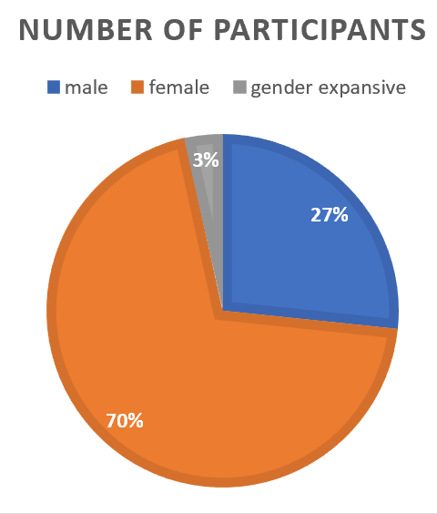
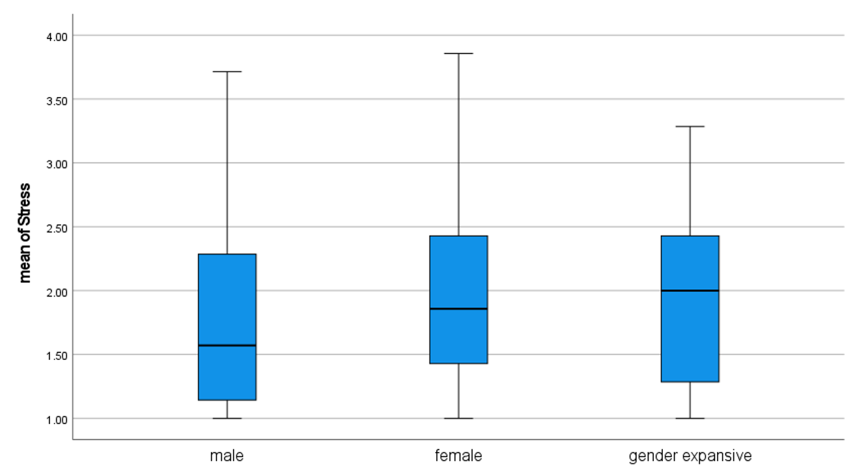
The Relationship Between Collegiate Student-Athlete
Gender Identity and Mental Health
Levone Lee¹, Meg Knuettel¹, Danielle Renner¹, Kate Maimone¹, Tarkington J. Newman¹, Kelly Thorne², Valerie Moyer³,
Nadine Mastroleo⁴, Patricia Kelshaw¹, Marsha Florio³, Adrienne Ekas⁵, Dolores Cimini⁶, Melissa Bessaha⁷, Karen Collins¹
University of New Hampshire¹, University of Vermont², America East Academic Consortium³, Binghamton University⁴,
University of Maryland, Baltimore County⁵, University at Albany, SUNY⁶, Stony Brook University⁷
Introduction
Method
Results
NCAA student-athletes are known to similar, and in some instance higher levels of, mental health concerns compared to their nonathlete peers (Blanco et al., 2008). In fact, one study indicated that 48% of female NCAA student-athletes and 31% of male NCAA student-athletes experience symptoms of depression and/or anxiety (Moreland et al., 2018). Further, LGBTQ+ student-athletes are less likely to participate in athletics compared to their heterosexual and cisgender peers and may feel more vulnerable in athletics settings (Kulick et al., 2019). However, there is a lack of understanding of mental health concerns among NCAA student-athletes based on gender identity. Therefore, the current study aims to examine the relationship between gender identity and the levels of stress, anxiety and depression among NCAA student-athletes.
A total of 320 collegiate student-athletes from eight universities within a single NCAA Division 1 athletic conference participated in the study. The majority identified their sex as female (n = 223, 69.9%), followed by male (n = 85, 26.6%) and gender expansive (n = 11, 3.5%). Additionally, the majority of participants identified as white (n = 286, 84%), followed by biracial (n = 19, 6%), and Black (n = 15, 4%). In total, 18 sports were represented (e.g., Soccer 12.9%, Track and Field 12.3%, Cross Country 12%, etc.)
The Depression Anxiety Stress Scales-21 (DASS-21; Lovibond & Lovibond, 1995) was used to independently measure depression, anxiety, and stress. To test differences of means regarding mental health indicators across groups of different gender identities, three one-way ANOVA analyses were employed. Post-hoc tests were performed to identify significant differences between pairs of means, such as a significant difference in the average level of stress between male and female student-athletes.
Female student-athletes had the highest average levels of depression (M = 1.85, SD = 0.72), anxiety (M = 1.70, SD = 0.06), and stress (M = 1.98, SD = 0.66), compared to student-athletes identifying as males or gender expansive. Between females and males, the difference regarding the mean level of stress was significant (p < .05) but there was only a weak association (η² = .02). Further, student-athletes who identified as gender expansive had higher median levels of depression (Mdn = 1.85) and stress (Mdn = 2.00) than those who identified as either male or female.
Implications & Conclusions
The present study observed that student-athlete gender identity is associated with differences in mental health outcome indicators. Athletic departments should consider offering gender specific mental health resources and support. Moreover, given research (DeFoor et al., 2018) has indicated that those receiving mental health treatment may do favorably if the provider’s gender identity matches that of the client’s, athletic departments should consider such information when hiring mental health professionals. Finally, future studies ought to strive for more focused sampling techniques to enhance the representation of gender minorities, in order to gain a better understanding of their distinctive lived experiences.
References
Blanco, C., Okuda, M., Wright, C., Hasin, D. S., Grant, B. F., Liu, S. M., & Olfson, M. (2008). Mental health of college students and their non–college-attending peers: results from the national epidemiologic study on alcohol and related conditions. Archives of general psychiatry, 65(12), 1429-1437.
DeFoor, M. T., Stepleman, L. M., & Mann, P. C. (2018). Improving wellness for LGB collegiate student-athletes through sports medicine: a narrative review. Sports medicine-open, 4, 1-10.
Kulick, A., Wernick, L. J., Espinoza, M. A. V., Newman, T. J., & Dessel, A. B. (2018). Three strikes and you’re out: Culture, facilities, and participation among LGBTQ youth in sports. Sport, Education and Society.
Moreland, J. J., Coxe, K. A., & Yang, J. (2018). Collegiate athletes' mental health services utilization: A systematic review of conceptualizations, operationalizations, facilitators, and barriers. Journal of sport and health science, 7(1), 58-69.
For more information, contact Levone Lee at Levone.Li@UNH.edu.

