Slide 1
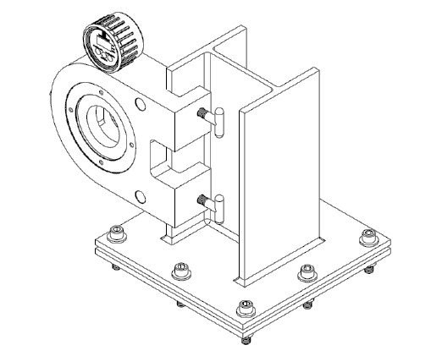
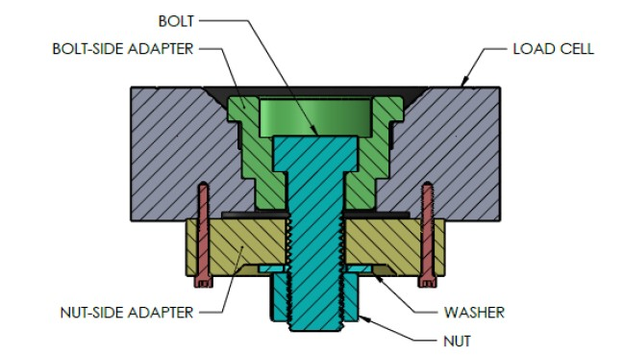
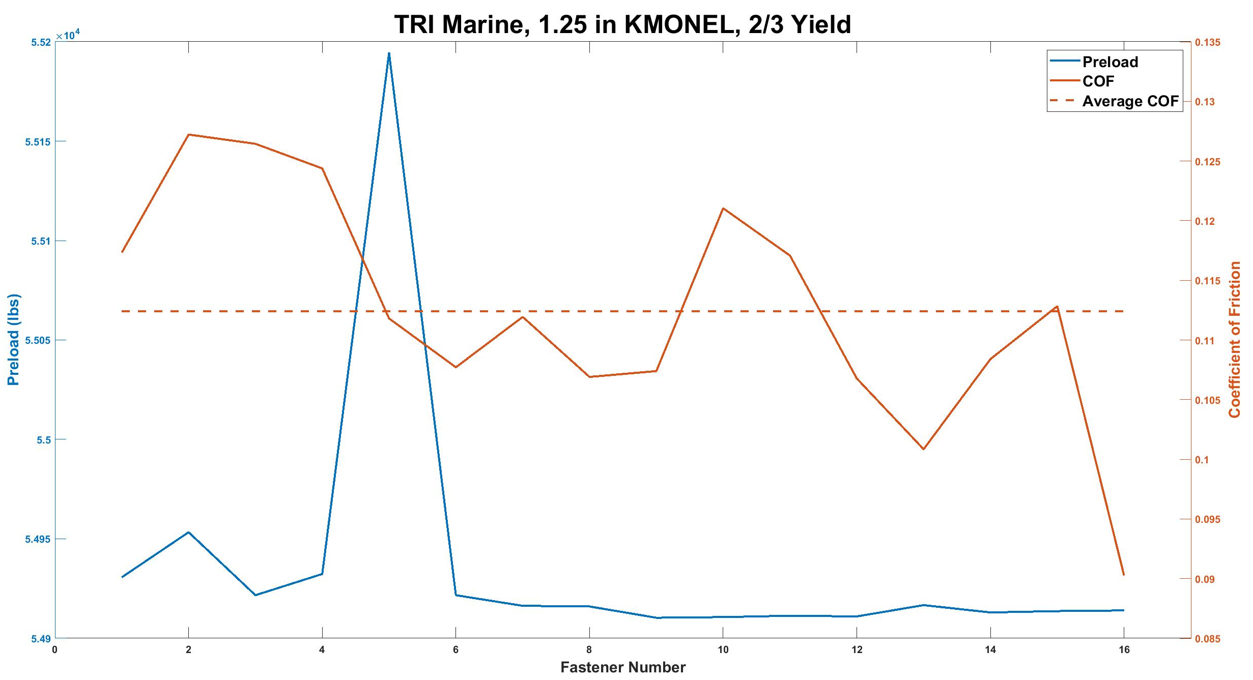
Reducing the Variability and Cost of Determining the Coefficient of Friction of Various Lubricants James Wirth Physics & Astronomy, University of New Hampshire, Durham, NH 03824
Introduction
Equipment
Recommendations
For fastening applications in US Navy, the coefficient of friction (COF) for the lubricant used must be known in all cases where a torque value is specified
There are few lubricants with a known COF that the Navy has approved for use. These can be more expensive and less effective than other lubricants with an unknown COF
Portsmouth Naval Shipyard (PNS), is performing tests to determine the COF for several lubricants, so these lubricants may be used in torqued applications
I was tasked by PNS to determine the COF of two lubricants and to optimize the testing process
Image #1: Testing Apparatus
Image #2: Load Cell Configuration
Decrease number of fasteners to 9 per group
Have two people watching the load cell
Purchase a step stool, larger ultrasonic cleaner, impact wrench, and a new machine to automate the process
Continue actions that help with the repetitive and mundane nature of the testing
Have a clearly defined system for cleaning and testing, so all those involved know where all the fasteners are in the testing procedure
If a calculated torque yield falls between two torque wrenches or torque multipliers, choose a torque value that will only require one of these tools. The relationship between the torque and preload is necessary, not the projected values
There is not a correlation between the consistency of the preload and the COF value (Graph #1), but torque multipliers/automation will take out any chance of error that this could cause. Also, torque multipliers/automation will decrease the time of the testing, because fatigue of the tester will not be an issue
Further recommendations were given
Image #1: The MZ-100 load cell and testing fixture.
Image #2: A cross section of the MZ-100 which displays how a fastener is loaded into the device for testing.
Methodology
Data Tables
Used both experimental and computational methods
Experimental:
Calculated the COF through testing a total of 256 fasteners, with a total of 1536 COF data points per lubricant (Table #1)
Made recommendations for non-procedural changes by determining ways to increase safety, decrease time, or decrease the repetitive nature of the testing
Computational:
Calculated a new quantity of fasteners to test for each lubricant while maintaining a high degree of confidence in the COF value (Table #3)
Plotted the data to determine trends or other information from the tests (Graph #1)
Table #1: Example Data Section
Impact from Recommendations
Past Impact
Pros
Decreased number of manhours by approximately:
200.5 hrs. decrease from projected to January tests
41.5 hrs. decrease from summer to January tests
Increased consistency of preloads
Reduced risk of injury by ergonomic correction, less repetitive actions, etc.
Reduced the need of PNS network connection
Impact in the Future if Recommendations are Followed
Pros
Decreased the number of manhours by 165.5 hrs. based on the January testing
Reduced cost by decreasing the number of fasteners
Further increased consistency of preloads
Increased diversity of user
Reduced storage
Better operating procedure which requires less skill and less risk of damaging the equipment
Less calibration required
Cons
More offsite upkeep of the machines
Table #1: An example of the data that is collected during testing.
Table #2: COF Results
Procedure
Table #2: The calculated COF results for both lubricants
For each fastener, there is a calculated 1/3 and 2/3 yield preload target value (read from the load cell) and torque value (read from torque wrenches or multipliers)
The fastener is cleaned, lubricated, and inserted in the load cell (Image #2), then is tightened until the 1/3 yield preload target is reached, then the torque is recorded. The fastener is then tightened to the 2/3 yield preload target, and the torque is recorded. After these two readings, the nut is loosened to remove all preload on the system. This process is repeated two more times (for a total of three times) for each fastener
The washer crush diameter is then determined by measuring the diameter of the circle scribed on the washer by the nut
The COF for each fastener may then be calculated using this equation:
Table #3 was calculated using the following equation for a confidence interval where CI is the confidence interval, t is the t-value for the specific confidence percentage, and s is the standard deviation of the data:
$$n={(\frac{ts}{CI})}^{2}$$
CI was determined to be 5% of the average because a 5% error is commonly accepted
Resulting Analysis
Graph #1: Consistency of Preload Argument
Table #3: Calculated Number of Fasteners per Group
References
DDS-COF-TP-0060 - Procedure for Determining the Coefficient of Friction of Various Lubricants on Common Naval Fastener Materials
C206.4 Summer Assignment – Data Analysis
S9086-CJ-STM-010; Naval Ships’ Technical Manual Chapter 075 – Fasteners
Skidmore Wilhelm – Model MZ-100 Bolt Tension Calibrator, User Manual, 2009, www.skidmore-wilhelm.com
Skidmore Wilhelm – HT-4000 User Manual, 6/24/2020
Tone Digitorqon – PD150ENA and PD300ENA, Instruction Manual No. 1409
Graph #1: Consistency in the preload values does not have a correlation to more consistent coefficient of frictions values.
Table #3: These calculated values show that a set of 16 fasteners per group is not necessary to maintain a high degree of confidence in a 5% error range.
Acknowledgements
Portsmouth Naval Shipyard
CACI Inc. - FEDERAL

