Slide 1


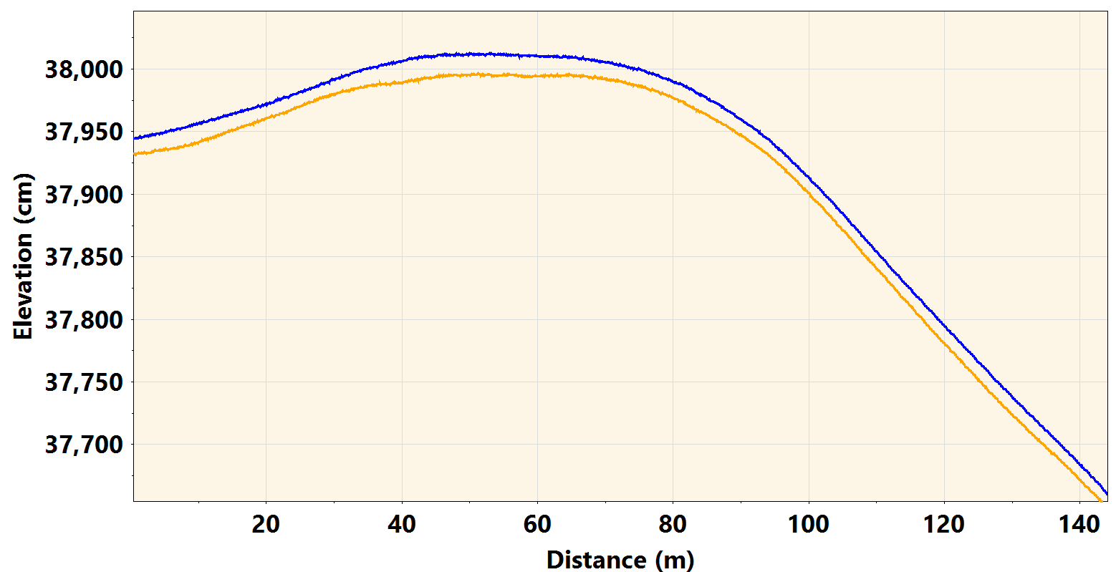

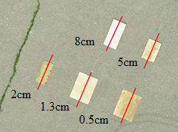
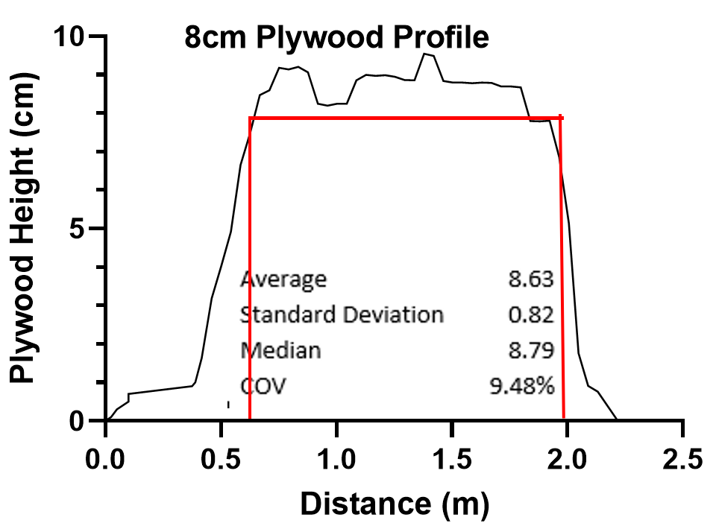
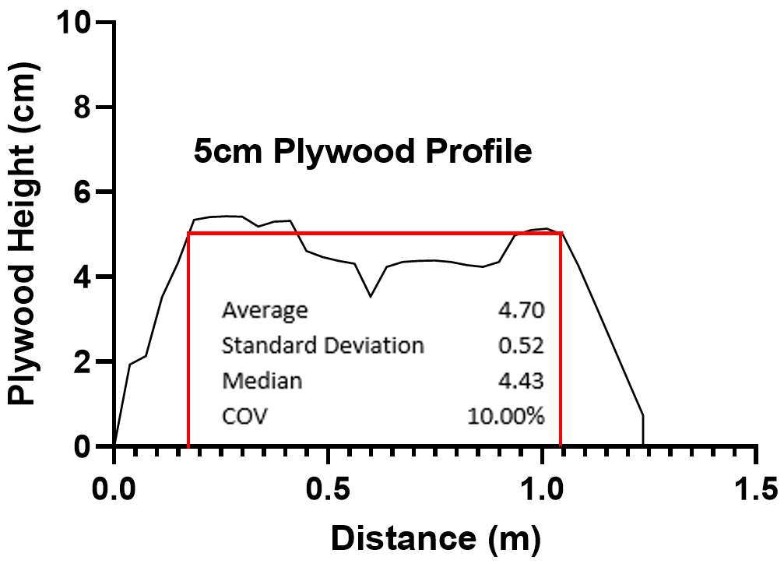
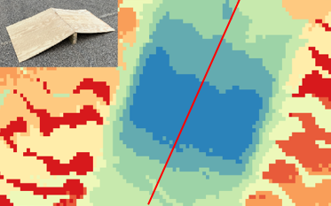
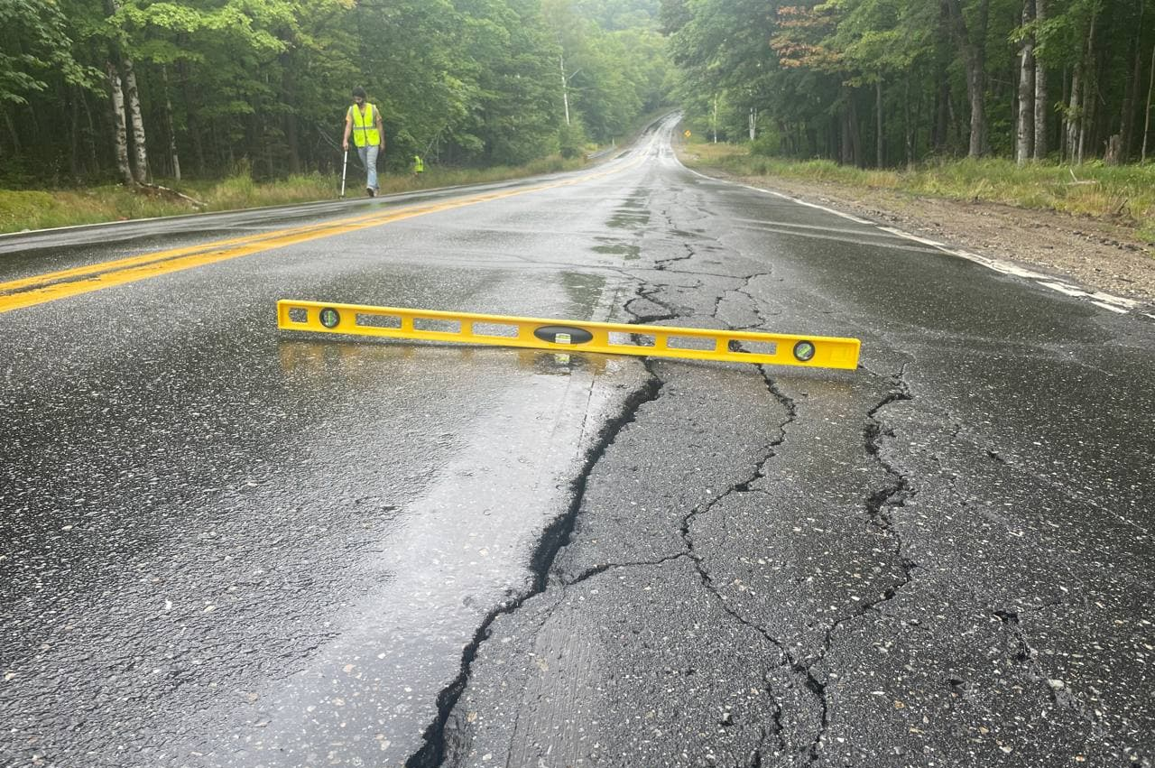
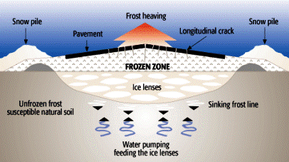
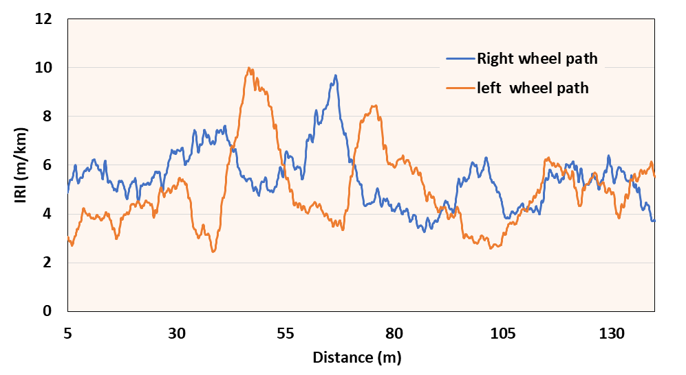
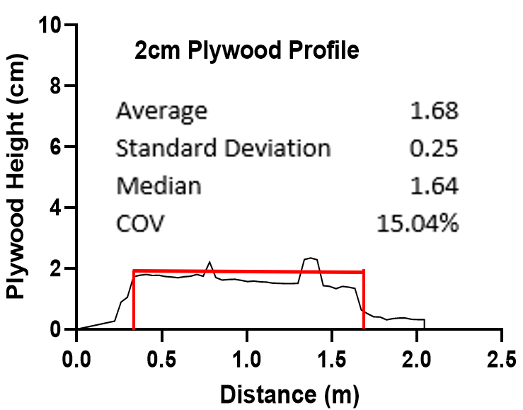
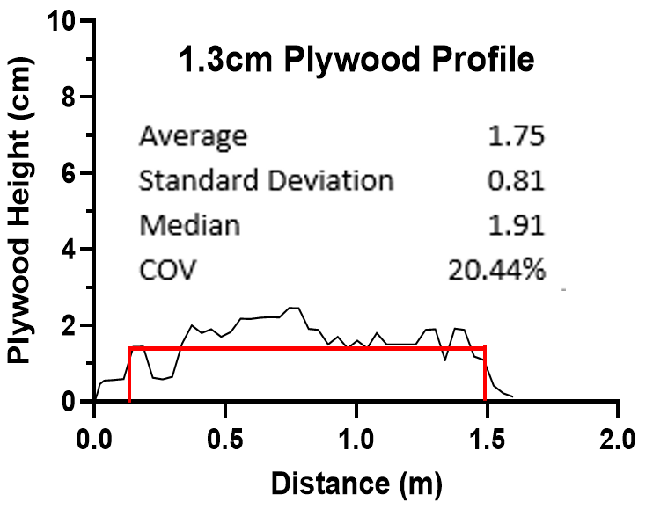
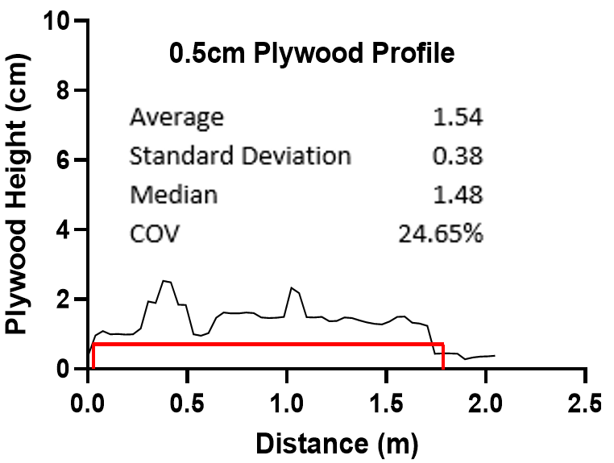
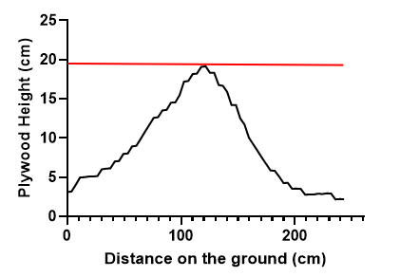
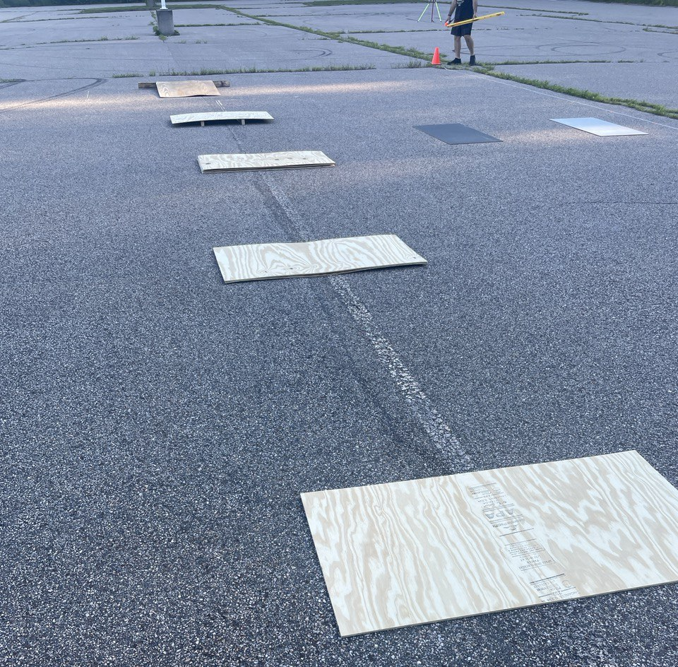
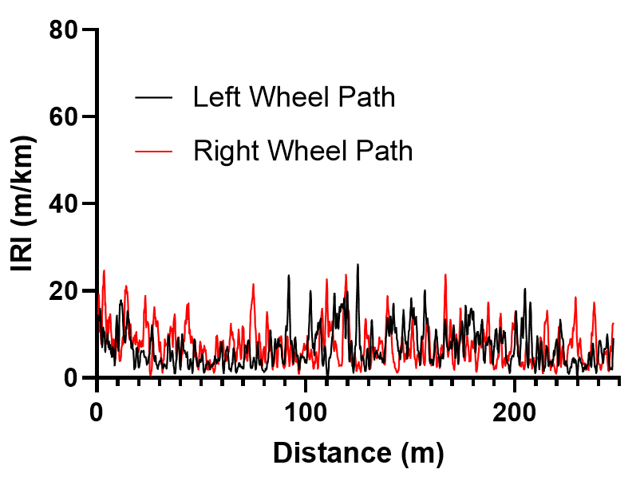
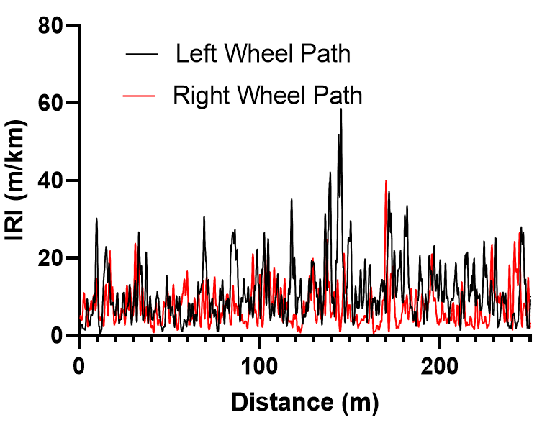
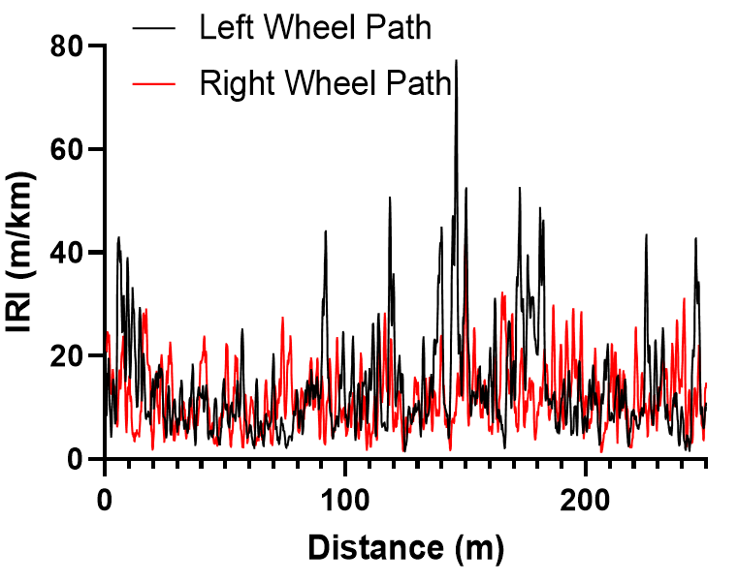
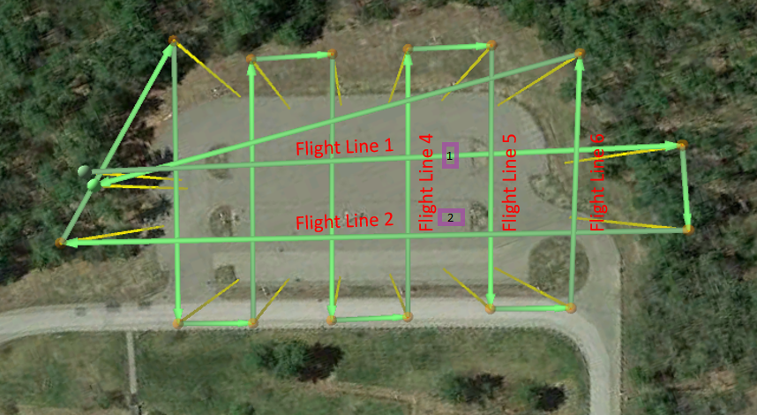
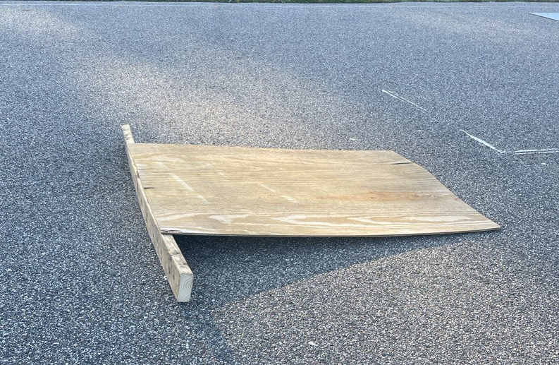
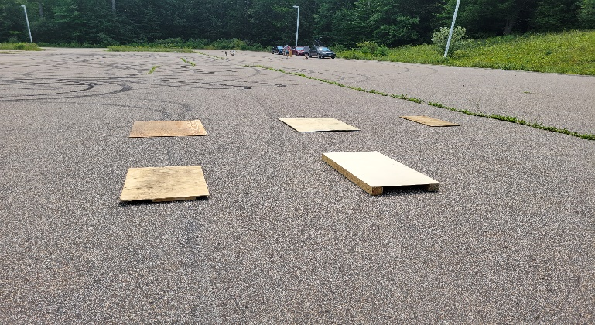
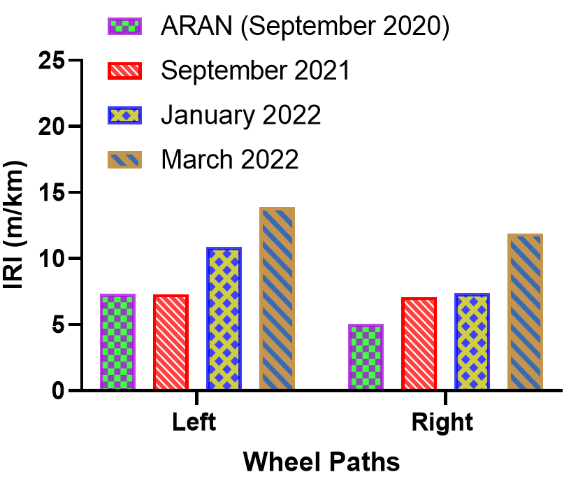
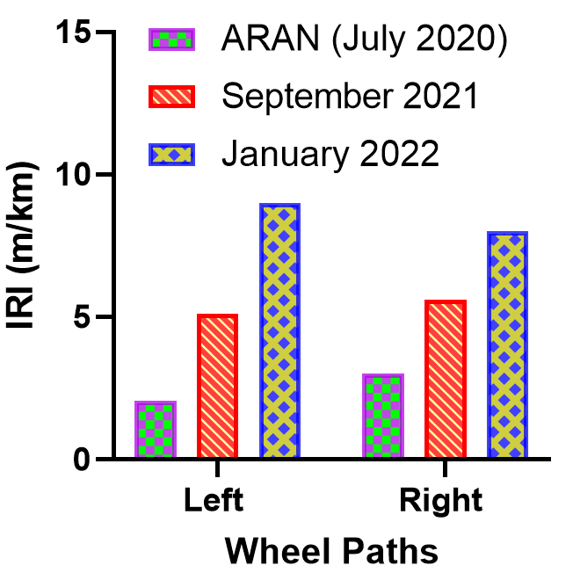
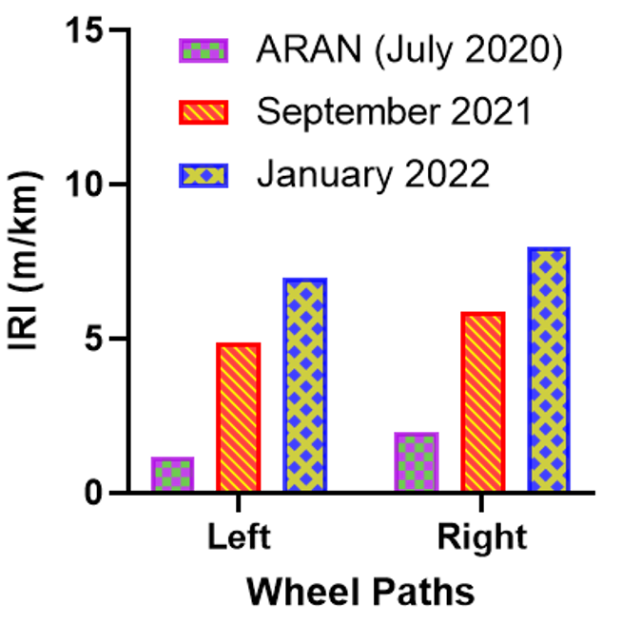
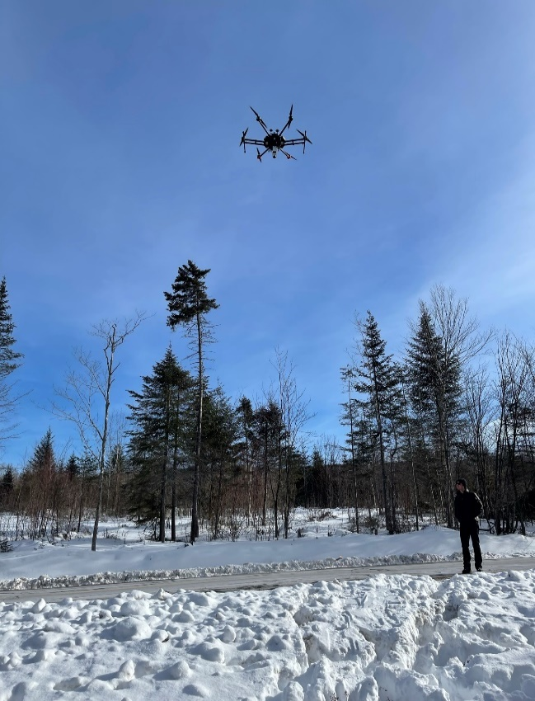
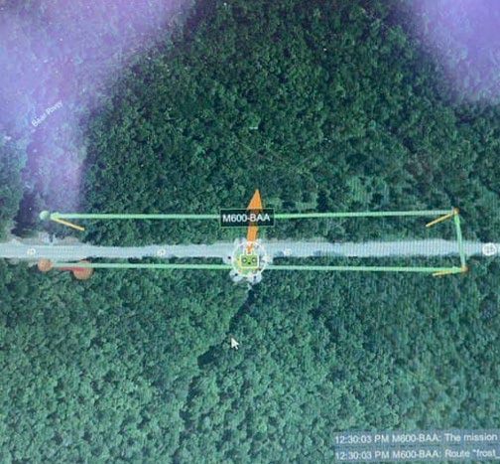
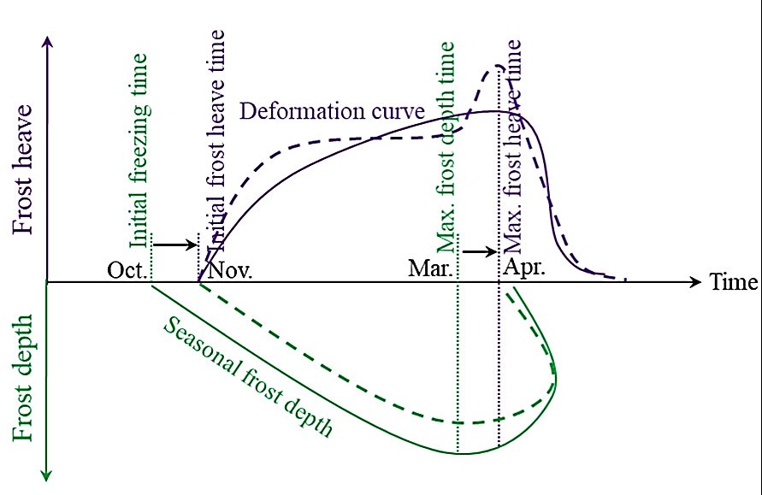
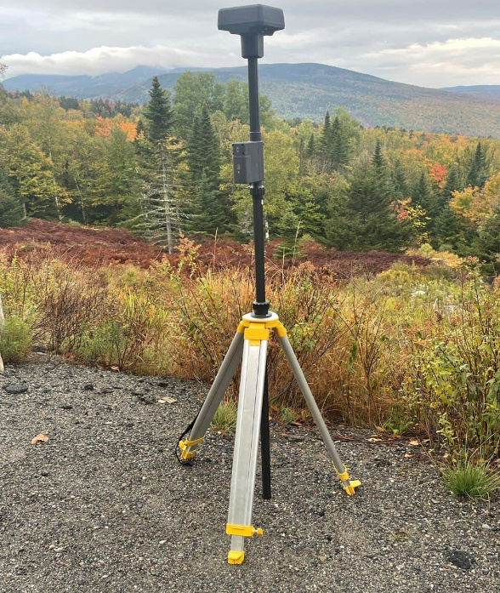
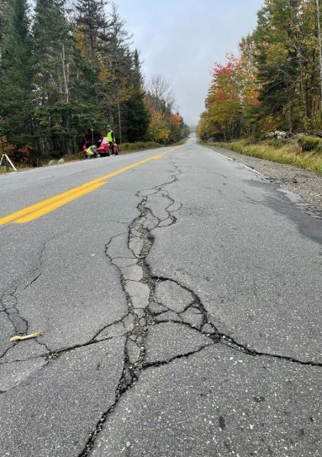
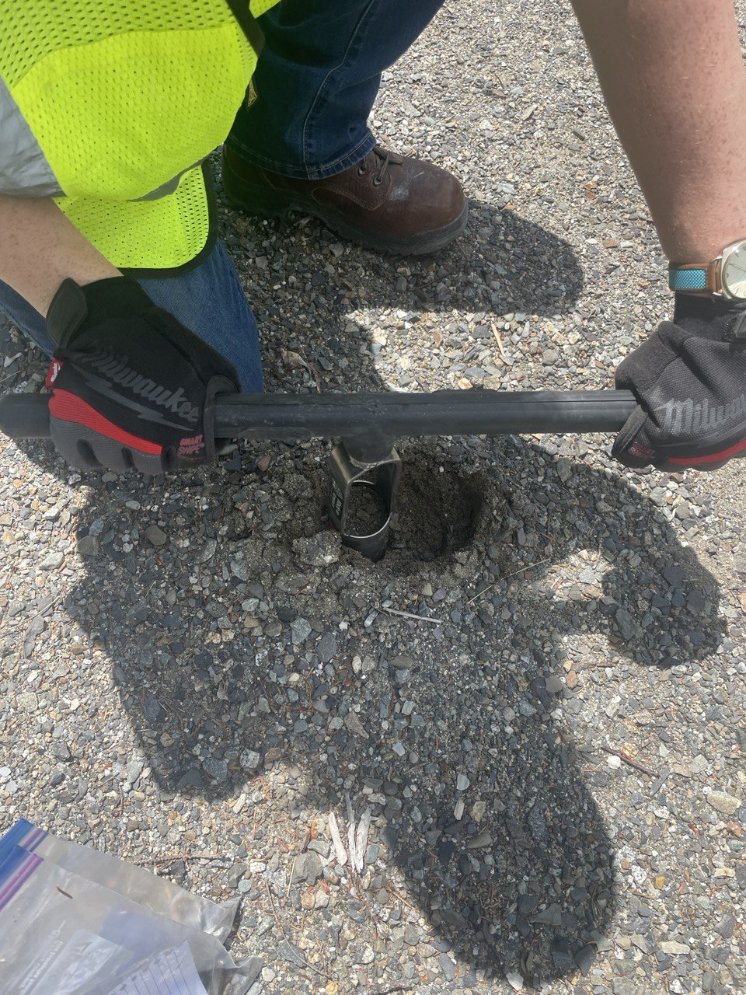
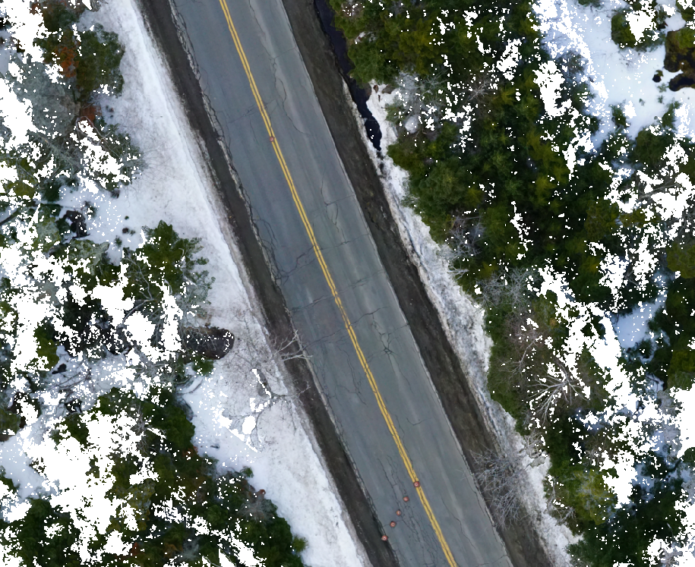
Development of a UAS-based Sensing Approach to Detect and Measure Pavement Frost Heaves
Farah Zaremotekhases (fz1008@usnh.edu), Adam Hunsaker, Eshan V. Dave, Jo E. Sias
Department of Civil and Environmental Engineering, University of New Hampshire
Introduction and Background
Data Acquisition and Processing
Results and Discussion
Frost heave is one of the major distresses in cold climate regions, which could lead to pavement surface cracking and an extensive surface roughness.
UAS-based systems are an effective and accurate system to assess the pavement condition in airfields and roadways in inaccessible regions.
Flights on Simulated Frost Heaves
Simulated frost heaves profile (solid red line: actual plywood height, black line: as sensed profile)
Road profile constructed from DEM
Motivation & Objectives
Improve safe road and air transportation in remote cold climate regions.
Develop measurement protocols and data analysis systems for frost heave using UAS and mobile platforms.
Adopting a machine vision automate pavement roughness measurements to calculate the extent of road roughness due to frost heave distresses.
Ride quality analysis results from ProVAL
Flights on Simulated Frost Heaves
Flights on In-Service Pavement Sites
Variables:
Flight pattern
Velocity
Altitude
Surface color
Number of returns
Different geometries
Ride quality analysis results for one of the field sections in September, January, and March:
September
January
March
Data Acquisition and Processing
  Flights conducted at two types of locations.
  Simulated heaves in a controlled location and in-service pavements at several field sites.
  LiDAR, optical, was performed.
  Measurements were conducted periodically on the pavement sections throughout summer, winter and spring.
  Point Cloud and QGIS are used to extract and analyze the LiDAR and Photogrammetry data.
  The extracted elevation data from the DEMs were used as an input for the Profile Viewing and Analysis (ProVAL) software.
  Pavement surface roughness has been calculated in terms of the International Roughness Index (IRI).
Comparing ride quality analysis results under the wheel paths:
Flights on In-Service Pavement Sites
Conclusions and Planned Work
Thermal–mechanical change process of subgrade in frozen ground regions
Photogrammetry elevation models can detect subtle elevation changes made by artificial frost heaves.
Pavement surface profile can be constructed from extracted photogrammetry elevation data providing a better understanding of the road condition and elevation changes due to the formation of the frost heaves.
The collected elevation data from optical imaging in different seasons can be used to measure the pavement surface roughness in terms of IRI.
The applied technology can help keep track of changes in pavement surface roughness and IRI values due to the formation of the frost heaves in freezing temperatures.
There is a reasonable agreements between IRI measurements using UAS-sensed with those measured using currently standardized measurement method.
As a next step, a machine vision-based algorithm will be adopted to calculate the extent of road roughness due to frost heave distresses, which can support safe aircraft and vehicle operations in remote locations.
UAS flight over the field sections
LiDAR flight pattern on the field
Acknowledgment
The authors would like to acknowledge Maine Department of Transportation (MaineDOT) for supporting this study. This material is based upon work supported by the Broad Agency Announcement Program and the Cold Regions Research and Engineering Laboratory (ERDC-CRREL) under Contract No. W913E5-21-C-0006
Captured photogrammetry image
GPS receiver
Sections with varying degrees of frost susceptibility
Soil sampling

