Slide 1
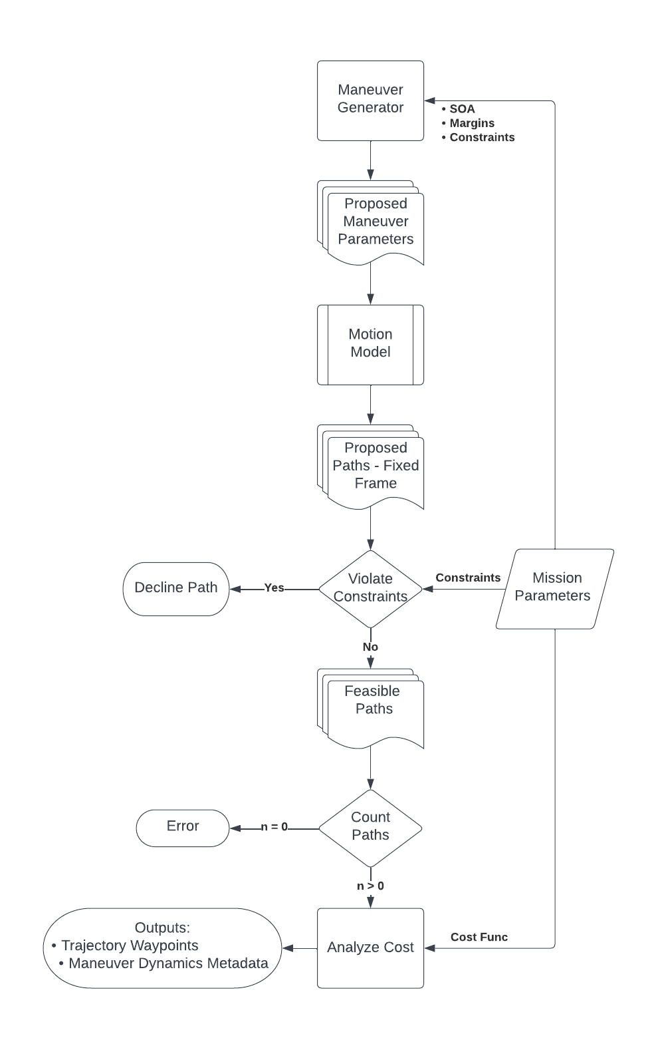
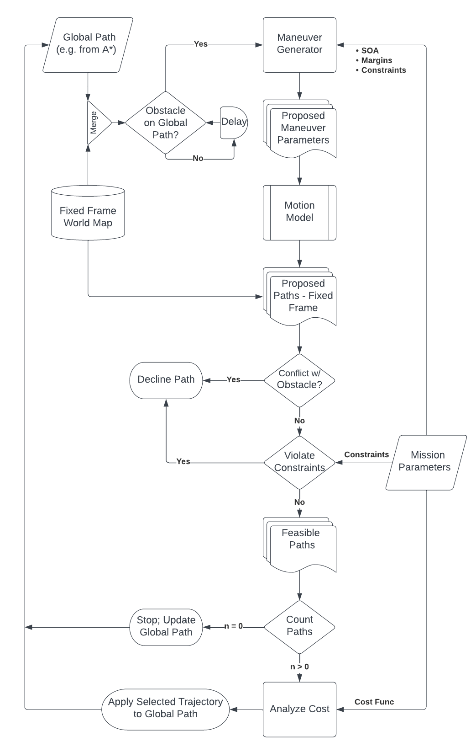
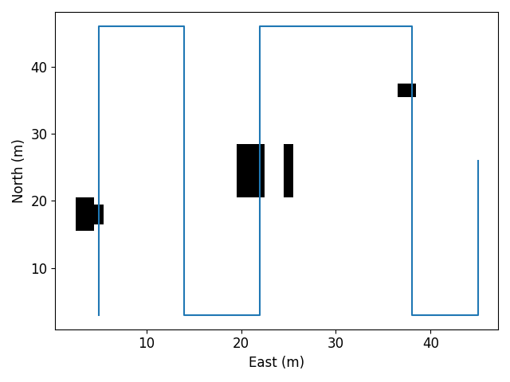
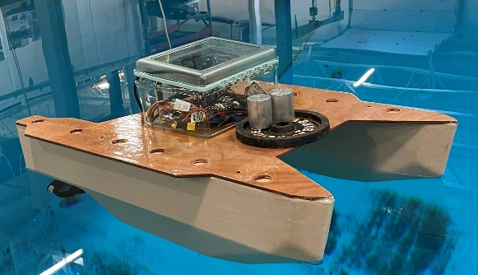
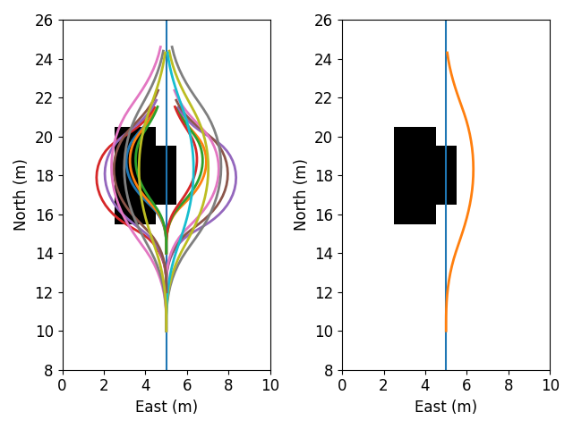
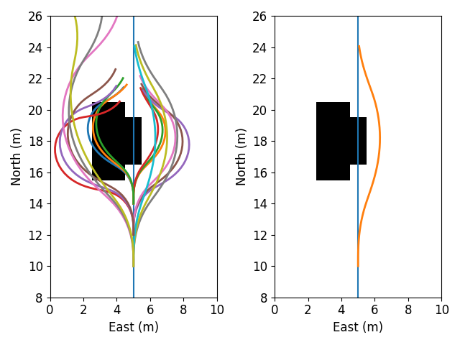
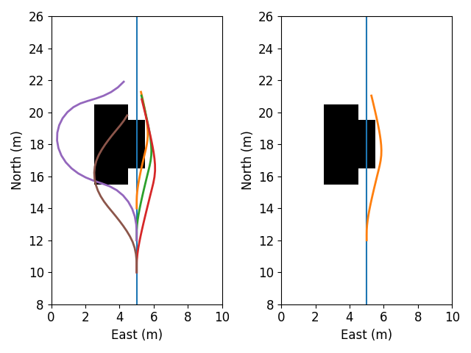
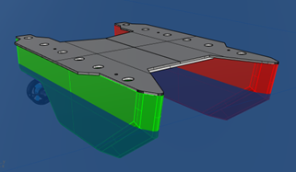
Autonomous Surface Vehicle Model-Based Motion Planning Nicholas Custer, Advisor: Prof May-Win Thein Ocean Engineering, University of New Hampshire, Durham, NH 03824
Introduction
Motion Planning Algorithm
Obstacle Avoidance Scenario
Model Development
Safe path planning is a fundamental aspect of autonomous surface vehicle (ASV) operation and cannot all be completed a priori. In situ methods are needed to address the many contingencies an ASV may face. Human supervision is often employed; however, to achieve full autonomy, the vehicle system itself must be “able to make decisions and determine actions by itself.” [1]
Marine vehicles dynamics are characterized by relatively large inertia (due to mass and added mass) and damping compared with vehicles operating in other domains. Additionally, traditional surface vehicle configurations are underactuated. These characteristics constrain the set of dynamically feasible paths available when planning a maneuver for contingencies like obstacle avoidance.
Some proposed methods place dynamic constraints on grid search algorithms to produce kinematically continuous paths. [2] [3] A downside of these methods is that they allow for high frequency unsteady inputs to the system, increasing transient conditions and accentuating modeling error.
This research investigates a model-based motion planning approach to design, model, and select hydrodynamically feasible maneuvers in response to a contingency scenario. Maneuvers are built from steady-input legs to reduce the influence of transients, leveraging the natural hydrodynamic motion of the vehicle as a human pilot would.
Stages:
Maneuver
Generator
Motion Model
Analysis and
Decision
The Motion Planner is triggered when an obstacle is detected on the planned trackline.
Six Degree of Freedom Body-Fixed Motion Model
$$\left(m−X_{\dot{u}}\right)\dot{u}+\left(mz_{G}−1/2 X_{\dot{u}}T\right)\dot{q}=$$
$$\begin{aligned}\begin{aligned}mrv+mx_{G}\left(r^{2}+q^{2}\right)−mwq−mz_{G}pr+ρgA_{WP}\left(Δz\right)\sin\left(θ\right)+ \\ X_{Hull}+X_{Res}+X_{Prop}+X_{Wind}\#\end{aligned}\end{aligned}$$
$$\left(m−Y_{\dot{v}}\right)\dot{v}−\left(mz_{G}+Y_{\dot{p}}\right)\dot{p}+\left(mx_{G}−Y_{\dot{r}}\right)\dot{r}=$$
$$\begin{aligned}\begin{aligned}m\left(pw−ru−z_{G}qr−x_{G}pq\right)−ρgA_{WP}\left(Δz\right)\sin\left(φ\right)\cos\left(θ\right)+ \\ Y_{Hull}+Y_{Prop}+Y_{Wind}\#\end{aligned}\end{aligned}$$
$$\left(m−Z_{\dot{w}}\right)\dot{w}−\left(mx_{G}+Z_{\dot{q}}\right)\dot{q}$$
$$\begin{aligned}m\left(uq−vp+z_{G}\left(p^{2}+q^{2}\right)−x_{G}rp\right)−ρgA_{WP}\left(Δz\right)\cos\left(φ\right)\cos\left(θ\right)+ \\ ρgA_{WP}x_{f}θ−2ζ_{w}ω_{w}w\#\end{aligned}$$
$$−\left(mz_{G}+K_{\dot{v}}\right)\dot{v}+\left(I_{X}−K_{\dot{p}}\right)\dot{p}+\left(mx_{G}z_{G}−K_{\dot{r}}\right)\dot{r}=$$
$$\begin{aligned}\begin{aligned}m\left(z_{G}ur−z_{G}wp−x_{G}z_{G}pq\right)+\left(I_{Y}−I_{z}\right)qr−mgGM_{TO}\sin\left(φ\right)\cos\left(φ\right)\cos\left(θ\right)+ \\ K_{Hull}+K_{Prop}+K_{Wind}−2ζ_{φ}ω_{φ}p\#\end{aligned}\end{aligned}$$
$$\left(mz_{G}−0.5X_{\dot{u}}T\right)\dot{u}−\left(mx_{G}+Z_{\dot{q}}\right)\dot{w}+\left(I_{Y}−M_{\dot{q}}\right)\dot{q}=$$
$$\begin{aligned}m\left(z_{G}vr−z_{G}wq+x_{G}vp−x_{G}uq+x_{G}z_{G}\left(p^{2}−r^{2}\right)\right)+\left(I_{Z}−I_{X}\right)pr− \\ mgGM_{LO}\sin\left(θ\right)\cos\left(φ\right)\cos\left(θ\right)+ρgA_{WP}x_{F}Δz+M_{Prop}−2ζ_{θ}ω_{θ}q\end{aligned}$$
$$\left(mx_{G}+N_{\dot{v}}\right)\dot{v}−\left(mx_{G}z_{G}−K_{\dot{r}}\right)\dot{p}+\left(I_{Z}−N_{\dot{r}}\right)\dot{r}=$$
$$\begin{aligned}m\left(x_{G}wp−x_{G}ur+x_{G}z_{G}qr\right)+\left(I_{X}−I_{Y}\right)pq− \\ ρg∇\left(−GM_{LO}\cos\left(θ\right)+GM_{TO}\right)\sin\left(φ\right)\sin\left(θ\right)+N_{Hull}+N_{Prop}+N_{Wind}\#\end{aligned}$$
Algorithm inputs that are known a priori are stored onboard in the mission parameters database, which includes:
Mission Plan
Waypoint List
Speed of Advance
Obstacle Map Resolution
Look Ahead and Alert Ranges
Typical Maneuver Definitions:
Thruster Actuations
Maneuver Durations
Expected Rate of Turn
Permutation Scaling Factors
Mass and location documented for each vehicle component to determine mass, center of gravity, and moment of inertia.
Hydrodynamic derivatives determined from low aspect air foil theory [4]
Time domain simulations completed via ode3 fixed time step solver
Propulsor thrust forces modelled via experimental bollard thrust measurements [5] and quadratic decay model for vehicle speed of advance [6].
Motion model adapted for this application from [7] and [8]
Parameterization and Simulation Results
Research Vehicle
The computational demand of the motion model solver is managed by limiting the number of candidate maneuvers. Novel parameterization schemes in the Maneuver Generator stage accomplish this using knowledge of the vehicle’s dynamics and the scenario to explore the solution space with a small number of maneuvers. Three parameterization schemes for static obstacle avoidance are outlined below.
Example obstacle avoidance scenario: The planned vehicle trackline (shown in blue) is defined by a waypoint list. Three obstacles (shown in black) are positioned along the trackline.
Avoiding the south-west obstacle is explored in simulations below.
Acknowledgements
This research is supported by the U.S. Coast Guard, Coast Guard Academy Department of Naval Architecture & Marine Engineering, NAVSEA Naval Engineering Education Consortium (grant N00174-20-1-0006), NH SeaGrant, John Ahearn, and the members of Team MANTARAY.
References
[1] IMO (International Maritime Organization), (2021). Outcome of the regulatory scopng exercise for the use of maritime autonomous surface ships (MASS). MSC.1/Circ. 1638
[2] Du, Z., Wen, Y., Xiao, C., Huang, L., Zhou, C., & Zhang, F. (2019). Trajectory-cell based method for the unmanned surface vehicle motion planning. Applied Ocean Research, 86, 207-221.
[3] Liu, D. Y., Gao, X. P., & Huo, C. (2022). Motion planning for unmanned surface vehicle based on a maneuverability mathematical model. Ocean Engineering, 265, 112507.
[4] Lewis, E. V. (1989). Principles of naval architecture: Motions in waves and controllability. Society of Naval Architects and Marine Engineers.
[5] BlueRobotics(2019). T-200 public performance data 10-20V September 2019. < https://bluerobotics.com/store/thrusters/t100-t200-thrusters/t200-thruster-r2-rp/>
[6] Allotta, B., Costanzi, R., Fanelli, F., Monni, N., Paolucci, L., & Ridolfi, A. (2017). Sea currents estimation during AUV navigation using Unscented Kalman Filter. IFAC-PapersOnLine, 50(1), 13668-13673.
[7] Fossen, T. I. (1999). Guidance and control of ocean vehicles. University of Trondheim, Norway, Printed by John Wiley & Sons, Chichester, England, ISBN: 0 471 94113 1, Doctors Thesis.
[8] Taimuri, G., Matusiak, J., Mikkola, T., Kujala, P., & Hirdaris, S. (2020). A 6-DoF maneuvering model for the rapid estimation of hydrodynamic actions in deep and shallow waters. Ocean Engineering, 218, 108103.
Speed of Advance (SOA) Scheme
In Situ Input: collision location, vehicle state
Approach: use a priori typical maneuver definitions for mission SOA to explore solution space
Obstacle Geometry Scheme
In Situ Input: collision location, vehicle state, obstacle width on each side of the trackline
Approach: (1) start from SOA scheme results, (2) adjust turning moment and leg duration to suit obstacle width
Clear Headings Scheme
In Situ Input: collision location, vehicle state, obstacle map
Approach: (1) check obstacle map for clear headings on either side of the trackline, (2) shape maneuvers to following clear headings
Hulls and Deck CNC Milled from CAD Model
Hull Material: Model Foam
Deck Material: Plywood
Epoxy Encapsulated
Dual Thrusters
Differential Thrust Steering
Principal Dimensions
Length Overall | 100 cm
Beam | 50 cm
Displacement | 10 kg
Top Speed | 2 m/s

