Slide 1

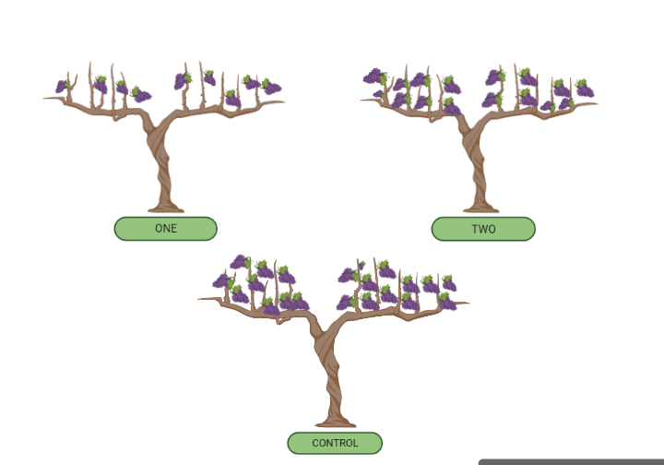
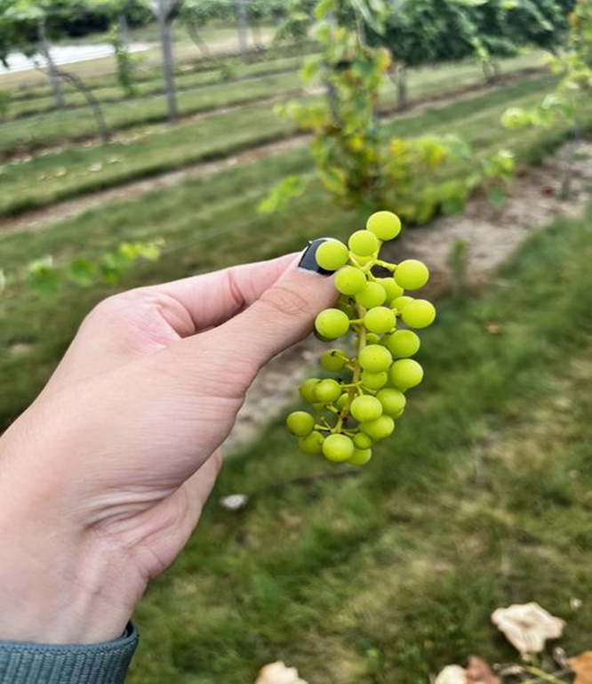
Effect of Cluster thinning on Fruit yield and quality in ‘Canadice’ and ‘Mars’ seedless table grapes grown in two different training systems.
Radhika Rani, Rebecca Grube Sideman, Ella Lukacz and Marley Gonsalves
University of New Hampshire, Durham, NH
Introduction
Treatment Structures
Results
Cluster thinning is a common practice of removing clusters to reduce the excess crop load and to improve vine vigor and fruit quality including cluster weight, berry weight and total soluble solids.
Previous work done focusing on the effect of cluster thinning on V.vinifera table grapes has shown positive outcomes in terms of fruit quality and composition, but much less information is available on the effect of cluster thinning for the interspecific (V. labrusca, V. vinifera, and others) seedless table grape cultivars that are adapted to New Hampshire.
Objectives; Hypothesis
The objective of this study was to evaluate the effect of cluster thinning on Total yield, berry weight, cluster weight, and Total soluble solids (TSS) of seedless table grape cultivars grown in two training systems.
We hypothesized that cluster thinning would reduce total yields while increasing fruit and cluster quality.
Treatment ONE = One cluster per shoot
Treatment TWO = Two clusters per shoot
CONTROL = All the clusters per vine.
Key Findings
Conclusion
We observed no significant effect of cluster thinning on total yield, cluster weight and berry weight.
We found a significant positive effect of cluster thinning on berry composition in terms of Total Soluble Solids (TSS)/Brix which is consistent with our hypothesis.
In terms of cultivars, Canadice (20.693 ± 0.205688) had higher Total Soluble Solids (TSS)/ Brix than Mars (18.34475 ± 0.249036).
In conclusion, our results do show that cluster thinning can improve berry composition in terms of brix without impacting total yield and cluster quality. However, taking into consideration labor costs and resources required for cluster thinning, our preliminary results suggest that cluster thinning may not be worthwhile for ‘Canadice’ and ‘Mars’ table grape production.
Experiment Design
Split-Split plot design with training system as main plot, cultivar as subplot, and thinning treatment as sub-sub plot.
We had 8 replications of each treatments with 4 replications each in vertical shoot positioning system (VSP) training system and munson (M) training system.
Experimental unit = one vine
Usually, There are 2-3 clusters per shoot.
** Mean values marked with the same letters do not differ significantly at P < 0.05 using Tukey’s HSD test.
** Treatments are significantly different for TSS with p value < 0.0001.
Acknowledgements
This work was supported by the NH Agricultural Experiment Station and the NH Department of Agriculture, Markets & Food through NH Specialty Crop Block Grant 14-SCBGP-NH-0033.
We are grateful for technical assistance from George Hamilton, Marta Lima, Annasamy Chandrakala, Evan Ford, Kyle Quigley, Mark Trabold, and many others.

