Slide 1
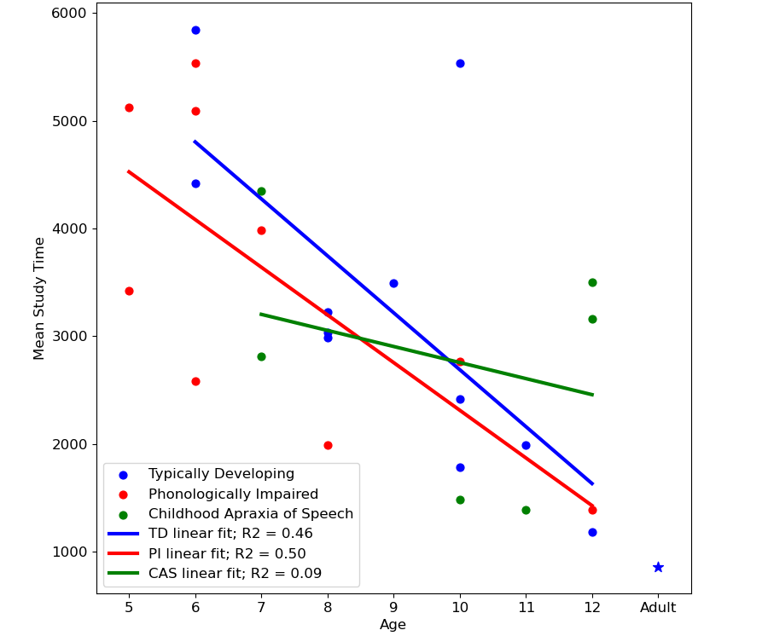
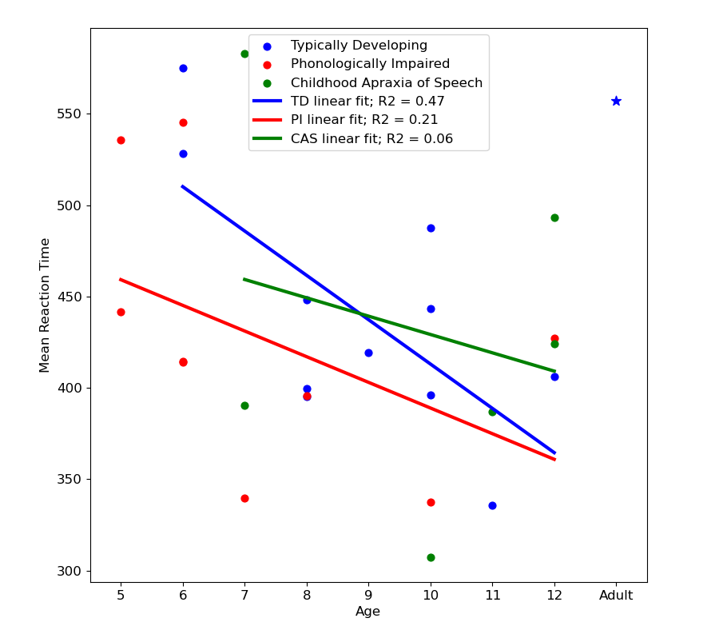
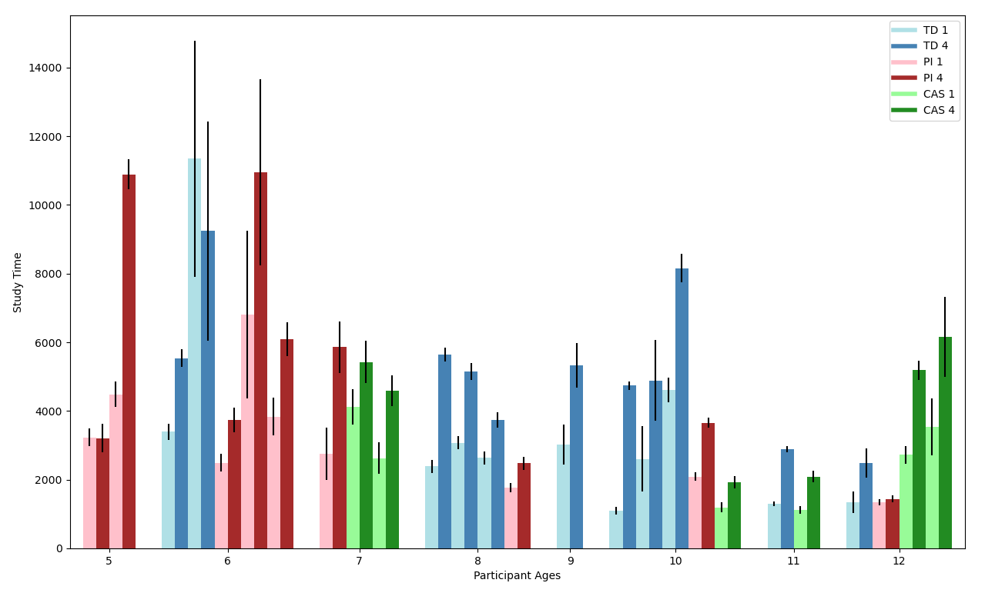
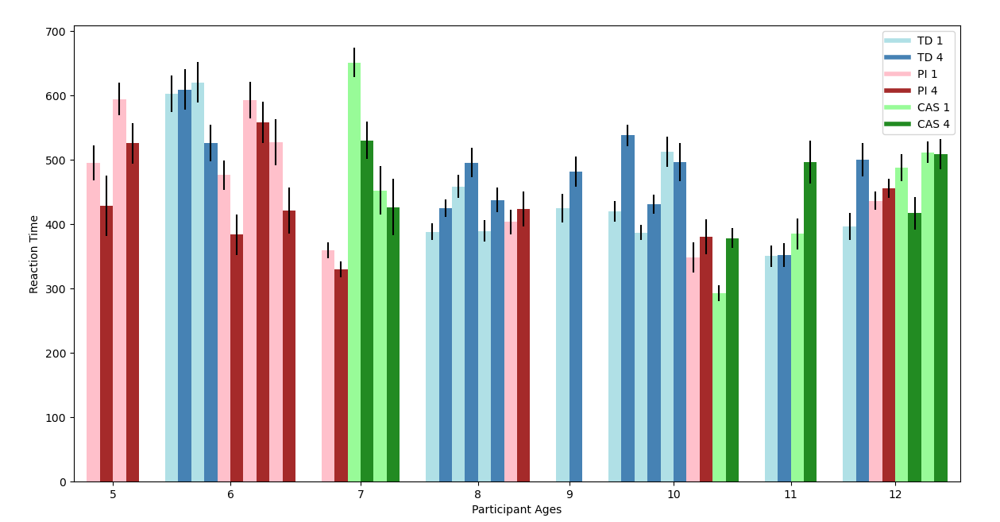
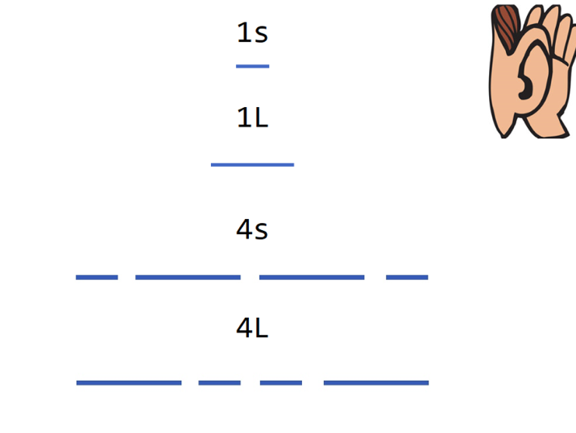
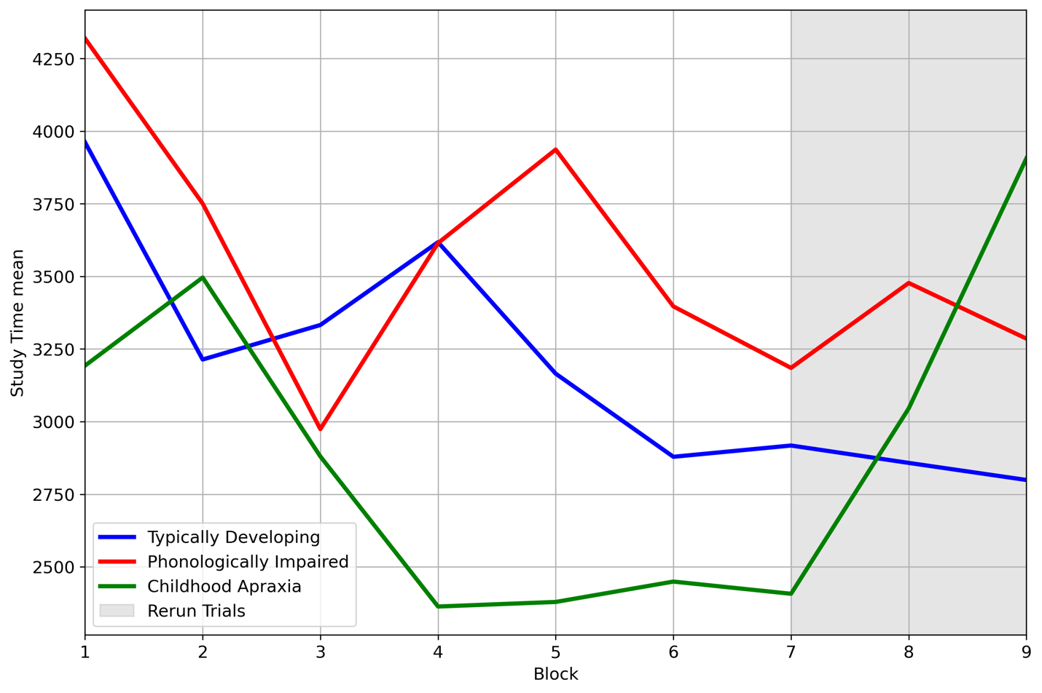
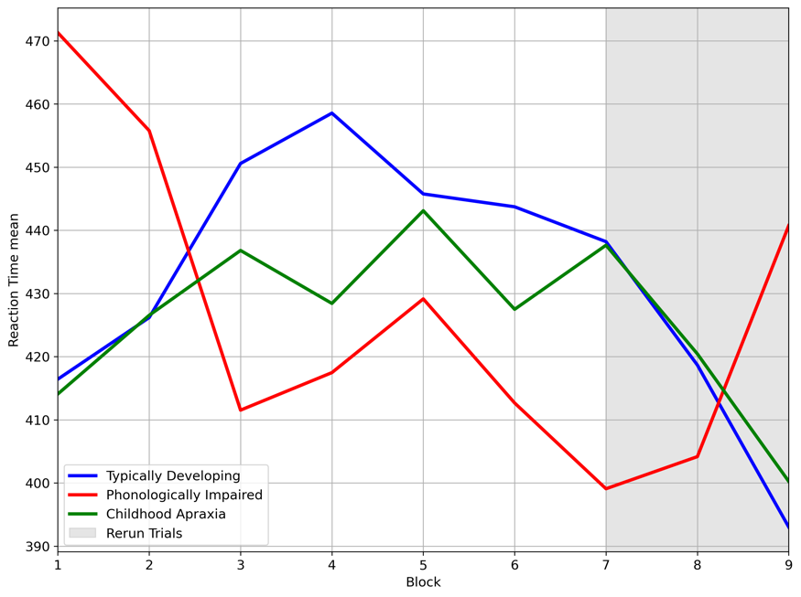
An Investigation of Motor Programming in Childhood Apraxia of Speech Madison J. Smith, Edwin Maas, Amy S. Plante, Kirrie J. Ballard, and Donald A. Robin Communication Sciences and Disorders, University of New Hampshire, Durham, NH 03824
Introduction
Correlation Between Age and ST/RT
Results
Childhood apraxia of speech (CAS)- a motor programming disorder that impacts the spatiotemporal parameters of speech-motor movements (McNeill, Robin, & Schmidt, 2009)
Perceptual characteristics include increased segments between syllables and words, equal stress across syllables in a word, and speech sound distortions.
Two-stage motor programming model (Klapp, 2003)
INT – organization of information about timing and spatial orientation necessary to produce a unit of movement and loading that information into a working memory buffer (short term memory store)
SEQ- sequencing motor units of movement into correct order
Motor programming in adults with apraxia- A study found that adults with apraxia of speech (AOS) demonstrated impairment in the INT stage of motor programming. The SEQ stage remained intact relative to controls (Maas et al., 2008) and impairment occurred in both speech and nonspeech movements.
Current Study- Application of a self-select paradigm which allows for the measurement of INT and SEQ in each trial (Wright et al., 2009) to three groups: (1) children with CAS, (2) children with phonological impairments (PI), (3) typically developing children (TD)
Hypotheses- (1) The impairment in CAS will be localized to one stage of the motor programming process (INT) while SEQ will be intact. (2) The impairment will mirror what is observed in AOS. (3) The impairment will be central (not modality-specific)
Mean Group ST by Age Mean Group RT by Age
Age and ST/RT
Negative correlation between ST and age for TD and PI participants - no significant negative correlation for participants with CAS.
Negative correlation between RT and age for TD participants, not the case for PI or CAS.
Similar performance across groups on RT.
ST/RT Across Blocks
Later in experiment as participants fatigue, ST increases dramatically for CAS, remains stable for TD and PI
Conversely, at the end of the experiment, RT patterns are similar for CAS and TD participants.
Non-speech Motor Tasks
Children across groups were unable to accurately execute motor responses required for the experiment, testing discontinued
Note. Adult data from Wright et al. (2009), Taken using self-select paradigm on 12 typical young adults.
Discussion and Future Directions
1 vs. 4 Press Cue Responses in ST/RT
Discussion:
Results displaying the age effect suggest that as TD and PI participants grow older, the motor programming process becomes more efficient. Children with CAS demonstrate a ‘leveling out’ in their ability to improve the efficiency of their motor programs.
At age 12, TD and PI participants perform similarly on ST to adults who completed the same paradigm (Wright et al., 2009), children with CAS have higher study time at age 12.
Increase in ST for participants with CAS at the end of the experiment in comparison to TD and PI participants suggests that INT is the underlying impairment in CAS
Comparable RT performance at the end of the experiment for TD and CAS participants suggests that the SEQ stage of motor programming is intact
Future Directions:
Replicate study with higher number of participants in each group
Longer training periods for non-speech motor tasks to include non-speech data in analysis.
Age Effect on ST Age Effect on RT
Methods
26 participants across three groups:
Typically developing n=11
Phonologically impaired n=9
CAS n=6
Ages 5-12
Experiment 1: nonspeech motor movement (finger tapping)
Experiment 2: speech motor movement (vocalization of the syllable ”ba”)
Study Time (ST): Amount of time that it takes for a child to prepare their response, reflects INT
Reaction Time (RT): Amount of time that it takes for a child to execute their response after the presentation of a ”go” signal, reflects SEQ
Note. TD=typically developing group, PI= phonological impairment group, CAS= childhood apraxia of speech group. 1=one press cue response, 4=four press cue response.
Acknowledgements
sTAMD Simulations
We are grateful for all the children who participated in this study. Special thanks to my mom, Rachelle Smith, and to my husband, Michael May for his assistance with data analysis.
Mean Group ST/RT Across Blocks
Mean ST Across Blocks Mean RT Across Blocks
References
Klapp, S. T. (1995). Motor response programming during simple and choice reaction time: The role of practice. Journal of Experimental Psychology: Human Perception and Performance, 21, 1015–1027.
Klapp, S. T. (2003). Reaction Time Analysis of Two Types of Motor Preparation for Speech Articulation: Action as a Sequence of Chunks. Journal of Motor Behavior, 35(2), 135–150. https://doi.org/10.1080/00222890309602129
Maas, E., Robin, D. A., Wright, D. L., & Ballard, K. J. (2008). Motor programming in apraxia of speech. Brain and Language, 106(2), 107–118. https://doi.org/10.1016/j.bandl.2008.03.004
Magnuson, C.E., Robin, D.A., & Wright, D.L. (2008). Sequencing multiple elements of the same duration: Detailing the INT process in Klapp's two-process account of motor programming. Journal of Motor Behavior, 40(6), 532-544.
McNeil, M. R., Robin, D. A., & Schmidt, R. A. (2009). Apraxia of speech: Definition and differential diagnosis. In Clinical management of sensorimotor speech disorders (pp. 249–268). Thieme.
Wright, D. L., Robin, D. A., Rhee, J., Vaculin, A., Jacks, A., Guenther, F. H., & Fox, P. T. (2009). Using the Self-Select Paradigm to Delineate the Nature of Speech Motor Programming. Journal of Speech, Language, and Hearing Research, 52(3), 755–765. https://doi.org/10.1044/1092-4388(2009/07-0256)
Data & Analysis
Analysis was only conducted on accurate responses:
Dependent variables
ST and RT
Independent variables
Group (CAS, TD, PI)
Outliers
Data points (+/- 1.5 group SD) away from participant mean were removed
Linear regression used in correlation figures

