Slide 1

Efficacy of Drug Treatment Court LASER Docket Program
A Mixed-Methodological Research Project
Bailey Allard, Paxton Morley, Daniela Roman

Slide 2
Present Study
Possible differences in all relevant variables between the treatment group and control group through a series of independent samples t-tests and conducted bivariate correlations on all relevant variables were examined through demographic characteristics. In addition to the quantitative analyses, we also qualitatively analyzed participants’ responses to interview questions by first using open coding and then analyzing the data within each code to examine possible patterns that may exist.
    The purpose of this study
    was to examine the
    recidivism rate among
    participants in the LASER
    docket program.
Notes:
Introduce the program and our gratitude for the opportunity to work on this project
Research question

Slide 3
Method
Quantitative Data
Treatment Group (N = 74)
  Drug Offenders
  LASER Docket program
  2016 to Present
Control Group (N = 65)
  Drug Offenders
  Non-LASER Docket Program
  Coarsened Exact Matching
    Sex
    Age
    Race
    Pretrial Risk Assessment
Quantitative Data
  Preexisting, Deidentified
  Uploaded to UNH Box
  Excel into SPSS

Slide 4
Method
Quantitative Data
  Criminal History
    Age of First Offense
    Number of Prior Arrests
    Number of Prior Convictions
    Risk Assessment Score
    Minimum Sentence Guideline
    Maximum Sentence Guideline
  Substance Use History
    Sober Living History
    Drug of Choice
  Program Factors
    Number of Failed Drug Tests
    Number of Missed Requirements
    Number of Sanctions Received
    Number of Jailtime Sanctions
    Number of Incentives Received
    Number of Technical Violations
    Number of Pretrial Arrests
  Control Variables
  Gender
  Age Entered LASER Docket
  Educational Level
  Employment Status
  Outcome Variable
  Program Completion Status

Slide 5
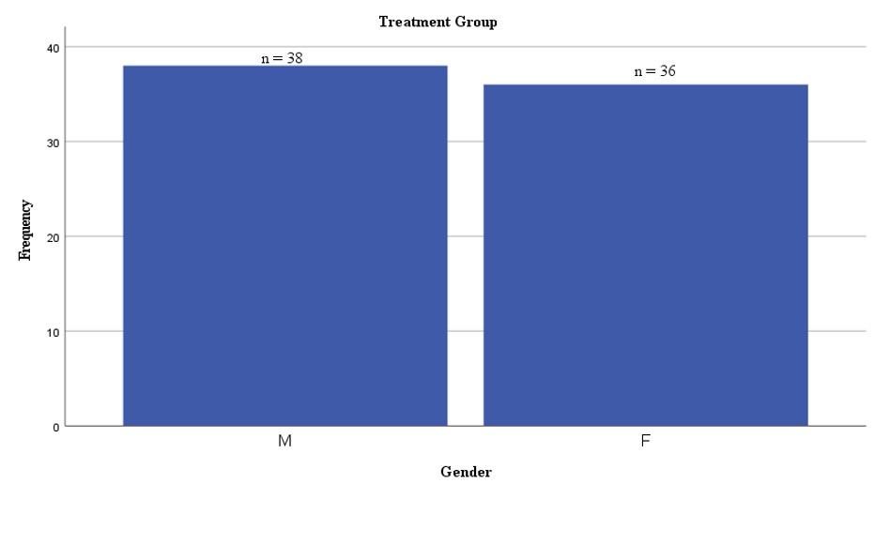
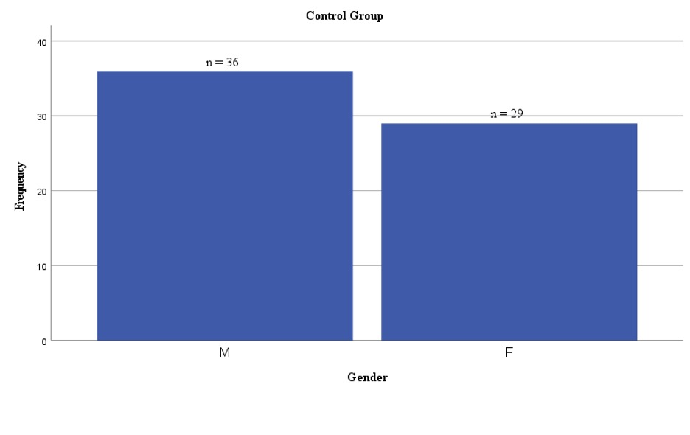

Gender
Female = 1
Male = 2

Slide 6
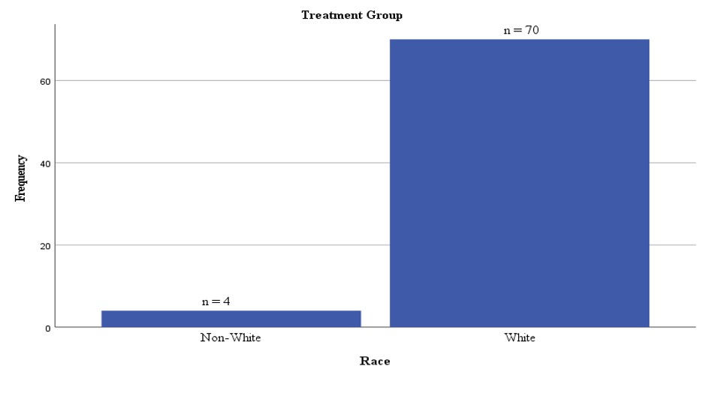
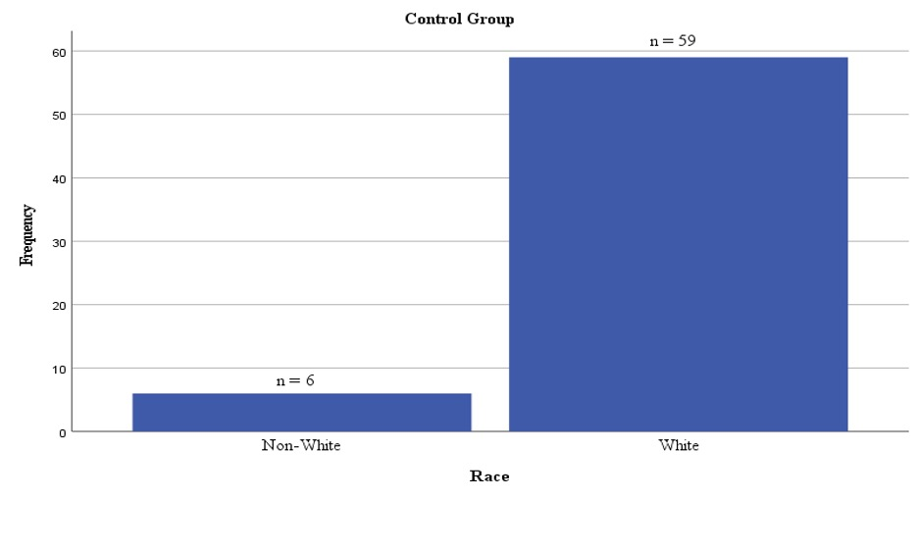
Race
White = 1
Non-White = 0

Slide 7
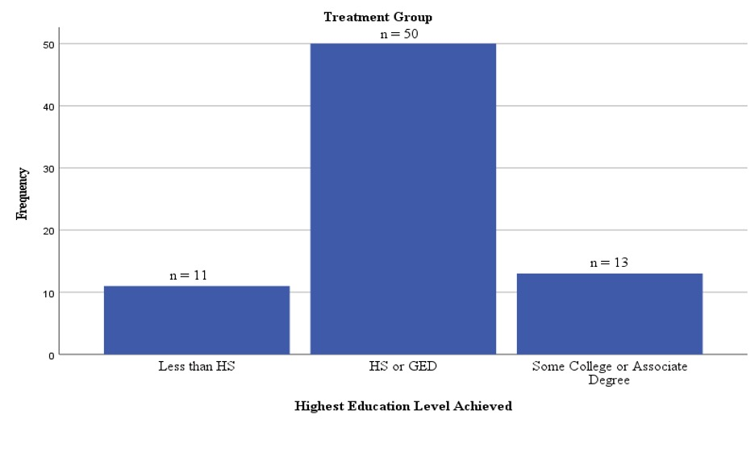
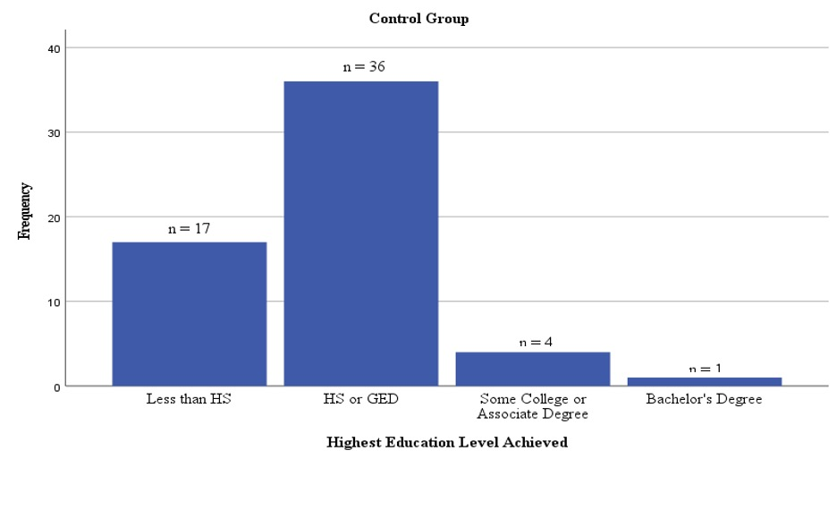
Educational Level
Less than HS = 1
HS/GED = 2
Some College = 3
Bachelor’s = 4

Slide 8
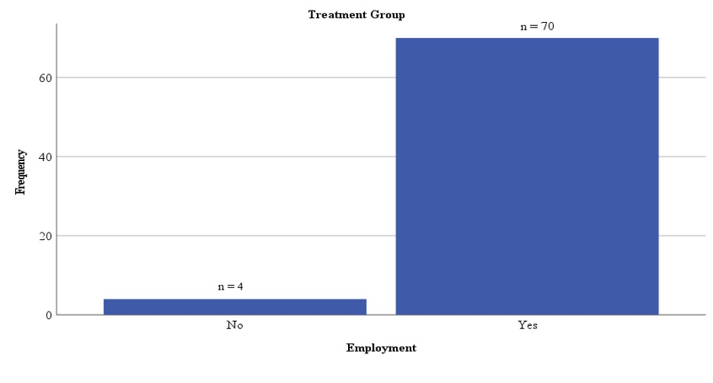
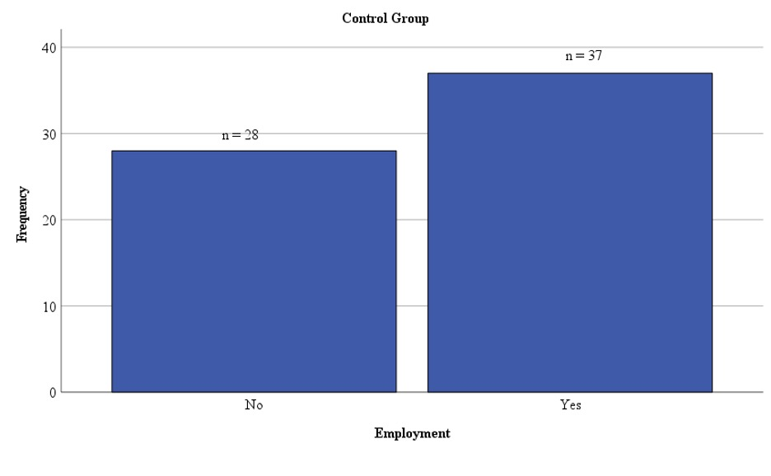
Employment Status
Employed = 1
Unemployed = 0

Slide 9
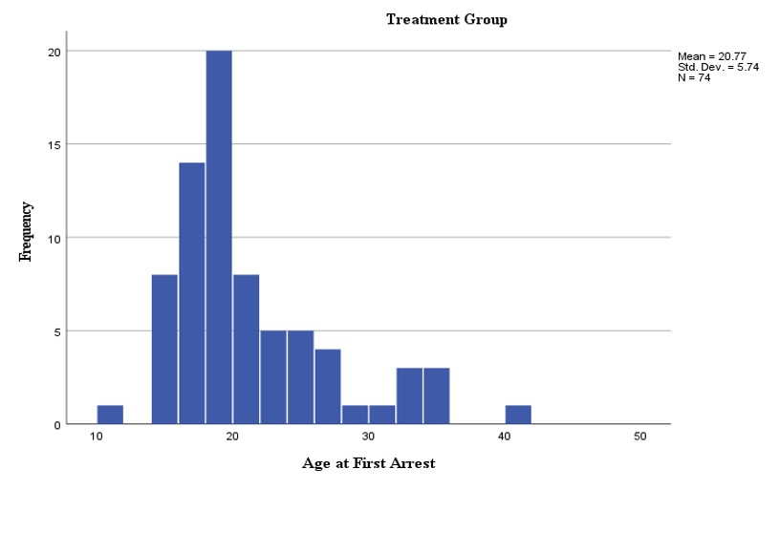
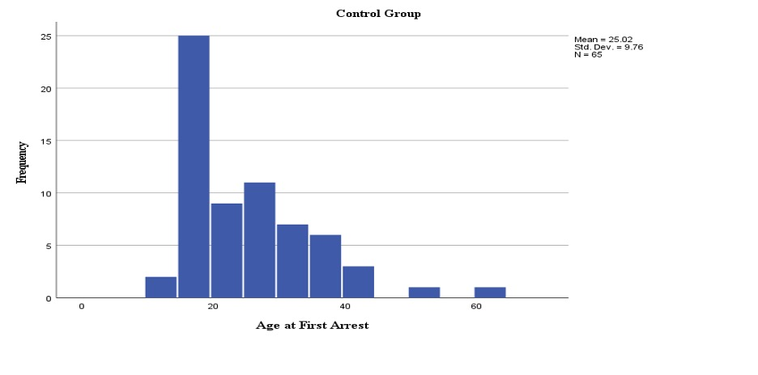
Age at First Arrest

Slide 10
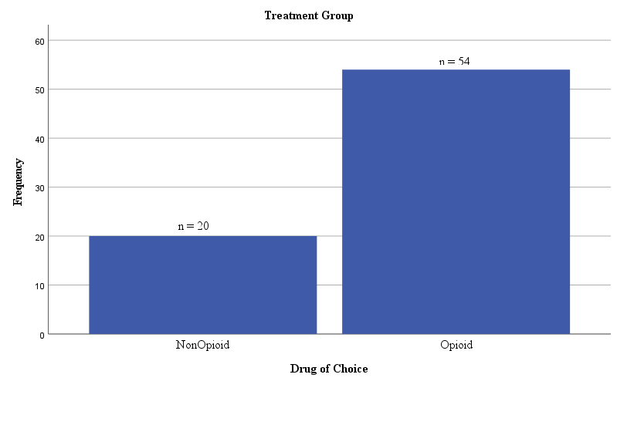
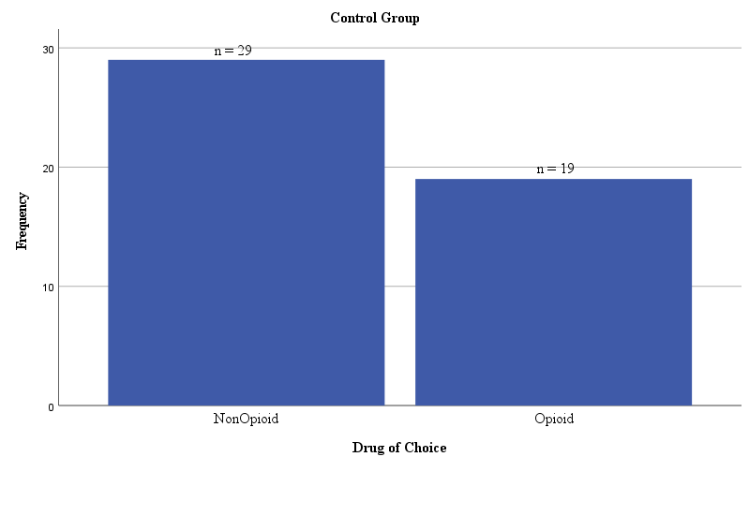
Drug of Choice
Opioid v. Non-Opioid
Opioid = 1
NonOpioid = 0

Slide 11
Quantitative Results

Slide 12
Overarching Findings:
Hierarchical Linear Regression: Predicting Sanctions | Individuals who enter DTC at an older age are less likely to receive sanctions compared to those who enter at a younger age.
Bivariate Logistic Regression: Successful Prediction of DTC Programs | Individuals in DTC who are employed have a higher successful completion rate than those who are not.
Poisson Regression: Factors Predicting Number of Failed Drug Tests | Males are 68% less likely to fail a drug test than females.
Notes:
Hierarchical linear regression predicting incentives and sanctions
Bivariate logistic regression successful prediction of DTC programs
Poisson Regression: Factors Predicting Number of Failed Drug Tests
>>>>> Males are 68% less likely to fail a drug test than females

Slide 13
Qualitative Results

Slide 14
Method
Qualitative Data
Treatment Group Only
  Drug offenders
  LASER Docket program
  2016 to present
  No longer under any supervision
    N = 20 eligible
    N = 6 responded (1 technical issues)
  Future supervision end dates
  N = 54
Excel File
  Last known contact information
    Email address
    Phone number
    Mailing address
  Uploaded into Box
    Zoom Interviews
    Recorded
    Transcribed

Slide 15
Overarching Findings
    From various sources
      Counselors
      Family Members
      Judges/Magistrates
      Probation Officers
      Sober Networks
Participants develop and learn the importance of supportive relationships, and emotional, personal connections by developing honesty, accountability, structure, recognizing triggers, and effective coping strategies.

Slide 16
  Personal Growth and Learning During Program
Importance of Honesty, Accountability, Structure
“Accountability with them is key and it’s an important component. I just can’t touch upon that piece [enough], that and the structure side of it.”
“Holding me accountable but also give me a little bit more freedom if I messed up there was still somebody there to help me.”
“Openly communicate with them because, from the time LASER began to now, that’s one component that I’ve taken away from that program that I continue to utilize every day.”

Slide 17
  Importance of Supportive Relationships, Emotional, Personal Connections
12-Step Programs
Most beneficial: “the sponsors and staying connected to narcotics anonymous. I still stay in touch with the sponsor that I got in that phase I could still call that same sponsor today.”
Supportive relationships: “Up until this day, [the friends] I met at NA meetings, which I never would have went if it wasn’t for them pressuring me, the requirement to go. It was 100% getting me to go to meetings which gave me that support group [and] led me to see that there was a life beyond drugs or even that program, keeping me off drugs what I looked at as possibly just temporarily.”

Slide 18
  Importance of Supportive Relationships, Emotional, Personal Connections
Family Members
“My kids were old, and it was the last shot I had at being a [parent] so I'm like, if I don't do it now, they're going to be adults. So, it was my last shot. So, I did everything I didn't want to do.”
“I wrote down the warning signs anytime my mom would see me getting frustrated she'd seen me get frustrated, and I’d go outside, and I’d just scream.”
“I have a son. To know that what I did greatly affected him at the same time I am watching him grow up finally, actually active in his life, but still I see that change from my actions.”
Notes:
Relationships with children is motivation for continued sobriety, whether establishing new relationships or renewing previous relationships with children.
For example, one who was establishing a parent-child relationship for the first time stated.
Others, who were renewing previous relationships with their children, also suggested that to be a motivation for their continued sobriety and successful program completion.
Some struggled with the stress and frustration of being a parent which they recognized as a trigger for substance use and sought support from a family member.
Also utilized strategies learned in the program to help mitigate those triggers, such as writing down warning signs and sharing those with family members.
Another recognized the negative effect of past substance use and the positive effect of sobriety on their child.

Slide 19
  Importance of Supportive Relationships, Emotional, Personal Connections
Court Appearances
“I think the encouragement from the judge was huge with everything that we all did when you did something right. I used to tell [judge],I said I'm really afraid to take [a] test because I hadn't been in school for many years and I'm like, I'm not going to pass it and [judge said] I know you're going to do it. I know you're going to do it and you know it.’ I wanted to do it more because people were encouraging me to do it and I think that that was a huge piece [Judge] treated me like I was a regular person [Judge] acted like [judge] was an everyday regular person if I was struggling with something, I didn’t have a problem telling [judge].”

Slide 20
  Importance of Supportive Relationships, Emotional, Personal Connections
Probation Officers
“I think [the probation officer] walked a fine line better than most people could’ve being an authority figure and, at the same time, came across as genuinely trying to help somebody.”
“I'm not sure who [the probation officer] was replaced with but [the probation officer] is like the contact in and out of court. So, I feel like that person is the most important of the whole program, the person that holds you accountable inside and outside, but genuinely wants you to succeed at the same time.”
“There wasn’t really strategies or techniques, it was more having that accountability, having to be honest all the time, and [the probation officer] did help on a personal level too. It was like having an extra counselor with me, [to help with] things that I am facing, things I could face, and [the probation officer] wasn’t there just doing their job. I mean, [the probation officer] really connected with me. That was really helpful too.”
Notes:
Participants also voiced their appreciation for the support they received from their probation officers:
Participants also voiced their appreciation for the support they received from their probation officers:
When asked about strategies or techniques PO used, another thought biggest influence was that the probation officers hold them accountable:
Another viewed the probation officer as instrumental for their success:

Slide 21
  Importance of Supportive Relationships, Emotional, Personal Connections
Sober Network
Many discussed having a supportive sober network both while during and after the program.
“I had built a sober network for myself away from that meeting stage. So, I had outside support all around me.”
“the sober network . . . I believe helped carry me through this entire process.”

Slide 22
Thank You!
Questions?

