Slide 1
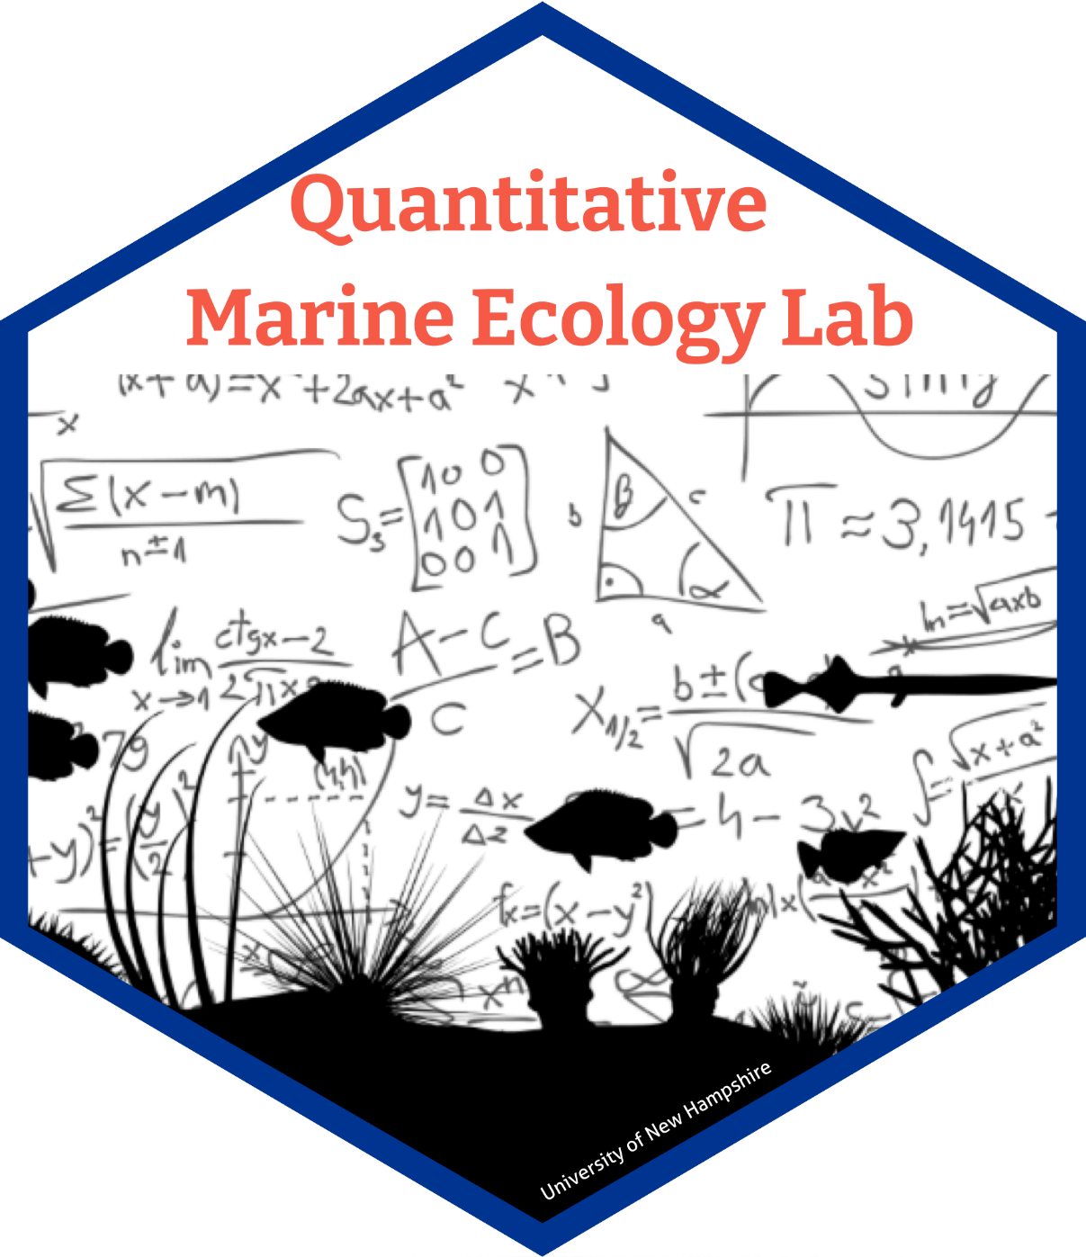
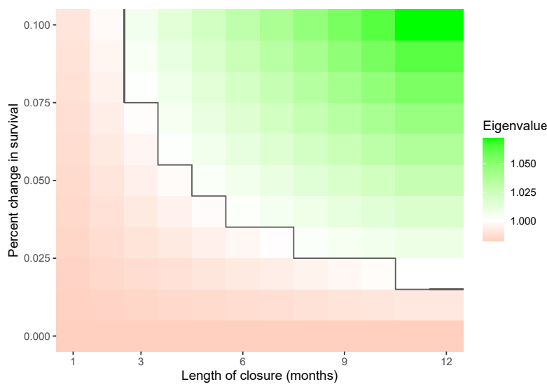
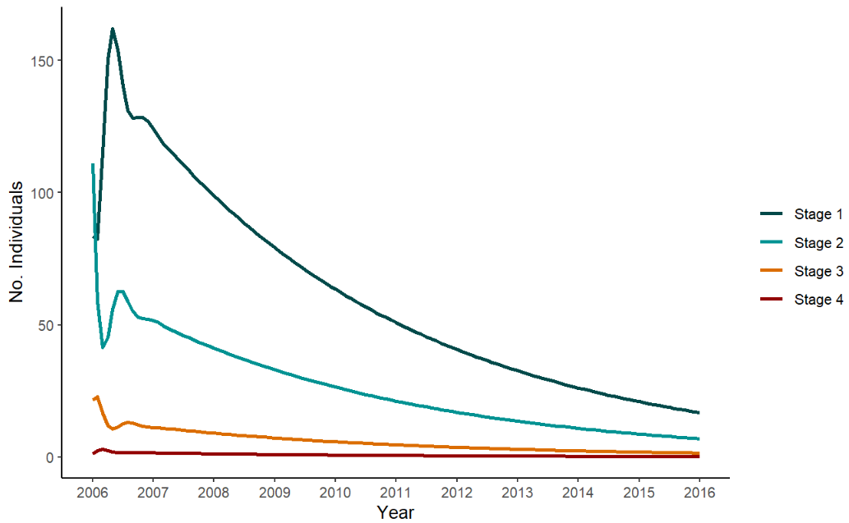
Using mechanistic models to assess temporary closure strategies for small scale fisheries
Sophie Wulfing, Easton R. White, , Ahilya Sudarshan Kadba
Sophie.wulfing@unh.edu
Quantitative Marine Ecology Lab
University of New Hampshire, Department of Biological Sciences
Introduction
Results
Increased urbanization in Madagascar has led to higher fishing pressure which has in turn resulted in a decline in fish catch and biomass.
In the early 2000’s, international export markets began to transform the fishery from subsistence to industrial harvest., Cephalopods have become the largest class of exports (Benbow et al., 2014; Humber et al., 2006)., leading to decreased catch.
Very few population modeling studies have been conducted on the cephalopod population of Madagascar. This project aims to understand how the region’s blue octopus community dynamics act under different levels of harvest and protection.
Figure 2: Stage-based population matrix model with parameters calculated from Raberinary and Benbow, 2012
From our matrix (Figure 2), we calculated a dominant eigenvalue of 0.982 and an average reproductive output of 1.756
Methods
We used Wood’s Quadratic Programming Method (Caswell 2001) to estimate our parameters for a stage-based Lefkovitch matrix population model from data collected in Raberinary and Benbow 2012.
F₄
Figure 4: Analysis of different conservation strategies and how the theoretical population would behave under different scenarios. Green and white areas represent overall population stability while the red represents strategies that do not result in viable population recovery.
Table 1: Survivability, stable stage distribution, and reproductive value of each stage of our blue octopus population as calculated from our matrix. Larval survivability was calculated by dividing our estimated number of larvae surviving back to Stage 1 (F₄) by 201,000 - the average estimated reproductive output of O. cyanea (Guard et al. 2009)
Conclusions and Further Directions
Stage 1
G₁
Stage 2
G₂
Stage 3
G₃
Stage 4
The dominant eigenvalue and population projection (Figure 3) indicate a gradual decline of the blue octopus's population in southwestern Madagascar.
Based on the analysis of different conservation methods (Figure 4), we recommend implementing closures at least once every five months, but the exact frequency of this closure can change depending on the resulting change in octopus survival.
We will also analyze how individuals in different stages contribute differently to population growth.
We hope to use this research to better inform what the best management scenarios are for this population and to implement fishing practices that both maintains healthy cephalopod population stocks and supports the local fishing community.
P₁
P₂
P₃
P₄
Figure 1: Visualization of matrix model. Here, the population of blue octopus is split into four distinct life stages: Stage 1 immature, Stage 2 incipient maturity, Stage 3 mature, and Stage 4 fully mature (Raberinary and Benbow, 2012). Only fully mature individuals reproduce, resulting in only one fecundity parameter (F₄)
Objectives
Investigate the status of the blue octopus populations in southwest Madagascar and evaluate if current fishing practices are sustainable
Determine the optimal frequency and intensity of fishing limits
Explore how individuals at different stages contribute to the population
Acknowledgements
Thank you so much to my undergraduate researcher Ahilya Sudarshan Kadba for your extensive background research and literature search. Thank you to Easton White for his support on this project, as well as the University of New Hampshire’s Department of Biological Sciences for this research opportunity. And finally, big thank you to the members of our Quantitative Marine Ecology Lab for their continued support and help on this project.
Figure 3: Blue octopus population projection calculated by multiplying our population matrix by a population vector. Each multiplication represents a month-long timestep

