Slide 1
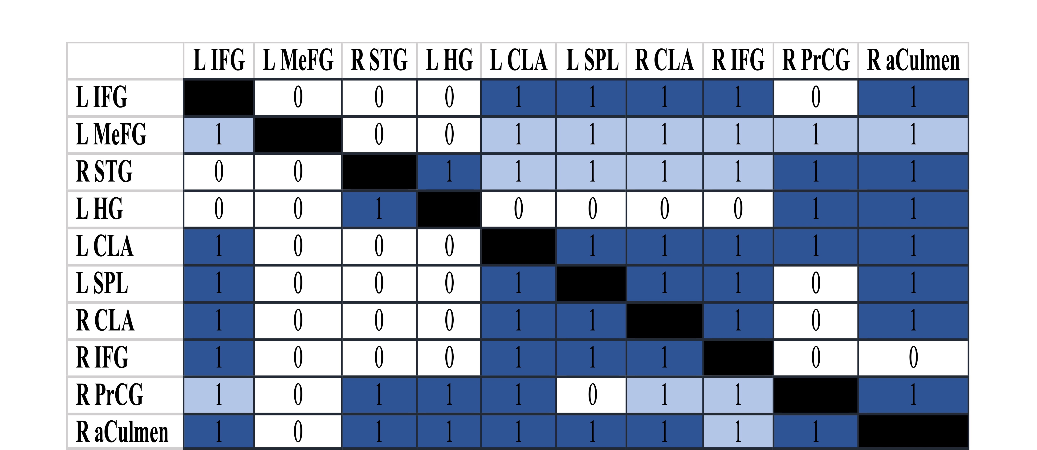
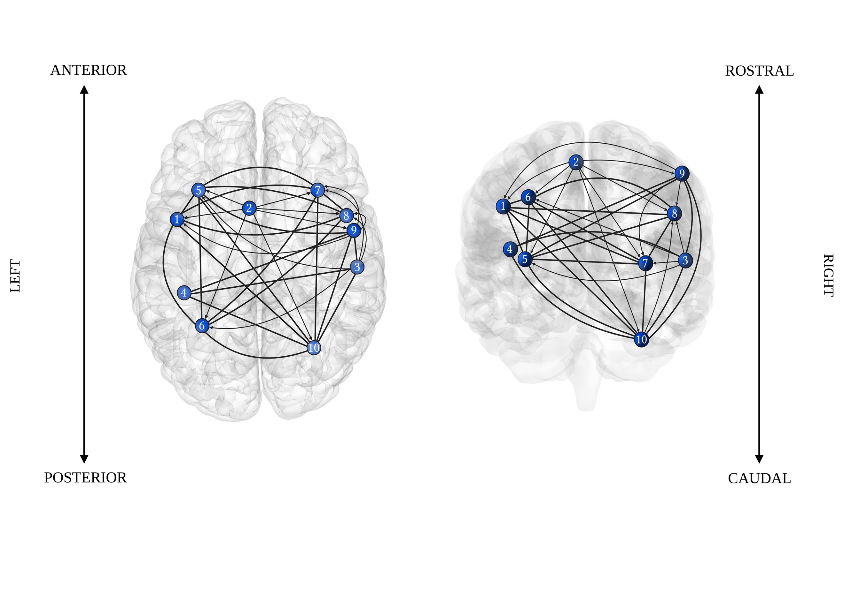
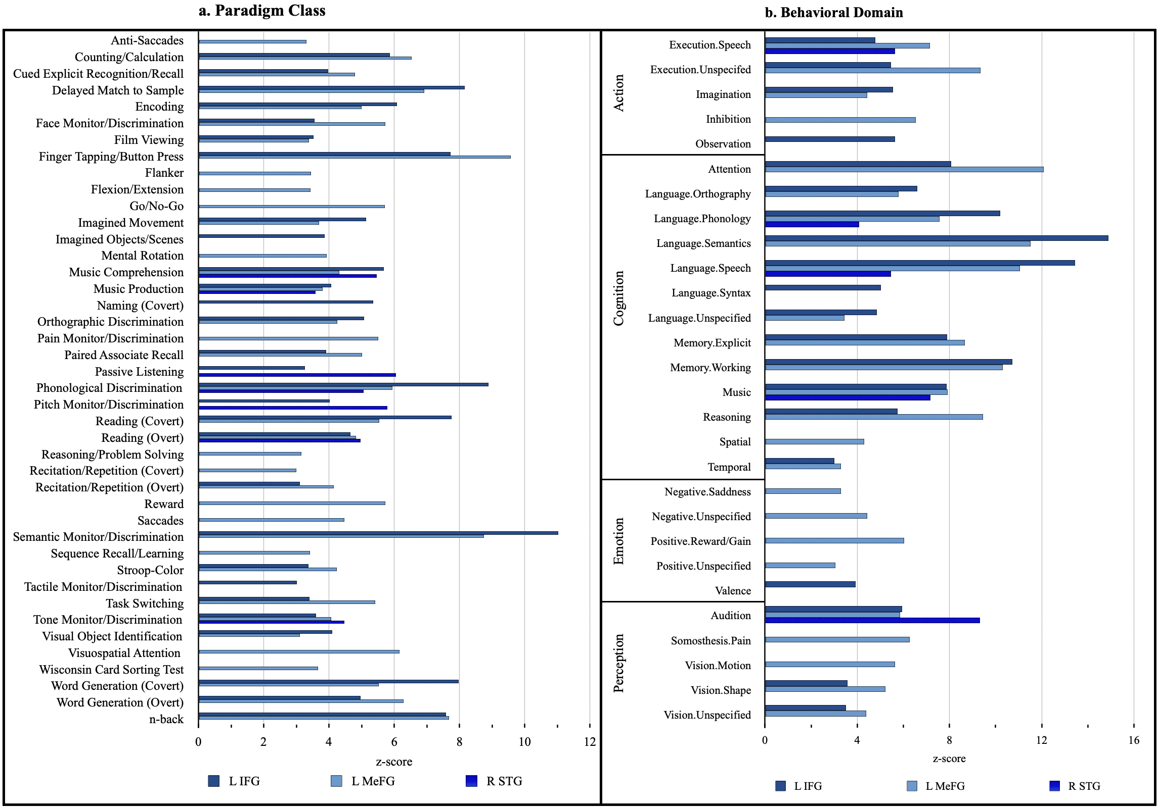
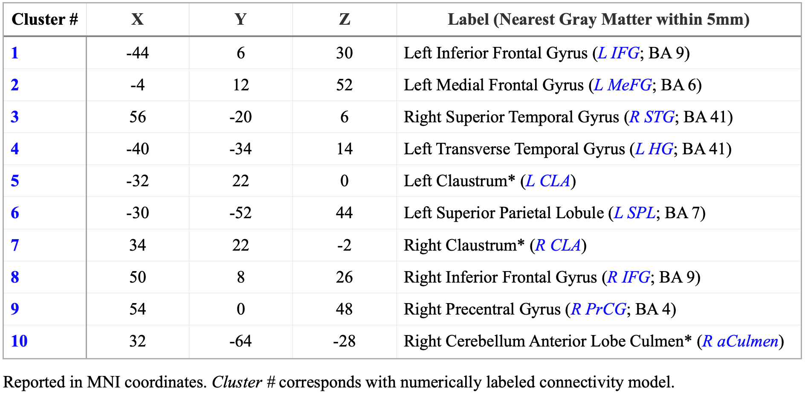
Right Neural Substrates of Language and Music Processing Left Out: Activation Likelihood Estimation (ALE) & Meta-Analytic Connectivity Modelling (MACM)
Lauren C. Keith¹ Advisor: Donald A. Robin^{1,2}, Ph.D. Committee: Amy E. Ramage^{1,2}, CCC-SLP, Ph.D., Kimberly L. Ray³, Ph.D. Department of Communication Sciences & Disorders¹, Interdisciplinary Program in Neuroscience & Behavior², University of New Hampshire,
Department of Psychology, University of Texas at Austin³
Introduction Results
Conclusions
The left hemisphere has traditionally been thought to contain specialized regions of language processing [4, 9].
Conversely, the right hemisphere has been considered to have specialized music processing regions [1, 3].
Modern neuroimaging studies have challenged the above noted reductionist models which assign intra-hemispheric specialized functions [1, 4, 7, 9].
Functional magnetic resonance imaging (fMRI) experiments have established regions of interest (ROI) associated with language and musical processing [4, 9].
Current neuroimaging investigations of language and music are beginning to focus on network connectivity and their functional significance; though, they currently remain elusive [1, 4].
This coordinate based meta-analysis [3, 8] used an activation likelihood estimation (ALE) procedure [2, 3, 5, 7] to statistically identify ROIs, based on how likely the activity of one voxel is associated with activity in another voxel, and their overlapping activation patterns during language and musical processing.
Using identified ROIs from the Omnibus ALE, we created a meta-analytic connectivity model (MACM) [11] quantifying shared functional connectivity and directionality.
Paradigm Class and Behavioral Domain analyses were conducted to aid in functional interpretation of MACM [6].
This meta-analysis was designed to study the neural underpinnings of language and music processing.
Aim – hypothesis (a): Data from the Omnibus ALE across 65 studies resulted in 10 peak regions that coactivate in language and music processing.
Aim– hypothesis (b): Network connectivity revealed each node to have one-way, two-way, or one-way + two-way functional connectivity across the cerebral and cerebellar cortex that are associated with various BrainMap paradigm classes and behavioral domains.
L MeFG one-way connectivity may be indicative it is a communication control center delivering information regarding volitional movements, but not vise versa.
R aCulmen two-way connectivity may be indicative it is a control panel for higher cognitive processes and locomotion.
These findings corroborate previously reported outcomes of areas of covariance.
We quantified functional connectivity between areas of covariance providing a novel network model of the relationship between both processes.
Omnibus Meta-Analytic Connectivity Model
Aims and Hypotheses
Bench-to-Bedside
Aims: Across a range of tasks and paradigms, (a) identify areas that consistently activate to predetermined stimuli and paradigm classes, and (b) create a novel meta-analytic network model depicting interhemispheric functional connectivity among language and music cognitive domains.
A priori hypotheses: (a) expect significant coactivation in the inferior frontal gyri and auditory cortex in ALE; and (b) observe significant functional connectivity in inferior frontal gyri, superior temporal gyri, Heschl’s gyrus, and affective-related regions such as the insula, cingulate gyrus, and cerebellum within the subsequent network as compared to other brain-networks in the whole brain analysis.
To reorganize normal brain structure, interventions should use rational design by targeting the underlying mechanism of action.
Based on principles of neural plasticity, one needs to have behavioral therapies that target specific neural networks that underlie normal functions.
Normative neurocognitive models must drive neuroscientific knowledge of speech and language disorders and development of evidence-based interventions [10].
Identifying normative covariance and connectivity within language and music processing can aid identification of neural substrates impacted at level of impairment [1, 10].
Literature Search and BrainMap Methods
Future Directions
Omnibus Workspace: 65 papers, 277 experiments, 2,344 locations, 1,538 normal adult subjects.
Activation Likelihood Estimation:
Revealed 10 peak clusters.
Meta-Analytic Connectivity Modelling:
Revealed one-way and or two-way significant connections between nodes within the respective ipsilateral and contralateral hemisphere.
Nodes visualized via BrainNet [12] and edges were created with Biorender.com
Paradigm Class and Behavioral Domain Analyses:
Paradigm Class: 8/10 significant node associations across 44 BrainMap paradigm classes.
Behavioral Domain: 8/10 significant node associations across 32 BrainMap behavioral subdomains.
MACM Analyses
Parcellate clusters and conduct individual MACMs on language production, language processing; music production, music processing to investigate the following:
Network connectivity specific to paradigm class within prespecified cognitive processes.
Network connectivity that may have been washed out by peak coordinate ROI generation.
Acknowledgements
I would like to firstly acknowledge the help and support of my mentor and advisor, Donald A. Robin, as well as the members of my thesis committee, Amy E. Ramage, and Kimberly L. Ray. Without their combined expertise, specifically in communication sciences, coordinate-based meta-analytic modelling, and graph theory, this work would not be possible.
I also extend my acknowledgements and gratitude to Lilah Read, for her contributions to this research by coding studies into BrainMap’s functional database, serving as a second reviewer for articles for inclusion, and assisting tabulation.
And finally, to the BrainMap Development Team for their support; namely, Janaye Dews, for assistance and training in coding BrainMap taxonomy.
References
[1] Chan, M. M. Y., & Han, Y. M. Y. (2022). The functional brain networks activated by music listening: A neuroimaging meta-analysis and implications for treatment. Neuropsychology, 36(1), 4–22.
[2] Eickhoff, S. B., Bzdok, D., Laird, A. R., Kurth, F., & Fox, P. T. (2012). Activation likelihood estimation meta-analysis revisited. NeuroImage, 59(3), 2349–2361
[3] Eickhoff, S. B., Laird, A. R., Grefkes, C., Wang, L. E., Zilles, K., & Fox, P. T. (2009). Coordinate‐based activation likelihood estimation meta‐analysis of neuroimaging data: A random‐effects approach based on empirical estimates of spatial uncertainty. Human brain mapping, 30(9), 2907-2926.
[4] LaCroix, A., Diaz, A., & Rogalsky, C. (2015). The relationship between the neural computations for speech and music perception is context-dependent: An activation likelihood estimate study. Frontiers in Psychology, 6.
[5] Laird, A. R., Eickhoff, S. B., Fox, P. M., Uecker, A. M., Ray, K. L., Saenz, J. J., Jr, McKay, D. R., Bzdok, D., Laird, R. W., Robinson, J. L., Turner, J. A., Turkeltaub, P. E., Lancaster, J. L., & Fox, P. T. (2011). The BrainMap strategy for standardization, sharing, and meta-analysis of neuroimaging data. BMC research notes, 4, 349.
[6] Laird, A. R., Fox, P. M., Eickhoff, S. B., Turner, J. A., Ray, K. L., McKay, D. R., Glahn, D. C., Beckmann, C. F., Smith, S. M., & Fox, P. T. (2011). Behavioral interpretations of intrinsic connectivity networks. Journal of cognitive neuroscience, 23(12), 4022–4037.
[7] Laird, A. R., Eickhoff, S. B., Kurth, F., Fox, P. M., Uecker, A. M., Turner, J. A., Robinson, J. L., Lancaster, J. L., & Fox, P. T. (2009). ALE Meta-Analysis Workflows Via the Brainmap Database: Progress Towards A Probabilistic Functional Brain Atlas. Frontiers in neuroinformatics, 3, 23.
[8] Moher, D., Liberati, A., Tetzlaff, J., Altman, D. G., & PRISMA Group. (2009). Preferred reporting items for systematic reviews and meta-analyses: the PRISMA statement. PLoS medicine, 6(7), e1000097.
[9] Price C. J. (2012). A review and synthesis of the first 20 years of PET and fMRI studies of heard speech, spoken language and reading. NeuroImage, 62(2), 816–847.
[10] Tucci, D. L. (2022). 2023-2027 NIDCD strategic plan: Advancing the science of communication to improve lives. National Institute on Deafness and Other Communication Disorders.
[11] Turkeltaub, P. E., Eickhoff, S. B., Laird, A. R., Fox, M., Wiener, M., & Fox, P. (2012). Minimizing within-experiment and within-group effects in Activation Likelihood Estimation meta-analyses. Human brain mapping, 33(1), 1–13.
[12] Xia M., Wang J., He Y. (2013) BrainNet Viewer: A Network Visualization Tool for Human Brain Connectomics. PLoS ONE 8: e68910.

