Slide 1

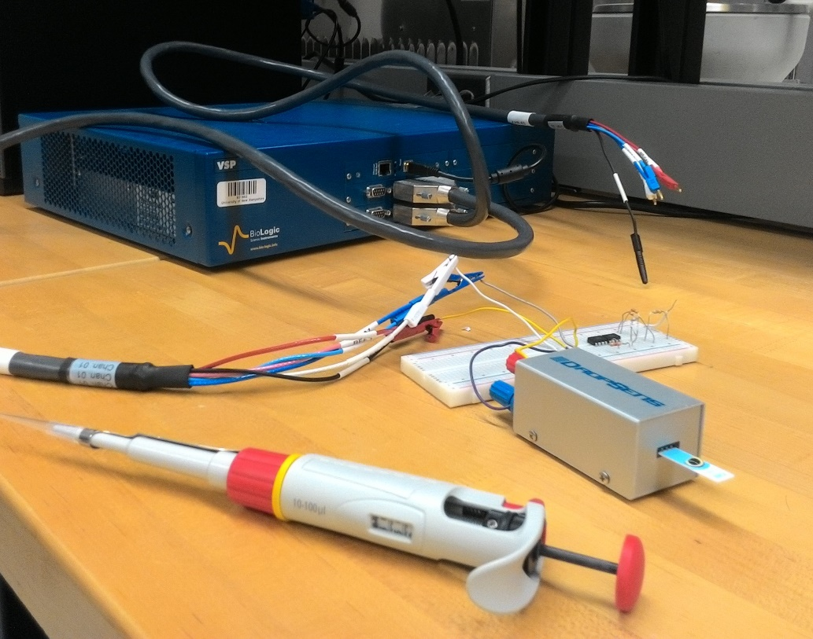
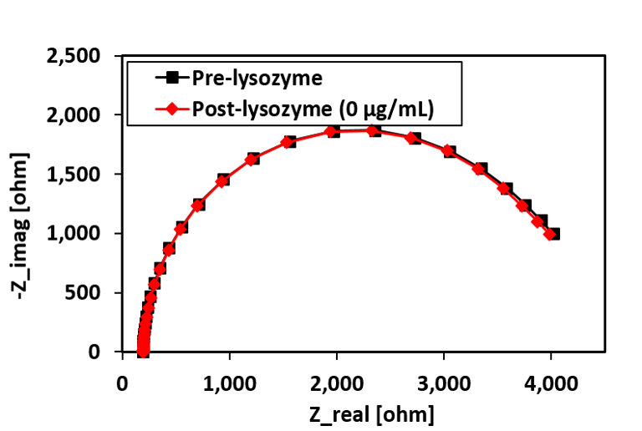
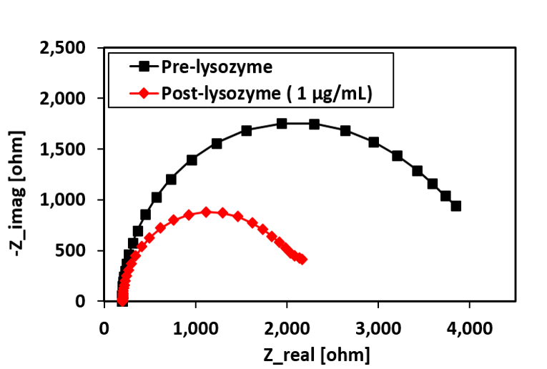

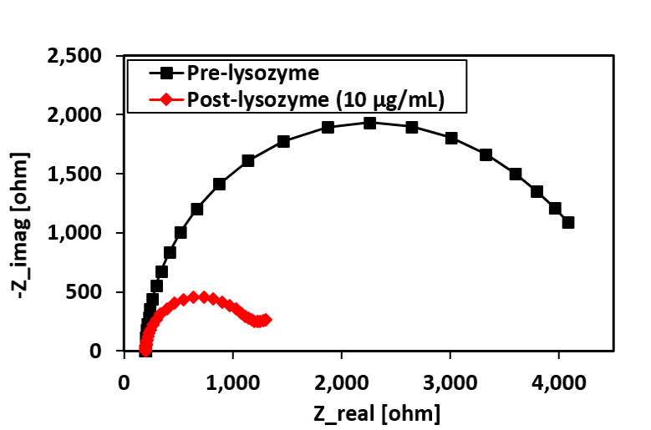
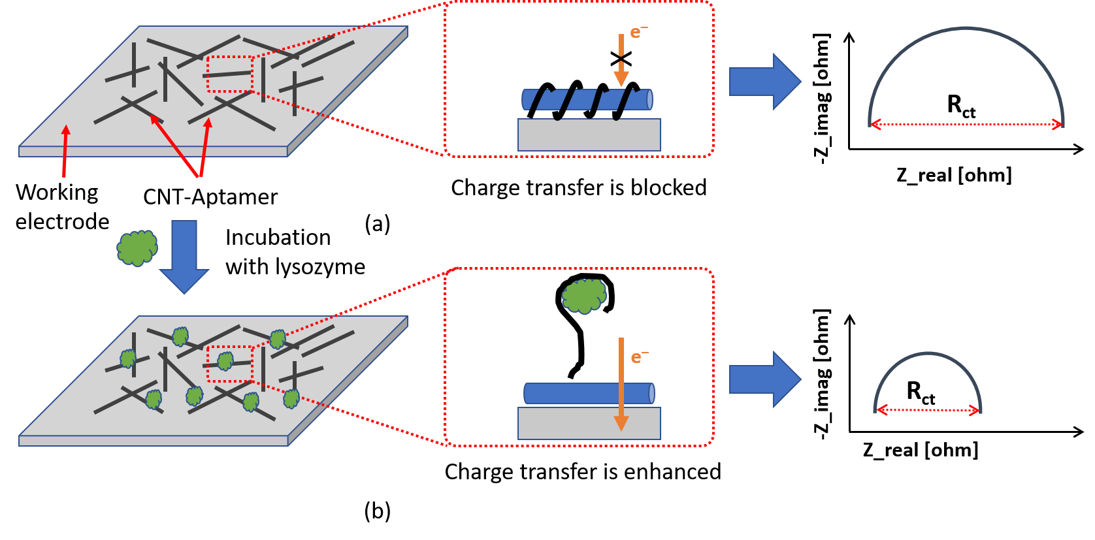
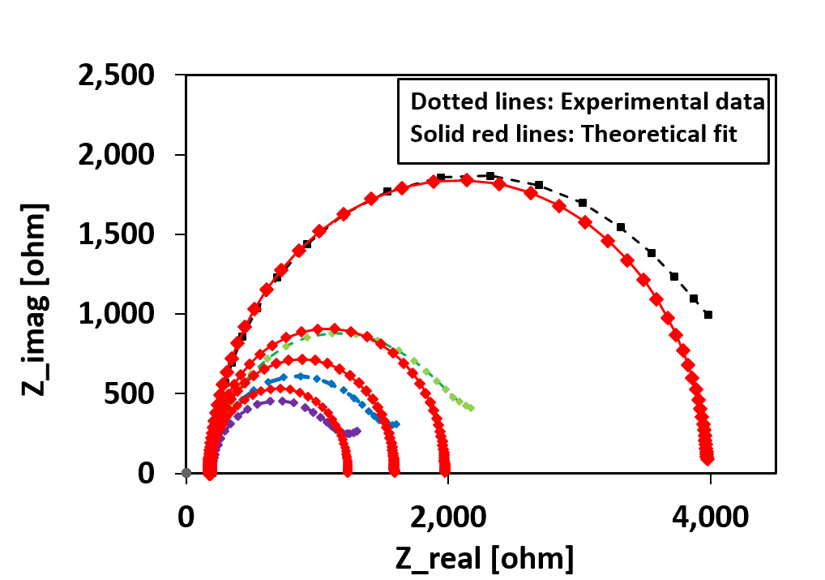
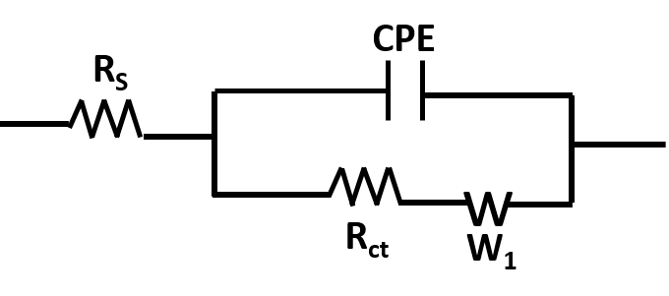
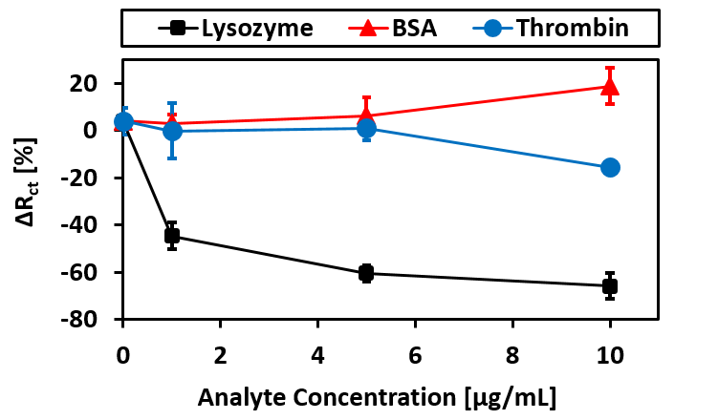
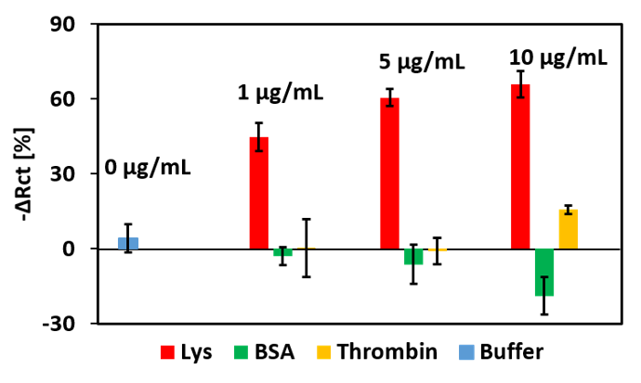
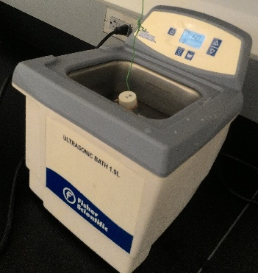
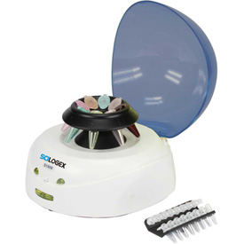
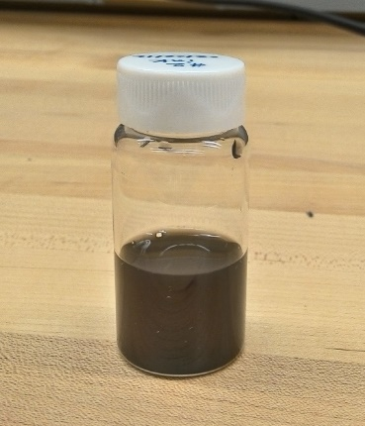
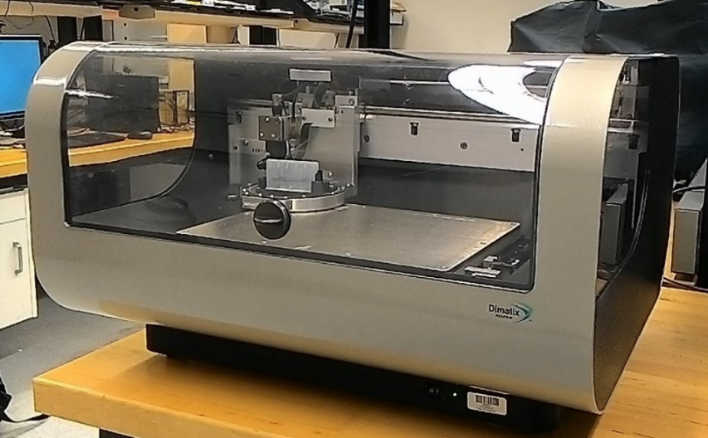
Inkjet-Printed Aptamer-Based Electrochemical Biosensor for Selective Detection of Protein Biomarker
Niazul Islam Khan¹ and Edward Song^{1,2,3}
The BioMEMS Lab @ UNH
University of New Hampshire, Durham, NH 03824 USA
¹Department of Electrical and Computer Engineering
²Material Sciences Program
³Center for Advanced Materials and Manufacturing Innovation (CAMMI)
Abstract
Electrochemical Sensing Method
This work presents an inkjet-printed aptamer-based biosensor for the selective detection of lysozyme, an important biomarker in various disease diagnosis. The strong affinity between carbon nanotubes (CNTs) and single-stranded DNAs is exploited to immobilize the aptamers onto the working electrode by printing the ink containing the CNT-aptamer dispersion. The inkjet-printing method enables aptamer density control as well as high resolution patternability. Our developed sensor shows a detection limit of 90 ng/mL with high target selectivity against other proteins. This technology has potential applications in developing low-cost point-of-care diagnostic devices for home healthcare.
Electrochemical Impedance Spectroscopy (EIS):
Potentiostat: Bio-logic (Model: VSP)
Electrode: Screen-Printed Carbon Electrode (SPCE)
DC potential: 0.115 V vs. Ag reference
AC voltage: 5.0 mV (RMS)
Frequency range: 100 kHz to 100 mHz @ 10 pts/decade
Electrolyte: 1mM K₄[Fe(CN)₆]/ K₃[Fe(CN)₆] (1:1) mixture in 10 mM PBS (50 µL)
Potentiostat
Ag Reference
SPCE
Working Electrode
Introduction
Results and Discussion
Counter Electrode
Aptamers are single-stranded DNA (or RNA)-based oligonucleotide used as synthetic molecular recognition elements in biosensor¹.
Aptamers are used for the selective detection of broad range of analytes including proteins, peptides, amino acids, drugs, metal ions, and even whole cells².
Lysozyme (Lys) is a universal protein used widely in food industries, protein research as well as biomarkers for diagnosing diseases like breast cancer³, Alzheimer’s Disease⁴, AIDS, rheumatoid arthritis⁵, malaria, etc.
Single-stranded DNAs have the tendency to wrap around CNTs due to the strong π – π interaction. A printable ink containing the CNT-aptamer complex is used to immobilize the target receptors onto the screen-printed carbon electrode (SPCE).
Electrochemical impedance spectroscopy (EIS) is used to transduce the recognition event to an electrical signal by measuring the charge transfer resistance (R_{ct}) between the electrolyte and the electrode that can be obtained from Randles equivalent circuit.
Initially, the charge transfer resistance is large due to the aptamers which are insulating and negatively charged (Figure 1a).
When the sensor is exposed to lysozyme, the aptamers unwrap from the CNT and capture the lysozyme opening up the path for electron transfer. Hence, the charge transfer resistance (R_{ct}) is decreased (Figure 1b).
Figure 8: Post-lysozyme exposure Nyquist curves for different concentrations of lysozyme: (a) 0
µg/mL, (b) 0.25 µg/mL, (c) 0.50 µg/mL, (d) 1 µg/mL, (e) 2 µg/mL, (f) 5 µg/mL, (g) 10 µg/mL, and
(h) 20
theoretically fit data.
EIS Measurement Results
(a) (b)
(c) (d)
Figure 3: The Nyquist curves before and after exposure to lysozyme.
Equivalent Circuit Modeling
Randles circuit
Figure 1: Working principle of our aptasensor
Calibration Curve and Selectivity
Experimental Method
Preparation and printing of CNT-aptamer ink
0.25 mg/mL MWCNT were mixed with 5µM anti-Lys aptamer in 30% N-Methylpyrrolidone (NMP) solution.
The CNT-aptamer mixture was sonicated using ultrasonic bath sonicator for 2 h and then centrifuged at 6000 rpm for 30 min.
After centrifuge, the supernatant solution was collected as the ink to be printed.
Then the CNT-aptamer ink was printed on the working electrode (WE) of the SPCE using Fujifilm Dimatix Printer (DMP-2831).
Figure 4: Calibration curves (left) and the selectivity of lysozyme (right).
Conclusions
An aptamer-based low cost biosensor was developed for the detection of lysozyme. Inkjet-printing was used to modify the electrode as well as to enhance the sensitivity of the biosensor. A detection limit as low as 90 ng/mL was observed. The sensor is also shown to be selective to lysozyme.
Acknowledgement
CNT-Aptamer
mixture in NMP
Sonication for 1 hr
Centrifuge for 30
min @6000 rpm
Filtering of
Undispersed CNTs
Dispersed CNT-
Aptamer ink
This research was supported by the College of Engineering and Physical Sciences (CEPS) at University of New Hampshire.
References
Figure 2: Experimental Procedures
[1] S.D. Jayasena, Clinical Chemistry, 45, pp. 1628–1650, 1999.
[2] J.S. Prakash, and K. Rajamanickam, Biomedicines, 3(3), pp. 248—269, 2015.
[3] C. Serra et al., Breast Cancer Research, 4(6), p. R16, 2002.
[4] L. Sandin et al., Alzheimer’s Dementia, 11(7), pp. 477–P478, 2015.
[5] I. Torsteinsdóttir et al., Rheumatology, 38 (12) , pp. 1249–1254, 1999.
Uniformly dispersed
CNT-aptamer ink
Fujifilm Dimatix Printer

