Slide 1

A Non-local Formulation of the Elastoplastic Self-Consistent Crystal Plasticity Model: Application to recrystallization and grain fragmentation
Zhangxi “Jesse” Feng
University of New Hampshire, Mechanical Engineering
NH EPSCoR Biomade Project
Support for the NH EPSCoR NH BioMade Project is provided by the National Science Foundation's Research Infrastructure Improvement Award # 1757371

Slide 2
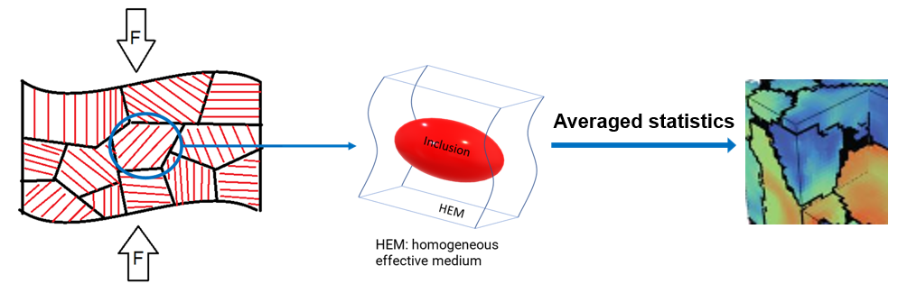
Elastoplastic Self-Consistent Model
Solves the Eshelby inclusion problem for each grain, assumed to be ellipsoids
Resolves sample boundary conditions onto individual grains
Mean-field model using average grain states and properties.

Slide 3
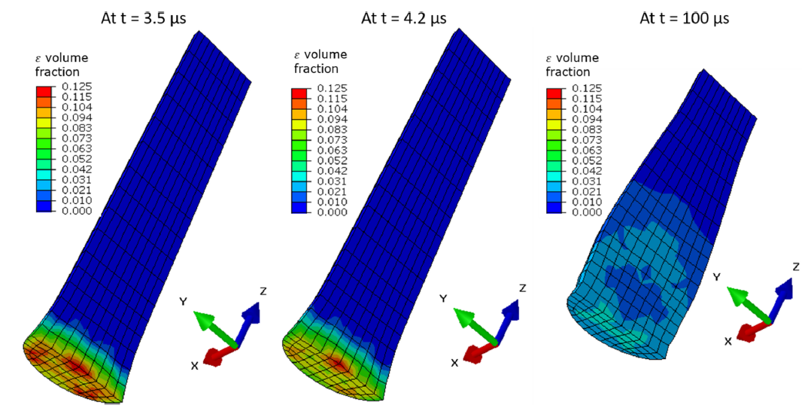
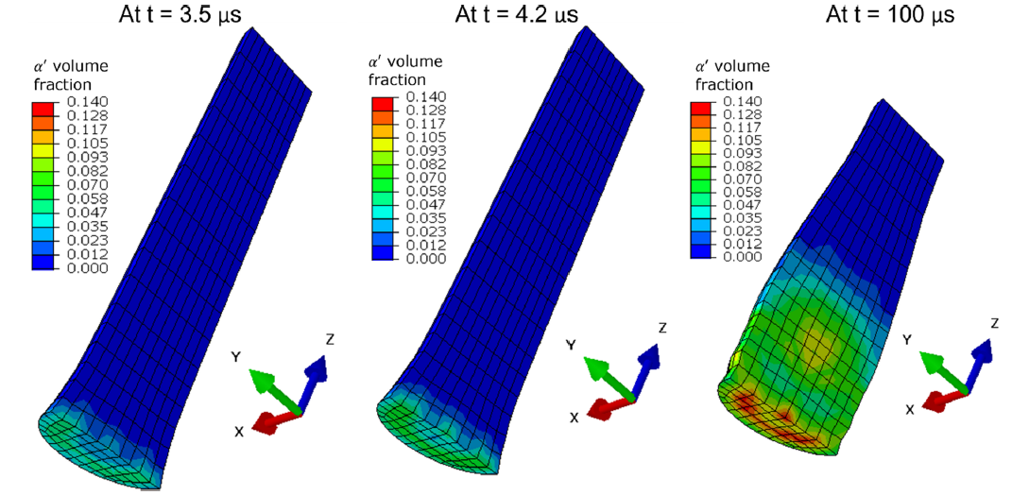

Extensions to EPSC and applications
Dislocation density-based hardening formulations (Beyerlein 2008):
$$\frac{∂ρ_{tot}^{s}}{∂γ^{s}}=k_{1}^{α}\sqrt{\sum_{s^{′}}{g^{ss^{′}}ρ_{tot}^{s^{′}}}}−k_{2}^{α}\left(\dot{ε},T\right)ρ_{tot}^{s^{′}}$$
$$\frac{k_{2}^{α}}{k_{1}^{α}}=\frac{χb^{α}}{g^{α}}\left(1−\frac{k_{B}T}{D^{α}{\left(b^{α}\right)}^{3}}\ln\left(\frac{\dot{ε}}{{\dot{ε}}_{0}}\right)\right)$$
Martensitic phase transformation in additively manufactured stainless steels (Feng 2022):

Slide 4
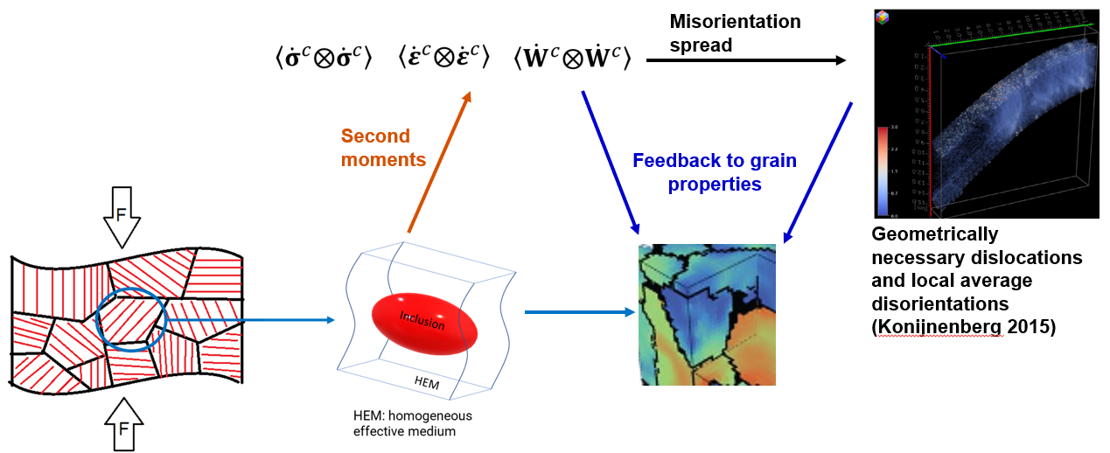
Proposed extension with non-local formulations

Slide 5




Implementation differences
VPSC
Partial derivatives derived from the effective stress potential:
Uses power law to describe shear rate on slip system, k:
EPSC
Partial derivatives are derived from the homogenization scheme:
Uses power law to describe shear rate on slip system, k:

Slide 6
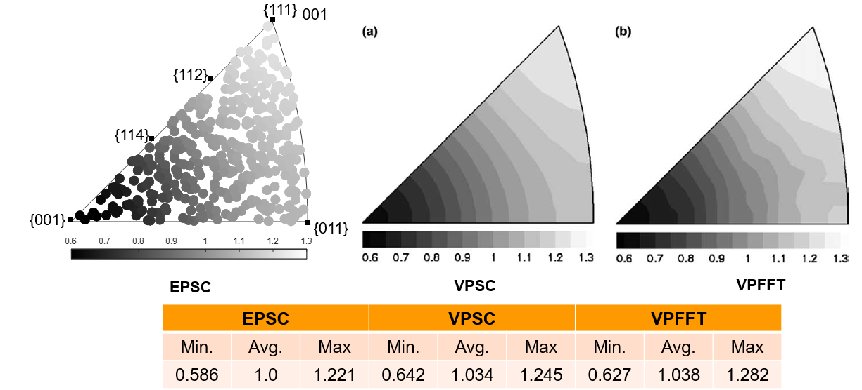
Normalized Von Mises stress at 0.35% strain

Slide 7
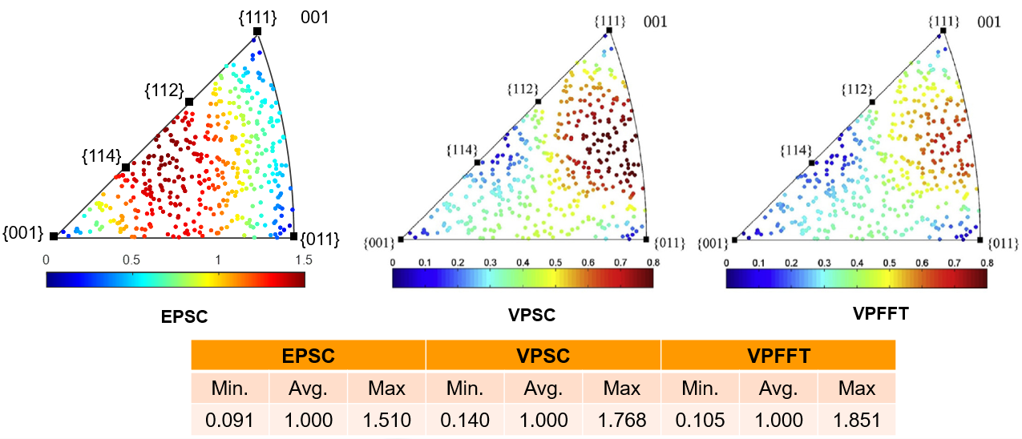
Average normalized rotation rate at 0.35% strain

Slide 8
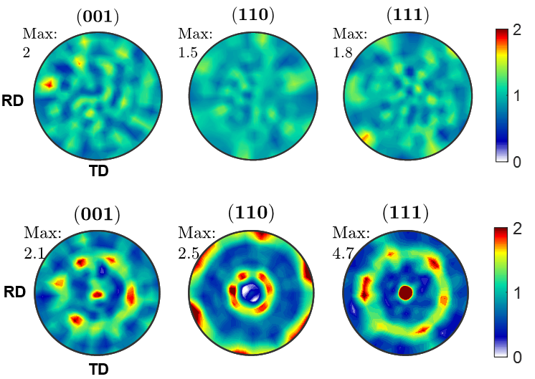
Modeling misorientation distribution
Initial random texture
Deformed texture after 25% tension in ND

Slide 9
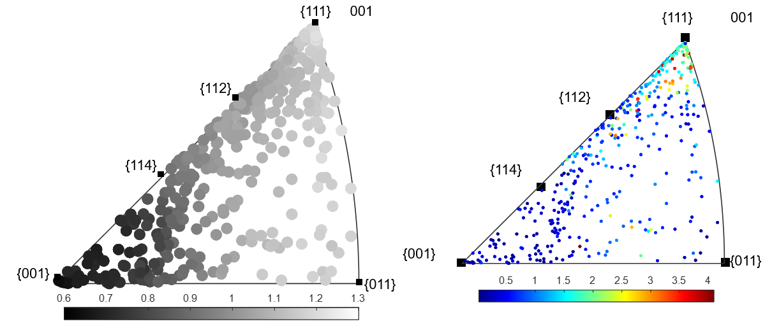
Svm and Average rotation at 25% strain

Slide 10
Summary and Future works
The mean-field EPSC model is extended with second moment formulations to predict misorientation distribution within grains to add capability of predicting full-field-like statistics.
Misorientation distribution predictions will be verified with established VPSC model for simulating recrystallization and grain fragmentation behaviors of annealed copper and steel samples.
Intragranular misorientation spreads will be extended to calculate GND densities which in turn adds to the existing dislocation density-based strain-hardening laws.
GND can then be used to predict backstress in the material during a deformation process.

