Slide 1
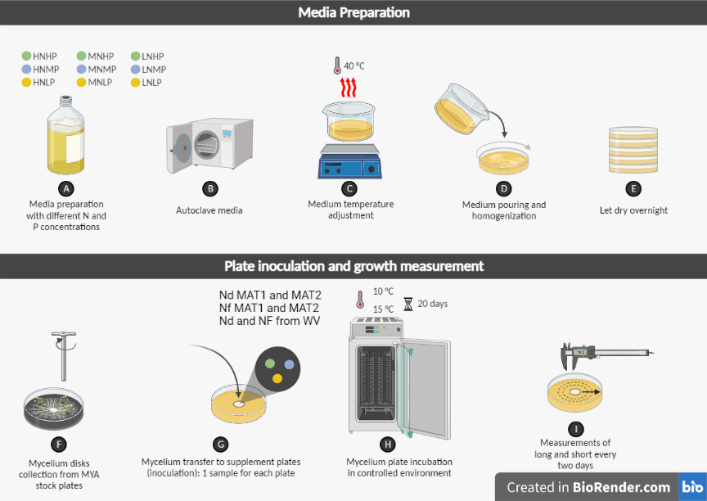
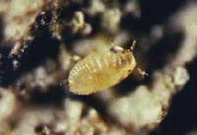
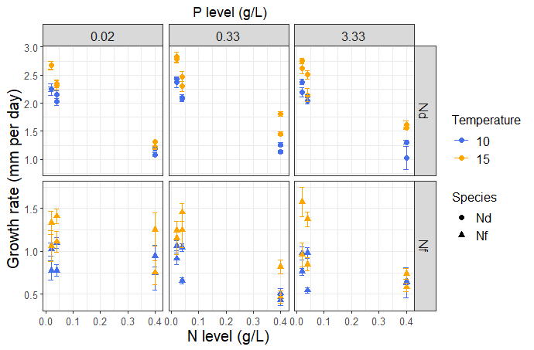
Influence of temperature and nutrient availability on beech bark disease fungal pathogen growth
Santiago Rivera-Reyes², Eric.W. Morrison² and Jeff Garnas²
¹Department of Microbial, cellular and biochemical sciences, , ²Department of Natural Resources and the Environment, University of New Hampshire, Durham, NH.
Introduction
Isolate selection
Experimental design
Since the introduction of beech bark disease (BBD) in 1890, American beech (Fagus grandifolia) populations throughout the United States have experienced widespread mortality (1).
BBD is a disease complex that consists of a scale insect, Cryptococcus fagisuga, and two species of Neonectria fungi, N. faginata and N. ditissima (2).
We currently lack an understanding of what regulates the prevalence of the two fungal species and how they respond to environmental variation.
Sampling sites across the BBD range
Completely randomized design with a 3x3x2 factorial arrangement with three levels of nitrogen, 3 levels of phosphorus, and two incubation temperatures 10℃ and 15 ℃.
We had three isolates of N. ditissima and three of N.faginata each with two replicates per treatment per temperature. The whole experiment was repeated three times.
The long and short of the fungal colony was measured in mm after 20 days of incubation to then do a linear regression to get the growth rate.
Beech bark disease complex
Treatment preparation and fungi culturing
Conclusions
Treatments
We found a significant positive effect of N on fungal growth rate. However, we also found an interaction indicating that the species responded differentially to N. There was no effect of P.
We observed that both fungi grew better at 15 ℃ than at 10 ℃. However there was not an interaction between temperature and species.
Geographical origin had a significant effect whereby isolates from NH had a faster growth than those from WV.
A. N. ditissima B. N.faginata
A. Perithecia produced by both fungal pathogens on beech trees
B. White wax masses caused by the initializing insect agent Cryptococcus fagisuga
Cryptococcus fagisuga
Objectives
sTAMD Simulations
Acknowledgements
Results
This research was presented at the north eastern forest pest council 2023 annual meeting held at Lake George, NY thanks to the funding provided by :
The Robert and Ruth Zsigray Academic Enrichment Fund.
MCBS department and the Graduate school at UNH travel grant.
We aim to compare optimal conditions for growth and reproduction across species and source populations of BBD pathogens by examining growth rates, perithecia production and competitive hierarchies of the two fungal species under controlled laboratory conditions, while systematically manipulating environmental factors, including temperature, nitrogen and phosphorous concentrations.
References
Cale, J. A., Garrison-Johnston, M. T., Teale, S. A., & Castello, J. D. (2017). Beech bark disease in North America: Over a century of research revisited. Forest Ecology and Management, 394, 86–103. https://doi.org/10.1016/j.foreco.2017.03.031
Morrison, E. W., Kasson, M. T., Heath, J. J., & Garnas, J. R. (2021). Pathogen and Endophyte Assemblages Co-vary With Beech Bark Disease Progression, Tree Decline, and Regional Climate. Frontiers in Forests and Global Change, 4. https://www.frontiersin.org/articles/10.3389/ffgc.2021.673099
Perrin, R., & Garbaye, J. (1984). Influence de la nutrition du hetre (Fagus sylvatica L.) sur la sensibilite au chancre provoque par Nectria ditissima Tul. Annales des Sciences Forestières 4 (41), 449-460. (1984). http://prodinra.inra.fr/ft/894AD6D7-9F0F-4B45-A9A2-FF77AE458DE9
Latty, E. F., Canham, C. D., & Marks, P. L. (2003). Beech bark disease in northern hardwood forests: The importance of nitrogen dynamics and forest history for disease severity. Canadian Journal of Forest Research, 33(2), 257–268. https://doi.org/10.1139/x02-183

