Slide 1



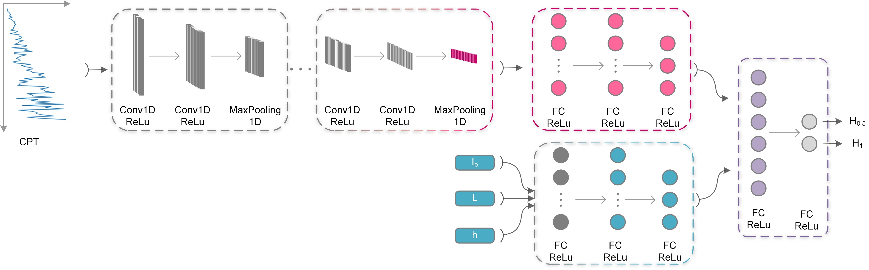
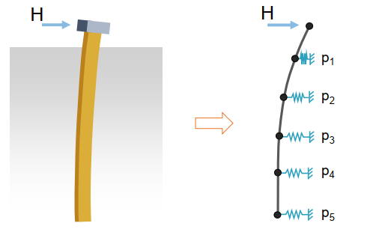
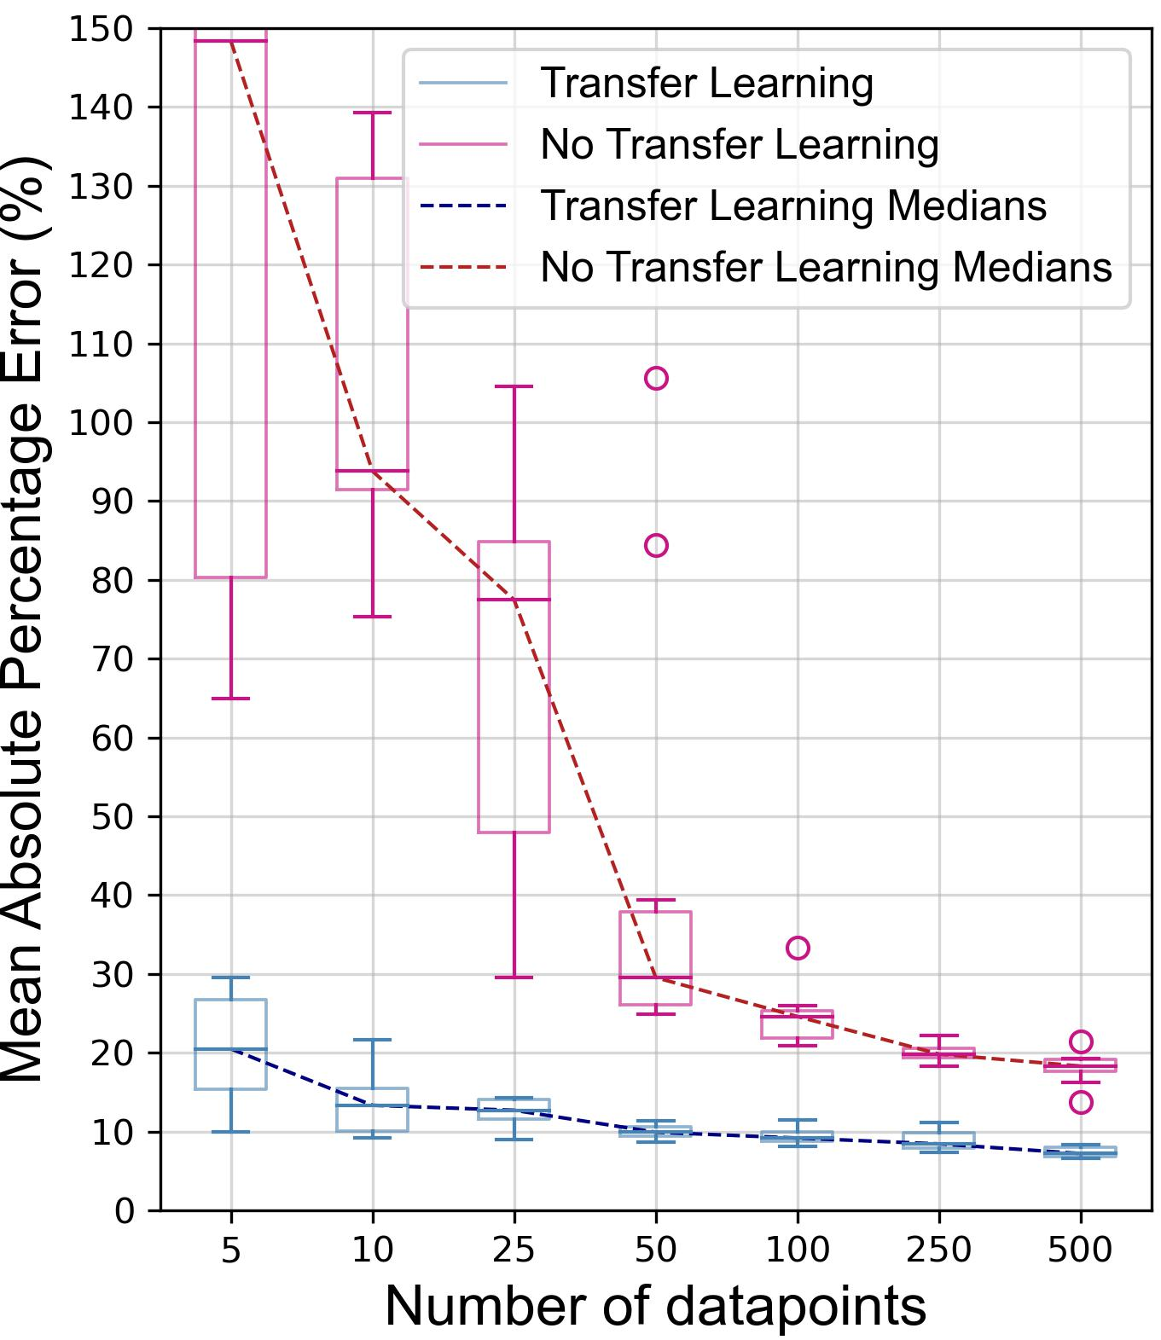
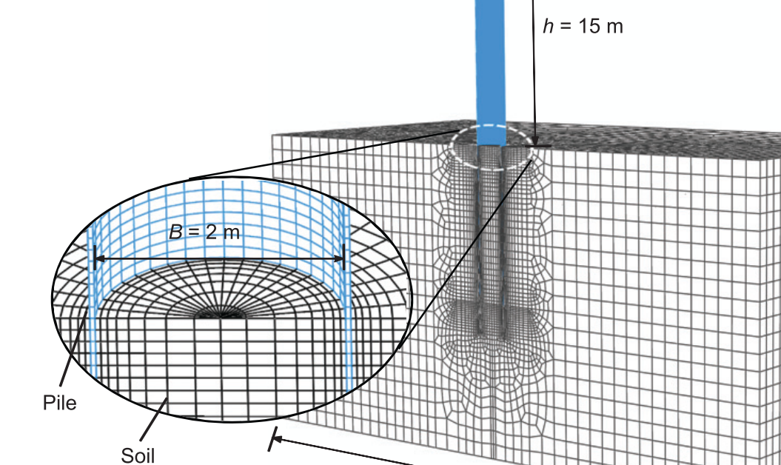
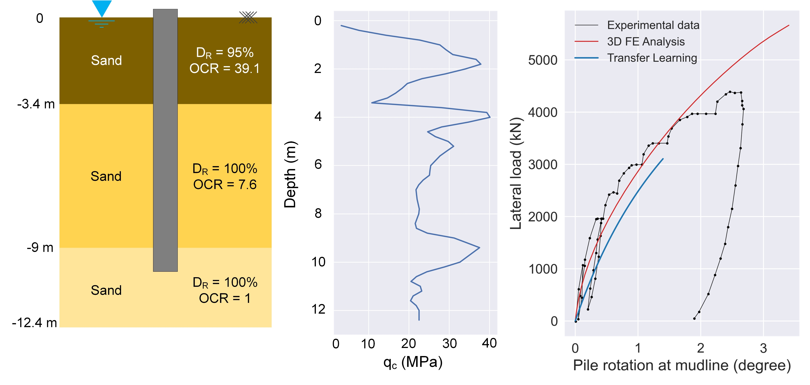
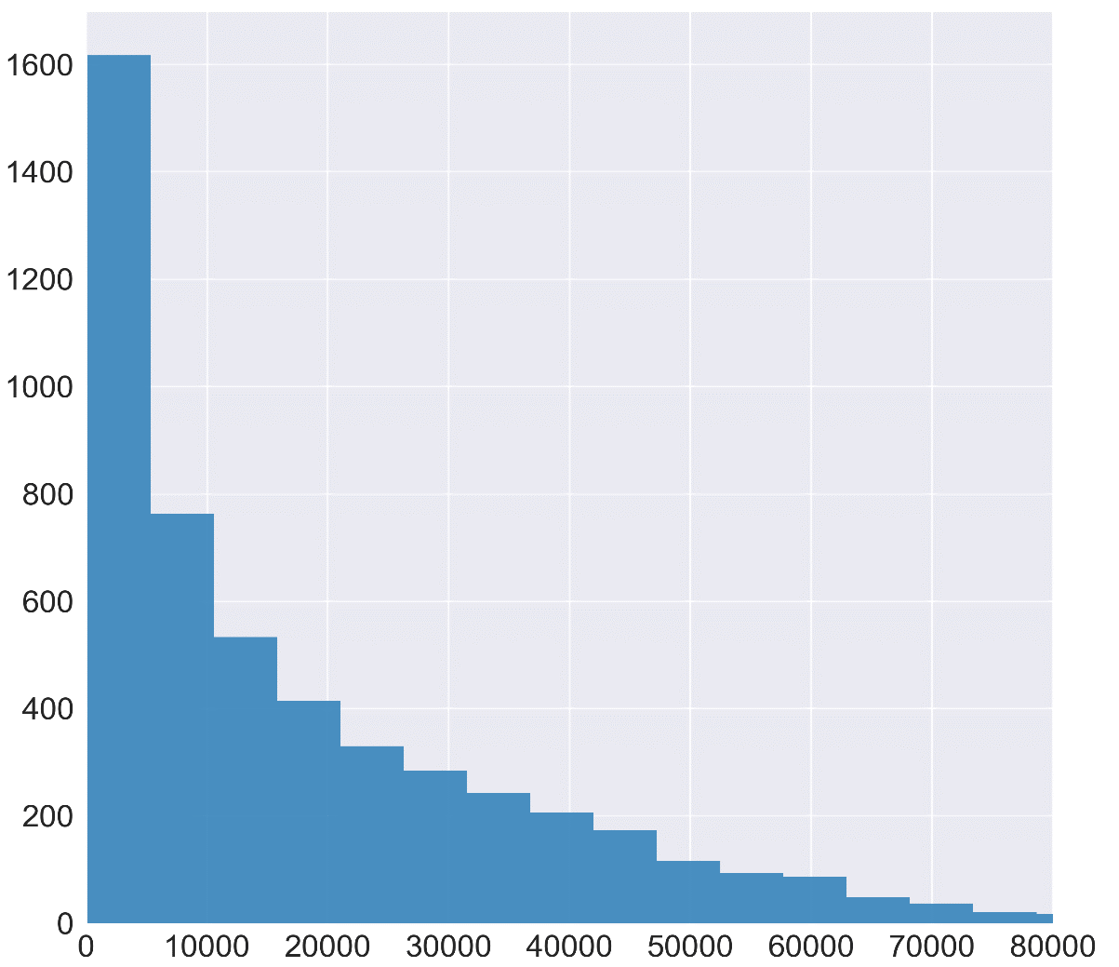
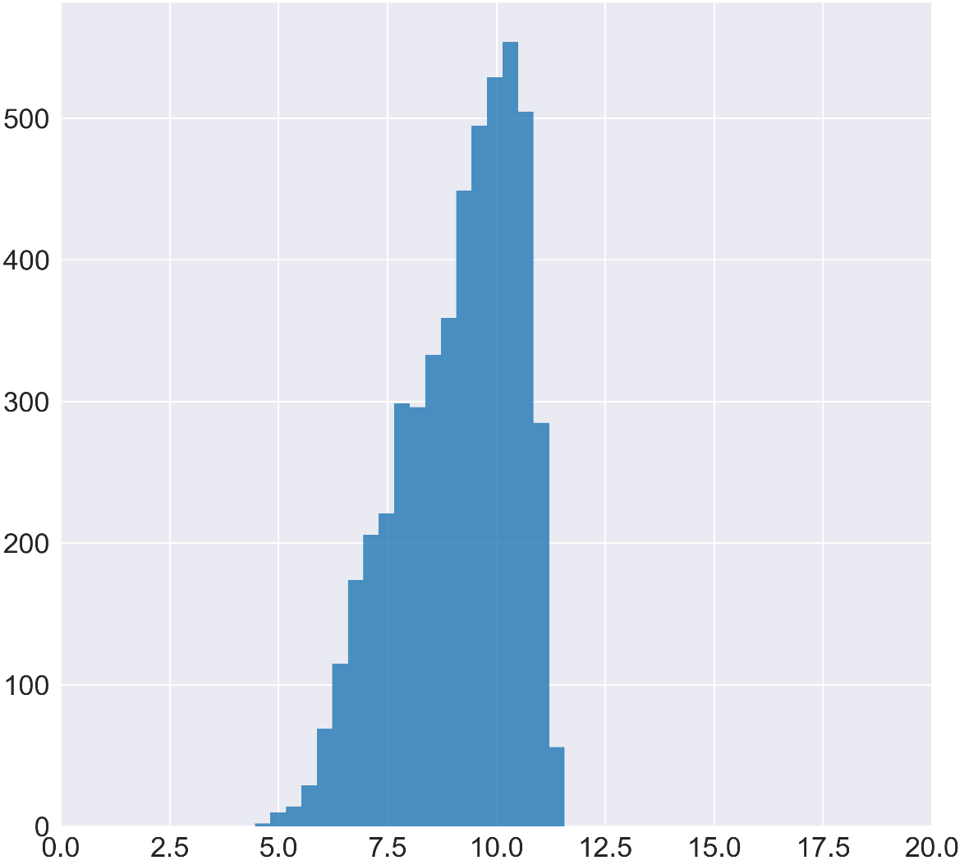
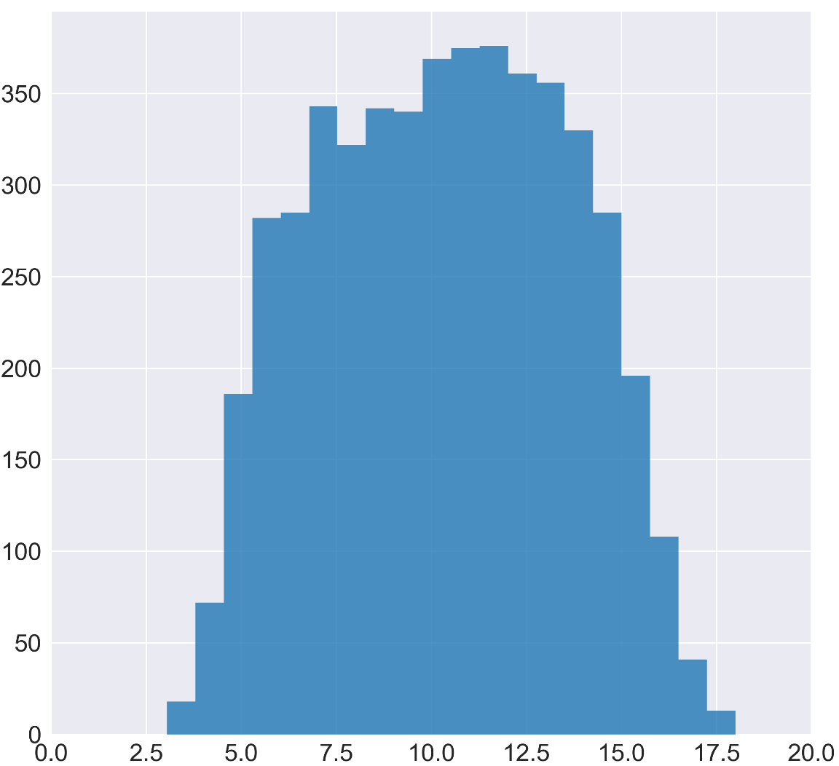
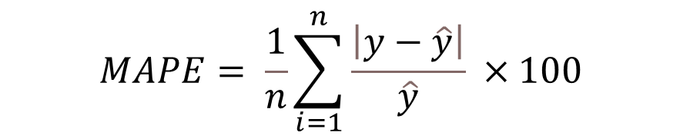





The power of transfer learning in developing prediction model for offshore monopiles using limited data
Amir Hosein Taherkhani¹, Mohammed Al-Duais², Qipei (Gavin) Mei², and Fei Han¹
¹University of New Hampshire, ²University of Alberta
University of Alberta
Geo-Congress 2023
Introduction
Error Analysis
Transfer Learning Model
The lateral load design for these large-diameter monopiles have traditionally relied on the p-y method. Evidences have shown that the p-y method may result in inaccurate predictions for the lateral response of monopiles.
we aim to develop a deep learning model to estimate the lateral capacities of monopiles in multi-layered sandy soil. The model takes pile geometry, the cone penetration test (CPT) data for soil, and loading condition as inputs, providing predictions for the lateral pile capacities.
In Transfer Learning model, the information gathered through solving the base model is stored in earlier layers. Then, the new problem is solved through adjusting the parameters of succeeding layers.
TL vs. No TL
Parameter | Base Model Dataset | TL Model Dataset
Pile Radius | 2-8 meters | 2-8 meters
Pile Length | 6-150 meters | 6-150 meters
Wall Ratio | 40-60 | 40-60
Load Eccentricity | 15-30 meters | 1-45 meters
Soil Relative Density | 35%-90% | 35%-90%
Thickness of sand layers | 1-126 meters | 1-126 meters
OCR of sand layers | 1 | 1-20
Results of the Base Model
p-y method
3D-FEM method
$$MSE= \frac{1}{n}\sum_{i=1}^{n}{{\left(y−\hat{y}\right)}^{2}}$$
$$MAPE= \frac{1}{n}\sum_{i=1}^{n}{\frac{\left|y−\hat{y}\right|}{\hat{y}} ×100 }$$
Model Development
Prediction vs. ground-truth outputs
Validation
Hybrid Neural Network Architecture
p-y vs. Hybrid Neural Network
Finally, the performances of model with Transfer Learning, without Transfer Learning, and 3D Finite Element methods were tested against experimental data.
Transformations
Capability the DL model to capture the nonlinearities in determining the lateral capacity of large-scale monopiles is highlighted through a common scenario.
Due to the high skewness in distribution of the generated outputs, the performances of the model using two common transformation in statistics was examined.
$${\overline{μ}}_{3}=1.28$$
$${\overline{μ}}_{3}=−0.58$$
$${\overline{μ}}_{3}=−0.03$$
Frequency
H_{0.5}
Ln(H_{0.5})
$$\sqrt[4]{H_{0.5}}$$

