Slide 1
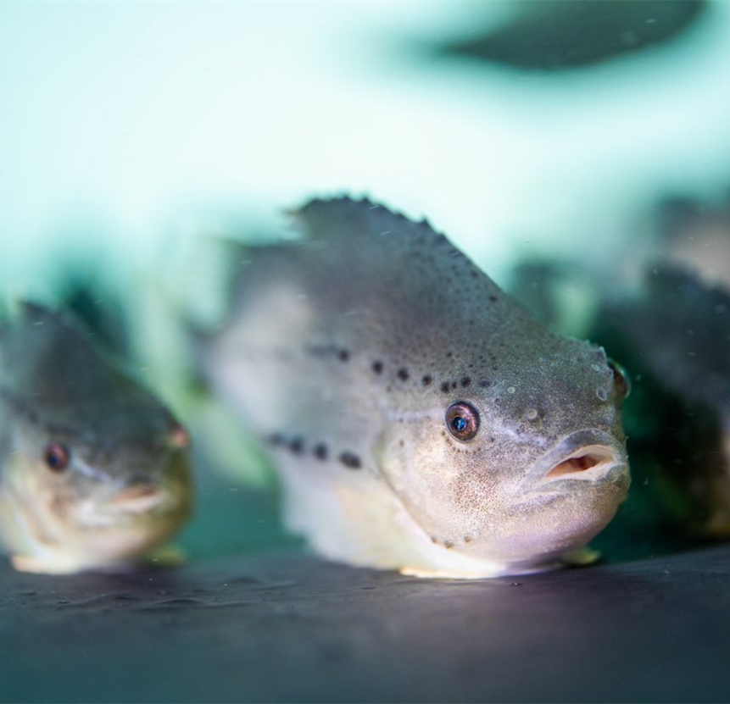



THE EFFECTS OF FISH SIZE, STOCKING DENSITY, AND PHOTOPERIOD ON JUVENILE LUMPFISH AGGRESSION
Shelby Perry and Elizabeth A. Fairchild
Department of Biological Sciences
University of New Hampshire
Durham, NH, USA
Notes:
Hi there, my name is Shelby Perry and today I will be discussing the effects of fish size, stocking density, and photoperiod on the aggression of juvenile lumpfish.

Slide 2
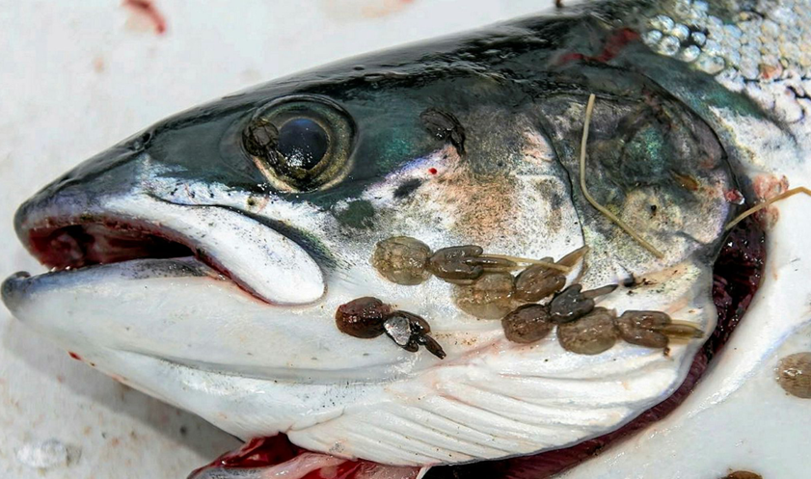
Cleanerfish
Cleanerfish are fish that perform services for other fish such as:
  Removing ectoparasites and dead tissue (Feder, 1966; Losey et al., 1999).
In the salmonid industry, cleanerfish are used to mitigate the ectoparasitic copepod sea lice.
Today, lumpfish are the most commonly used cleanerfish in the salmonid industry (Powell et al., 2017).

Slide 3
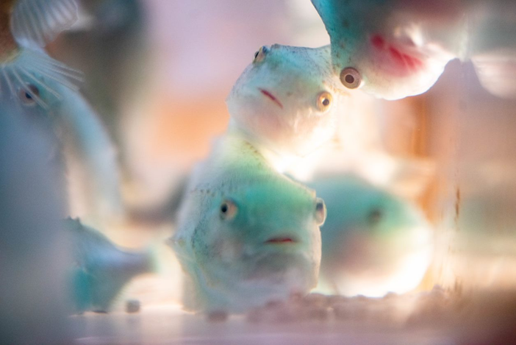

Global lumpfish production for cleanerfish use ~50 million/per year.
Lumpfish are reared in the hatchery until roughly 25g.
Juvenile lumpfish can be extremely aggressive to conspecifics (Haaland, 1996; Jonassen et al., 2018).
Cannibalism poses one of the largest causes of mortality in the hatchery.
Notes:
Lumpfish aquaculture has skyrocketed, becoming a booming industry, producing roughly 50 million fish per year.
Lumpfish are reared in hatchery until roughly 25 grams. However, during this period of intensive rearing, juvenile lumpfish can be extremely aggressive to conspecifics, resulting in cannibalism.
Juvenile Lumpfish tend to be highly territorial, and in some instances, hierarchies can be established, forcing smaller juveniles to the bottom of the tank (Haaland, 1996; Jonassen et al., 2018).
Size grading, the act of sorting and separating the fish by size into homogenous populations, is a standard protocol that hatcheries use to minimize cannibalism; however, despite this frequent and labor-intensive process, cannibalism still occurs. And as it stands, poses one of the largest causes of mortality in the hatchery.

Slide 4
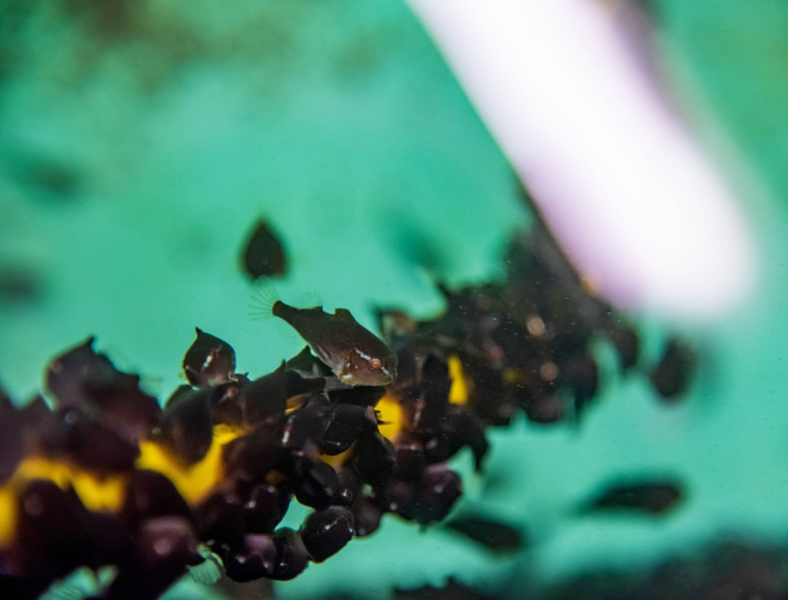

Lumpfish are most often Type I cannibals, nipping at each others’ fins.
However, this cannibalism appears to be a finite phase, occurring most often at 5g.
Notes:
There are two types of cannibalism, Type I, in which the individual is not fully consumed and Type II, in which the individual is completely consumed (Hecht & Appelbaum, 1988).
In some instances, a fish’s entire caudle fin can be consumed and have severe damage to the caudle peduncle.
This fin nipping, can be extremely detrimental to the fish’s health, leading to secondary infections that can result in death.
Based off observations during the 2019 and 2020 lumpfish rearing seasons at the University of New Hampshire (UNH) Coastal Marine Laboratory (CML), this cannibalism was observed to be a finite phase, most common in 5g fish.

Slide 5
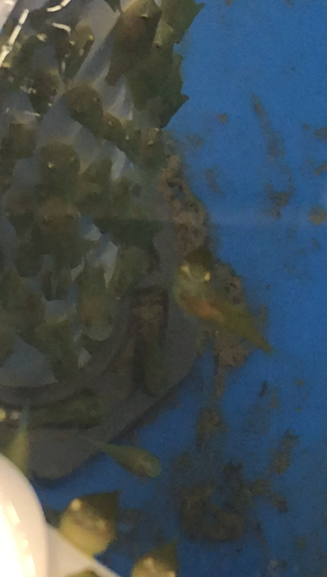
Cannibalism in Fishes
Tends to be more common in larval and juvenile stages (Hecht & Pienaar, 1993; Baras et al., 2002).
Reported more often in cold water fishes of high latitudes (Strictar et al., 2017).
Affected by a number of differing variables such as food, light, and shelter availability (Naumowicz et al., 2017; Lopes et al., 2018; Hans et al., 2020).
Notes:
This is often attributed to their scope for growth being large and in turn consuming large amounts of feed compared to their body size (Hecht & Pienaar, 1993; Baras et al., 2002).

Slide 6
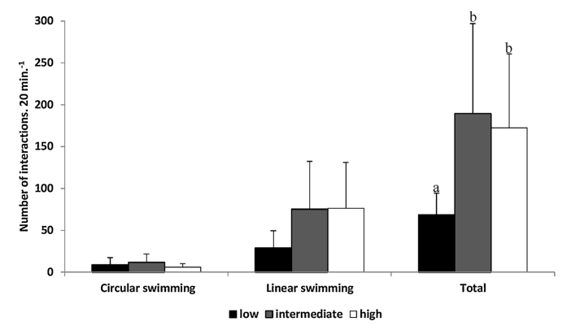
Cannibalism Stressors
Light plays a key role in various fishes’ biological processes (Lopes et al., 2018).
Light has been linked to the secretion of the hormone melatonin (Ekström & Meissl, 1997; Falcon et al., 2010).
Melatonin reductions can lead to increased aggression (Munro, 1986).
(Lopes et al., 2018)
Notes:
Now to zero In on some of these stressors.
Including but not limited to metabolic rate, hormone secretion, and body pigmentation (Lopes et al., 2018).
With melatonin levels increasing as light levels decrease.
Thus, lower light intensities may aid in mitigating aggression and ultimately cannibalism.

Slide 7
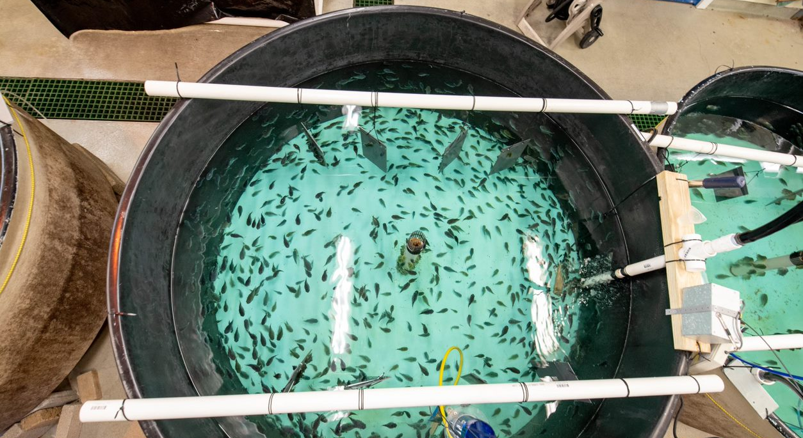
Cannibalism Stressors
Additionally, stocking density could exacerbate cannibalism during intensive rearing (e.g., Naumowicz et al., 2017; Hans et al., 2020).
Facilitating higher chances of individual interactions may promote cannibalism (Baras et al., 2002).
Notes:
As cannibalism can be a density dependent population regulator (Polis, 1981).

Slide 8
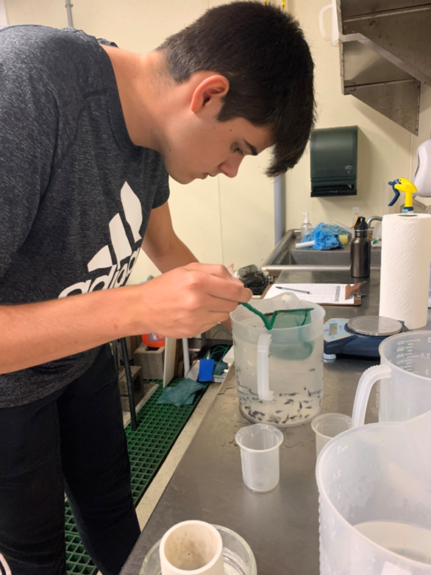
Previous Study
Prior work, conducted by Nathaniel Spada at UNH, looked at:
  The effects of stocking density on the growth, survival, and aggression of juvenile lumpfish.
  Four stocking densities: 40, 60, 70, and 90 g/L
  Two juvenile sizes: 2g “small” and 13g “large”
Elizabeth A. Fairchild
(Spada, 2021)
Notes:
The lowest stocking density (40g/L) was chosen to reflect the reported industry standard, while the highest (90 g/L) was chosen to test the limits of lumpfish growth, survival, and aggression under extreme crowding.
This experiment was tested in triplicate over 8 weeks.

Slide 9
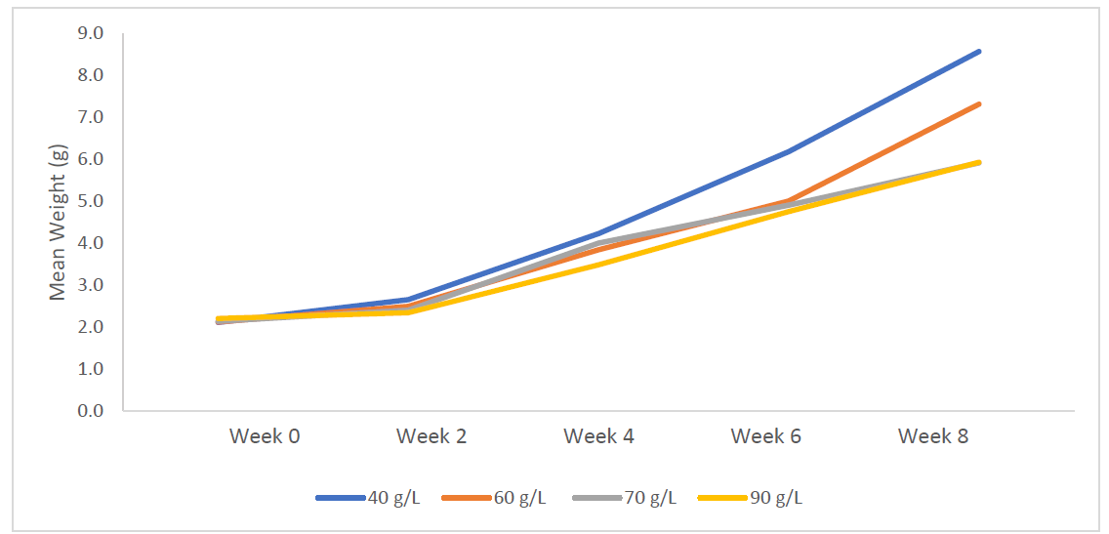
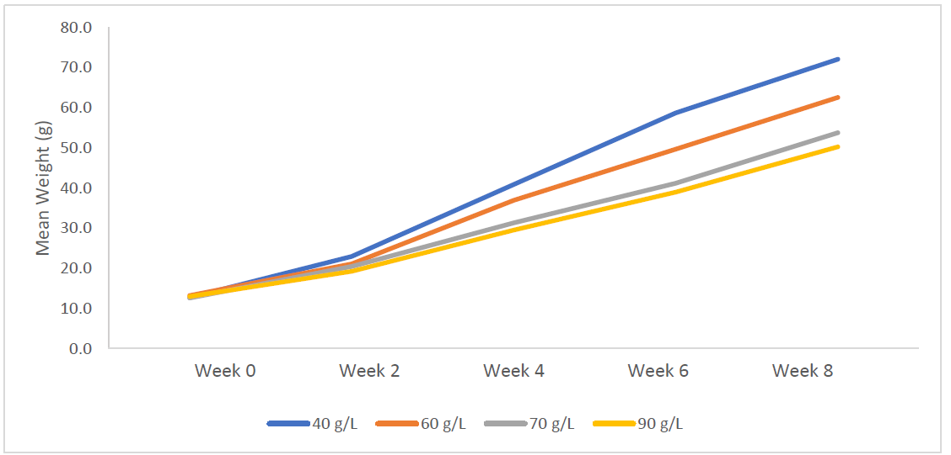
Previous Study: Results
2g Lumpfish
13g Lumpfish
(Spada, 2021)
Notes:
For both the small 2g and the large 13g fish
Survival was not affected
Stocking density did affect overall percent growth.
Stocking density did not significantly affect the occurrence of fin nipping.
Based off of this previous study, we wondered what other stressors may impact juvenile lumpfish aggression.

Slide 10
Objectives
Determine and pinpoint the stage (fish size) at which cannibalism is most prevalent and determine if this is a finite period.
Examine the effects of various light intensities and their interactions with stocking densities on cannibalism in juvenile lumpfish.
Notes:
This leads me into my current research. Though stocking density did not affect fin nipping, we posed the question, would another stressor, that of light, have an effect, whether that be an individual effect or a compounded one.

Slide 11
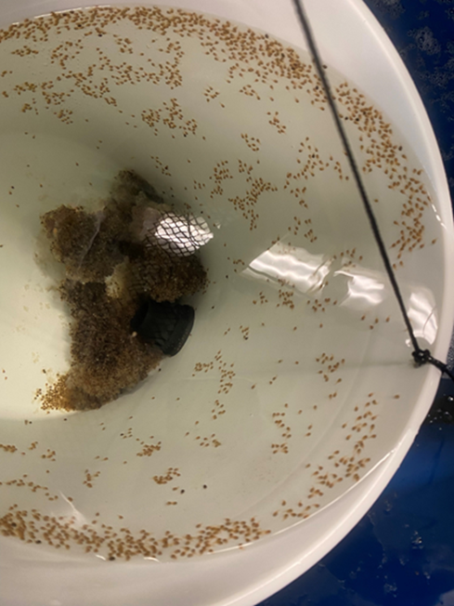
Lumpfish Source
Fish Cohort
  2021- Memorial University
Lumpfish were reared at the University of New Hampshire’s Coastal Marine Laboratory.
All fish were graded, using an adjustable bar grader to the desired initial size prior to stocking out the experiment.
Notes:
Eggs from the 2021 cohort were procured from memorial university -
Time yourself and if need more time add in stuff about our rearing protocol. Add in between the fertilized egg stage and the size grading

Slide 12
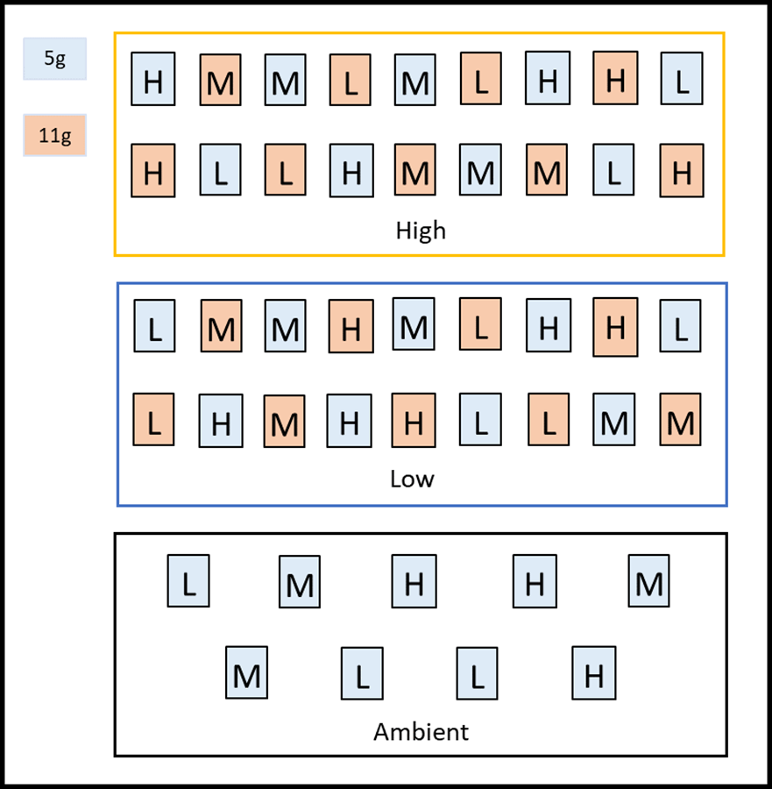
Experimental Design
Treatments include:
  Fish size (5g, 11g)
  Light Intensity (High, Low, and Ambient)
  Stocking Density (High 90g/L, Medium 65g/L, and Low 40g/L)
  Experiment was run for 8 weeks.
Notes:
And again, fish size was chosen as a treatment due to observations during previous rearing seasons.
Light Intensity, again, was chosen for its role in biological processes, as well as lumpfish are visual feeders.
Stocking density, as high stocking densities would facilitate higher interactions between individuals.
Here in this figure, you can see our set up, in which each of these boxes (points to large boxes) represent a light treatment.
You can see that in each of the light treatments, we have 5 and 11g fish tanks, except in ambient treatment. This was due to a lack of 11g fish due to a die off that had occurred during the rearing season. Tank placements were randomly assigned with 5g and 11g alternating.

Slide 13
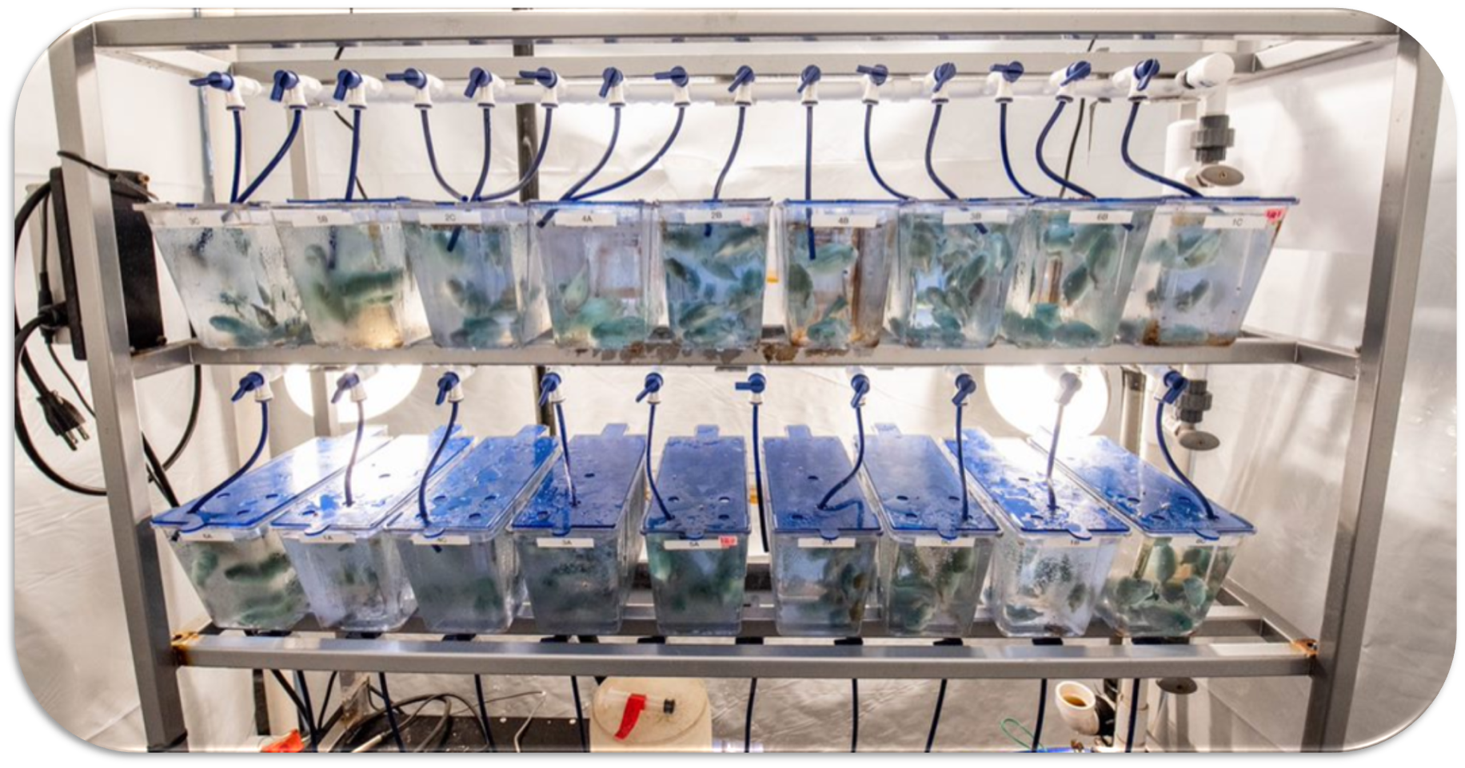
Notes:
Fish were stocked into 3L aquaria. This small scale allows for greater replication, due to lack of space in our laboratory.
The aquaria were then placed into three separate flow-through, ambient temperature and salinity filtered seawater systems.
Each system comprised an individual light treatment and was housed in an enclosure constructed from a PVC frame and thick panda film in order to block out any ambient laboratory lighting.

Slide 14
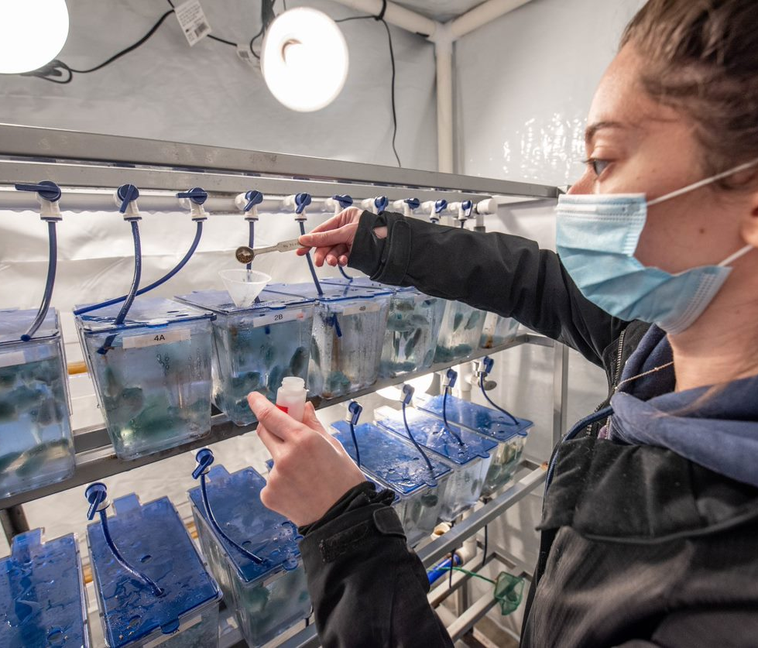
Daily Feeding
Fish were fed 5 times a day at 3% body weight per fish/day.
Fish were fed Gemma Wean (Skretting).
Feed Times: 8:00am, 10:00am, 12:00pm, 2:00pm, 5:00pm
Notes:
*At the beginning of the experiment, 5g fish were fed a starting size of 0.8mm, transitioned to 1.2mm at two weeks, and to 1.8mm feed at 6 weeks. 11g fish were fed a starting diet size of 1.2mm, transitioned to 1.8mm at 2 weeks, and 2.0mm feed at 6 weeks. *
As fish grew, feed size was adjusted accordingly

Slide 15
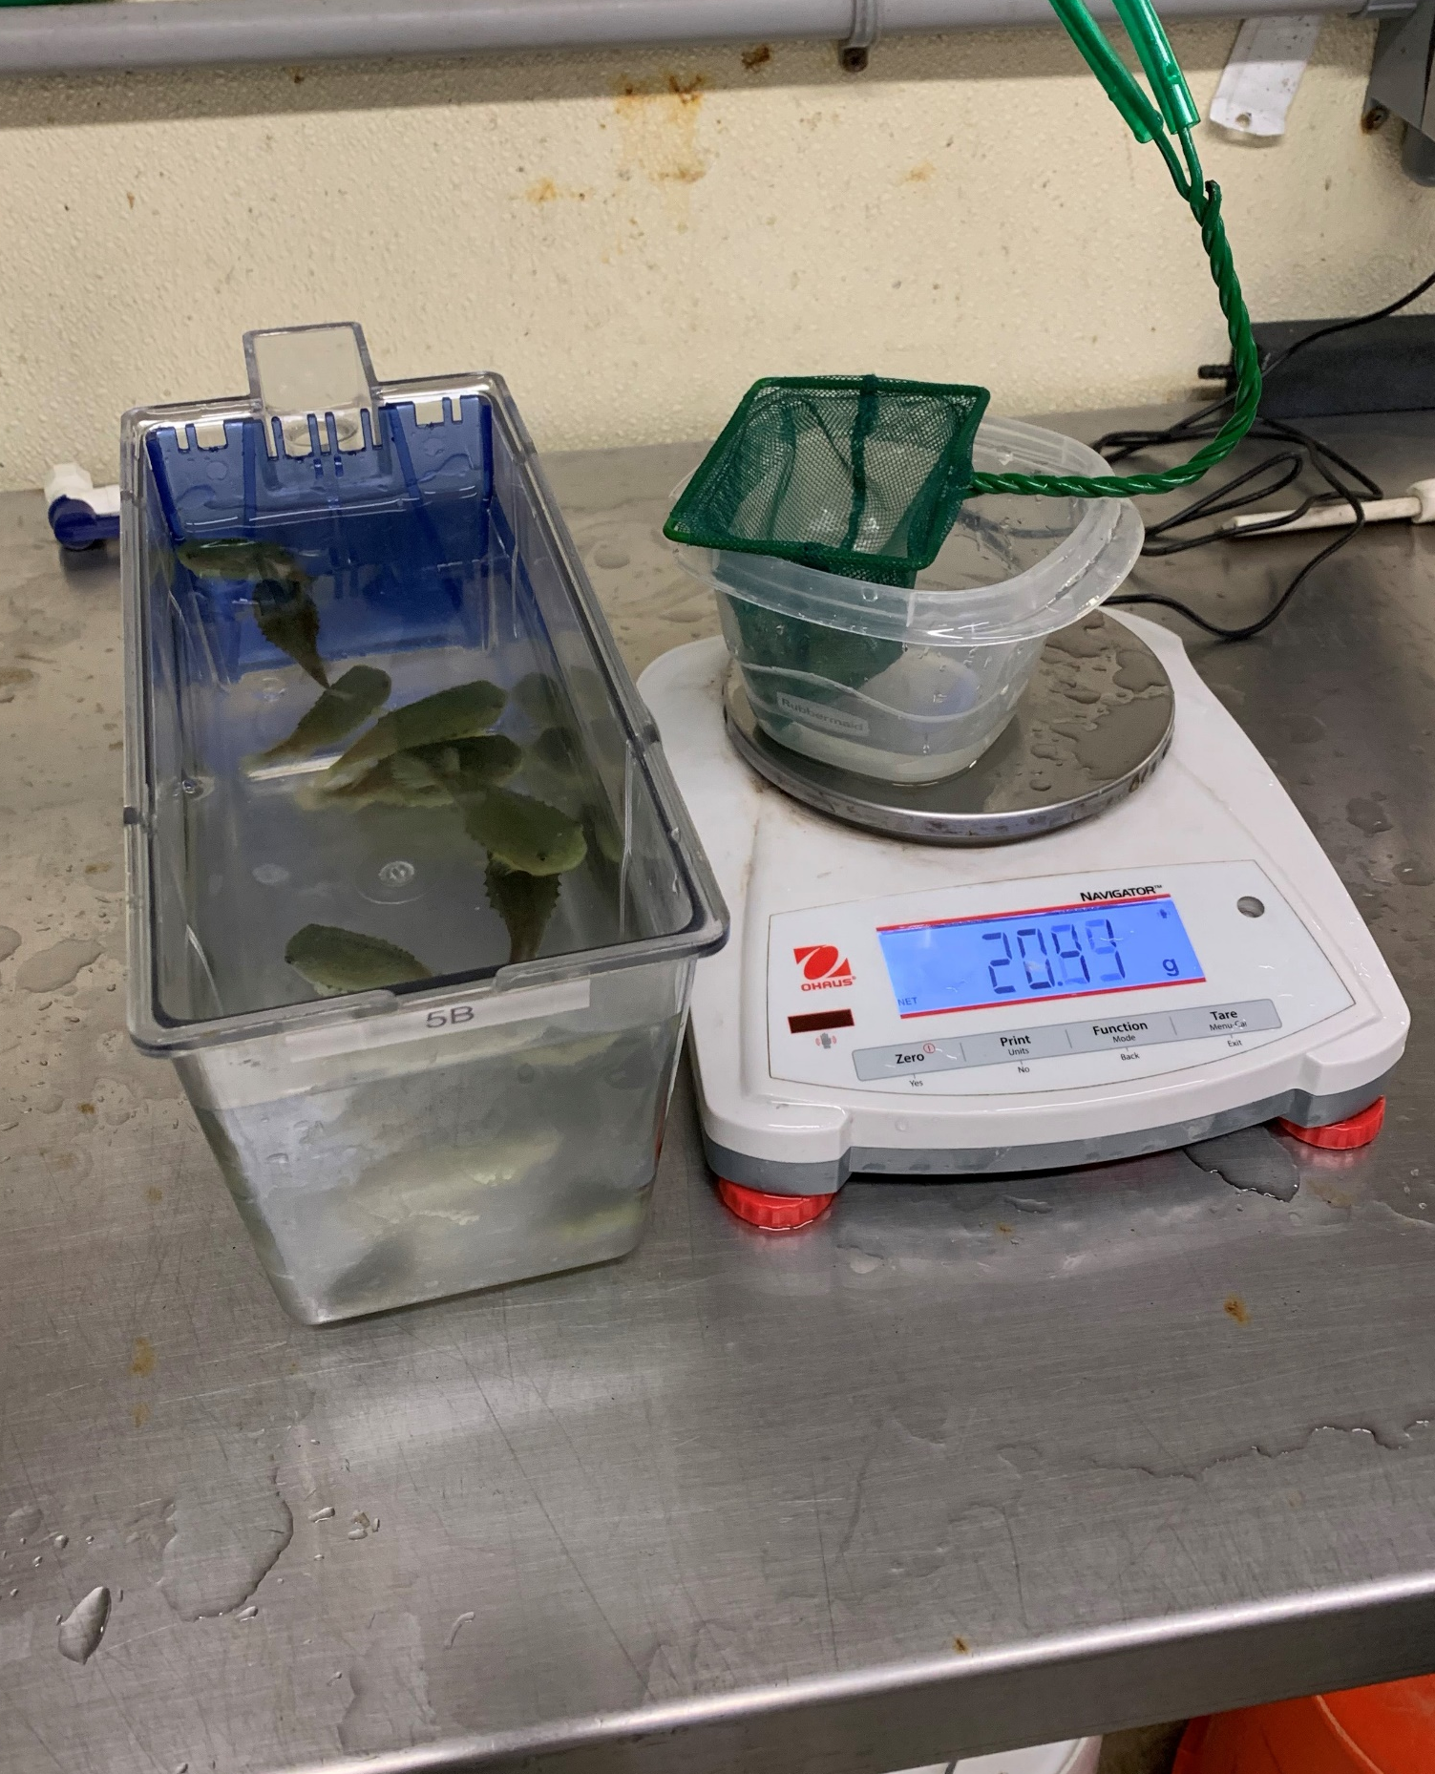

Sampling
Fish were sampled bi-weekly
  5g fish - 20 fish subsampled
  11g fish - entire tank sampled
Weight and a fin nipping score assigned to each fish sampled.
Notes:
It is during this time that Aggression was quantified with the use of a fin nipping scale.
In order to maintain stocking density, from the sampled fish, a tank density was estimated, and fish were then removed in order to revert the tank back to its original stocking density.

Slide 16
Fin Nipping Scale
Increasing Fin Nipping Severity (0-5)
Reproduced from Spada, 2021

Slide 17
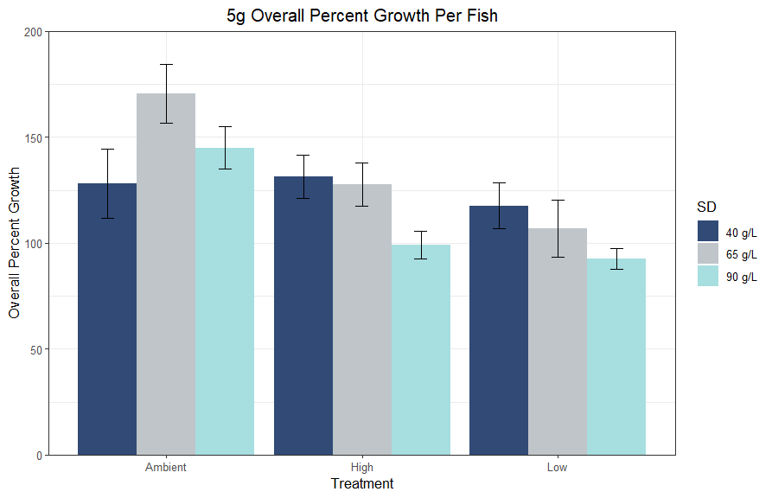
Two-Way ANOVA
a
a
a
b
b
b
b
b
b
Notes:
This leads me to my results
Due to the difference in treatment levels, the size classes were analyzed separately.
Light did have a significant effect on overall percent growth.
Ambient light was significantly different from high and low light treatments.
SD did not have a significant effect on overall percent growth.

Slide 18
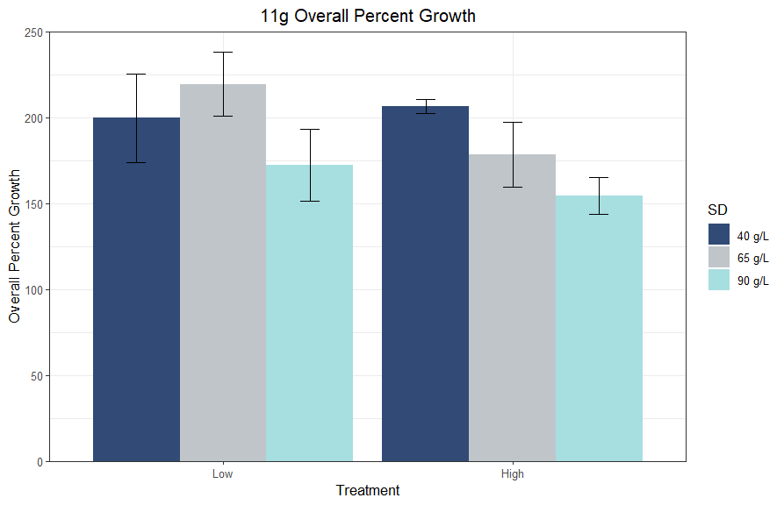
Two-Way ANOVA
Notes:
There was no significant effect on the overall percent growth of 11g.

Slide 19
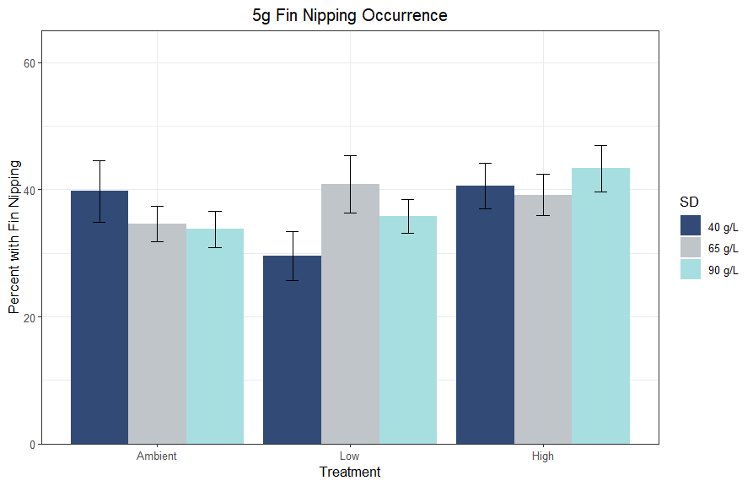
Binomial Generalized Linear Mixed Model
ab
b
b
ab
ab
ab
ab
ab
a
Notes:
Here we have the fin nipping Occurrence for 5g fish
I found that there was a significant interaction between SD and Light
In the Low light treatment, SD1 is significantly different from SD2. Low Light SD1 was also significantly different from high light SD1.
For 5g fish, severity was not analyzed, as scores were generally low, with the highest score at week 8 being a 1.2.

Slide 20
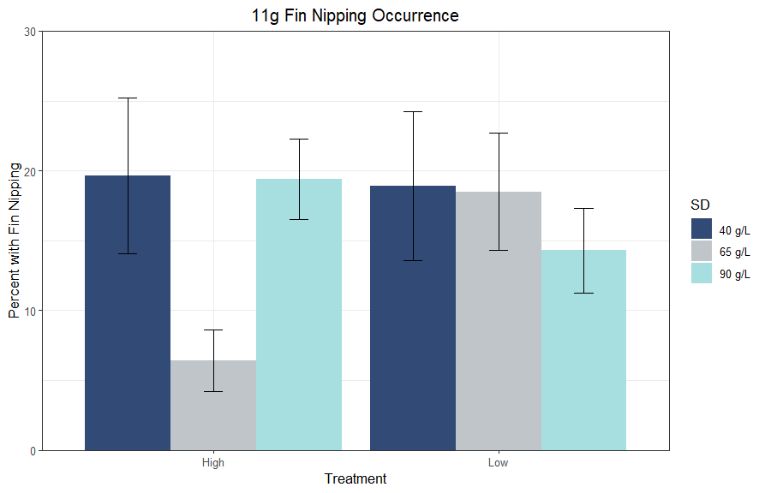
Binomial Generalized Linear Mixed Model
Notes:
Here we have the fin nipping Occurrence for 11g fish
For 11g fish, there was no significance between treatments.
Though the size groups were analyzed separately, there is generally more fin nipping occurring in the 5g fish tanks.
The overall mean % occurrence of fin nipping for 5g was roughly 45%, while 10g was roughly 20%.
Due to the relatively low occurrence of fin nipping in 11g fish, severity of fin nipping was not analyzed.
Less than 1% of fish sampled (4 out of 962 samples) had fin nipping scores above a 1, with the highest score being only a 2

Slide 21
Conclusions
Manipulating lighting and stocking density (up to 90 g/L) can be used to suppress or increase growth rates in small lumpfish without resulting in increased aggression.
These factors appear to be less effective for larger juveniles.
Future studies should focus on how these variables affect lumpfish < 5g as there are indications that aggression is most severe at this size class.

Slide 22


Acknowledgements
Thank you to everyone at the Coastal Marine Laboratory, especially Nathan Rennels, Lily Wong, Danielle Danis, Samantha Brady, Abby Concannon, and Mike Doherty.
Thank you to my Master’s Thesis Committee, Dr. Brittany Jellison and Dr. Nathan Furey.
Thank you to the University of New Hampshire Graduate School, Department of Biological Sciences, and the School of Marine Science and Ocean Engineering for travel funds.
This research is funded by the New Hampshire Agricultural Experimental Station.
Notes:
Add logos.

Slide 23
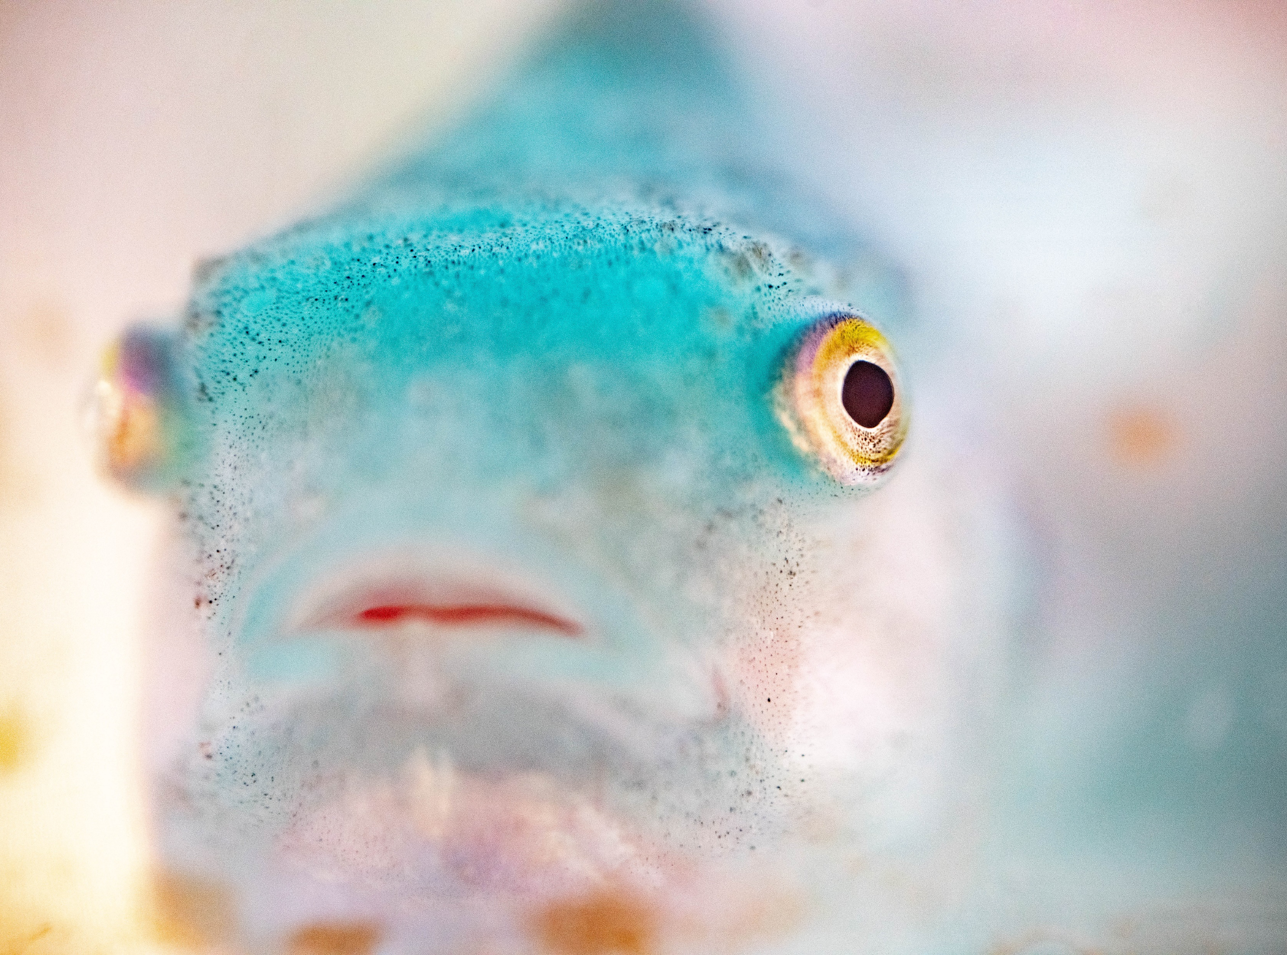
Questions?
Shelby.perry@unh.edu

