Slide 1
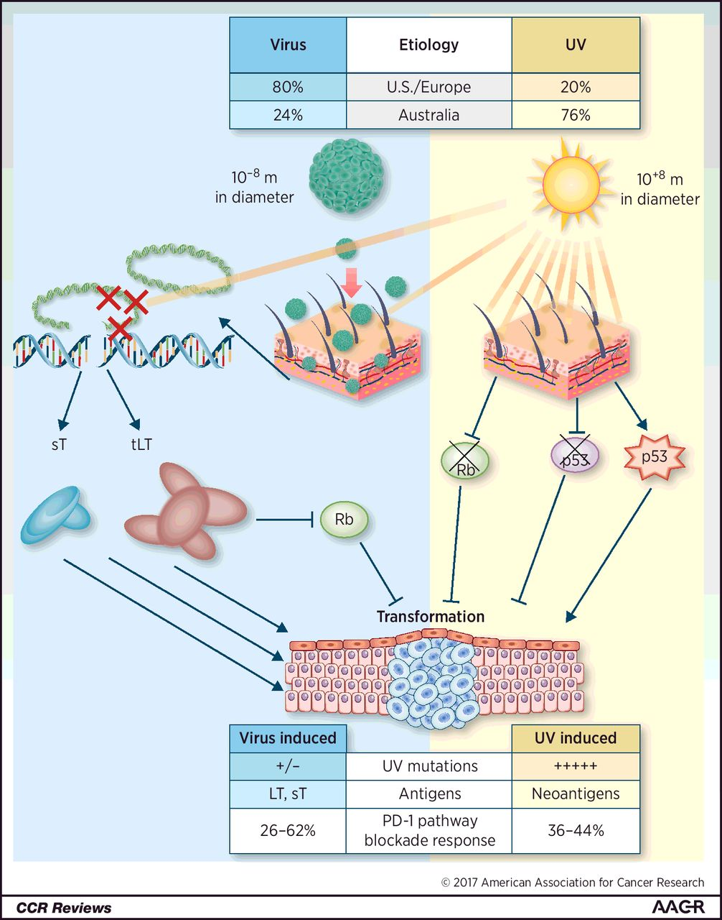
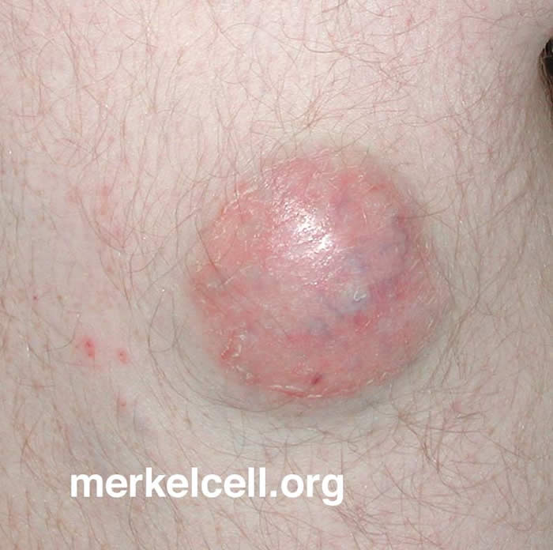
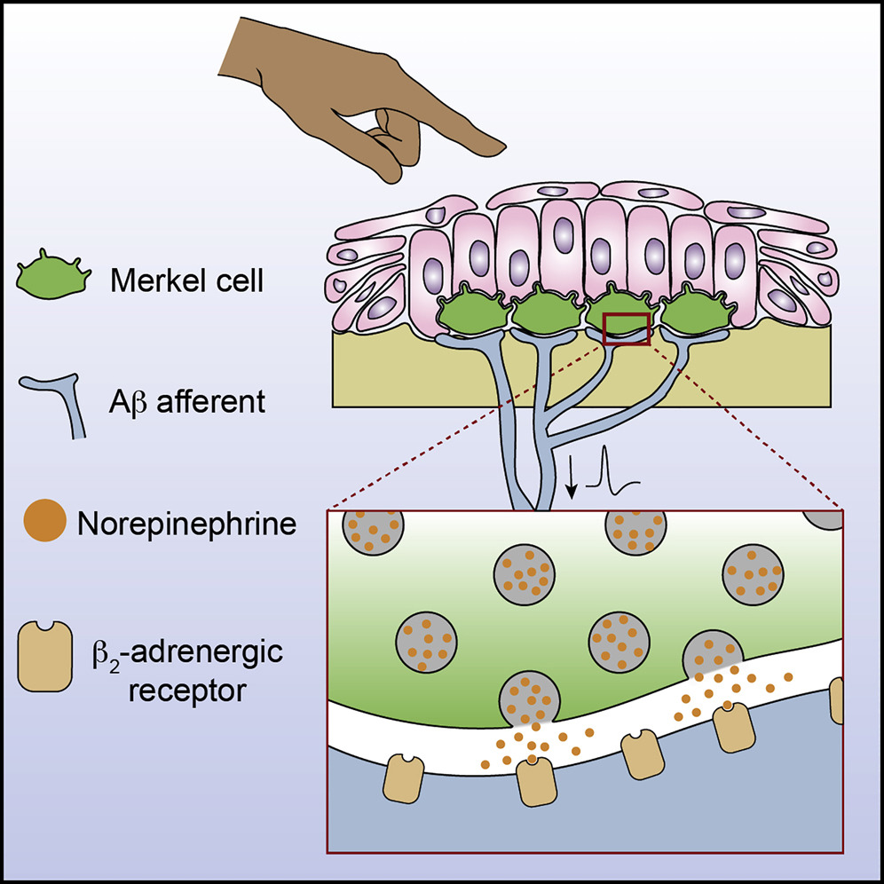
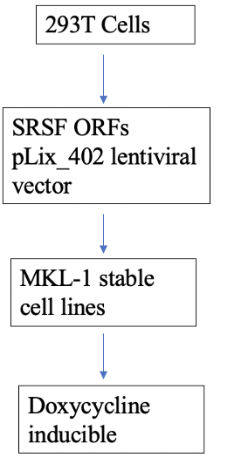
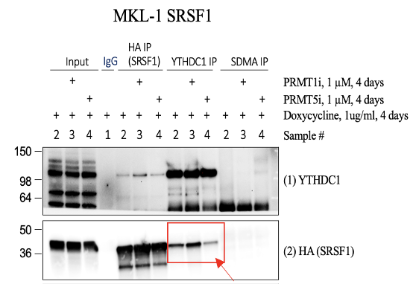
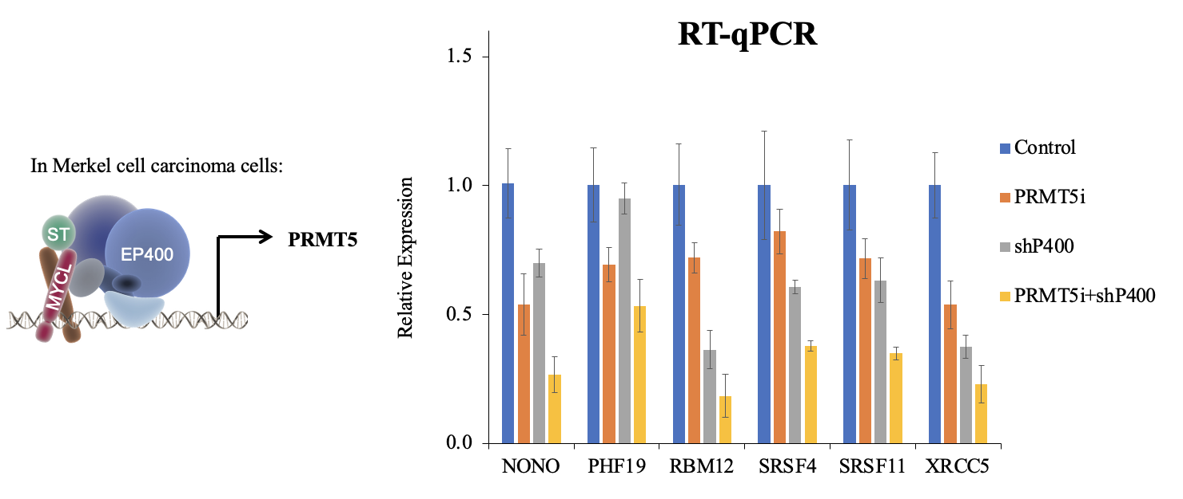
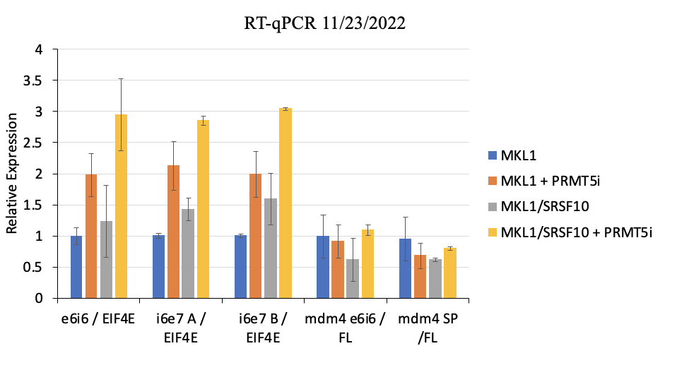
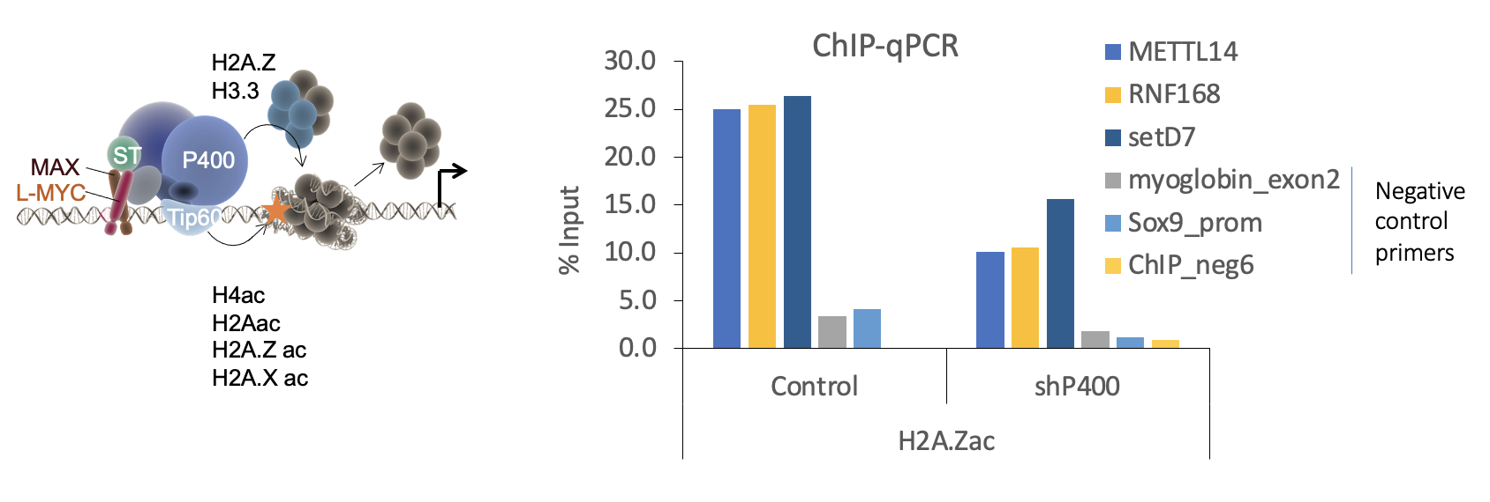
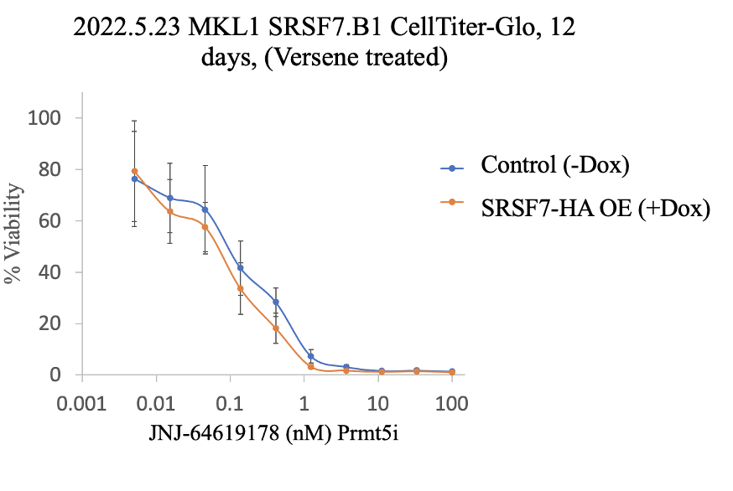
Investigating the roles of PRMT5-mediated epigenetic regulations of RNA binding proteins and histones in Merkel Cell Carcinoma Devya Gurung and Jingwei Cheng Department of Molecular, Cellular and Biomedical Sciences at University of New Hampshire, Durham, NH 03824
Introduction
Virus Positive MCC vs. Virus Negative MCC
Results
Merkel cell carcinoma (MCC)
Highly aggressive neuroendocrine skin cancer
2,500 new cases/year in USA: 30% mortality
Melanoma (invasive) 77,000/ year: 13% mortality
80% of MCC cases are caused by Merkel Cell Polyomavirus (MCPyV).
Risk factors
A: Asymptomatic/lack of tenderness
E: Expanding rapidly
I: Immune suppression: HIV patients
O: Older than 50 years of age
U: Ultraviolet-exposure induced DNA damage
PRMT5-mediated arginine methylation of SRSFs increases their affinities with m⁶A reader YTHDC1.
IP-WB
Virus Positive vs. Virus Negative
Virus-induced cellular network perturbations may mimic disease-causing mutations.
Epigenetic deregulation and DNA mutations converge to the same oncogenic pathways.
kDa
RT-qPCR Data
Summary
Hypotheses
PRMT5-mediated arginine methylation of histones and RBPs such as SRSFs is required for MCC tumorigenesis:
Arginine methylation of SRSFs is required for recruiting SRSFs to m⁶A sites for R-loop structure resolution, perturbation of which will induce replication stress and result in DNA damage.
In histones, arginine methylation affects the acetylation of nearby lysine residues that are involved in the regulation of gene expression and neuroendocrine cell differentiation.
This study validated H2A.Zac as a good marker. H2A. Z are involved in acetylation and are located at promoter regions.
RT-qPCR experiment shows that constitutive expression of SRSF10 in MKL-1 cells can further increase detained intron levels in addition to PRMT5i.
We successfully generated MKL1-SRSF cell line and performed IP-Western Blot to show protein-protein interactions.
P400 knockdown and PRMT5 inhibition show synergistic down-regulation in a subset of genes.
Constitutive expression of SRSF10 in MKL-1 cells show increase detained intron levels of EIF4E, which is a translation initiation factor.
Methodology
Why PRMT5?
Cell Culture Conditions: Merkel Cells MKL-1 were grown and maintained in 10% FBS medium at 37ºC.
Cell viability: Test cell sensitivity with inhibitors.
Immunoprecipitations (IP)-Western Blots: Cells were treated with PRMT5 and PRMT1 on MKL-1 cells that overexpress SRSF1, SRSF3, SRSF7, and SRSF10 to detect protein-protein interactions.
Chip-qPCR: Chromatin DNA was extracted. Performed ChIP-qPCR to analyze histone modifications at the promoter regions of genes associated with neuroendocrine cell differentiation.
RT-qPCR: extracted genomic DNA and reverse transcribed. It was used to understand transcription sites and study gene expression.
PRMT5 is a downstream target gene of the ST-MYCL-EP400 complex.
PRMT5 is a Major type II arginine methyltransferase group.
It mediates symmetric dimethylarginine (SDMA) marks on histones and RNA binding proteins (RBPs).
It was the top target gene identified among 390 cell lines that were screened.
PRMT5 also plays a crucial role in gene regulation, cell development, chromatin regulation, splicing, and DNA damage response.
Acknowledgements
This research was supported by an Institutional Development Award (IDeA) from the National Institute of General Medical Sciences of the NIH under grant number P20GM113131.
References
Shailesh H., Zakaria Z. Z., Baiocchi R., Sif S. Protein arginine methyltransferase 5 (PRMT5) dysregulation in cancer. Oncotarget. 2018; 9: 36705-36718.
https://merkelcell.org
Tanda, E et al., Merkel Cell Carcinoma: An Immunotherapy Fairy-Tale?. Frontiers in oncology, (2021), 11, 739006. https://doi.org/10.3389/fonc.2021.739006
Hoffman, B et al., Merkel Cells Activate Sensory Neural Pathways through Adrenergic Synapses. Neuron, 100(6), 1401–1413.e6.
Inducible expression of SRSF7 didn’t sensitize cells to PRMT5 inhibitor.

