Slide 1

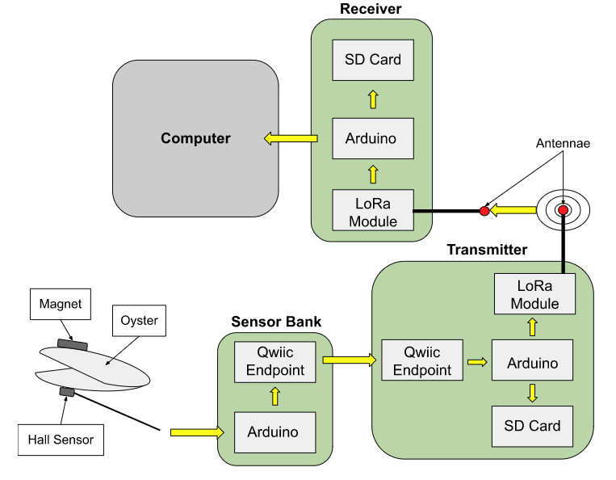
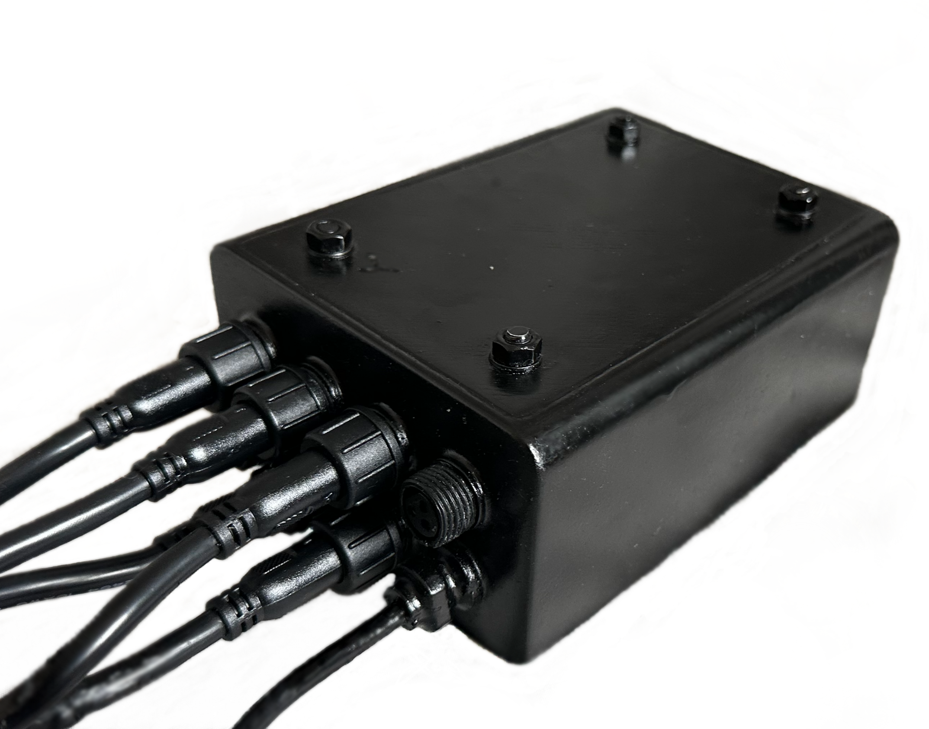
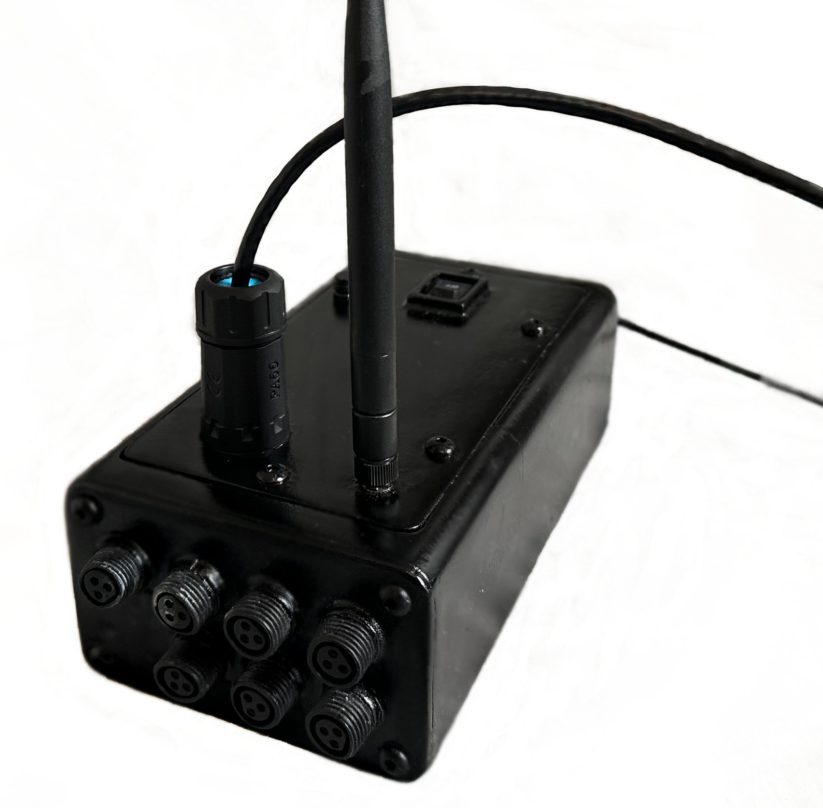
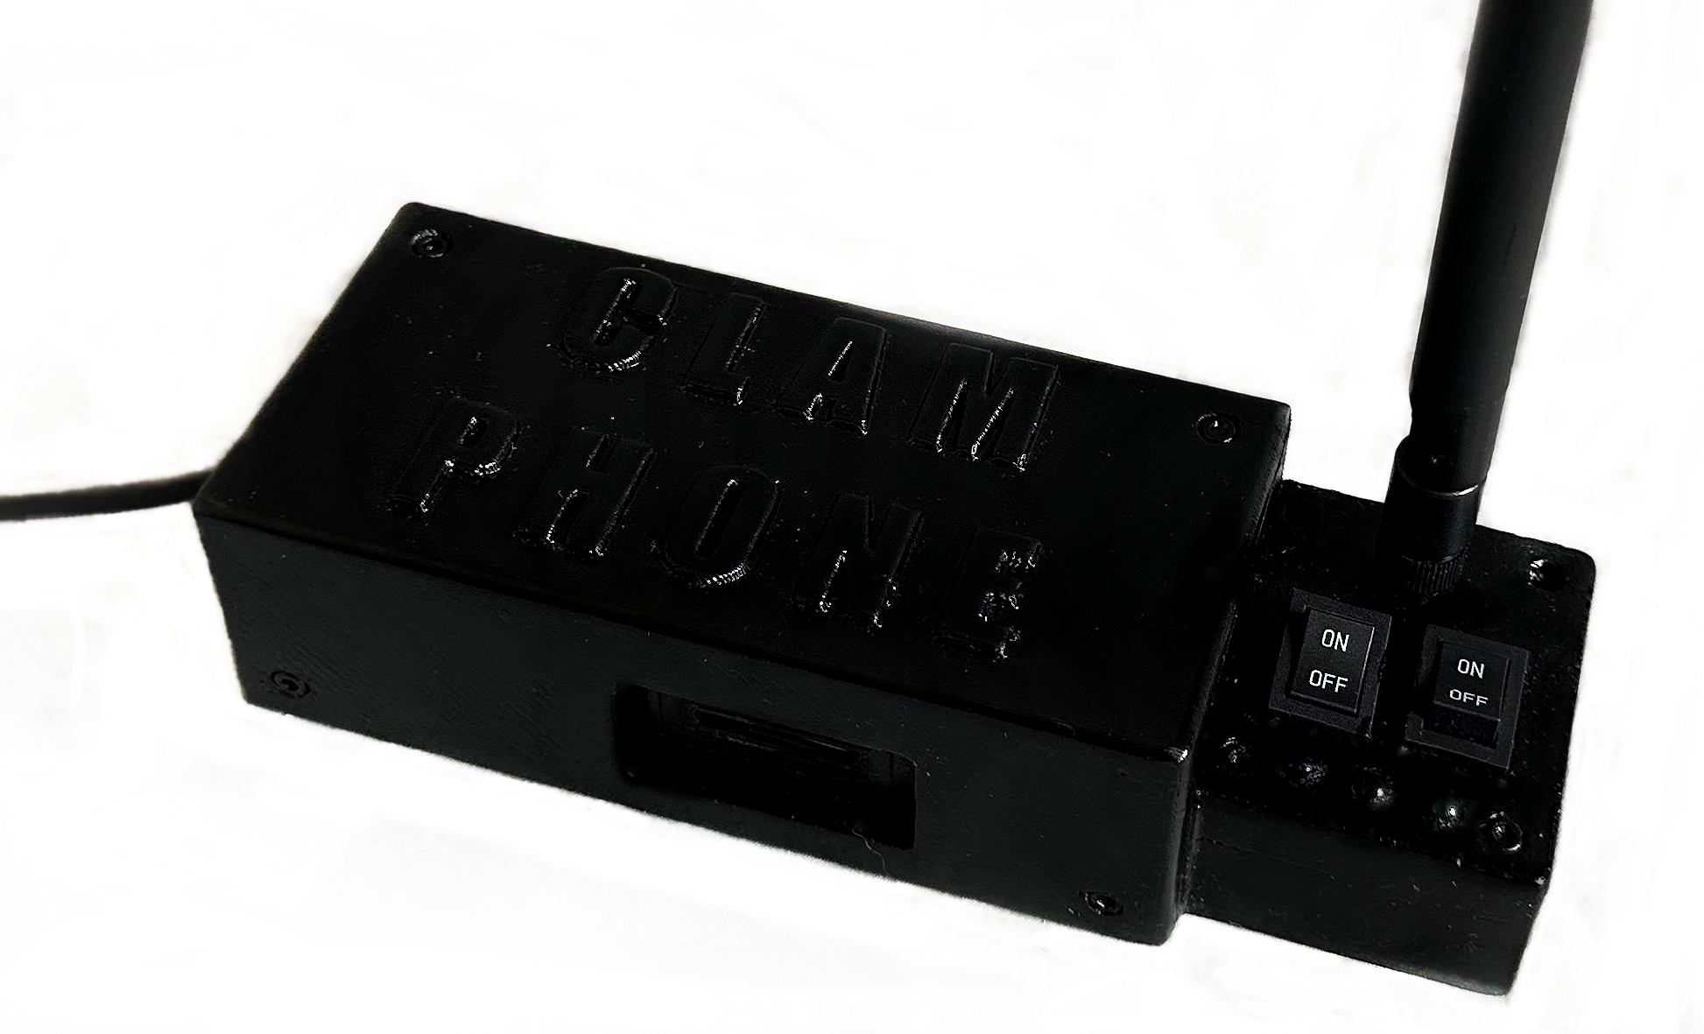
Data-Collection Device for Use of Oysters as Bioindicators
Authors: Nicholas M. Pitkin, Cole Henke,
Advisors: Dr. Easton White, Dr. Brittany Jellison, Drew Villeneuve
Department of Ocean Engineering & Department of Biological Sciences, University of New Hampshire
Introduction
Major Design Choices
Data Flow
Next Steps
It is known that the gaping behavior of bivalves will change in response to fluctuations in their environment, including water conditions or physical stimuli. To study this, a data-collection device was built for researchers at the University of New Hampshire to study oyster gaping behavior. This device is to be used offshore in oyster farms to measure oyster gape and water conditions. For this project, an Arduino-based prototype with wireless (radio) capabilities was designed and built for remote monitoring of the behavior of oysters. As an extension of this project, devices were also built for studies to be conducted strictly in-laboratory.
Data from Hall Effect Sensors is received by the Sensor Bank.
Data is sent to the transmitter through I2C. Here it is saved to the SD Card and transmitted to the receiver.
The receiver receives the data through radio transmissions. Here, is saved to the computer and the SD card.
Arduinos were chosen as the brains of the system; these microcontrollers and accessories are easily obtained with a wealth of accompanying open-source code.
Ratiometric Hall-Effect sensors were chosen as the tool for monitoring the gape of the oysters.
The vessel for wireless capabilities of the system are LoRa modules, chosen for their low power consumption and exceptional range.
Micro SD cards are used as the backup storage for all collected data, as they are small, cheap and the necessary SPI communication is easy to implement.
Sparkfun Qwiic Bus Endpoints make wired transmission from below to above surface possible over long distances using I2C communication.
Finish in-laboratory systems and use them to begin collecting measurements.
Design and assemble buoy and 5V solar power supply for offshore components in oyster farms.
Add sensors to transmitter to monitor water conditions.
Deploy and test system offshore.
Replicate system to be deployed in multiple locations.
Project Objectives
Monitor gaping behavior of oysters
Wirelessly transmit measurements
Create reliable data-backup
Package data in a way that is useful to researchers.
Sensor Bank
Transmitter
``
Receiver
`
`
Contacts
Dr. Easton White: Easton.White@unh.edu
Dr. Brittany Jellison Brittany.Jellison@unh.edu

