Slide 1
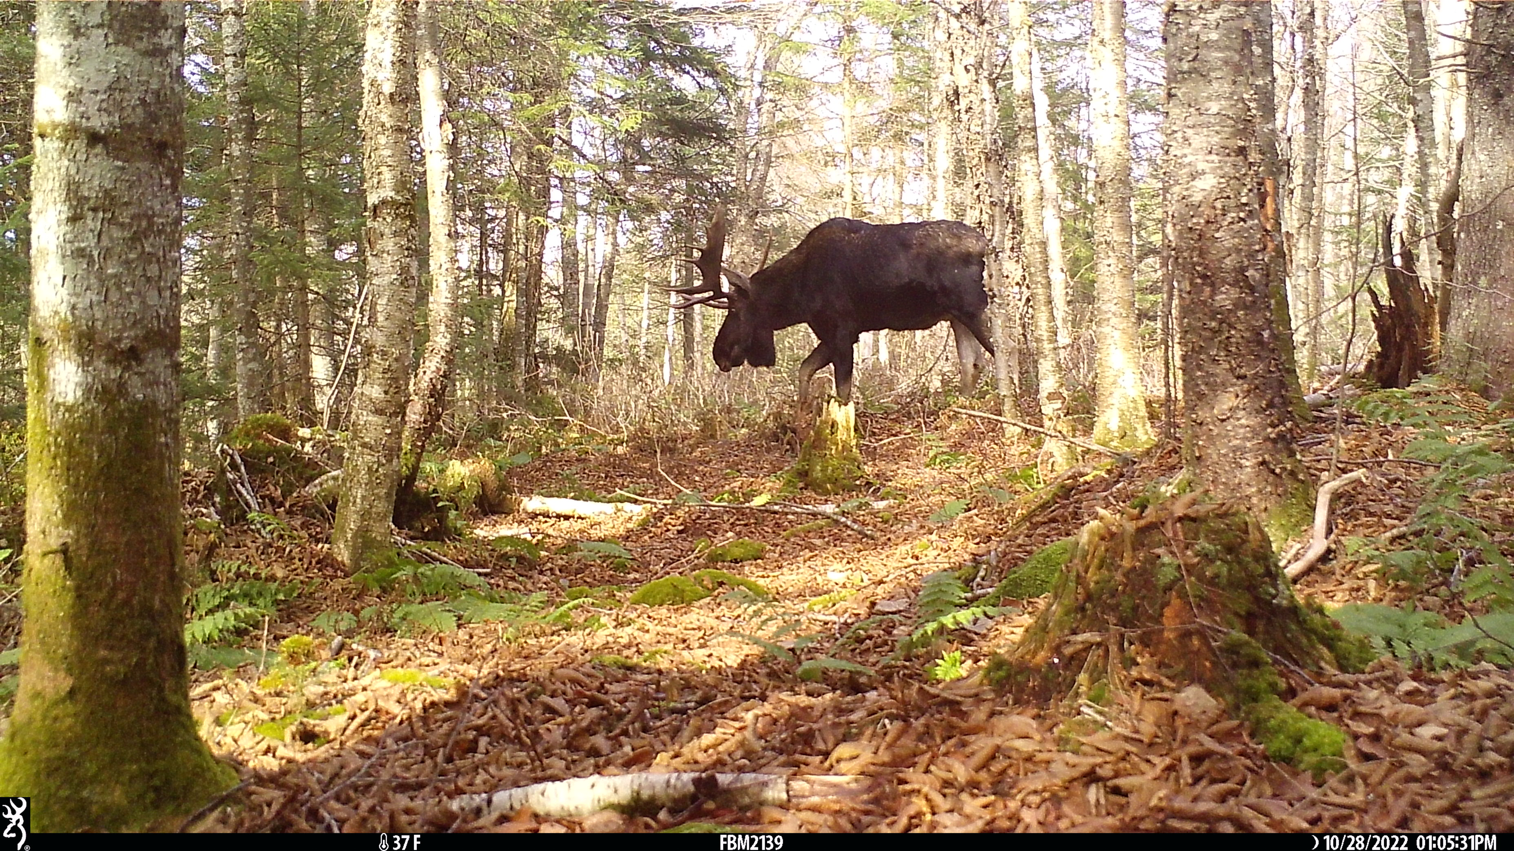
Novel Techniques for Monitoring Moose:
Drones, Cameras, Action!
Lily Hall
Notes:
1st Yr Masters Student

Slide 2
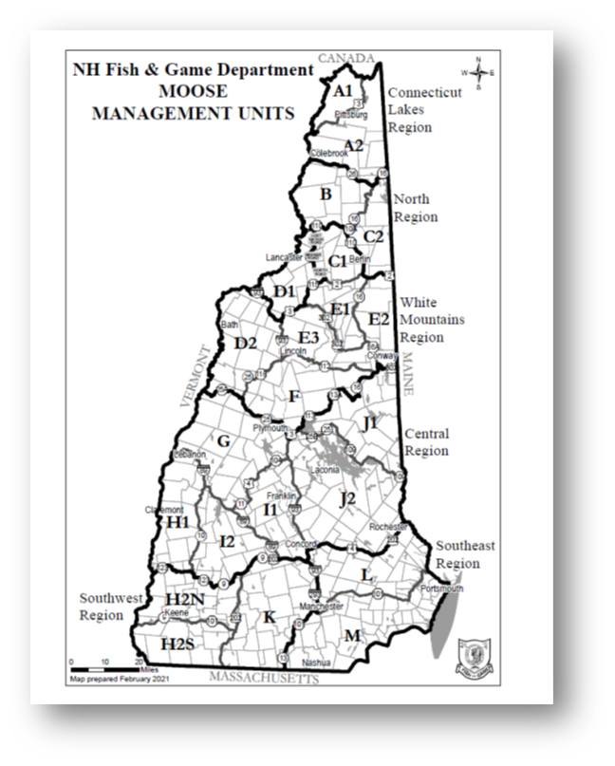
Background
Accurate moose (Alces alces) density estimates desired at the Wildlife Management Unit scale
  Ellingwood et al. 2020, Jones et al. 2019, Wattles & DeStefano 2011

Slide 3
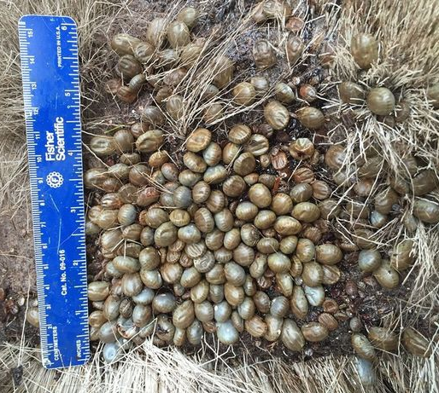
Background
Accurate moose (Alces alces) density estimates desired at the Wildlife Management Unit scale
  Hunting Regulations
  Forest Management
  Understanding climate change
    Winter tick (Dermacentor albipictus) dynamics
Ticks!
https://i2-prod.dailystar.co.uk/incoming/article21568563.ece/ALTERNATES/s615b/1_Hordes-of-bloodthirsty-ticks-drinking-animals-dry-in-Vermont-90000-found-on-1-moose.jpg
  Ellingwood et al. 2020, Jones et al. 2019, Wattles & DeStefano 2011
Notes:
Specifically understanding moose population dynamics informs decisions related to
Moose can have up to 20 lbs of ticks on them or 10s of thousands of ticks… that weaken moose through blood meals until they die, especially calves

Slide 4
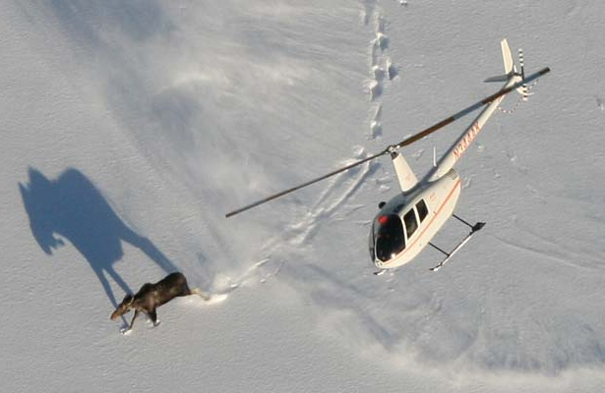
Background
Moose (Alces alces) populations have been monitored historically with:
  aerial surveys
  deer hunter surveys
  Bontaites et al. 2000
https://www.d.umn.edu/base/home_pics/2011/moose_heli.jpg
Notes:
Historically information on the moose population has been collected with
No people

Slide 5
Background
Moose (Alces alces) populations have been monitored historically with:
  aerial surveys – expensive
  deer hunter surveys – index = recalibration needed
  Bontaites et al. 2000
https://www.d.umn.edu/base/home_pics/2011/moose_heli.jpg
Notes:
1 year of aerial survey data is equal to buying 3 nice drones. CONTRACT
Calibrated the deer hunter survey in 1990s with thermal assessment from a fixed wing aircraft
Deer pop, hunter demographics, moose populationis

Slide 6
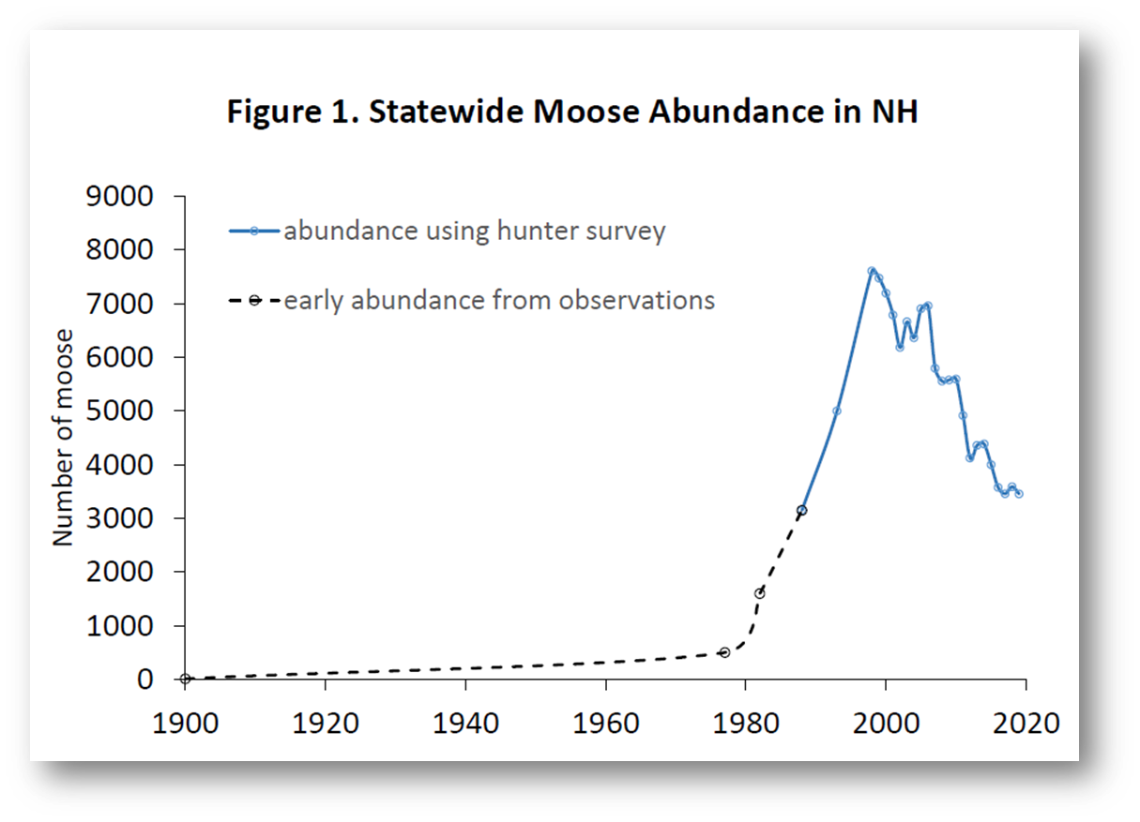

Background
Last Calibration of deer hunter survey
  Bontaites et al. 2000
Notes:
With that in mind,
How will estimates with CHANGE SLIDE

Slide 7
Background
Last Calibration of deer hunter survey
Camera Traps & Drones???
  Bontaites et al. 2000
Notes:
How will estimates with Camera and drones relate to estimates from the deer hunter survey

Slide 8
Camera Traps
Notes:
1st I wanted to briefly explain my camera trap work but largely focus on the drone research for this presentation

Slide 9
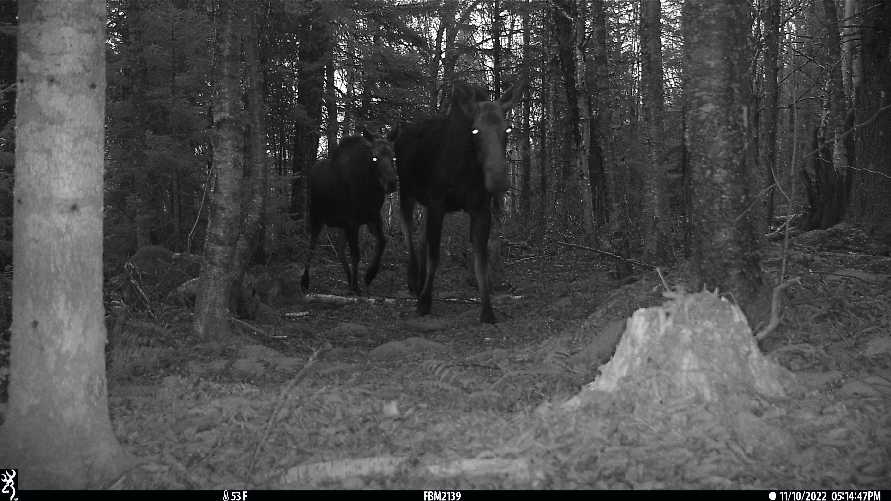
Camera Traps
Unmarked Population
Utilizing 2 models:
  Time to Event - TTE
  Random Encounter & Staying Time - REST
Notes:
We have just over 300 cameras across the state of new Hampshire & Ill use 2 statistical models for calculating density of an unmarked species
Unmarked species = cant ID individuals, so moose. Whereas marked population could be with GPS collared individuals or jaguars with unique spot patterns

Slide 10
Unpiloted Aerial Systems (UASs),
Drones

Slide 11
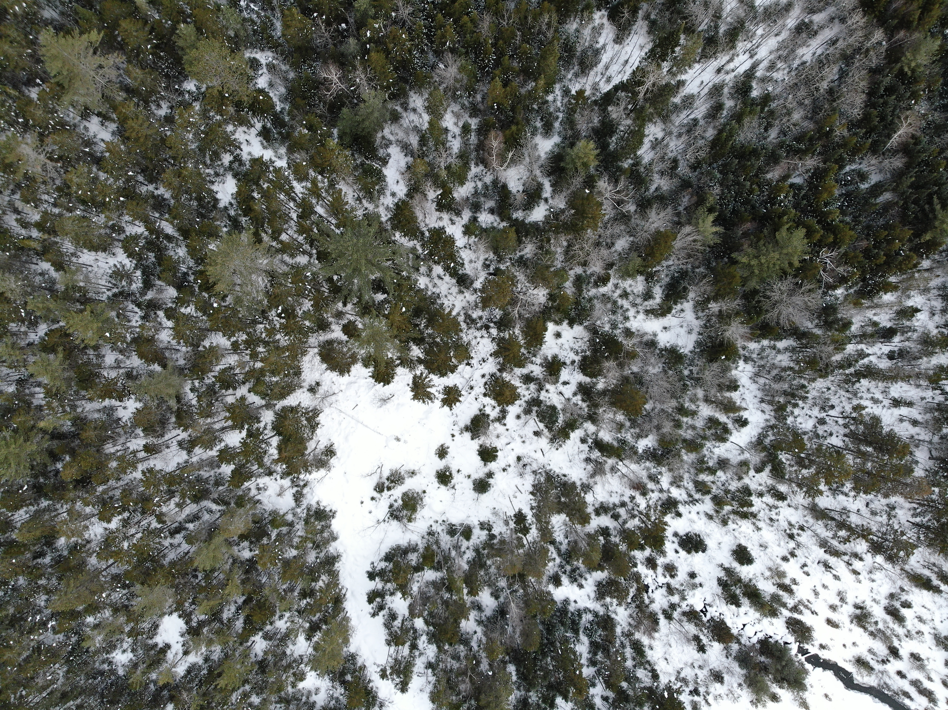

Slide 12
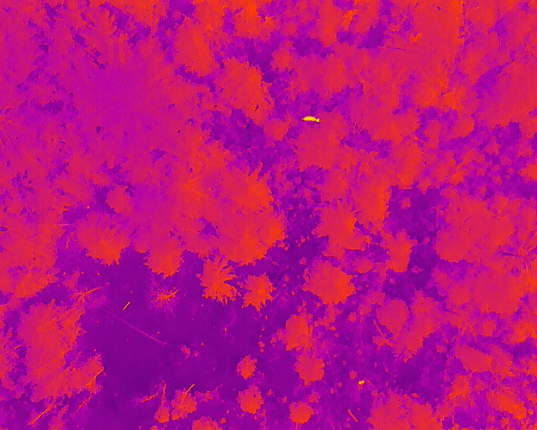

Slide 13
Notes:
This is really amazing technology

Slide 14
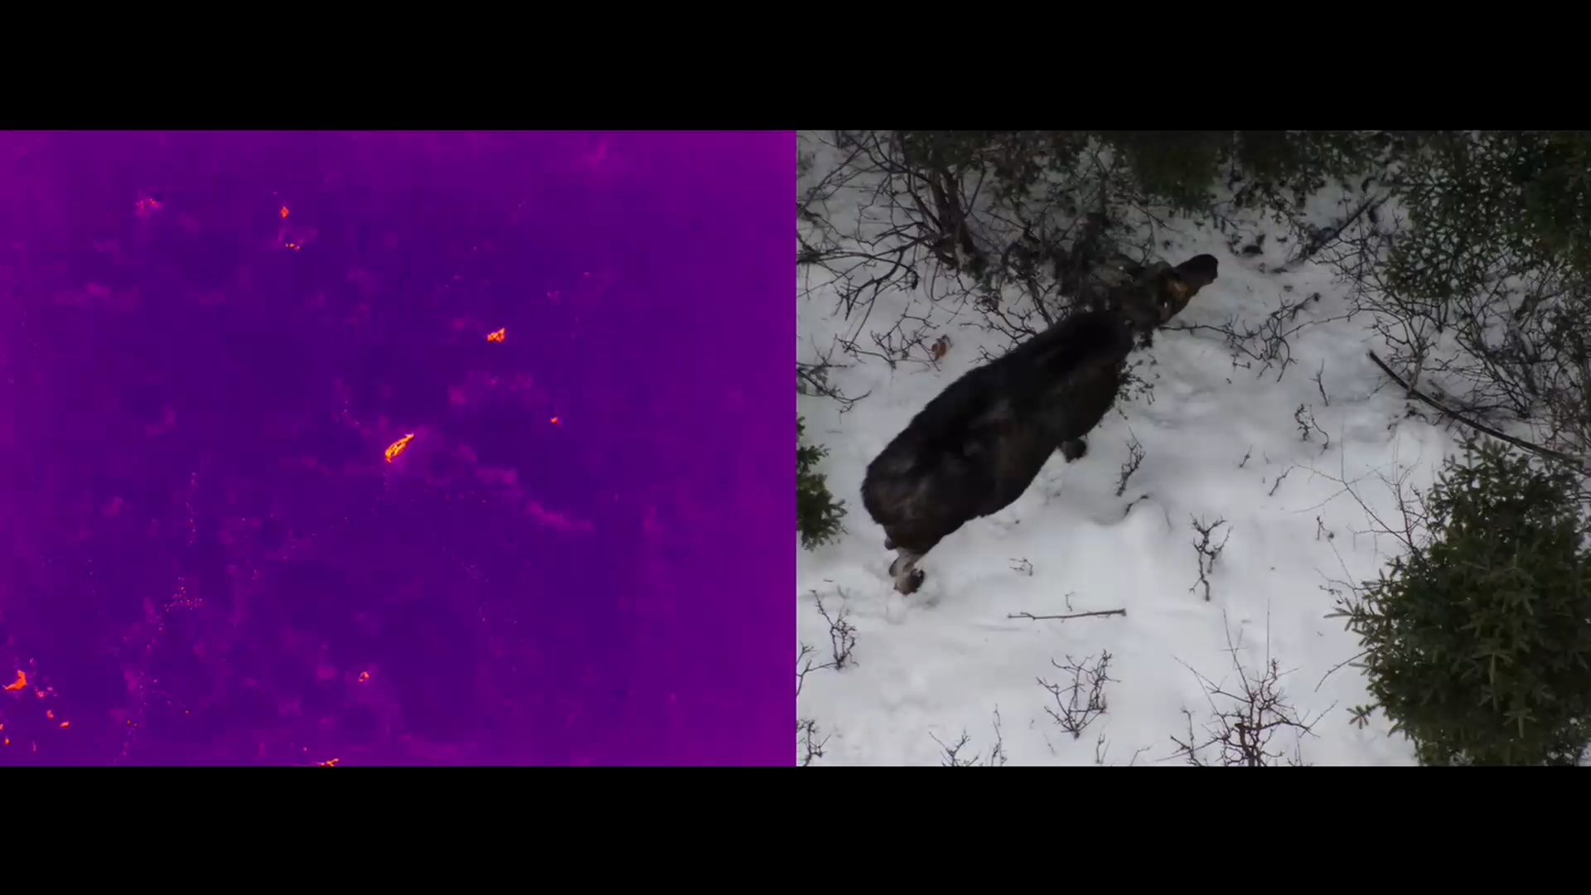
Drones & Thermal Imaging
~100 m altitude & 40x zoom
Notes:
For example

Slide 15
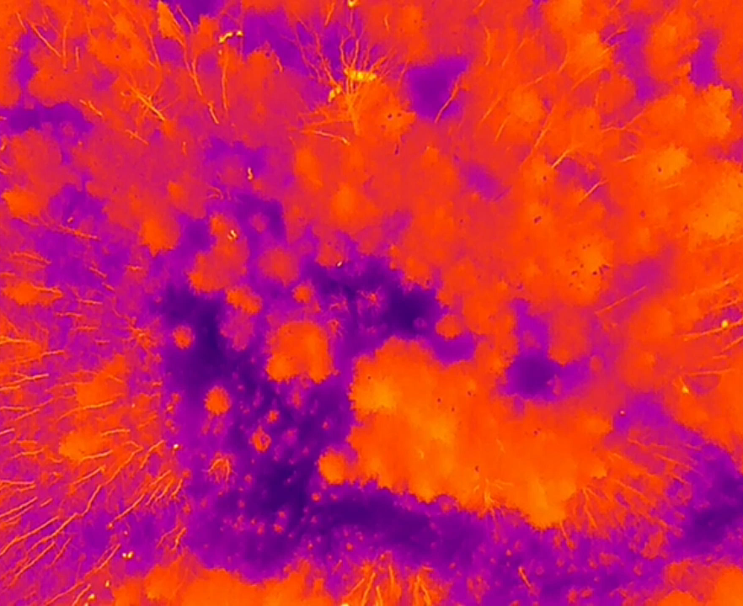
Drones & Thermal Imaging
Detected 1 deer and 3 snowshoe hares
Notes:
And promising for smaller species as well.

Slide 16
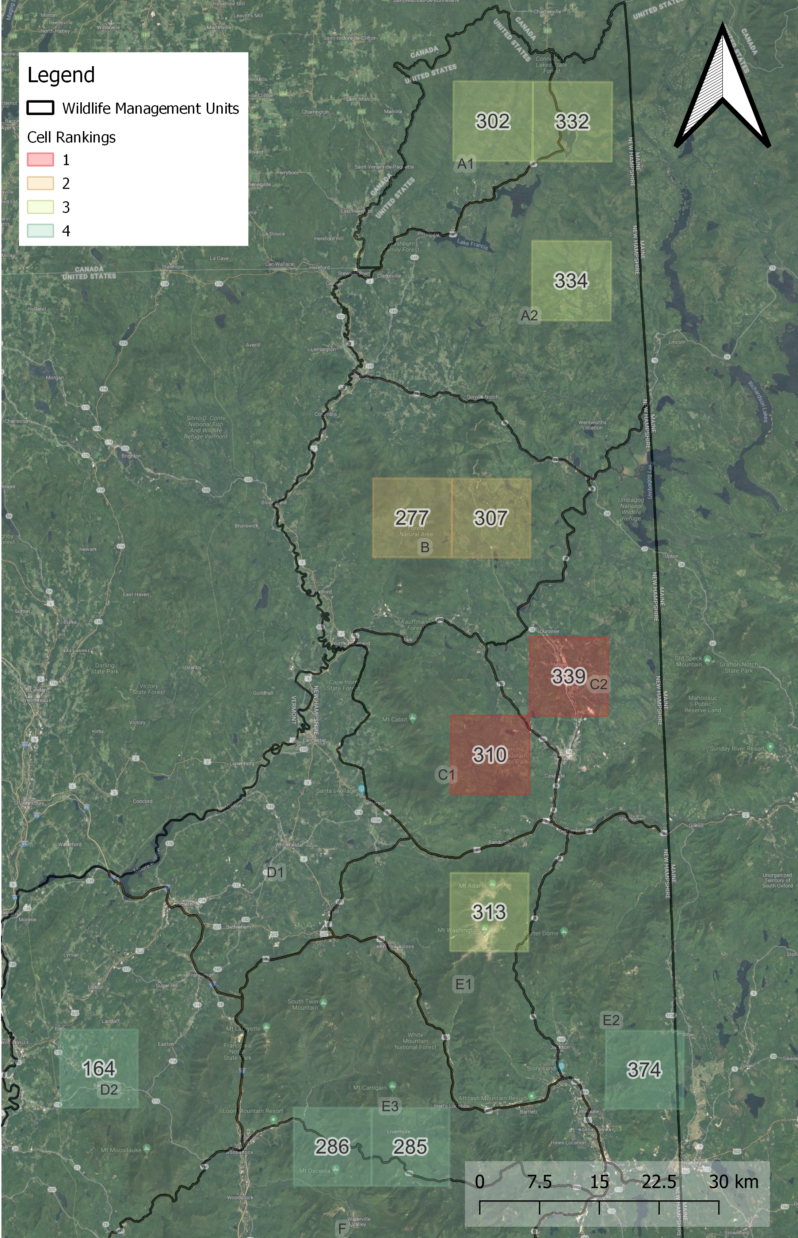
Drones & Thermal Imaging
Winter 1: Account for sightability
  Conifer canopy cover
  Weather
  Observation Angle
Notes:
Our ability to see moose – for example accounting quantify the probability of us not detecting a moose when there was a moose

Slide 17
Drones & Thermal Imaging
Winter 1: Account for sightability
  Conifer canopy cover
  Weather
  Observation Angle
Winter 2: Sampling flights
Notes:
Our ability to see moose – for example accounting for false negatives, when there was a moose but we didn’t detect it

Slide 18
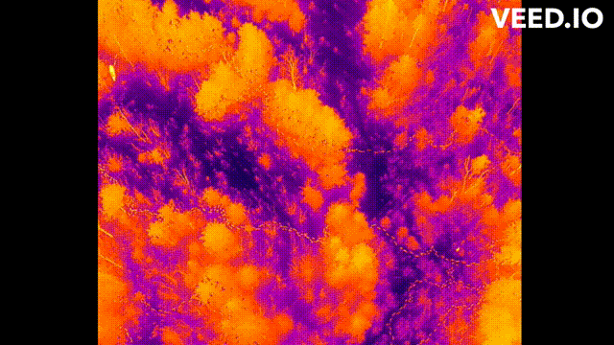
Drones & Thermal Imaging
Notes:
Visualize the impacts of these factors on moose Sightability here is a clip from our Sightability maneuver. As moose “moves” across screen, becomes undetectable,
Changes in relative position of the tree, which is essentially random (what side of the tree the moose stands on relative to the drone) but also trees in the edges of the view are at shallower observation angles than directly under the drone leading to a larger ground footprint blocked by the canopy
You could also imagine that the thermal signature of the tree would increase with ambient temperature potentially obscuring more moose
These are factors we want to model

Slide 19
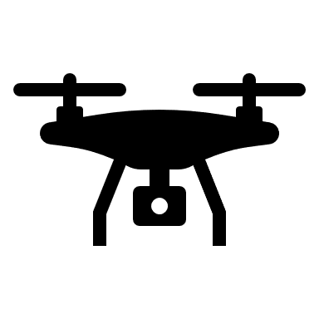

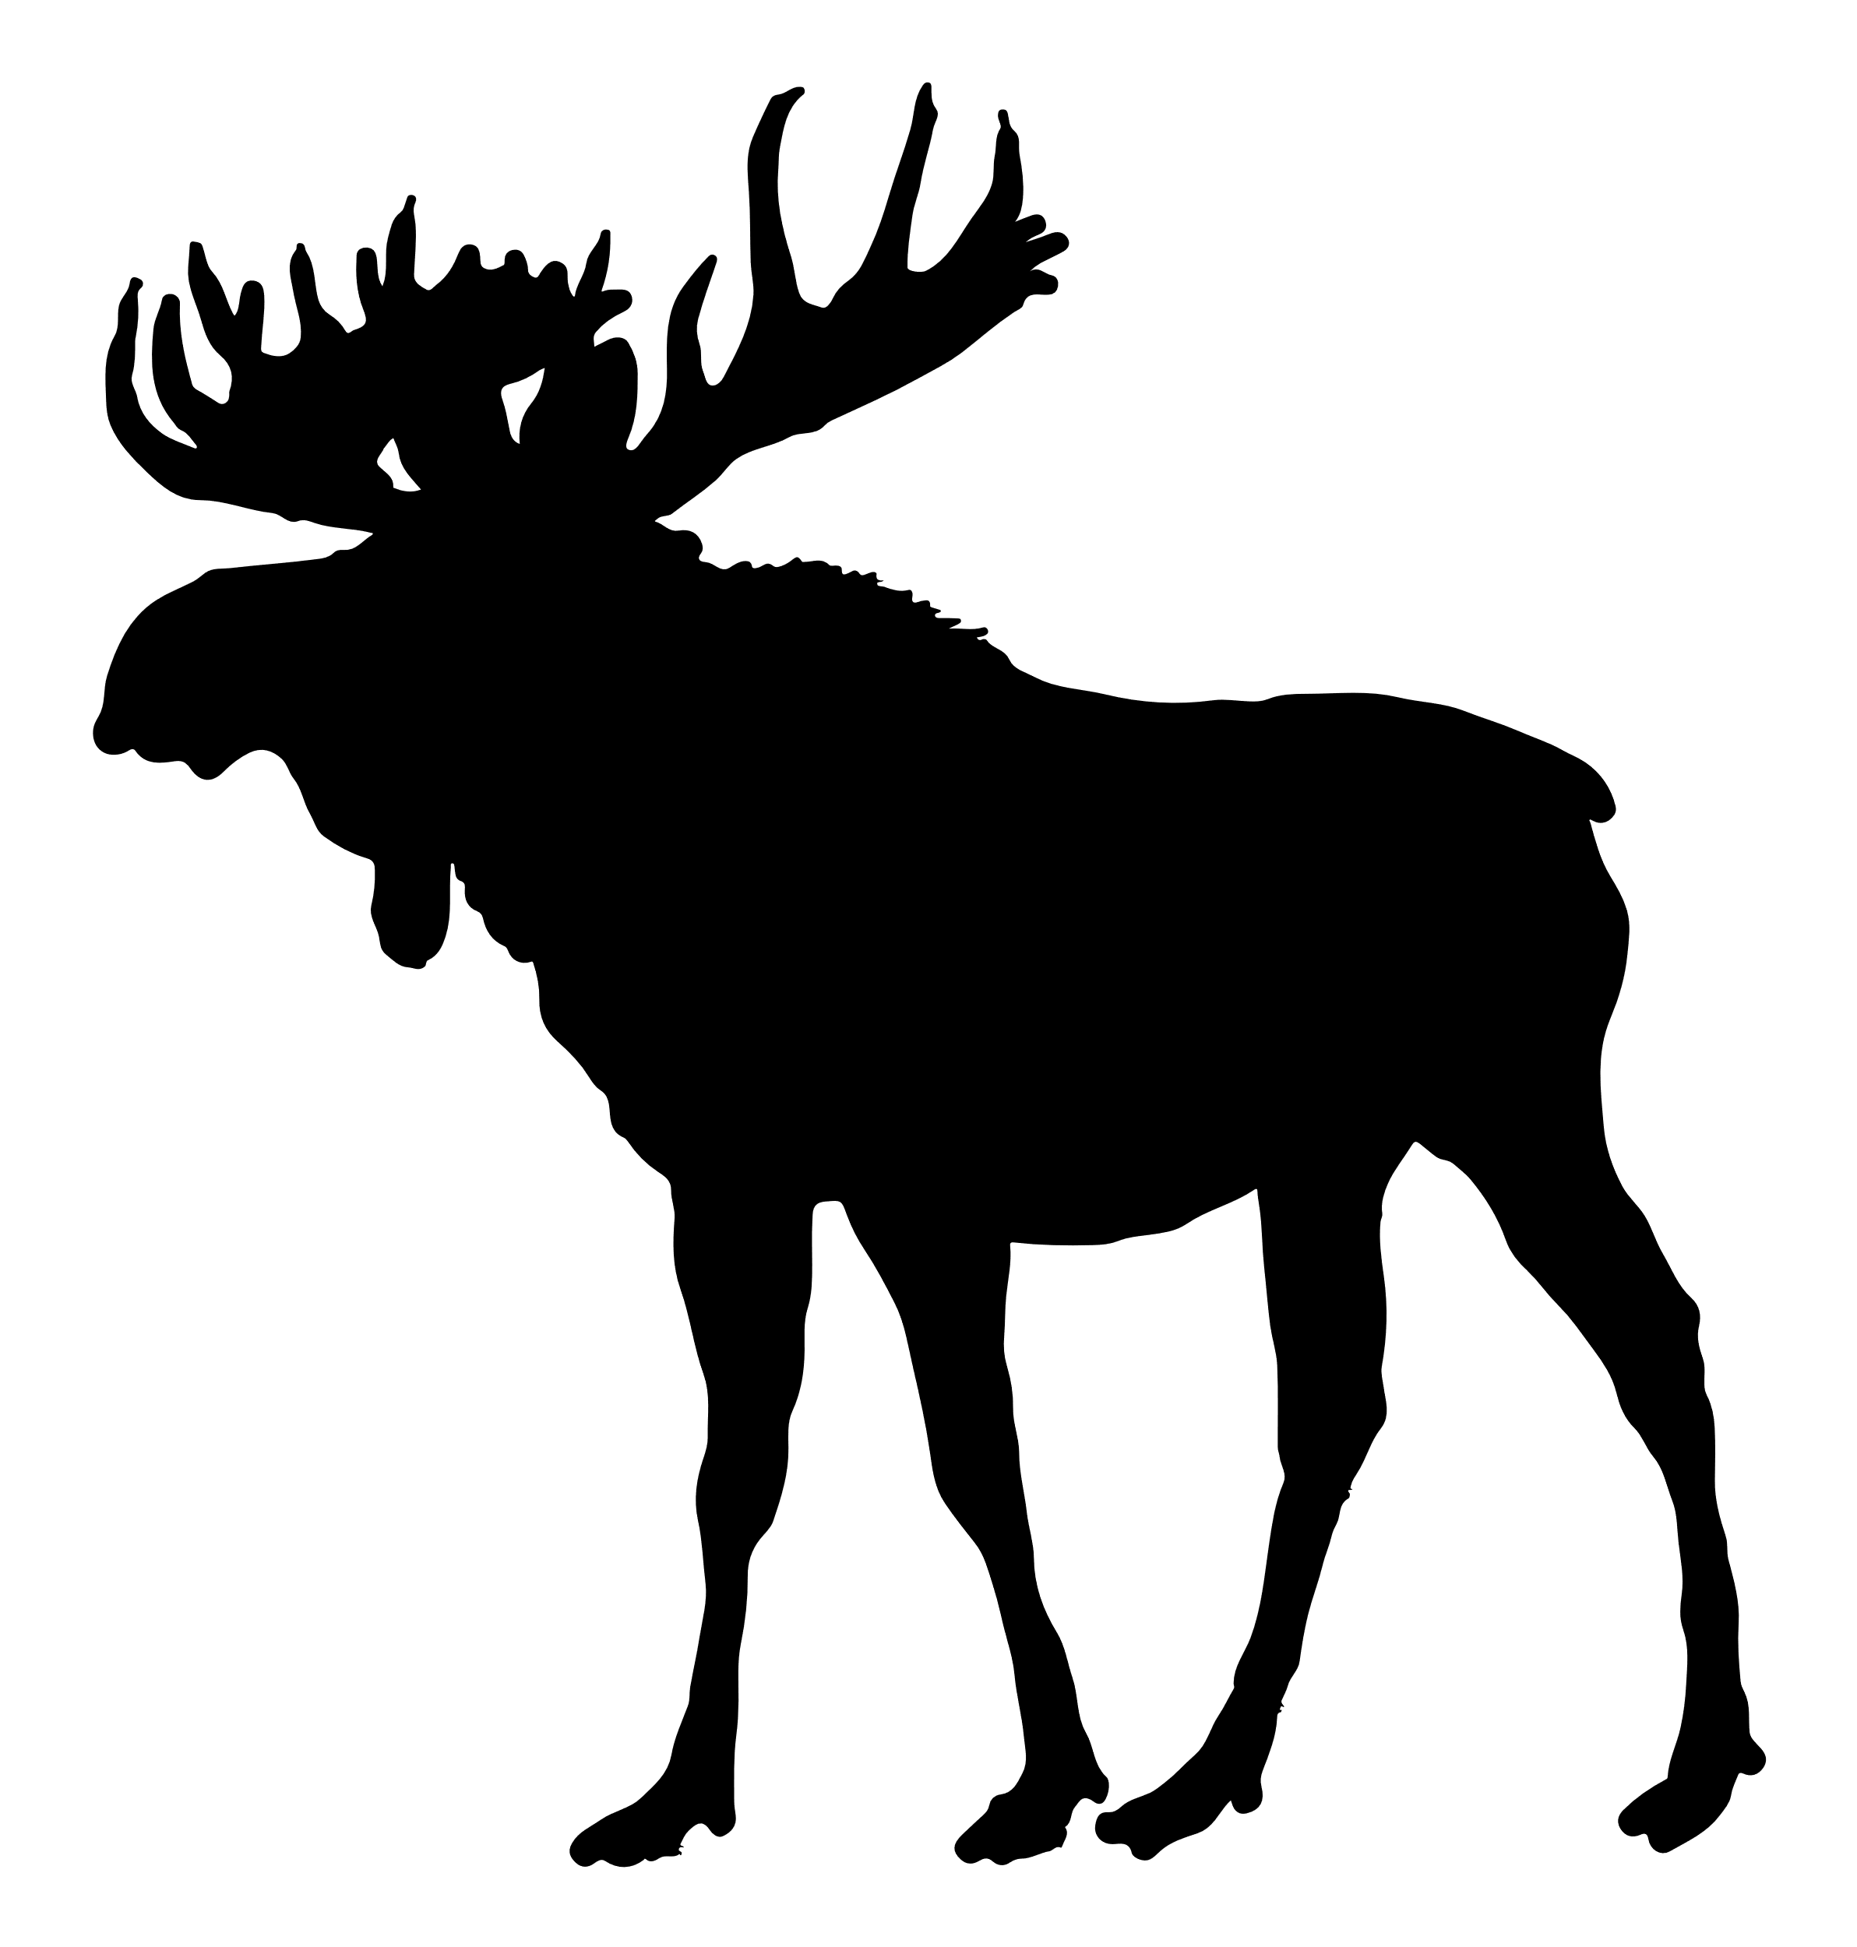
Drones & Thermal Imaging
horizon
Start with sensor facing straight down (-90 degrees relative the horizon)
90°

Slide 20
Drones & Thermal Imaging
horizon
90°

Slide 21
Drones & Thermal Imaging

Slide 22
Drones & Thermal Imaging

Slide 23
Drones & Thermal Imaging

Slide 24
Drones & Thermal Imaging

Slide 25
Drones & Thermal Imaging
horizon
75°
Once all 9 transects are done, the sensor is rotated to -75 degrees, then reflown in each cardinal direction

Slide 26
Drones & Thermal Imaging

Slide 27
Drones & Thermal Imaging

Slide 28
Drones & Thermal Imaging

Slide 29
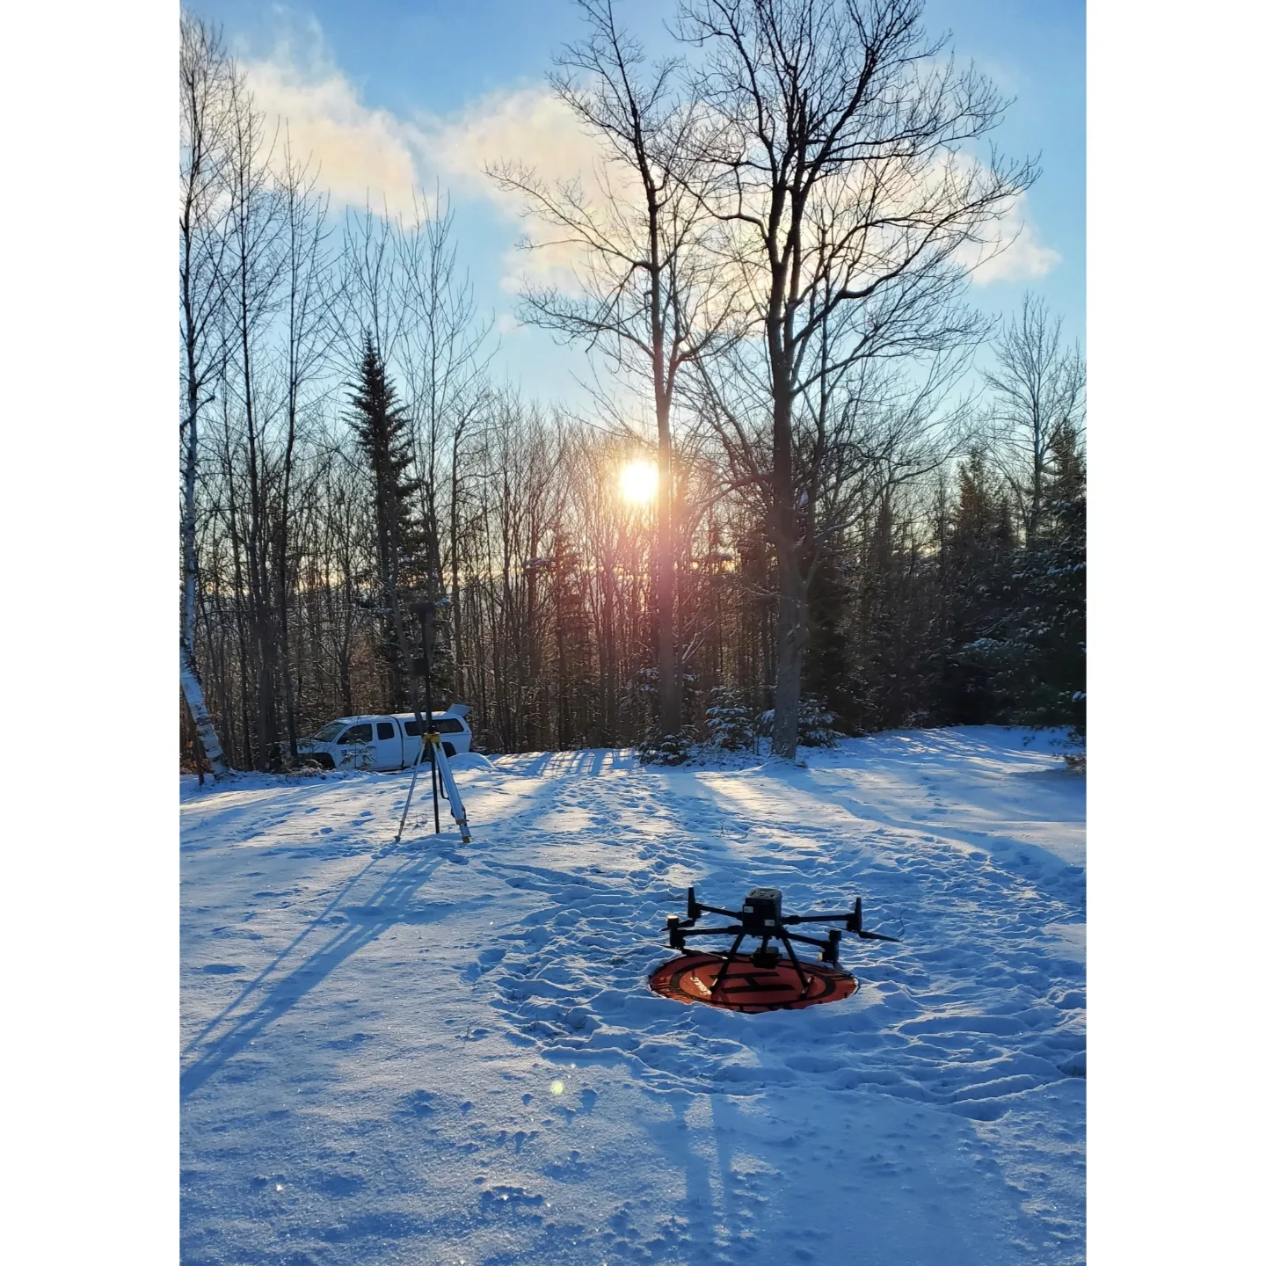
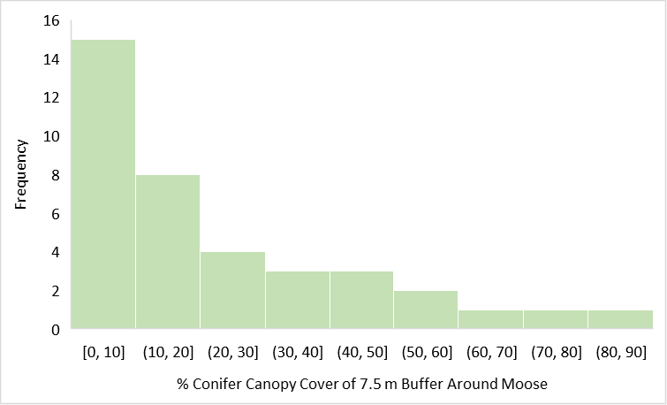
Drones & Thermal Imaging
2023
  35 flights, 59 moose
Notes:
DJI Matrice 300 RTK quadcopter equipped with a DJI Zenmuse H20T

Slide 30
Drones & Thermal Imaging
2023
  35 flights, 59 moose
Fewer observed because of truly less moose in these areas? Or because of decreased sightability?
Notes:
DJI Matrice 300 RTK quadcopter equipped with a DJI Zenmuse H20T

Slide 31
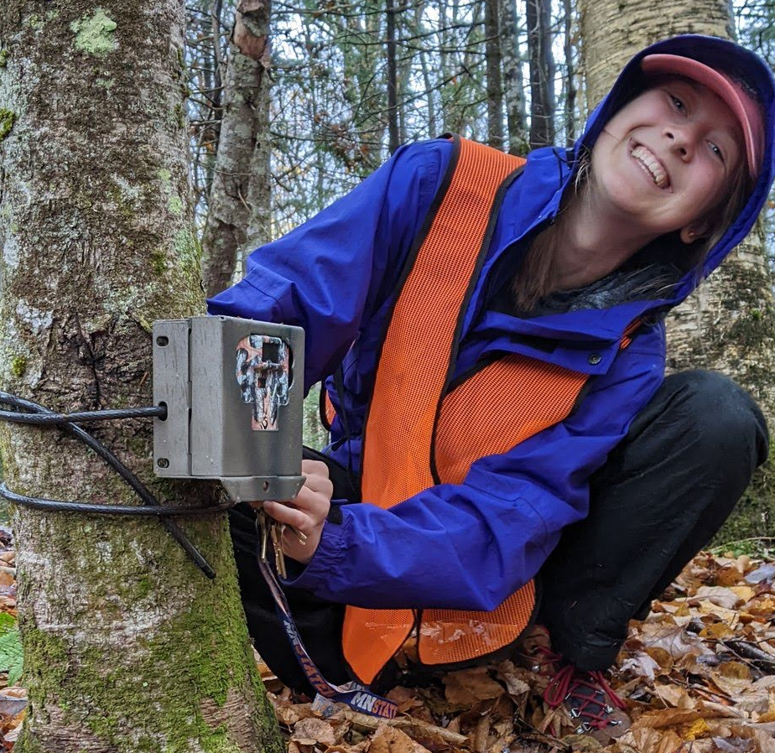
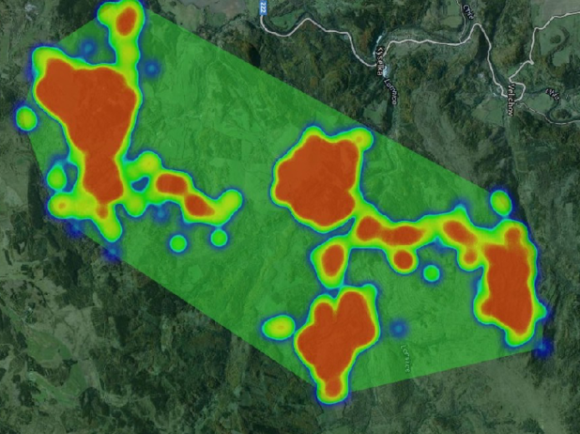
Summary of Techniques & Objectives
Equipment | Technique | Objective
Camera Traps | TTE & REST Model | Spatially Explicit Moose Density Estimation
Drone Thermal Imaging | Sightability Flights (Winter 1) | Correction Factor for Model
 | Sampling Flights (Winter 2) | Spatially Explicit Moose Density Estimation
https://www.researchgate.net/profile/Michal-Stoces/publication/283819477/figure/fig1/AS:393036644274176@1470718646330/Animal-movement-heat-map-and-home-range-polygon-solution-in-GoogleMaps.png
(Blouin et al. 2021 , Bergeron et al. 2011, Ellingwood et al. 2020, Koitzsch 2002)
Notes:
Overall, I will be evaluating two approaches (camera traps & drones) to get spatially explicit moose density estimates that we can compare to each other as well as the deer hunter survey results to determine what might be an effective monitoring approach moving forward

Slide 32
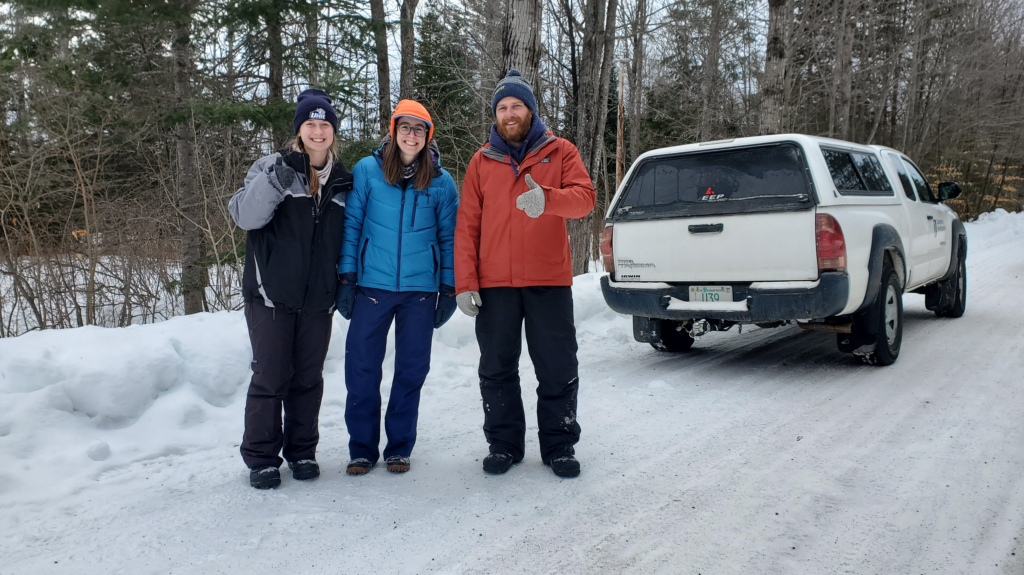



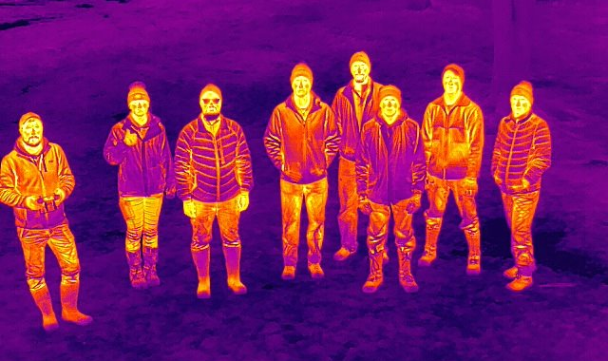
References
Thank you! Questions?
Thanks to Franklin Sullivan, Henry Jones, Sophie Burke, Michael Palace, and Remington Moll
Bergeron, D., Pekins, P., Jones, H. & Leak, W. MOOSE BROWSING AND FOREST REGENERATION: A CASE STUDY IN NORTHERN NEW HAMPSHIRE. 47, (2011).
Blouin, J. et al. MODELING MOOSE HABITAT USE BY AGE, SEX, AND SEASON IN VERMONT, USA USING HIGH-RESOLUTION LIDAR AND NATIONAL LAND COVER DATA. Alces: A Journal Devoted to the Biology and Management of Moose 57, 71–98 (2021).
Bontaites, K. M., Gustafson, K. A. & Makin, R. A Gasaway-type moose survey in New Hampshire using infrared thermal imagery: preliminary results. Alces: A Journal Devoted to the Biology and Management of Moose 36, 69–75 (2000).
Ellingwood, D., Pekins, P., Jones, H. & Musante, A. Evaluating moose Alces alces population response to infestation level of winter ticks Dermacentor albipictus. Wildlife Biology 2020, (2020).
Koitzsch, K. B. Application of a Moose Habitat Suitability Index Model to Vermont Wildlife Management Units. Alces 38, 89–107 (2002).
Jones, H. et al. Mortality assessment of calf moose (Alces alces) during successive years of winter tick (Dermacentor albipictus) epizootics in New Hampshire and Maine. Canadian Journal of Zoology 97, (2019).
McMahon, Michael C., Mark A. Ditmer, Edmund J. Isaac, Seth A. Moore, and James D. Forester. “Evaluating Unmanned Aerial Systems for the Detection and Monitoring of Moose in Northeastern Minnesota.” Wildlife Society Bulletin 45, no. 2 (June 1, 2021): 312–24. https://doi.org/10.1002/wsb.1167.
Wattles, D. W. & DeStefano, S. STATUS AND MANAGEMENT OF MOOSE IN THE NORTHEASTERN UNITED STATES. Alces: A Journal Devoted to the Biology and Management of Moose 47, 53–68 (2011).

Slide 33
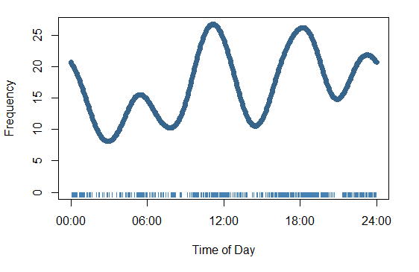
Moose activity is spaced out periodically

Slide 34
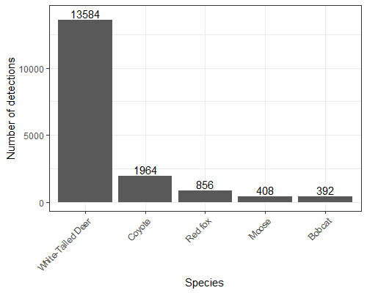
Moose detections compared to other NH species

