Slide 1

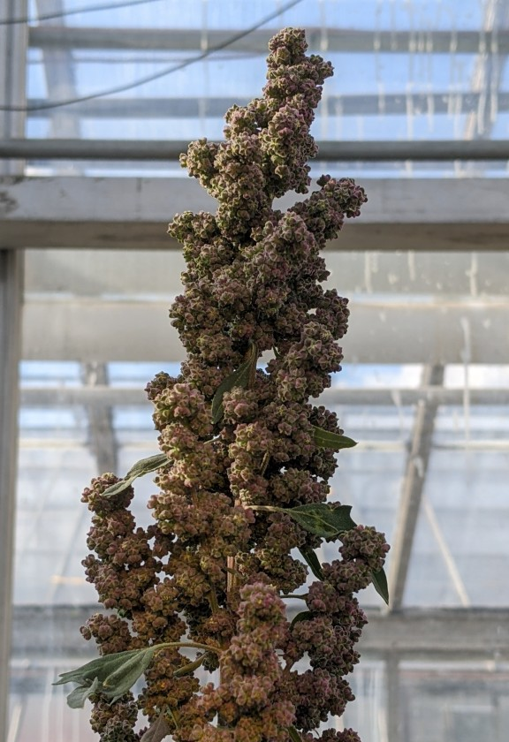

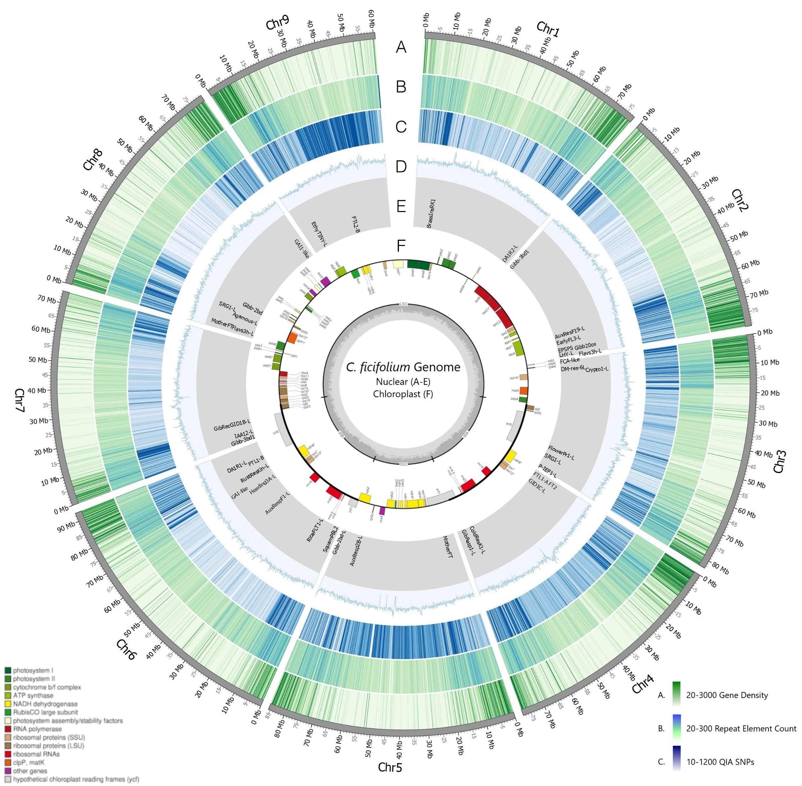
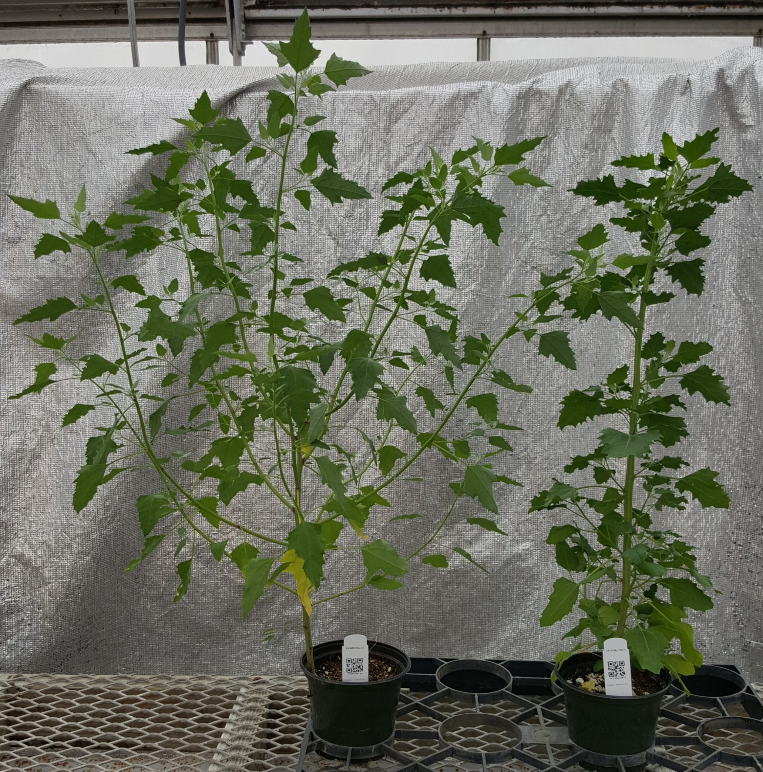
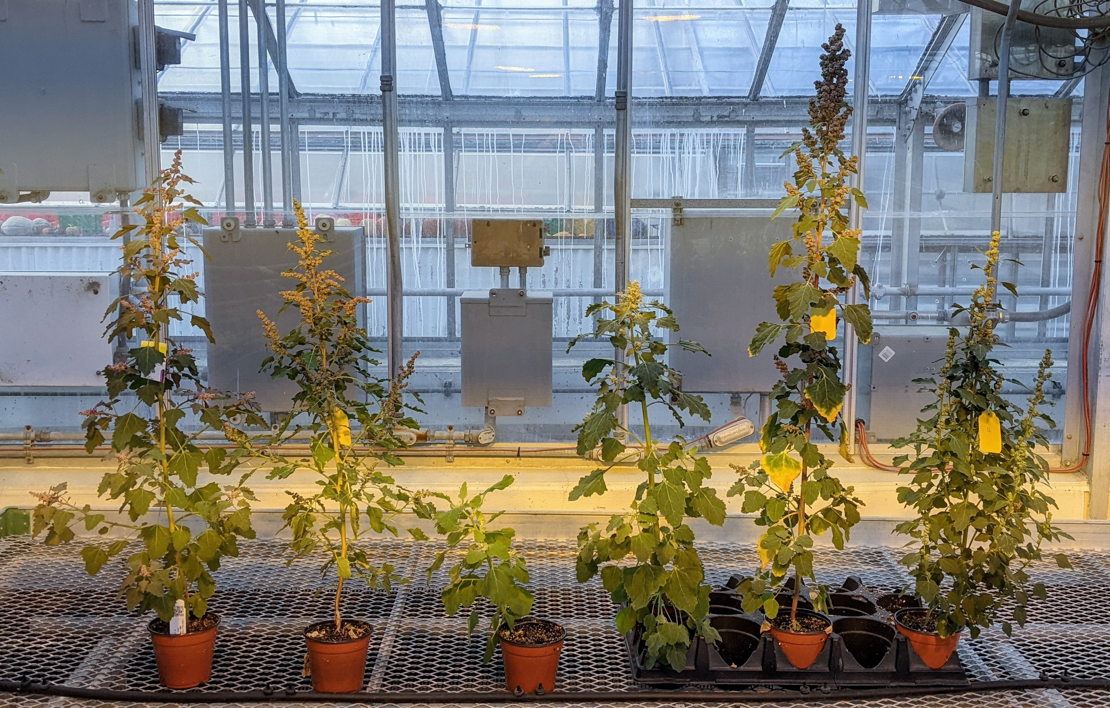

Breeding and Developing Genetic Resources within the Chenopodium genus to Advance the de novo Domestication of C. berlandieri
Clayton Ludwig, Thomas Davis
University of New Hampshire
Introduction
The C. ficifolium Genome
Chenopodium quinoa Willd. (2n = 4x = 36: AABB) is a pseudocereal native to the Andean Altiplano [1] and produces a highly nutritious seed [2]. Quinoa production in the northeastern United States is currently limited by its susceptibility to Peronospora variabilis, the causal agent of downy mildew which can reduce yield substantially [3], as does humid conditions during grain filling [4]. Chenopodium berlandieri var. macrocalycium (BvM) (2n = 4x = 36: AABB) is a weedy species native to Northern New England (NNE) that is well adapted to the local conditions, thrives in poor soils, is less susceptible to downy mildew, and can be crossed with quinoa. Our long-term goal of this study is to produce a quinoa-like crop through crossing and/or de novo domestication that can thrive in the New England climate on marginal soils and produce a source of nutritious, locally grown food.
To achieve this goal this research focuses on utilizing three species native to the NNE region as sources of germplasm and genetic data; BvM (2n = 4x = 36: AABB), C. foggii (2n = 2x = 18: AA), and C. ficifolium (2n = 2x = 18: BB). C. ficifolium is being advanced as a diploid model system as its diploidy and reduced generation time makes it a preferred candidate. To that end, a reference genome is currently under development. Using these germplasm and genomic resources, this work seeks to investigate allelic variation in domestication-related traits and expands genetic resources to be used in marker assisted breeding programs.
QC
This assembly of the C. ficifolium “Portsmouth” nuclear genome comprises 9 chromosomes and spans 711.5 Mb. a. Gene density determined using a pipeline that includes SNAP, MAKER, and AUGUSTUS. b. Repetitive element density produced by REPEATMODELER c. SNPs present compared to a C. ficifolium accession from Quebec City, Canada (QC). d. G/C content. Graph represents 20%-55% G/C Ratio. e. A small selected set of potential domestication-related genes and their approximate location within the genome. f. Chloroplast assembly.
Tetraploid Crosses
A male sterile quinoa (PI 510536) was crossed with two BvM accessions local to NNE yielding several male-fertile F1 plants and subsequent F2 populations. These are currently being screened under glass and will be outplanted next season to investigate in-field performance. Individuals are being assessed for a series of domestication-related traits and can be used in future crosses and/or as a foundation for future breeding and cultivar development.
Objectives and Approaches
C. berlandieri (left), C. quinoa (right)
Project Goal
Employ C. berlandieri (BvM), a locally adapted Crop Wild Relative (CWR) to develop a quinoa-like crop for New England.
Achievement of this goal has the potential to:
  Improve food security in the region
  Be cultivated on marginal land unsuitable for production of other major crops
  Increase income of local growers
Objectives
Expand genetic resources through germplasm collection
Utilize several BvM and quinoa accessions to develop segregating populations
Identify allelic variation responsible for conferring domestication-related traits in a 50-gene panel
Develop markers to be used in a tetraploid-level breeding program
An F2 population sample from a quinoa X BvM cross displaying segregation for height, inflorescence architecture, and leaf morphology amongst other traits.
Acknowledgements
Approaches
This work is supported by Agricultural and Food Research Initiative grant no. 2022-67014-36427 from the USDA National Institute of Food and Agriculture and through the New Hampshire Agricultural Experiment Station NHAES Hatch Project NH00678
Use beneficial traits in quinoa, BvM, and other species within the genus to define a target ideotype for BvM domestication
Focus on well defined simply inherited (monogenic or digenic) domestication-related traits
Develop and utilize C. ficifolium as a diploid model species including the assembly of a reference genome and establishment of in vitro protocols
Bibliography
[1] P. J. Maughan et al., “Single Nucleotide Polymorphism Identification, Characterization, and Linkage Mapping in Quinoa,” Plant Genome, vol. 5, no. 3, pp. 114–125, 2012.
[2] S. E. Jacobsen, “The Situation for Quinoa and Its Production in Southern Bolivia: From Economic Success to Environmental Disaster,” J. Agron. Crop Sci., vol. 197, no. 5, pp. 390–399, 2011.
[3] S. Danielsen, S. E. Jacobsen, J. Echegaray, T. Ames, and others, “Impact of downy mildew on the yield of quinoa,” CIP Progr. Rep., vol. 2000, no. October, pp. 397–401, 1999.
[4] J. A. Kellogg and K. M. Murphy, “Grains: Growing Quinoa in Home Gardens,” Washington State University Extension. 2017.
[5] Jarvis, D. E. et al. The genome of Chenopodium quinoa. Nature 542, 307–312 (2017).

