Slide 1
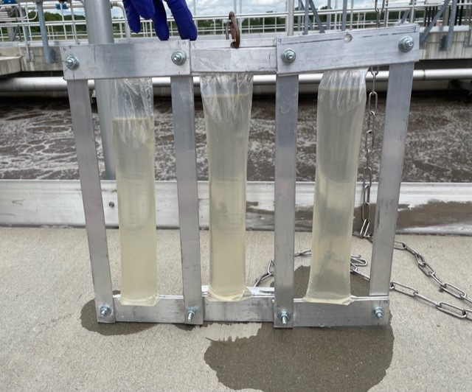
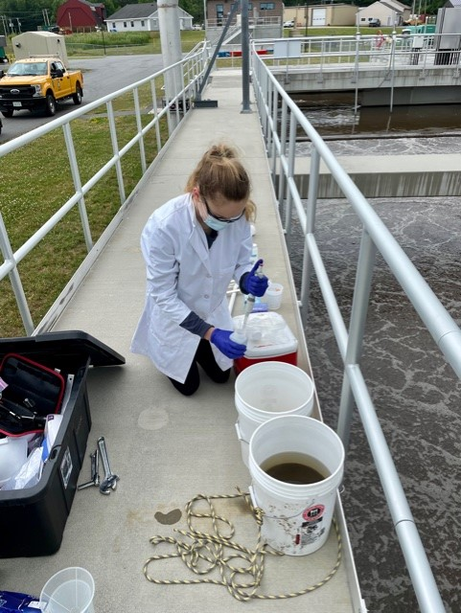
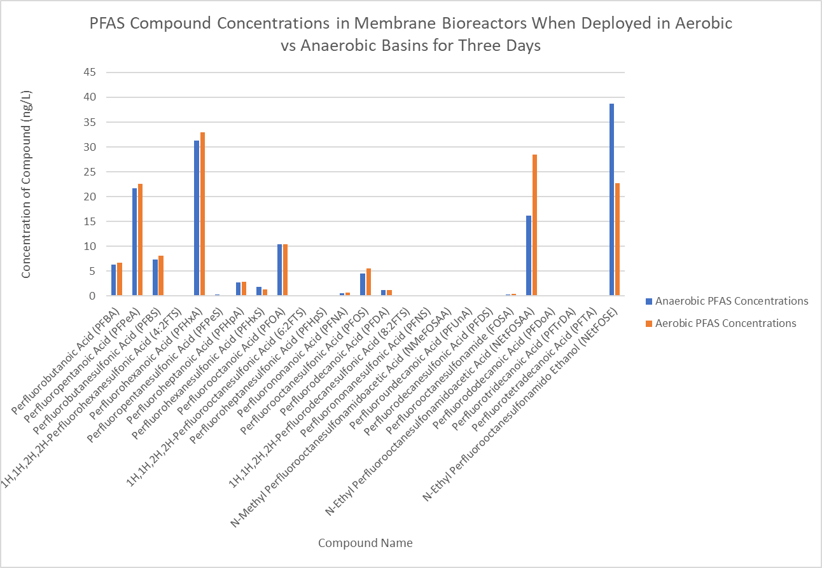
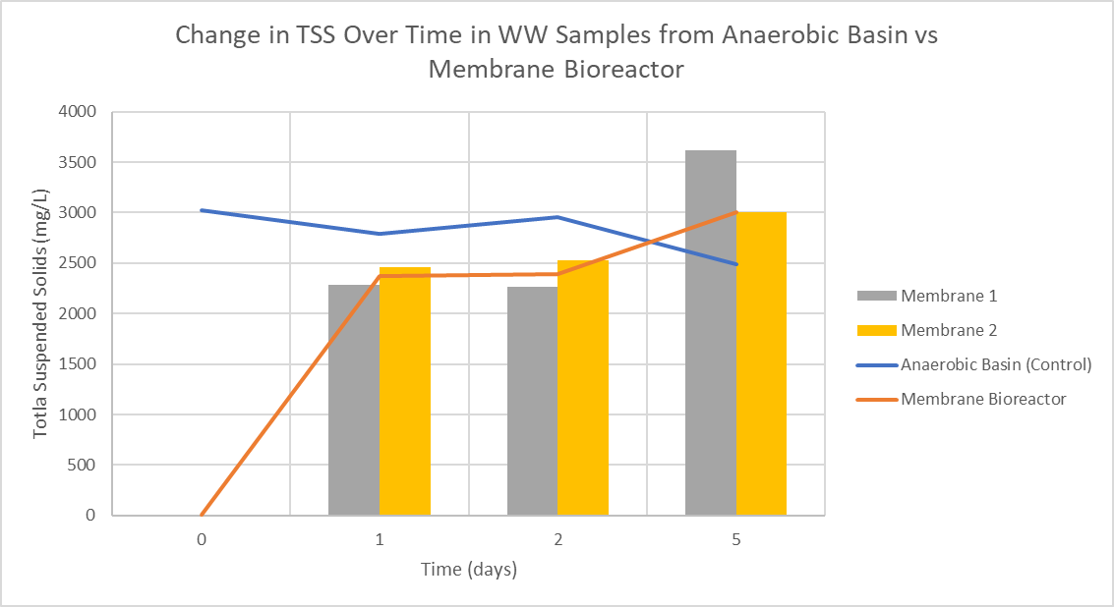
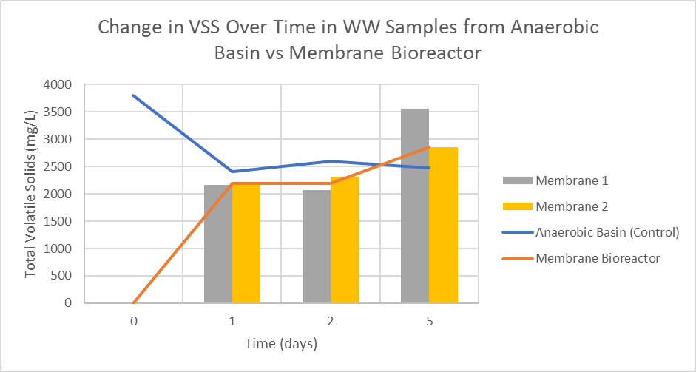
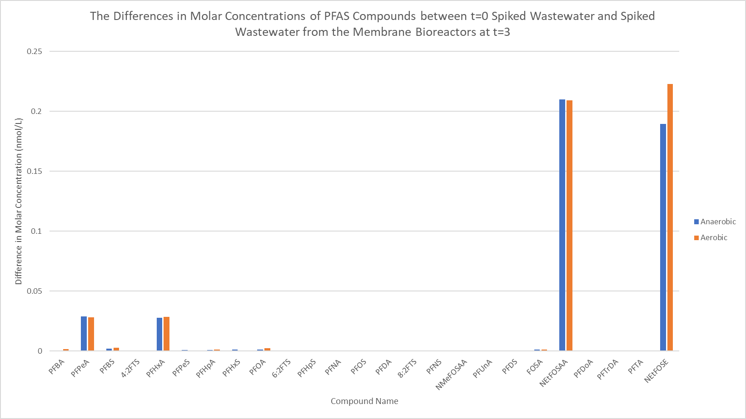
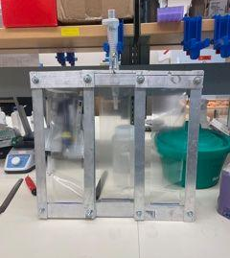
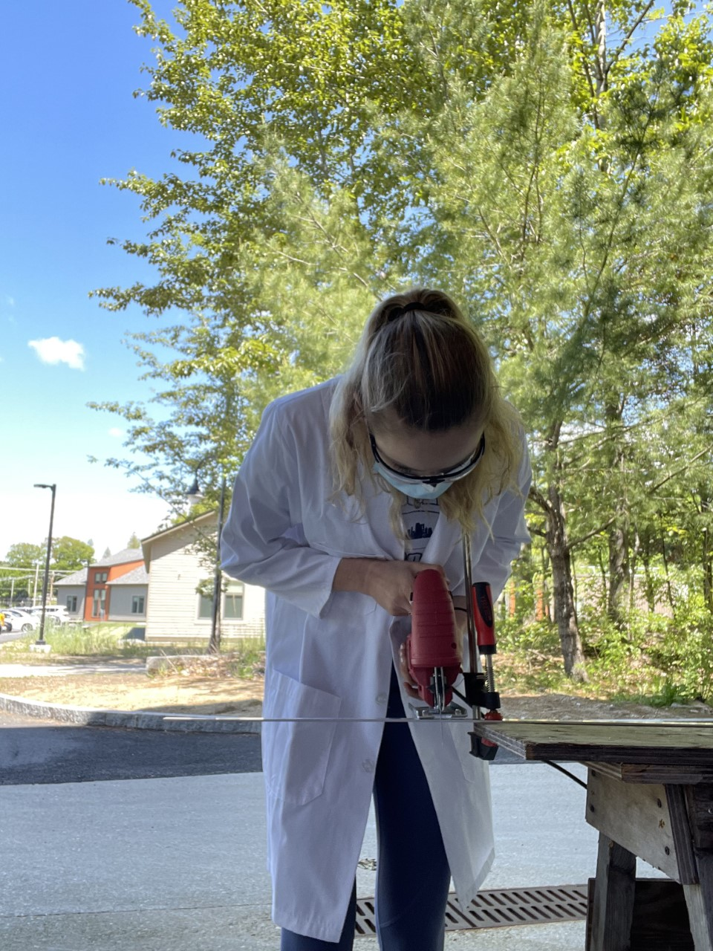
The Influence of Dissolved Oxygen on the Degradation and Transformation of NEtFOSE Within a Secondary Wastewater Treatment Bioreactor System
Introduction
Research
Conclusion
Material
Methodology
Conclusion
Condensed abstract/abstract
Recommendations
Analysis
Results
Background
Discussion
Hypothesis
Acknowledgements
Objectives
Models
Contact Info
Alexis Eaton, Environmental Engineering and Sustainability
Dr. Paula Mouser, Professor of Civil and Environmental Engineering
BACKGROUND
Per and polyfluoroalkyl substances, more commonly known as PFAS, are synthetic compounds that have been used in commercial and industrial settings since the 1940s.
These substances are commonly used to produce surfactants and polymers due to their hydrophobicity, oleophobicity, surface activity, and thermal stability.
These persistent organic pollutants (POPs) exhibit effects such as immunotoxicity, genotoxicity, reproductive toxicity, neurotoxicity, and carcinogenicity; they have also been shown to interfere with thyroid function in humans (Zhang et al., 2020).
PFAS have proven to be extremely problematic because of their tendency to partially degrade and transform in the environment, earning them the nickname “forever chemicals.”
N-ethyl perfluorooctane sulfonamido ethanol (NEtFOSE) is a precursor to many PFAS. The compound itself is toxic but it degrades into even more harmful and bioaccumulative compounds including perfluorooctane sulfonic acid (PFOS).
MEMBRANE SLUDGE HEALTH PRELIMINARY EXPERIMENT
Prior to spiking the membranes with NEtFOSE, it was necessary to ensure that the sludge within the membranes remains healthy as time progresses.
In order to do so we filled the two membrane systems with wastewater and placed them in a secondary aerobic wastewater basin; we regarded this as day 0. We collected samples from two of the individual membranes per day on day 1, day 2, and day 5. We also collected regular wastewater samples from the basins on each of these days (control samples).
With each of the samples, I conducted TSS (total suspended solids) and VSS (volatile suspended solids) analyses.
The idea behind the experiment was that if bacteria within the membranes were dying, they would rupture, and we would see a change in the solids concentration; if the cells within the membrane remained active and healthy, the solids concentrations would match that of the samples taken from the treatment basin.
We expected the TSS and VSS values for the wastewater samples taken from the treatment basin itself to remain relatively constant over time.
Results:
biomass within the membranes greater than solid concentrations in the basin itself. We were able to conclude that the loss of suspended solids was due to the consumption of organic matter within the membranes. The gain in biomass on day five suggests that the membrane systems were “trying” to be in equilibrium with their environment. Water was leaving the membranes to balance the system with the surrounding wastewater.
Ultimately, this experiment proved that there are two major complications with the membrane systems: solid sorption and differing solid concentrations in the membranes. To avoid such problems, the wastewater should be decanted prior to being put in the membranes.
PRIMARY EXPERIMENT
First, a NEtFOSE stock solution was prepared to spike the membranes.
2.85 ml of stock was added to each individual membrane.
We let the solids settle out from the wastewater before adding it to the membranes to ensure that we were only assessing the liquid phase.
One of the systems
was deployed in the
anaerobic basin, and
the other was placed
in the aerobic basin.
The bioreactors were
hung from a railing
and attached to a
chain so they were
suspended about ten
feet into the basins.
The bioreactors were deployed for three days.
NEtFOSE could not leach out of the membranes and
contaminate the basins because the membrane pore sizes
were smaller than the size of the compound itself.
PRELIMINARY RESULTS CONT’D
My next step was to create a potential biotransformation pathway that would display the differences in how NEtFOSE breaks down in anaerobic vs aerobic environments. I included the compounds with visible bars in the pathway, as well as a few compounds that other studies suggest serve as intermediate metabolites (Singh et al., 2019).
Ultimately, the same metabolites were generated under both anaerobic and aerobic conditions, yet the concentrations of such compounds varied in some cases. The most significant differences in concentrations between the two environments were the amount of NEtFOSE remaining and the amount of NEtFOSAA generated.
My study suggests that in well oxygenated systems, scientists can focus their efforts on targeting NEtFOSAA; whereas, in poorly oxygenated systems, NEtFOSE itself will be of larger concern.
Elimination of PFAS from natural and built environments will ensure the health and longevity of our ecosystems and of humankind.
Jupiter is a gas giant and the biggest planet in the Solar System
Since Jupiter is a gas giant, it doesn’t have a solid surface. Jupiter is the planet that spins the fastest
Venus has a beautiful name, but also very high temperatures
Despite being red, Mars is actually a cold place. It's full of iron oxide dust, which gives the planet its reddish cast. Mars has two moons
A bioreactor filled with the decanted wastewater.
Saturn is a gas giant and has several rings
Spiking the wastewater.
Jupiter is the biggest planet in the Solar System
Neptune is the farthest planet from the Sun. It's the fourth-largest planet by diameter in the Solar System
PRELIMINARY RESULTS
It is challenging to fully compare the control samples to the experimental samples without taking into account the molar masses of each of the individual PFAS compounds. By converting the ng/L concentrations to molar concentrations, I was able to truly see whether or not there was a difference in the amount of each compound present in the membranes vs the controls.
This graph displays the
absolute values of the
differences in the
compounds’ molar
concentrations in the
membrane samples vs
the “t=0 samples,”
also known as the
basin samples that
were spiked with
NEtFOSE. The
compounds included in
the graph above of
which had visible bars, meaning there was a difference between compound concentrations in the membrane samples vs the t=0 samples, were therefore influenced by the presence or absence of oxygen.
Write your recommendations here
Write your recommendations here
Write your recommendations here
Write your recommendations here
PROJECT OBJECTIVES
Build and test an in situ bioreactor using a semi-permeable membrane system to determine how dissolved oxygen levels during secondary wastewater treatment influence the degradation and transformation of N-ethyl perfluorooctane sulfonamido ethanol, or N-EtFOSE.
In order to study the effect of oxygen, the membranes were deployed in both aerobic and anaerobic zones of a secondary treatment basin.
Observe the biotransformation pathways of NEtFOSE in both the aerobic and anaerobic zones, and make meaningful comparisons.
Neptune is the farthest planet from the Sun. It's the fourth-largest object by diameter in the Solar System
The graph suggests that the only significant change in NETFOSE breakdown between the two environments relates to NETFOSAA, as most of the bars have similar heights, indicating that the metabolite concentrations are similar. The chart suggests that under aerobic conditions, most of the NEtFOSE transforms into NEtFOSAA; whereas, under anaerobic conditions, a smaller concentration of NEtFOSE breaks down into NEtFOSAA; a majority of the NEtFOSE remains intact.
Venus has a beautiful name and is the second planet from the Sun. It’s terribly hot, even hotter than Mercury
Mercury is the closest planet to the Sun and. Its name has nothing to do with the liquid metal
The Sun is the star at the center of the Solar System. Pluto is now considered a dwarf planet
Mars | Mercury | Jupiter
30 | 14 | 25
17 | 38 | 12
83 | 24 | 13
Mercury is the closest planet to the Sun and the smallest one in the Solar System
BIOREACTOR DESIGN
The first stage of my research project was spent designing and building the membrane bioreactors that would be used for the project.
The membranes used for the experiment were made from food-grade dialysis tubing. The membranes can be thought of as “sausage casings” that enclose a liquid or solid.
Aluminum flat stock was used to press the membranes closed when attached with the appropriate hardware.
Both the TSS and VSS results show that solid concentrations within the membranes were slightly less than the solid concentrations in the membrane for day 1 and day 2. Data from day 5 suggested that there was an increase in
You can write a hypothesis here
You can write a hypothesis here
You can write a hypothesis here
Follow the link in the graph to modify its data and then paste the new one here. For more info, click here
Venus has a beautiful name, but it’s extremely hot. It’s the only planet that spins clockwise
Two bioreactors with three membranes in series for each were constructed so triplicate samples could be deployed in both the aerobic and anaerobic zones.
Ceres
Ceres is located in the main asteroid belt
Earth is the only planet known to harbor life in the Solar System
Venus has a beautiful name and is the second planet from the Sun
Saturn
Earth is the only planet known to harbor life. It’s full of water, so that’s why it’s also known as the blue planet
youremail@freepik.com
+91 620 421 838
yourwebsite.com
Me cutting flat stock outside Gregg Hall to build the bioreactors.
Saturn is a gas giant and has several rings
A completed bioreactor system
References: Singh, R. K., Fernando, S., Baygi, S. F., Multari, N., Thagard, S. M., & Holsen, T. (2019, February 15). Breakdown Products from Perfluorinated Alkyl Substances (PFAS) Degradation in a Plasma-Based Water Treatment Process. ACS Publications. Retrieved July 29, 2022, from https://pubs.acs.org/doi/10.1021/acs.est.8b07031., Zhang, W., Pang, S., Lin, Z. Mishra, S., & Bhatt, P. (2020). Biotransformation of perfluoroalkyl acid precursors from various environmental systems: advances and perspectives. Environmental Pollution, 0269-7491.

