Slide 1
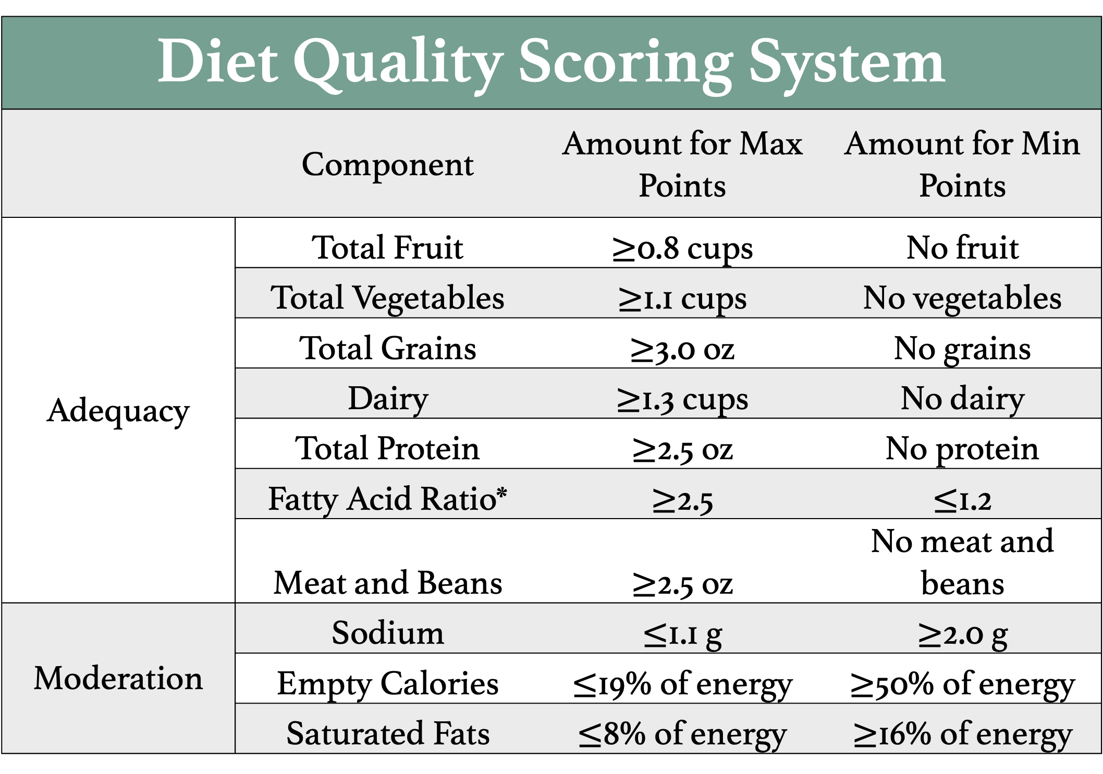
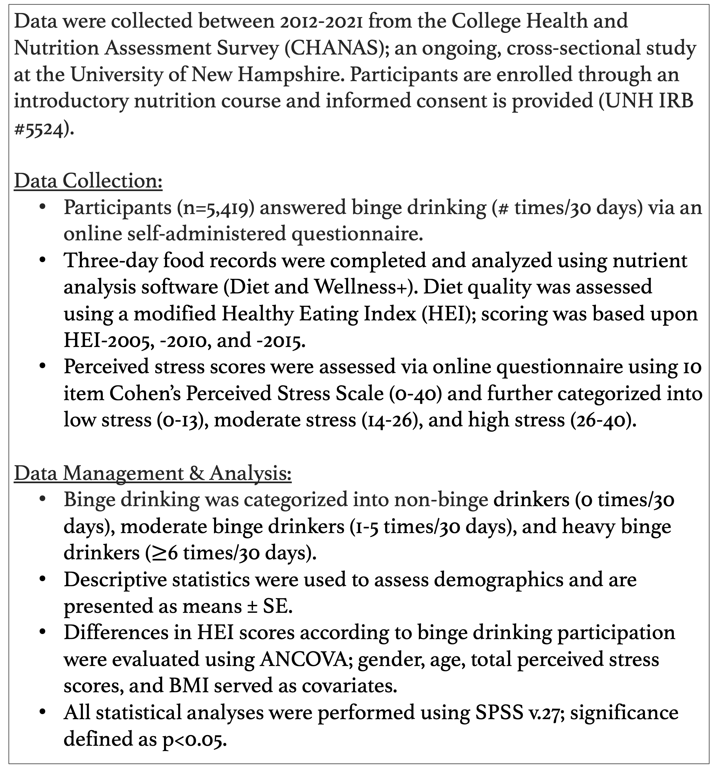
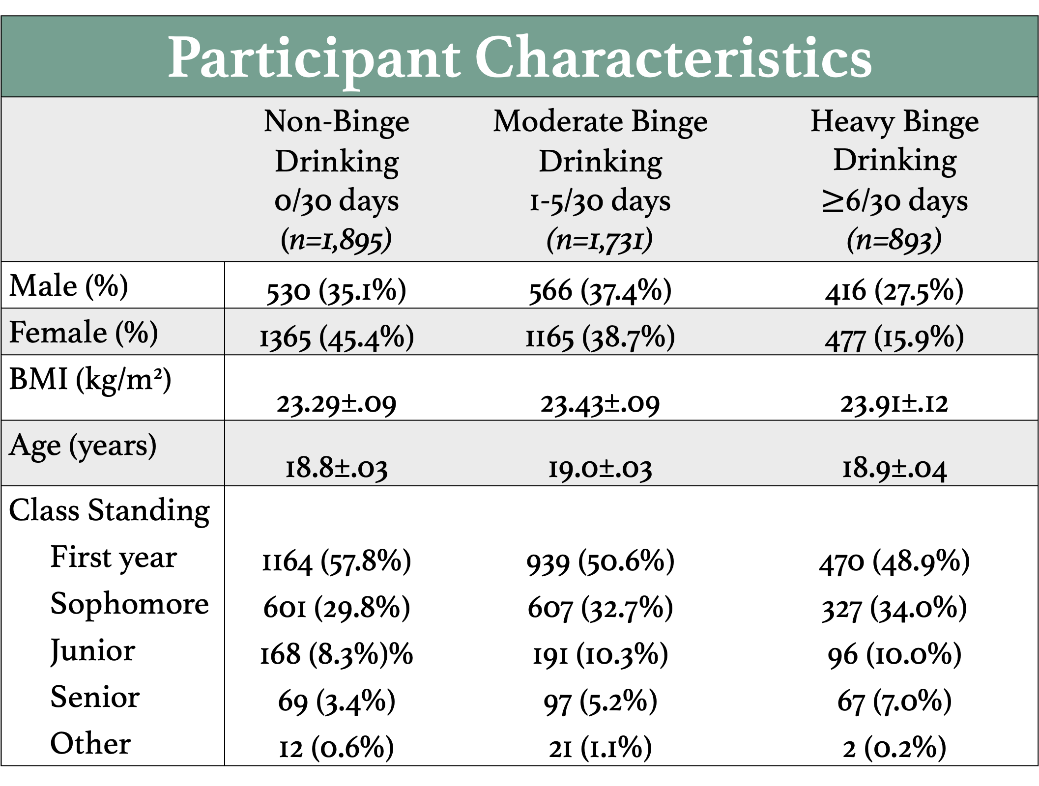
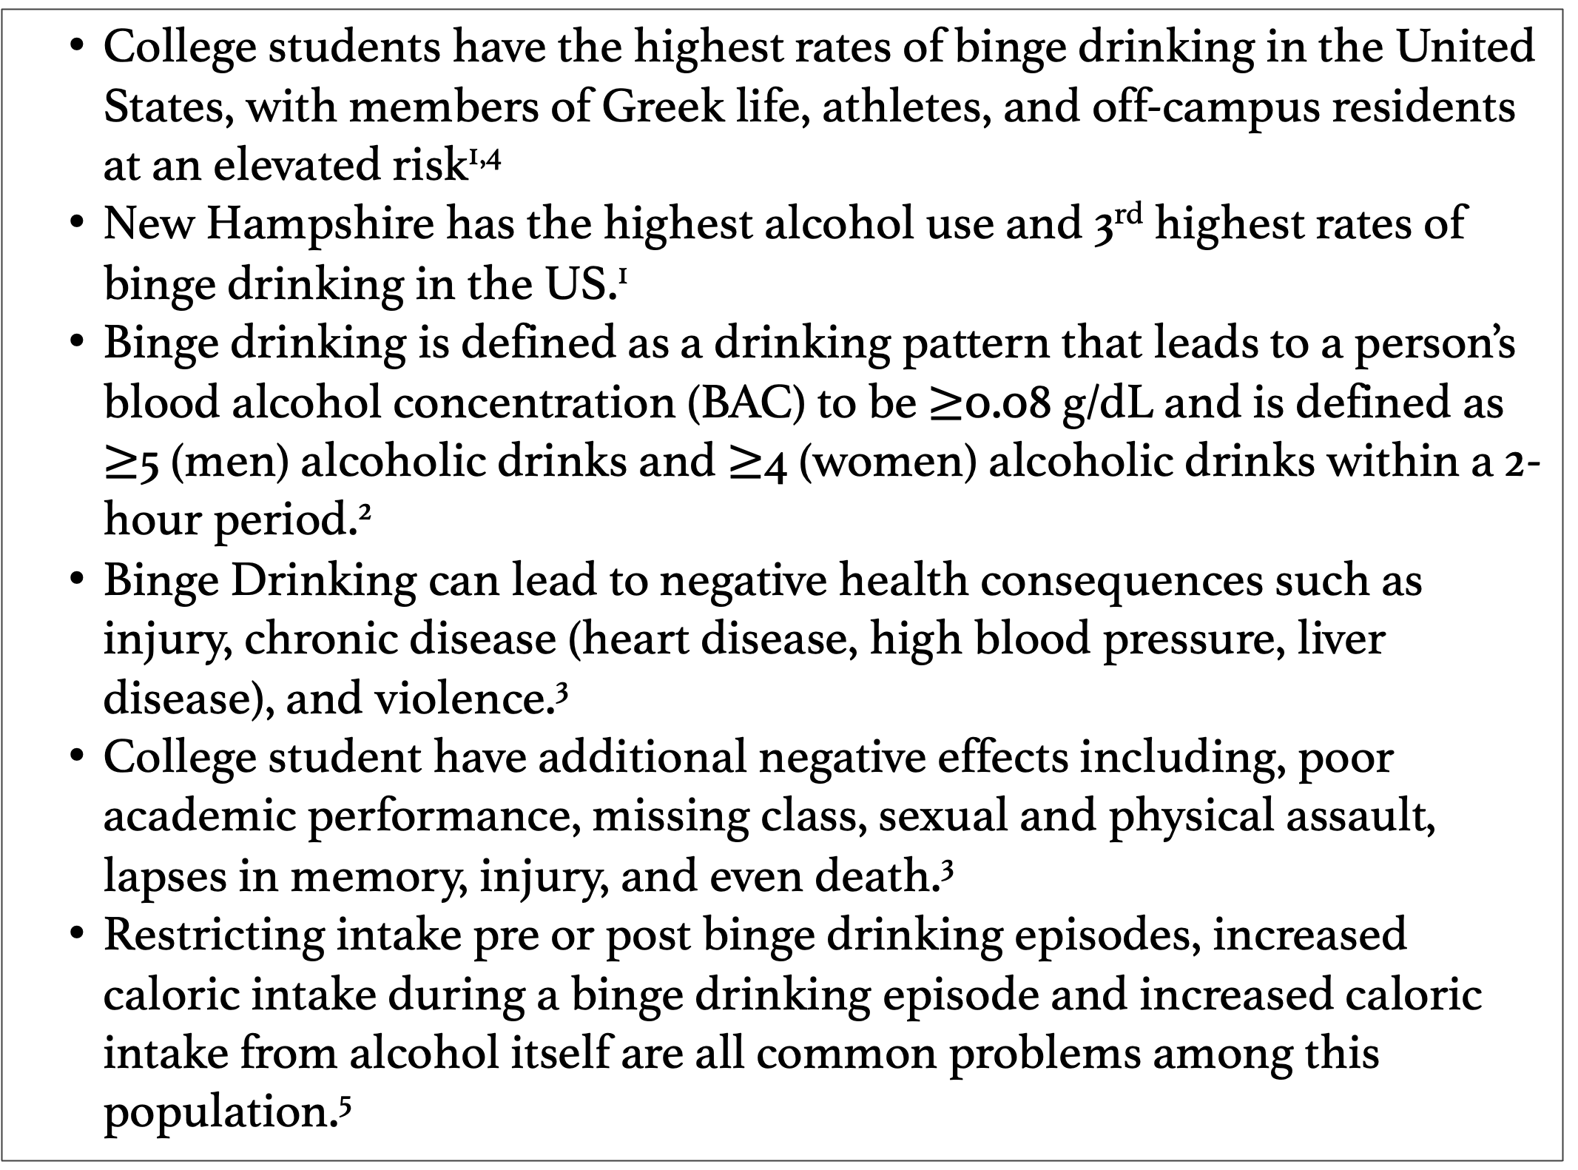
Relationship Between Binge Drinking and Diet Quality Scores Among College Students
Rebecca Maida, BS and Jesse Stabile Morrell, PhD
Department of Agriculture, Nutrition, and Food Systems
Introduction
Objective
Diet Quality Scores and Binge Drinking Category
  College students have the highest rates of binge drinking in the United States, with members of Greek life, athletes, and off-campus residents at an elevated risk­^{1,4}
  New Hampshire has the highest alcohol use and 3rd highest rates of binge drinking in the US.¹
  Binge drinking is defined as a drinking pattern that leads to a person’s blood alcohol concentration (BAC) to be $≥$0.08 g/dL and is defined as $≥$5 (men) alcoholic drinks and $≥$4 (women) alcoholic drinks within a 2-hour period.²
  Binge Drinking can lead to negative health consequences such as injury, chronic disease (heart disease, high blood pressure, liver disease), and violence.³
  College student have additional negative effects including, poor academic performance, missing class, sexual and physical assault, lapses in memory, injury, and even death.³
  Restricting intake pre or post binge drinking episodes, increased caloric intake during a binge drinking episode and increased caloric intake from alcohol itself are all common problems among this population.⁵
  Determine the relationship between different levels of binge drinking and diet quality scores among college students at a large, northeastern university.
HEI-2015 National Average: 59⁶
Diet Quality Scoring System
 | Component | Amount for Max Points | Amount for Min Points
Adequacy | Total Fruit | $≥$0.8 cups | No fruit
 | Total Vegetables | $≥$1.1 cups | No vegetables
 | Total Grains | $≥$3.0 oz | No grains
 | Dairy | $≥$1.3 cups | No dairy
 | Total Protein | $≥$2.5 oz | No protein
 | Fatty Acid Ratio* | $≥$2.5 | $≤$1.2
 | Meat and Beans | $≥$2.5 oz | No meat and beans
Moderation | Sodium | $≤$1.1 g | $≥$2.0 g
 | Empty Calories | $≤$19% of energy | $≥$50% of energy
 | Saturated Fats | $≤$8% of energy | $≥$16% of energy
Participant Characteristics
 | Non-Binge Drinking 0/30 days (n=1,895) | Moderate Binge Drinking 1-5/30 days (n=1,731) | Heavy Binge Drinking $≥$6/30 days (n=893)
Male (%) | 530 (35.1%) | 566 (37.4%) | 416 (27.5%)
Female (%) | 1365 (45.4%) | 1165 (38.7%) | 477 (15.9%)
BMI (kg/m²) | 23.29±.09 | 23.43±.09 | 23.91±.12
Age (years) | 18.8±.03 | 19.0±.03 | 18.9±.04
Class Standing
First year | 1164 (57.8%) | 939 (50.6%) | 470 (48.9%)
Sophomore | 601 (29.8%) | 607 (32.7%) | 327 (34.0%)
Junior | 168 (8.3%)% | 191 (10.3%) | 96 (10.0%)
Senior | 69 (3.4%) | 97 (5.2%) | 67 (7.0%)
Other | 12 (0.6%) | 21 (1.1%) | 2 (0.2%)
HEI 2005- Fruits, Vegetables, Grains, Dairy, Meat and Beans; HEI 2010- Protein, Fatty Acid Ratio, Sodium, Empty Calories; HEI 2015- Saturated Fat; *MUFA+PUFA/SFA
Methods
Modified HEI Score is on a scale from 0-100
*significance of p<0.001
Data were collected between 2012-2021 from the College Health and Nutrition Assessment Survey (CHANAS); an ongoing, cross-sectional study at the University of New Hampshire. Participants are enrolled through an introductory nutrition course and informed consent is provided (UNH IRB #5524).
Data Collection:
  Participants (n=5,419) answered binge drinking (# times/30 days) via an online self-administered questionnaire.
  Three-day food records were completed and analyzed using nutrient analysis software (Diet and Wellness+). Diet quality was assessed using a modified Healthy Eating Index (HEI); scoring was based upon HEI-2005, -2010, and -2015.
  Perceived stress scores were assessed via online questionnaire using 10 item Cohen’s Perceived Stress Scale (0-40) and further categorized into low stress (0-13), moderate stress (14-26), and high stress (26-40).
Data Management & Analysis:
  Binge drinking was categorized into non-binge drinkers (0 times/30 days), moderate binge drinkers (1-5 times/30 days), and heavy binge drinkers ($≥$6 times/30 days).
  Descriptive statistics were used to assess demographics and are presented as means ± SE.
  Differences in HEI scores according to binge drinking participation were evaluated using ANCOVA; gender, age, total perceived stress scores, and BMI served as covariates.
  All statistical analyses were performed using SPSS v.27; significance defined as p<0.05.
Results
  More than half (n=2,624; 58.1%) reported binge drinking within the past 30 days
  One out of five (19.8%) reported binge drinking 6 or more times within the past 30 days.
  The mean modified HEI score was 64.8±.2.
  Heavy binge drinkers had the lowest HEI scores when compared to moderate and non-binge drinkers (63.8±.4 vs. 64.8±.3 and 65.5±.3, p=0.05, p<0.01)
References
Implications
2020 National Survey of Drug Use and Health. Substance Abuse and Mental Health Services Administration.
National Institute of Alcohol Abuse and Alcoholism. NIAAA council approves definition of binge drinking. NIAAA Newsletter.2004;3.
White A, Hingson R. The burden of alcohol use: excessive alcohol consumption and related consequences among college students. Alcohol Res. 2013;35(2):201-218.
Hill EM, Lego JE. Examining the role of body esteem and sensation seeking in drunkorexia behaviors. Eat Weight Disord. 2020;25(6):1507-1513.
Kwok A, Dordevic AL, Paton G, et al. Effect of alcohol consumption on food energy intake: a systematic review and meta-analysis. Br J Nutr. 2019;121:481-495.
HEI Scores for Americans. USDA Food and Nutrition Service. 2019
  Many college students will benefit from reducing binge drinking habits as data suggests a modest relationship with diet quality.
Acknowledgements
  This research was funded by New Hampshire Agriculture Experiment Station and USDA National Institute of Food and Agriculture Hatch Project 1010738. Additional acknowledgements go to the Department of Agriculture, Nutrition, and Food Systems, and Chris Guarino, BS.

