Slide 1

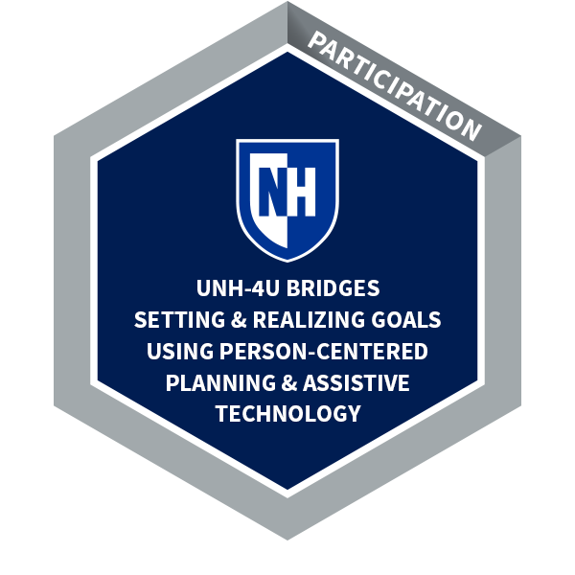
UNH-4U Comprehensive Transition Program & Bridges Training Series
Jade Doherty, B.S., Occupational Therapy
NH-ME LEND Institute on Disability at the University of New Hampshire
Importance of Transition Programs
Consider individual’s strengths, preferences, and interests
Promotes independence, competence, employment opportunities, power of experiences, inclusion, and expectations
Measurable postsecondary goals
UNH-4U Team
Student and Family (guardians)
Inclusion facilitators
Academic coach
Peer Mentor/Campus Ambassador
Residential Support Assistant
Leadership Activities
Served as a UNH-4U Peer Mentor: support student in academic and campus involvement
Introduction
The mission of UNH-4U is to build inclusive higher education capacity in New Hampshire and provide educational experiences that address the unique gifts and talents of individuals with intellectual disability (ID) that result in career and independent living opportunities.
UNH-4U piloted their 2-year Comprehensive Transition Program (CTP), this 2021-2022 academic year, focusing on academic enrichment, campus involvement, independent living skills, and work experiences/career skills. Students have goals that are person-centered, and work toward digital badge obtainment, which are issued by UNH and document the student’s learning, competencies, and experiences that can be used for future employment opportunities.
Facilitated small group discussions in Bridges course, Setting and Realizing Goals
Strengths of Pilot Year
Communication, flexibility within roles
Staff with a background in disability, vocational rehab, area agencies, or occupational therapy
Students are meeting goals and involved in the campus community
UNH-4U Funding:
TPSID Grant
Vocational Rehabilitation: goals related to career exploration
Area Agencies/Medicaid: goals related to independent living skills
Family/Guardians: housing and meal plan
Presented at Bridges information sessions related to campus and social opportunities of UNH-4U
Bridges to College and Career Webinar Training Series
Collaborated in multiple team meetings for student
UNH-4U Bridges Webinar Series consists of 4 virtual training courses offered to young adults with intellectual disabilities previously eligible for special education under the Individuals with Disabilities Education Act (IDEA). Trainings aims to prepare students for higher education, independent living, career goals, and healthy aspects of college life. The Bridges Series can be taken to prepare for a career pathway and are a prerequisite for the 2-year CTP, UNH-4U.
Next Steps
Conducted annotated bibliography on digital badges and micro-credentialing
Develop/Improve advising and curriculum structure of the Bridges Series
Continue to develop UNH-4U structure for academic coaching and campus ambassadors
Continue to make connections with UNH academic faculty, and campus services/resources to support inclusion of students.
Communicate with UNH-4U team members to monitor academic progress and communicate with faculty as needed.
Continue to develop criteria and standards of the program in measurable data for analysis and program development.
UNH-4U 2-year CTP
Bridges Webinar Series
Authentic campus and academic opportunities
Independent living skills
Advising & peer mentoring support
Digital Badge Obtainment,
Employment Opportunities
References
https://iod.unh.edu/unh-4u/unh-4u-bridges
https://www2.ed.gov/programs/tpsid/index.html
https://iod.unh.edu/unh-4u

