Slide 1
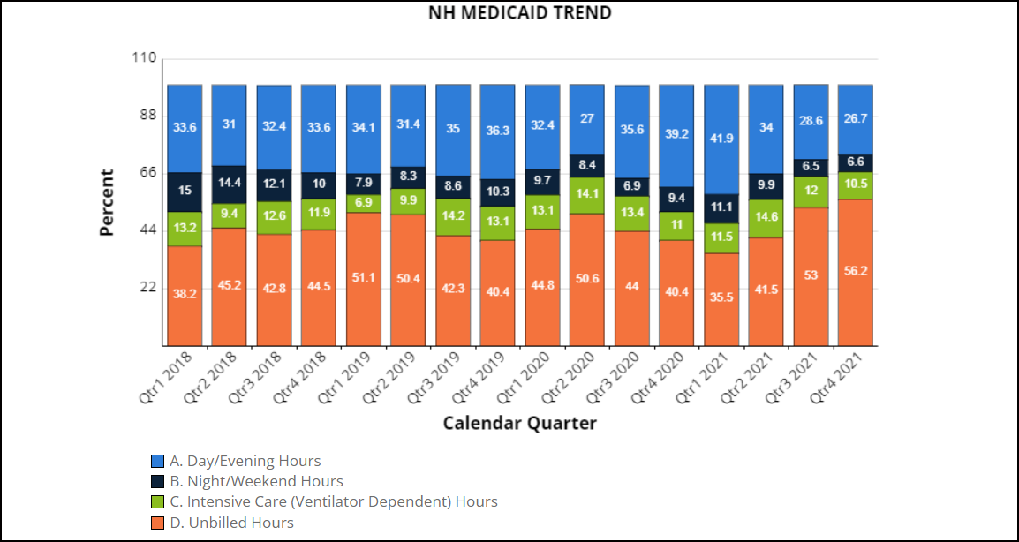
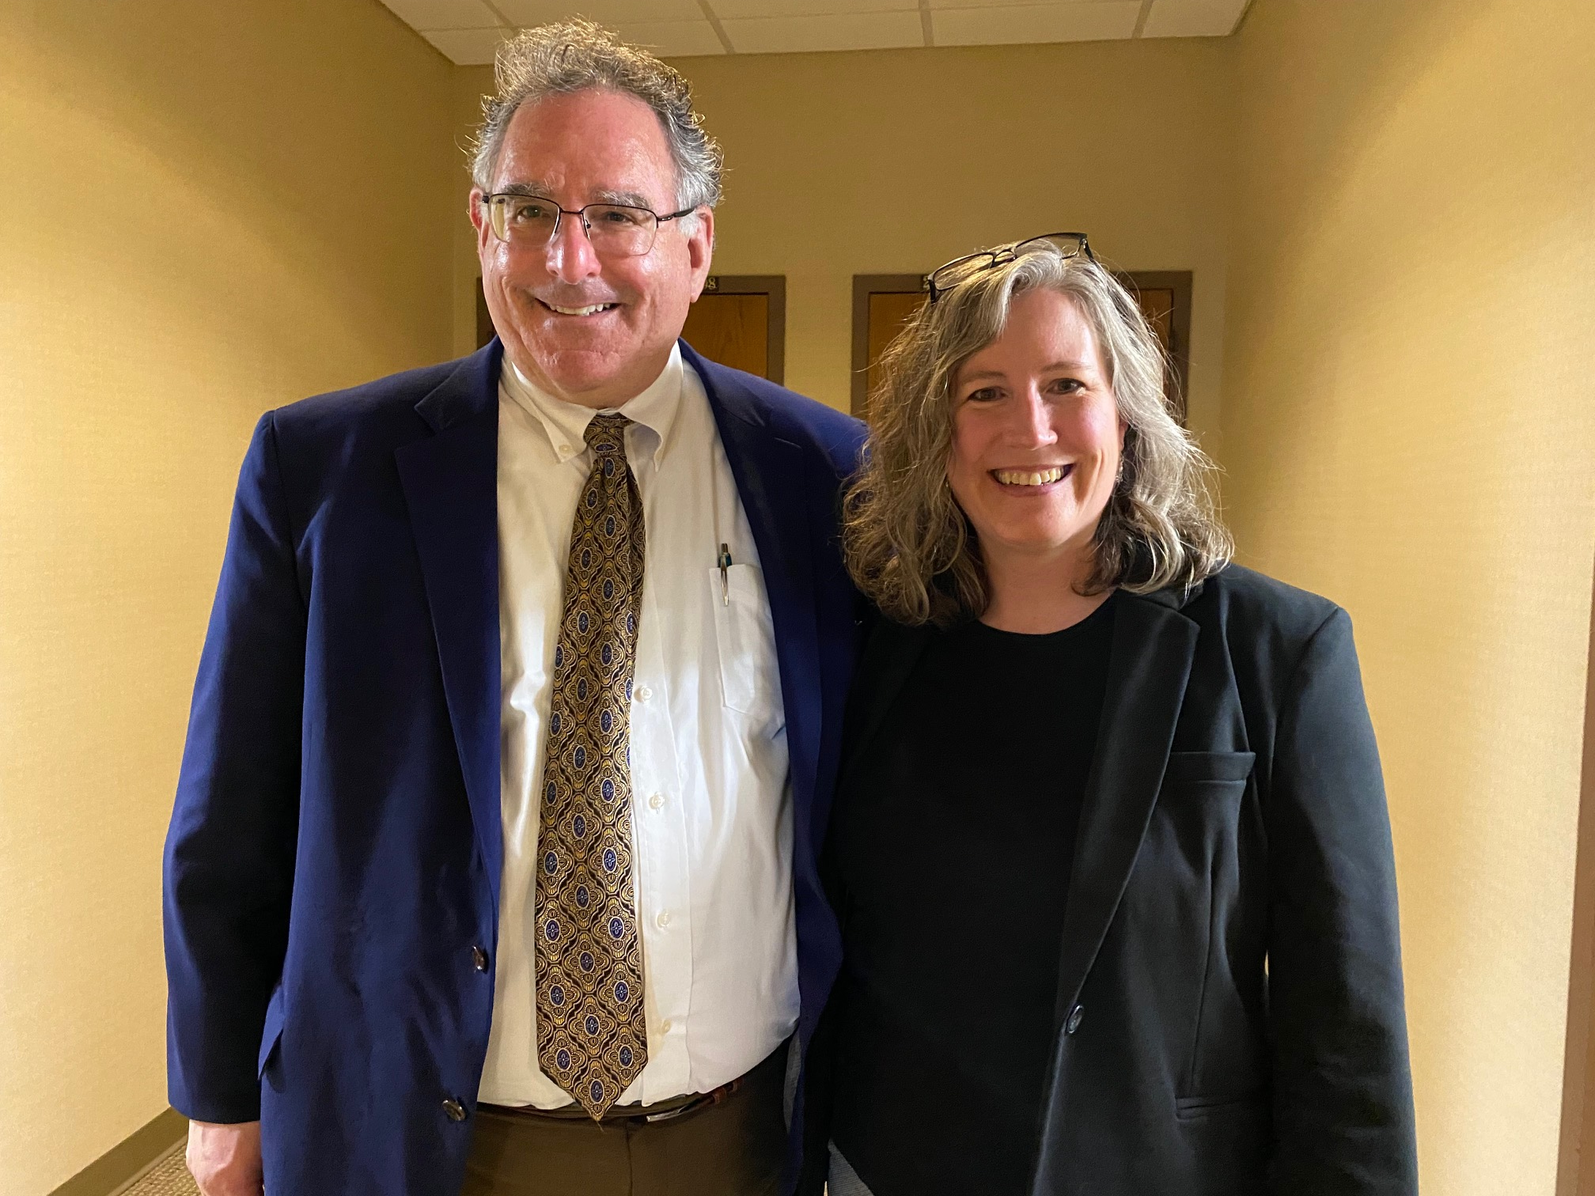
Workforce Shortage Solutions for New Hampshire Direct Care Workers: Department of Health and Human Services (DHHS) Medicaid Program for Parent Caregivers, and Educational Guidelines for Direct Support Professionals
Audrey Gerkin, M Ed. Educational Disabilities, Rivier College
NH-ME LEND, Institute of Disability, University of New Hampshire
Senate Bill 430
Parent Payment Program
Senate Bill 430 (SB430) is a legislative bill submitted on behalf of the NH DHHS. The bill contains twenty-three different “issues” and is sponsored by Senator Jeb Bradley. Section 25 contains a placeholder for the 1135 and 1915j waiver submission requests by DHHS to the Center for Medicare and Medicaid Services(CMS). These requests are looking to make a Covid-19 Public Health Emergency (PHE) Order program permanent after the Order ends. The Granite State Independent Living (GSIL) program pays parents to work as Personal Care Attendants to care for their disabled children because of the workforce shortage crisis. The state of New Hampshire will continue the program for two more years, with a fiscal note of $700,000, if the waivers are denied by CMS, hence being called a placeholder. This bill is marked as Ought to Pass as of April 22, 2022.
This program is broken down into two different groups of eligibility; families who are eligible for Personal Care Attendants (PCA)* and Private Duty Nursing (PDN)*. GSIL handles the administration of the program.
228 people participate in total; 174 as PCA’s and 54 as PCA’s receiving PDN eligibility.
PDN families face on average over 50% of PDN authorized hours unfilled.
Program provides more financial security and compensation for parents covering unfilled shifts of registered nurses and PCA’s.
Families eligible for the PDN program portion are paid at a rate of $15.00 an hour for 50% of the hours covered for the PCA portion of defined work. Essentially, parents working a PDN shift are paid $7.50 an hour. In stark contrast, the Medicaid PDN rate is $55.07 (January 2021).
My NH-ME LEND Leadership Placement was a 70-hour policy placement with the New Hampshire Council on Developmental Disabilities (NHCDD). The NHCDD is a federally funded state required agency under the Developmental Disability Act. The Council supports public policies and initiatives for people with disabilities. One way this is done is through separate Policy and Workforce committees to address current issues in New Hampshire affecting the quality of life or full equitable inclusion in the community for children and/or adults with disabilities.
Data
Legislative Path
Project Activities
Adult PDN Authorized Hours
SB430 was introduced to the Senate Health and Human Services Committee and passed over to the Senate Finance Committee as Ought to Pass. Section 25 left the Senate Finance Committee untouched and moved SB430, over to the House Health, Human Services and Elderly Affairs Committee. The House committee pushed the bill over to the House Finance committee after a lengthy Executive Session. Section 25 was left intact.
Policy Committee
Participated in monthly Developmental Disability Council (DDC) policy meetings.
Assisted with prioritizing legislative bills for the 2022 session and forming a draft list.
Organized pertinent legislative bills within the TrackBill software.
Submitted testimony on behalf of the DDC for HB1141, Relative to Special Education Services for Children in Chartered Public Schools.
Met with State Senator Jeb Bradley and State Senator Tom Sherman to discuss SB430, Relative to Health and Human Services.
Provided education to Senator Bradley on why families eligible for Private Duty Nursing (PDN) would benefit from 100% payment coverage versus 50% payment coverage.
Met with U.S. Senator Maggie Hassan’s Legislative Liaison to request clarification around 50/100% rule for PDN families.
NH Director of Medicaid, Henry Lipman and Audrey Gerkin
Testimony
Children PDN Authorized Hours
On April 12, 2022, I submitted testimony to the House HHS Committee in support of SB430, section 25 with a request to increase the pay wages for families covering private duty nursing shifts for a more equitable pay of someone providing hospital or nursing home level care in their home. I was prepared to testify in person, but the hearing was running 3 hours behind. The Executive Session closed at 10pm with a final vote. Currently, no amendment or fiscal note change has been made to Section 25 as the bill is in the hands of the House Finance Committee.
Workforce Committee
Participated in DDC Workforce meeting and workgroup subcommittee for Direct Support Professionals Education and Certificates Guidelines.
Collaborated with members to plan, write and submit a letter on behalf of the DDC to the Department of Health and Human Services (DHHS) on family concerns in relation to Direct Support Professional workforce for the Bureau of Developmental Service Systems Work.
Next Steps
At any time, CMS could approve PHE flexibility waivers rendering Section 25 of SB430 unnecessary, and enacting the parent payment program as permanent. If denied, NH will temporarily keep the program running for 2 years (if SB430 is passed into law) to allow more time for solutions to the workforce shortage crisis.
Workforce Shortage Crisis
Caregivers
Private Duty Nurses
Personal Care Attendants
Direct Support Professionals
Resources
Charts: NH DHHS, Medicaid Quality
NH DHHS, NH Medicaid Quality https://medicaidquality.nh.gov/report-search?sq=private+duty+nursing
Granite State Independent Living https://mm.nh.gov/media/dhhs-trainings/introduction-to-centers-for-independent-living/presentation_content/external_files/PCA%20-%20Description%20(002).pdf
NH DHHS, Learning to Date-Emergent Support Initiative & Private Duty Nursing Rate Increase, Deb Scheetz, October 27, 2016 SB430, NH Legislative Session (2022) https://www.gencourt.state.nh.us/bill_status/billinfo.aspx?id=2065&inflect=2
NH Council on Developmental Disabilities (March 2022) https://www.nhcdd.nh.gov/
*Private Duty Nurse: A registered or Licensed Practitioner (RN/LPN) who provides the same level of care a person would receive if they were in a skilled nursing facility or hospital, except that care is provided right in their own home. Skills can include Ventilator and/or tracheostomy care, G and/or J tube feedings and care, and other special medical equipment and technology care. *Personal Care Attendant: A nonprofessional, who is trained by the person receiving services and can provide an array of personal care services to the person. The person needs assistance with at least 2 of the 7 following activities of daily living (ADL’s): bathing/grooming, dressing/undressing, eating, mobility, passive range of motion exercise, taking medication and/or toileting.

