Slide 1

UNDERSTANDING “COMMUNITY” IN COMMUNITY BASED NATURAL RESOURCES MANAGEMENT (CBNRM): A CASE STUDY OF GHANZI DISTRICT IN BOTSWANA
Olorato Boineelo Kaekwe
Natural Resources and the Environment, MSc
Advisors: Cat Ashcraft and Heidi Asbjornsen
Fikirte Erda( committee member)

Slide 2
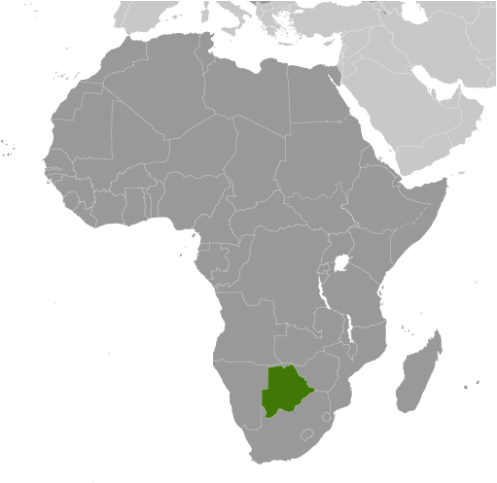
CBNRM in Botswana
Introduced in 1989
The main objective was to establish a foundation for conservation-based development by creating opportunities for community participation in natural resources management (CBNRM Policy, 2007).
https://www.dol.gov/agencies/ilab/country/ilab-botswana
Notes:
-CBNRM is a common program in developing countries
-and with this approach, natural resources management is decentralised to engage rural communities
-in Botswana it was introduced to address issues of declining wildlife populations and abject poverty in rural areas
-its main objective is sustainable development
-CBNRM is basically based on the assumption that the economic gains from the use of natural resources will be incentive enough for communities to engage in conservation
-Because of CBNRM, the tourism sector has grown and improved our economy over the years. Most of this success has been in the north where we have the worlds largest inland delta- The Okavango Delta

Slide 3
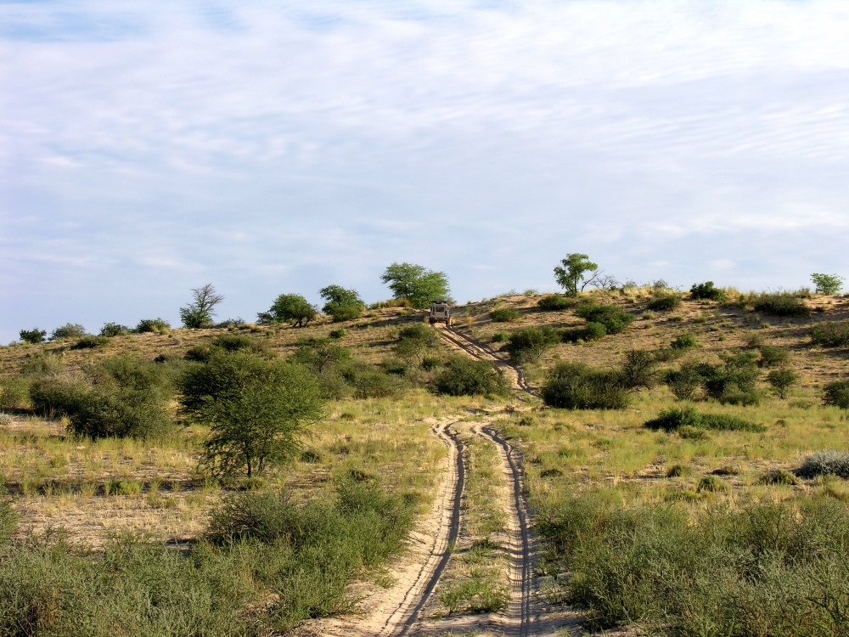
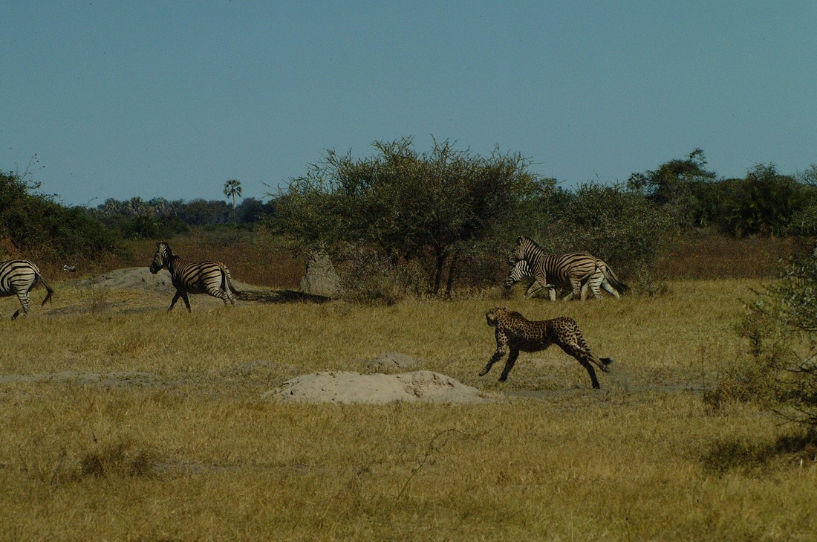
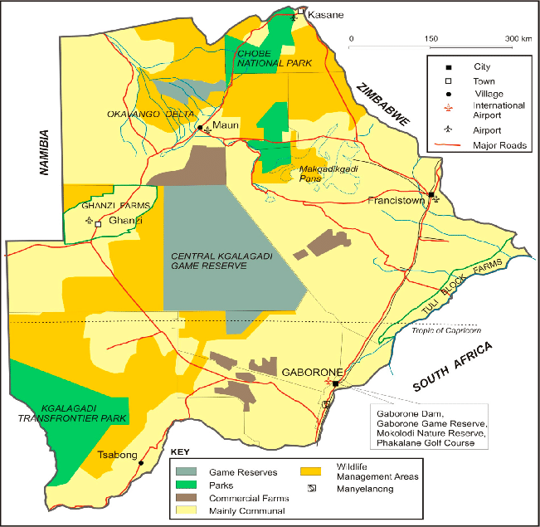
Study Area
Size- 1800 km²
Population- 21 420
Ethnic groups- Basarwa (San), Baherero, Bakgalagadi and Afrikaners
https://www.cheetahconservationbotswana.org/uploads/6/4/3/3/64330039/5569840.jpg
https://www.botswanatourism.co.bw/explore/central-kalahari-game-reserve
https://www.researchgate.net/profile/Brijesh-Thapa/publication/339337031/figure/fig1/AS:861201093386241@1582337749950
Notes:
And just south of the Okavango, is my study area, Gantsi and it is in the middle of the Kalahari desert and it offers a different ecosystem from the Okavango because it is much drier
And to give a brief explanation of the map, the red star is the Ghanzi district, the gray is the CKGR which I believe is the second largest wildlife reserve in Africa and of great significance to CBNRM is the orange areas around the protect areas, that is where the CBNRM projects take place

Slide 4
Policy objectives
Establish a framework that provides incentives for communities to manage natural resources in a sustainable manner
Create opportunities for community participation in natural resources management
Encourage communities to participate meaningfully in the monitoring of CBNRM
(CBNRM Policy, 2007)
Notes:
The objectives of the policy address both the development goals and conservation goals
-environmental awareness and education
-capacity-building for the communities

Slide 5
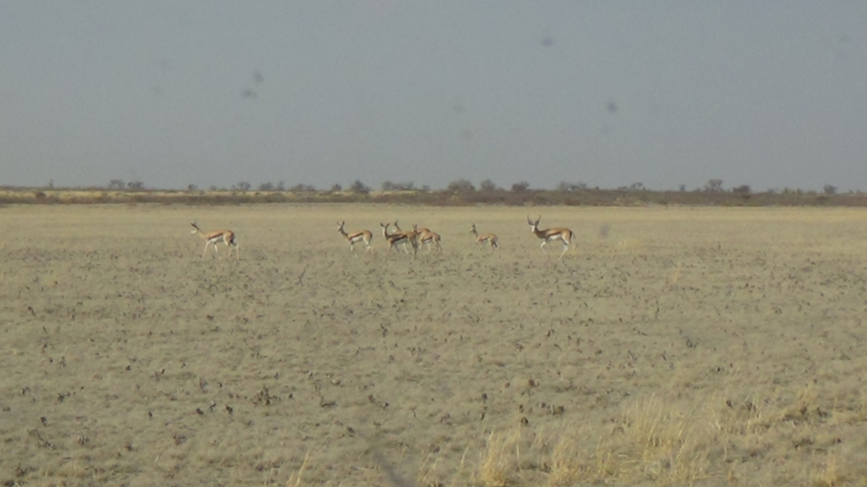
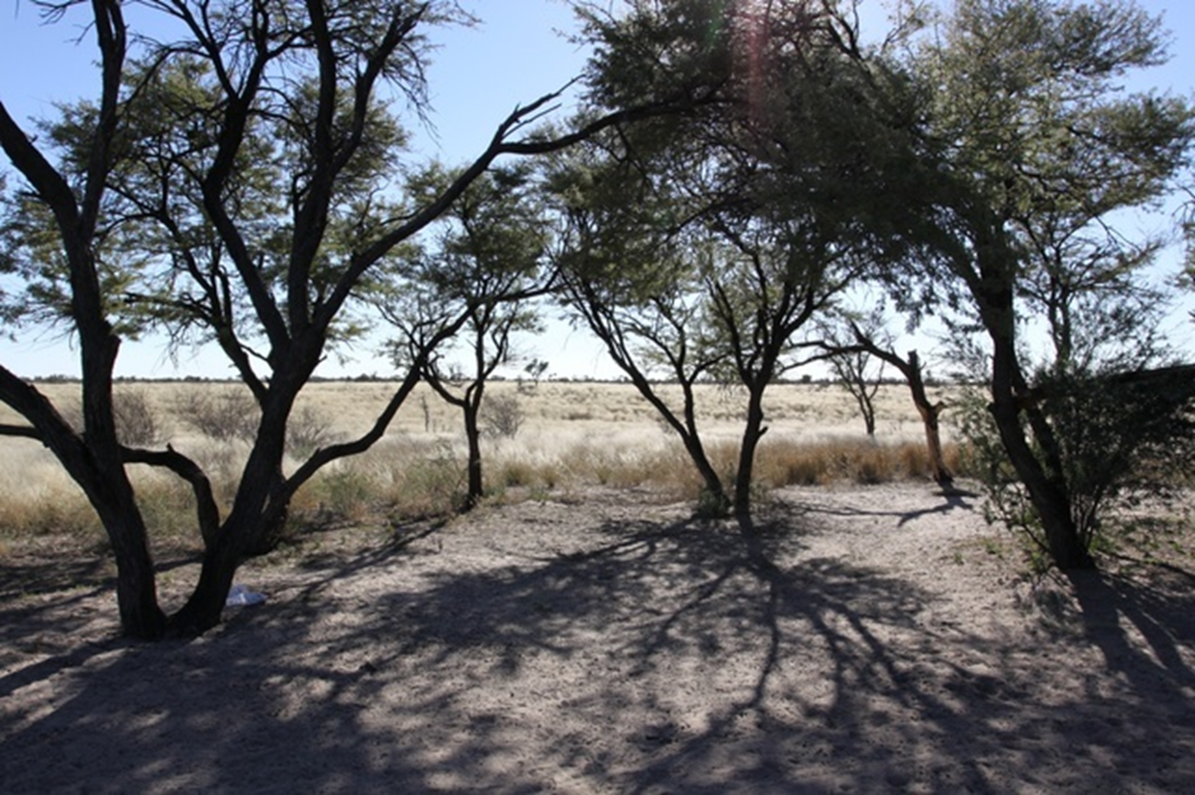
Key issues identified from literature
Lack of power devolution (Twyman, 2000; Cassidy, 2020)
Limited benefits to intended beneficiaries (Sebudubudu et al, 2014)
Short-term nature (Mbaiwa, 2015)
Reliance on foreign involvement (Ngwira et al, 2013)
the implementation process…
Notes:
-decision-making favours government and decisions are imposed on the communities
Two years ago I worked for the DEA. And DEA is part of the government departments responsible for the implementation of the CBNRM program known as the TAC. On one occasions, the TAC was tasked with identifying areas within the CKGR that will serve as campsite areas for some of the Gantsi communities. However, during this whole process, there were no community representatives. And so, we went, identified some sites and these would later be given to the community

Slide 6
Research objectives
To uncover and understand the community perceptions of CBNRM.
Understand what community participation means in practice
Understand how the implementation of the program influences participation and consequently rural development
Notes:
The purpose of my study is to understand how communities view CBNRM
And look at the participation framework of the program during the implementation process and how that affects the outcomes

Slide 7
Methods
Qualitative research methods
  Interviews (semi-structured)
  institutional interviews (TAC)
  Participant observation (project stakeholder meetings)
  focus groups
Notes:
-This summer
-The population size for the interviews is 15-20 participants and because these are human subjects, I will apply for IRB approval
-Semi-structured interviews create an opening for discussions allowing me to explore the deeper meaning of the responses
-Some of the questions I will be asking are;
*what motivates them to participate in CBNRM projects
*in what ways have they been involved
*have they had opportunities to communicate what is important to them..i.e. their needs
-The second method, participant observation basically entails me joining the stakeholder meetings and studying what is happening- and taking note of how the meetings are conducted-how many times did the participants comment vs the government representatives-who set the agenda
-Focus groups with the participants

Slide 8
Expected outcomes
characterization and analysis of public participation opportunities,
amplification of the voices of community participants,
analysis of CBNRM implementation, and
recommendations for improving CBNRM implementation.
Notes:
Anticipated outcomes include
-in CBNRM in an understudied rural development context
-to improve participation in CBNRM
-relative to institutional and community participants’ objectives

Slide 9
References
Cassidy L. Power dynamics and new directions in the recent evolution of CBNRM in Botswana. Conservation Science and Practice. 2021;3:e205. https://doi.org/ 10.1111/csp2.20
Lekgau, R.J. & Tichaawa, T.M. (2020). Community Perceptions on the Socio-economic Impacts of Wildlife Tourism from the Kgalagadi Transfrontier Park in Botswana: The Case of Tsabong. African Journal of Hospitality, Tourism and Leisure, 9(6):1044-1059. DOI: https://doi.org/10.46222/ajhtl.19770720-67
Mbaiwa, J. E. (2015). Community-based natural resource management in Botswana. In Institutional arrangements for conservation, development and tourism in Eastern and Southern Africa (pp. 59-80). Springer, Dordrecht.
Moswete, N., & Thapa, B. (2018, January). Local communities, CBOs/trusts, and people–park relationships: A case study of the Kgalagadi Transfrontier Park, Botswana. In The George Wright Forum (Vol. 35, No. 1, pp. 96-108). George Wright Society.
Ngwira, P. M., Mbaiwa, J. E., & Kolawole, O. D. (2013). Community based natural resource management, tourism and poverty alleviation in Southern Africa: What works and what doesn’t work.
Read, B. L. (2018). Serial interviews: When and why to talk to someone more than once. International Journal of Qualitative Methods, 17(1), 1609406918783452.
Republic of Botswana (2007). Community Based Natural Resource Management Policy. Botswana: Government Printers.
Sebudubudu, D., Makepe, P. M., Montsi, K., & Bodilenyane, K. (2014). Governance of Land and Natural Resource for Sustainable Development in Botswana: Possible Lessons for the Agricultural and Tourism Sectors. International Journal of African Development, 2(1), 7.
Twyman, C. (2000), Participatory Conservation? Community-based Natural Resource Management in Botswana. Geographical Journal, 166: 323-335. https://doi.org/10.1111/j.1475-4959.2000.tb00034.x

Slide 10
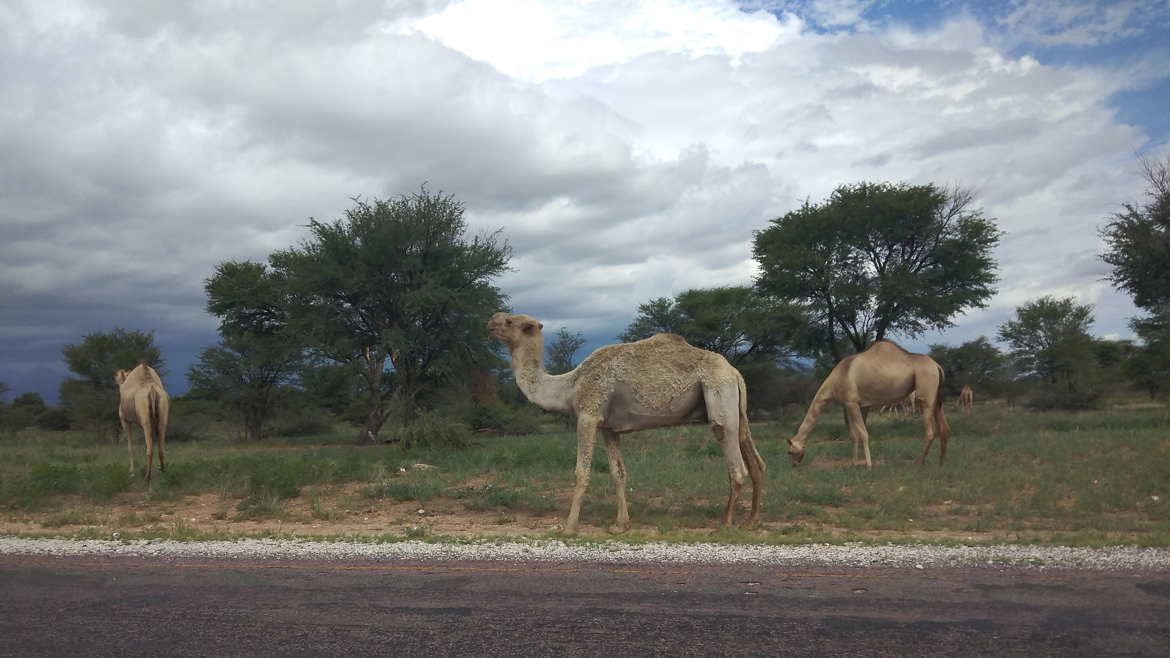
THANK YOU!

