Slide 1
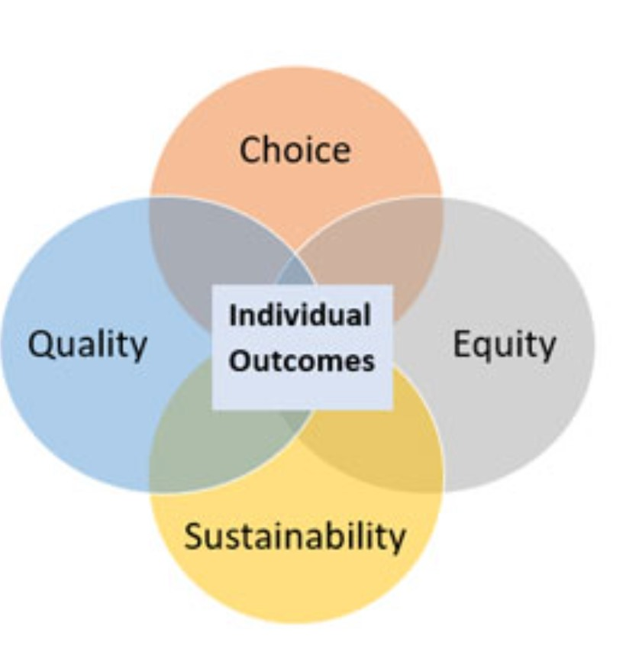
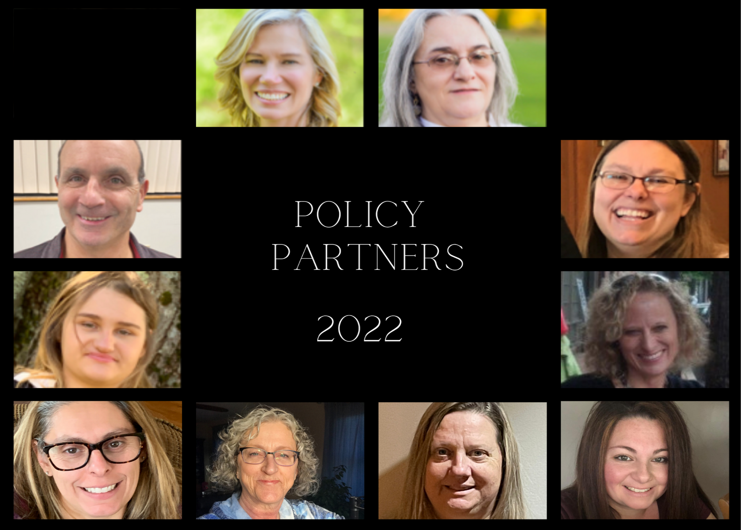
The Policy Process: “Alone we can do so little; together we can do so much”-Helen Keller
Amy Girouard, LEND FAMILY TRAINEE
NH-ME LEND, Institute on Disability, University of New Hampshire
BDS Systems Redesign:
Conclusion:
The state of NH is working with a consultant on three different areas: waivers, information technology and rates. This represents a major shift in the delivery of services for people with developmental disabilities. The current system is not equitable. It is imperative all stakeholders are at the table.
Creating sound policy involves the blending of values of stakeholders, the use of data and a collaborative exchange of ideas. The complexities of this process are evident in the process of the two adult dental benefit bills going through the NH legislature.
Seek to understand the past and present of developmental disability services. Bring your creativity and solutions to the table. Lead the way forward and advocate for an equitable system of services that honors choice and quality of life. Families closed the Laconia State School. We can pave the way for a new era of community living that focuses on providing supports and services for people to grow and flourish.
Community Crossroads’ mission is to provide people in need of long term supports, either through age or disability, with the information, guidance, support and advocacy they need to remain in their chosen homes and live full, independent lives.
https://www.dhhs.nh.gov/dcbcs/bds/systems.htm
Leadership Mentor: Jennifer Bertrand, Director of Community Partnerships at Community Crossroads
The Policy Process is a Muddy Tug of War
Activities:
Policy Partners
Participated in Policy Partners class
Conducted 1:1’s with an Executive Councilor, State Representatives and School Board Candidate
Followed bills through the Community Support Network, Inc. (CSNI) process and watched legislative hearings
Attended CSNI Legislative Liaison meetings
Wrote letter in support of Adult Dental Bill
Participated in informational workforce meeting and subsequent roundtable with Department of Health and Human Services Commissioner and community leaders
Watched sessions on the Bureau of Developmental Services systems redesign
This Photo by Unknown Author is licensed under CC BY-NC-ND
Policy Partners: Top Row (L to R)- Jennifer Bertrand, Program Director & Cathy Spinney, Mentor 2nd Row (L to R)- Mick Natoli, Mentor & Regan Burke, Mentor 3rd Row (L to R)- Samantha Baskin, Mentor & Amy Girouard, UNH LEND Trainee & Mentee Bottom Row
(L to R)- Danielle Karcz, Mentee, Gina Cox, Mentee, Debbie Conlon, Mentee & Janemarie Tolson, Mentee
Policy analysis is a complex process that requires active debate and analysis from many individuals and groups in order to create solutions to complex problems.
Adult Dental Bills HB 103, SB 422-FN
What Can You Do?
Discussions have happened around financial costs, quality of life, health and wellness of Medicaid recipients, resource allocation and equity. Stakeholder engagement has been vital to the process and outcome.
Be Informed/analyze policy
Testify and share your story
Write Letters in support or opposition to bills
Participate on advisory groups or councils
Attend hearings and ask questions of policy/lawmakers
Check bias
Be solution focused in your participation
Create a coalition of people around you
Participate in Policy Partners and become empowered!

