Slide 1


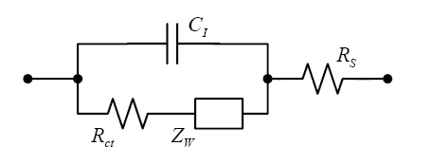
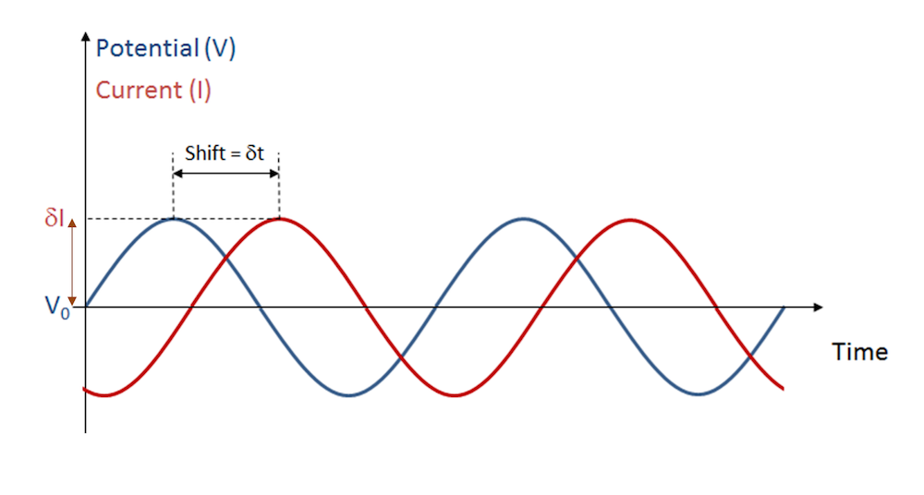
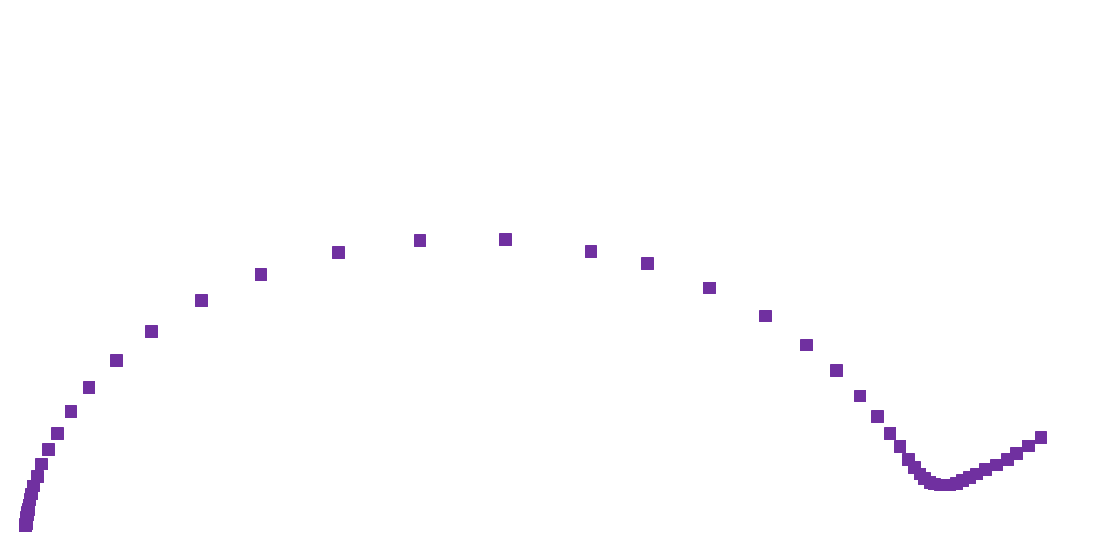
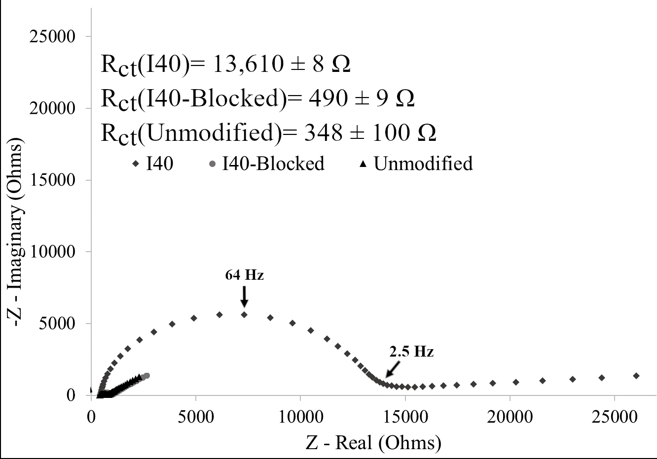
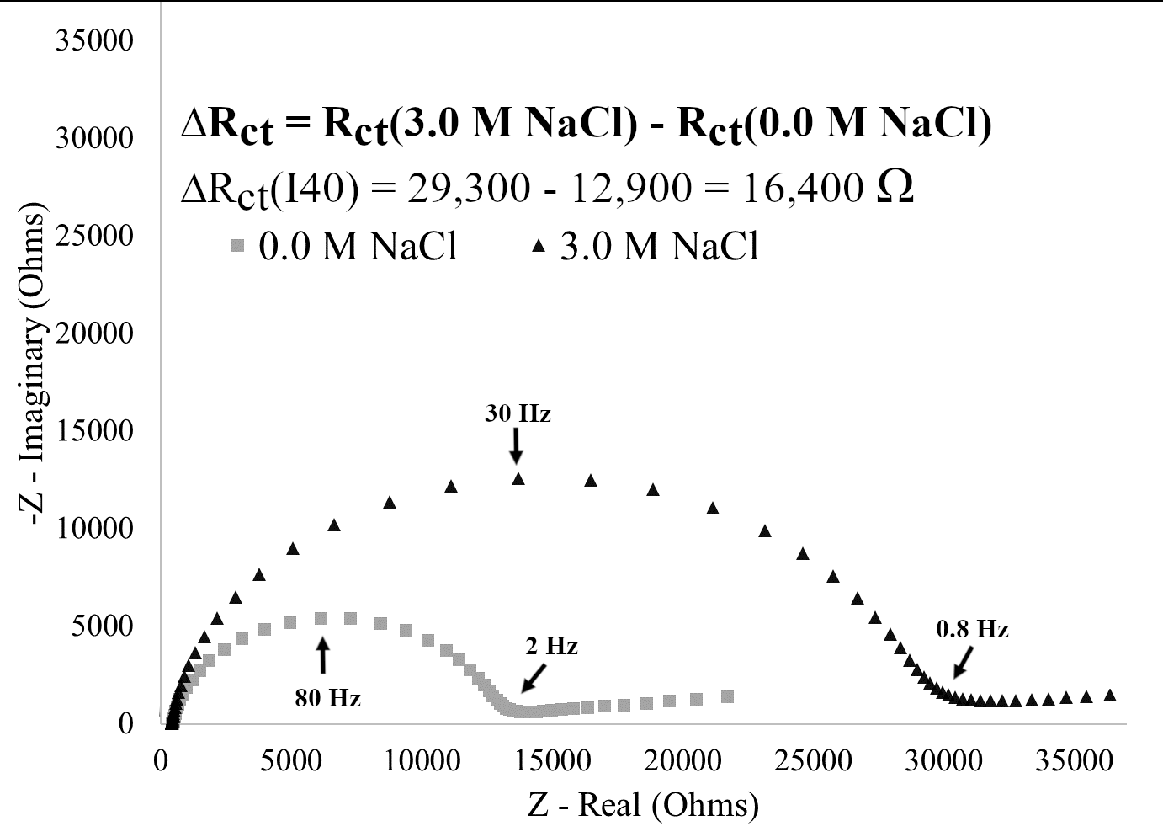
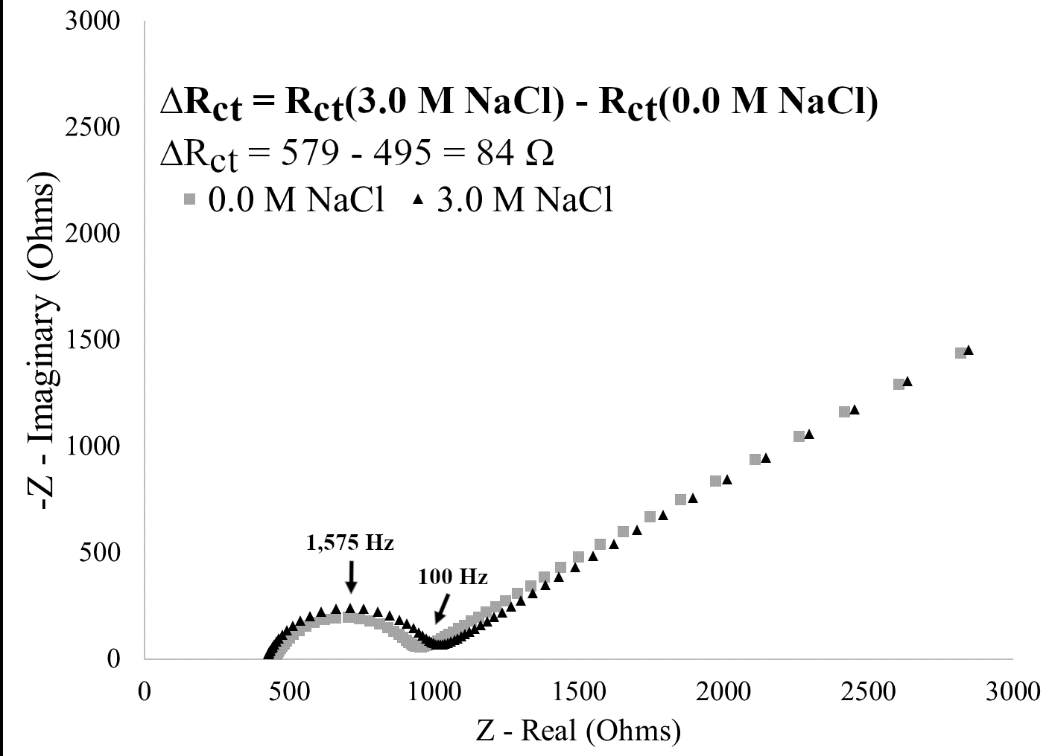
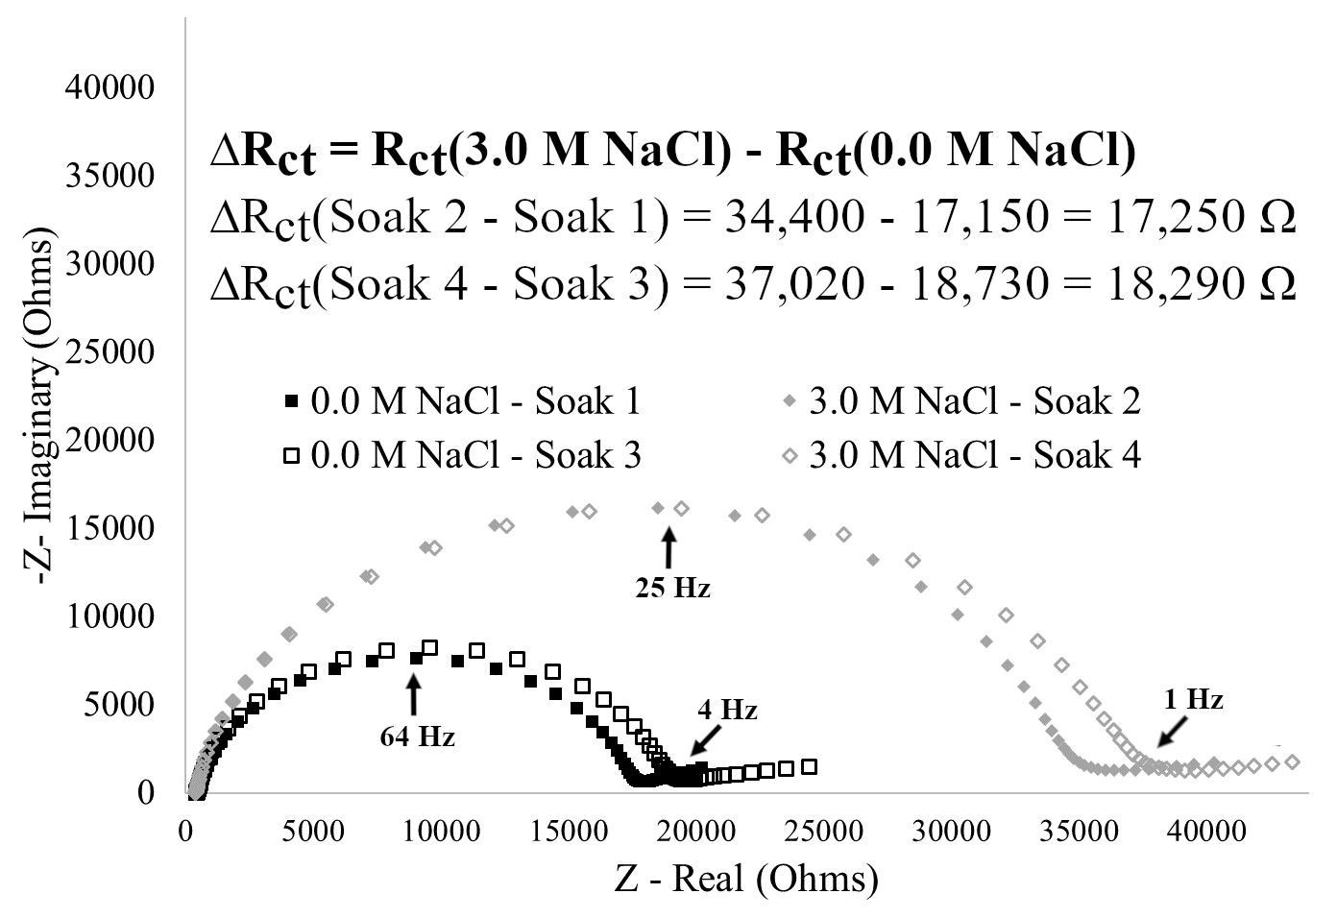
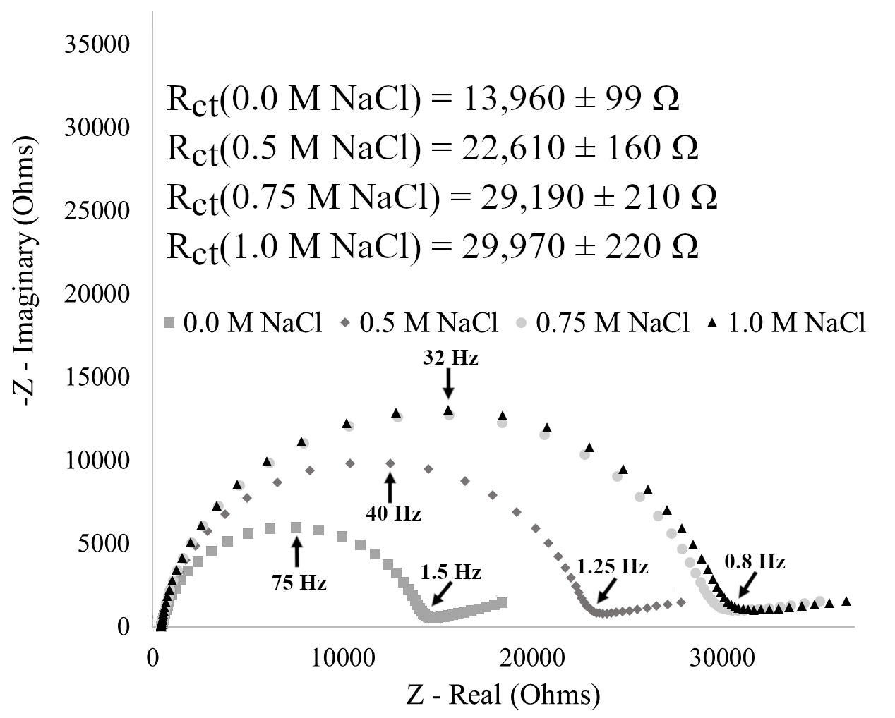
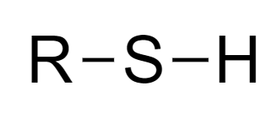
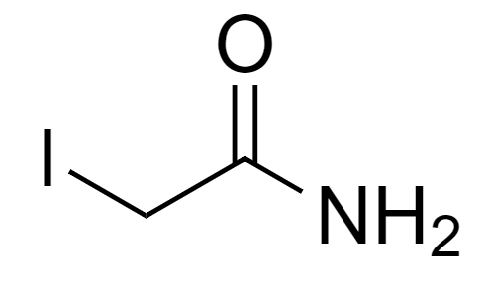
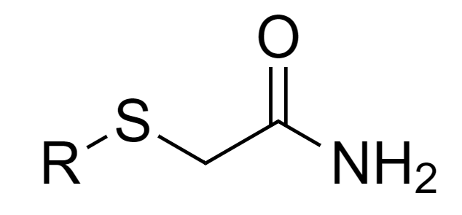
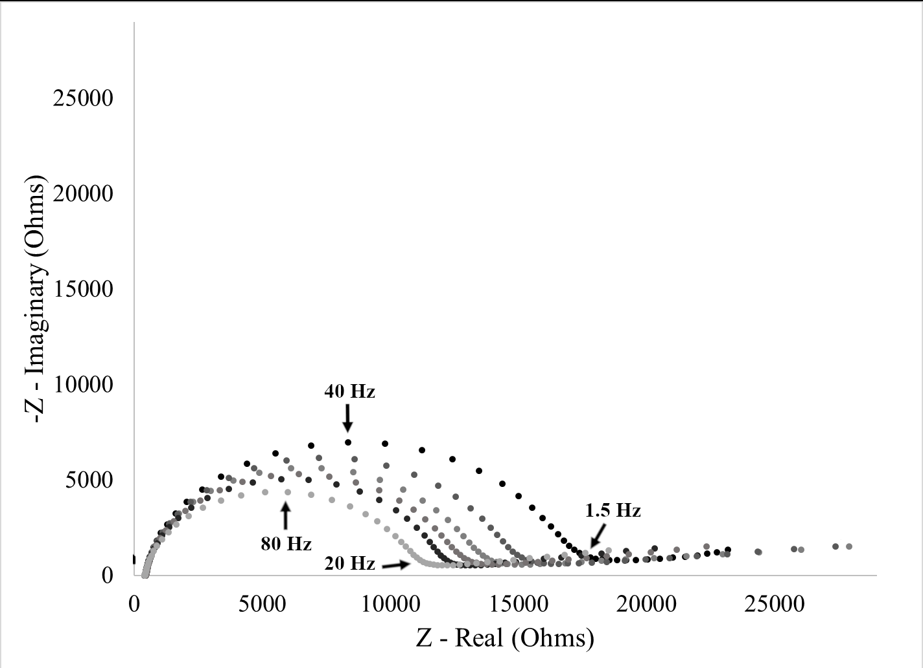
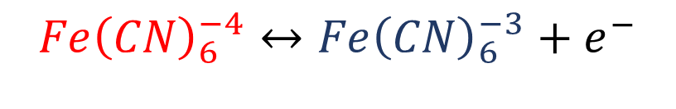
Electrochemical Characterization of the Stimuli-Response of Surface-Immobilized Elastin-like Polymers
Marissa A. Morales¹, Eva Rose M. Balog², Jeffrey M. Halpern¹
Contact: mm1452@wildcats.unh.edu or jeffery.halpern@unh.edu
¹Chemical Engineering, University of New Hampshire ²Chemistry and Physics, University of New England
ELASTIN-LIKE POLYMERS
STIMULI-RESPONSE
ELECTROCHEMICAL IMPEDANCE SPECTROSCOPY
ELPs share a repetitive pentapeptide sequence
ELPs are intrinsically disordered, adopting environment dependent conformations
Redox Couple
Ferri/Ferrocyanide
Randles Circuit
(Val-Pro-Gly-X-Gly)_{n}
Transition Temperature (T_{t}):
T < T_{t} - ELPs are solvated with decreased intermolecular interactions
T > T_{t} - Decreased solubility with increased intermolecular and intramolecular interactions
$$Fe{\left(CN\right)}_{6}^{−4}↔Fe{\left(CN\right)}_{6}^{−3}+e^{−}$$
I40
(Val-Pro-Gly-Ile-Gly)₄₀
Alternating Voltage Potential
Nyquist
X = Isoleucine (I)
n = 40 pentapeptide repeats
T > T_{t}
Extended
Collapsed
T < T_{t}
R_{ct}(Extended) < R_{ct}(Collapsed)
-Z – Imaginary (Ohms)
T_{t} influenced by ELPs structure or solvent conditions
  Decreases T_{t} – ELPs experience isothermal stimuli-response
R_{ct}
Z – Real (Ohms)
SURFACE-IMMOBILIZATION
STIMULI-RESPONSE
Surface-immobilization of I40 was dependent on the thiol interaction with gold and reproducible
Electrochemical impedance spectroscopy was used to characterize the stimuli-response of surface-immobilized I40 demonstrating reversibility and intermediate stimuli-responses
0.0125 mg/mL I40
3.5 mM TCEP pH 7
T = 4˚C
t = 0.5 hours
Extended
Collapsed
0.0 M NaCl
3.0 M NaCl
ΔR_{ct} = R_{ct}(3.0 M NaCl) – R_{ct}(0.0 M NaCl)
ΔR_{ct}(I40) = 16,400 Ω
ΔR_{ct}(I40-Blocked) = 84 Ω
I40-Blocked: Contains cysteine residue modified using iodoacetamide
Iodoacetamide
ACKNOWLEDGEMENTS
3.0 M NaCl
0.5 M NaCl
0.75 M NaCl
The authors would like to acknowledge the University of New Hampshire Graduate School, Pilot Research Project of the Collaborative Research Excellence Initiative at University of New Hampshire, NSF EAGER CBET 1638896 (JMH), NSF EAGER CBET 1638893 (ERMB), and NSF MRI 1531296 for the funding of this work.
1.0 M NaCl
Extended
0.0 M NaCl
Collapsed
Extended
Collapsed
Notes:
Template File: 1901_CIBBR Retreat_MAM

