Slide 1
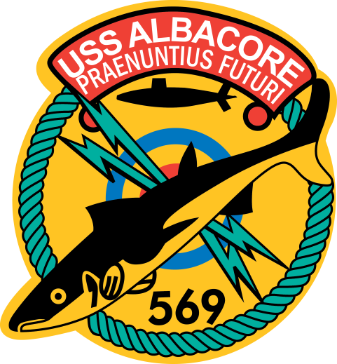
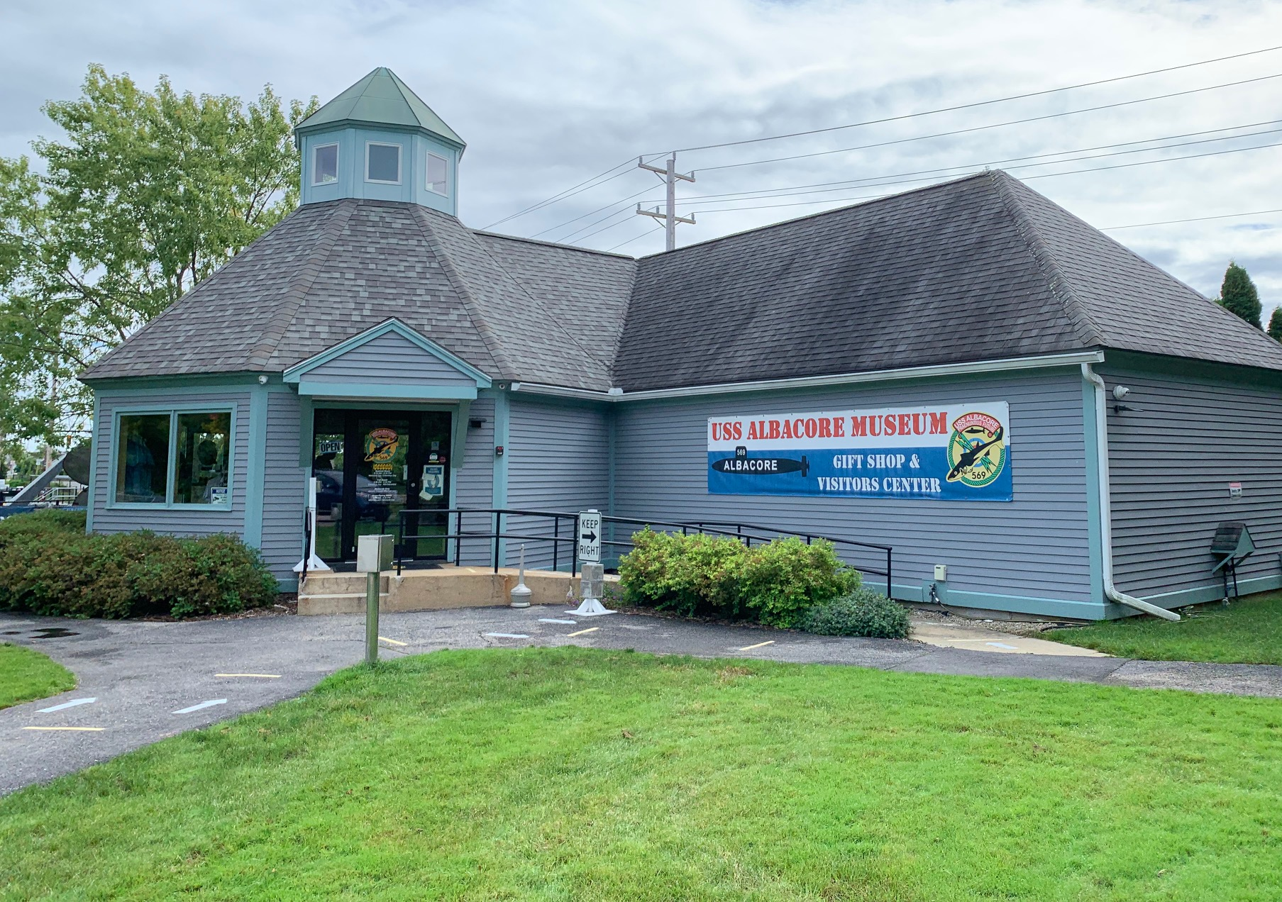
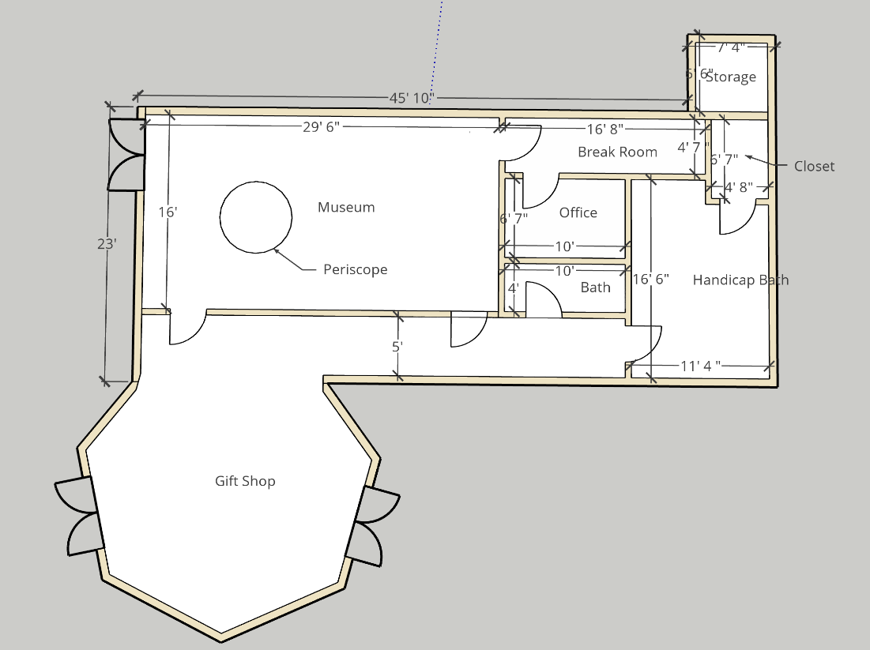
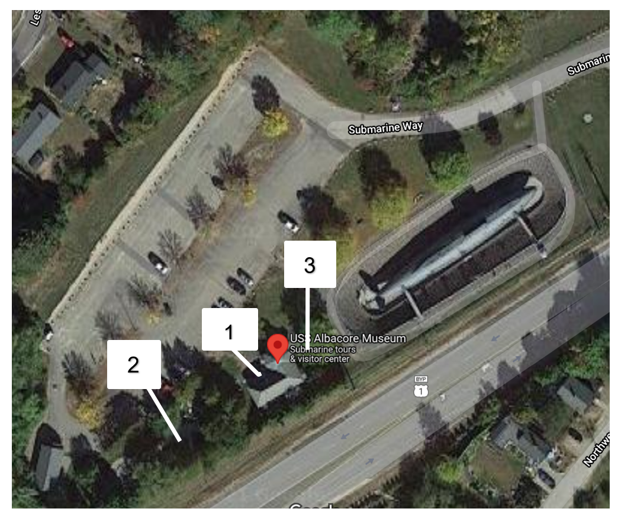
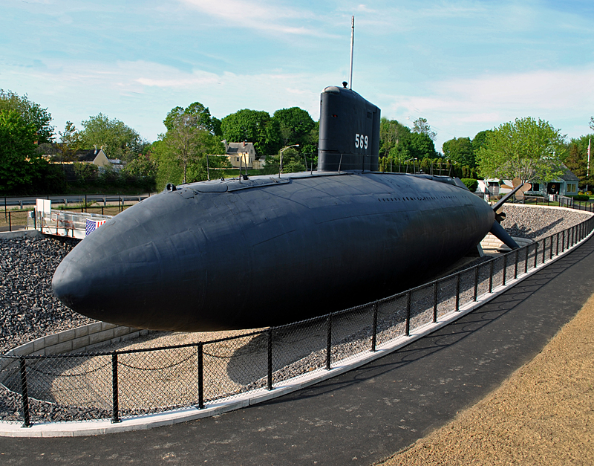
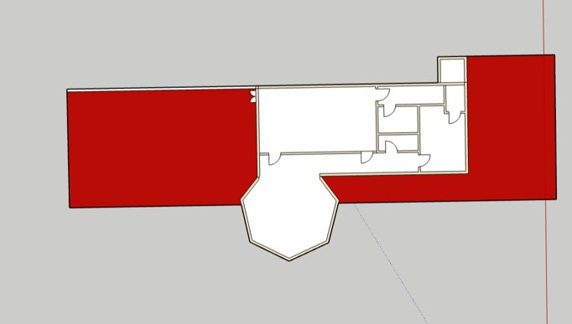
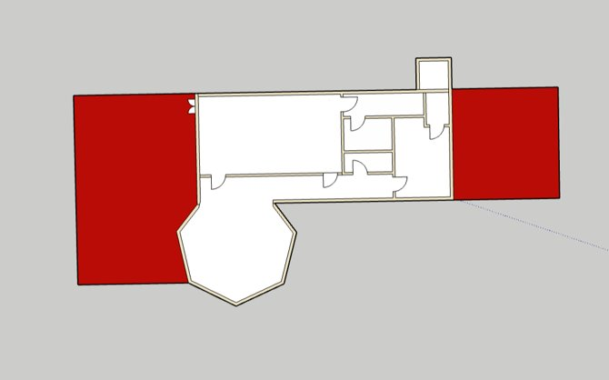
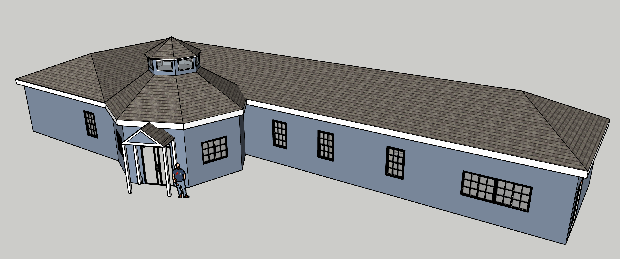
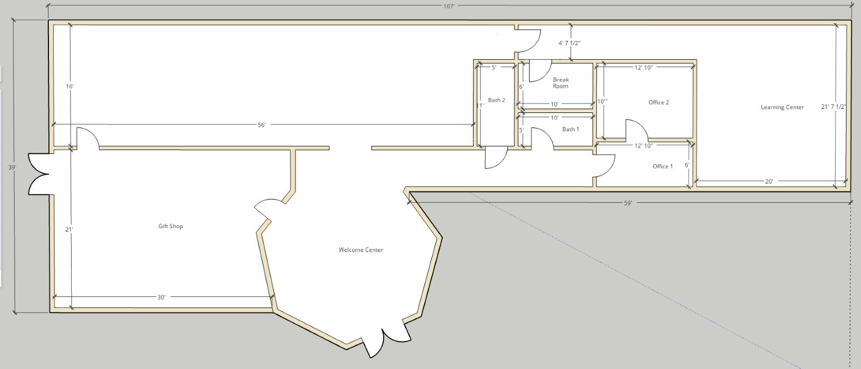
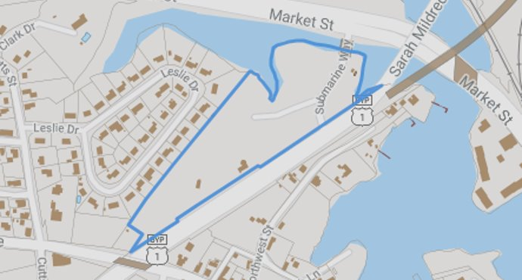
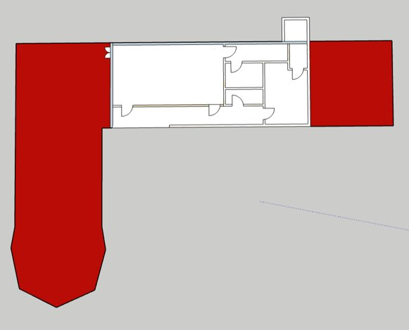
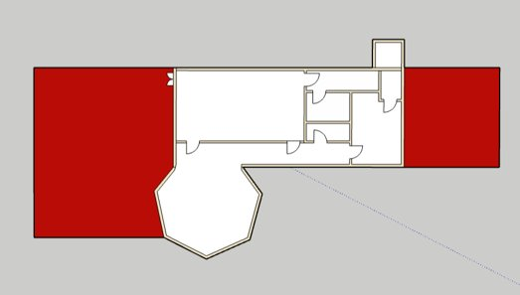
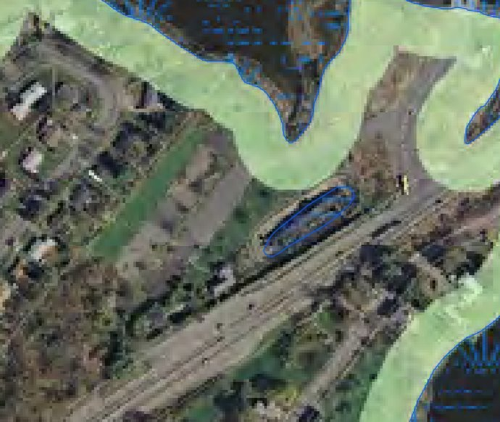
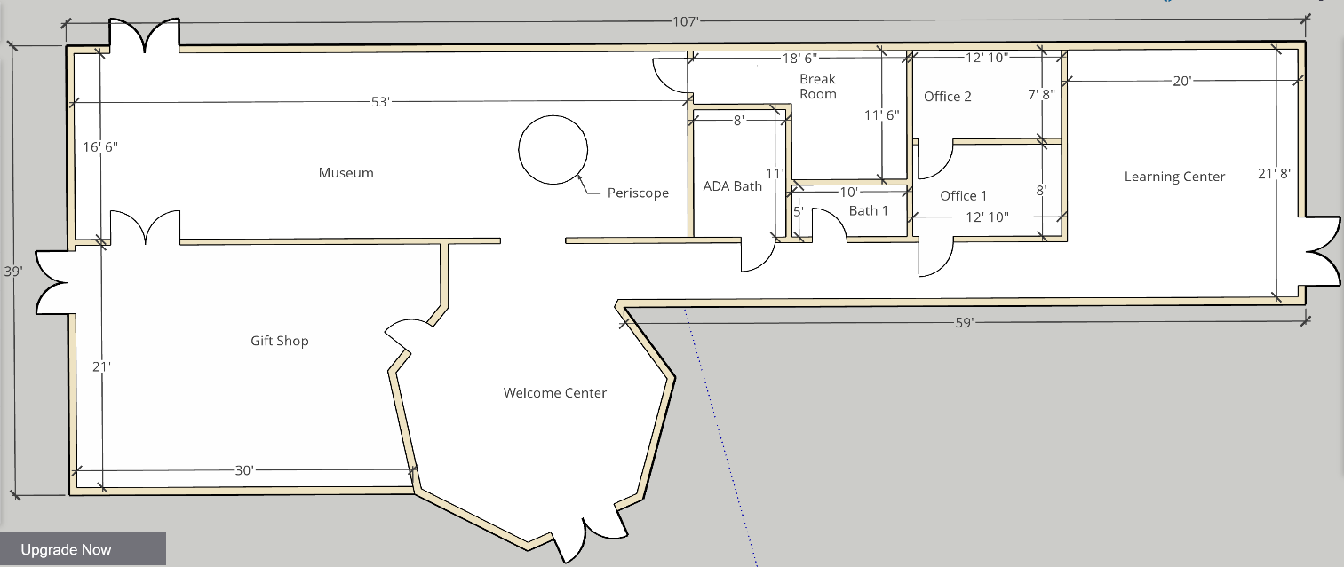
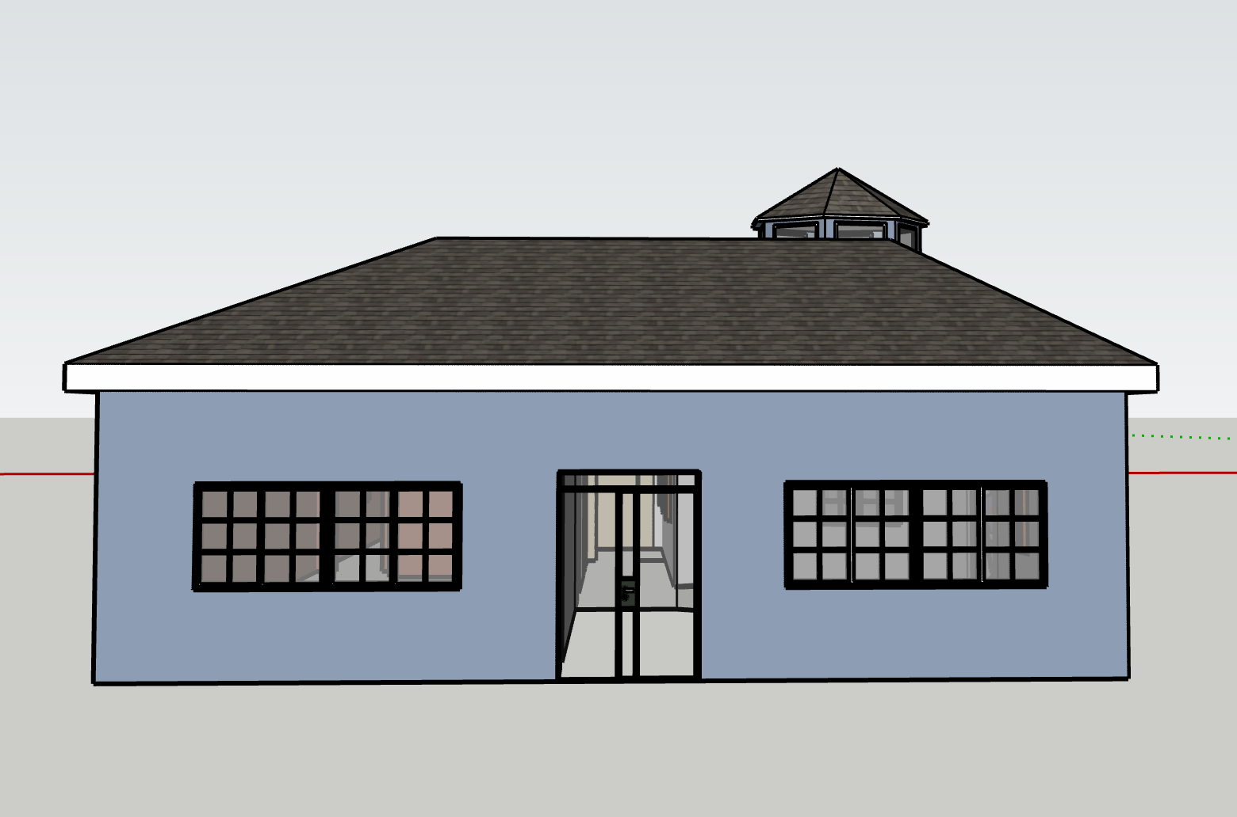
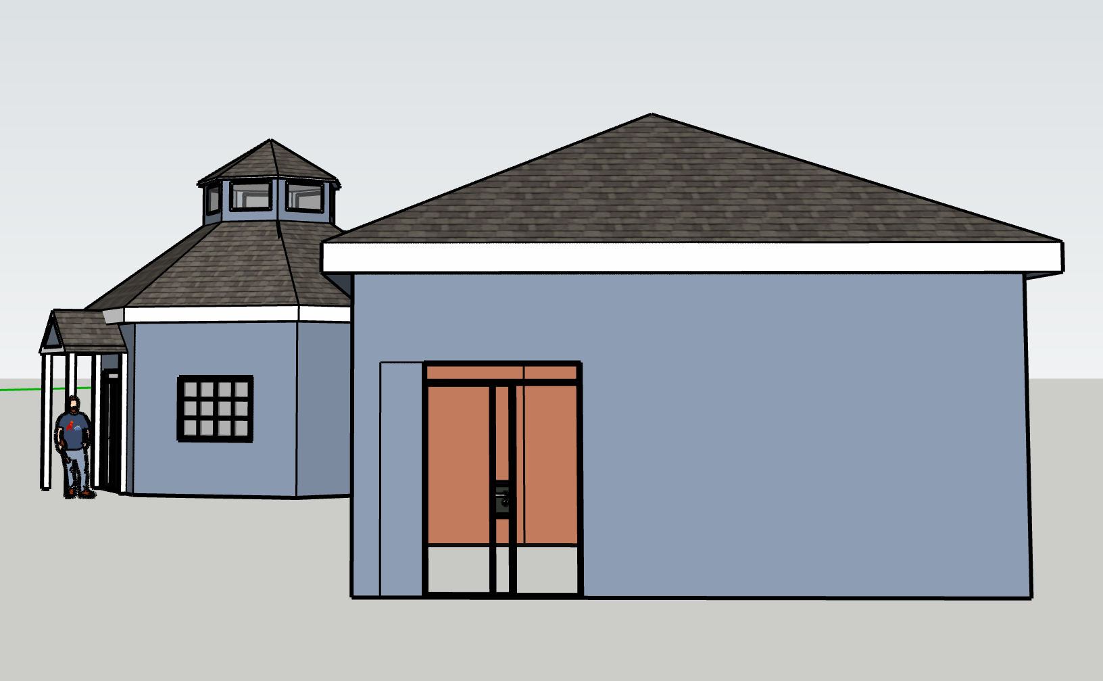
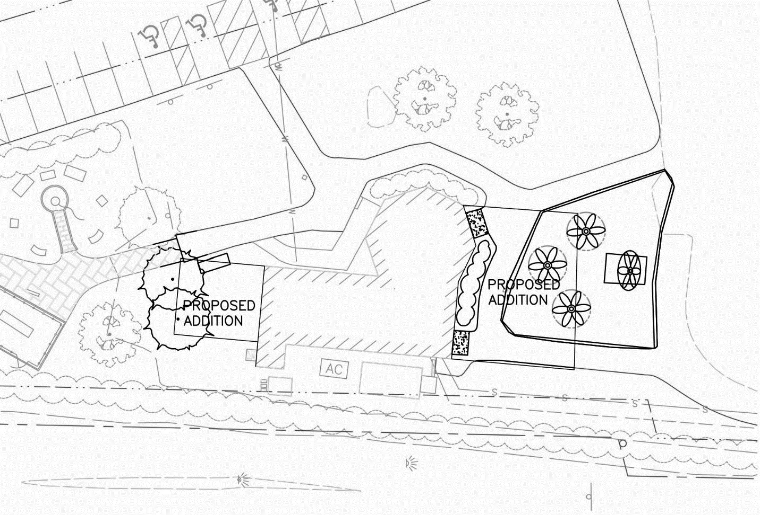
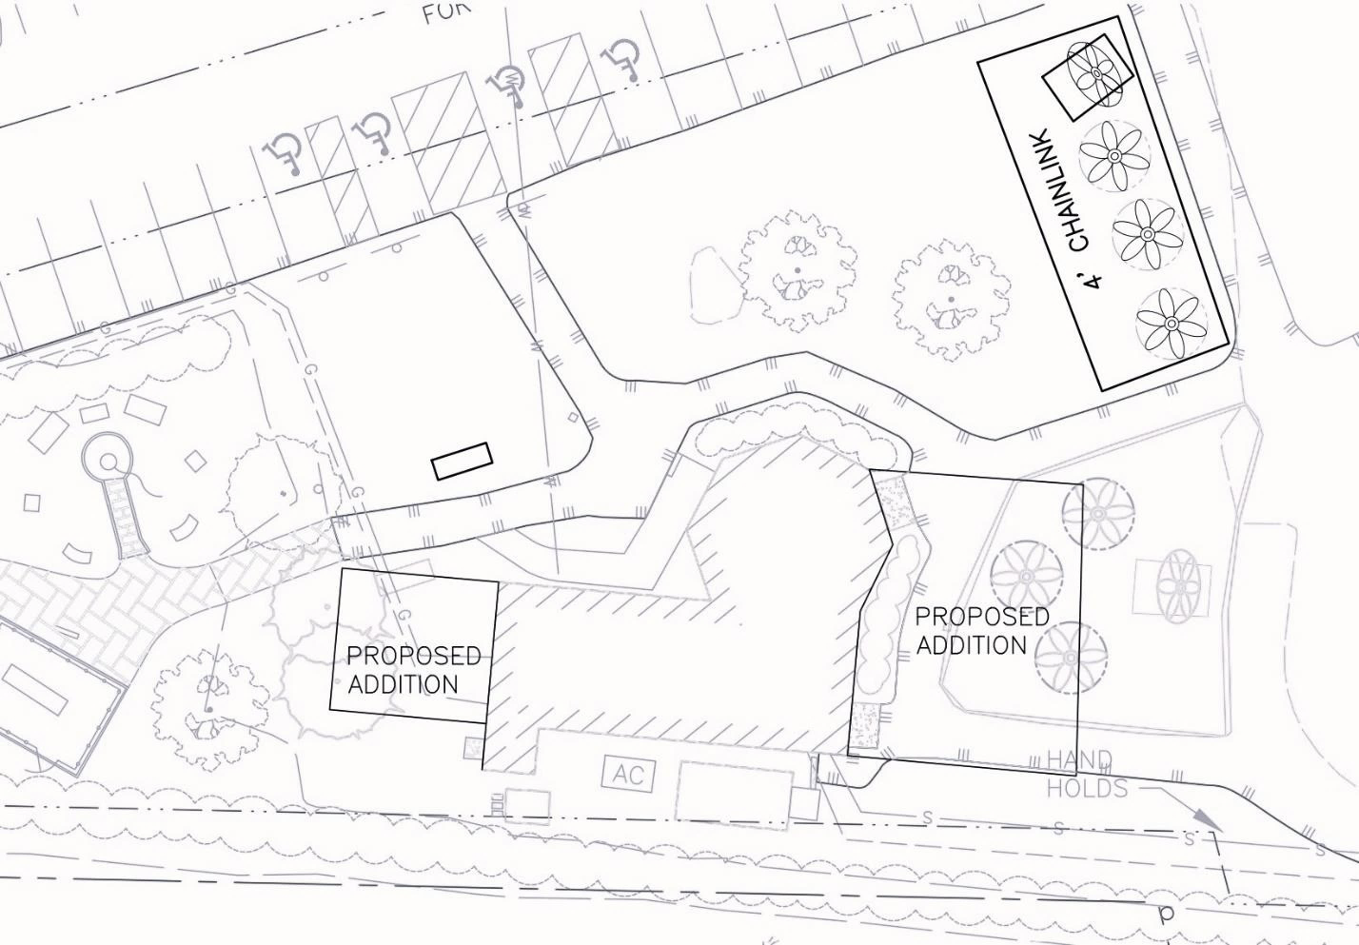
The USS Albacore Park Expansion Catherine Rieger, Gregory Chase, Rebecca Dean, Jeffrey Edwards, Patrick Potter Civil and Environmental Engineering, University of New Hampshire, Durham, NH 03824
Introduction
Existing Conditions
Scope of Work
USS Albacore Park:
Museum founded in 1985, consists of memorial garden, visitor center, and propellor field
Albacore submarine on display for its famous use of testing technology during WWII
Managed by Portsmouth Submarine Memorial Association
Location:
Off Route 1 By-pass in Portsmouth, NH
8.55 acre lot
Purpose:
Outgrowing current footprint
Expand existing building in order to increase visitation and public knowledge
Visitor Center Building
Existing Floor Plan
Expand the current footprint by double the space
Primary Goals:
More exhibit space
Addition of a learning center
Secondary Goals:
Increase gift shop space
ADA accessible
Direct foot traffic from submarine into gift shop post-tour
Additional Tasks Included:
Site visits and site measurements
Prepare as-built plans
Propose a demo, site, and floor plan of proposed design
Provide a cost estimate of proposed design
1
Visitor Center
Memorial Garden
Propellor Field
2
3
Final Visitor Center Expansion
Proposed Concept Layouts
3D Rendering
Initial Approach:
Met spatial requirements requested by client
Preserved existing structure layout
Current layout provides optimal view of the submarine
Directed traffic through giftshop to enhance customer sales
Improvements:
Optimized traffic flow throughout building
Increased ADA Bathroom size to meet code
Eliminated unnecessary hallway
Installed Emergency Exit located in learning center
Incorporated loading Dock
Preliminary Floor Plan
Site Constraints
Existing building located
very close to Route 1
Zoned as Residential
State Land Use Designation
Restricted based on
current layout of lot use
Submarine Location
Parking lot/existing structures
Recent drainage work not to be altered
Wetland zone restrictions
Concept 1
Potential for unique viewing experience
New roof structure
Concept 2
Roof structure stays the same
Will need roof cricket for runoff
Building Elevations
Final Floor Plan
Parking Lot Elevation
Route 1 By-pass Elevation
Concept 3
Preserves distinct lighthouse look
Additional cost to move structure
Concept 4
Takes advantage of available space on site
Will need roof cricket for runoff
Cost Estimate
Front Elevation
Back Elevation
Acknowledgments
The Albacore Museum gave us a budget of $800,000
Cost estimate came out to $723,300.00
Proposed Demolition and Site Plan
Patricia Violette, Executive Director/Curator (Project Sponsor)
Kenneth Flesher, PE Civil Engineer (Project Faculty Advisor)
Portsmouth Submarine Memorial Association Board
Division: | Cost:
Architectural: | $98,585.00
Accessories/Furniture: | $37,200.00
Piping: | $2,702.00
Mechanical: | $41,100.00
Electrical: | $47,850.00
Controls: | $20,650.00
Site Work: | $46,100.00
Rigging: | $15,000.00
Landscaping: | $1,800.00
Rigging: | $15,000.00
Fencing: | $9,400.00
Siding/Roof: | $45,700.00
Building, Framing, Roofing | $212,500.00
Contingencies (10%) | $57,858.70
GC, Insurance, Fee (15%) | $86,788.05
Total: | $723,300.00
Demolition Plan
Site Plan
Proposed New Location of Propeller Field
Escape Pod – To Be Moved
Propeller Field –
To Be Moved
Proposed New Location of
Escape Pod Artifacts
References
John Chagnon, Ambit Engineering
City of Portsmouth Building Codes
Shanti Wolph, Chief Building Inspector of Portsmouth
Felix DeVito, Registered Architect
Chip Dean, Axis Construction Corp.
Albacore Presentation and Report by Ryan Murphy, Emily Frazzoni, and Aaron Wolfson-Slepian, 2016-2017
Proposed changes to the existing site
Proposed site after construction

