Slide 1

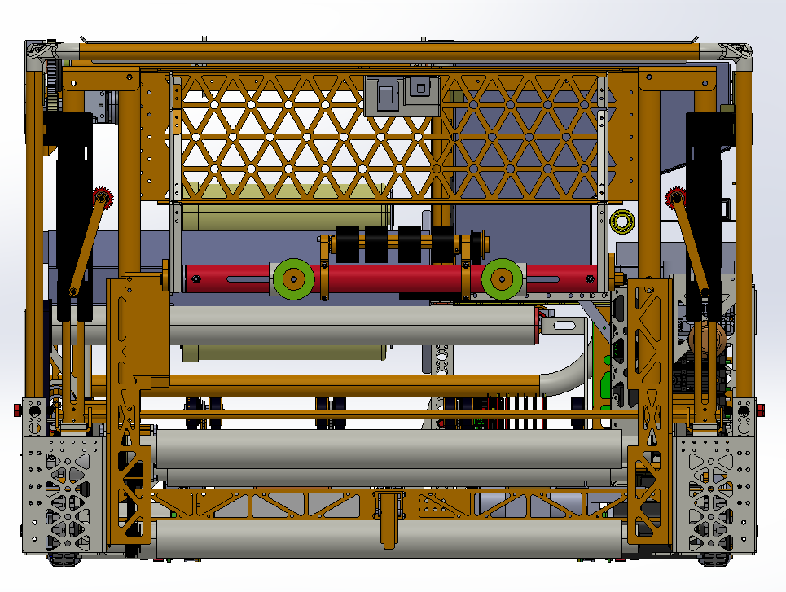
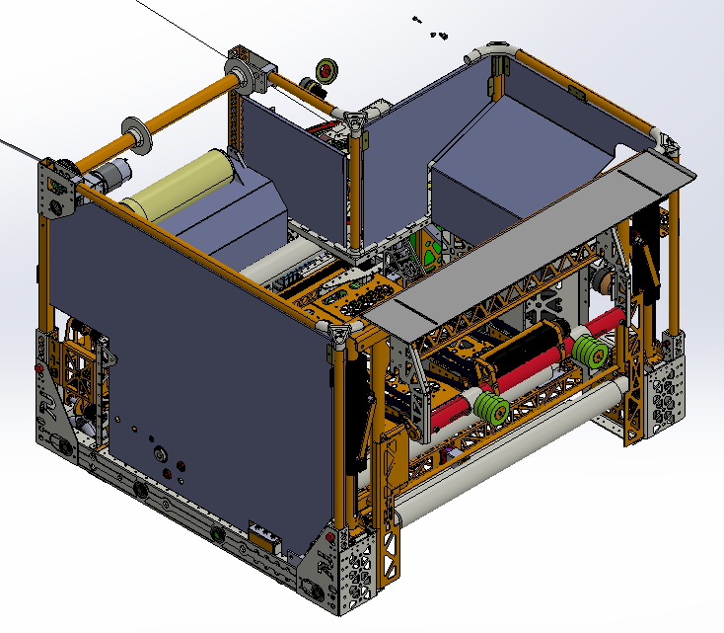
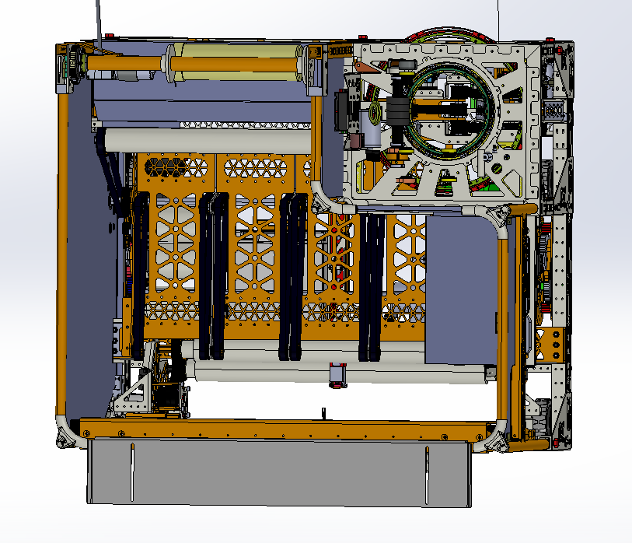
Manufacturing Center Scrapbot
Kelsey Purnomo, Kathleen Hanson
Innovation Scholars (Advanced Manufacturing), University of New Hampshire
Problem Statement
Design Choices
CAD Design
Many hazards can occur in the manufacturing work environment, the most serious of which is scrap metal that cannot be seen with the naked eye. Workplace injuries are widespread in factories, particularly among employees in their first year of employment. Minor mishaps can result in major damage. This Scrapbot will assist in removing part of the danger and lowering the rate of accidents.
Bumpers are located on the front of the robot to prevent collisions (green circles)
Rollers are located at the front of the robot to pick up scrap metal.
      The needle-sized bristles that are meant to pick up the scrap are not visible.
Scraps are gathered inside the robot
      The big opening on the top gives access for the user to pick up the scraps easily
Not shown in design A bin and trash bag will be placed inside to collect the scrap metal
Removable interactive parts to make the Scrapbot look like Wall*E (Entertaining and innovative way to clean up scrap)
Built to be approximately 14" x 14" x 13”
What it Does
Autonomously follows a predetermined path
Improves the workplace's safety.
The design provides an enjoyable experience
It collects fragments ranging in size from needle size to 4 inches.
Works better on hard floor surfaces
Who Its for
Future
      Aimed at adults in a manufacturing context, but it will be appropriate for people of all ages to purchase in most settings
      The robot's appearance will promote customer interest in acquiring and using it.
Complete the development of a functioning model.
Design robot bin
Prototyping the code

