Slide 1


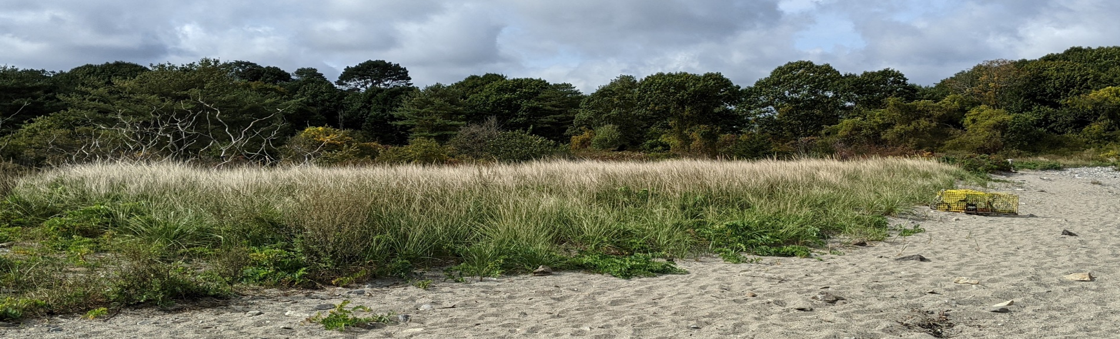
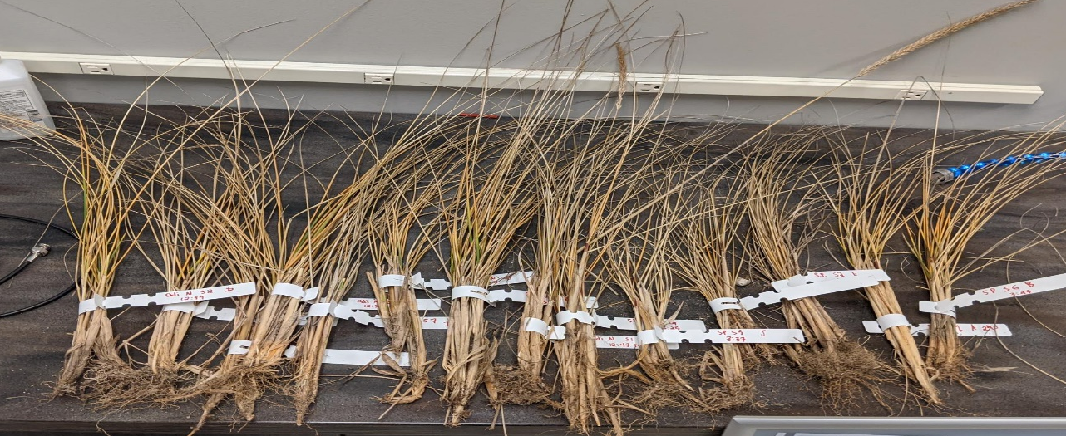
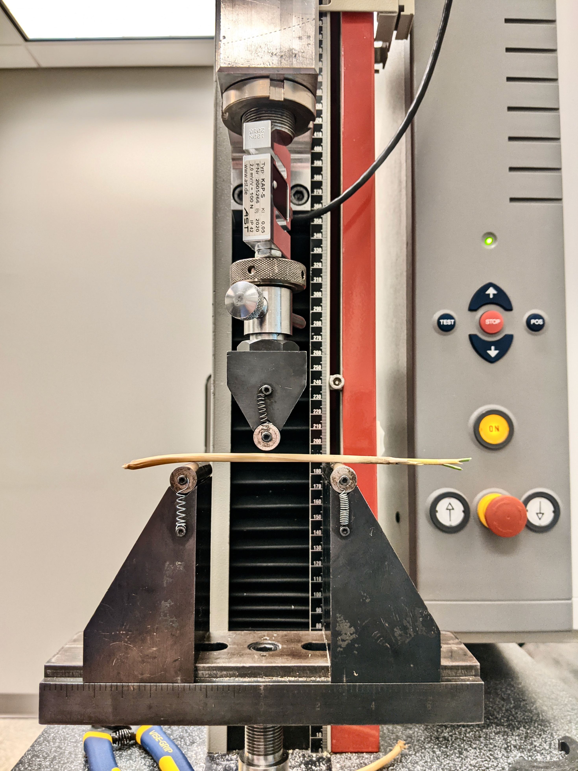
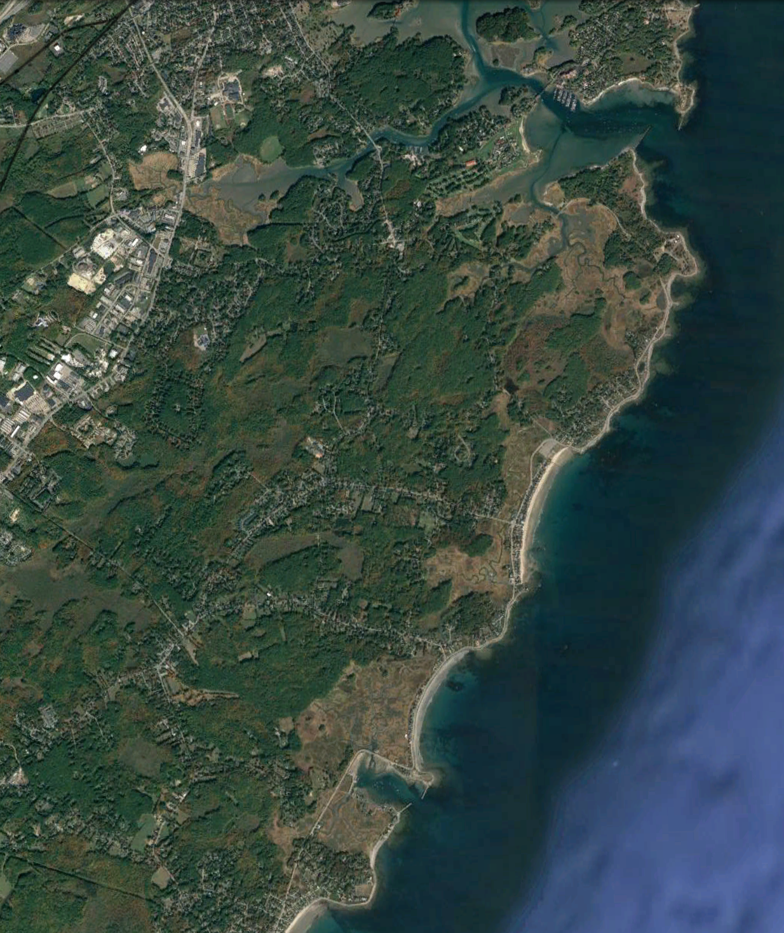

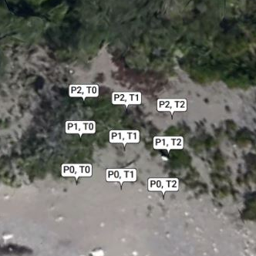
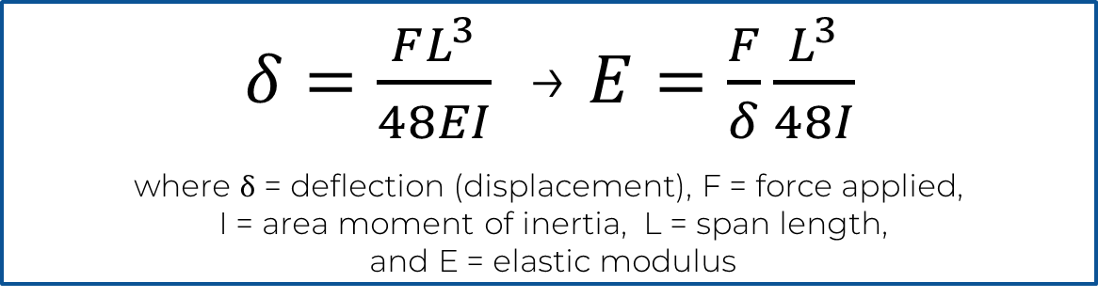

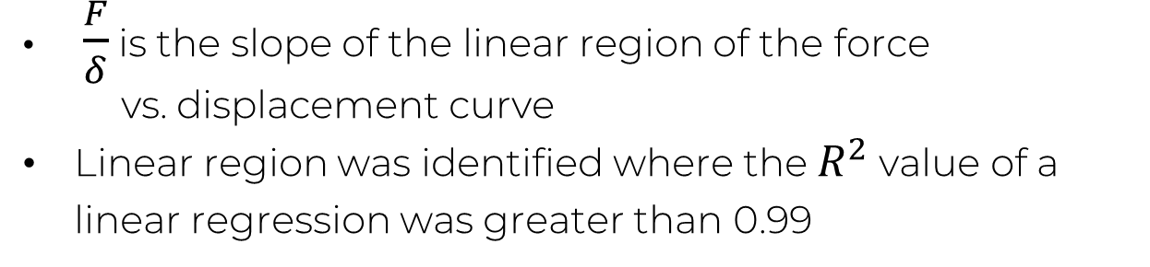
Seasonal Variation in the Biomechanical Properties of American Beachgrass
Jenna Ehnot & Dr. Tracy Mandel, Center for Ocean Engineering, University of New Hampshire
Introduction
Methodology
Results
American beachgrass, Ammophila breviligulata, is one of the most common dune grass species native to the East coast. Known for its densely growing stems and intricate root systems, the beachgrass is integral to dune stabilization and wave energy dissipation. As a perennial plant, it undergoes seasonal senescence and regrowth.
Hydrodynamic analysis can be done to understand how flows such as dune overwash move through and are modified by vegetation. A key component to modeling flow through coastal vegetation is the elastic modulus of the plant stem. To fully understand how this coastal grass can protect from flooding, waves and erosion, we must ask:
Sampling:
Sampling occurred on a bi-monthly basis, with one vegetative sample containing 3-6 stem specimens being taken per grid section at each site
Recorded specimen overall length, stem length, and stem diameter
Data collection:
Bend tests performed at UNH Olson Center using a Zwick-Roell tension/compression machine
Tests performed within 10 hours of sampling to prevent wilt
Specimen approximations:
  Isotropic
  Solid
  Round
Preliminary results show that the elastic modulus decreases from summer to winter across all sites
Elastic Modulus of Sites by
Sample Month
Analysis:
The equation for the elastic modulus can be found from the equation for beam deflection:
Elastic Modulus E (MPa)
Determination of the Elastic Modulus:
Three-Point Bend Test
$δ=\frac{FL^{3}}{48EI}$ → $E=\frac{F}{δ}\frac{L^{3}}{48I}$
where ẟ = deflection (displacement), F = force applied,
I = area moment of inertia, L = span length,
and E = elastic modulus
Common method to determine the modulus of elasticity experimentally
Specimen can be evaluated as a transversely loaded cantilever beam
How does A. breviligulata’s elastic modulus vary on a seasonal time scale?
$\frac{F}{δ}$ is the slope of the linear region of the force
vs. displacement curve
Linear region was identified where the $R^{2}$ value of a linear regression was greater than 0.99
Sample Month
Sampling limited by weather events and functionality of Zwick-Roell machine
Load cell
Conclusion
Sample Sites
Determination of Elastic Region from the Force-Displacement Curve
The elastic modulus of beachgrass in NH may vary by up to a factor of 2 throughout the year, indicating that plant flexibility changes significantly with the seasons. This project will continue into the summer to complete sampling for a full seasonal cycle. The sampling and data analysis procedure developed can be followed to repeat the study over several years.
Sediment overwash had been observed at Straw’s Point and Odiorne Point State Park
Grids were established at 4 sites and the location of grid points was taken using a Trimble RTK GPS
Upper die
Portsmouth, NH
Odiorne Point
State Park
Specimen stem
Force (N)
$R^{2}$= 0.9928
Odiorne Site 1:
Slope = 1.59
Rye, NH
∴ E = 940 MPa
The authors gratefully acknowledge funding from New Hampshire Sea Grant. We are thankful for the collaboration and support of Dr. Diane Foster, Dr. David Burdick, Dr. Todd Gross, Grant McKown, Melissa Marry, Spencer Marquardt, the NH Division of Parks and Recreation, and our colleagues at the Olson Center for Advanced Manufacturing at UNH on this project.
Upper die applies force to specimen until breakage. Force applied is recorded as a function of upper die displacement
Upper Die Displacement (mm)
Straws Point
Average of elastic modulus found for each section and site
.

