Slide 1


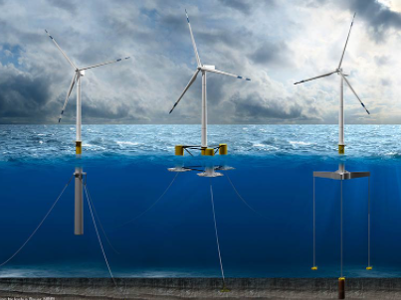
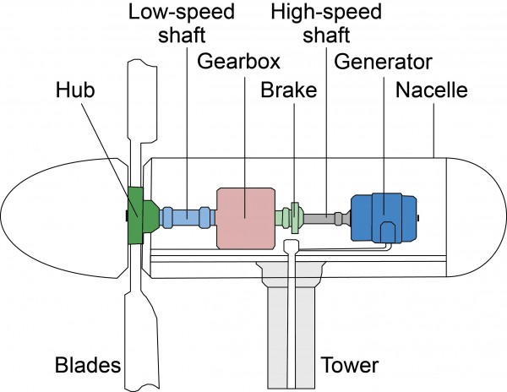
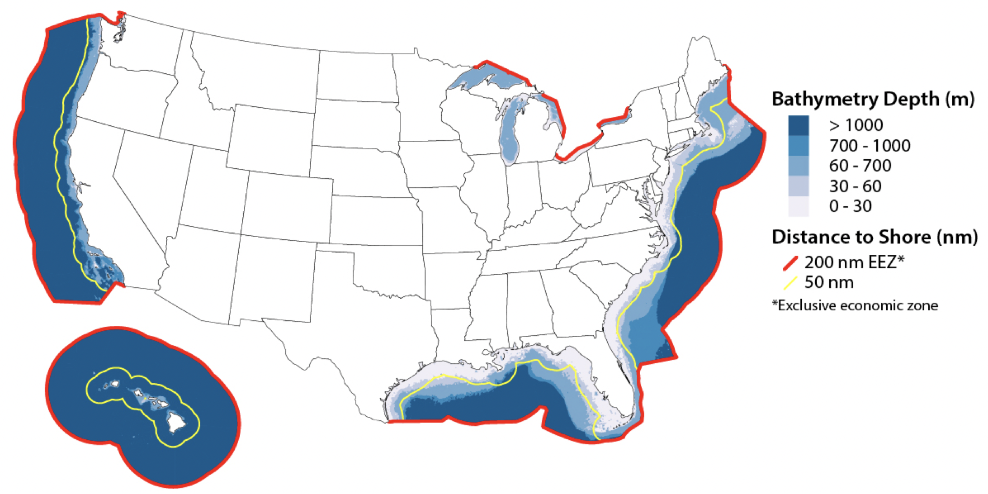
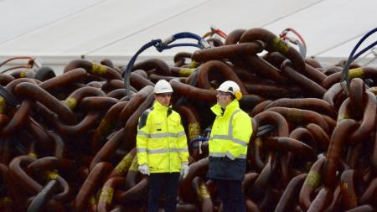
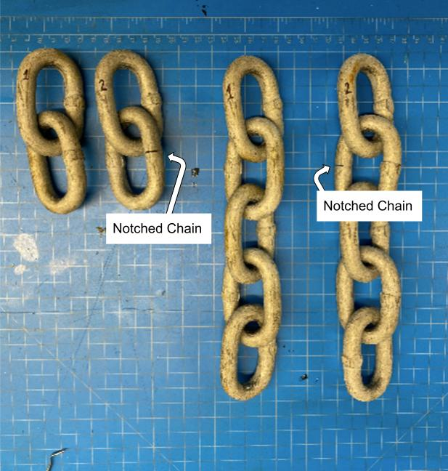
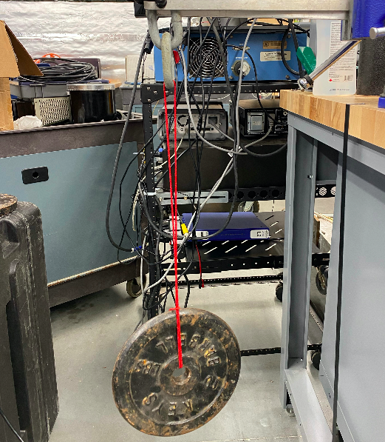
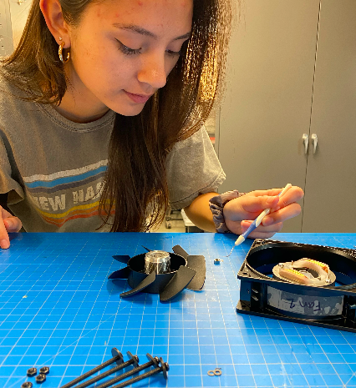
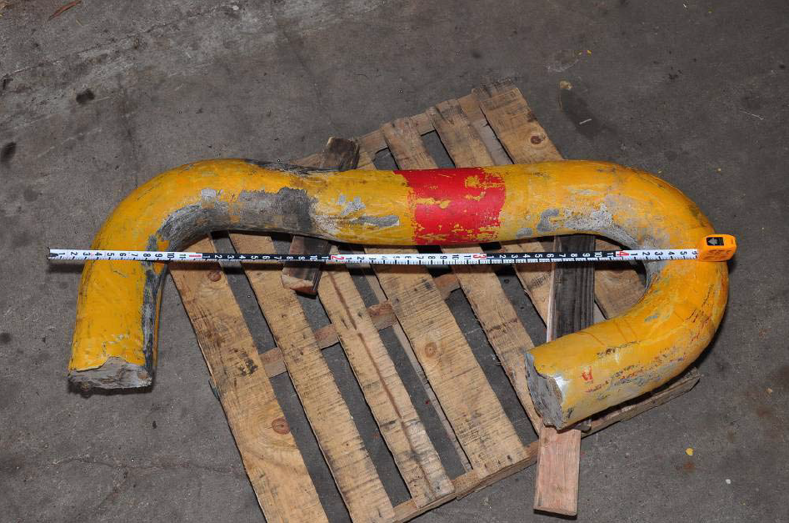
Acoustic Monitoring of Floating Offshore Wind Turbines
Elizabeth Hauschild and Rose Walker
Advisors: Martin Wosnik, Tom Weber, and Jerica Nolte (Attentive Energy)
Department of Ocean Engineering, University of New Hampshire, Durham, NH 03824
Introduction
Motivation for Floating Offshore Wind
Turbines can only be fixed to the seafloor in water depths of 0-60 meters. 80% of offshore wind resources are in waters greater than 60 meters [1,2].
Problem Statement
One of the many challenges of floating offshore wind farms is determining when to conduct cost and time sensitive maintenance and inspections.
With the help of industry partner, Attentive Energy, tests were performed to investigate the feasibility of using acoustics for structural health monitoring of mooring chains and for turbine generators of floating wind turbines (FWTs).
Acoustic Emission Technology
Acoustic emission (AE) monitoring is a passive structural health monitoring (SHM) technique that uses the analysis of sound intensity and frequency to identify failure in a structure [3,4].
Spar
Semi-Submersible
Tension Leg Platform
Center for Sustainable Systems, University of Michigan
Walt Musial, NREL
Josh Bauer, NREL
Eva Sleire, Equinor
Methods
Results
Conclusions
Experimental Setup
A series of tests were performed in air and recorded using a Blue Yeti Stereo Microphone, sampling at 22,050 Hz and 48,000 Hz. The time series were transformed to the frequency domain, processed, and analyzed using MATLAB.
Mooring Chain Experiments
A small length of steel chain was used to represent a FWT mooring chain. It was fixed in a vice grip, loaded with weight to induce tension, and acoustically excited by swinging. The chain emissions for the following conditions were recorded:
Varying chain length (two links, five links, ten links)
Varying chain load (2.27 kg, 4.53 kg, 15.88 kg)
Introducing a notch cut (defect) into the chain
Acoustic Emissions Comparison of Broken and Unbroken Mooring Chain
Mooring Chain Experiments
Chain length and the load impact the amplitude of acoustic emissions
Introducing a defect into the chain results in changes to the frequency spectra
Wind Turbine Generator Experiments
The healthy fan used emits a predictable spikes in frequency at 120 Hz​ and subsequent harmonics
Damaging the ball bearings of a fan impacts the amplitude of acoustic emissions
Uneven loading results in observable changes of amplitude and shifts in the frequency plot
Peaks in frequency at 65 Hz, 98 Hz, and 118 Hz for 2-link and 5-link unbroken chains
Spike in frequency for 2-link broken chain but not for 5-link broken chain
Acoustic Emissions Comparison of Fan Ball Bearing Performance
Acoustic Emissions Comparison of Fan with Uneven Loading
Next Steps
Scale the test chain link and test for alternative chain breaking cases by varying location and severity of the defect
Perform underwater AE tests for the mooring chain and in situ AE tests for the generator
Healthy two and five link chain (left) next to notched two and five link chain.
Weighted chain experimental setup in the acoustics lab.
Group member, Rose Walker, removing and inspecting fan bearings.
Cesar Del Vecchio , Stress Engineering Services Inc.
Wind Turbine Generator Experiments
A fan was used to represent a turbine generator. The fan emissions for the following conditions were recorded:
Healthy fan
Uneven loading on one fan blade
Damaged ball bearings using salt
References
Magnitude of spikes changing with tampering
New spike occurred at 48.5 Hz with loading
Shift in frequency spike
1. Musial, W. (2020). Overview of Floating Offshore Wind. Offshore Wind Research Platform Lead National Renewable Energy Laboratory.
2. Abbelurg et al. (2014). Project: Acoustic Monitoring of Floating Offshore Wind.
3. Tonelli, D. et al. (2020). Structural Health Monitoring Based on Acoustic Emissions: Validation on a Prestressed Concrete Bridge Tested to Failure.
4. Mba, D. and Rao, B. K. N. (2005). Development of Acoustic Emission Technology for Condition Monitoring and Diagnosis of Rotating Machines. The Shock and Vibration Digest.
Notes:
In situ testing, underwater testing, frequency analysis of a generator to get a frequency spectrum
Notes from 7 april:
Include a photo of a floating turbine, nacelle, human scale photo
Trying to simulate the mechanical and electromechanical processes in the lab environment that occur on floating wind turbines
Annotate turbine photo in motivations
No full sentences
Quick summaries
Annotate images
Add axes to all plots

