Slide 1

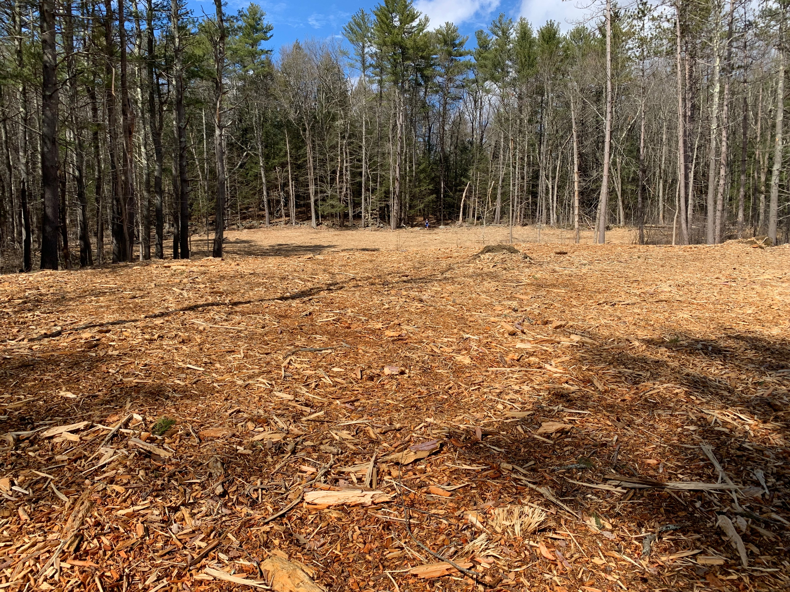
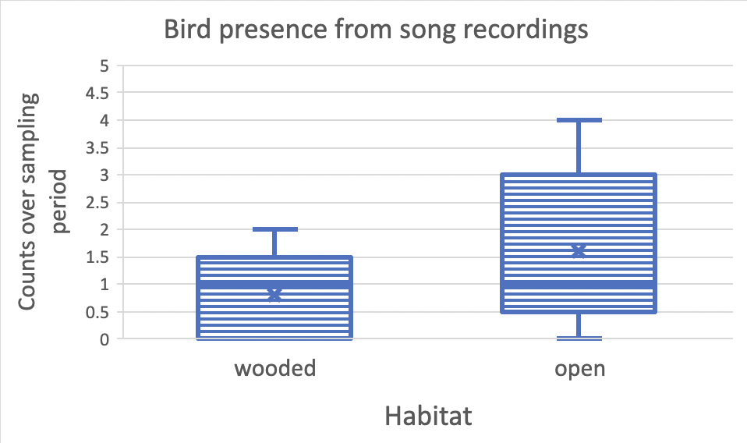
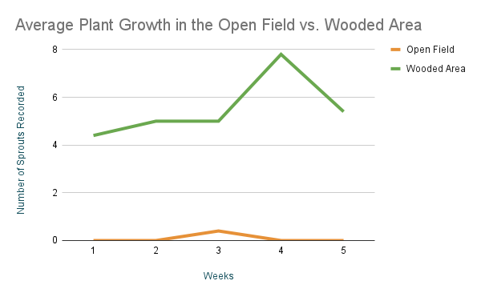
Analysis of the Value of Regenerating Woodlands for Biodiversity
Trever Federico-Grome, Amelea Hauer, Samantha Pearson, Avery Wilson, CEPS, University of New Hampshire
1. background
3. methods
5. Bird results
UNH’s college woods red pine plantations were infested by the red pine scale, a non-native pest that kills the trees.
To prevent further spread, the university harvested a large section of a plantation by the drinking water facility at the edge of college woods.
Following this tree felling, we sought to document the plants and animals seen in this regenerating area compared to the heart of college woods over the winter-spring transition.
Initially, we hypothesized that since there are fewer trees to nest in, there would be fewer birds near the open area.
On average, the open area had twice as many bird varieties than the wooded area.
There may be other variables that explain why birdsong is more frequent in this open environment.
We sampled within the regenerative zone and adjacent wooded areas of college woods.
At each site, vegetation cover was recorded along a 2m-wide 5m transect.
The site was split into 10 different sections where we recorded the number of saplings and vegetation growth over 5 weeks
We observed the number of birds present in both sampling areas by taking song recordings preceding each transect.
4. Sprout Results
While the sprout data we collected depended upon many underlying variables our data supports the claim that there is more growth in the undisturbed wooded area than in the open field.
Recently cleared area of College Woods
6. conclusions
Observing the regenerating woodlands provided some unexpected results.
More birdsong was observed in the open versus wooded areas on most days. It is possible birds used the greater visibility and sound transmission over the open area to find foraging opportunities or to communicate.
Spring plant growth in the wooded area was seen to be increasing quicker than the open area. since the regenerating area had such a destructive event recently.
If we were able to conduct this study differently, we would have wanted to be able to look at multiple different sites instead of two. that all had different conditions and observe them over a longer period to study the full restoration process.
2. Hypothesis
The regenerating woodlands will not have less diverse and numerous fauna and plants than the mature woodlands.
The regenerating woodlands will have a higher density of sprouts and small plants, rather than large trees like the mature woodlands.

