Slide 1
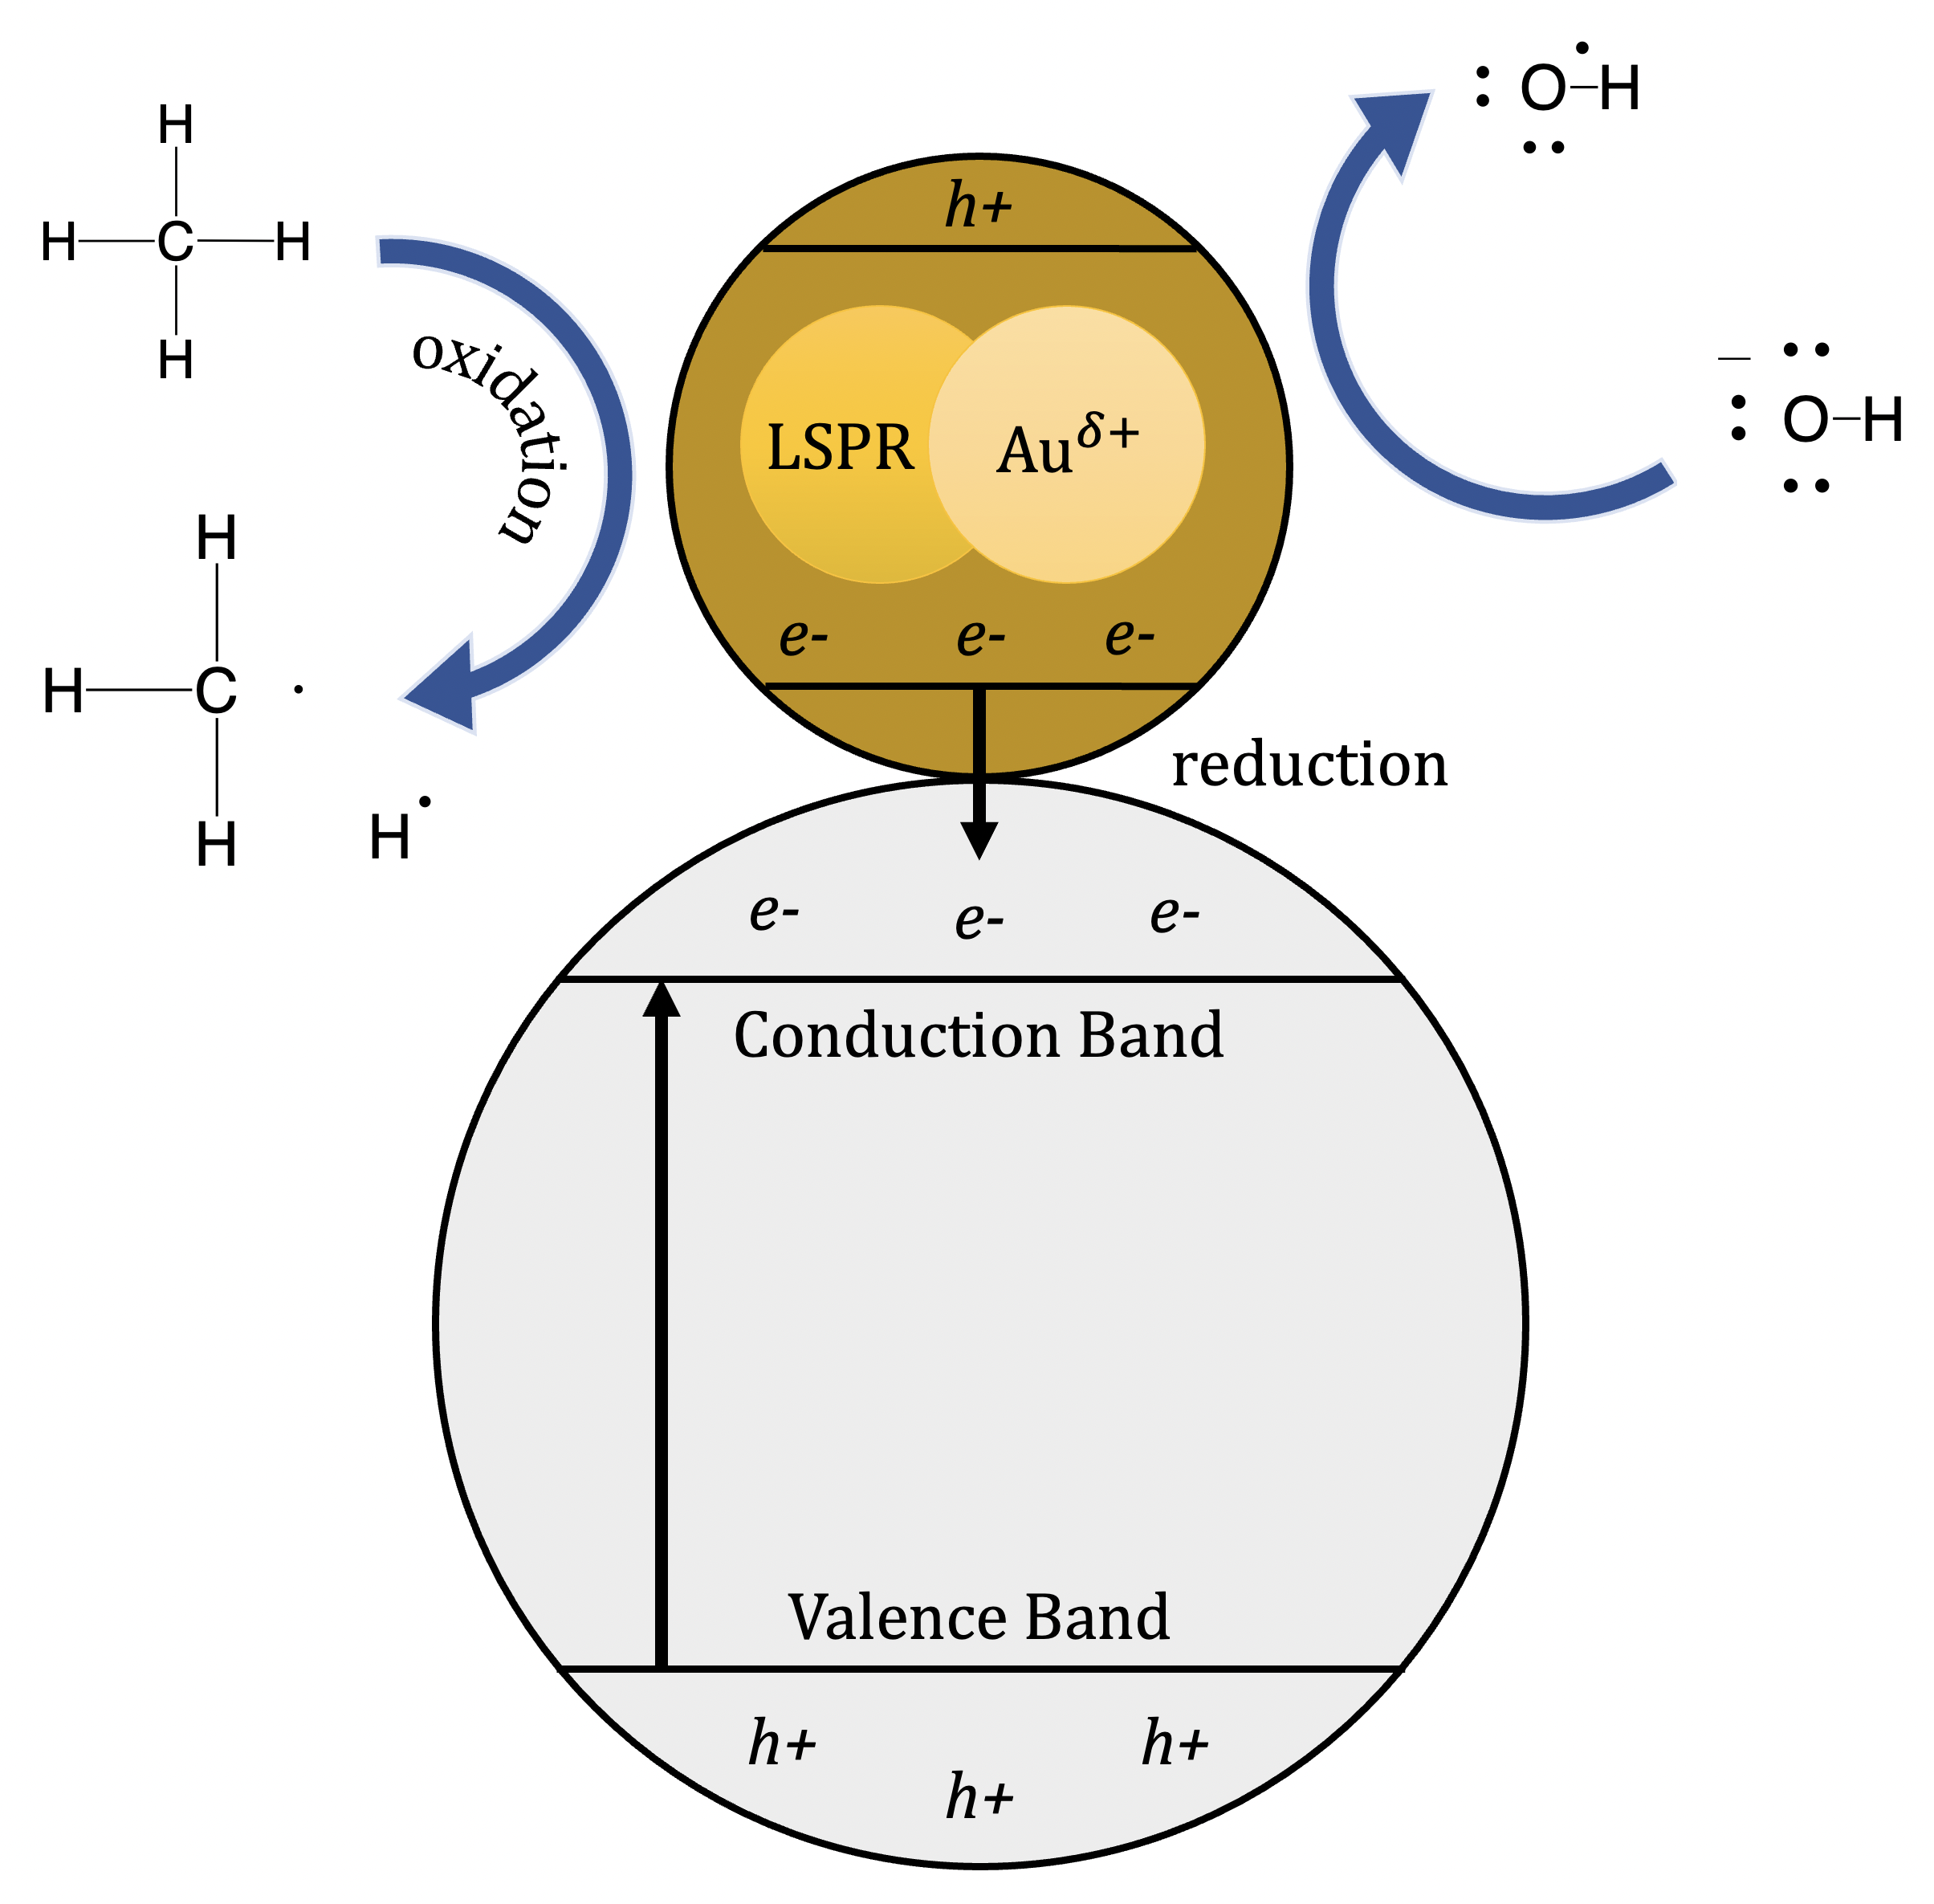
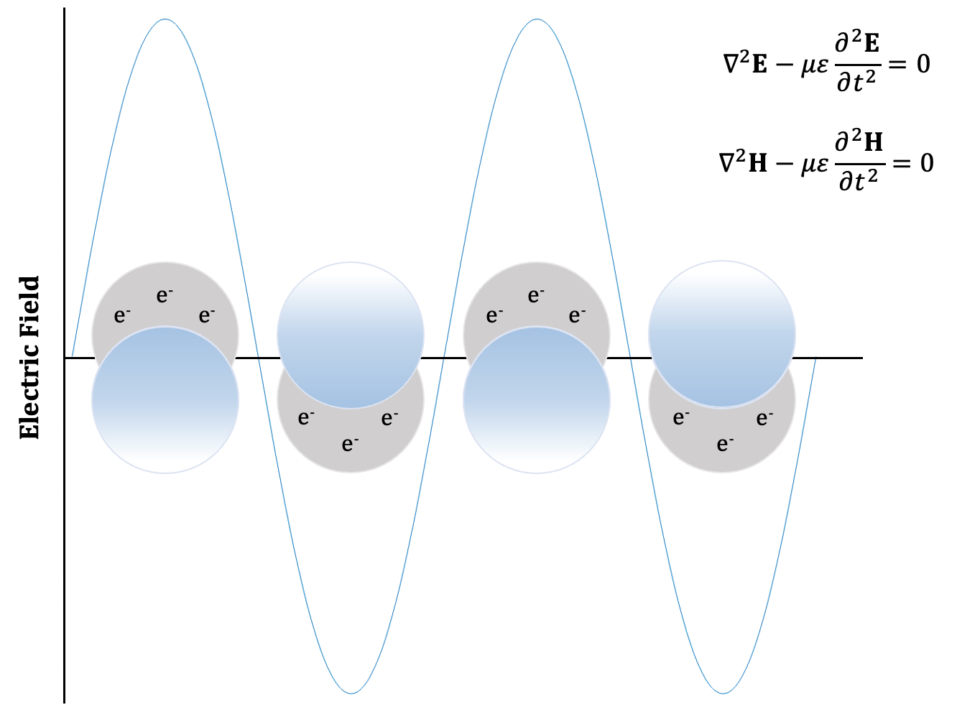
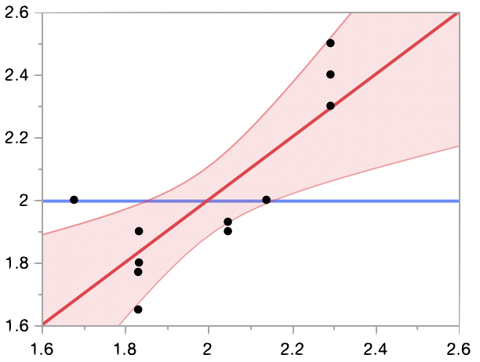
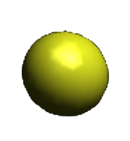
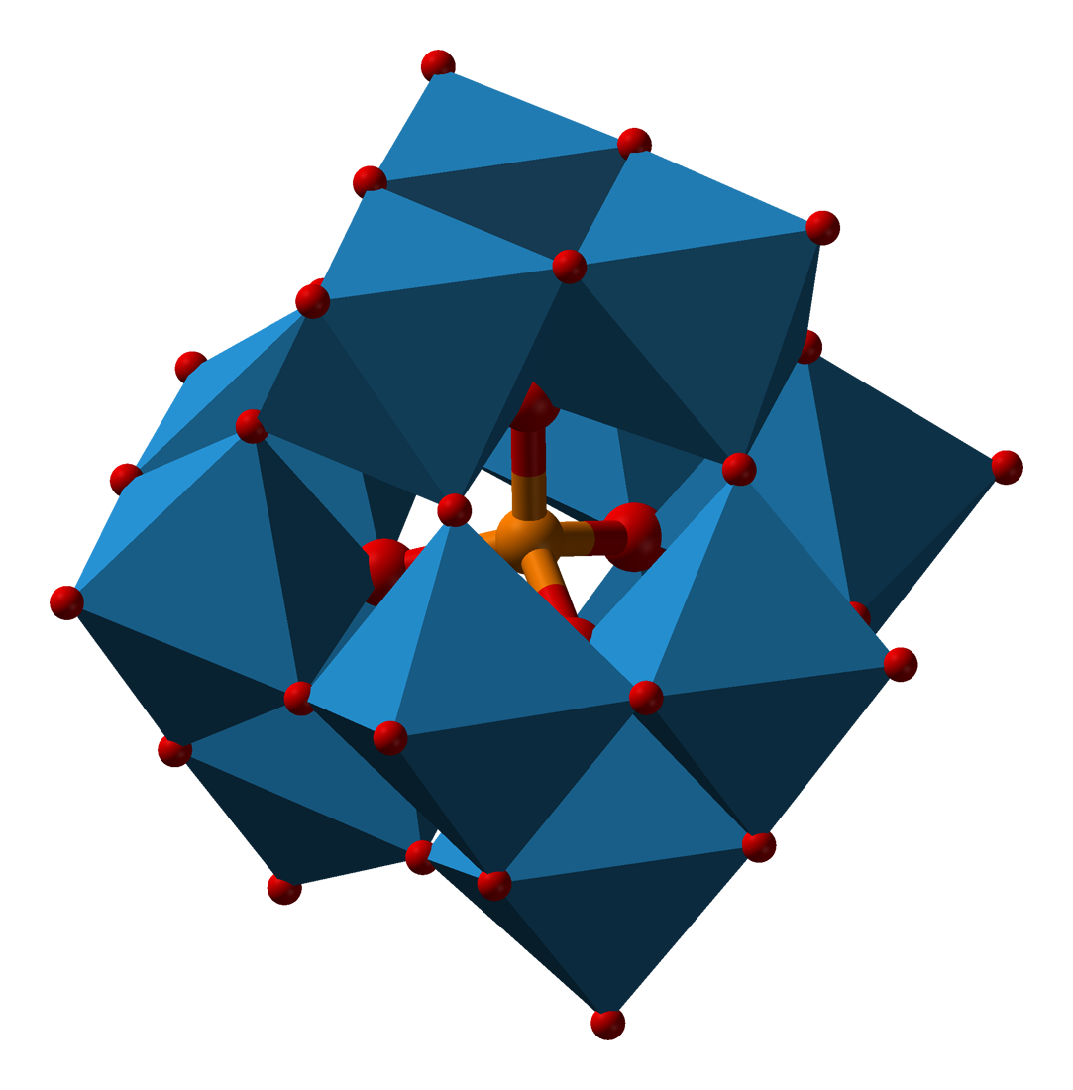
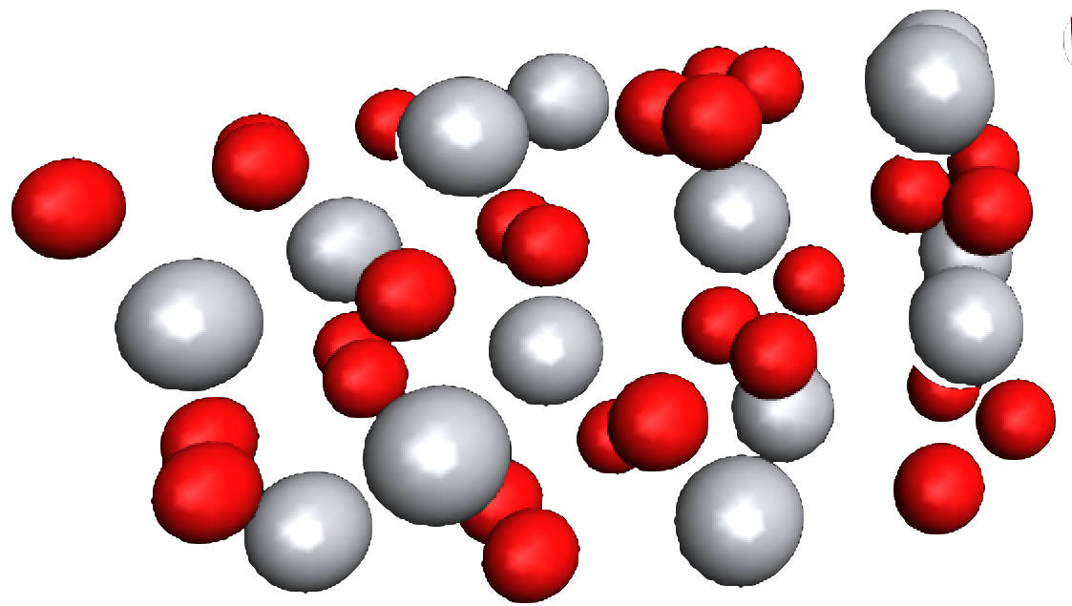
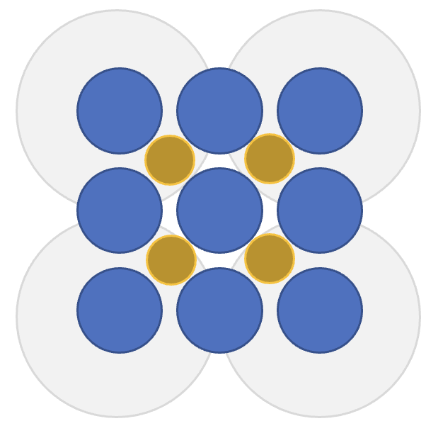
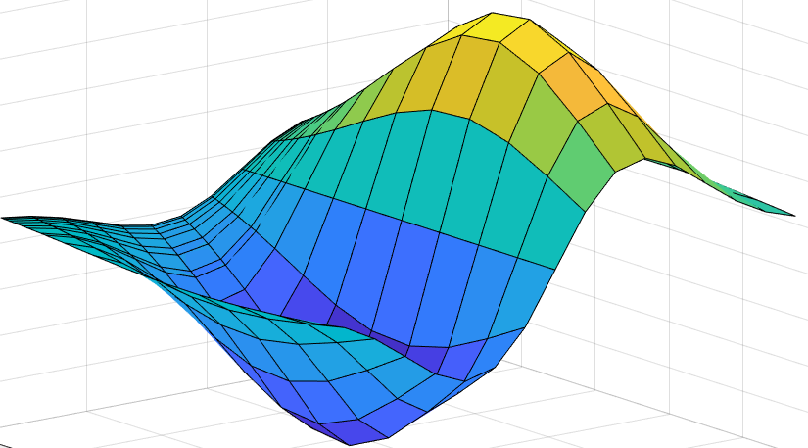
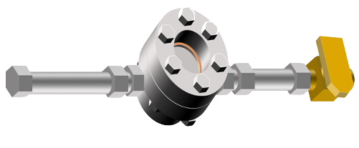
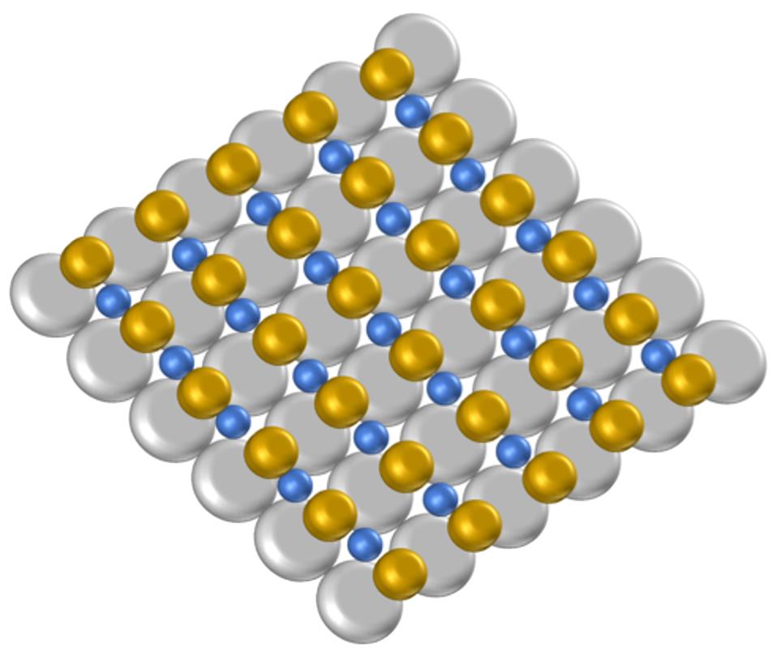
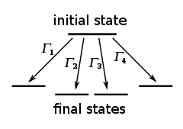
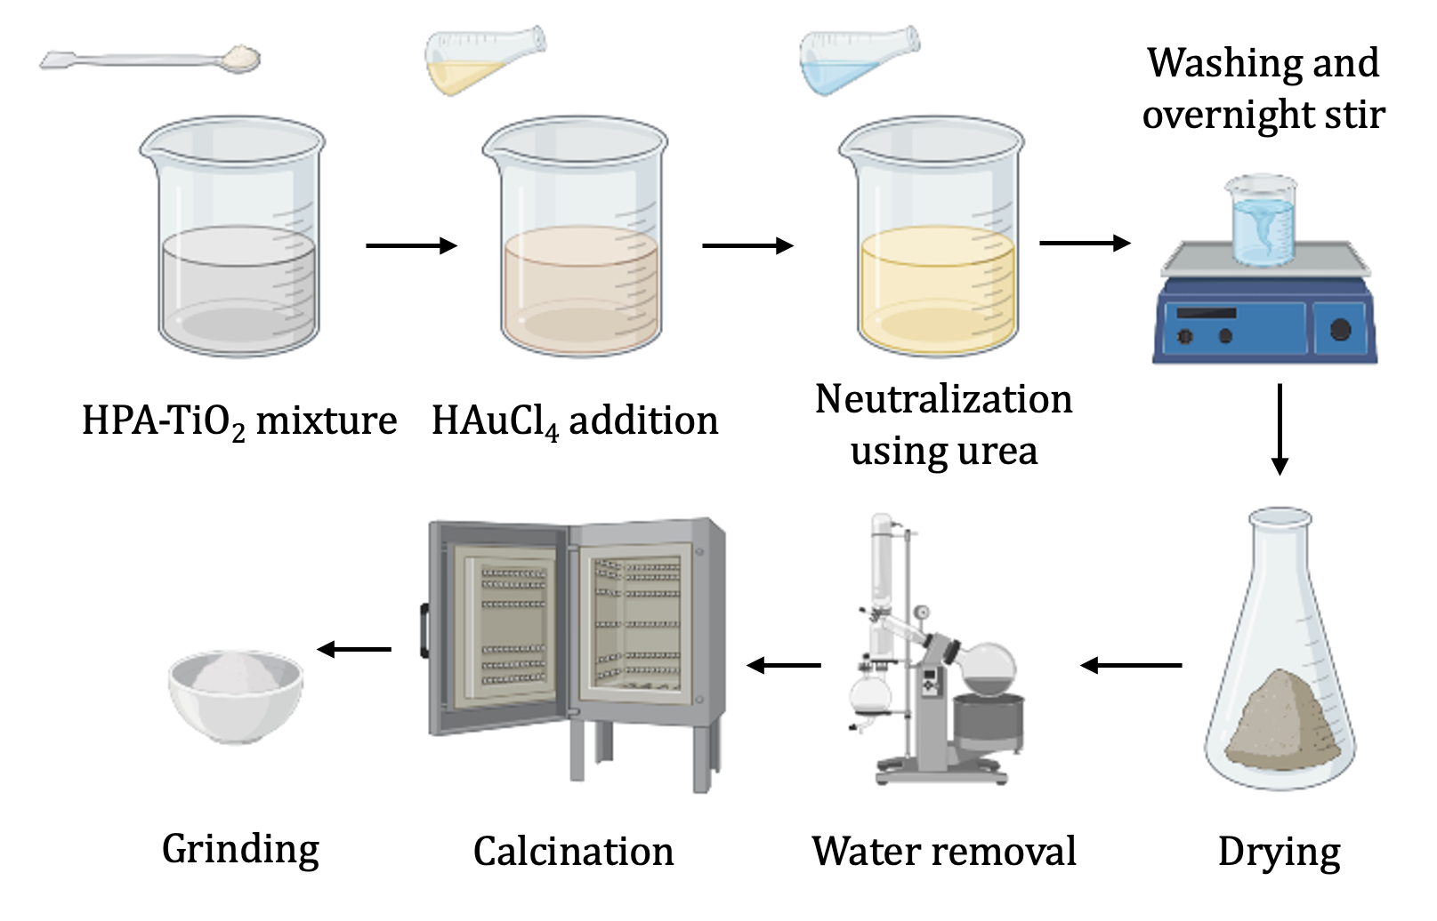
Enhancement of Plasmonic Gold Catalysts for Photocatalytic Methane Conversion
Samuel Mercer and Dr. Nan Yi
Department of Chemical Engineering, University of New Hampshire, Durham, NH 03824
Introduction
Localized Surface Plasmon Resonance (LSPR)
Machine Learning for Catalyst Design
Methane is a potent greenhouse gas that is the main component of natural gas, providing energy worldwide. Although it is an important fuel for combustion, it also holds promising potential to be reutilized for direct conversion to desirable chemicals (such as methanol and syngas).
Methane has a high thermodynamic barrier that requires high activation energies of 435 kJ mol⁻¹.
Photocatalytic reactions may facilitate methane conversion through a novel nanocomposite design, Au-HPA-TiO₂, that absorbs light to generate free radicals (rather than by traditional thermal or electrochemical methods).
//
//
//d
//d
Assisted learning neural networks are trained to predict plasmon resonance based on catalyst properties surveyed in literature and experimentally.
Supervised learning for synthesis parameters
ML predicted LSPR band gap reaction coordinate
Au-H₃PW₁₂O₄₀ (HPA)-TiO₂
Electric field enhancement
Calculation of Electronic Properties using DFT
LSPR is an effect of incident light on the gold nanoparticle that causes conduction band electrons to oscillate, enhancing the electric field on the particle’s surface and prompting radical formation at photocatalyst active sites.
//d
Electronic properties and material behavior were calculated based on density functional theory by programming a simplified lattice model in C++ for the optimal photocatalyst from QuantumESPRESSO.
Methodology
Illustration of LSPR mechanism
Low yield of desirable products prompted mechanistic study of LSPR effects on Au-HPA-TiO₂ photocatalysts.
//
Combined experimental and computational approach.
Material Characterization and Tuning LSPR
Lattice model and potential energy surface
Novel catalysts are designed to enhance activity, selectivity, and stability for photocatalytic methane conversion.
//
//
Effect of HPA loading
Different nanocomposite designs
Probabilistic Modeling of Methane Adsorption
$${CH}_{4}\left(g\right)+\left[∗\right]→[{CH}_{4}∗]$$
$$[{CH}_{4}∗]→{CH}_{4}\left(g\right)+\left[∗\right]$$
$$\left[{CH}_{4}∗\right]+\left[∗\right]→\left[{CH}_{3}∗\right]+[H∗]$$
$$\left[{CH}_{3}∗\right]+\left[∗\right]→\left[{CH}_{2}∗\right]+[H∗]$$
$$\left[{CH}_{2}∗\right]+[∗]→\left[CH∗\right]+[H∗]$$
$$2\left[O∗\right]→O_{2}\left(g\right)+2\left[∗\right]$$
$$\left[C∗\right]+\left[O∗\right]→\left[CO∗\right]+[∗]$$
The activity and selectivity of the optimal catalyst design for methane conversion is modeled using kinetic Monte Carlo (kMC) simulations from an open-source Python-based interface.
Data is queried into a library for ML-assisted analysis and ab initio simulations prior to lab experimentation.
$$r_{ij}\left(t\right)=N_{ij}k_{ij}\prod_{a∈i}{Θ_{a}(A,t)}$$
$$\left\langle r^{β}\right\rangle =\frac{1}{t_{KMC}}\sum_{n=1}^{N_{KMC}}{\sum_{j}{k_{ij}^{β}∆t_{escape,n}}}$$
//d
Catalyst Synthesis and Activity Testing
Kinetic Monte Carlo reactivity model
//
//
Simulated elementary steps
Ten photocatalysts were synthesized with unique loadings.
Activity testing was accomplished by preparing a packed bed photoreactor loaded with 5 mL of H₂O₂ for steady state methane flow under 300W UV light.
Effect of HPA structure
Effect of Au loading
Significance and Conclusions
//
//
Clean usage of methane for chemical production is possible with photocatalytic methane conversion at ambient conditions.
The composition of the photocatalyst heavily influences its plasmonic resonance. The powerful computational model programmed provides data that analyzes, models, assesses, and filters the most viable catalyst designs for methane conversion.
Future research may improve the application of computational methods and further characterize the photocatalyst. The synergistic effect of a bimetallic photocatalyst may also be investigated.
hv
H₂O₂ (5 mL)
$\dot{n_{1}}$(2.5%)
$\dot{n_{2}}$(2.5%)
$H_{2}O/O_{2}$(5%)
Ar (90%)
CH₄ (10%)
Ar (90%)
Deposition-precipitation method
Photocatalytic activity testing
Metal-NP | Polyoxometalate (HPA) | Method
Au (0.5 wt%) | H₃PW₁₂O₄₀ (5 wt%) | Deposition-Precipitation
Au (0.5 wt%) | H₃PW₁₂O₄₀ (12 wt%) | Deposition-Precipitation
Au (0.5 wt%) | H₃PW₁₂O₄₀ (15 wt%) | Deposition-Precipitation
Au (0.5 wt%) | H₃PW₁₂O₄₀ (20 wt%) | Deposition-Precipitation
Au (1 wt%) | H₄PW₁₂O₄₀ (20 wt%) | Deposition-Precipitation
Au (1 wt%) | H₃PW₁₂O₄₀ (12 wt%) | Deposition-Precipitation
Au (0.5 wt%) | N/A | Impregnation
N/A | H₃PW₁₂O₄₀ (20 wt%) | Impregnation
N/A | H₄PW₁₂O₄₀ (20 wt%) | Impregnation
Ir (0.3 wt%) | H₃PW₁₂O₄₀ (15 wt%) | Deposition-Precipitation
Elevated loading of Au nanoparticles negates plasmonic activity while increased HPA loading enhances it. However, HPA addition also hinders catalyst stability and leads to sintering at lower temperatures.
Thermogravimetric analysis confirmed that all variants of the Au-HPA-TiO₂ synthesized decomposed at elevated temperatures and lost stability.
Ir-HPA-TiO₂ showcased heightened levels of stability at elevated temperatures, demonstrating that metallic alloys have unique synergistic properties with HPA.
Experimental results are combined with those from literature to create a library of catalyst designs. This database of catalyst syntheses provided valuable data to quantify the optimal synthesis parameters and tune the material design.
Acknowledgments
Thank you to Dr. Nan Yi, Dr. Gonghu Li, Dr. Gagandeeph Singh, Dr. Guoqiang Cao, Ehab Shaaban, and Darcy Fournier for supporting my research.
UNH Hamel Center for Undergraduate Research
UNH University Instrumentation Center, Department of Chemical Engineering, and Department of Chemistry
References
[1] Horn, Raimund and Schlögl, Robert. Catal. Lett. 145: 23-29, 2015.
[2] Kozhevnikov, Ivan. Chem. Rev. 98: 171-198, 1998.
[3] Zakaria, Zulfirdau and Kamarudin, Siti Kartom. Renew. Sust. Energy. Rev. 65: 250-261, 2016.
[4] Toyao, Takashi et. al. ACS Catal. 10(3): 2260-2297, 2020.
[5] Song, Hui et. al. Joule 3(7): 1606-1636, 2019.

