Slide 1
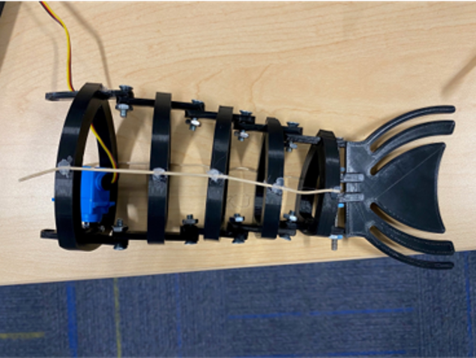
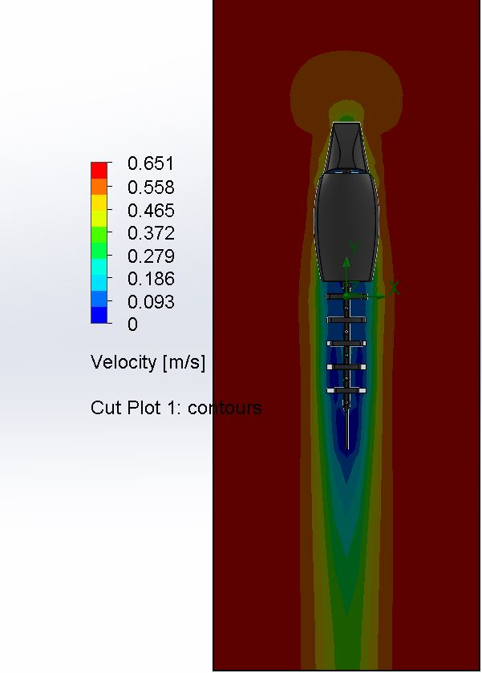
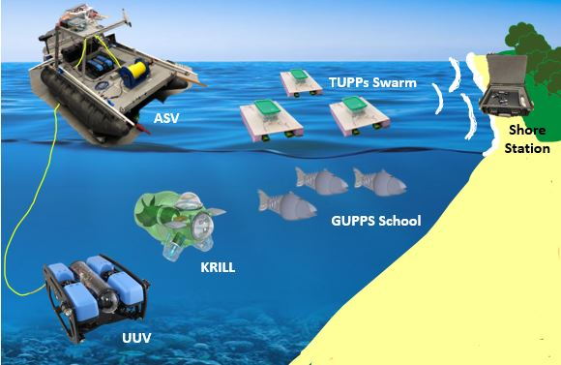
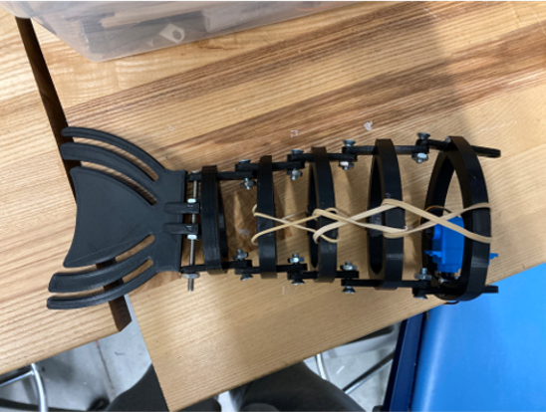
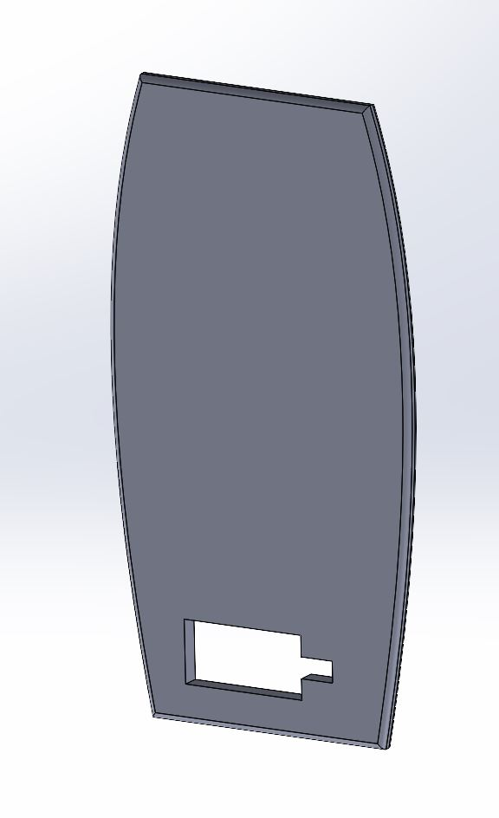
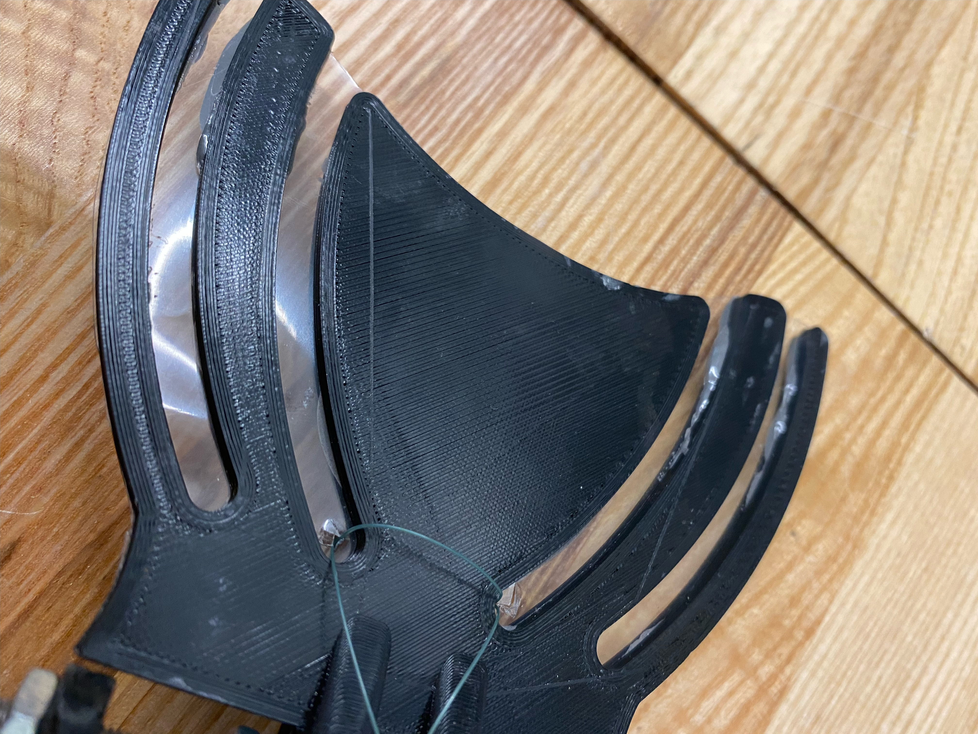
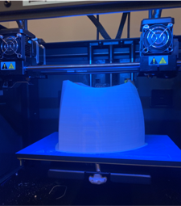
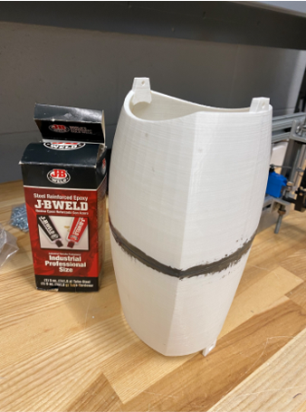
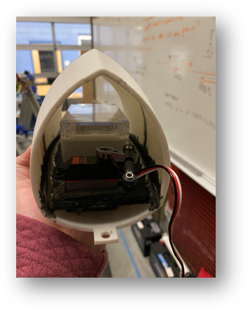
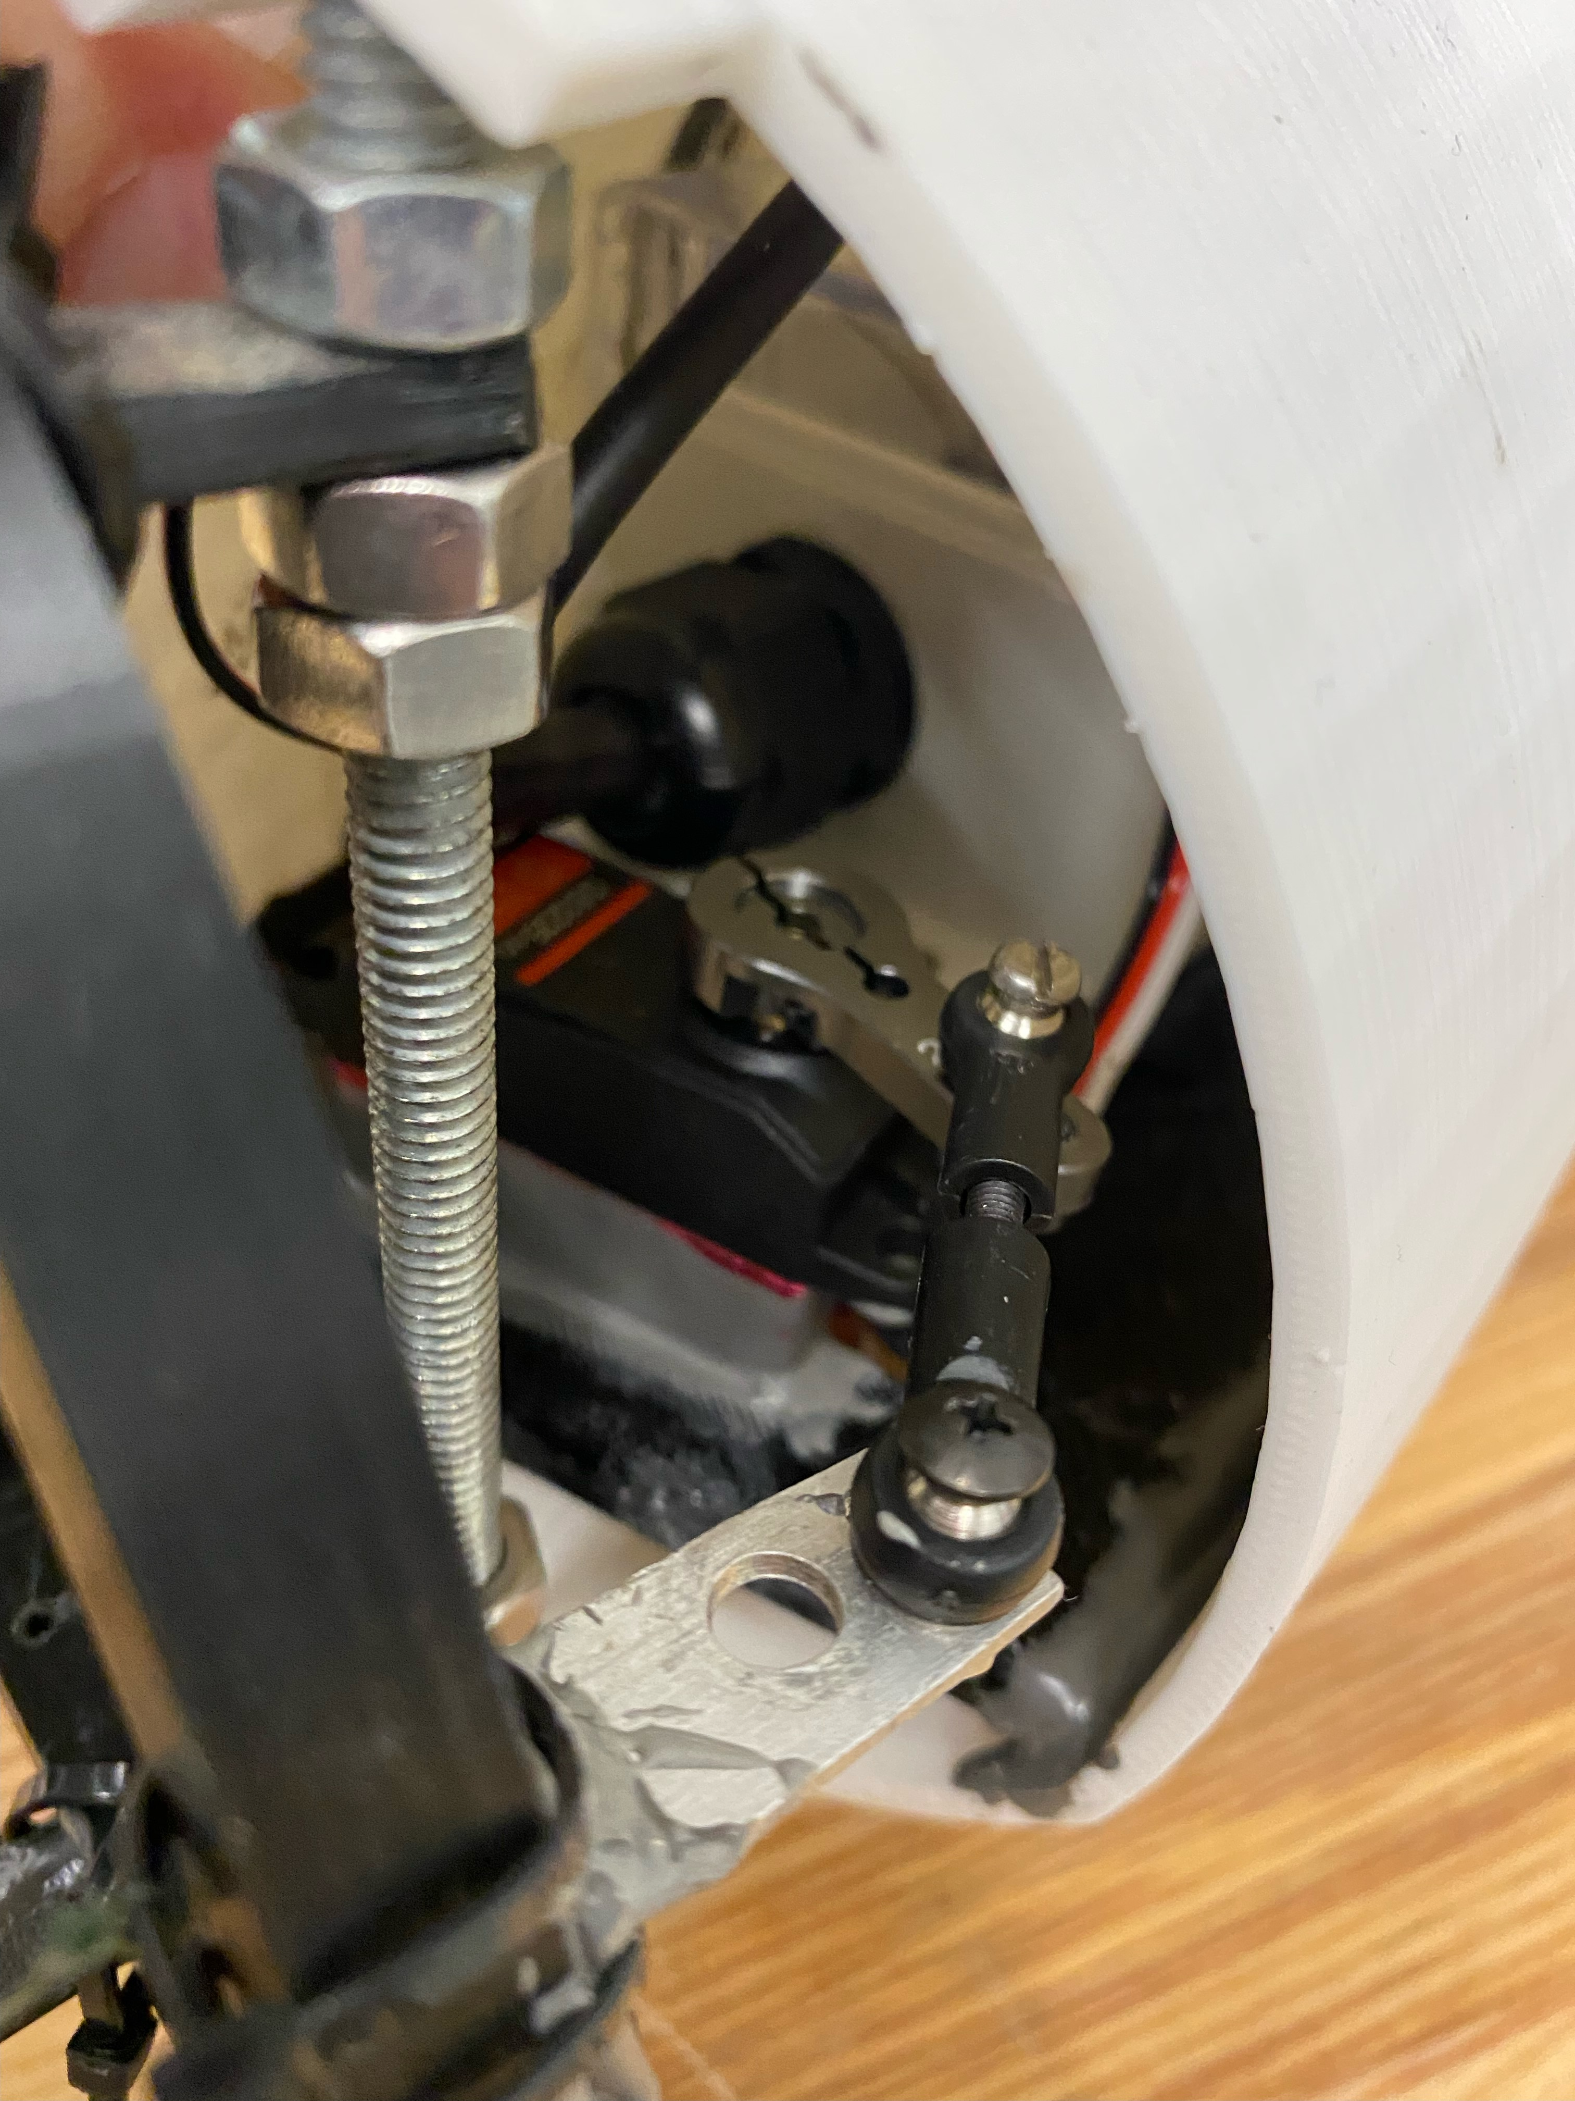
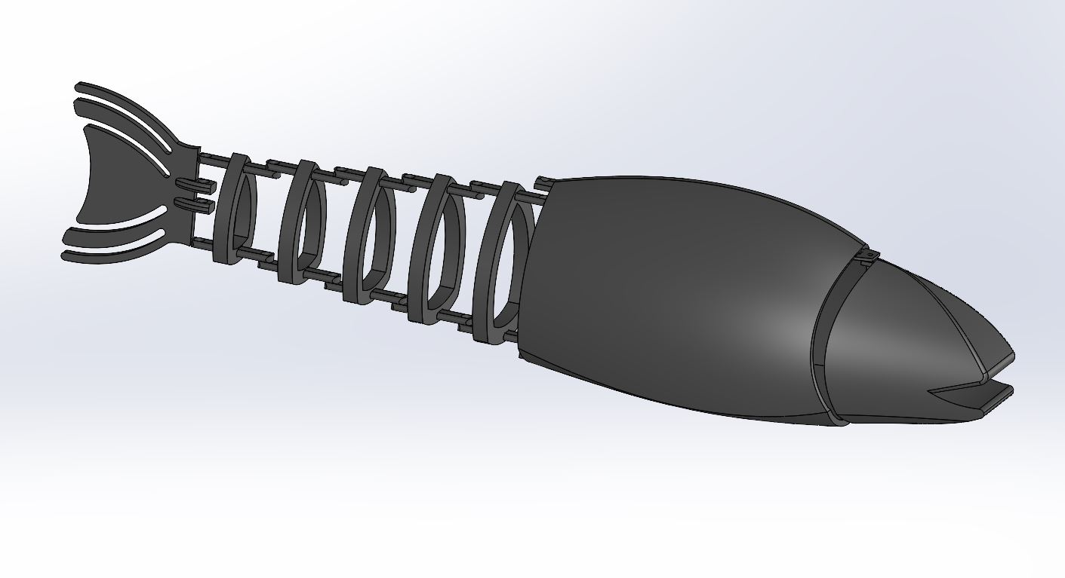
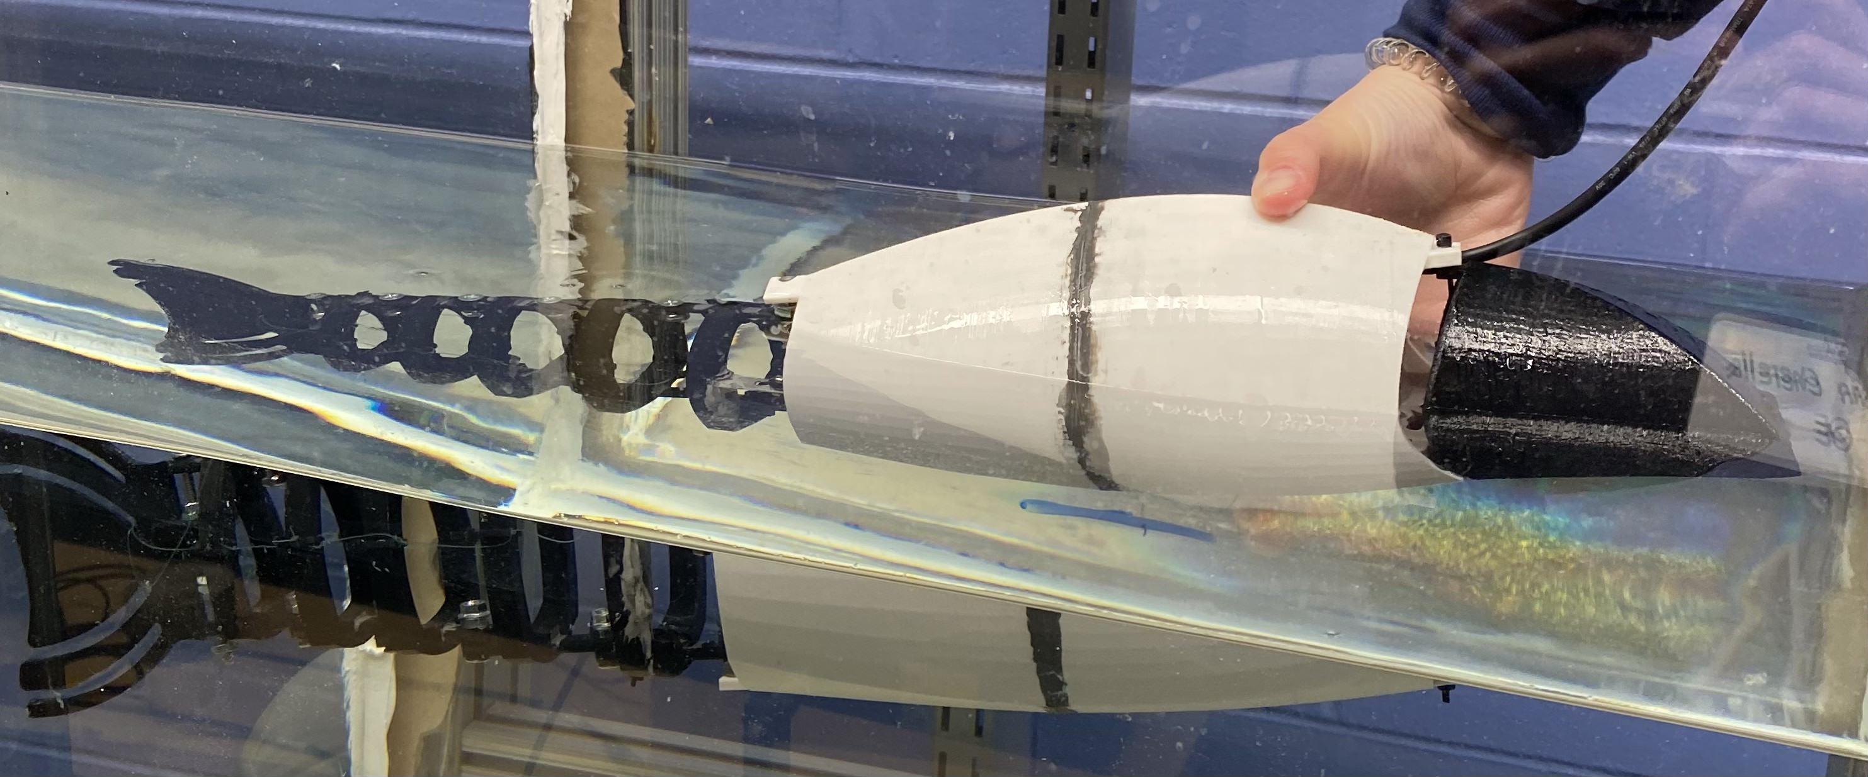
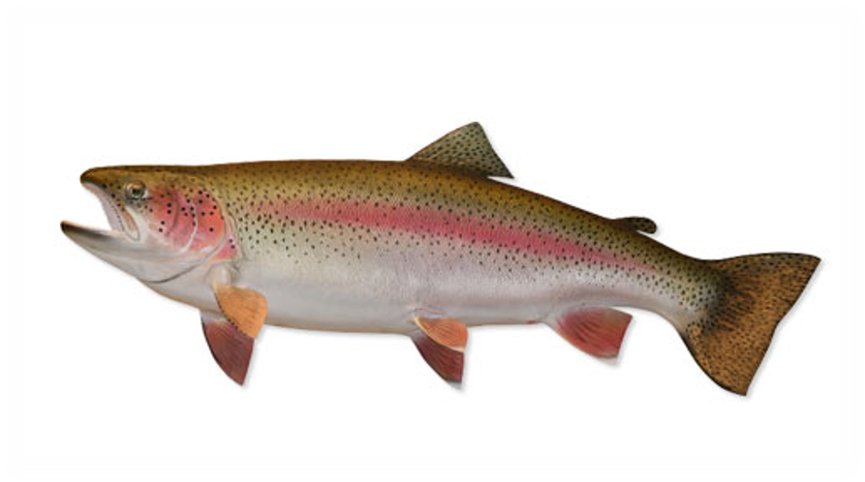
Marine And Naval Technological Advancements for Robotic AutonomY (MANTA RAY): Ghost Unpiloted Performance Platform Submersible (GUPPS)
Project Advisors: Dr. May-Win Thein, Dr. Yuri Rzhanov, Dr. Elizabeth Fairchild, Michael Chambers
Graduate Advisors: Ozzy Oruc, Hannah Arnholt, Nicholas Custer, Igor Vladimirov, Richard Randall
Team Members: Caroline Russell (ME), Will Conner (OE), Amanda Enderson (ME), Gavin Cherella (OE),
Shelly Lancaster (Wildlife & Conservation Biology), Heather Nelson (Zoology)
DESIGN SPECIFICATIONS & EVALUATION
Manta Ray Mission
Tail tensioning
3D Model
Modifying dimensions so proportions are accurate to steelhead trout
Approximately 2 feet in length
Adjusting CAD model for printability
Understanding waterproofing needs of future model and designing for that
Dynamics
Propelled by tail motion
High focus on tail mechanics and tensioning
Modularity
Shelf
Removable electronics container
Evaluation
Simplified Flow simulation
Turbulent areas of interest
Team MANTA RAY is an interdisciplinary project dedicated to creating, maintaining, and expanding a network of marine robots for seafloor mapping and underwater perception. The network began as just the autonomous surface vehicle (ASV) and unpiloted underwater vehicle (UUV), but has expanded to include a prototype of the ASV, known as TUPPS, and two kinds of remotely operated vehicles, known as GUPPS and KRILL. With these systems, students work to improve communication between vehicles, develop autonomous behaviors and algorithms, and upgrade existing mechanical systems to improve precision and performance.
Tests Primarily in Air
Tension System Added to Simulate Damping
Numerous Design Iterations
Simple rubber band strand
Looping rubber band
Fishing line
Fishing Line Yielded Best Results
Most like real fish movement
Great propulsion
Turbulent areas of interest
Reliable and improved resistance
Feasibility in water tests
Film in Caudal Fin
Additional resistance with film
CONSTRUCTION
Tail Connections
Cross tightening technique
17 separate pieces for mobility
Connector arm from servo to tail
3D Printing
Limitations on size of printer
Overcome misprint issues, adaptability
Affixing Components Together
Combing two halves of body
Insertion and securement of shelf
Head, Body, Tail Connections
Manufactured pin to connect head and body
Shaft to connect body and tail
GUPPS SUBTEAM mission
GUPPS is one of newest additions to the MANTA RAY fleet. The purpose of GUPPS is to non-intrusively investigate underwater areas of interest using a biomimetic robotic fish. Previous to this year, GUPPS existed solely as an idea with basic drafts of CAD models. The GUPPS team goal this year was to finalize design specifications and bring it to life as a working model in air.
Current model
Dimensions
22' 7/16" x 4' 3/8" x 5' 1/8''
Weight
1.9 lbs.
Design State
Detachable head to easily access electronics
SafetyBox containing Arduino nano
Waterproofed tether gasket to connect electronics to controls
Waterproof 25KG high torque RC Servo
Tail motion testing
Biology and biomimicry
Future work
GUPPS is modeled after a Oncorhynchus mykiss, commonly known as a Steelhead trout. Steelhead trout are native to Northeastern region of the United States and are currently being raised in the UNH AquaFort. Implementation of GUPPS would initially be at this location to monitor the health of the trout without disturbing
Buoyancy and Ballasting
Soft Robotics
Sensors
Temperature, pressure, optics, etc.
Increased Modularity
Removable shelf insert for better access to electronics
Integration into MANTA RAY Fleet
Tethered to TUPPs for telemetry
Code & Circuit Design
Tail motion is to follow biomimicry of fish
Arduino code to power a servo to provide tail motion
155° tail sweep motion
Testing in and out of water
Motion in air is different than movement with added resistance in water
Improved latency for smoothest possible motion
the habitat or stressing the fish. In future work after integration of various sensors, they can also be used to monitor the oxygen and temperature levels within the netted off AquaFort area.
Special Thanks to Dr. Martin Renken, Thai Tran, Laura Gustafson, Kelly Danforth, Scott Campbell, Debarpan Bhowmick and the Olson Center
Notes:
To change this poster, replace our sample content with your own. Or, if you'd rather start from a clean slate, use the New Slide button on the Home tab to insert a new page, then enter your text and content in the empty placeholders. If you need more placeholders for titles, subtitles or body text, copy any of the existing placeholders, then drag the new one into place.

