Slide 1
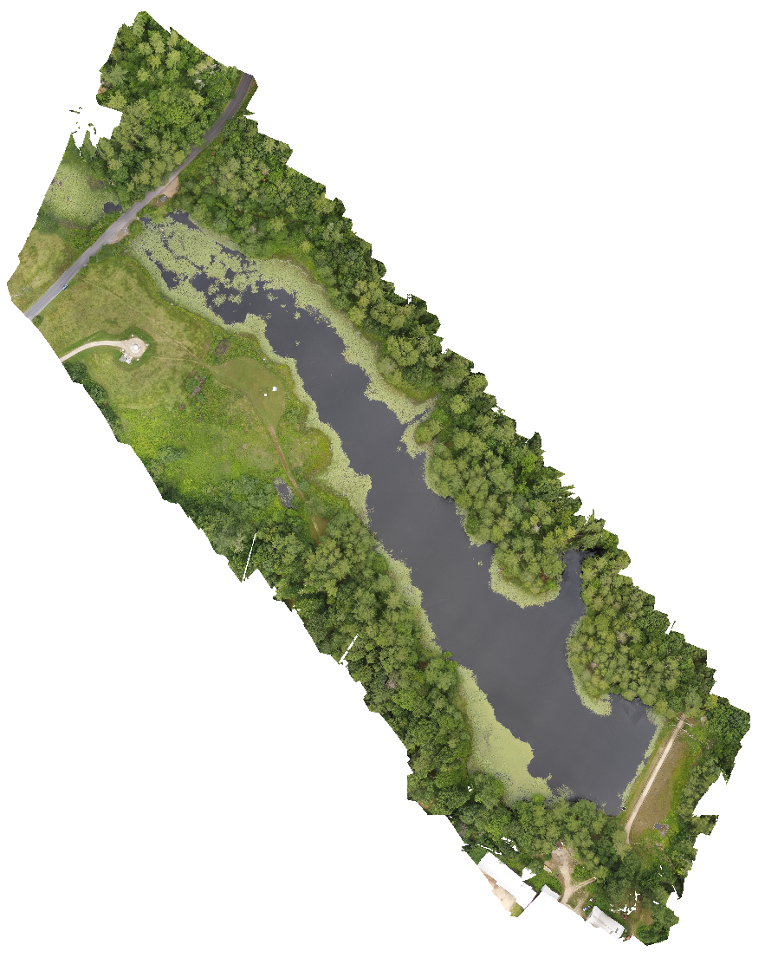
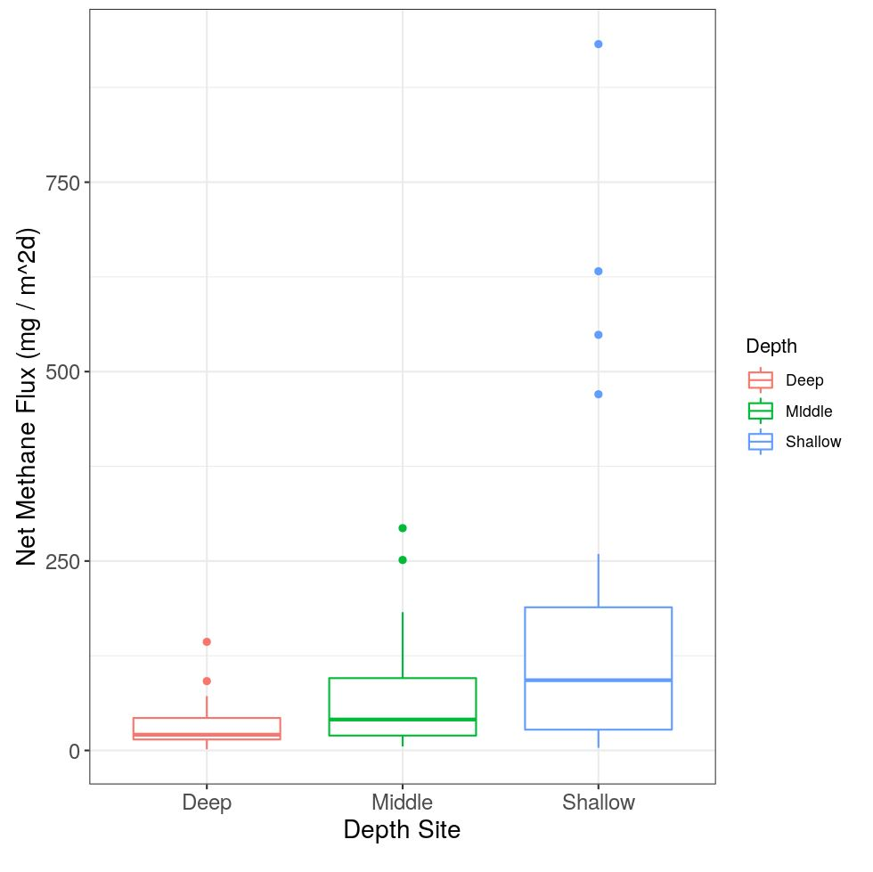
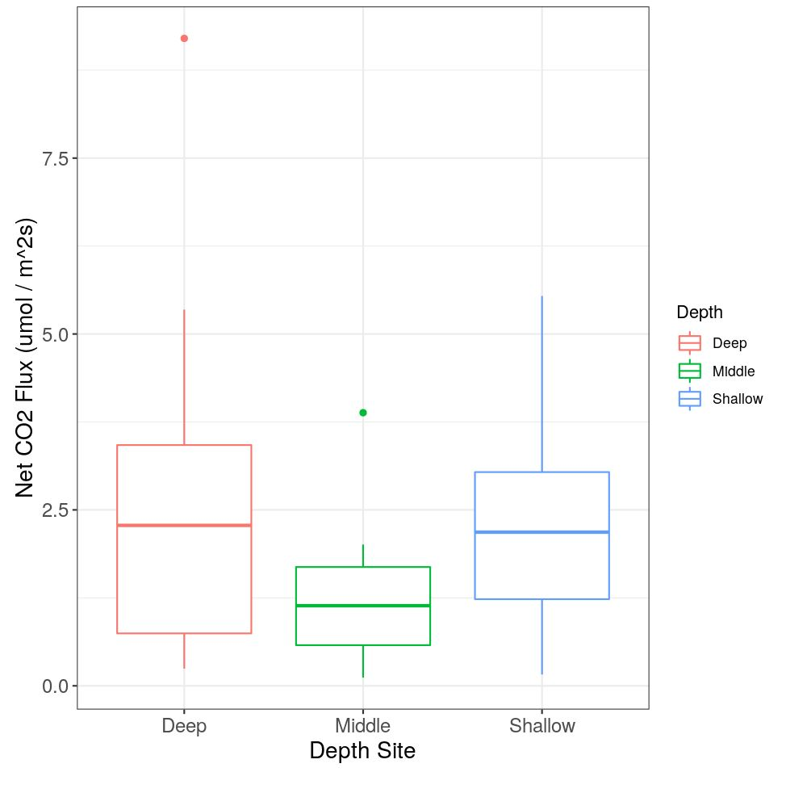
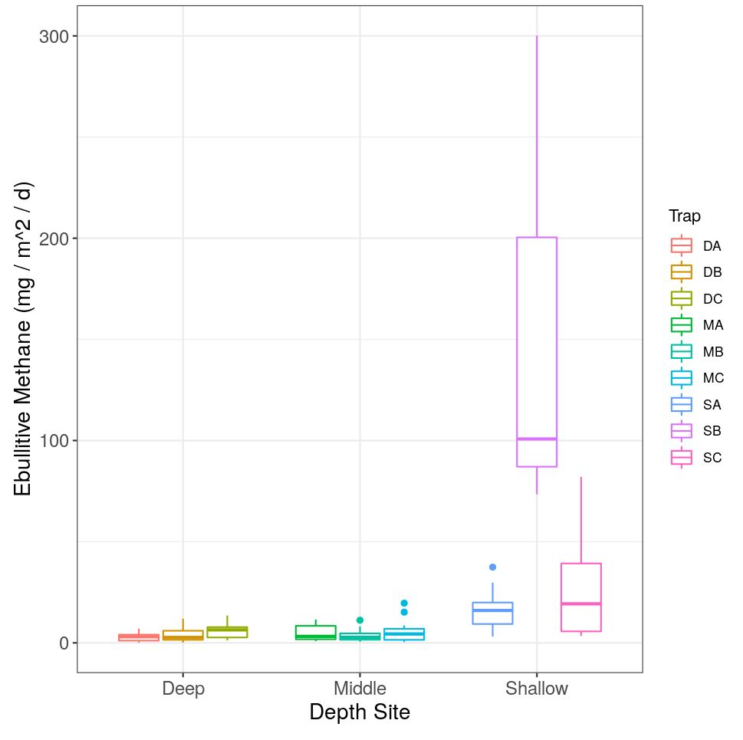
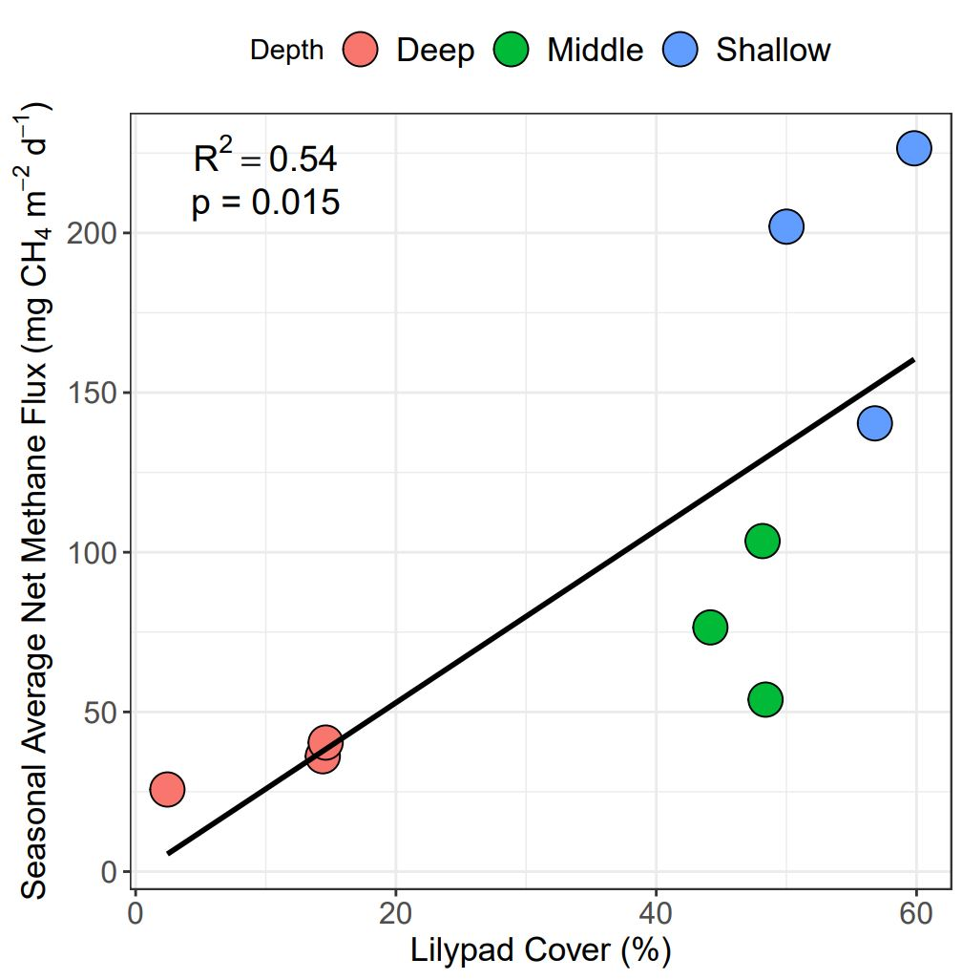
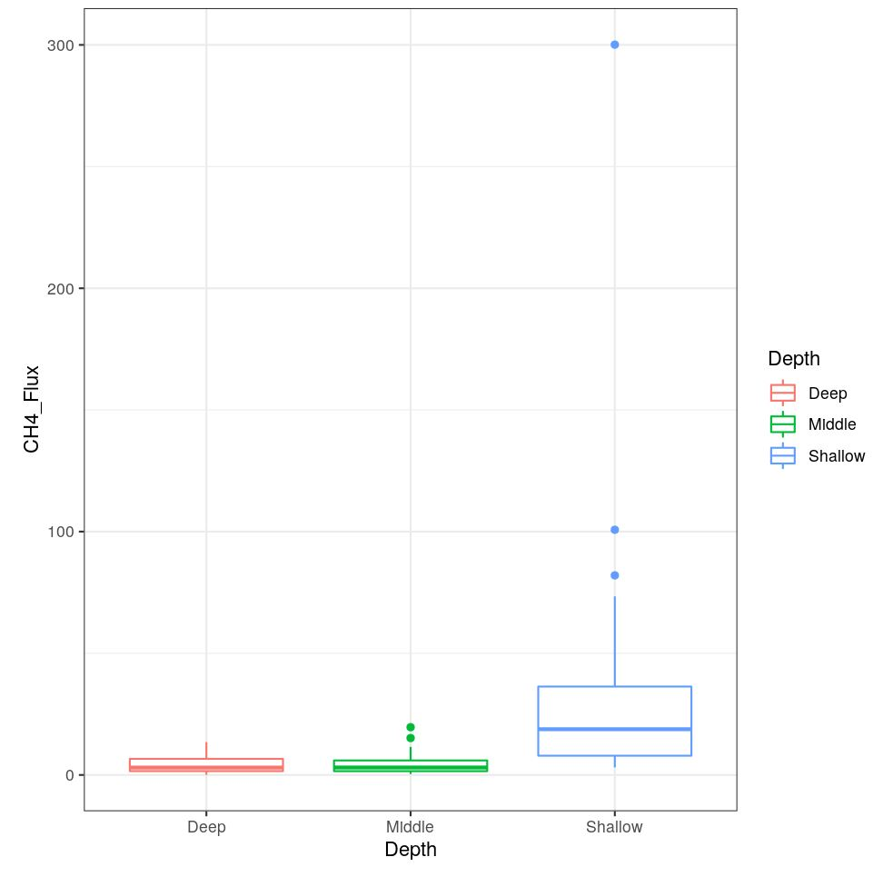
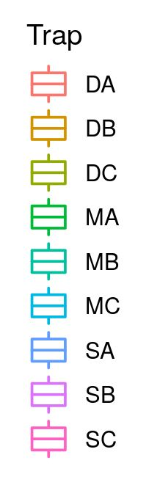
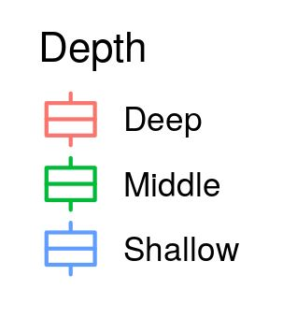
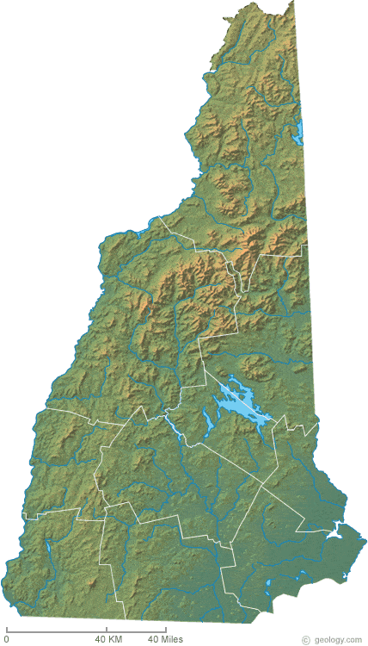
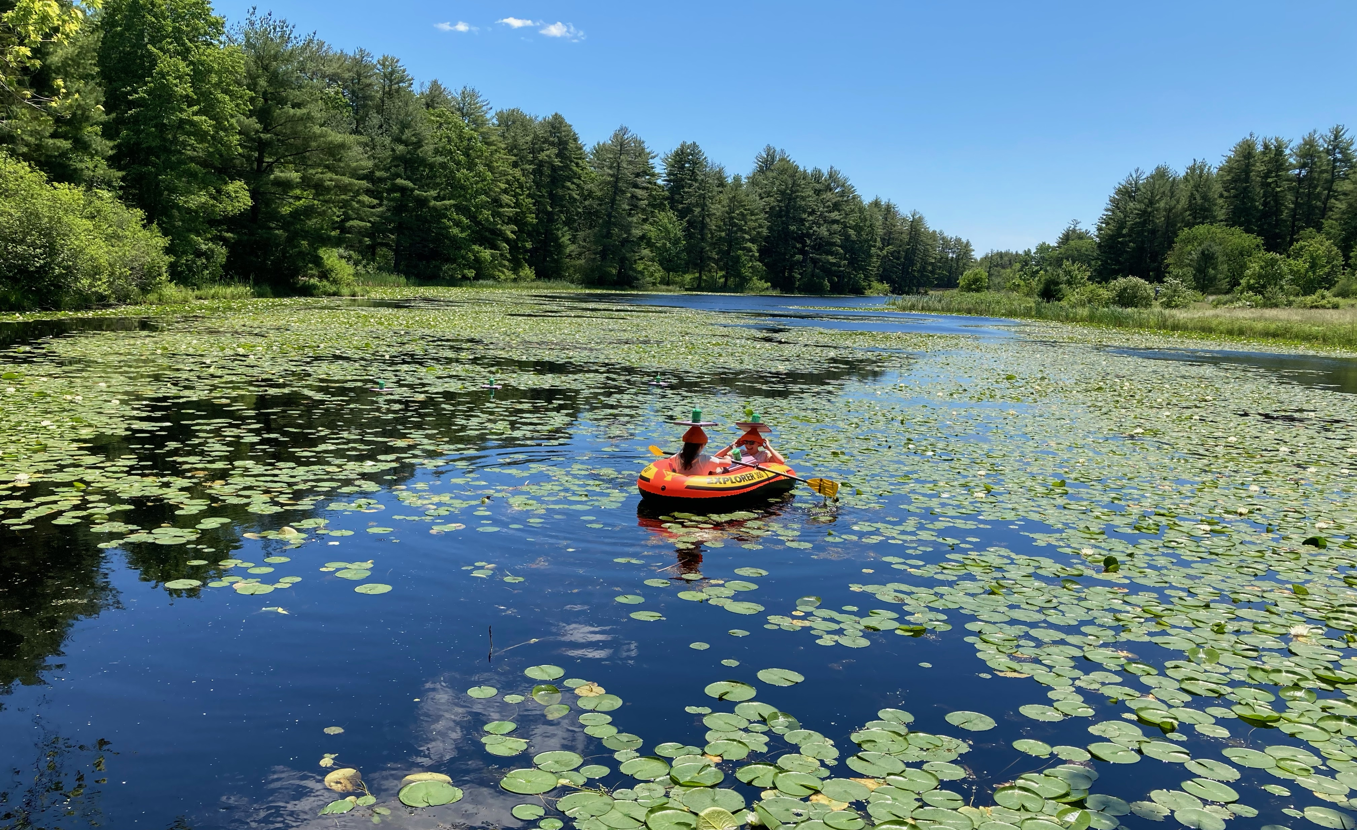
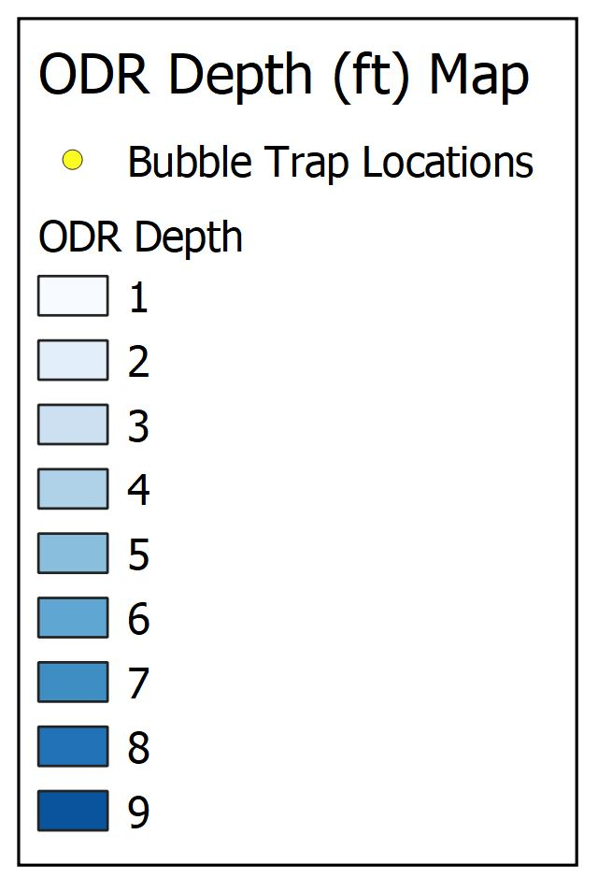
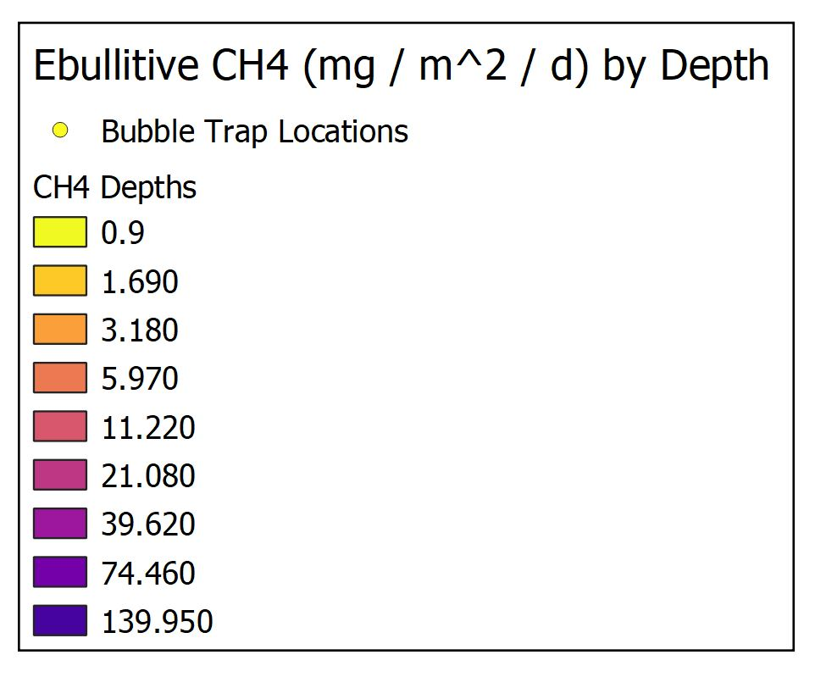
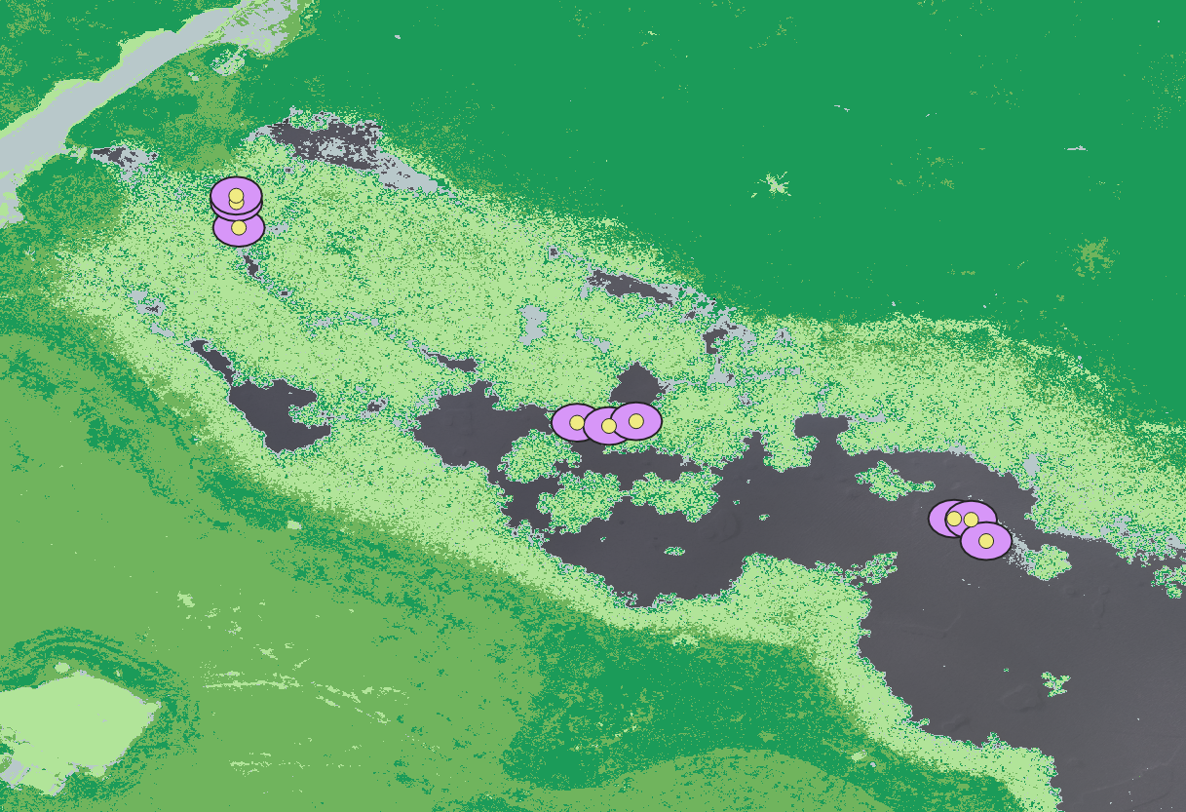
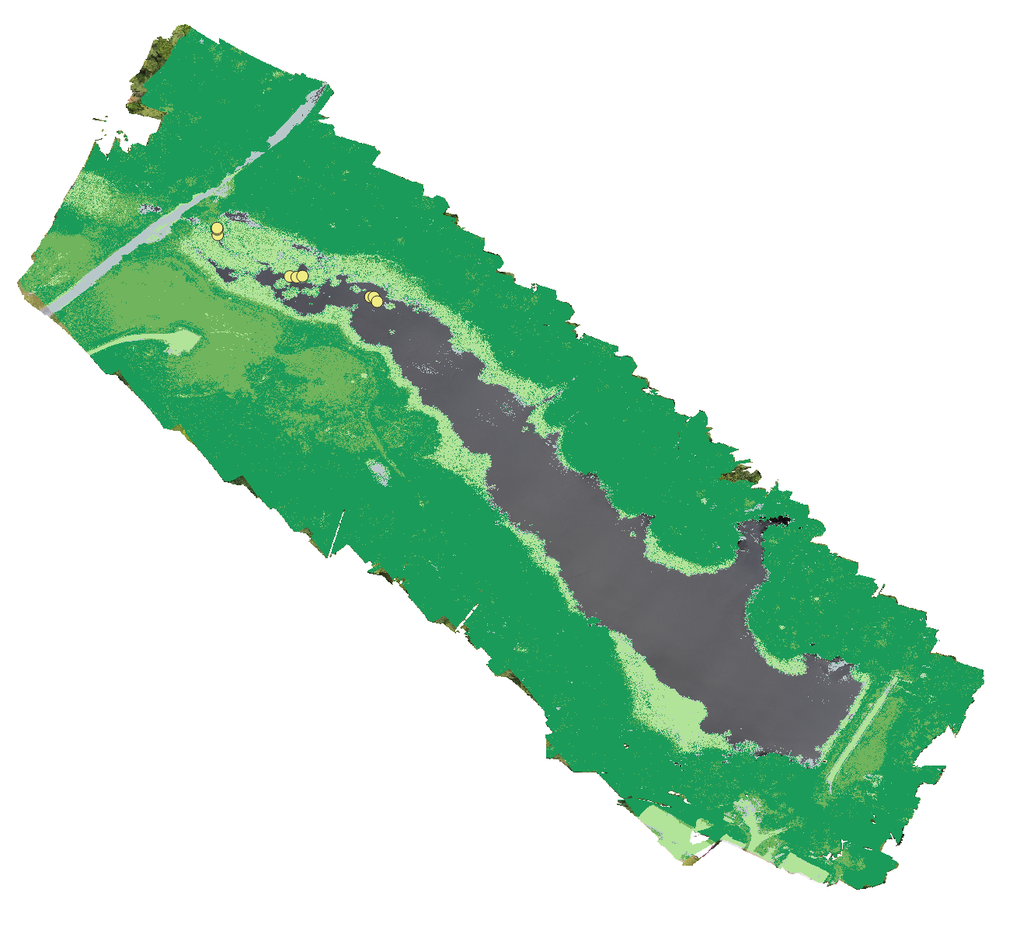
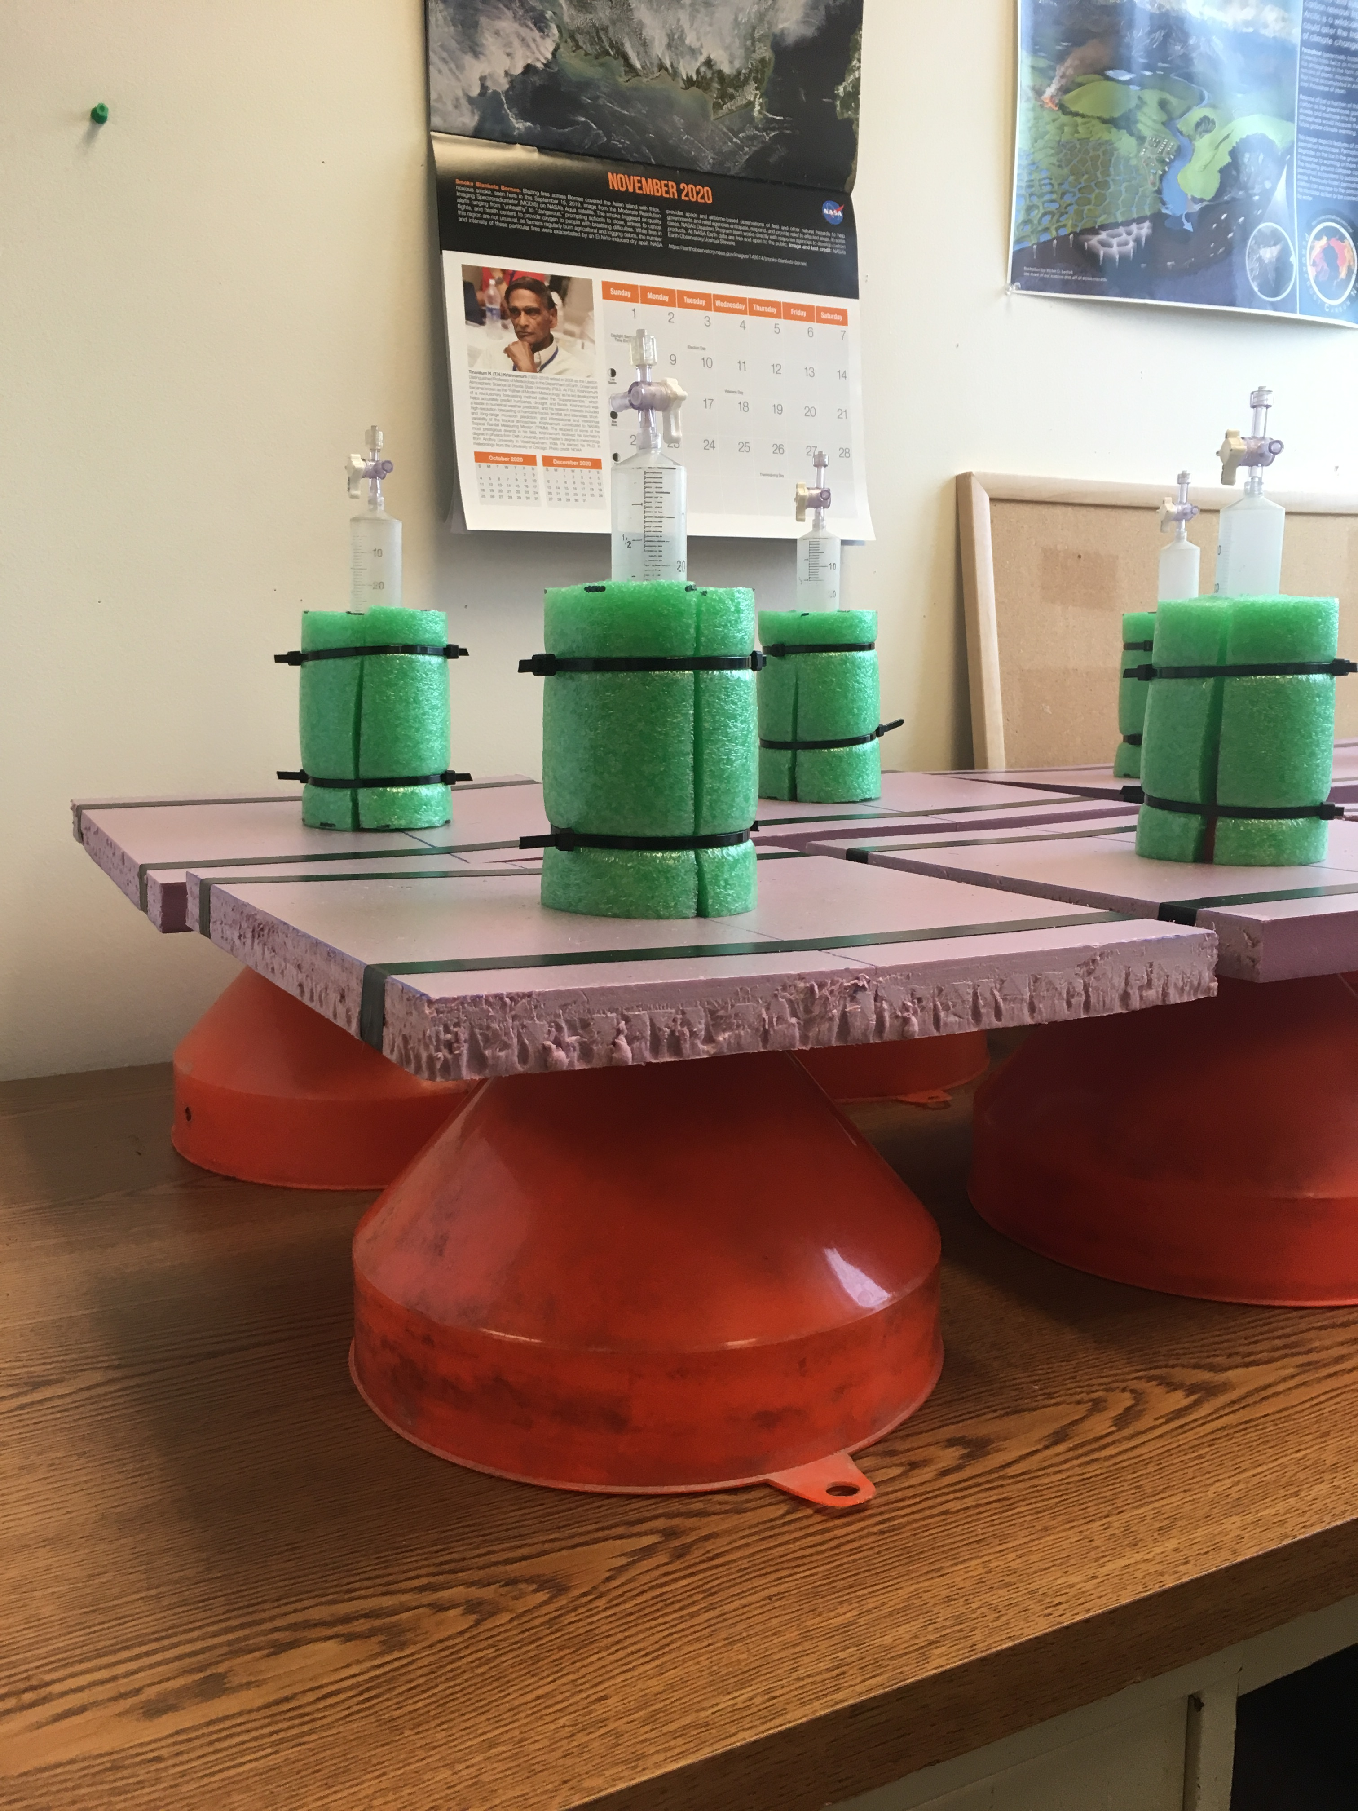
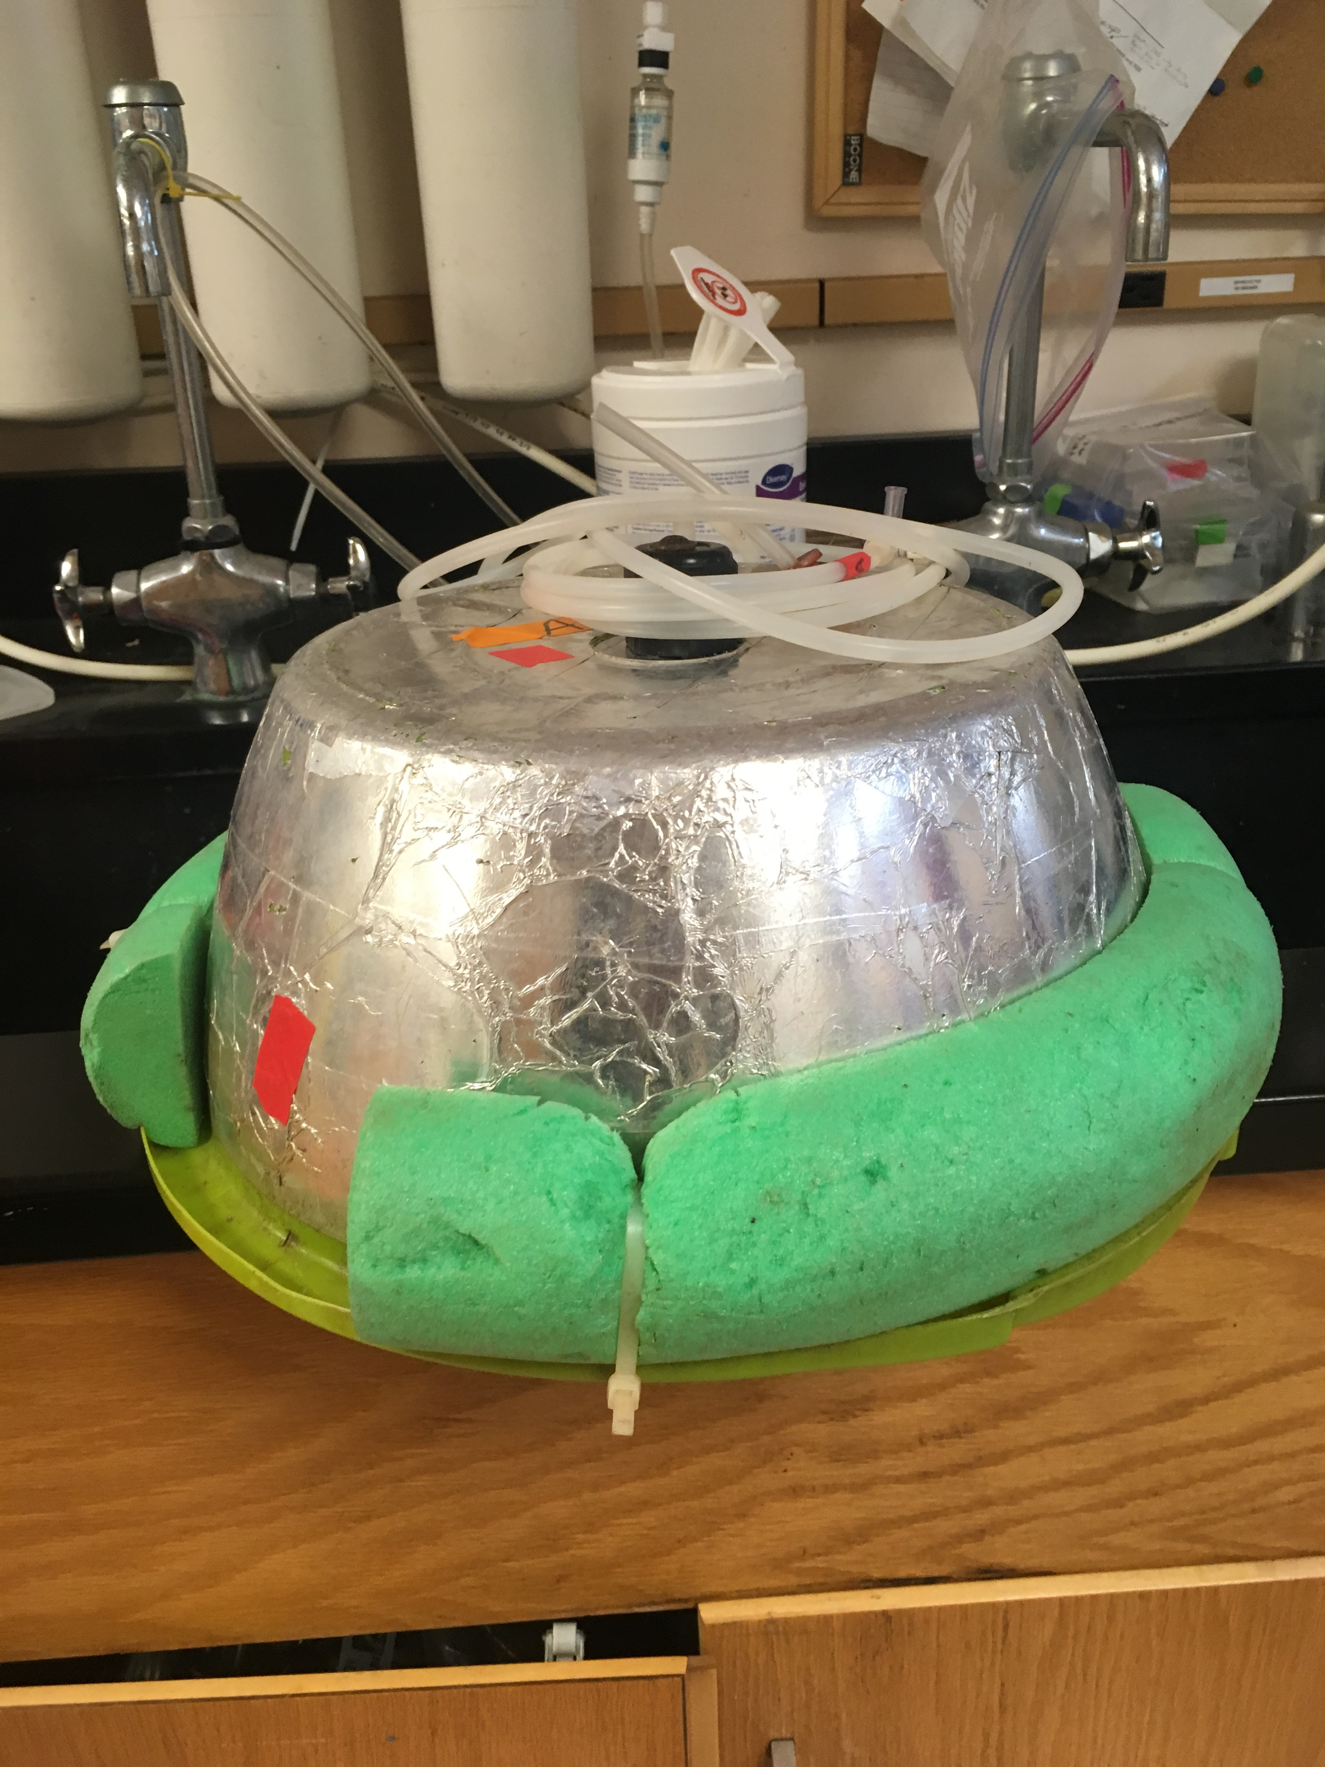
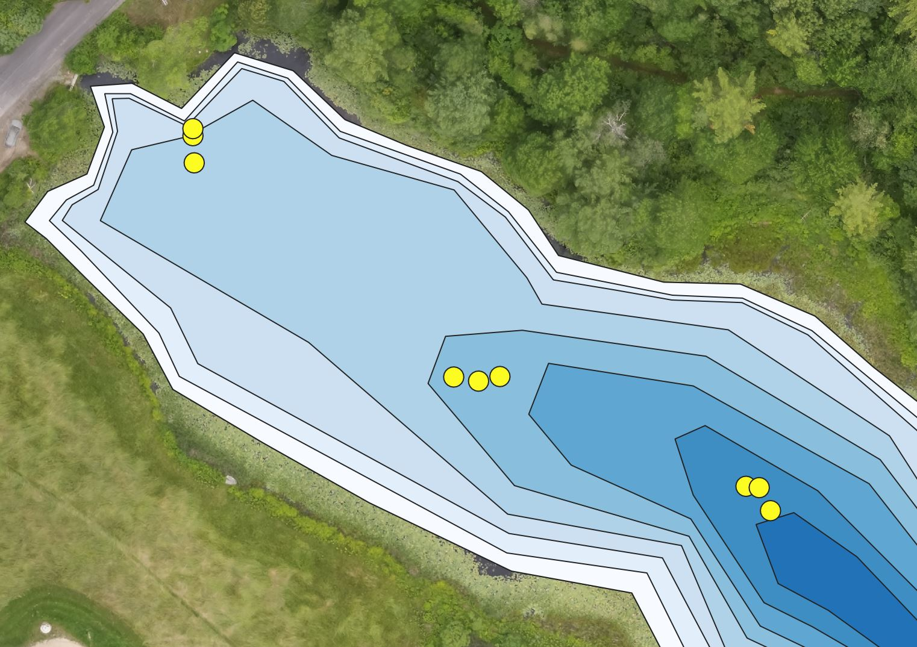
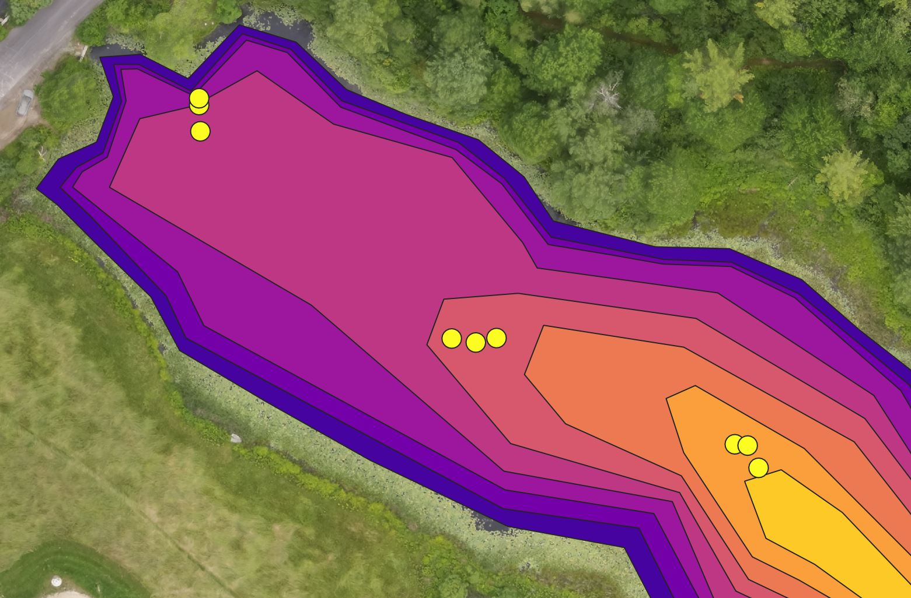
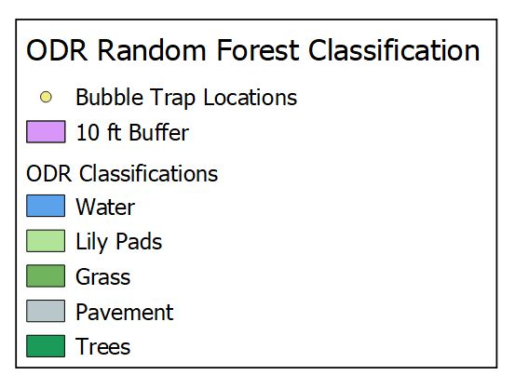
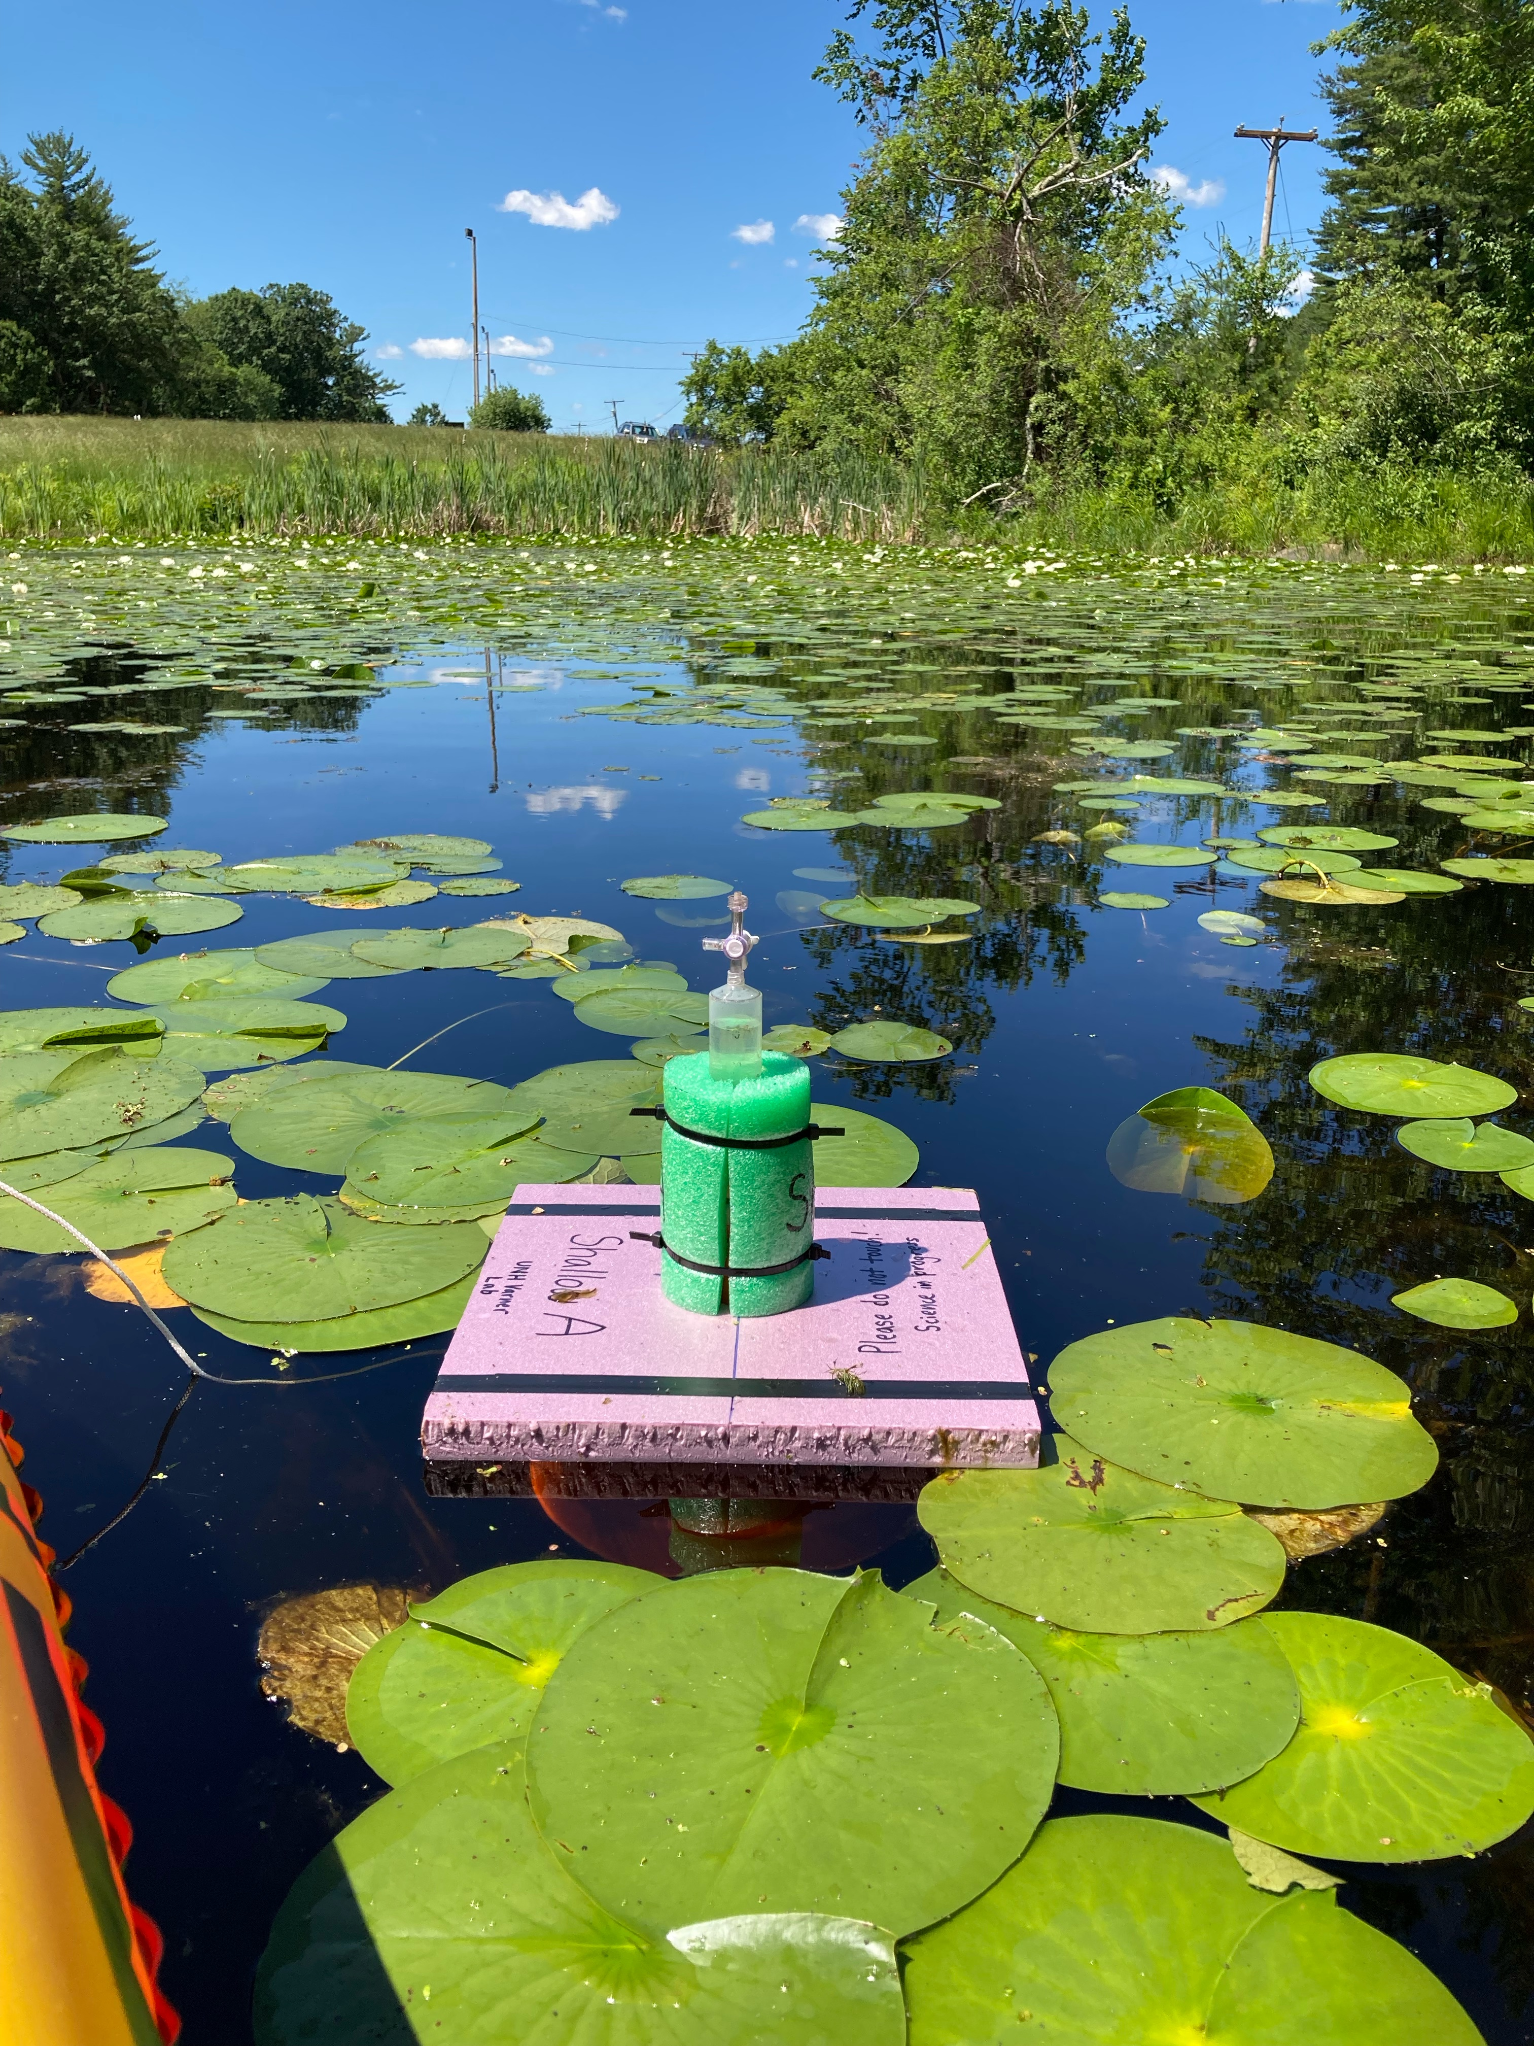
Assessing Controls of Methane and Carbon Dioxide Emissions from a Temperate Reservoir
Angelica M. Dziurzynski^{1,2}, Clarice R. Perryman^{2,3}, Natalie A. White⁴, Ruth K. Varner^{2,3}
¹Department of Biological Sciences, University of New Hampshire, Durham, USA, ²Department of Earth Sciences, University of New Hampshire, Durham, USA, ³Institute for the Study of Earth, Oceans, and Space, University of New Hampshire, Durham, USA, ⁴Department of Natural Resources and the Environment, University of New Hampshire, Durham, USA
B35E - 1472
Fig. 1. Aerial image of ODR taken on July 8th using UAS. Image courtesy of Michael Palace and Franklin Sullivan (palace@guero.sr.unh.edu) and geology.com.
Background:
Temperate inland waters are major sources of atmospheric CH₄ and CO₂ ^{1,2}
Increased climate warming will lead to increased CH₄ and CO₂ emissions as warming encourages microbial metabolism of organic carbon in lake sediments ^{3,4}
Inland waters are projected to have increased productivity, leading to excess CH₄ and CO₂ emissions ^{5,6}
Study Site:
The Old Durham Reservoir (ODR) is a 13 acre highly eutrophic inland water body located in Durham, NH, USA ⁷ (Fig. 1, 2)
Characterized by calm waters and is dominated by Nymphaea odorata (American water lily)
Results:
(a)
(b)
Fig. 4. Average net CH₄ fluxes (mg m⁻² d⁻¹) (a) and average net CO₂ fluxes (µmol m⁻² s⁻¹) (b) compared to depth sites. Depths at sampling sites are 4.26 ft, 5.24 ft, and 7.54 ft at the shallow, middle, and deep sites, respectively. Net CH₄ fluxes decreased with depth (ANOVA, p = 0.011), but net CO₂ fluxes were not different between the three sites (p = 0.078). Seasonal average net CH₄ fluxes increased with the proportion of lily pad cover (R² = 0.54, p = 0.015).
Ebullitive CH₄ (mg m⁻² d⁻¹)
n = 12
n = 12
n = 12
Net CH₄ Flux (mg m⁻² d⁻¹)
Net CO₂ Flux (µmol m⁻² s⁻¹)
Ebullitive CH₄ (mg m⁻² d⁻¹)
n = 12
n = 12
n = 12
n = 12
n = 3
n = 12
Depth | DOC (mg C/L) | TDN (mg N/L) | NO₃ (mg N/L) | Surface Temperature (°C) | Bottom Temperature (°C) | Surface pH | Bottom pH | Lilypad % Cover
Shallow | 20.7 ± 5.0 | 0.76 ± 0.2 | 0.0091 ± 0.002 | 24.4 ± 3.8 | 20.8 ± 3.3 | 5.8 ± 0.4 | 5.3 ± 0.3 | 55.5
Middle | 19.7 ± 4.2 | 0.70 ± 0.1 | 0.0088 ± 0.002 | 23.7 ± 4.5 | 19.3 ± 2.1 | 5.7 ± 0.4 | 5.3 ± 0.4 | 46.9
Deep | 17.7 ± 4.5 | 0.69 ± 0.1 | 0.0089 ± 0.003 | 22.8 ± 4.3 | 18.8 ± 1.9 | 5.9 ± 0.6 | 5.4 ± 0.4 | 10.5
Fig. 5. Average ebullitive CH₄ (mg m⁻² d⁻¹) collected from floating bubble traps compared to depth sites. Samples (total number = n) were collected from June 21st through October 22nd, 2021. Note: trap SB broke on July 8th, resulting in 3 samples being taken. Ebullitive CH₄ was extrapolated to modal emissions by depth using an exponential fit (y = 263.04e^{-0.631x}) with R² = 0.8135. Ebullitive fluxes varied between traps (ANOVA, p = 0.001)), and overall were larger in the shallow area than in the middle or deep areas (p = 0.003).
Table. 1. Average water quality and temperature measurements and N. odorata percent coverage by depth site. DOC, TDN, and NO₃ were measured from surface water samples.
Research Questions:
What is the magnitude of ebullitive CH₄ emissions across the reservoir?
How do net CH₄ and CO₂ emissions from the reservoir vary with depth?
(a)
(b)
⁻² ⁻¹
Fig. 7. Random forest classification analysis of ODR. Classification results had 100% accuracy. Classes were used to differentiate lily pads to determine percent cover for depth sites (see Table. 1) based on 10 ft buffers.
Fig. 2 Dominant vegetation at ODR (Nymphaea odorata, American water lily)
Fig. 6. Depth (ft) gradient of ODR (a) and ebullitive CH₄ emissions (mg m⁻² d⁻¹) scaled by depth (b). ODR drone imagery was georeferenced to a previously made bathymetry map of the reservoir. Polygons were created to signify depth variation. Extrapolated ebullitive CH₄ data
(y = 263.04e^{-0.631x}) from Fig. 5 was used to scale emissions across the reservoir.
Methods:
Flux Measurements:
Deployed nine bubble traps to collect ebullitive CH₄
emissions (Fig. 3 a,c)
Used three floating static flux chambers to measure net CH₄ and CO₂ approximately weekly (Fig. 3 b)
Sampled water temperature and pH at water surface and sediment surface
Collected surface water samples to be analyzed for dissolved CH₄ and CO₂, DOC, TDN, and other water quality parameters
Drone Imagery:
UAV was flown over reservoir on July 8th, 2021 and captured multispectral images
Analyzed images using QGIS and Google Earth Engine
Georeferenced bathymetry map to scale ebullitive fluxes ⁸
Random forest classification used to differentiate vegetation
Trace Gas Analysis:
Samples were analyzed for CH₄ (GC-FID) and for CO₂ (IRGA)
Data was analyzed using R-coding and Excel
(a)
(b)
Conclusions:
Average net CH₄ emissions were strongly associated with depth, whereas average net CO₂ emissions were not (Fig. 4)
Ebullitive CH₄ emissions varied with depth, and when scaled, the ebullitive CH₄ budget for the reservoir was 1.0 kg d⁻¹ (Fig. 5, 6b)
Differences in CH₄ and CO₂ fluxes between shallow, middle, and deep sites may also be impacted by differences in vegetation cover (Table. 1, Fig. 7), as emergent and floating aquatic vegetation can impact carbon inputs, microbial activity, and gas transport in freshwater ecosystems
Random forest classification found that lily pad percent cover decreased as depth increased, which could be tied to decreasing CH₄ emissions with increasing water depth (Fig. 4a)
As the climate continues to warm, temperatures will increase and lead to further primary productivity and nutrient availability, which will contribute to increased CH₄ and CO₂ emissions
Future studies can be done to determine seasonal changes in CH₄ and CO₂ emissions from ODR
(c)
Fig. 3. Bubble trap before deployment (a). Floating static flux chamber (b). Bubble trap deployed at ODR (c).
Acknowledgements:
This work was supported by the Hamel Center for Undergraduate Research through the University of New Hampshire. Thank you to the UNH Trace Gas Biogeochemistry Laboratory for the use of their facilities. Special thanks to Dr. Michael Palace, Dr. Sophie Burke, and Mr. Franklin Sullivan for the drone imagery and QGIS assistance. Special thanks to Mr. Owen Price for his endless support. Thanks to Ms. Cynthia Bova for collecting additional samples.
References:
¹Bastviken et al. (2011), Science.; ²Raymond et al. (2013), Nature.; ³Audet et al. (2017), Freshwater Biology.; ⁴Marotta et al. (2014), Nature Climate Change.; ⁵Beaulieu et al. (2019), Nature Communications.; ⁶Wik et al. (2013), Journal of Geophysical Research.; ⁷Blanchette and Haney (2002), Center for Freshwater Biology. ⁸”Durham Reservoir Depth Map,” <https://usa.fishermap.org/depth-map/durham-reservoir-nh/#top-content>.

