Slide 1
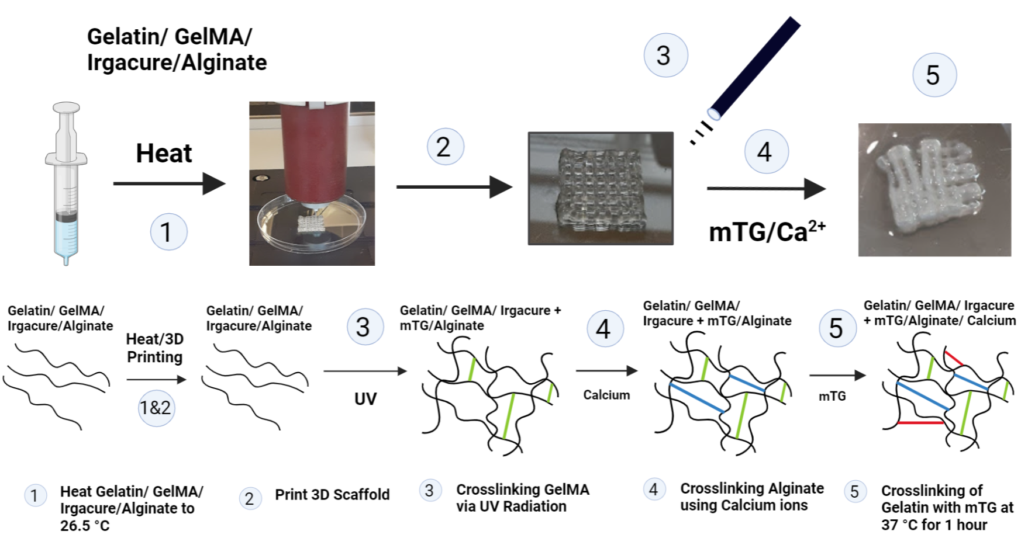
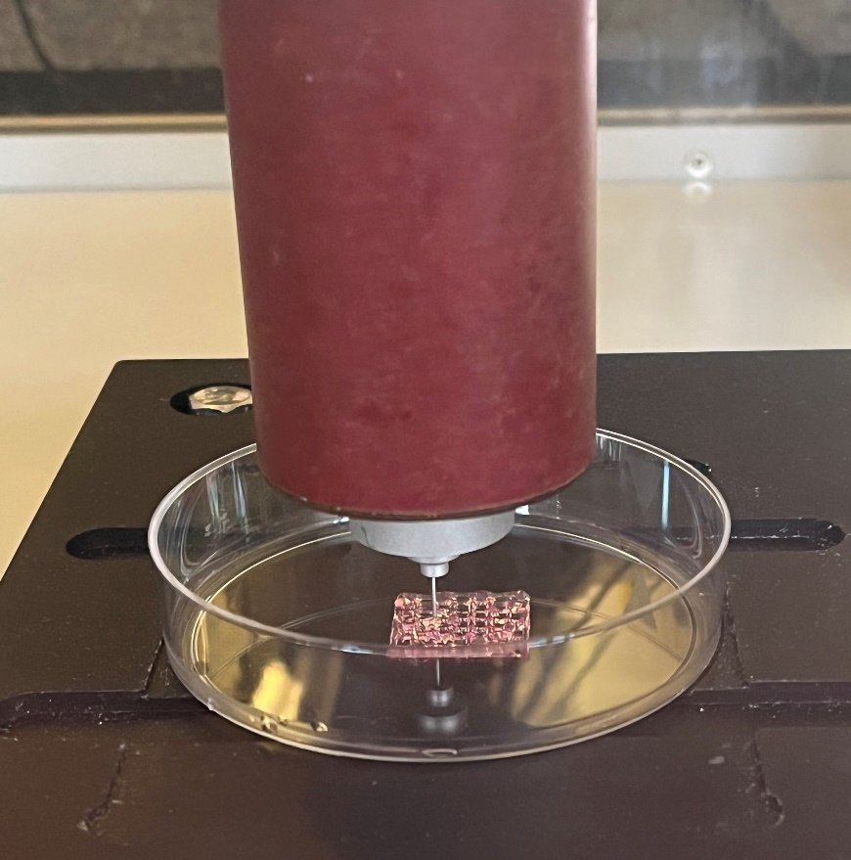
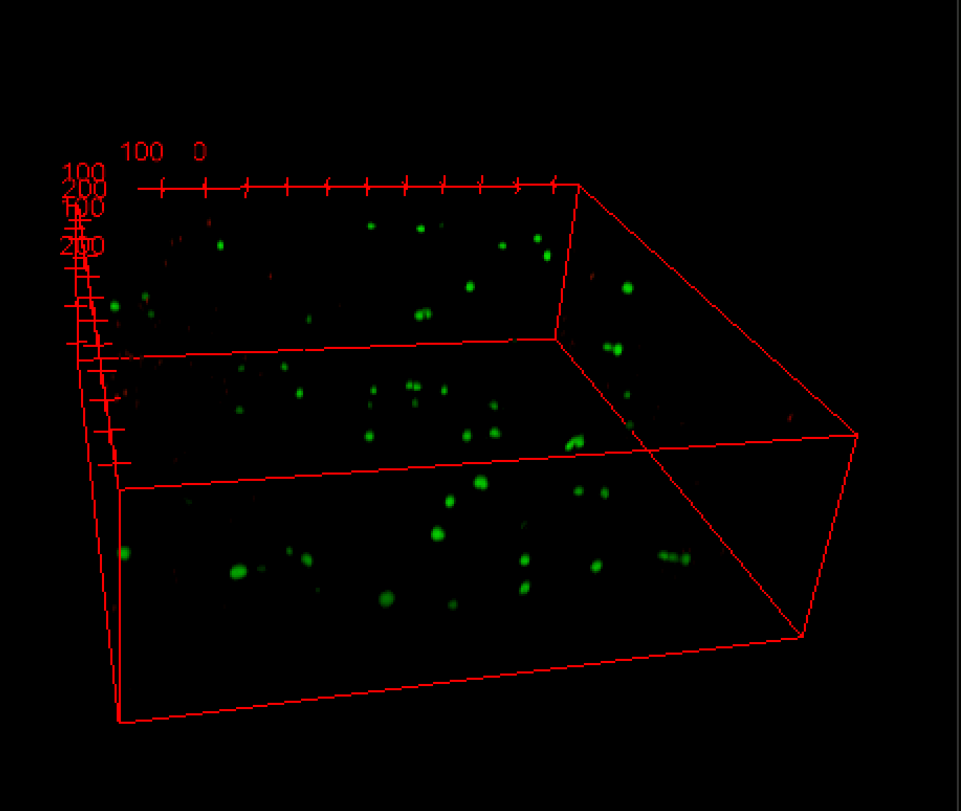
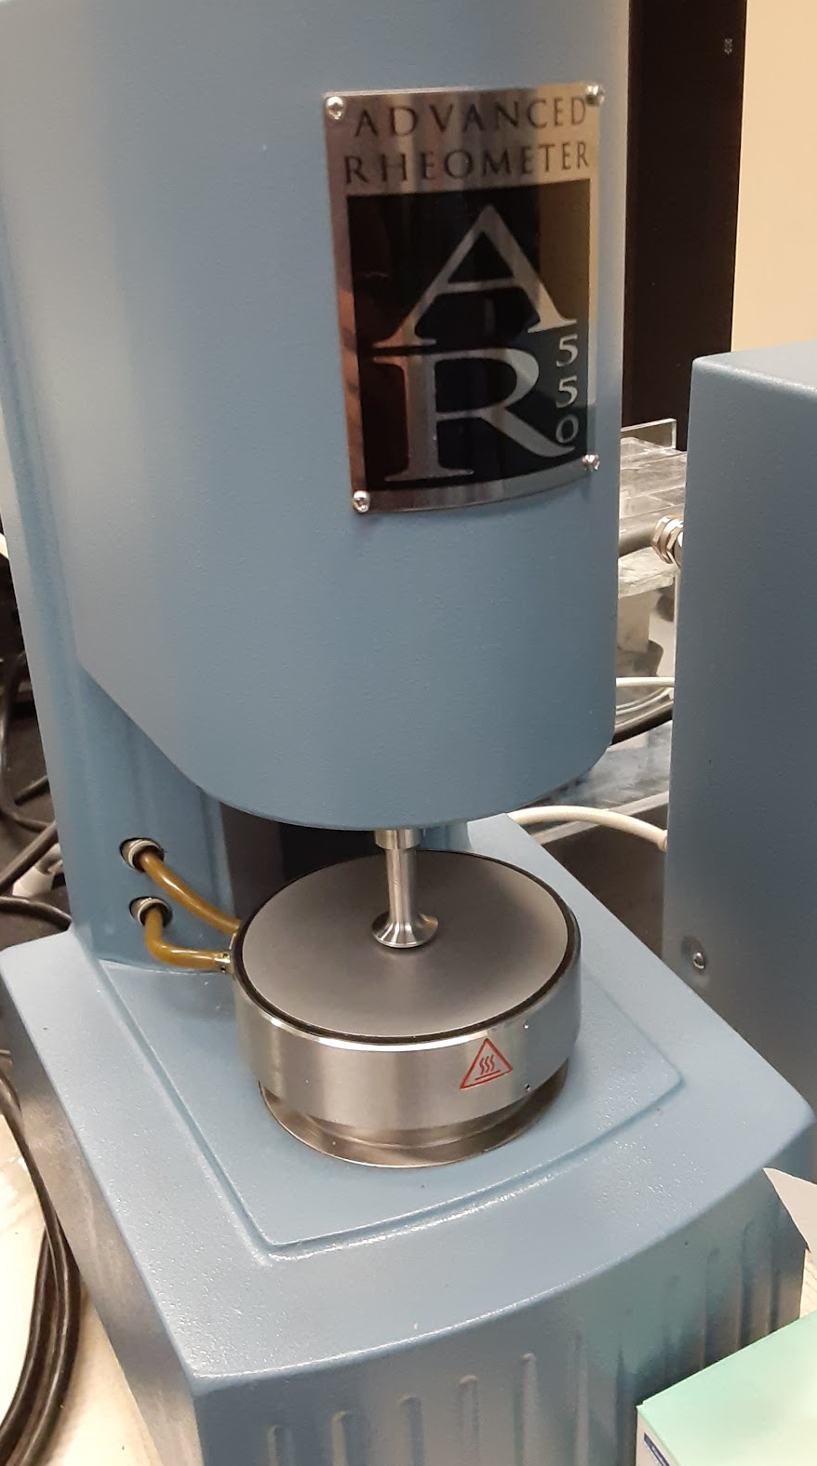
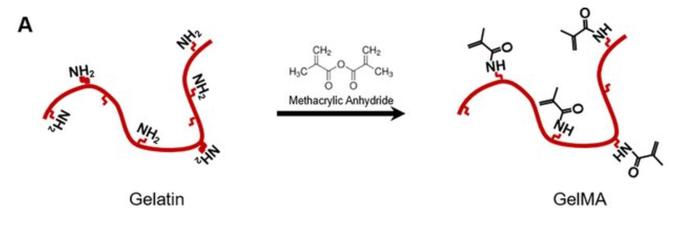
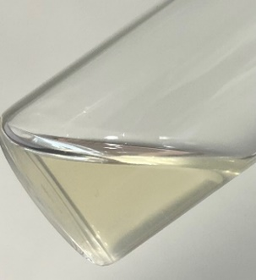
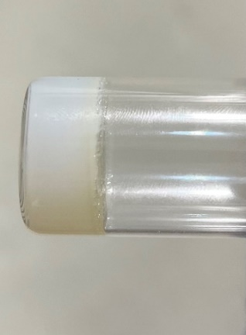
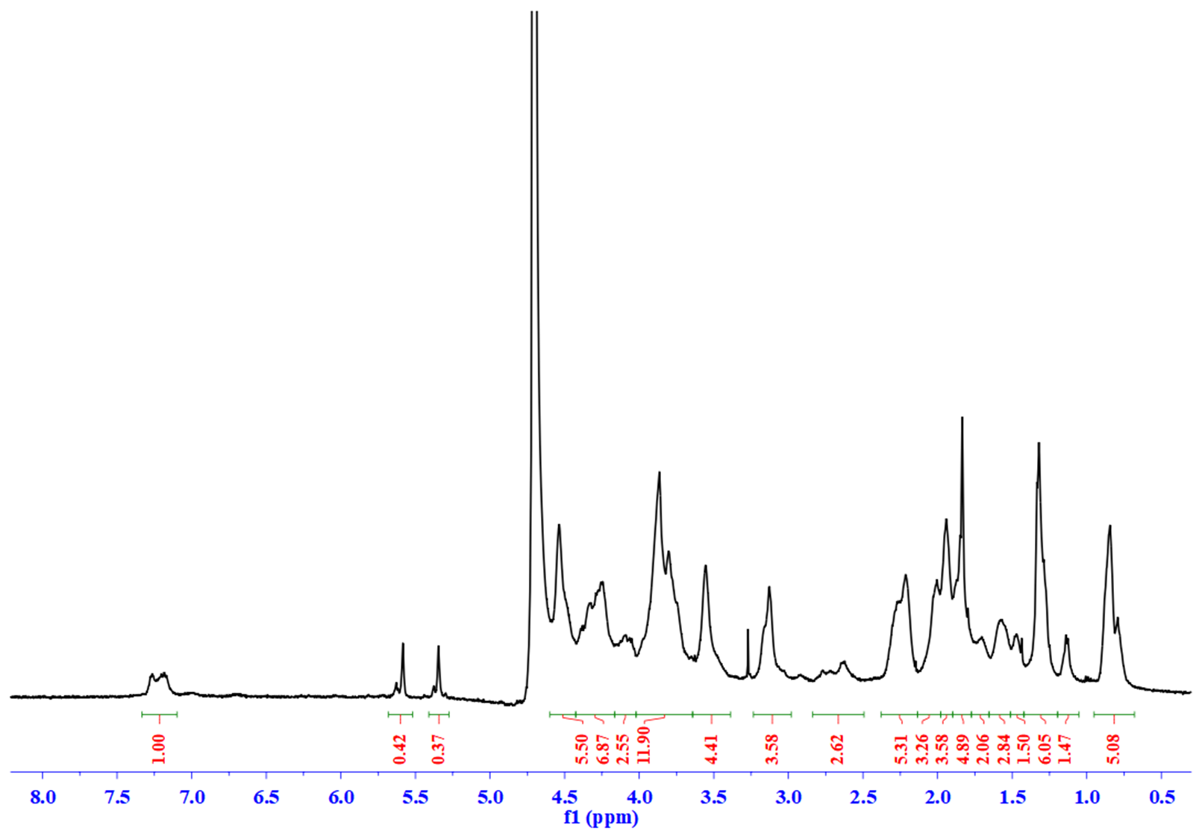
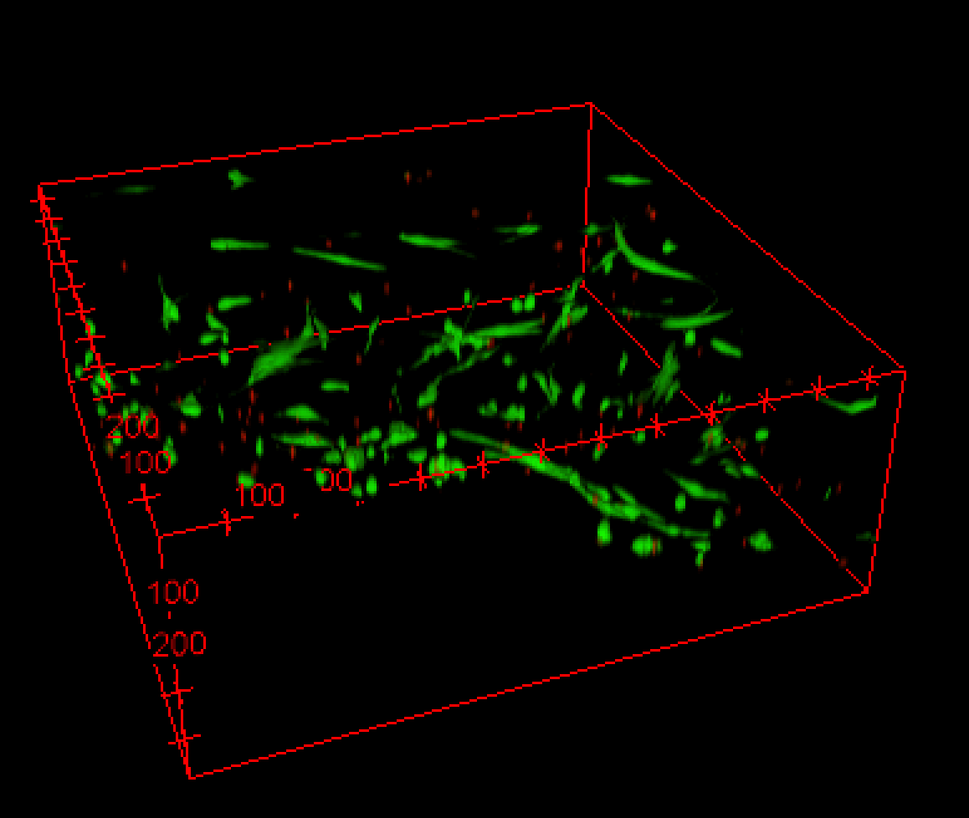
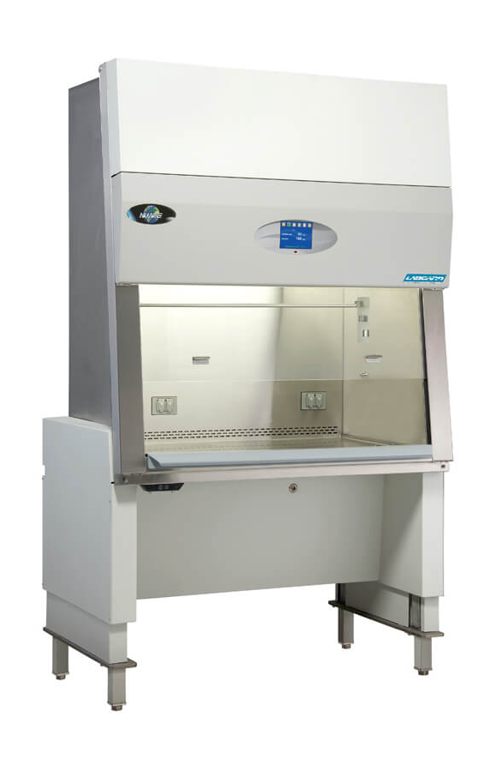
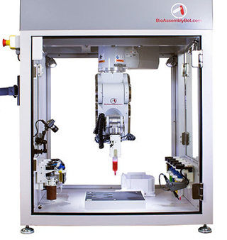
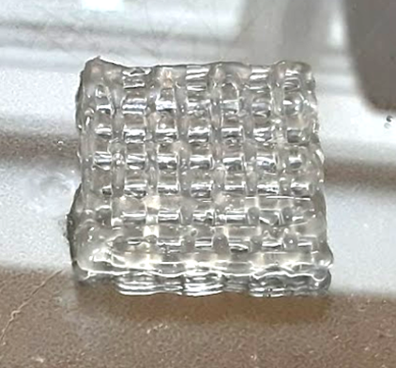
Gelatin/GelMA composite bioink for improved biocompatibility and mechanical stability of 3D printed tissue-like structures Maria Skidmore¹, Patrick Earley², Kyung-Jae Jeong^{1*} ¹Department of Chemical Engineering, University of New Hampshire, Durham, NH 03824 ²Department of Mechanical Engineering, University of New Hampshire, Durham, NH 03824 *Corresponding Author KyungJae.Jeong@unh.edu
Introduction
Schematic
3D Bioprinting
The shortage of donor tissue for transplantation, along with a need for a three-dimensionally and accurate tissue microenvironments for drug development, has led to the recent use of 3D bioprinting. 3D bioprinting has the potential to produce complex patient-specific biological structures that mimic native tissue with even cell distribution, tunable mechanical properties, biocompatible materials, various tissue architectures, and improved vasculature for cell growth and proliferation. Cell-laden biomaterials, called bio-inks, are deposited layer-by-layer into predetermined structures from stereolithography files produced by computer-aided design (CAD) and medical image processing. To date, finding a printable bio-ink that displays both excellent biocompatibility and mechanical strength remains a challenge. We propose a design of a composite bio-ink with enhanced mechanical strength and biocompatibility by forming an interpenetrating network (IPN) between naturally occurring biopolymers gelatin, gelatin-methacryloyl (GelMA), and alginate.
Human Dermal Fibroblast (HDF) Culture
HDF 2D Culture
3D Bioprinting with Thermal Control
Methods
2000 μm
Crosslinking Methods
Photo-polymerization (GelMA), ionic crosslinking (Ca²⁺ with alginate), and enzymatic crosslinking (mTG and Gelatin)
LIVE/DEAD Assay with Confocal Microscopy
Day 1
Day 1
Preparation of Bio-inks
Sterile solution of Irgacure (0.5% w/v), Gelatin (5% w/v), and GelMA (5% w/v)
Alginate (1% w/v) was added to the solution and dissolved at 37 °C
Synthesis and Characterization of the Composite Bio-Ink
Synthesis of GelMA
a
b
Rheological Testing
Measures amount of stress and strain
Frequency-dependent sweep was performed on the hydrogel at 25 °C
Angular frequency was changed, while storage modulus (G’) and loss modulus (G’’) were observed
Bae et al. (2016), PLoS ONE.
Day 7
Day 7
Lysine is an amino acid found in gelatin’s structure
Primary amines on lysine residues react upon the addition of methacrylic anhydride (MA) to form photocrosslinkable groups
Before UV (a) and after UV (b)
UV irradiation rapidly crosslinks GelMA
Cell Culture
Human Dermal Fibroblasts (HDF) were cultured to 80-90% confluence at 37 °C and 5% CO₂
Cells were fed every 2 to 3 days with DMEM media supplemented with 1% penicillin/streptomycin and 10% fetal bovine serum
HDF cells (5×10⁶ cells/mL ) were mixed with the bio-ink
a
Rheology
b
a) UV irradiation rapidly polymerizes Gelatin/GelMA
mTG and Ca²⁺ bath increased hydrogel stiffness by 700-800 Pa.
b) Storage modulus is much larger than the loss modulus, showing that the structure forms a hydrogel that is strong and has solid-like properties
Summary
GelMA was successfully synthesized with 90% substitution
Composite bio-ink printed at extrusion pressures at 2-5 psi with high resolution layer-by-layer at 26.5°C
Gelatin, GelMA, alginate composite bio-ink rapidly cross-linked by UV photopolymerization
Post-processing (mTG and Ca²⁺ ) bath increased hydrogel stiffness after UV curing
LIVE/DEAD assay with confocal microscopy showed biocompatibility of the bio-ink and 3D bioprinting method
Over 7 days, HDF proliferated and fully spread in the 3D bio-printed structure
NUAIRE
3D Bioprinting
BioAssemblyBot 400 and TSIM modeling software (Advanced Solutions Life Sciences)
Bioprinter sterilized with 10% bleach, and 70% ethanol and HEPA filtration system
Bio-ink printed at 26.5 °C, 2-5 psi, and 5 mm/s
Printing of the Composite Bio-Ink
CAD Design
Tested
7 different printing methods
46 polymer combinations
4 CAD designs
Found optimal extrusion pressure, printing speed, and printing temperature for each method
Bio-Ink Printing
Acknowledgements
This research was sponsored by the U.S. National Science Foundation and was accomplished under the Grant No. OIA-1757371. Thank you to Seth Edwards for assisting with the confocal microscopy and Jeil Lee, PhD for assisting with the ¹H NMR.
Advanced Solutions Life Sciences

