Slide 1
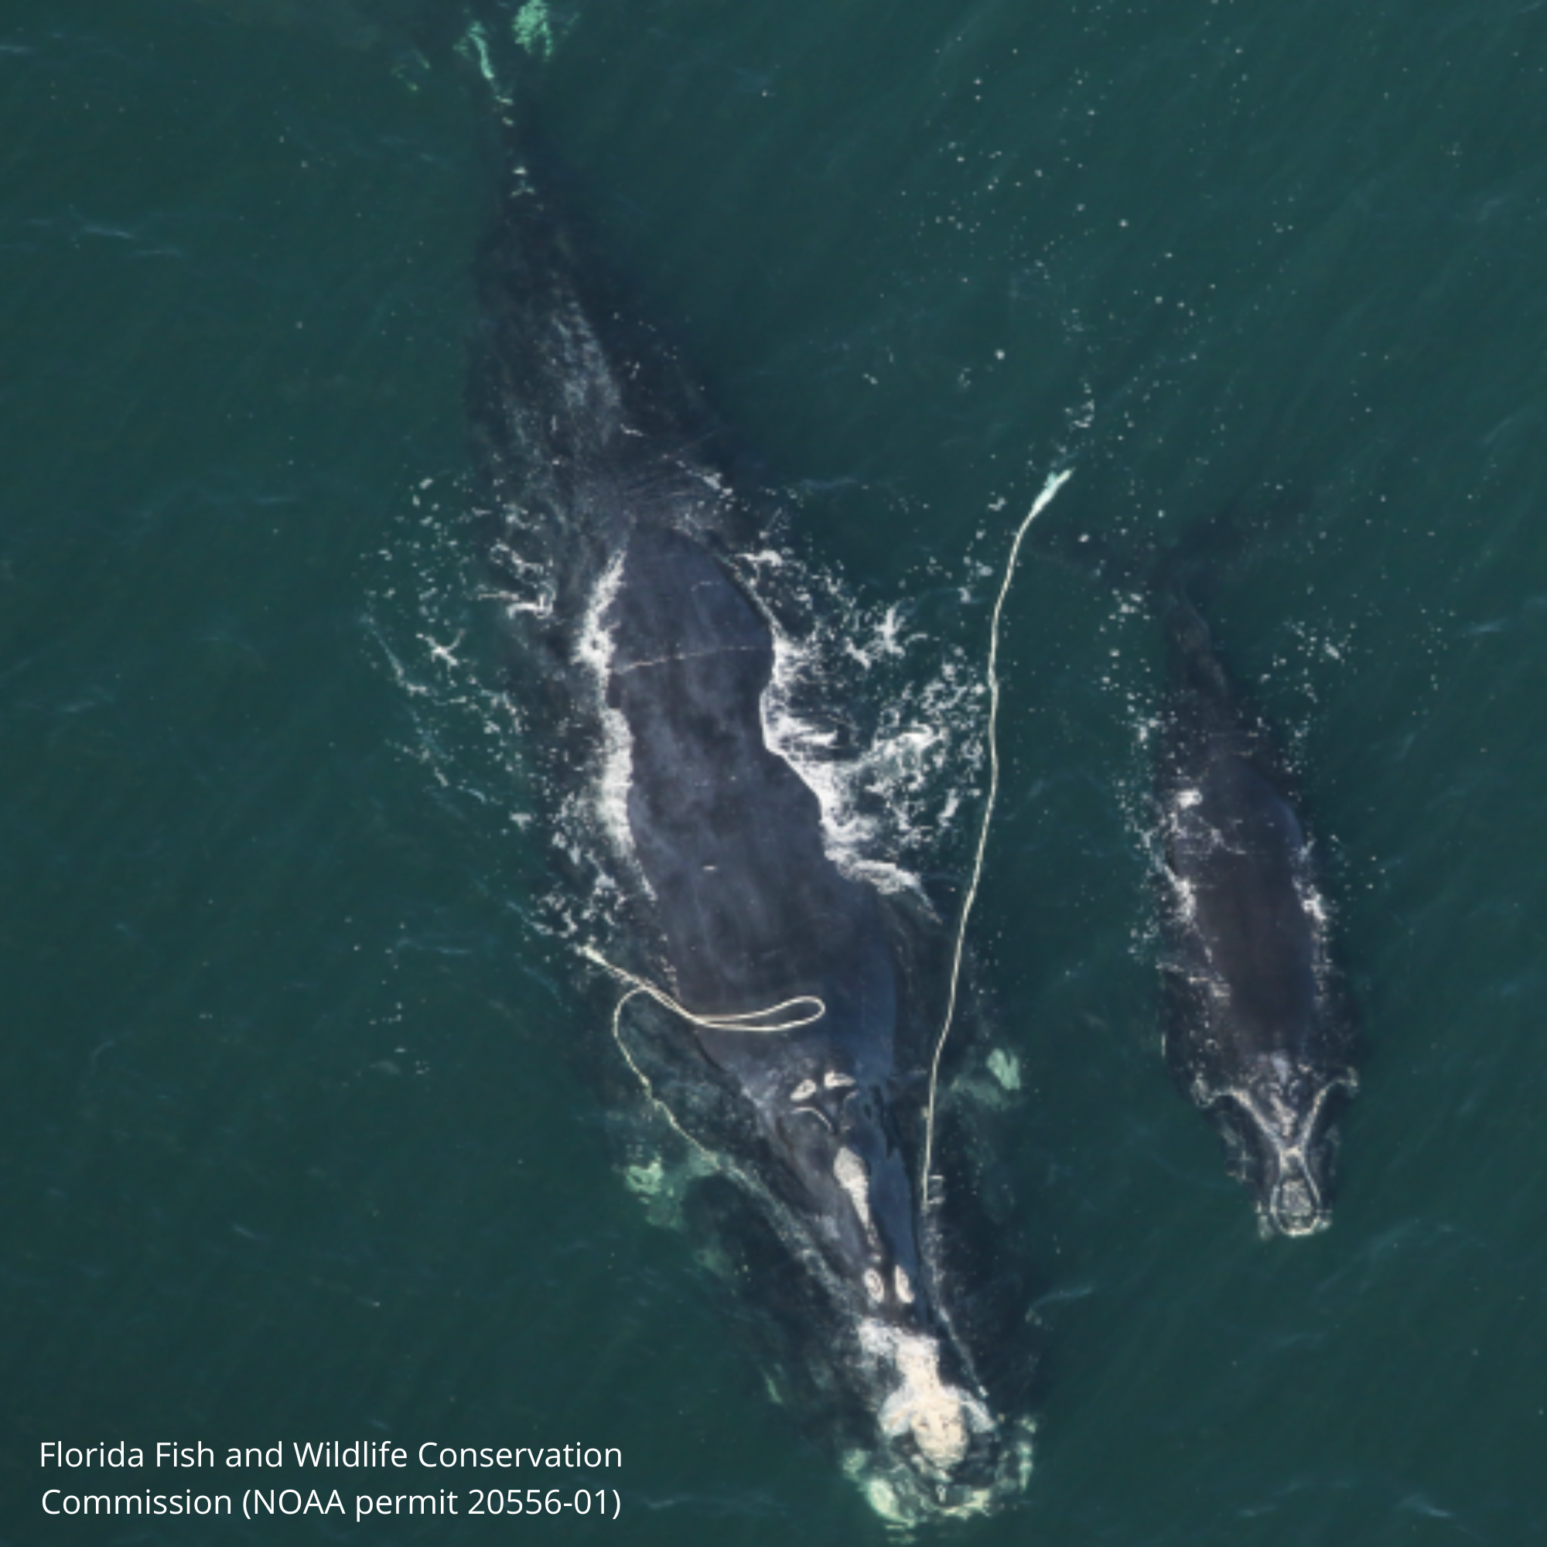
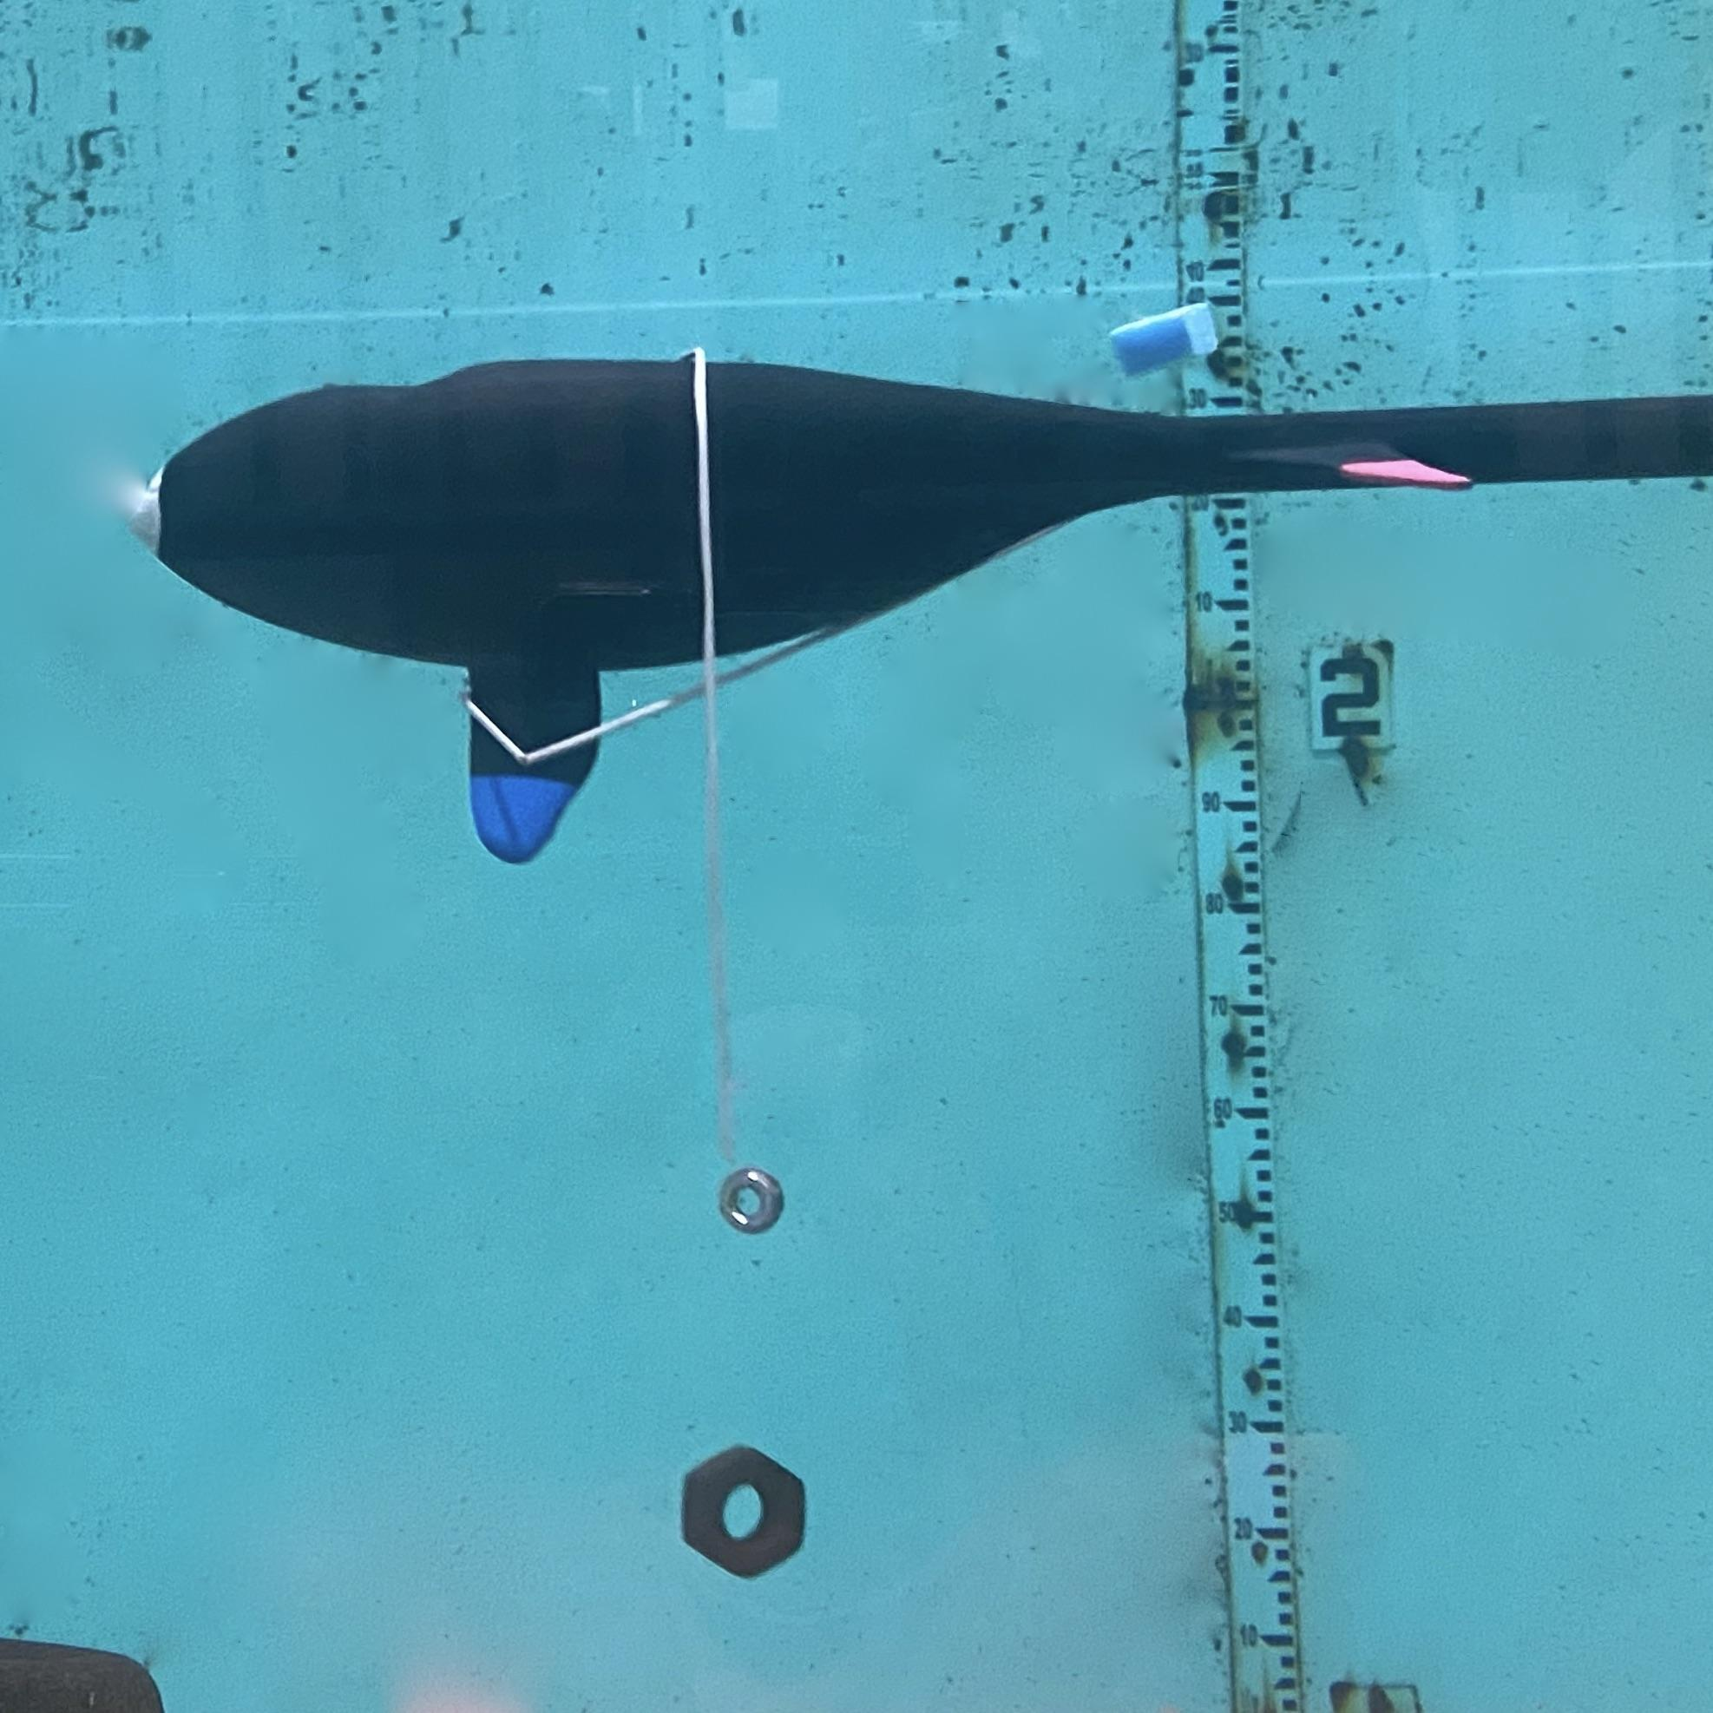
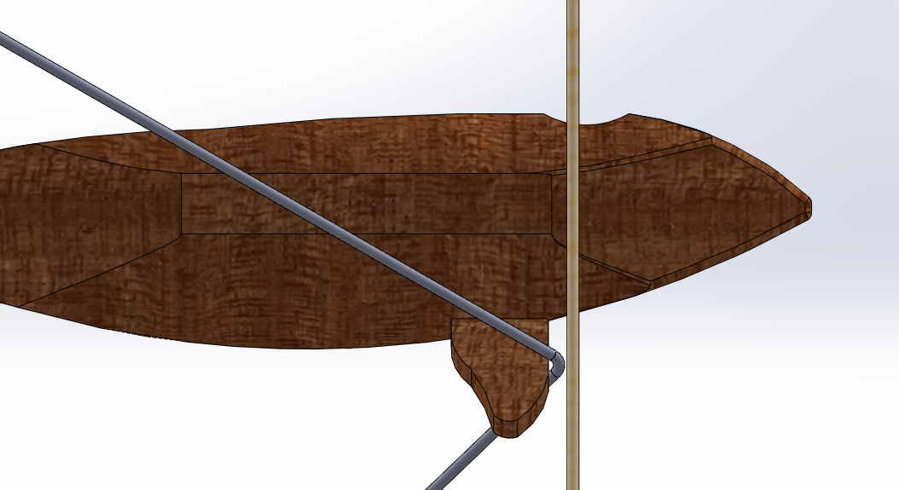
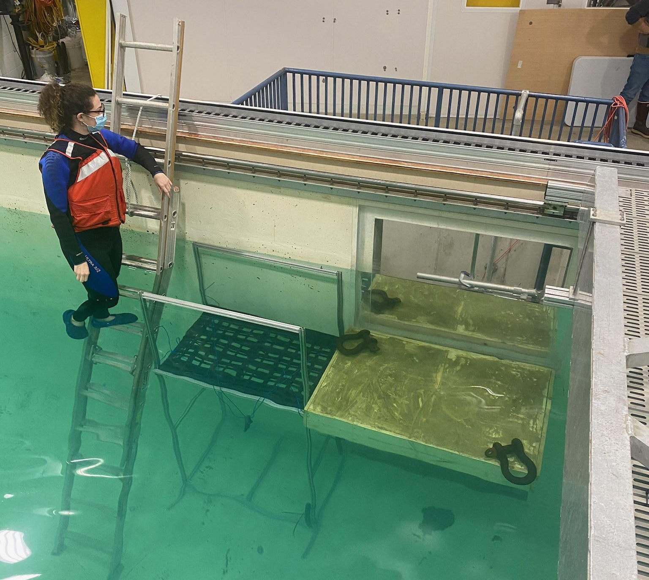
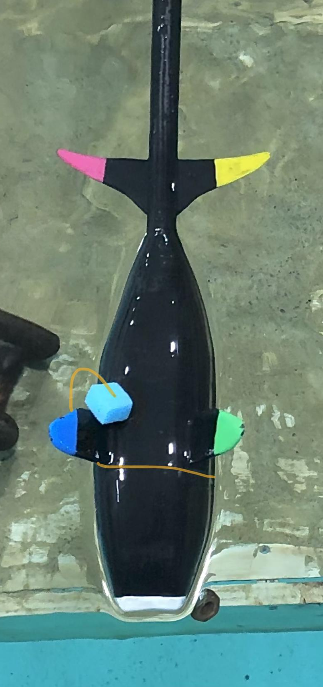
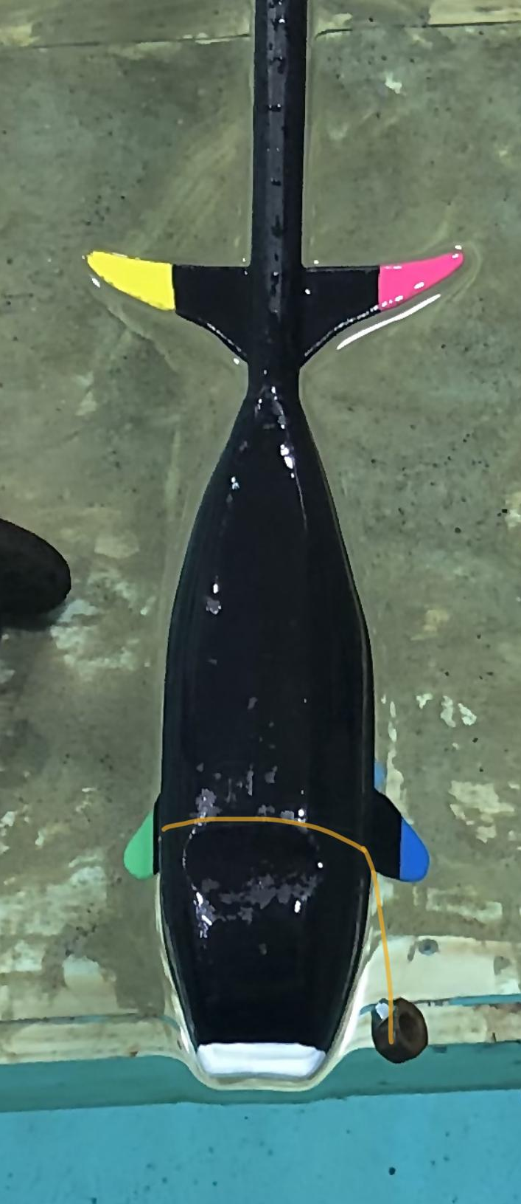
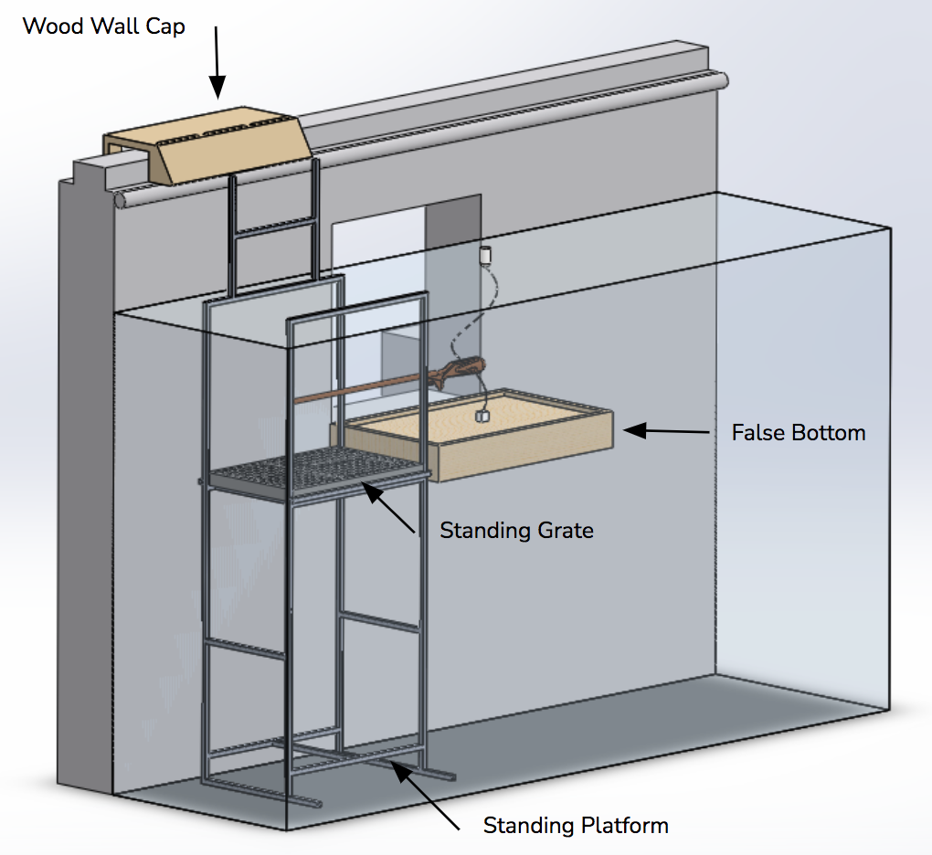
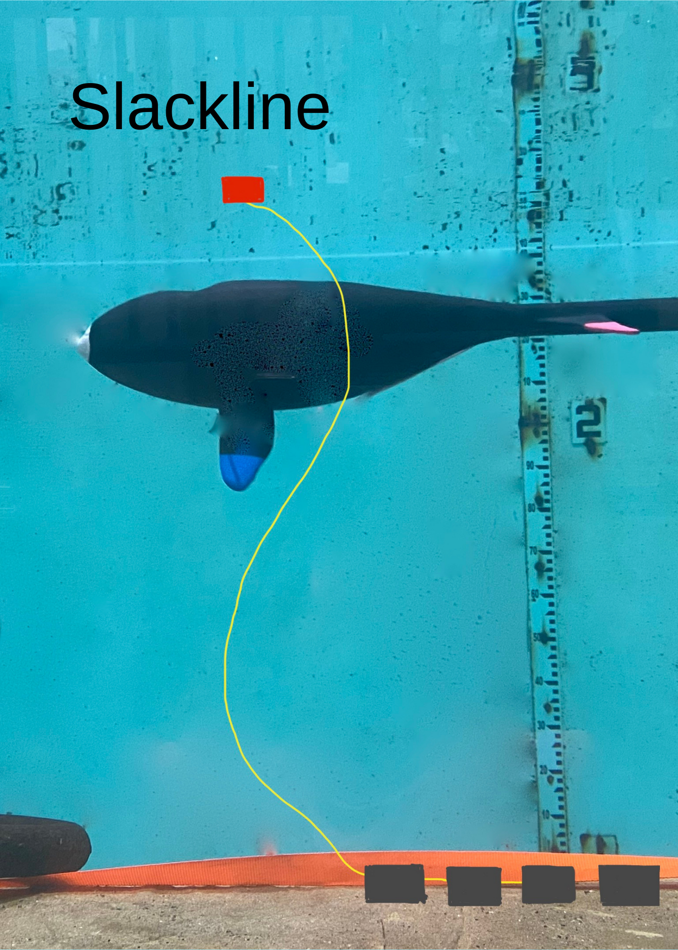
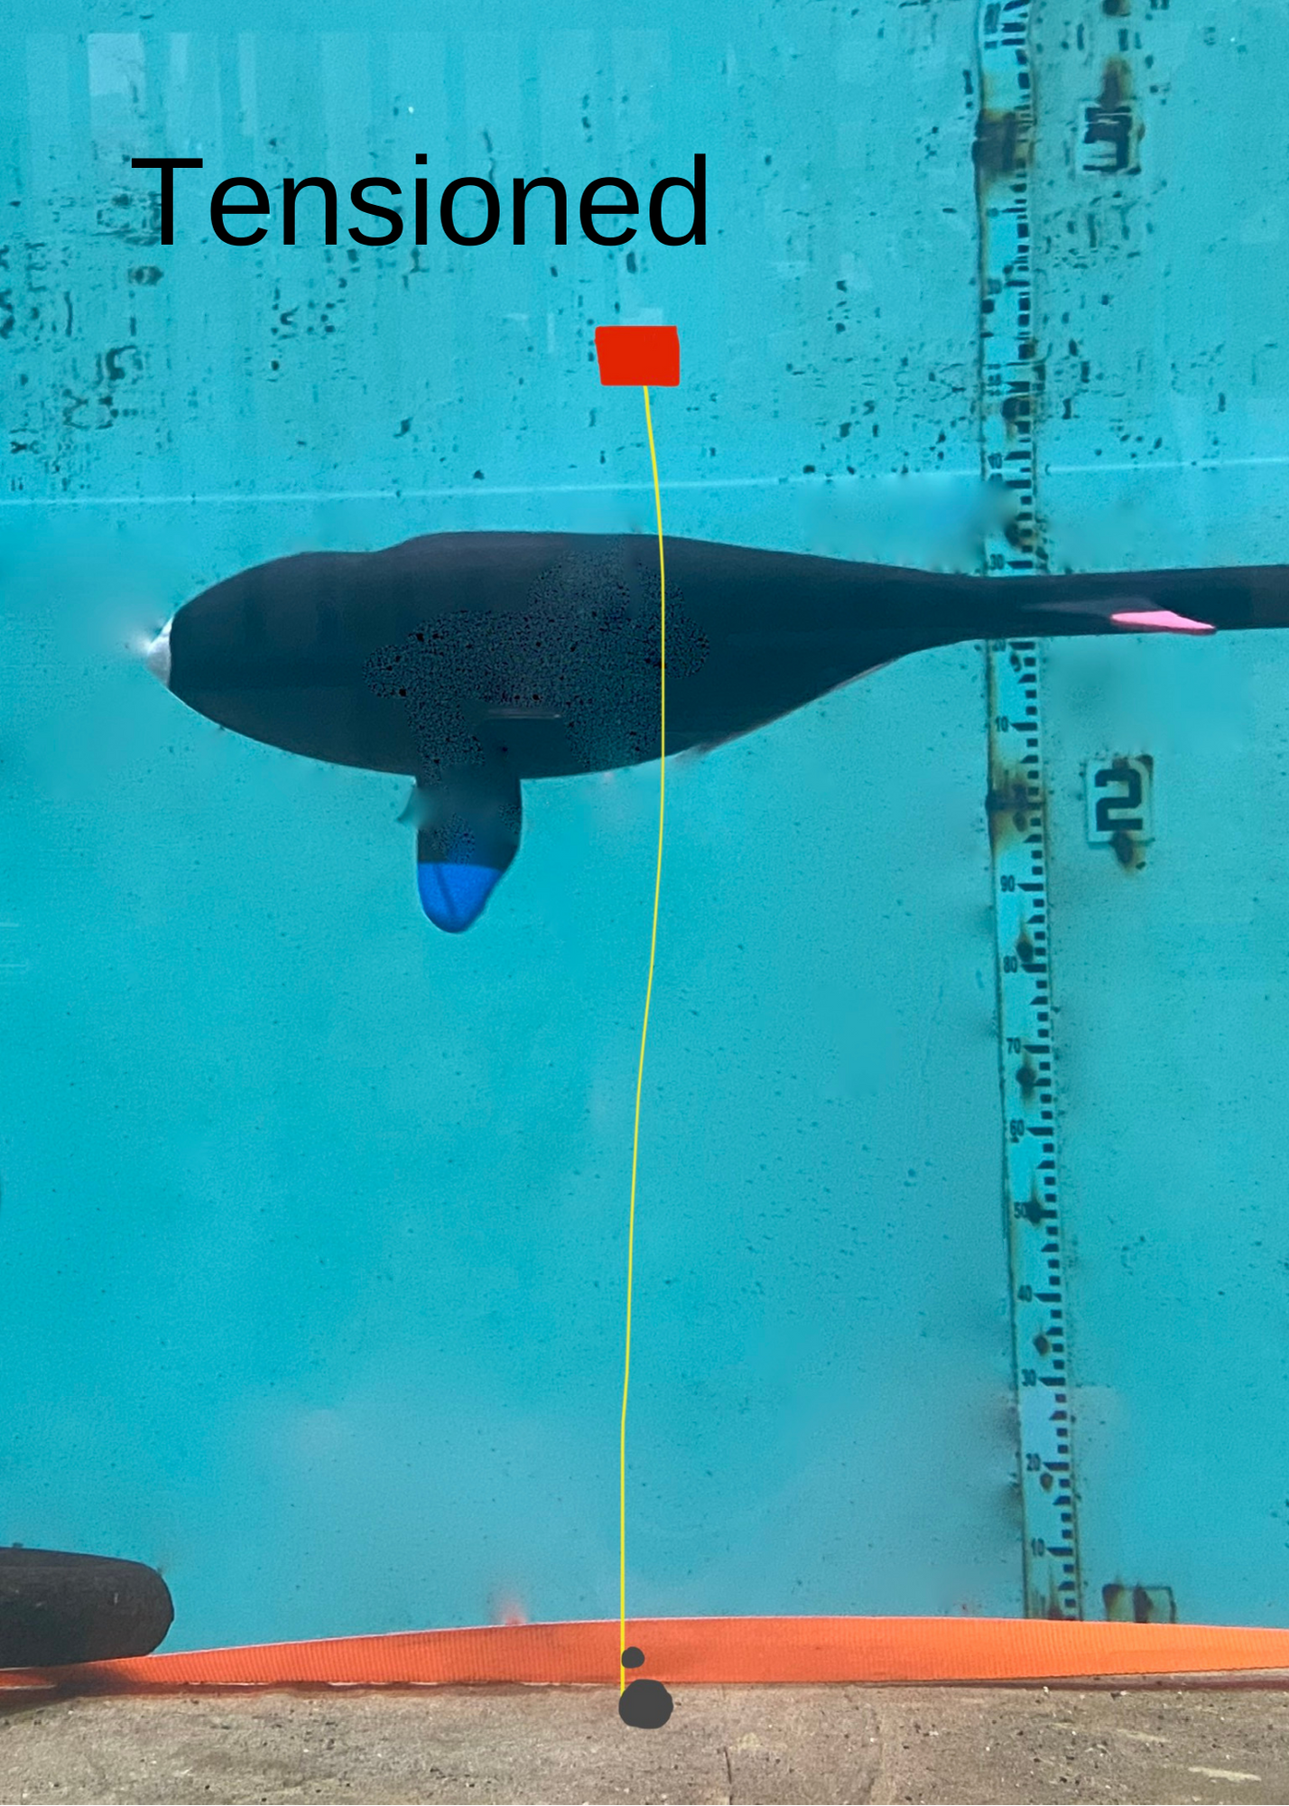
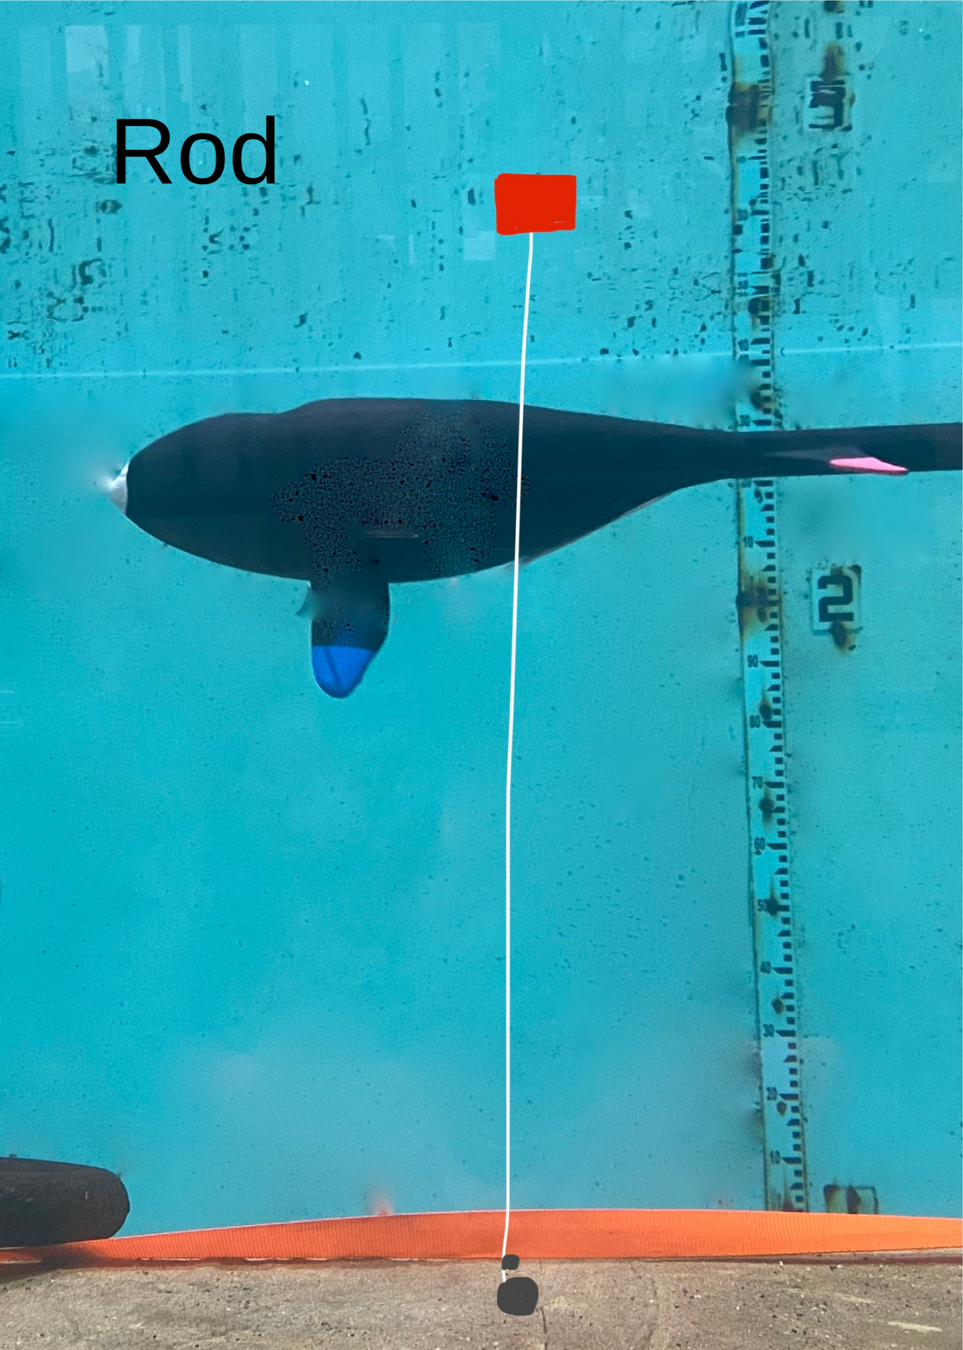
Right Whale Entanglement Simulation Team TECH 797: Undergraduate Ocean Research Project Lindsay Cartmell (BIO), Alexis McGarry (ME) & Katie Swenson (OE)
Project Advisor Professor M. Robinson Swift, graduate student Louis Gitelman Department of Ocean Engineering, University of New Hampshire
Introduction
North Atlantic Right Whale Simulation Speeds
Target versus Simulated Speeds
Speed Type | Description | Full Scale Speed | Model Speed
Top Speed | Migration Speed | 6 mph | 15.6 in/s
Mid Speed | Middle Speed | 2.2 mph | 5.77in/s
Low Speed | Leisure Speed (most common) | 1 mph | 2.62in/s
Discussion
Fewer than 336 NARW
Ongoing anthropogenic
Unusual Mortality Event
83% have been entangled
80% of cases are from fixed
fishing gear, though offshore
development is expanding
Nobody has witnessed the entanglement process, but
reverse engineering studies show a roll away from mooring lines upon detection is typical
Howle et al. show entanglement with slackline scenarios in a computer simulation
Goal: Investigate if specific mooring configurations could prevent entanglement.
Tensioned moorings and rod moorings show lower rates of entanglement than slackline moorings
If rods with bending stiffness are implemented, they must fracture completely to ensure no entanglement
Composite rods and tensioned mooring lines may be implemented in aquaculture, marine structures, and buoy systems
As the need for offshore energy grows, the use of low risk entanglement structures may be the most viable option while protecting marine life
NARW are Critically Endangered, but other species benefit as well
Results
Slackline mooring system replicated Hain et al. slackline computer simulations, both based off of entanglement theory proposed by biologists
Both low and high tensioned mooring resulted in entanglement during high speeds and no entanglement at low speeds
Upon collision, an intact rod slid off the whale’s flipper and
resulted in no entanglement
In one trial, an incomplete fracture occurred in the low stiffness rod and resulted in entanglement
If the rod had a complete break, no entanglement would have occurred
Methods
1:45 Scaled, wooden model is used to simulate whale and mooring interactions
Slackline Lobster Trawl
Two Tensioned Moorings
Low and High Tensioned
Two Rod Moorings
Low and High Bending Stiffness
Hand-maneuvered into mooring line, rotated away
Each simulation tested at three speeds and three depths
References
Hain, J.H.W., Hampp, J.D., McKenney, S.A., Albert, J.A., Kenney, R.D., (2013). Swim speed, behavior, and movement of North Atlantic right whales (Eubalaena glacialis) in coastal waters of northeastern Florida, USA. PLoS ONE 8(1): e54340. https://doi.org/10.1371/journal.pone.0054340
Howle, L.E., Kraus, S.D., Werner, T.B. and Nowacek, D.P. (2019), Simulation of the entanglement of a North Atlantic right whale (Eubalaena glacialis) with fixed fishing gear. Marine Mammal Science, 35(3): 760-778. https://doi.org/10.1111/mms.12562
Knowlton, A.R., Hamilton, P.K., Marx, M.K., Pettis, H.M., Kraus, S.D., (2012). Monitoring North Atlantic right whale Eubalaena glacialis entanglement rates: a 30 yr retrospective. Mar Ecol Prog Ser 466:293-302. https://doi.org/10.3354/meps09923
Pettis, H.M., Pace, R.M. III, Hamilton, P.K. 2022. North Atlantic Right Whale Consortium 2021 Annual Report Card. Report to the North Atlantic Right Whale Consortium. https://www.narwc.org
Quintana-Rizzo, E., Leiter, S., Cole, T. V. N., Hagbloom, M. N., Knowlton, A. R., Nagelkirk, P., O’Brien, O., Khan, C. B., Henry, A. G., Duley, P. A., Crowe, L. M., Mayo, C. A., Kraus, S. D., (2021). Residency, demographics, and movement patterns of North Atlantic right whales Eubalaena glacialis in an offshore wind energy development area in southern New England, USA. Endang Species Res, 45: 251-268. https://doi.org/10.3354/esr01137
Simulation Data Trends
Frequency of Entanglement
Set-up Configurations | Configuration Description | # of Entanglements |  |  | Percent Entangled
 |  | Low Speed | Medium Speed | High Speed
Slackline | Slackline lobster trawl configuration with four lobster traps and a buoy. | 11/11=100% | 9/10=90% | 9/9=100% | 29/30=96.66%
Low Tensioned Line | A 250 lb tension line configured with a dead weight and counterweight. | 0/11=0% | 0/9=0% | 13/14=92.9% | 13/34=38.24%
High Tension Line | A 10,000 lb tension line configured with a dead weight and counterweight. | 0/11=0% | 0/10=0% | 9/9=100% | 9/30=30%
Low Stiffness Composite Rod | A shop made nonlinear .0625" pine dowel with a low bending stiffness connected to a buoy, counterweight, and dead weight. | 0/8=0% | 0/9=0% | 1/4=25% | 1/21=4.8% (Entanglement due to incomplete rod fracture)
High Stiffness Composite Rod | A .125" birch dowel with a high bending stiffness connected to a buoy, counterweight, and dead weight. | 0/8=0% | 0/6=0% | 0/11=0% | 0/25=0%
Acknowledgements
This work was funded in part by New Hampshire Sea Grant's Workforce Development Project E/WFD-1, pursuant to National Oceanic and Atmospheric Administration Award No. NA18OAR4170090

