Slide 1

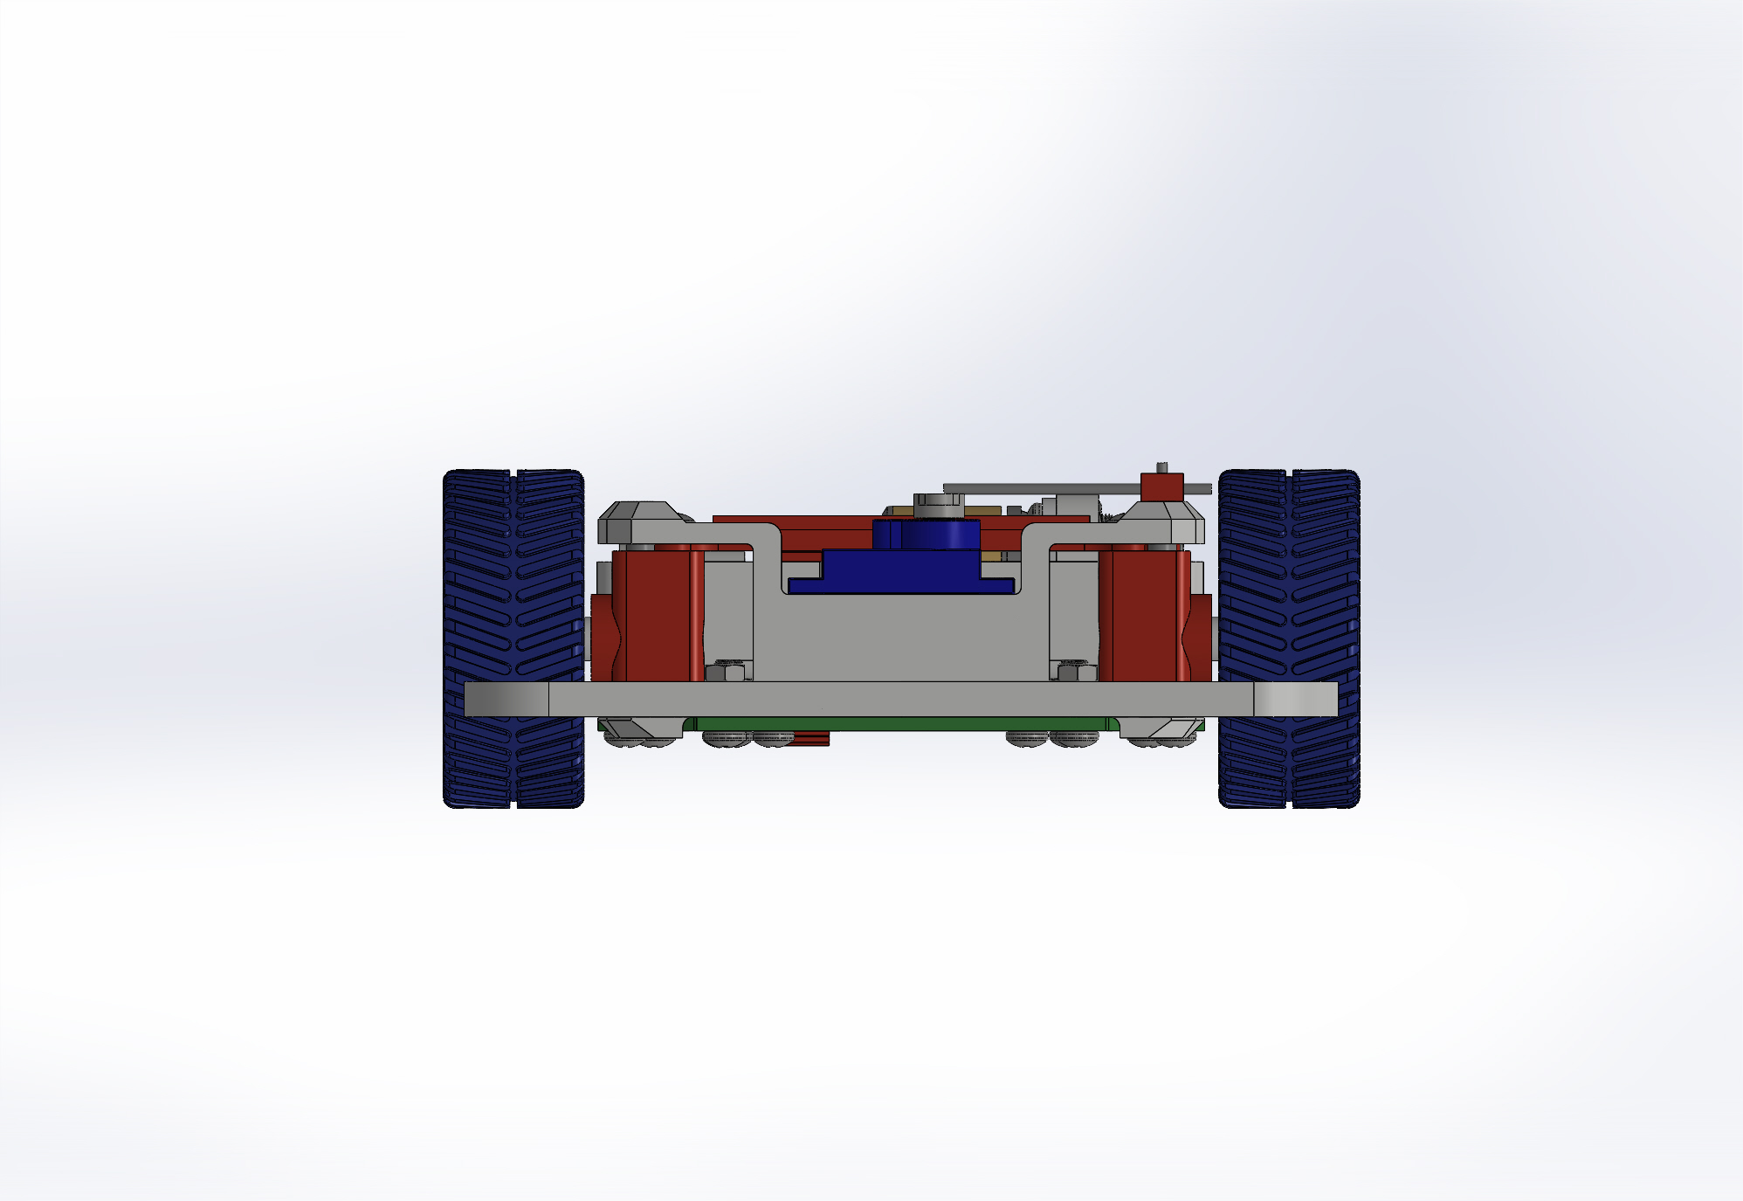
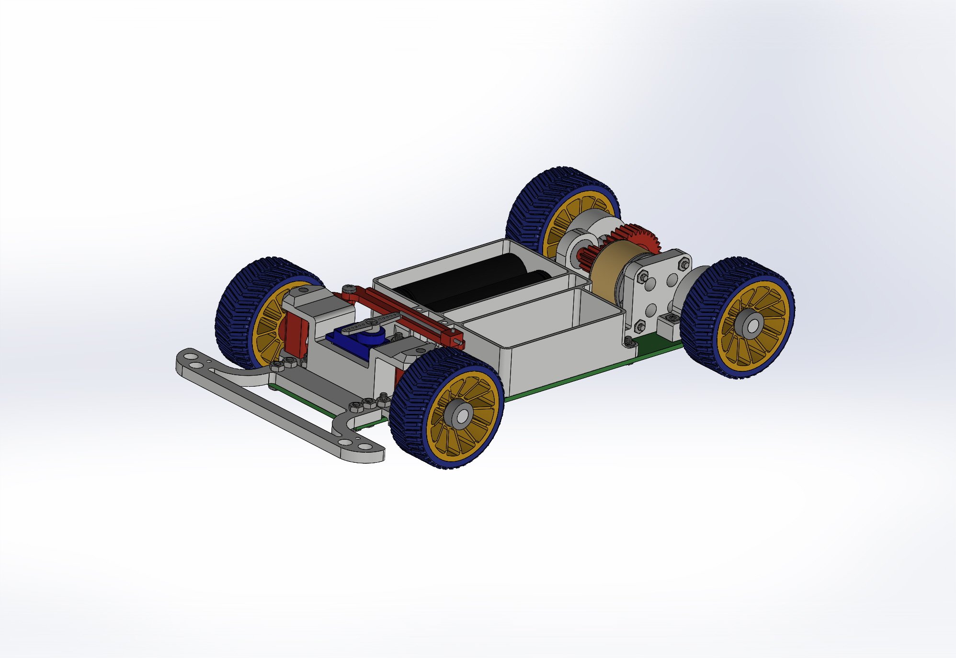
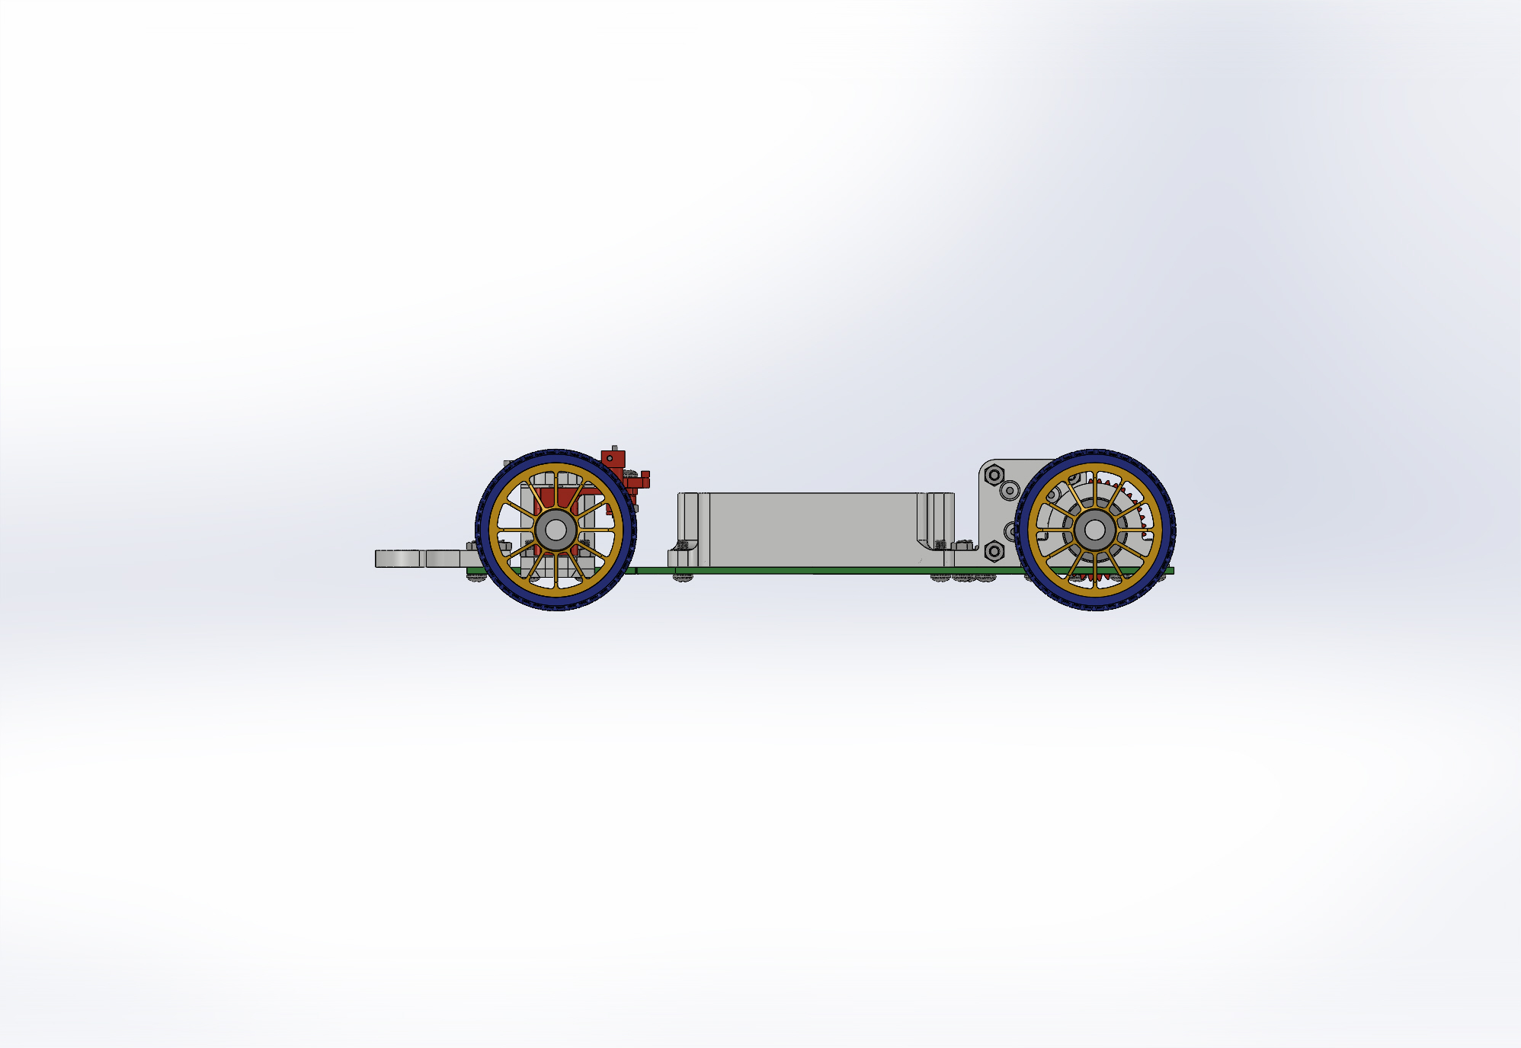
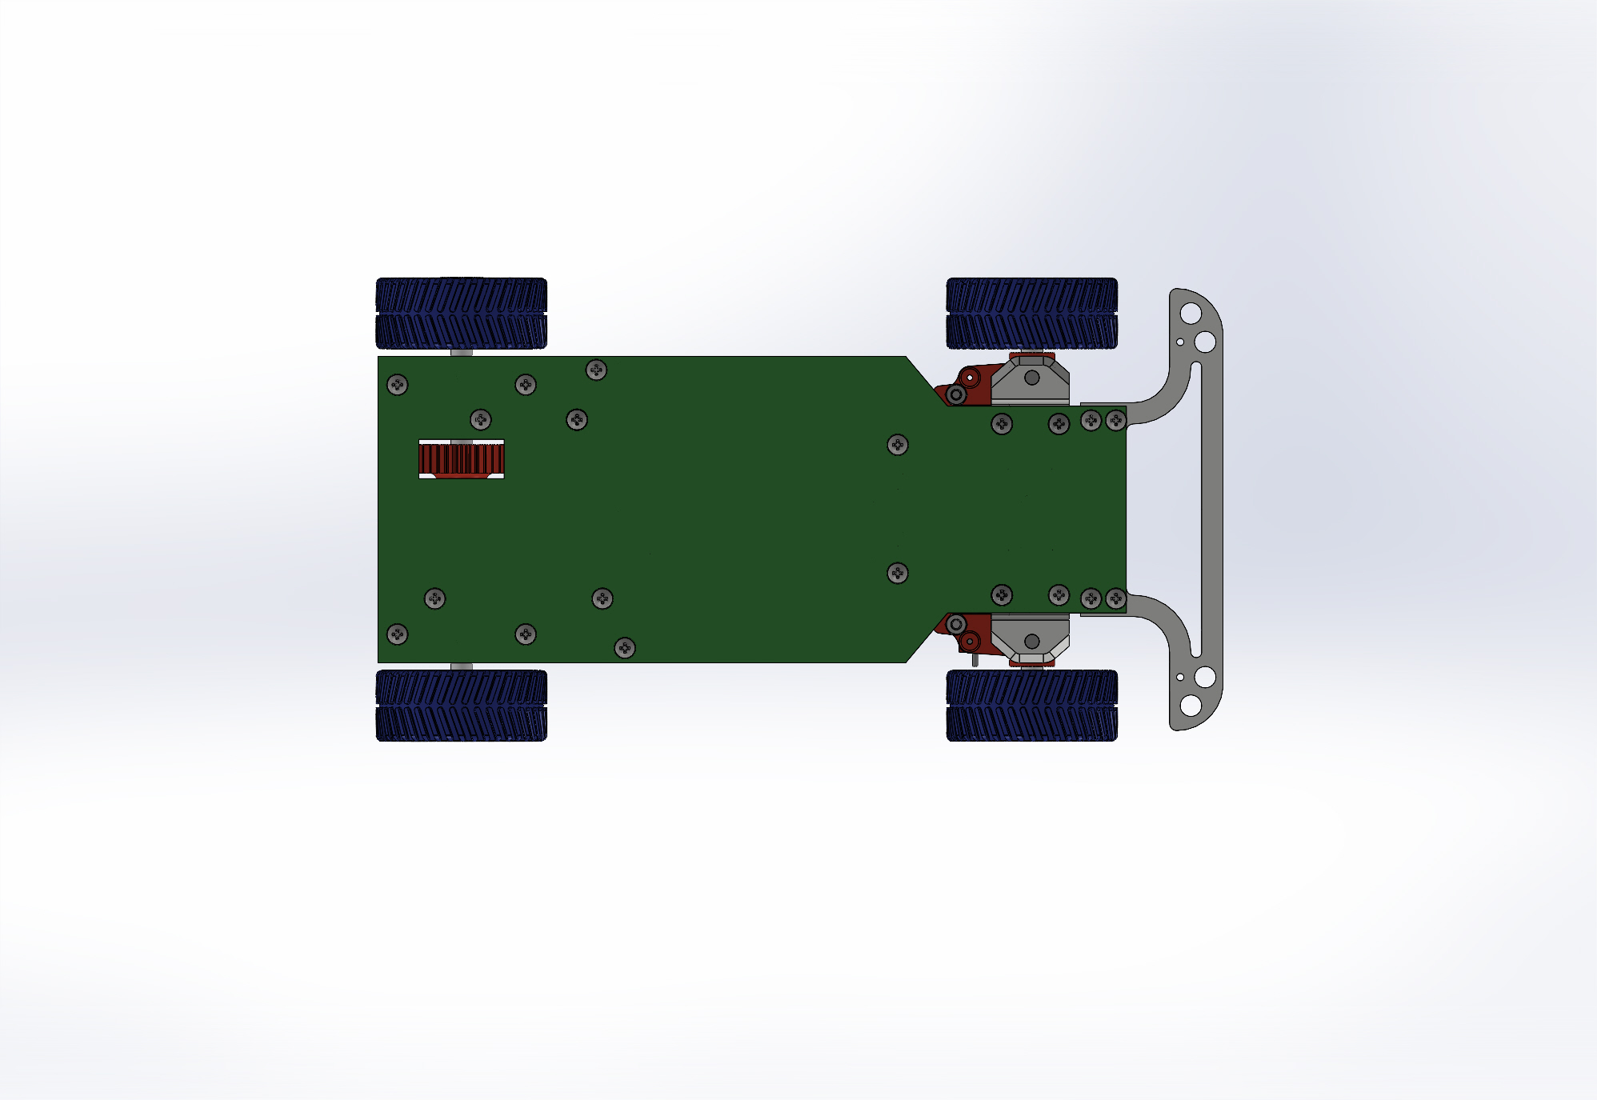
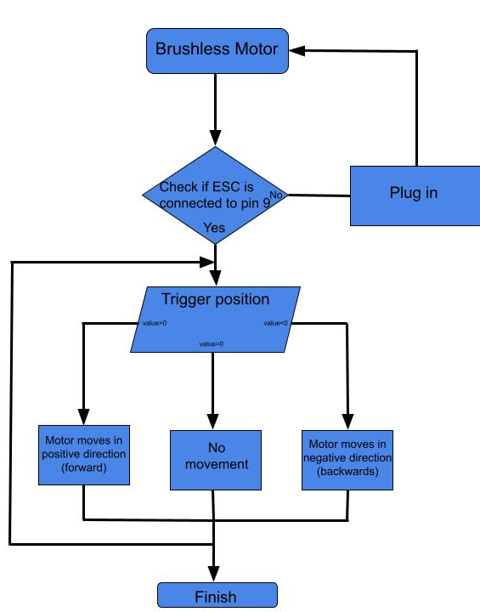
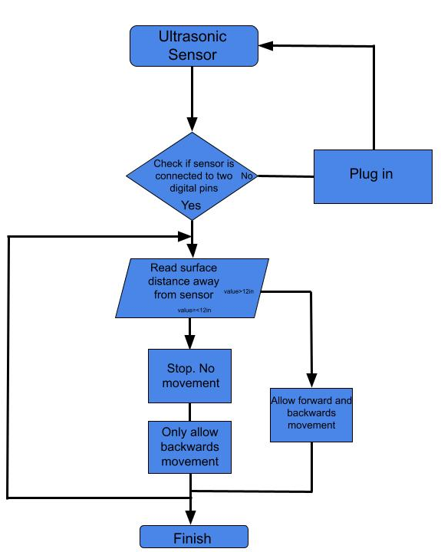

Toy Electric Car
Adam Elsner, Tatum Vansicklen, Abby Pierce, Jackson Weber, Zach Bialous
TECH 412 Innovation Scholars, Advanced Manufacturing
College of Engineering and Physical Sciences, University of New Hampshire, Durham, NH 03824
Introduction
CAD Models
Design Overview
Our goal for this project was to create a battery powered toy car operated by a radio controlled remote with ultrasonic sensors attached to the front and back that detect the distance of objects from the car and stop the car to avoid collision.
3D Printed vehicle utilizing Arduino board to run multiple functions such as ultrasonic sensor for collision detection, direction control, and speed control.
Modifications
Sensors on the forward and rear end of the vehicle to sense proximity to obstacles.
3D printed components to personalize our vehicle.
Arduino Uno board used to connect to remote for physical manipulation of the vehicle.
9 Volt battery used to power the vehicle.
Non-Printed Components
Servo motor
9 Volt battery
Battery clip connector
Arduino uno board
Axels (stainless steel solid round rod)
RC Transmitter and remote controller
Ultrasonic distance sensor
SolidWorks design of electric toy car base
Arduino System Functions
Problems/Future
Supply Chain back up for parts and delayed shipment
Complete the car and connect the remote control to the circuit.
3D print different wheels for better grip
Acknowledgements
Thank you, Professor Kinsey, for this opportunity to create this project and for the knowledge we gained.
Funding
UNH, Innovation Scholars Advanced Manufacturing Program

