Slide 1
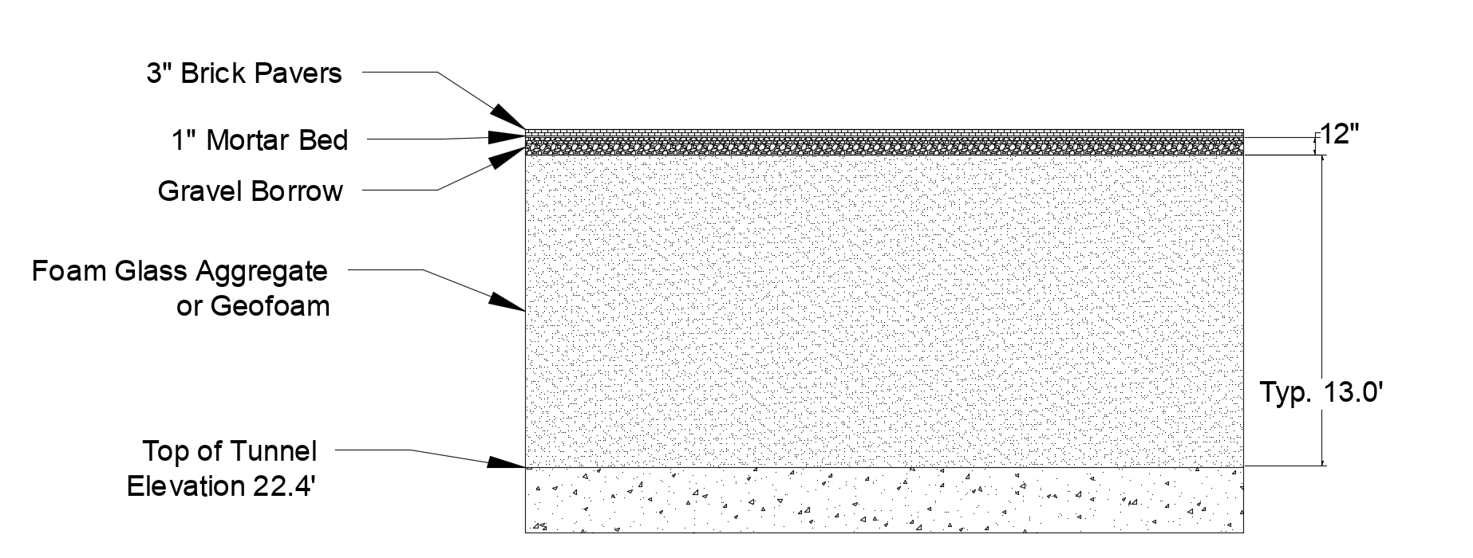
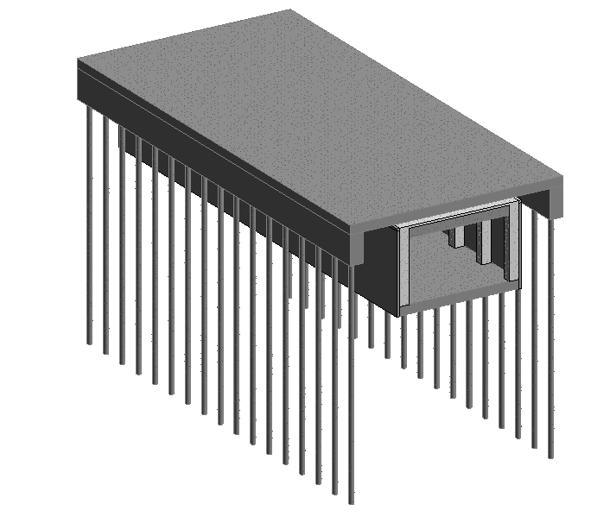
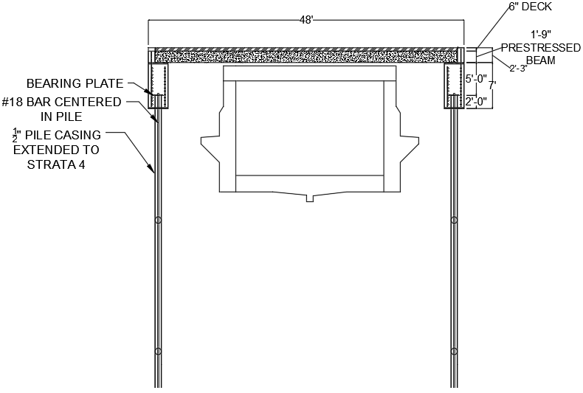
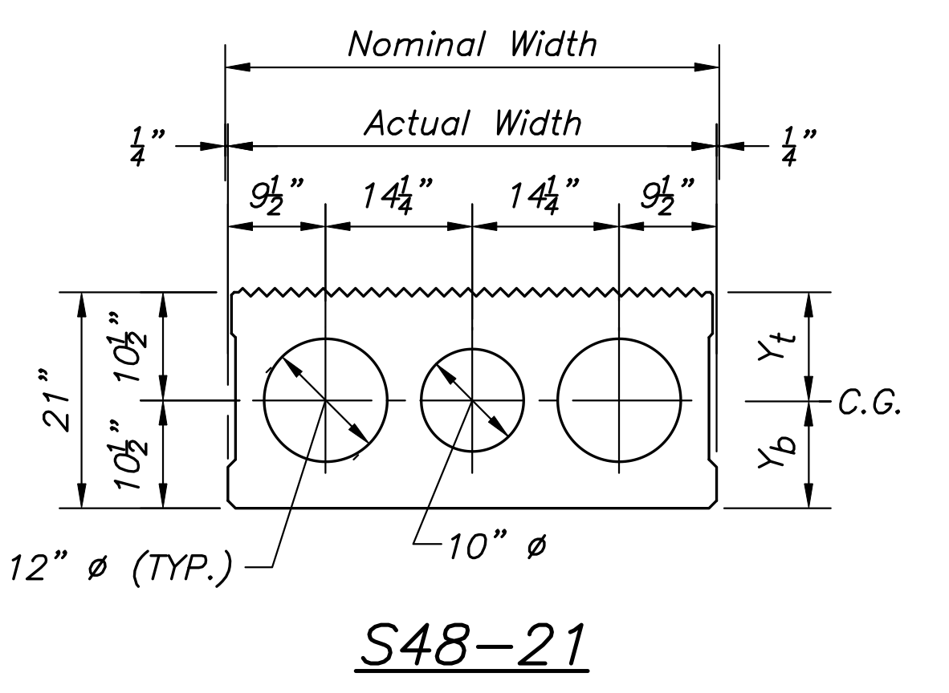
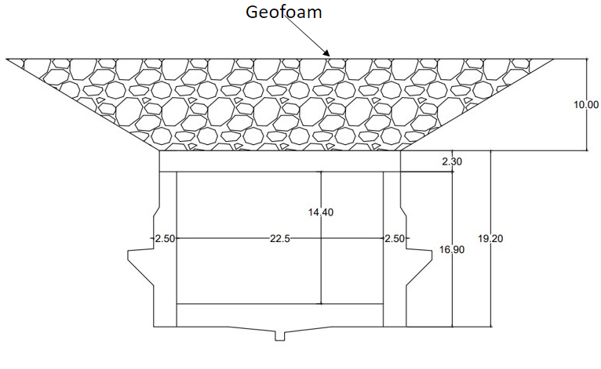
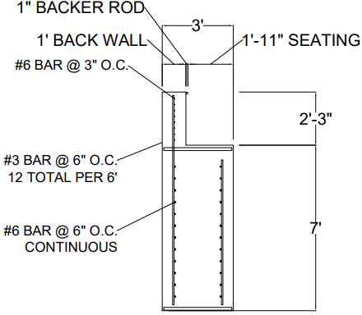
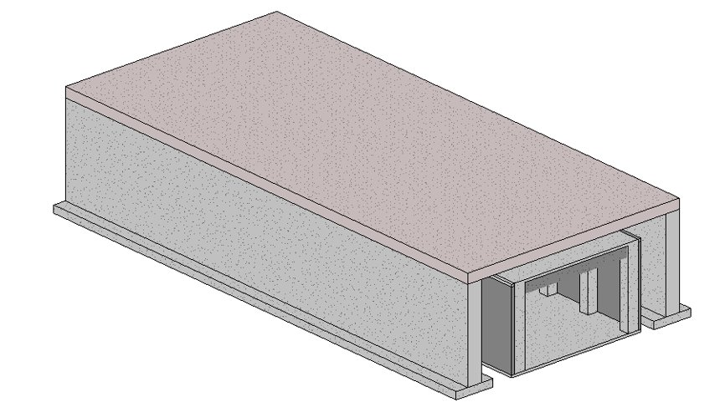
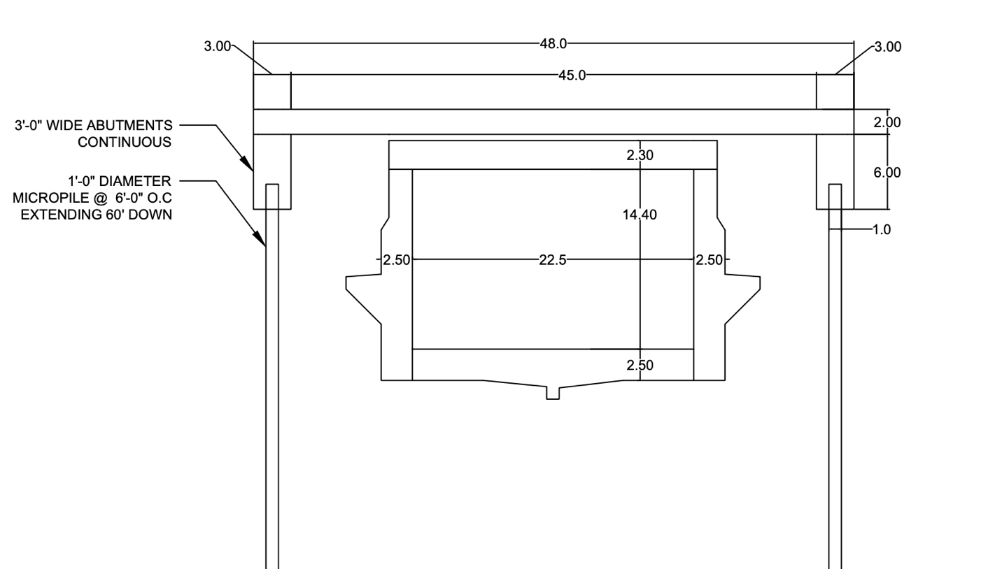
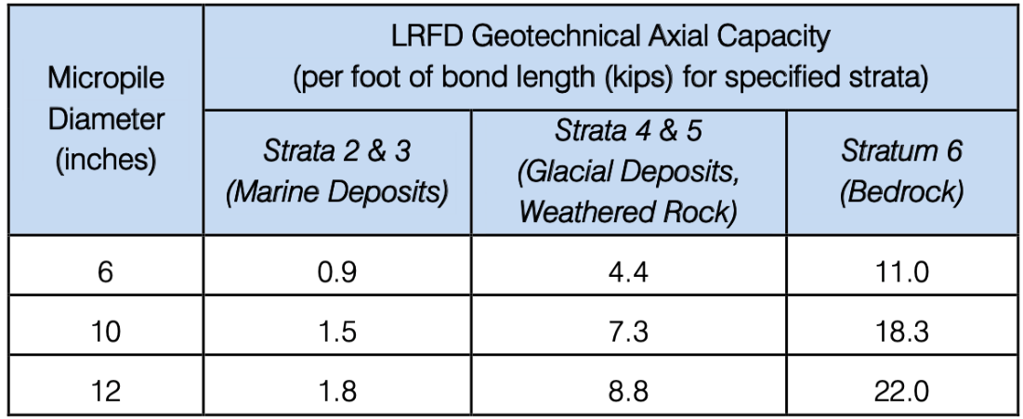
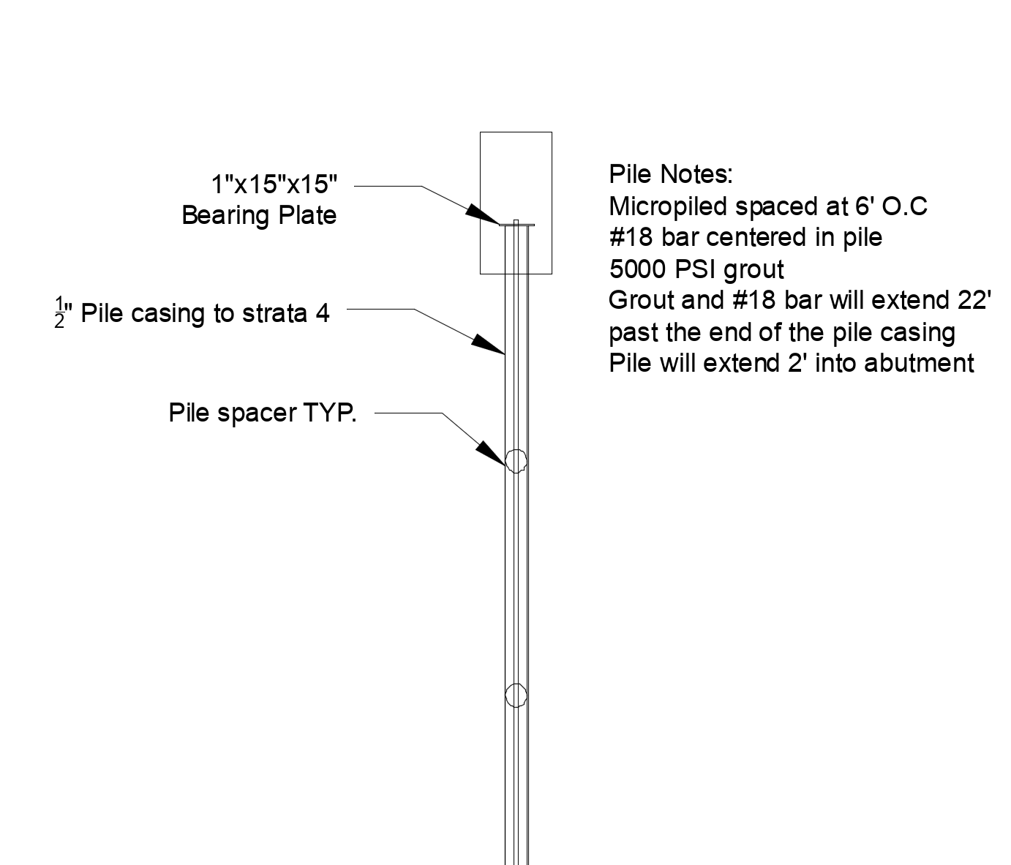
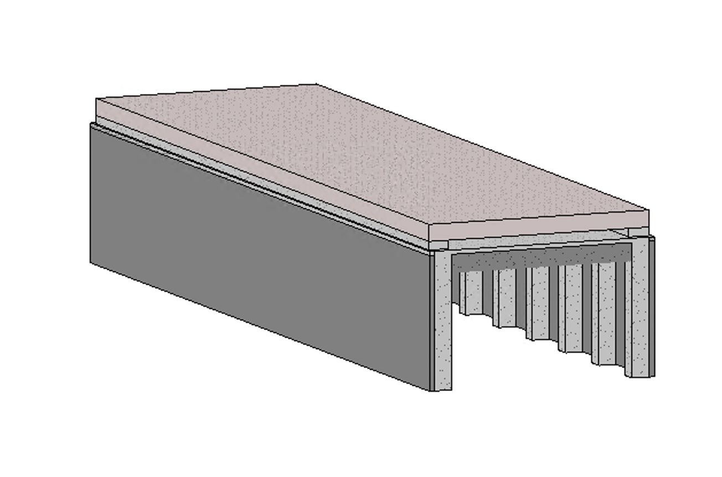
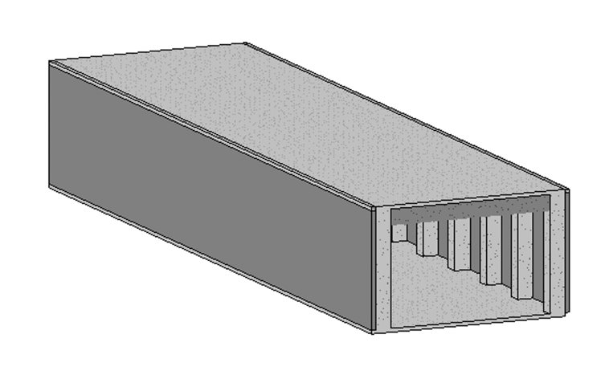
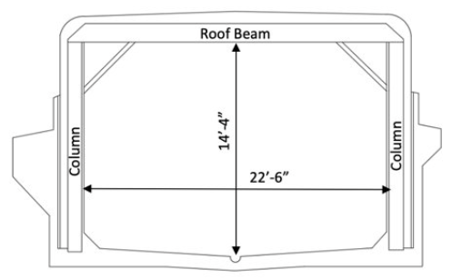
Boston City Hall Plaza Renovation
Travis Tkaczek (PM), Sam Daigle, Nicholas Lowe, Steven Mason
University of New Hampshire, College of Engineering and Physical Science
Introduction
Loading
Components of Recommendation
Moment Calculations
Maximum moment was found at the midspan of the beam
The value on the moment influence line was multiplied by the load of each axle of the fire truck
This value was the maximum moment that the beam would encounter
Dead load Calculations
The top of the existing tunnel will be 13’ below proposed grade
Use of light weight material would allow for a smaller structure, saving material costs
Geofoam weights 1.4 lbs per cubic foot
Foam glass aggregate weights 18 pounds per cubic foot compacted
Design Recommendation Revit Model
Design Recommendation
Cross section
Boston City Hall Plaza Render provided by Sasaki
Beam and Deck Design:
S48-21 MassDOT precast concrete beam
The beam was selected and then checked with maximum moment calculations to determine if it was going to be sufficient.
The maximum moment was found at the midspan of the beam and was created using a firetruck as the load.
Each beam is 48 ft long and 4 ft wide
A total of 25 beams will be used
6-inch topping slab on top of the beams will be cast-in-place after installation of the beams
The Boston City Hall Plaza is currently under construction to improve the quality and accessibility of the space. This renovation will result in greater loading on the MBTA subway tunnels that run under the plaza. Sponsored by Weston and Sampson, the goal of this project was to design a structure or system to lower the new loads imposed on the existing roof beams and columns of the MBTA Green Line Hanover Tunnel that runs below the Boston City Hall Plaza.
Alternatives Analysis
Design Alternative 1: Lightweight Substitution
No change to substructure
Only addition is use of EPS22 Type II Geofoam
Goal: lighten the load only the substructure as much as possible, most economical option
Load deemed too heavy to be viable
Methodology (Design Criteria)
Typical Beam Cross-Section
Design Criteria: Due the age and importance of the tunnel system, there were several factors looked at. Concerns were given about the added dead and live loads of the new plaza plan and their effect on the MBTA Green Line. The final design had to be both economically viable as well as light enough to not cause damage to the existing tunnel structure. The structure had to be entirely below grade. The substructure also had to support the additional loads that the new plaza design would apply.
MBTA Specific Concerns: The MBTA Green Line transports well over 100,000 people daily. The design had to cause as little impact as possible to the tunnel system during construction. MBTA-specific criteria that were considered were making sure the design was far enough away from the tunnel to prevent tunnel impact during construction. Another important factor was making sure construction could occur without impacting the subway system. This meant it would be favorable to have a design that could be worked on in the few hours of MBTA tunnel closure each night.
Lightweight Fill Design Alternative
Abutment Design:
2’-3”x1’-0” backwall on top of a 7’-0”x3’-0” abutment wall, cast-in-place
Rebar designed to handle stress in multiple forms of flexure, with a bar splice to connect rebar from abutment to the backwall
1” Backer Rod used between the backwall and beam to allow for thermal expansion of structure
Reinforcement calculated using ACI 318-19 and MassDOT Code compliance
Design Alternative 2: Shallow Foundation
Consists of two continuous strip footings with retaining walls on either side of the existing tunnel
The two retaining walls will be connected by precast concrete beams
A 6-inch topping concrete slab placed on top of the beams
Would have to excavate too far down to make this design alternative feasible
Shallow Foundation Design Alternative
Typical Abutment Cross-Section
Durham-Owned Land
Design Alternative 3: Deep Foundation
Design features 3 simple components, Micropiles, Abutment, and a typical MassDOT beam
Top of deck would be 10 ft below proposed grade
Design would use Geofoam to reduce the dead load imposed on the beams
Micropiles could be installed near the MBTA tunnel without disruption to service
Design alternative has the least impact on the MBTA
University of New Hampshire-Owned Land
Existing Infrastructure
Pile Design:
12” diameter Micropile spaced at 6 ft on center
Micropiles can be installed near existing structures with a small to medium sized drill rig
The weight of the total system was determined and a factor of safety of 2.0 was applied to fine the amount of capacity needed
The pile was designed using LRFD axial capacities provided by Weston & Sampson
Using equations in the Federal Highway Administrations handbook for micropile design , the structural capacity was also checked
A pile casing will extend through marine clay.
Grout will adhere directly to glacial till allowing for 8.8 kips of capacity per bond foot
Each pile will need 22 ft of bonding
NH Fish & Game-Held Conservation Land
Oyster River Cooperative School District Parcel
The existing Green Line tunnels underneath the Boston City Hall Plaza were constructed in 1902. The existing tunnels are not strong enough to carry the new loads that are going to be imposed on them. The tunnels traverse east to west along the north side of the site. Weston and Sampson provided a geotechnical report with boring logs and recommended designs based on the subgrade. The subgrade was mostly urban fill with varying spots and depths of marine clay. For the micropile design chosen, the recommended depth for the micropiles is bedrock. Bedrock for our section of tunnel was at an average of 100 feet. The figures below show the cross section of the existing tunnel and the Revit model of the existing tunnel.
NH Route 108/Newmarket Road
Deep Foundation Design Alternative
LRFD Axial Capacity
Design Alternative 4: Knee Wall
New 1 ft high knee wall placed continuously on top of existing tunnel columns
New Pre-cast deck supported by knee wall
Geofoam fill placed above pre-cast deck
Lower cost and construction time compared to other designs
Loading on existing columns determined to be greater than allowable
Knee Wall Design Alternative
Typical pile cross section
Acknowledgements:
Project sponsors, Connor Western – AEW and Eric Reiter – Weston & Sampson
Faculty Advisor, Majid Ghayoomi
References:
EPS Geofoam. (n.d.). EPS Geofoam Data Sheet - northwest foam. EPS Geofoam. Retrieved December 1, 2021, from https://www.northwestfoam.com/pdf/geofoam-eps-data-sheet.pdf
Grainger. (n.d.). Water-resistant closed cell, foam roll, Eva, 1 in, 36 in, 108 in, black. Grainger. Retrieved December 1, 2021, from https://www.grainger.com/product/497K43?ef_id=Cj0KCQiAkZKNBhDiARIsAPsk0WgLU-lxADklGMGqfInO-Cu_yi3ZFljLfJnE-IG30abK1cNNeXHrjc4aAqffEALw_wcB%3AG%3As&s_kwcid=AL%212966%213%21281698275984%21%21%21g%21471318999483%21&gucid=N%3AN%3APS%3APaid%3AGGL%3ACSM-2295%3A4P7A1P%3A20501231&gclid=Cj0KCQiAkZKNBhDiARIsAPsk0WgLU-lxADklGMGqfInO-Cu_yi3ZFljLfJnE-IG30abK1cNNeXHrjc4aAqffEALw_wcB&gclsrc=aw.ds
Mass.gov. (n.d.). Framing Plan- Precast Concrete Deck Beams. Mass.gov- Official Website of the Commonwealth of Massachusetts. Retrieved December 1, 2021, from https://www.mass.gov/files/documents/2013/06/bfv/4_1_1.pdf
Sabatini, Paul, et al. “Micropile Design and Construction.” U.S Department of Transportation Federal Highway Administration , Dec. 2005, https://www.earth-engineers.com/earthengineers/pdfs/FHWA%20Micropile%20Design%20and%20Construction%20%282005%20version%29.pdf.
.

