Slide 1
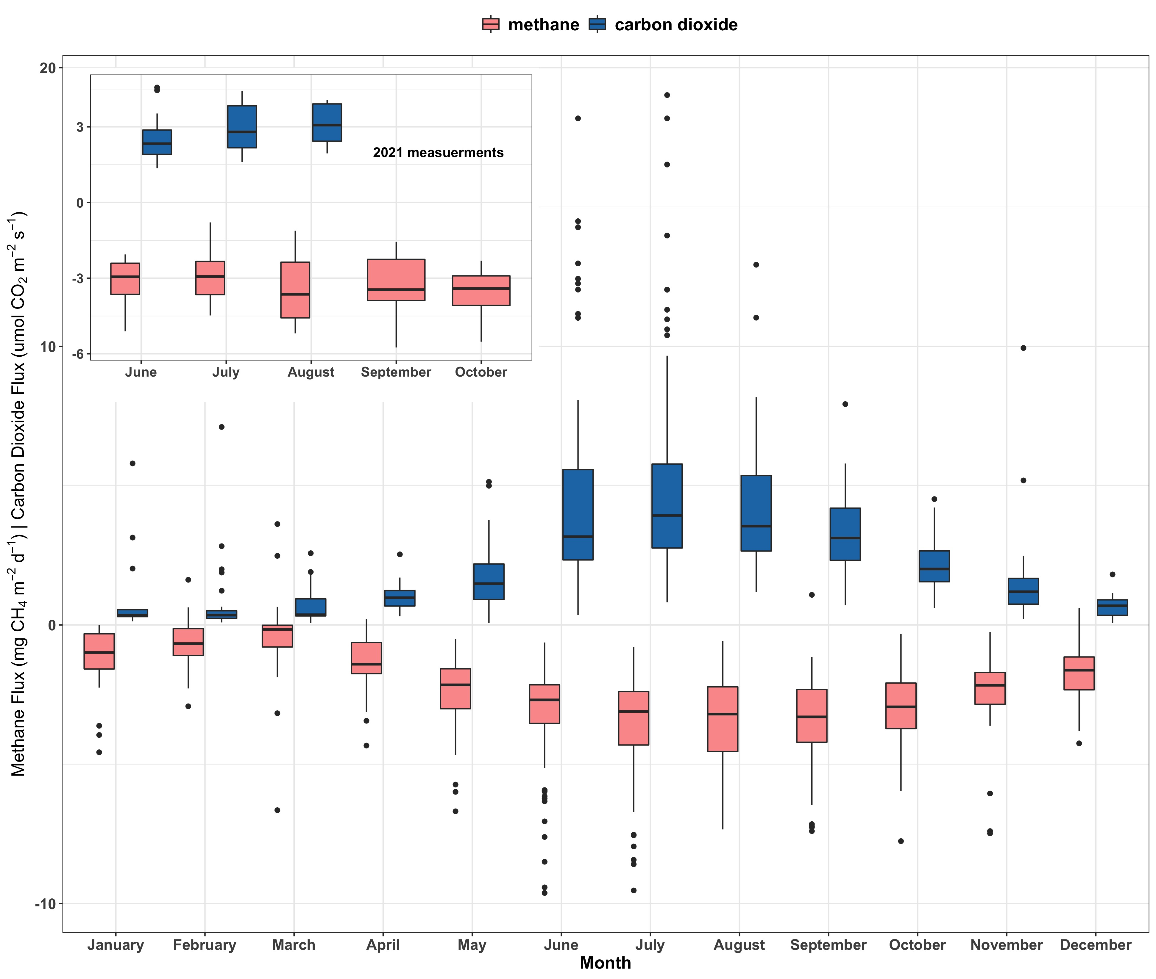
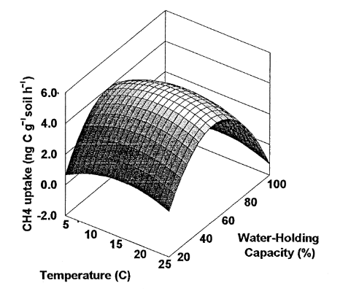
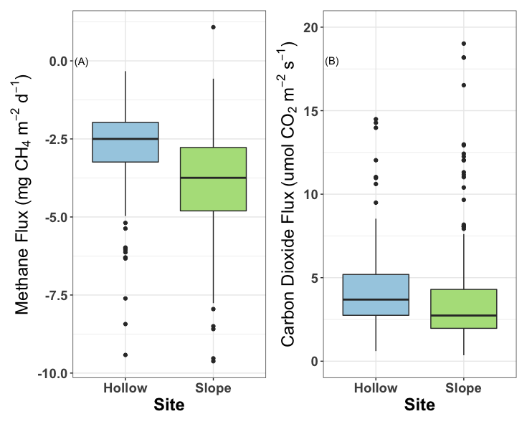
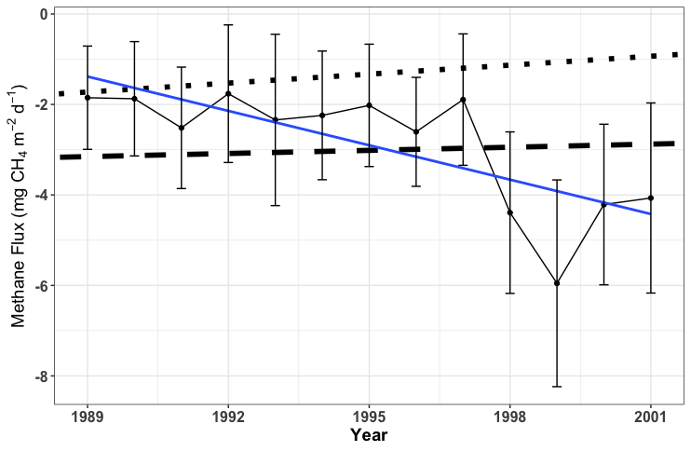
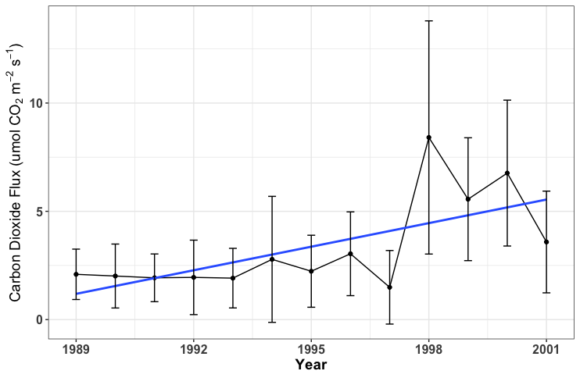
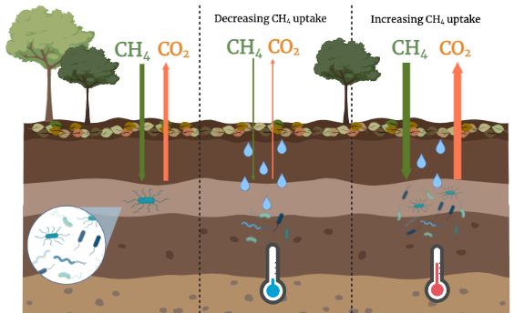
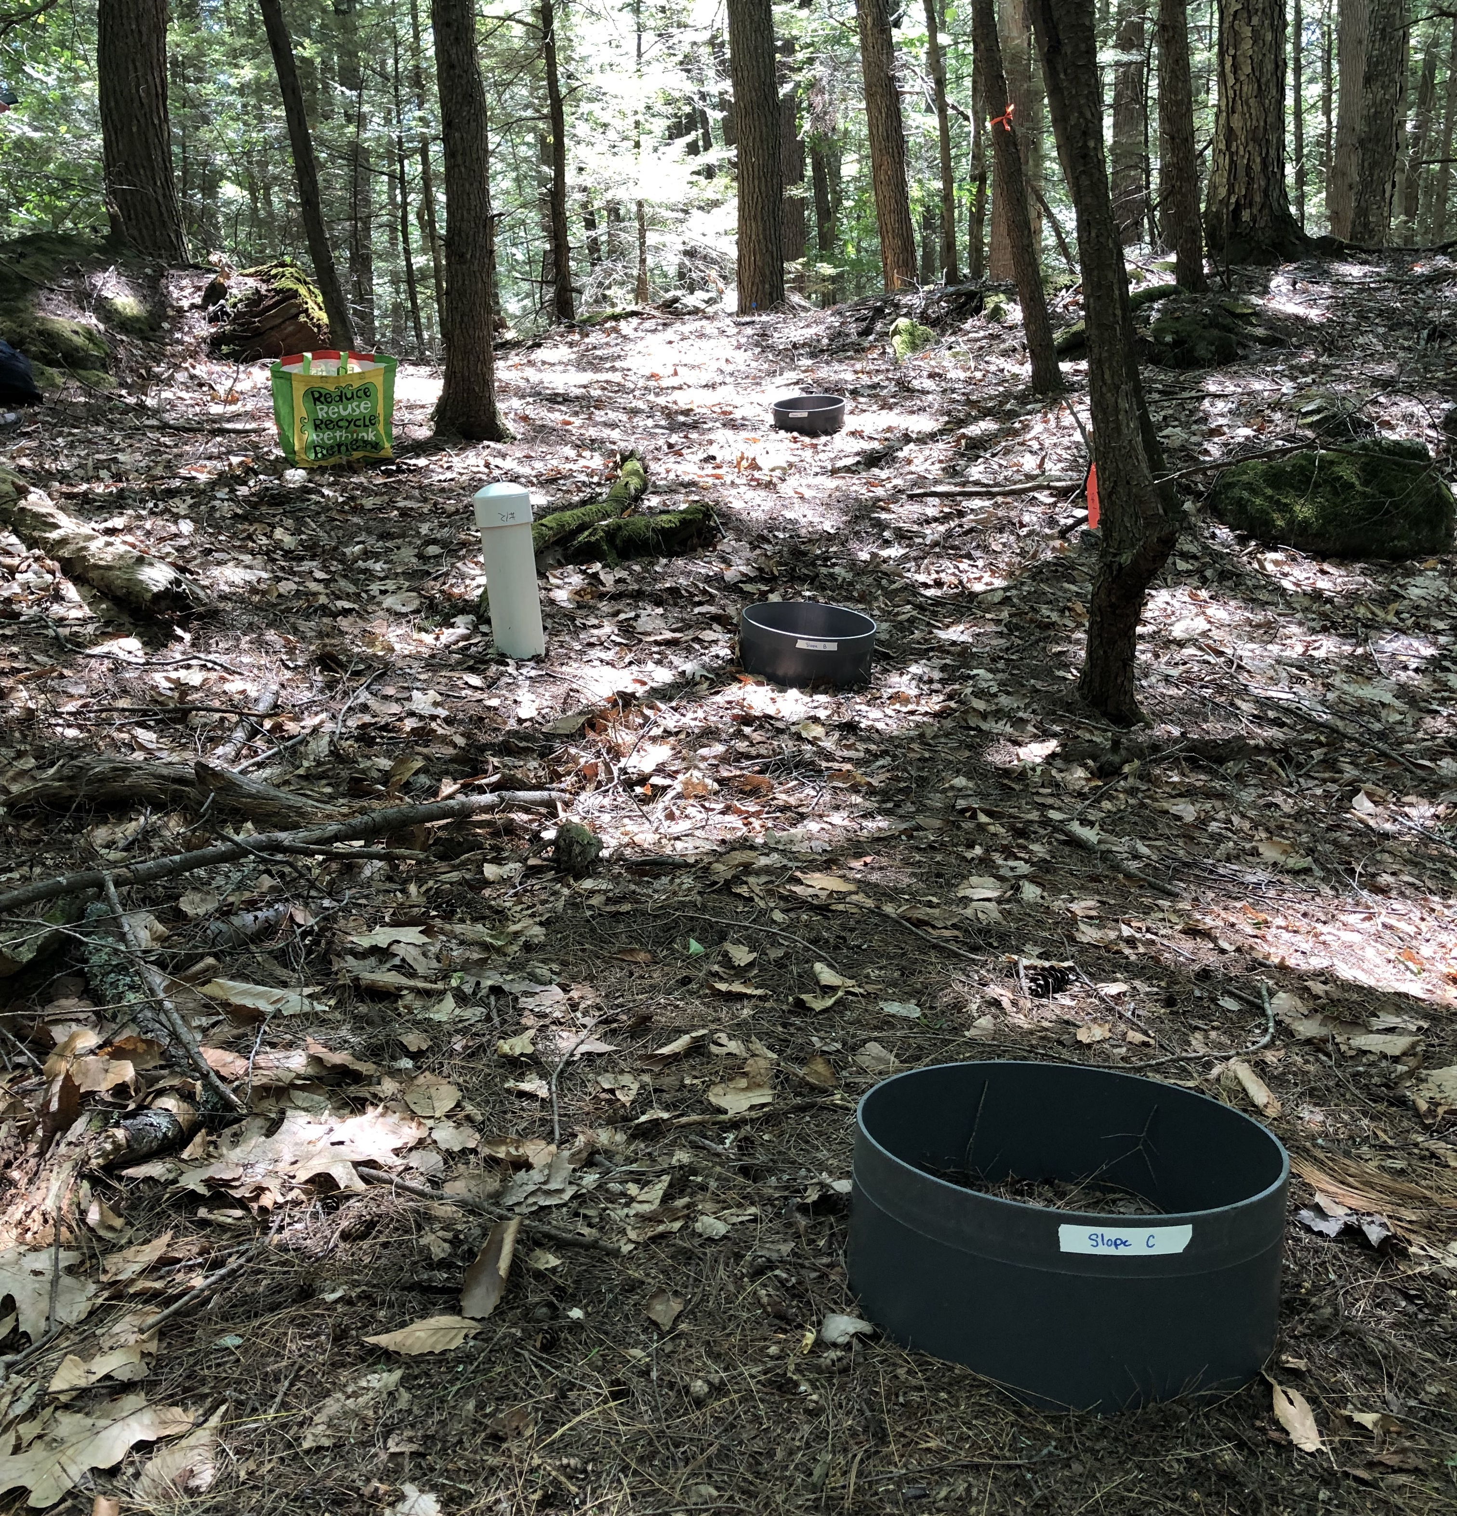
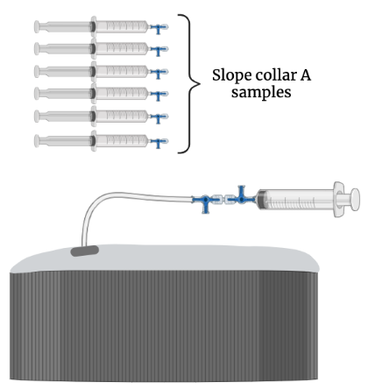

Controls on Carbon Gas Fluxes From a Temperate Forest Soil
Natalie White¹, Clarice Perryman²,³, Angelica Dziurzynski²,⁴, Patrick Crill⁵, Ruth Varner²,³
¹Department of Natural Resources, University of New Hampshire, Durham, USA, ²Department of Earth Science, University of New Hampshire, Durham, USA, ³Institute for the Study of Earth, Oceans, and Space, University of New Hampshire, Durham, USA , ⁴Department of Biological Sciences, University of New Hampshire, Durham, USA, ⁵Department of Geological Sciences, Stockholm University, Stockholm, Sweden
INTRODUCTION
RESULTS AND DISCUSSION
Methane (CH₄) is a greenhouse gas with a warming potential 32 times that of carbon dioxide (CO₂).¹
Atmospheric CH₄ uptake by methanotrophs in upland soils is an important global CH₄ sink consuming ~5% of annual global CH₄ emissions.²
What is the magnitude of monthly CH₄ and CO₂ flux at this site?
How do carbon gas fluxes at this site respond to environmental changes?
Figure 1: Polynomial regression model of temperature and moisture on CH₄ uptake, taken from Bowden et al., 1998. Soil moisture acts as a stronger control of CH₄ uptake than temperature, yet both have optimal values for methanotrophs to oxidize methane. Climate change is impacting global temperature and moisture regimes, with both increases and decreases in uptake reported.^{4,5}
Monthly Mean Methane Flux (mg CH₄ m⁻² d⁻¹)
p < 0.05
p = 0.13
Methane Flux (mg CH₄ m⁻² d⁻¹) ⎸Carbon Dioxide Flux (umol CO₂ m⁻² d⁻¹)
STUDY SITE
Monthly Mean Carbon Dioxide Flux (umol CO₂ m⁻² d⁻¹)
College Woods,
Durham,
New Hampshire
43.135 °N, -70.944 °E
250-acre hemlock-hardwood-pine forest
Soils are in the Inceptisol order⁶
Figure 6: CH₄ flux (left) and CO₂ flux (right) by site. Data were combined for June to October from 1989-2001 and 2021.
Jan. Feb. Mar. Apr. May June July Aug. Sept. Oct. Nov. Dec.
MONTH
Figure 5: Hysteresis of CH₄ uptake and CO₂ emissions throughout the year. Fluxes differ with changes in temperature, but seasonal differences indicate interaction with a controlling variable of equal or higher importance than temperature. Increased soil moisture in spring physically limits diffusion of CH₄ into soils while colder temperatures in late fall and winter limit biological activity of methanotrophs. CO₂ emissions are impacted by availability of soil organic matter and size and activity of biological processes over the seasons.
Figure 4: Timeseries showing monthly CH₄ uptake and CO₂ soil fluxes. Calculated including historical data and data from 2021 (see inset). Seasonal variation is represented in the changing fluxes by month. This is consistent with the expected fluxes in temperate New England forests.
Have carbon fluxes between June and October changed from 1989 to 2021?
Figure 7: Timeseries graph of CH₄ soil uptake between 1989-2001. The blue trendline calculated from this study’s data shows that year does not explain significant variance in the amounts of CH₄ uptake (R²=0.098, p-value=0.15). Both lines imposed on top of this study’s data are adapted from Ni and Groffman, 2018; The dotted line represents the linear regression of global CH₄ soil uptake between 30-60°N from 1987-2016, and the dashed line is the CH₄ uptake in Hubbard Brook from 2002-2015.
Figure 8: Timeseries graph of CO₂ soil emissions between 1989-2001. Blue trendline calculated from this study’s data shows an insignificant increase in emissions.
RESEARCH QUESTION
How do historic CH₄ and CO₂ fluxes within College Woods compare to contemporary fluxes? What factors are driving these differences?
METHODS
. . .
- - -
Existing dataset:
  Study site was established in 1989 (Crill et al., 1991). CH₄ and CO₂ fluxes were monitored biweekly from 1989-2001 with the static chamber method. Collars were installed on similar soils in a hollow and on a slope (Figure 2).^{7,8}
  Sampling sites were reestablished in 2021.
Flux measurements and analysis:
  Each collar was sampled approximately weekly between June and October 2021 using the static chamber method. 5 samples of chamber headspace were collected over a 20- minute period using 60 ml syringes (Figure 3).
  Samples were analyzed on a GC-FID to measure CH₄ concentration and on an IRGA LiCOR to measure CO₂ concentration.
  A combination of Excel, JMP, and R were used for statistical analysis⁹.
Environmental measurements:
  Soil moisture, soil, air, and surface temperature, and weather at each sampling were recorded.
y = 48.9 - 0.023 x, R²=0.23, p<0.05
y = 168.7 - 0.083 x, R² =0.52, p<0.05
y = 128.4 – 0.066 x, R²=0.098, p = 0.15
y = 126.99 x – 0.065
R² = 0.06
p = 0.396
CONCLUSIONS
Seasonality is a big driver of CH₄ and CO₂ fluxes at this site, with soil moisture limiting diffusion and thus oxidation of methane in the early spring.
Trends in CH₄ fluxes between 1989-2001 in College Woods are not consistent with findings of contemporary studies reporting decreasing soil CH₄ uptake in temperate forests.⁵
Landscape position influences CH₄ uptake during the summer and fall (Figure 6).
Insignificant changes in average precipitation and temperature in College Woods since 1989 indicate several interacting controls on CH₄ and CO₂ fluxes.
Future work should investigate the seasonal dynamics of the CH₄-oxidizing microbial community to determine how microbial community composition and activity influence soil CH₄ uptake.
Acknowledgements: This study site and design for the 1989-2001 data was established by Dr. Patrick Crill and measurements were made over that period by many technicians and undergraduate students. For the 2021 measurements I would like to thank the Hamel Center for Undergraduate research for supporting this research through a Summer Undergraduate Research Fellowship grant and thanks to Alix Contosta for lending us equipment.
References:
¹Holmes et al. (2013), Atmospheric Chemistry and Physics; ²Dutaur (2007), Global Biogeochemical Cycles; ³Bowden, et al. (1998), Soil Biol. Biochem. ⁴Turetsky et al. (2014), Global Change Biology; ⁵Ni and Groffman (2018), PNAS; ⁶Mikhailova et al. (2021), Earth; ⁷Crill et al. (1988), Global Biogeochemical Cycles; ⁸Crill (1991), Global Biogeochemical Cycles; ⁹R Core Team (2020), R Project for Statistical Computing and Wickham H (2016), ggplot2: Elegant Graphics for Data Analysis.
a
b
c
Figure 3: Reestablished study site showing slope transect.
Figure 2: Model of field setup showing flux sampling from collar.

