Slide 1

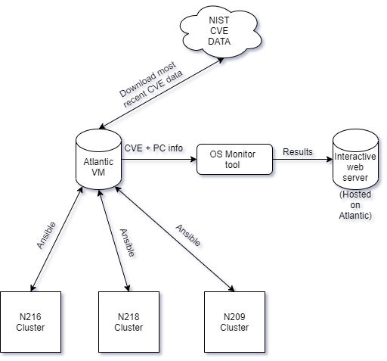
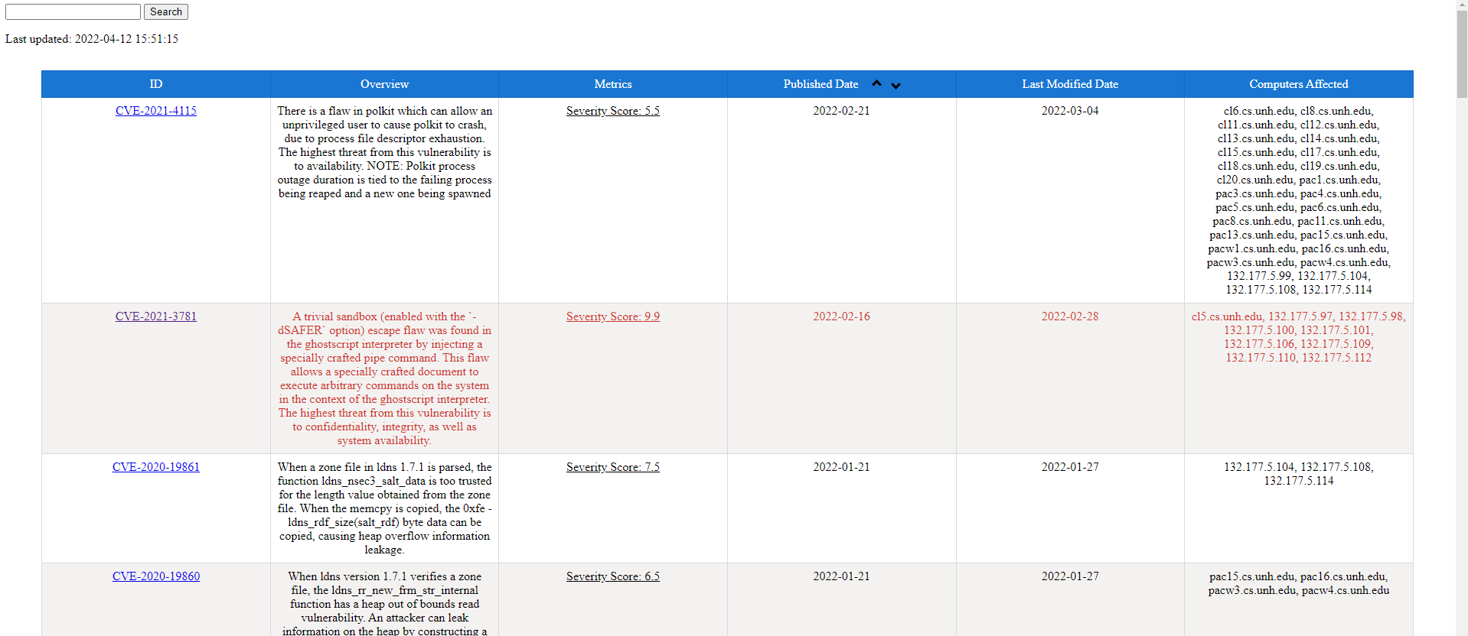






CS Department Clusters Security Monitor
Justin Moening, Ryan Tremblay, Trevor Morrison, Joey Pillote, Information Technology, University of New Hampshire
INTRODUCTION
ARCHITECTURE
FRONT END
Context: Since cyber attacks are so common, there is a need for system administrators to assess their risk on a regular basis
Problem: The computer science department does not currently have any idea of what vulnerabilities could be on the computing cluster machines
Solution: Use the National Institute of Standards and Technology’s National Vulnerability Database (NIST NVD) to show potential vulnerabilities based on the OS or installed packages
The front end was built with PHP, HTML, and CSS. We used PHP as a means of connecting to our MariaDB table. We then ran queries to show an itemized list of each vulnerability that varies depending on the machine you are on. Additional functionality on this front-end includes:
A keyword-search function to search by specific words or phrases
A timestamp of when the database was last updated
Automated coloring system which changes depending on the severity of the vulnerability
A button that sorts by most recently published ascending and descending
A list of computers that are affected by vulnerabilities
GOALS
Develop a monitoring alert tool within two school semesters that correctly identifies vulnerabilities, determines the level of risk and places them in a centralized location.
Import 100% of all relevant documented vulnerabilities in the NIST system.
Web interface should display the correct number of vulnerabilities for each machine
Display the threat level of the vulnerability itself (quantifying the severity)
The tool should be able to send out an email alert with the discovery of a new vulnerability
Web interface should show a view of CS PC software packages with versions
Database should store information such as inventory devices and metadata (example location, purpose, OS & version)
Database should be backed up in case of system failure
Atlantic VM → NIST.gov API
Interacted through NIST.gov’s API to download and store CVE data onto Atlantic VM
Atlantic VM → PC clusters
An Ansible playbook will be used to interact with multiple PCs in a given cluster at a time, allowing us to collect and store their package data in a database
This will be done through an SSH connection and uses a shared account with low privilege to access specific package information
OS Monitor tool → Web server
The OS monitor tool will be triggered by Anacron to run weekly to email our sponsor with any new vulnerabilities and update the table displayed on our front facing web interface
The web interface will show vulnerabilities based on the packages stored in the database, and the end user has the capability to filter the data based on severity or by using keywords
COMPONENTS
Technology | Description | Usage
 | Ansible is an open-source software provisioning, configuration management, and application-deployment tool enabling infrastructure as code. | Using this program allows us to gather all relevant info (package name/version) on cluster PCs at once using SSH.
 | MariaDB Server is an open source relational database. It is made by the original developers of MySQL. | MariaDB served as our backend database server through our virtual machine. We stored the NIST data here, where it would be later pulled by the web server.
 | Python is an interpreted, general purpose programming language. | We coded a script in Python that would extract the data from the NIST website, and automatically update the database daily on our virtual machine. This script also will send an automatic email of any new vulnerability that may apply to a cluster PC based on severity.
 | Anacron is a computer program that performs periodic command scheduling. It can be used to control the execution of daily, weekly, and monthly jobs on systems. | We configured Anacron to automatically run the previously mentioned python scripts on a weekly basis. This eliminated the need for human interaction in the backend of our tool.
 | The Apache HTTP Server is a free and open-source cross-platform web server software. | We used the Apache HTTP Server to run the front end of our tool in the VM, configured such that only IP addresses within the UNH network can access it. We also used local Apache servers (along with mySQL) to to test our php code,
 | PHP is a general-purpose scripting language geared towards web development. | We utilize PHP scripts to interact with the database using SQL commands. When the call is made to our server the script grabs the data and formats it into a table.
RESULTS
Successful implementation of functionality of storing all of the data found both from the NIST website and the computers from the managed clusters that we along with the data management we were also able to display the information onto a web interface that we were able to test.
Vulnerability Identification/Alert Tool (aka OS Monitoring tool)
Indexation of all PC’s under the umbrella of this project (N209, N216, N218) for monitoring vulnerabilities of OS versions and corresponding packages.
Risk evaluation feature (for vulnerabilities identified)
Creation of website medium (to host online interactive web server)
Webserver to handle vulnerabilities and alerting, which is also used to store PC information and versions.
DATABASE
Structure
Each row is a Common Vulnerability/Exposure (CVE)
Columns consist of a CVE ID, Description, Severity Metrics, Initial Publish Date, last modified Date, and a list of computers affected.
Security
Because of the type of information being stored in this database, it was stressed to us that this information be confidential.
Encrypted using AES-128
Accessible only to group members and sponsor

