Slide 1
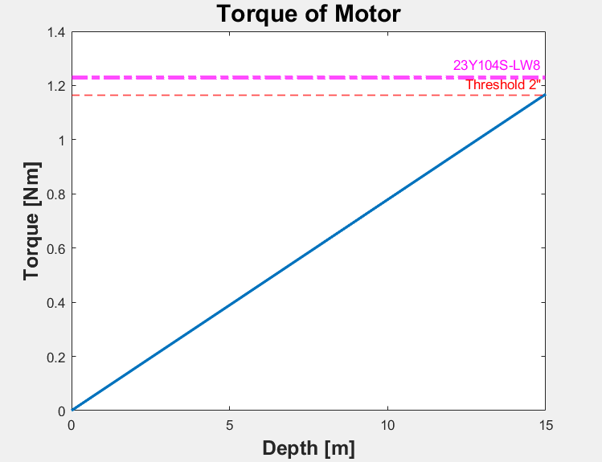
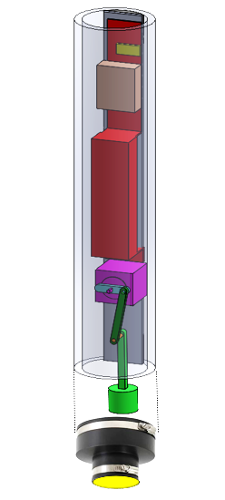
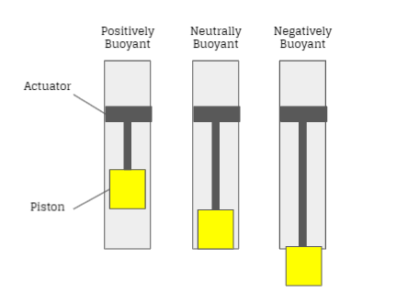
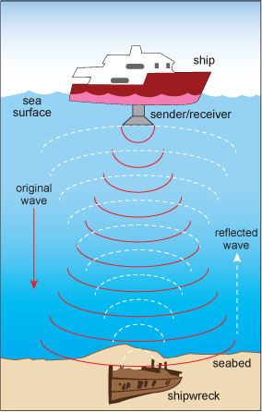
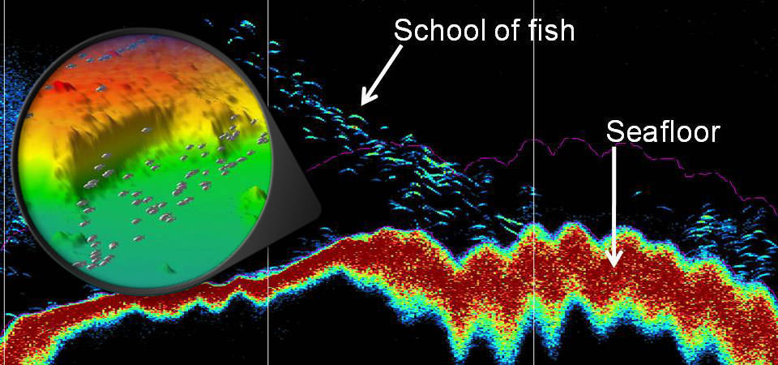
A Platform Design for the Analysis of the Distribution and Abundance
of Fish and Investigate the Relation to Seabirds
Katie Swenson, Rising Senior of Ocean Engineering, University of New Hampshire
Mentor: Thomas Weber, Associate Professor, Ocean Engineering
Email: kws1009@wildcats.unh.edu
Introduction
Platform Design
Implementations
Currently, sonars are generally mounted to vessels, however the upper portion of the water column is often overlooked. The purpose of this project was to develop a free-floating acoustic system to fill in the gap that sonars omit. The upper portion of the ocean is very important as many interactions and processes take place such as air-sea gas exchange, oil spills, pollution, prey available to seabirds, and circulation. The platform is a buoyancy engine and attached will be a sonar that a previous student has built.
The buoyancy engine works by displacing fluid to change the volume, as changing the volume or mass will change the depth. When the platform is positively buoyant, the platform will rise and when the platform is negatively buoyant, the platform will sink (Skillings, B.2004). Maintaining a depth is possible when tuning the volume so that a neutral buoyancy can be managed.
The housing for the buoyancy engine consists of a Schedule 80 clear 4"PVC pipe. An aluminum backplate is attached to 3D printed mounts which are in turn glued to the interior of the PVC pipe. The backplate holds a stepper motor and driver, an Arduino Pro microcontroller, and lead-acid batteries.
It is important to keep in mind that this device is made for saltwater and to go a depth of 15 meters. The torque must be high enough for the diameter, which is why we are reducing the diameter at the bottom, where the latex will be located. The torque of the motor must be at least the threshold torque of the 2-inch diameter of the latex as shown in Figure 3. The motor chosen can withstand the torque of the given surface area.
The Arduino is programmed to control the stepper driver, which then controls the motor to rotate slightly clockwise then counterclockwise. The piston is moved by the motor and allows the piston to push against the latex then relax repeatedly.
Figure 4 shows the components of the platform, and the parts are referred to Table 1.
Observations On:
Marine Species
Discovery
Abundance
Distribution
Air-Sea Gas Exchange
Oil Plumes
Pollution
Vertical Mixing
Ocean Circulation
Figure 3: The depth goes up to 15 meters, as the platform is designed. Torque is calculated based on the given depth. The threshold for 2” is shown in red. The motor that was chosen for the design is shown in magenta.
A
B
Future Suggestions
C
Add a pressure sensor
Motor functions based on pressure sensor reading
Add fins to prevent spinning
Piston be made of a stronger material possibly
Find batteries that are less “bulky”
K
E
D
J
Figure 1: A basic mechanism of how a buoyancy engine works. The platform incorporates this basic maneuver.
 | Part | Purpose
A | Arduino Pro | To Control the Stepper Driver and Motor
B | Stepper Driver MCB25081TB | To Control the Motor
C | Battery and Battery Holder (3-D Printer) | For Mounting batteries, Arduino and Controller
D | Stepper Motor 23Y104S-L8W | To Move the Piston Vertically
E | Connector for the Piston and Motor (3-D Printed) | To Connect the Piston to the Motor for Movement
F | Piston (3-D Printed) consisting of 3 parts | To Push Against Elastic
G | Flexible PVC Reducing Coupling w/ Clamps | To Reduce the Diameter of the PVC Pipe to a Size for the Elastic and Motor can Handle
H | TheraBand Resistive Bands | The Elastic at the Bottom for the Piston to Push Against for Volume Change
I | 4” x 2’ Schedule 80 PVC Pipe | The Structure of the Buoyancy Engine
J | Aluminum Bar | Back Plate to Hold Parts
K | Cylindrical Pieces | To Attach Aluminum Bar to PVC Pipe
F
G
Sonars emit sound pulses and the rate at which the reflection comes back is measured. Ocean mapping uses this technique to map the seafloor. There is a cone shape that is created for the emission of pulses. For this application of the upper ocean, the cone shape will be facing upwards rather than downwards.
I
H
Acknowledgements
Figure 4: The final design of the platform and its components are shown. The letters correspond to Table 1 and their parts.
Next Steps
I appreciate the McNair staff and program for this opportunity and the help that has been offered. Dr. Thomas Weber was my mentor through this program. Lisa Sulmasy created the sonar that I will be attaching to my buoyancy engine. I incorporated a design of Sean Gillam, Michael Monahan and Tom Spiro, into my own design.
Adjust coding for platform to go 15 meters
Test the platform in the Engineering Tank at Jere A. Chase Laboratory
Attach the echosounder
Test the sonar and adjust/program for analyzing fish
Collect data at sea – docking off Judd Gregg Marine Research Center in New Castle, NH
References
Figure 2: A display of a sonar attached to a ship. This technology will be used along with the platform to detect fish.
Analytical science: Secrets of the Mary Rose. (n.d.). Retrieved from https://www.open.edu/openlearn/science-maths- technology/analytical-science-secrets-the-mary- rose/content- section-2.1
Skillings. (2020, May 27). Skillings, B. Retrieved from https://nrc- publications.canada.ca/eng/view/object/?id=698c1eba- bfcc-4f0c-a4e2-742f716e6e66
US Department of Commerce, N. O. (2015, March 11). What is LIDAR. Retrieved from https://oceanservice.noaa.gov/facts/fish- sonar.html
Specifications
Sink and resurface
Retrieve data and locate fish
Sink to a depth of 15 meters and hold position +/- 1m
Table 1: Parts are listed for the design and corresponding letters are shown in Figure 4. The purpose of each part is included.

