Slide 1
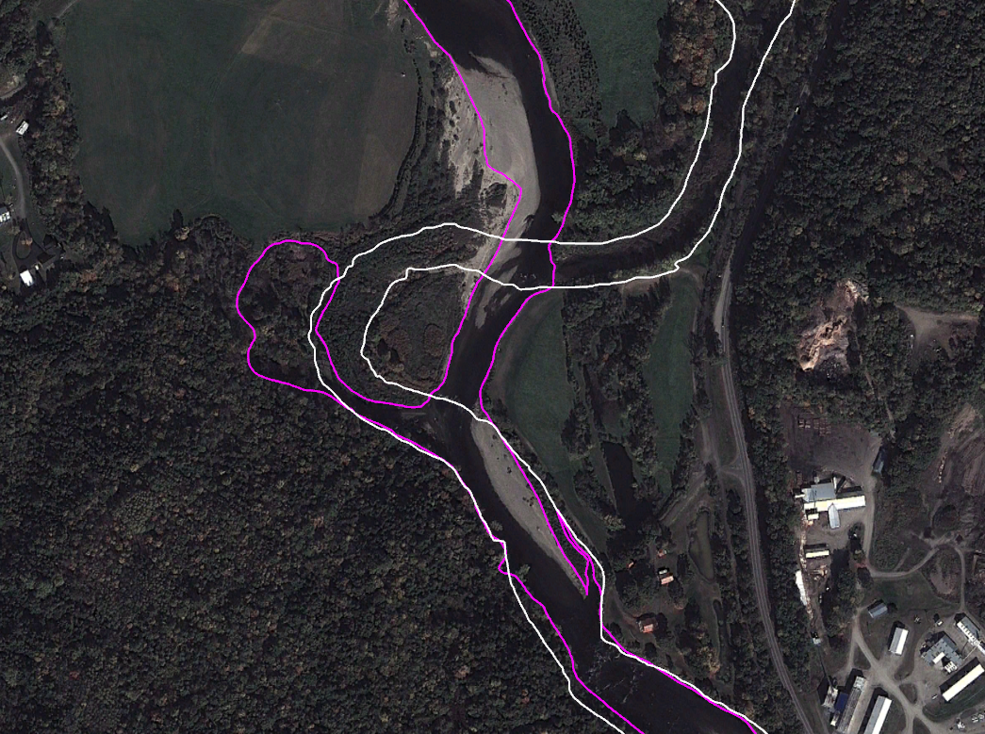
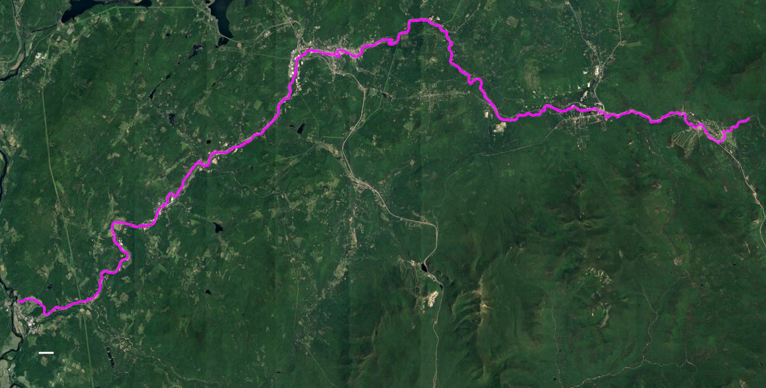
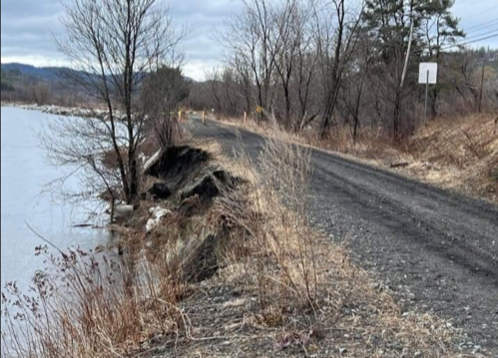
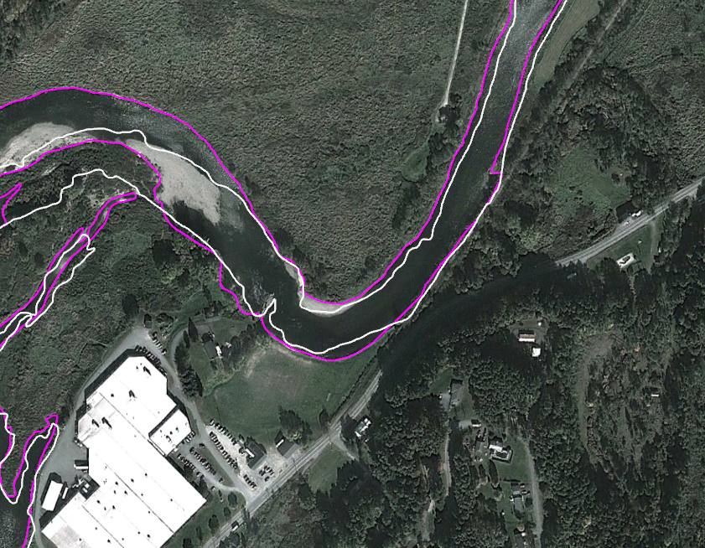
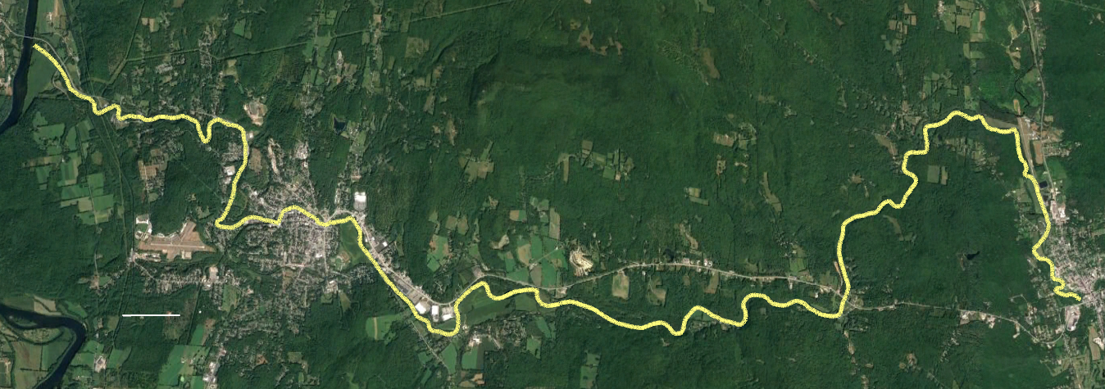
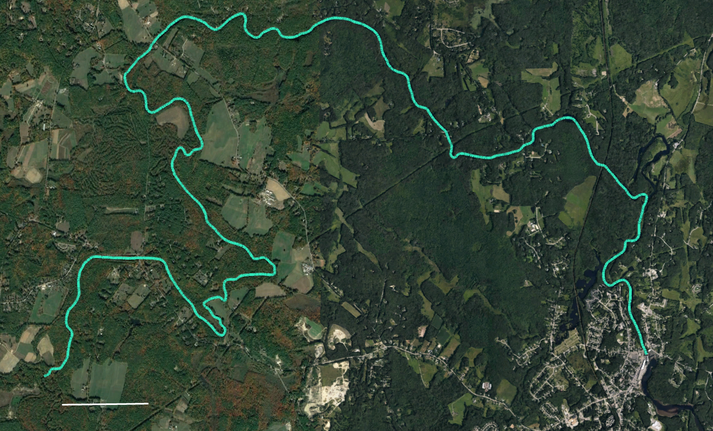
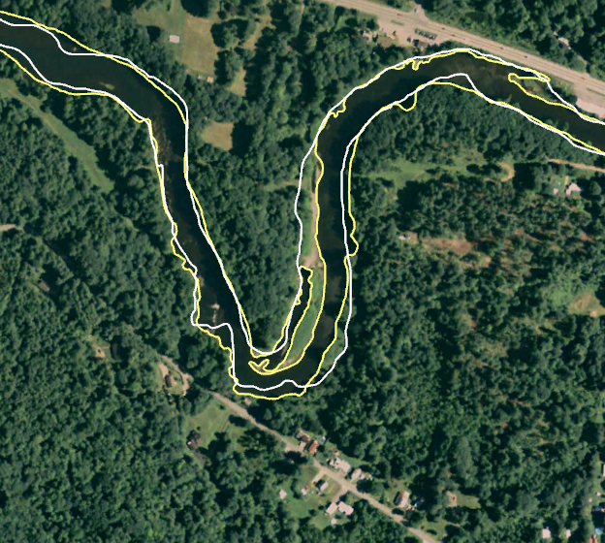
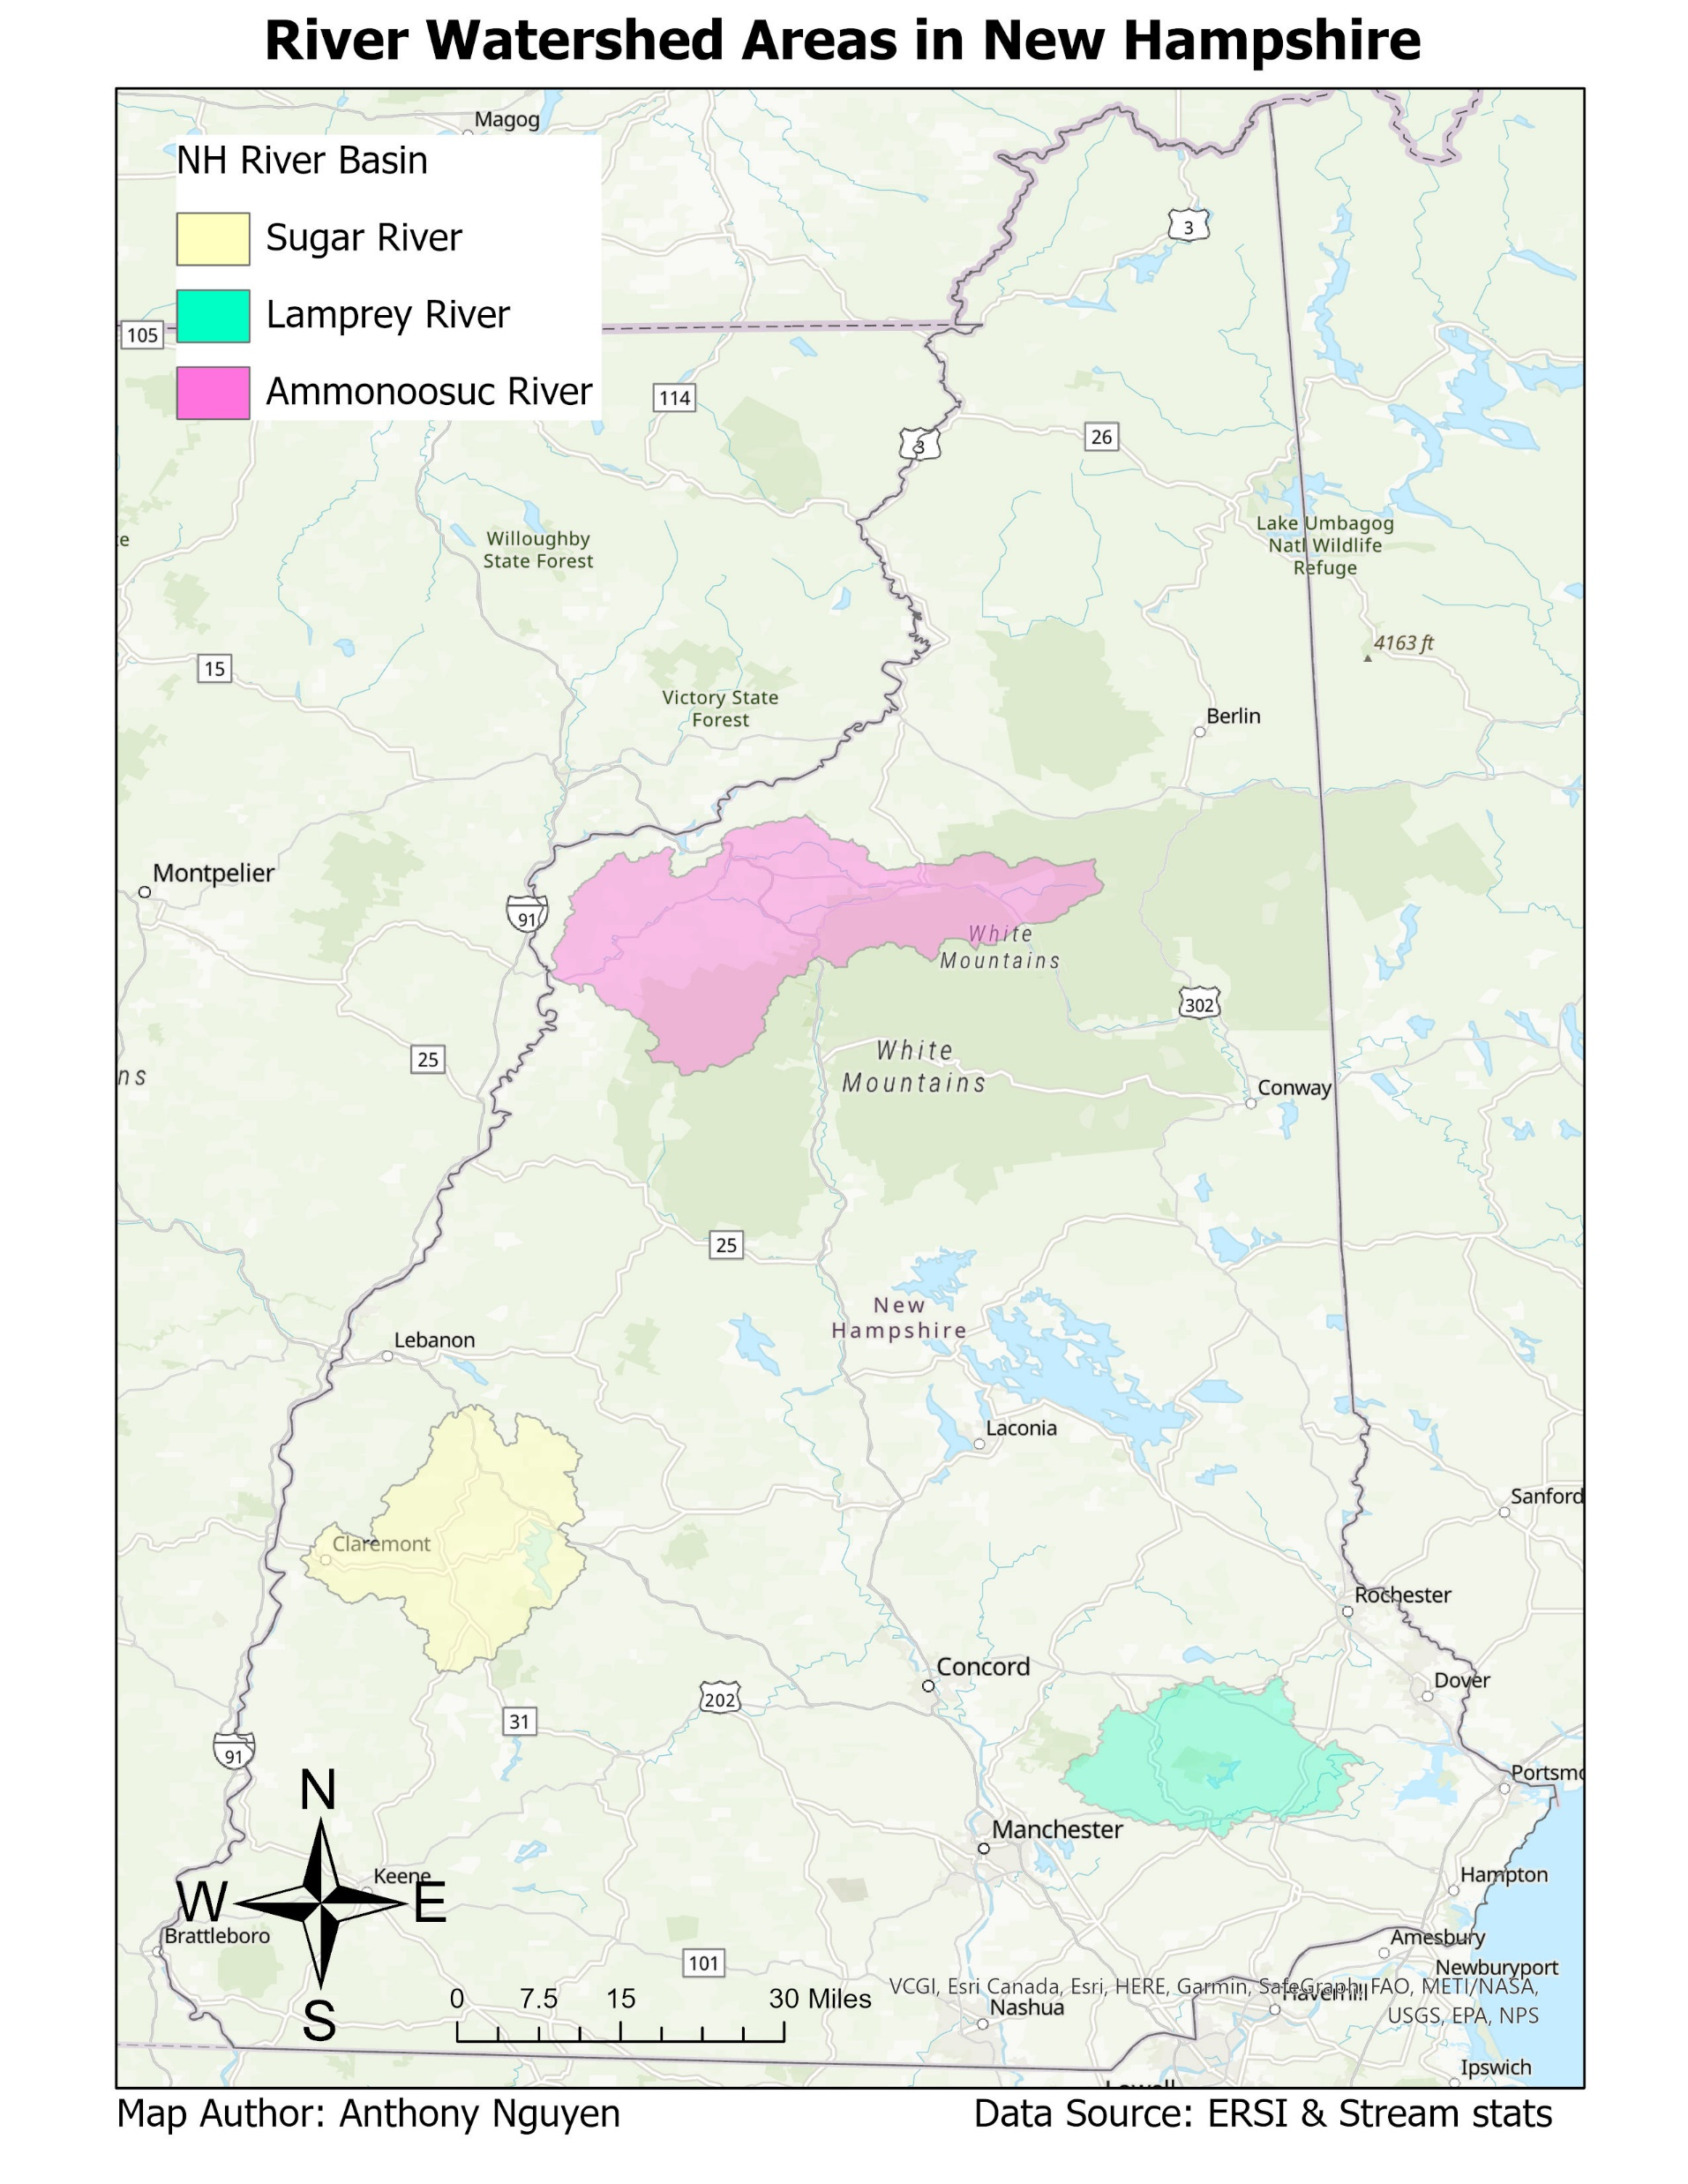
Estimating historical river channel change in New England Anthony Nguyen Advisor: Anne Lightbody Department of Earth Sciences, University of New Hampshire
Introduction
River Delineation
Rivers and streams are an important part of the ecosystem and are constantly changing over time. Erosion, which results when bank sediment is lost and carried downstream, can threaten infrastructure that is located along the bank (Figure 1). Deposition results when sediment accretes on the bank, forming new land or islands. The goal of this study was to estimate the rate and location of historical channel change for three rivers in New Hampshire.
A
A
A
Figure 1 & Figure 4B
Flow direction
Figure 4A
1 km
Ammonoosuc River
B
B
B
Sugar River (Lower)
Flow direction
1 km
1 km
Figure 4C
Sugar River (Upper)
1 km
Figure 1. Erosion occurring next to train tracks along the Ammonoosuc River in Spring of 2022. Photo credit: Ammonoosuc Valley ATV Club.
C
C
Study Area
Flow direction
C
1 km
Lamprey River
Figure 3. Delineation of the main stem of the (A) Ammonoosuc, (B) Sugar, and (C) Lamprey Rivers. Google Earth Pro was used to manually delineate points along the bank lines, centerlines, and islands for two different imagery dates for each river. Points were then imported into ArcGIS Pro, where a Python code was used to calculate channel change for 5-meter-long polygons.
Figure 4. Close ups of delineated channel change on study rivers. (A) Avulsion on the Ammonoosuc River. (B) Erosion on the Ammonoosuc River. (C) Deposition on the Sugar River.
Figure 5. Erosion, deposition, and total channel change for the (A) Ammonoosuc, (B) Sugar, and (C) Lamprey Rivers. Erosion was calculated for each polygon by dividing its positive horizontal area change by length by number of years between images. Deposition was calculated for each polygon by dividing its negative horizontal area change by length by number of years. Total change was calculated by summing erosion and deposition.
1km
Change Comparison
Conclusion
Table 1. Erosion, deposition, and total change (average ± standard deviation) for non-backwater regions of each river. Letters (a, b, c, etc.) indicate which values are significantly different from each other (p ≤ 0.05).
Historical aerial photos provide useful information about channel change in New Hampshire rivers. Accurate estimation requires leaf off satellite imagery for the beginning and the end of the study period.
Erosion and deposition were present in all three studied rivers and were focused in shorter (in general, less than 100-meter-long) reaches.
The Lamprey River did not change much compared to the Ammonoosuc River and the lower portion of the Sugar River, underscoring the importance of local geomorphology on river movement.
Areas with recent channel change can help identify fluvial erosion hazards which can affect people and properties.
Changes to climate and land use are likely to increase flood peaks and high flow velocities and therefore accelerate channel change in New England rivers.
 | Ammonoosuc River | Sugar River (Lower) | Sugar River (Upper) | Lamprey River
Time period | 1994 - 2011 | 1998 - 2011 | 1998 - 2011 | 1998 – 2013
Average Erosion (m/yr) | 0.4 ± 0.3ª | 0.3 ± 0.3^{c} | 0.2 ± 0.2e | 0.3 ± 0.2^{c}
Average Deposition (m/yr) | 0.3 ± 0.3^{b} | 0.6 ± 0.5^{d} | 0.3 ± 0.2e | 0.3 ± 0.3e
Average Total Change (m/yr) | 0.8 ± 0.5 | 1.0 ± 0.7 | 0.5 ± 0.2 | 0.6 ± 0.4
Acknowledgements
Figure 2. Location of watershed areas for the Ammonoosuc, Sugar, and Lamprey Rivers, which were each delineated during two different years to be able to estimate channel change.
I would like to thank Trevor Fenoff and Anne Lightbody for all their help, guidance, and support throughout all the phases of this project. I am grateful that Trevor shared his python program to be able to compute the delineation data from Google Earth Pro to ArcGIS and Excel.

