Slide 1

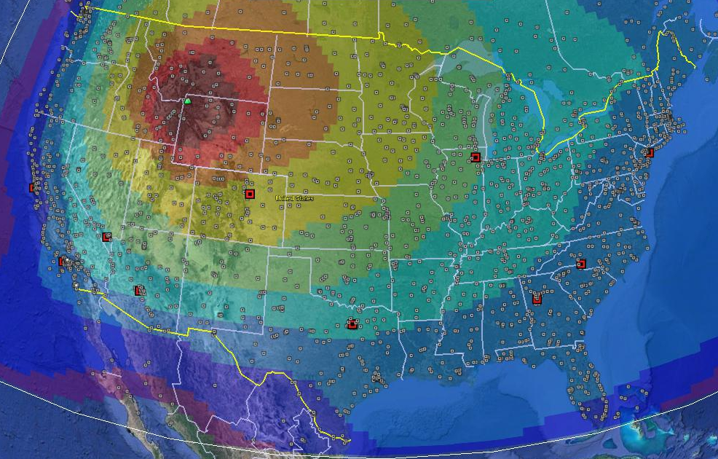
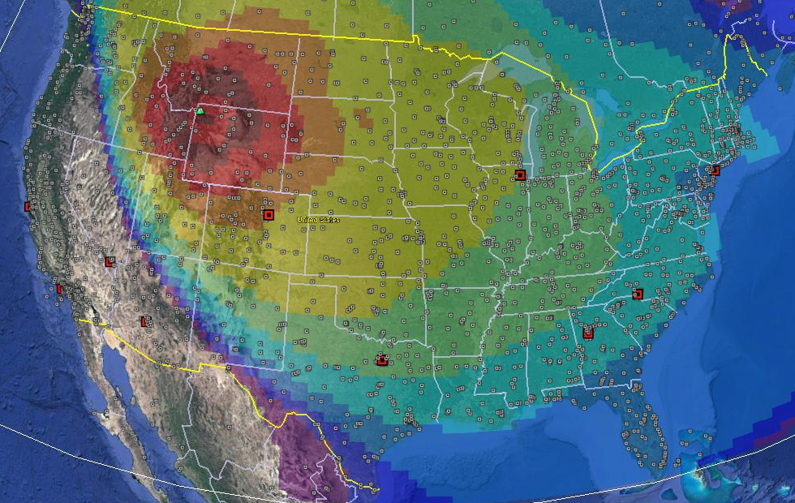
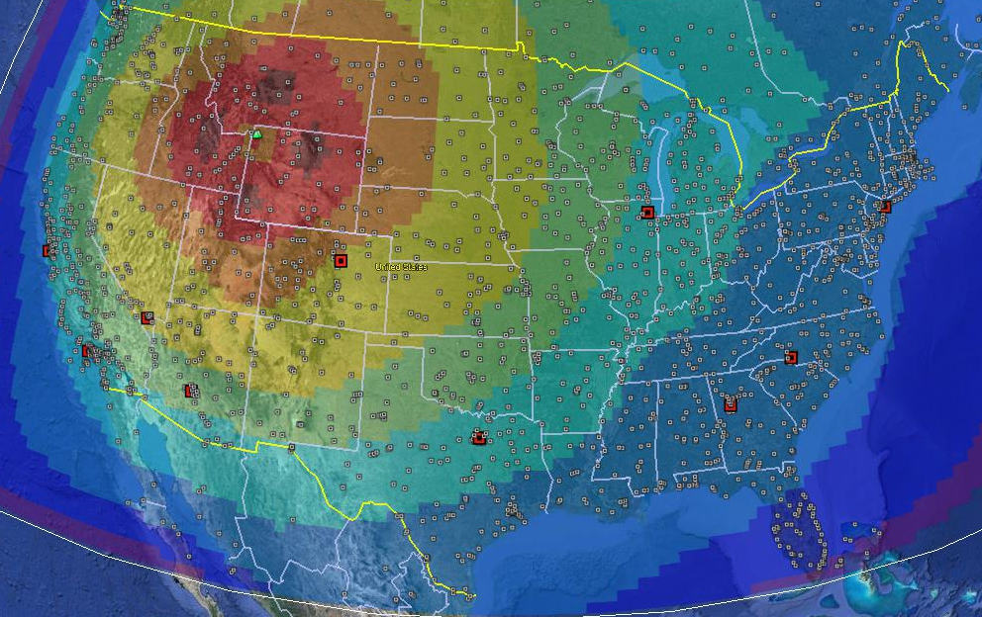
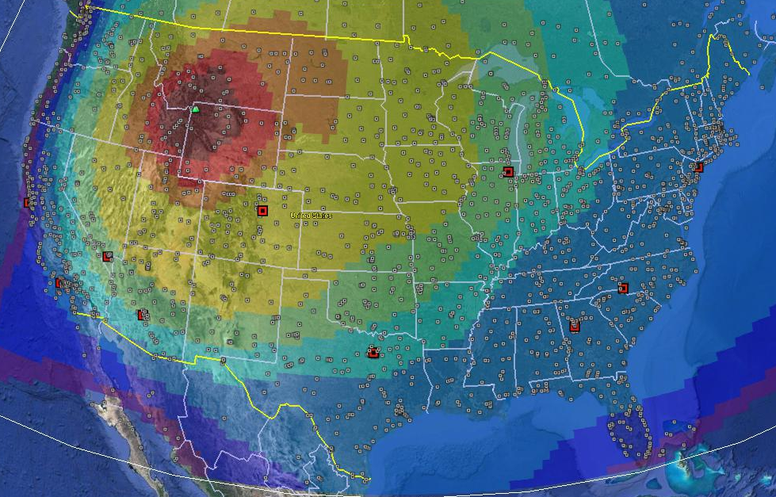
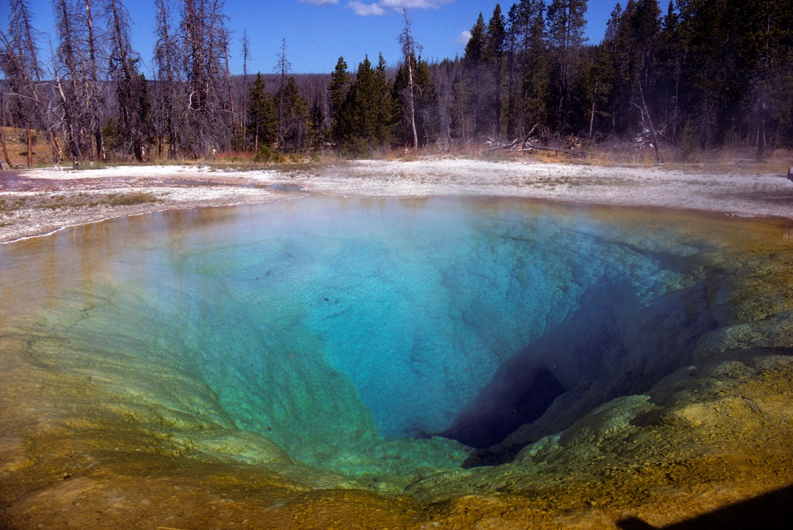
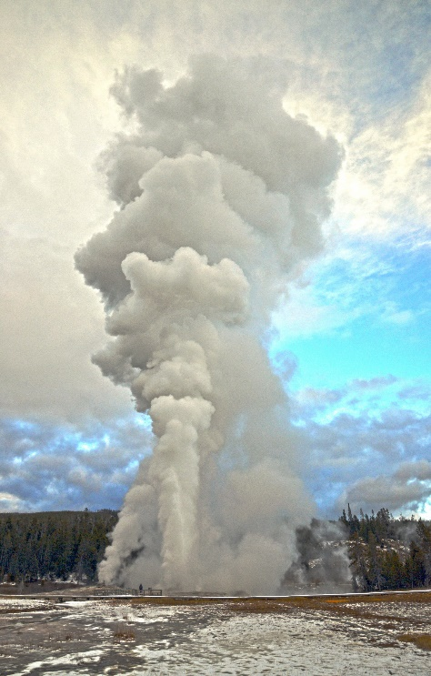
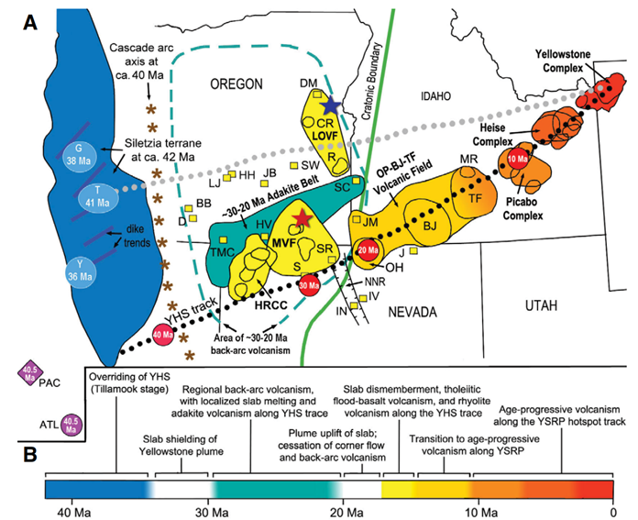
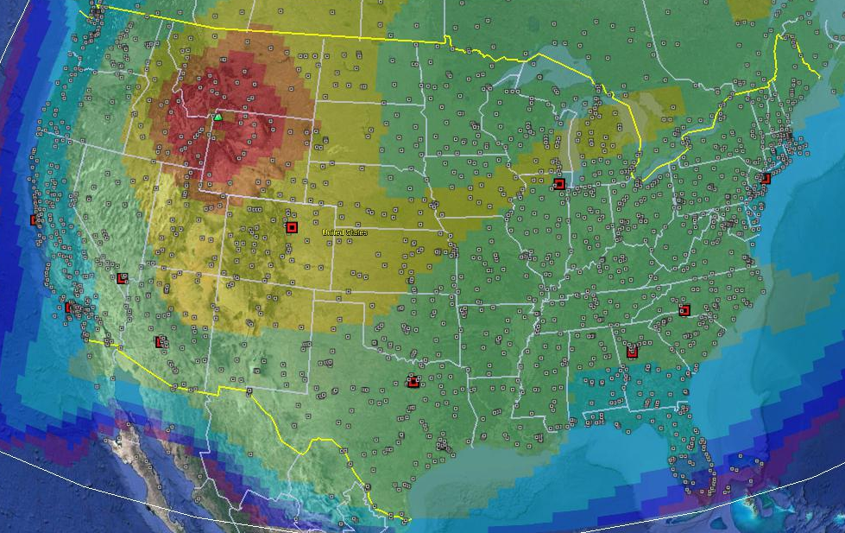
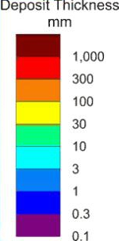
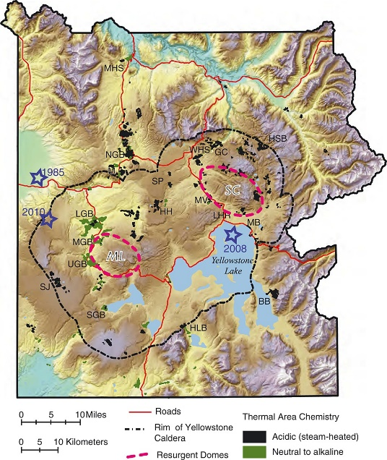
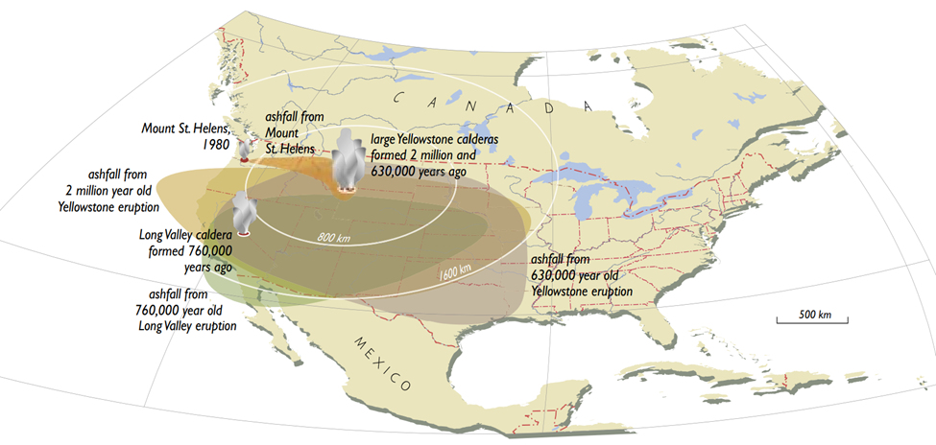
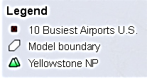
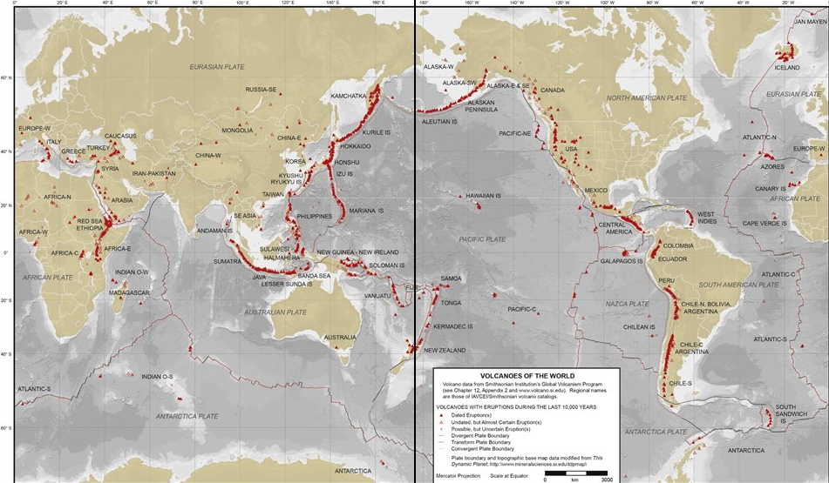
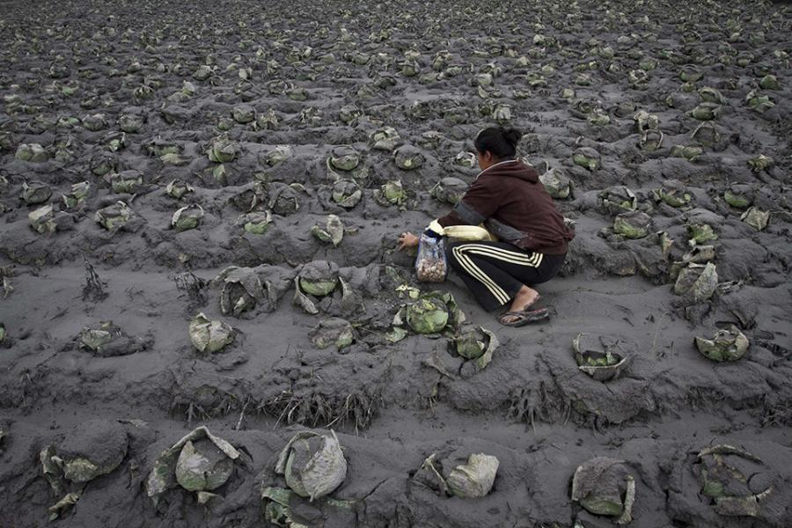

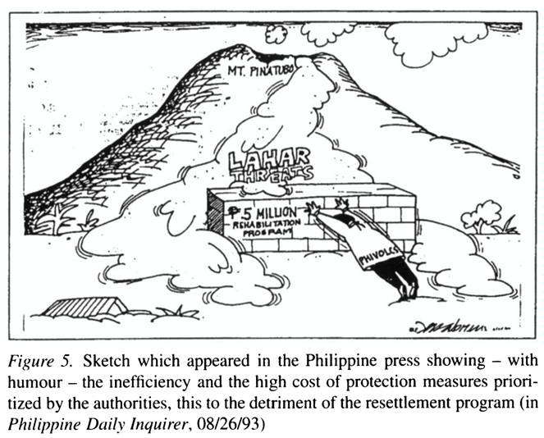
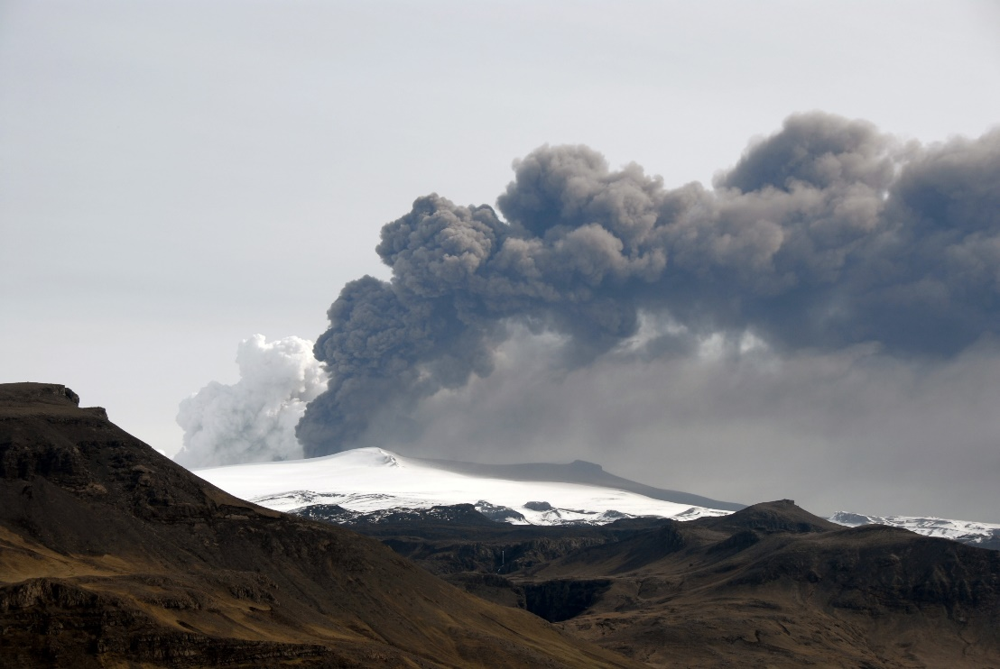
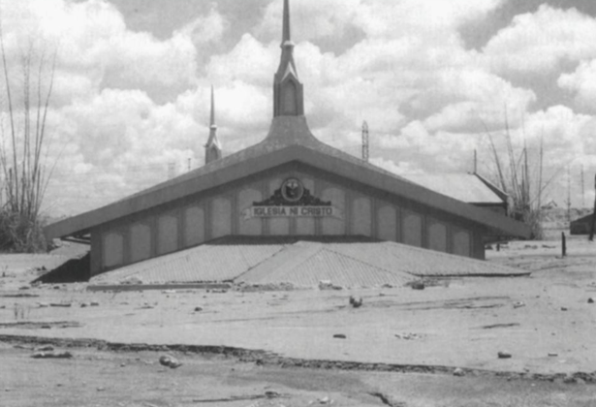
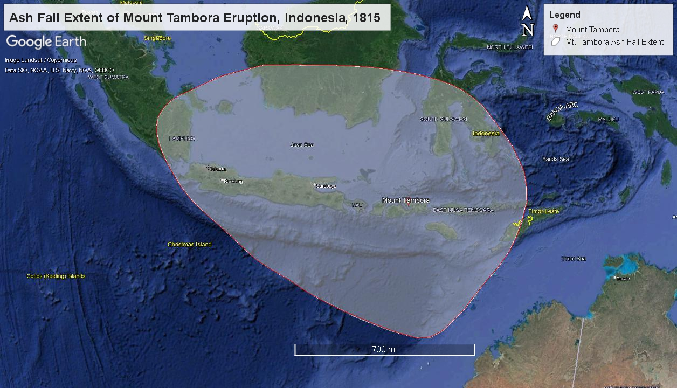
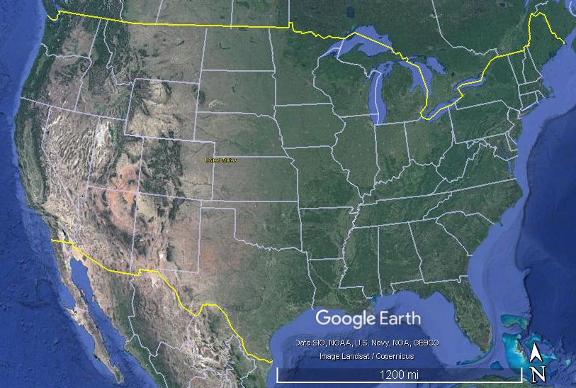
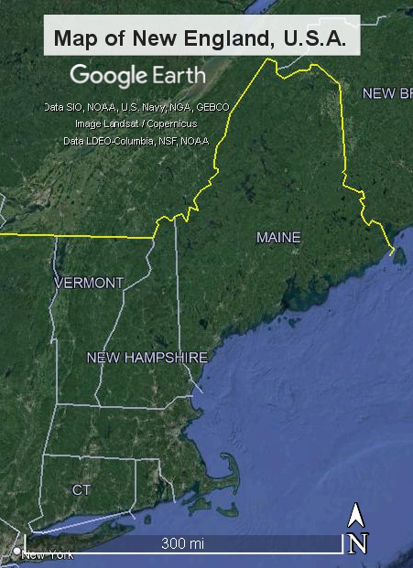
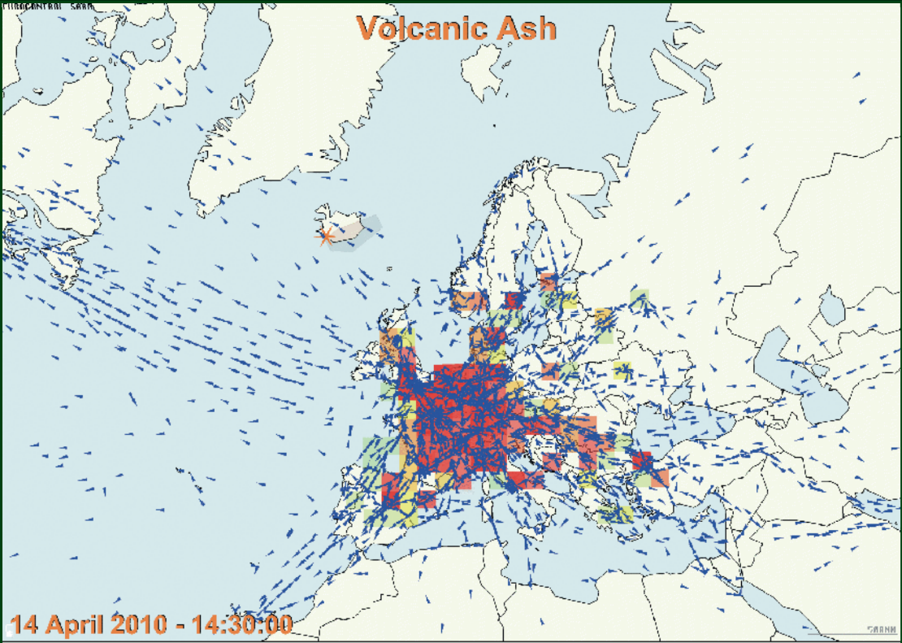
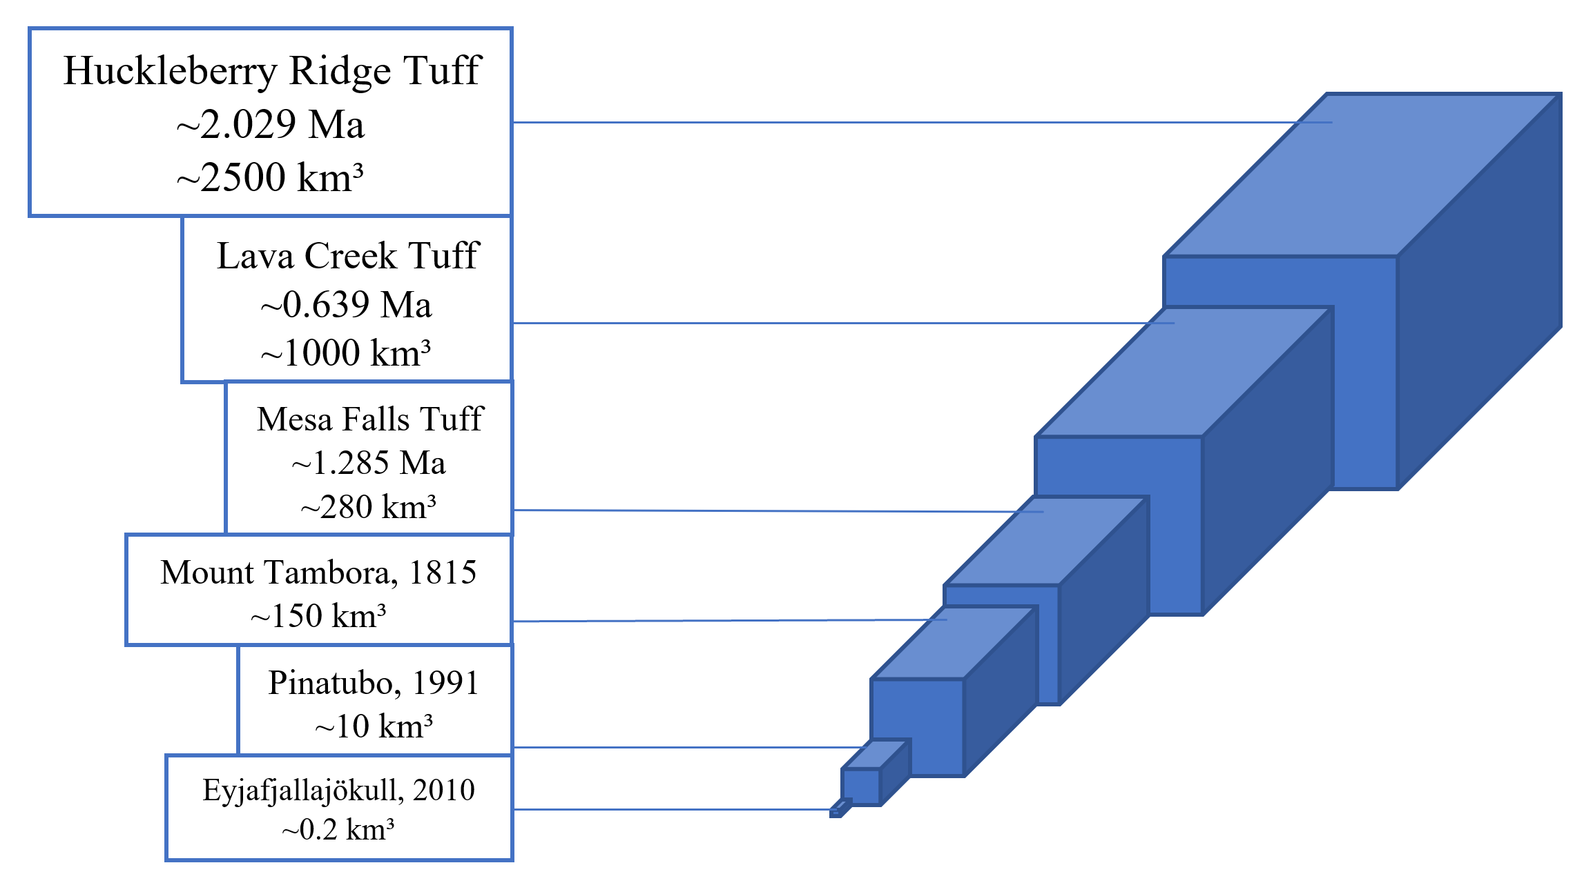
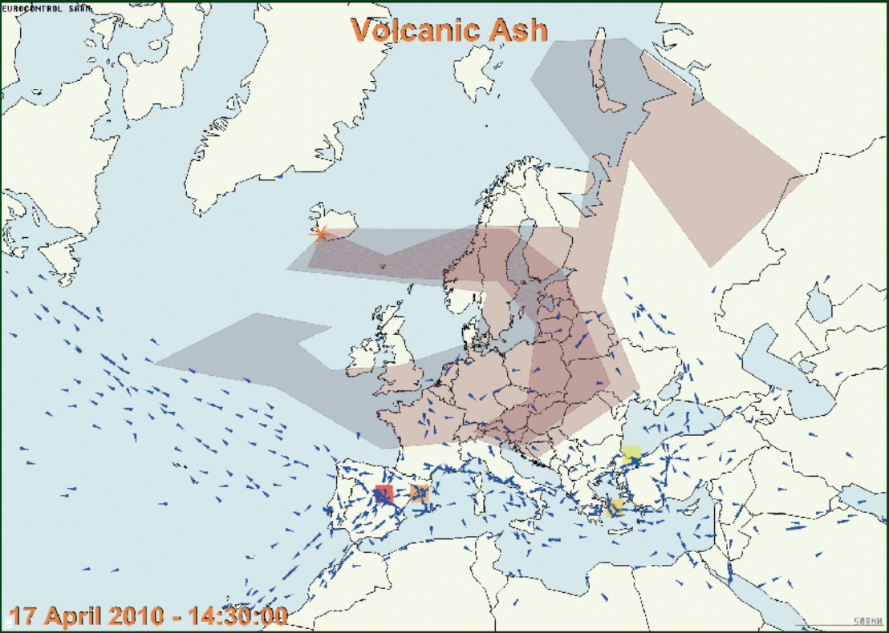
Environmental and Societal Impacts of a Potential
Yellowstone Eruption on New England
Serena Butler - Department of Earth Sciences - University of New Hampshire
1. Project goals
4. Ash fall models and impacts
6. Mitigation strategies
Investigate significant eruptions in human history to evaluate Yellowstone’s potential impacts
Determine what could happen to New England if Yellowstone’s “super-volcano” were to erupt
Evaluate predictions of ash fall models in terms of environmental and societal effects
Develop mitigation strategies to limit devastating effects of an eruption
A
A: Month-long eruption with umbrella cloud height of 25 km and heavily aggregated grain size distribution
B: 3-day long eruption with umbrella cloud height of 25 km and heavily aggregated grain size distribution.
B
Prepare: monitoring and alert systems in place across U.S.; plans made and practiced; risk assessments for most affected areas; scientists provide advice to public, government, and first responders
Respond: put management strategies into action; move residents to evacuation centers in New England and other eastern states; organize funds for immediate relief; halt unnecessary transportation; protect livestock; clear ways to hospitals; distribute masks and eye protection
Recover: declare immediate danger is over; clean up ash and infrastructure damage; move residents back into homes if possible (if not, organize funds to re-establish communities and provide employment opportunities)
2. history of the Yellowstone hotspot
April 1-30
Height: 25 km
April 14-16
Height: 25 km
C
C: Week-long eruption with umbrella cloud height of 15 km and heavily aggregated grain size distribution
D: Week-long eruption with umbrella cloud height of 35 km and heavily aggregated grain size distribution
D
The hotspot beneath Yellowstone National Park has been associated with three highly explosive eruptions during the Quaternary Period (~2.029 Ma, ~1.285 Ma, ~0.639 Ma). These events distributed volcanic ash deposits across the western U.S. The park is monitoring the hotspot's ongoing hydrothermal and seismic activities, but it is poorly understood what the pre-cursors would look like for a "super-volcano"-scale eruption because events of this magnitude have not occurred during human history.
April 21-27
Height: 15 km
April 21-27
Height: 35 km
E
E: Week-long eruption with umbrella cloud height of 25 km and weakly aggregated grain size distribution.
Figure 7: A-E represent the simulated tephra fall thickness from a Yellowstone eruption of 330 km³ assuming April 2001 wind fields with prescribed parameters for umbrella cloud height, grain size distribution, and duration of eruption. Airports within U.S. are also shown, and the ten busiest airports are shown in red to show the effects on air travel in the U.S.. Under all these simulations, New England is predicted to receive some ash fall. Data from Mastin et al. (2014).
Photo 1 (left): Morning Glory pool in Yellowstone National Park (YNP). Photo 2 (right): Giant Geyser in YNP with person for scale. Photos by Joe Licciardi.
Adapted from Sigurdsson et al. (2015)
April 21-27
Height: 25 km
7. Conclusion
Figure 2: Shaded relief image of Yellowstone National Park from Hurwitz and Lowenstern (2014). The Yellowstone Caldera (outlined) formed the Lava Creek Tuff ~0.639 Ma. Thermal features and resurgent domes are also shown.
These tephra fall models over the United States indicate New England will receive 1-30 mm tephra fall depending on the parameters of umbrella cloud height, duration of the eruption, and the grain size distribution of the tephra. These data are based on 2001 wind fields, but if past eruptions have occurred during a glacial period, ice sheet topography would likely alter atmospheric circulation patterns and affect the distribution of tephra fall.
There is a 99.9% confidence that the 21st century will not experience a Yellowstone super-volcano eruption (Mastin et al., 2014). However, there are plenty of other less monitored active calderas that could erupt, therefore underlying the importance of having mitigation strategies in place..
Figure 1: (A) History of the Yellowstone hotspot track from Camp and Wells (2021). Evidence for the track suggests its evolution began just off the western coast of the U.S., and as the overriding North American plate has moved over time, the hotspot is now centered near the borders of Wyoming, Montana, and Idaho as the Yellowstone Complex. (B) Timeline of tectonomagmatic events along the Yellowstone hotspot track.
Figure 3: Ash falls from two larger Yellowstone eruptions and other historic eruptions for comparison. Yellowstone’s eruptions deposits cover the greater part of the western U.S. and not the eastern states. Figure derived from Sparks and Self, et al. (2005).
5. Impacts on new england
3. Significant eruptions in human history
Campi Flegrei
Yellowstone
Santorini
Aira
Long Valley
Eyjafjallajökull, Iceland
Mount Pinatubo, Philippines
Mount Tambora, Indonesia
Toba
Taal
Rabaul
Taupo
La Pacana
Laguna del Maule
Photo 5: Ashfall on crops in Karo, Sumatra, Indonesia after the eruption of Mt. Sinabung in 2014. Photo from USGS.
Photo 6: Quito International Airport during eruption of Reventador Volcano covered with 3-5 mm ash on 3 November 2002. Airport was closed for 8 days for cleanup. Photo from USGS.
Figure 8: Cartoon in the Philippine Daily Inquirer (08/26/1993) showing the ineffective and expensive protective measures prioritized by authorities for possibly political reasons, much to the detriment of important resettlement programs for displaced people (Leone and Gaillard, 1999).
Health:
  Those with pre-existing respiratory conditions likely impacted by silicosis and chronic pulmonary disease; others will experience inflamed lungs, irritated eyes and skin
  Diseases more common due to overcrowding
  Mass starvation from crop failures and harmed livestock
  Fluorosis will develop if exposed to polluted water
Figure 10: Volcanoes considered active around the world that have erupted during the last 10,000 years. The pink ovals represent some of the largest calderas in the world still considered to be active systems (cf. Mason et al., 2004) such as Toba (Indonesia), Yellowstone (U.S.), La Pacana (Chile), Taupo (New Zealand), Long Valley (California, U.S.), as well as other active systems such as Aira (Japan), Rabaul (Papua New Guinea), Taal (Philippines), Campi Flegrei (Italy), Santorini (Greece), and Laguna del Maule (Chile). Not including extinct caldera systems. Figure modified from Sigurdsson et al. (2015).
Photo 3: View of Eyjafjallajökull ash cloud in 2010. Photo by Joe Licciardi.
Photo 4: Only the top of this church in Bacolor is exposed, as the lower parts are covered by a lahar flow. Photo taken by F. Leone, June, 1996. (Sparks and Self, et al., 2005).
Figure 5: Shaded area represents the ash fall extent of the eruption of Mount Tambora, Indonesia, 1815. Modified from Boers (1995) using Google Earth Pro.
8. references
Agriculture: ash can destroy crops and harm livestock grazing/drinking on polluted land/waters
Climate: predicted average cooling of 3-5°C, could incite new ice age (Sparks et al., 2005)
Relocation: influx of western U.S. residents to eastern states, adding need for evacuation centers and relief funds/materials
Transportation: air traffic shut down if ash is a hazard, affecting 18th busiest U.S. airport (Boston-Logan Int.); roads slick from ash
Economy: all the above will impact U.S. economy, which can domino and affect entire world
Boers, Bernice de Jong. (1995). Mount Tambora in 1815: A Volcanic Eruption in Indonesia and Its Aftermath. Indonesia, 60, 36-60. https://doi.org/10.2307/3351140 ​
Camp, Victor E. and Wells, Ray E. (2021, January). The Case for a Long-Lived and Robust Yellowstone Hotspot. The Geological Society of America. Vol. 31, no. 1, pp. 4- 10. https://doi.org/10.1130/GSATG477A.1. CC-BY-NC. ​
"CY 2014 Primary Airports -- Preliminary Data" (PDF). Faa.gov. Retrieved 13 April 2022.​
Global Volcanism Program, 2013. Volcanoes of the World, v. 4.10.6 (24 Mar 2022). Venzke, E (ed.). Smithsonian Institution. Downloaded 14 Apr 2022. https://doi.org/10.5479/si.GVP.VOTW4-2013.
Hurwitz, Shaul and Lowenstern, Jacob B.. (2014, August 11). Dynamics of the Yellowstone hydrothermal system. Reviews of Geophysics, 51, 375-411. doi:10.1002/2014RG000452. ​
Hansell, A.L., Horwell, C.J., and Oppenheimer, C. (2006). The Health Hazards of Volcanoes and Geothermal Areas. Occupational and Environmental Medicine. Vol. 63, No. 2, pp. 149-156. Doi: 10.1136/oem.2005.022459.​
Leone, F. (1996) Impacts et gestion des crises liés à l'éruption du volcan Pinatubo (1991-1996). Contribution à l'analyse du système institu-tionnel philippin de réponse aux catastrophes volcaniques. PANGEA, Bulletin du Centre International pour la Formation et les Echanges en Géosciences (CIFEG), Orléans, France, n. 26, Décembre 1996, pp. 13-34.​
Leone, F. and Gaillard, J.C. (1999). Analysis of the Institutional and social responses to the eruption and the lahars of Mount Pinatubo volcano from 1991 to 1998 (Central Luzon, Philippines). GeoJournal. Vol. 49, No. 2. https://www.jstor.org/stable/41147418?seq=1 ​
Lund, K. A. and Benediktsson, K. (2011). Inhabiting a risky Earth: The Eyjafjallajökull eruption in 2010 and its impacts. Anthropology Today. Vol. 27, No. 1.
Mason, B.G., Pyle, D.M. & Oppenheimer, C (2004). The size and frequency of the largest explosive eruptions on Earth. Bull Volcanol 66, 735–748. https://doi.org/10.1007/s00445-004-0355-9 ​
Mastin, L. G., A. R. Van Eaton, and J. B. Lowenstern (2014). Modeling ash fall distribution from a Yellowstone supereruption. Geochem. Geophys. Geosyst., 15, 3459–3475, doi:10.1002/ 2014GC005469. ​
Self, S. (2006). The Effects and Consequences of Very Large Explosive Volcanic Eruptions. Philosophical Transactions: Mathematical, Physical and Engineering Sciences, 364(1845), 2073–2097. http://www.jstor.org/stable/25190315
Sigurdsson, H., et al. (2015). The Encyclopedia of Volcanoes. Academic Press. ​
Smith, Robert B. and Braile, Lawrence W. (1994). The Yellowstone hotspot. Journal of Volcanology and Geothermal Research. Vol.61, no.2-4, pp. 121–129, 135–187, doi:10.1016/0377- 0273(94)90002-7​
Sparks, S. & Self, S., et al. (2005). Super-eruptions: global effects and future threats. Report of Geological Society of London Working Group. 2nd (print) Ed., Original (Web) edition available at www.geolsoc.org.uk/supereruptions. ​
​
Figure 6 : The rectangular prisms represent the volume of eruptive material for the three Yellowstone hotspot eruptions compared to the eruptions of Mount Tambora, Pinatubo, and Eyjafjallajökull. Figure modified from Smith and Braille (1994).
Durham, NH
Mount Tambora, 1815: largest volcanic eruption during human history; had devastating impacts on entire globe, therefore is closest comparator for impacts of Yellowstone eruption.
Mount Pinatubo, 1991: closely monitored; locals were given warning to evacuate area, but after-effects of lahars and political self-interests negatively impacted residents; even with efficient warning systems, societal recovery could be prolonged due to people interfering for their own gain.
Eyjafjallajökull, 2010: erupted for 59 days; 80% of European air traffic shut down from ash; estimated economic impact of 5 billion USD (Sigurdsson et al., 2015); if larger Yellowstone eruption occurred, air traffic could shut down across globe.
MA
RI
Figure 4: Air traffic in Europe before and during the Eyjafjallajökull eruption in Iceland. Shaded area references closed air space. Figure from Lund and Benediktsson (2011).
Figure 9: Map of New England and its location in the United States of America. Images from Google Earth Pro.
I would like to thank my advisor for this thesis, Joseph Licciardi from the Department of Earth Sciences, for his expertise and passion for volcanoes as well as assisting and guiding me throughout this project. I would also like to thank the UNH Department of Earth Sciences for the past four years of opportunities and education.

