Slide 1
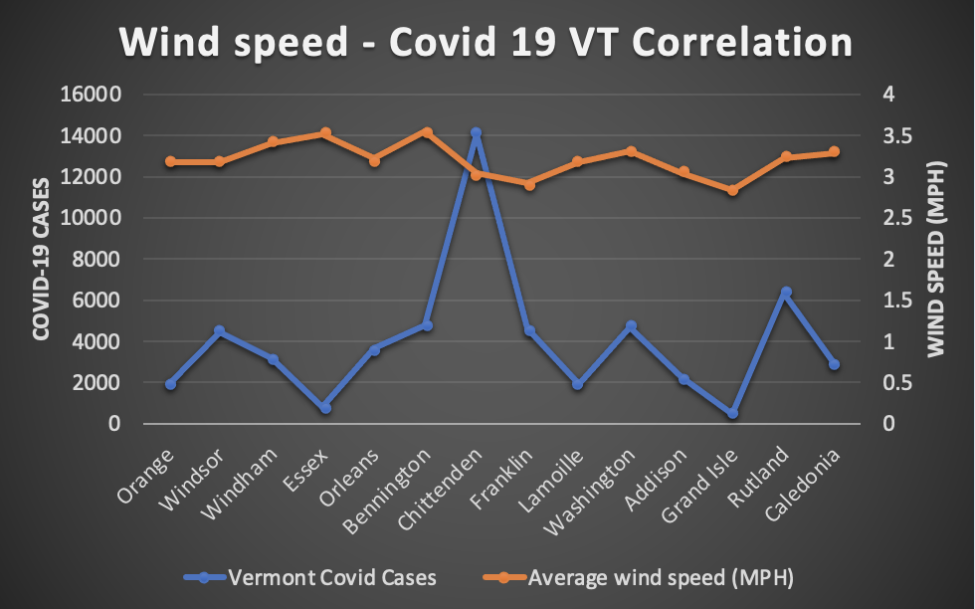
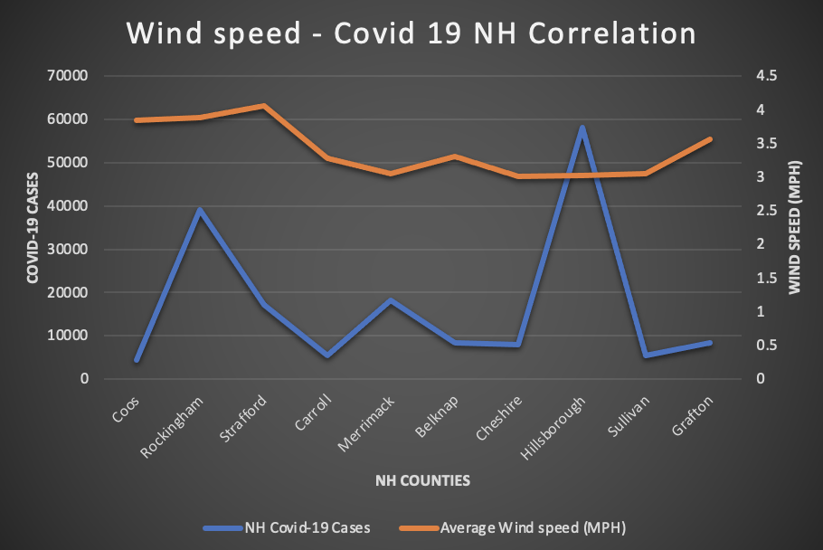
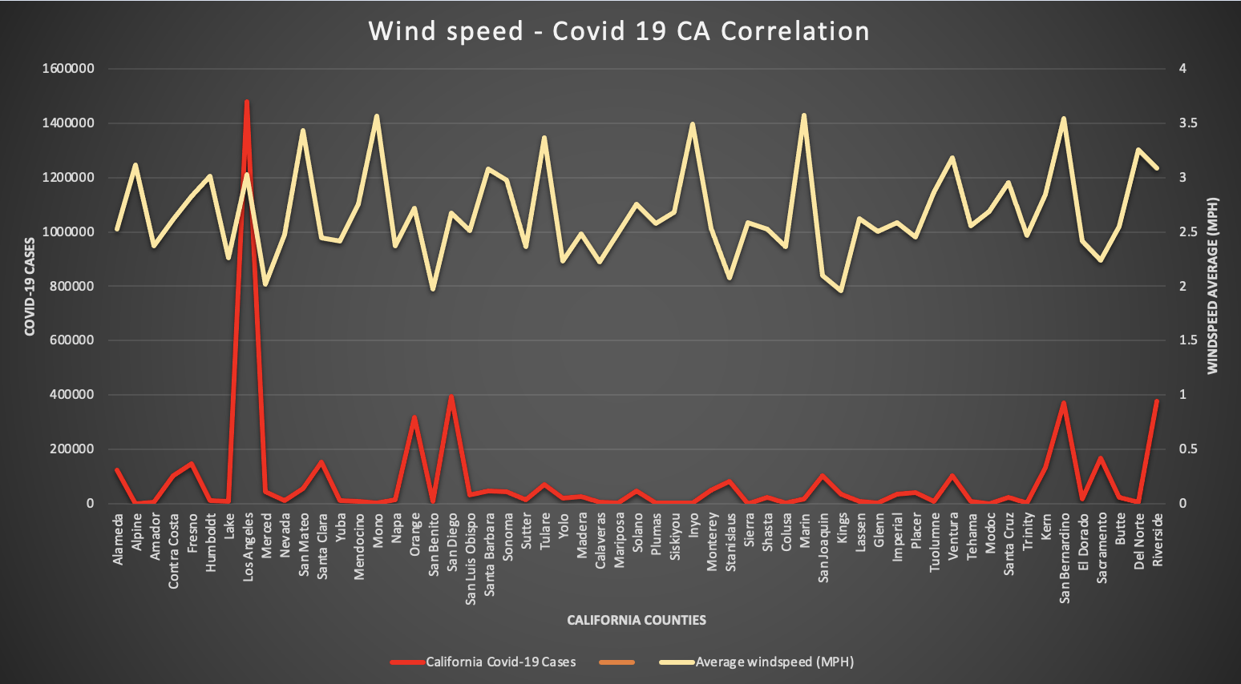
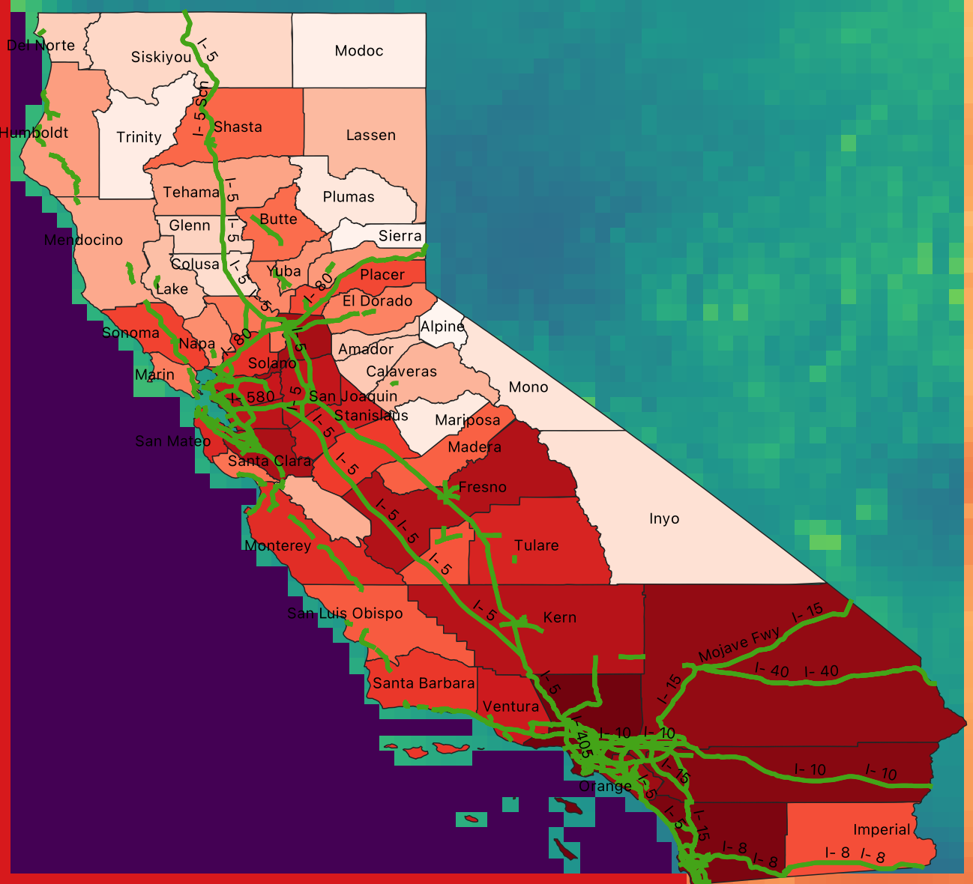
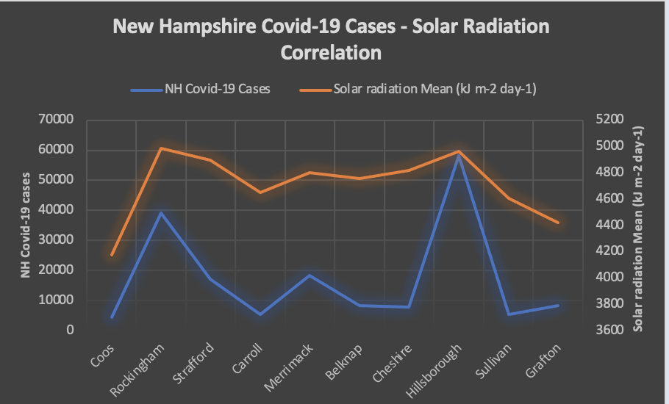
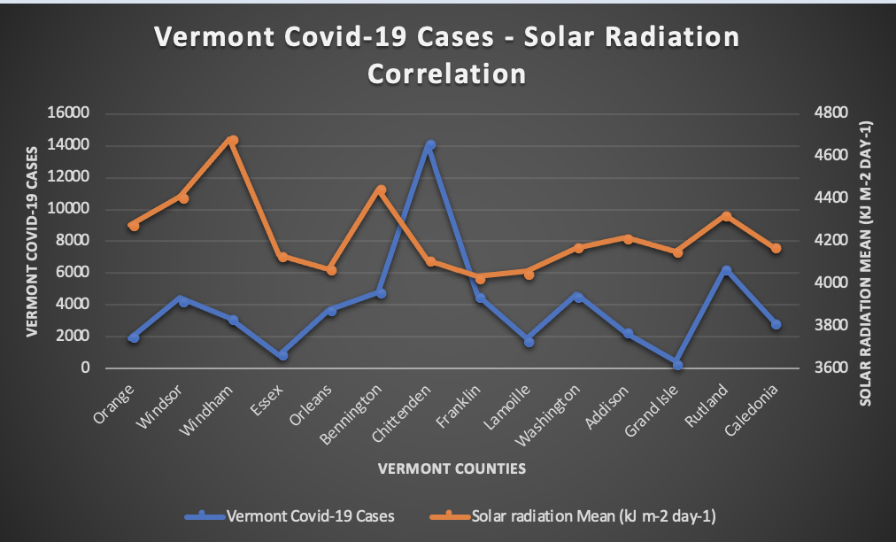
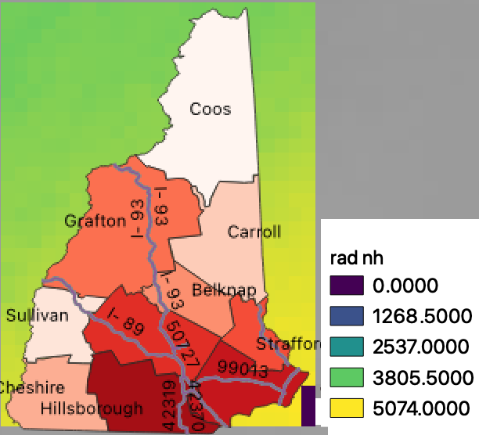
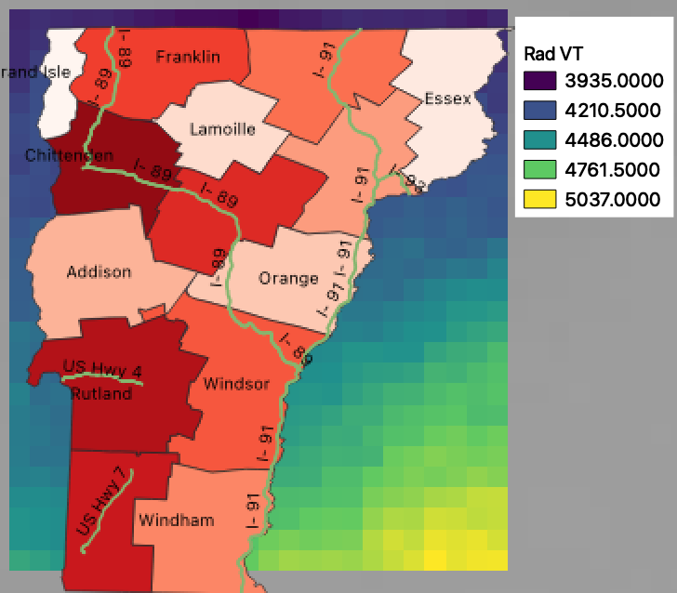
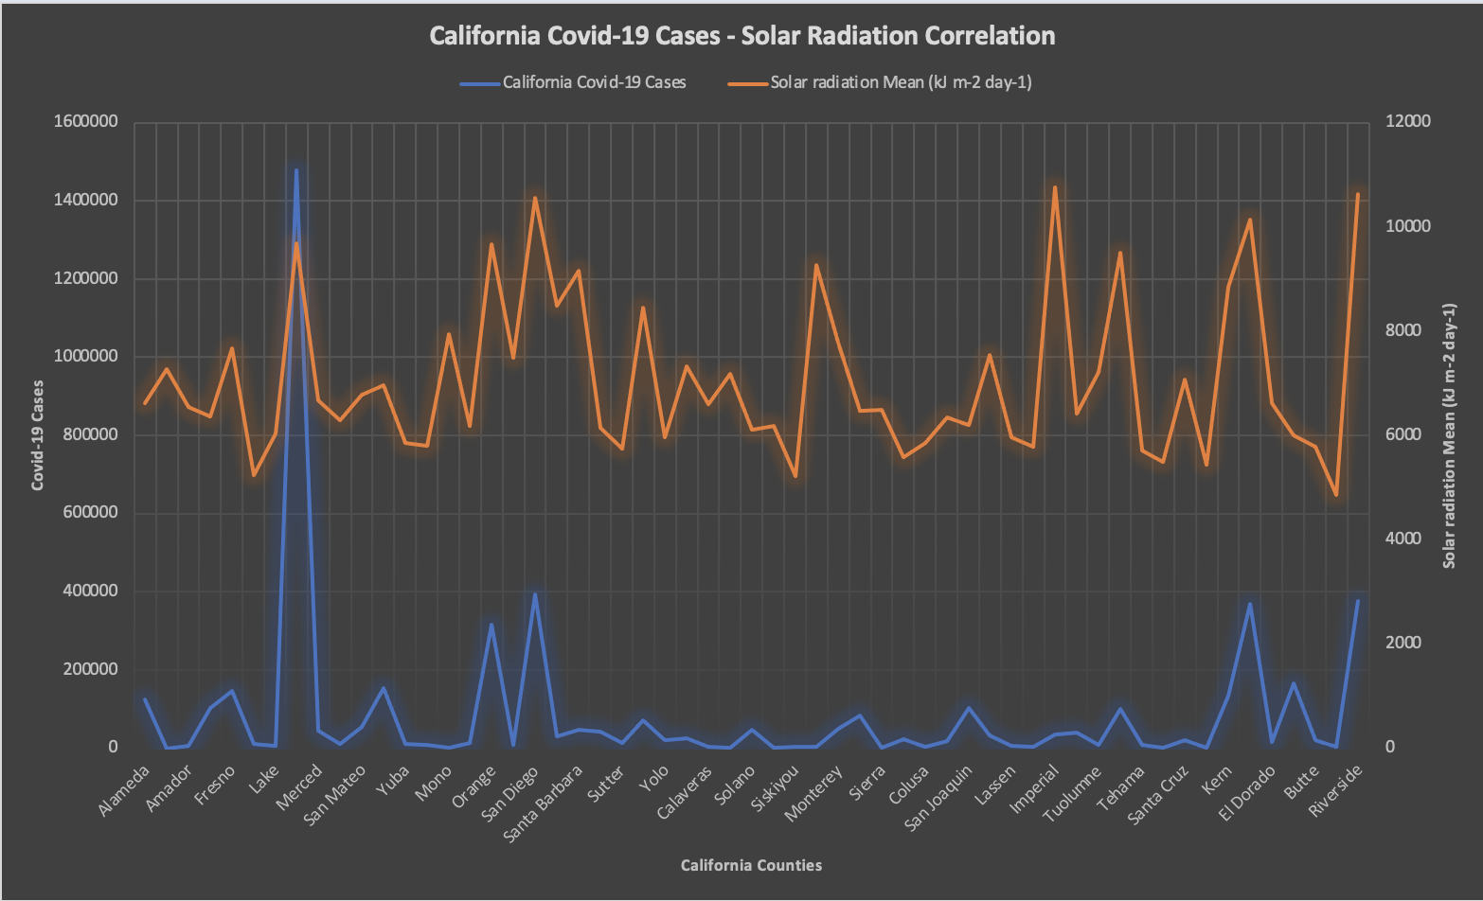
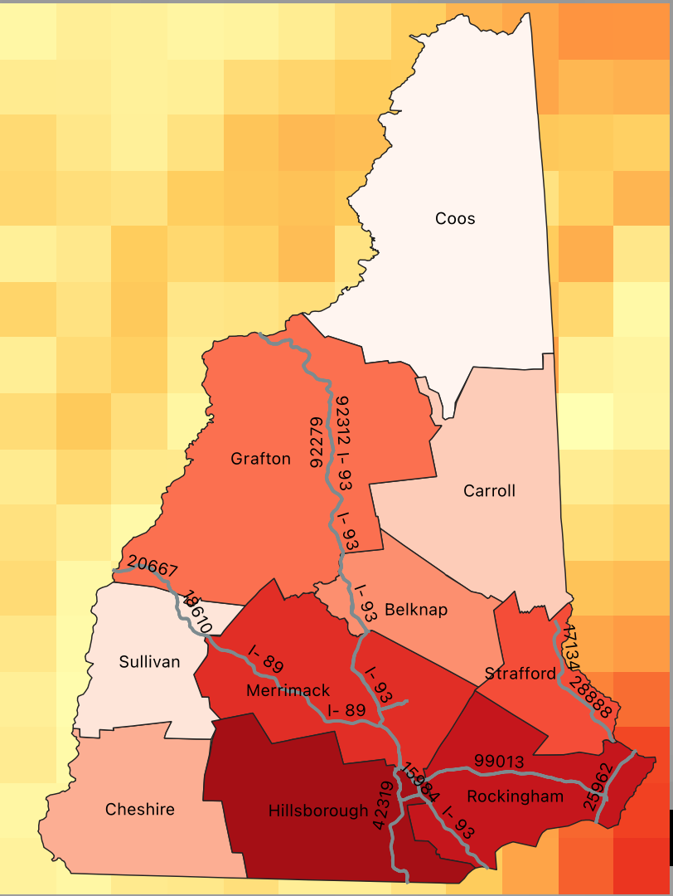
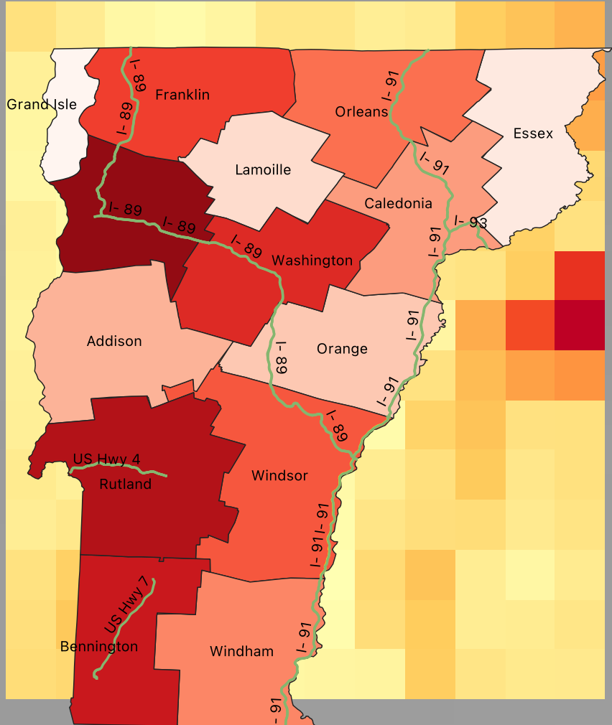
Using Q-GIS to Analyze Road Networks and Climate Factors to show Covid-19 Correlation Between New Hampshire, Vermont and California
Ritwik Baral
College of Engineering and Physical Sciences - Hydrology , University of New Hampshire
Background
Results
Conclusions
Ever since 2020, our world has never been the same. The Covid-19 Pandemic has taken a major toll on families and businesses all around the world. Here we are looking at 3 specific states to see how some factors effected the spread of this disease. We will be using population, wind speed, solar radiation, and road networks to create an effective conclusion between New Hampshire, Vermont and California.
Between the 3 states, California had the highest population, as well as the highest Covid-19 cases. Looking at the major road networks in California, we can see that there is a major junction and a lot of travel between the counties that are next to Los Angeles, as well as Santa Clara. This indicates that those are high impact areas, and since so much travel occurs between those counties, there is much more human interaction and points of interest as those are also high tourist areas.
Wind speed in California ranged from 1.9 MPH to 3.7 MPH between counties. Surprisingly, from many research studies, it has been shown that higher windspeeds diminish the disease in the air and break down the particles faster, so it is less transmissible.
However, higher windspeeds can also correlate to transmission rates being higher, this is due to people socializing more inside when wind rates are high, since windspeed cannot be measured from climate indoors, Covid-19 is more transmissible in standstill air conditions.
Looking at the windspeed scatter for New Hampshire, we can see that when windspeed is at its lowest, the cases are at the highest. However, there are other factors effecting this correlation, for example, population of the county, as well as the most major road network crossing through Hillsborough county.
The same correlation occurs within the windspeed scatter for Vermont, within Chittenden and Franklin county. A major road network crosses through these counties, and these counties also having the highest cases and most transmissible rates.
Methods
First image below shows the state of California, the green lines represent major road networks throughout the state, each county is separated, and color coded with in the manner of highest cases per state. This image is an example of solar radiation around the state. Multiple research studies have shown a correlation between the effects of solar radiation and Covid-19 cases/deaths.
Moving forward to solar radiation in all 3 states, we can see that with a higher solar radiation reading, the disease is most transmissible. California, being on the west coast had the highest solar radiation rates. Much higher than both New Hampshire and Vermont.
The increase of solar radiation shows a direct correlation to the number of cases, with other effecting factors such as population and human interaction and road network intersections. Sunlight causes disease inactivation and the increase of Vitamin-D activation, also effecting human white blood cells.
Solar radiations ended at a maximum in the mid 4000’s for both New Hampshire and Vermont. California nearly reaches 11,000 Kilojoules which is more than double the amount.
Having a warmer state also means that there are more tourist attractions, as well as beaches and outdoor activities.
With the population already being extremely high, and solar radiation rates exceeding both states in conversation, and windspeeds being lower than both New Hampshire and Vermont, California has the highest cases as well as deaths caused by the Virus.
The x-y scatters above show the correlation of average windspeeds in miles per hour for each state, and how It effects the cases of Covid-19 within each state. The x-y scatters below show correlation of Covid-19 cases and solar radiation in Kilojoules within each state. Using Zonal Statistics in Q-GIS, I was able to retrieve mean statistics of both windspeed and solar radiation for each county within each state.
The two images below shows wind speed around New Hampshire and Vermont, the correlation for wind speed and Covid-19 transmission was quite interesting. Many human factors related to this correlation.
New Hampshire Solar Radiation
Vermont Solar Radiation
The pie charts below simply show populations of each county within the states, to give a better understanding of why the Covid-19 statistics may vary by state.
References:
“SARS-COV-2 Transmission: The Effect of Wind Speed.” Medical News Today, MediLexicon International, https://www.medicalnewstoday.com/articles/covid-19-do-windy-days-reduce-transmission#We-need-a-multifaceted-approach.
2. Isaia, Giancarlo, et al. “Does Solar Ultraviolet Radiation Play a Role in COVID-19 Infection and Deaths? An Environmental Ecological Study in Italy.” Science of the Total Environment, vol. 757, Feb. 2021, p. 143757, 10.1016/j.scitotenv.2020.143757.
‌
Thanks to: Michael Palace
New Hampshire Windspeed
Vermont Windspeed

