Slide 1


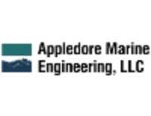
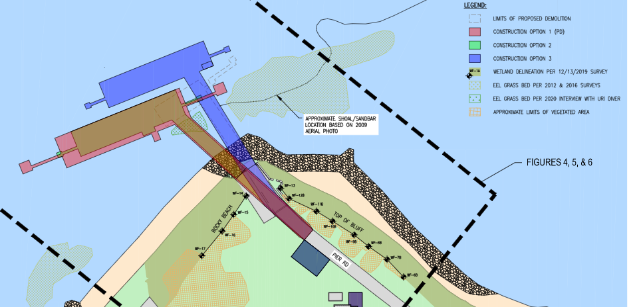
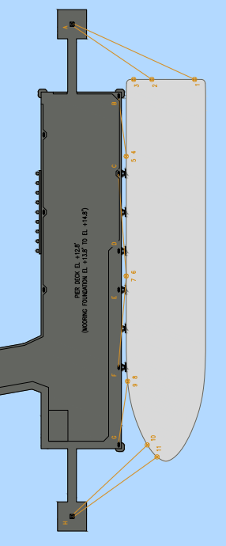
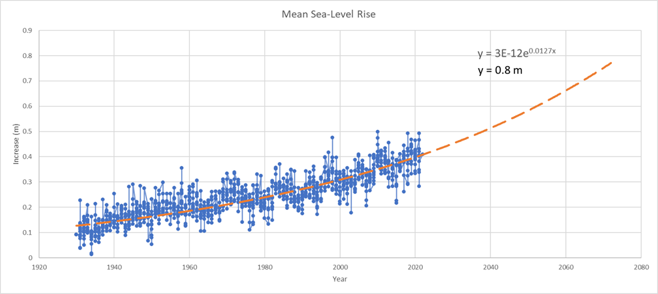
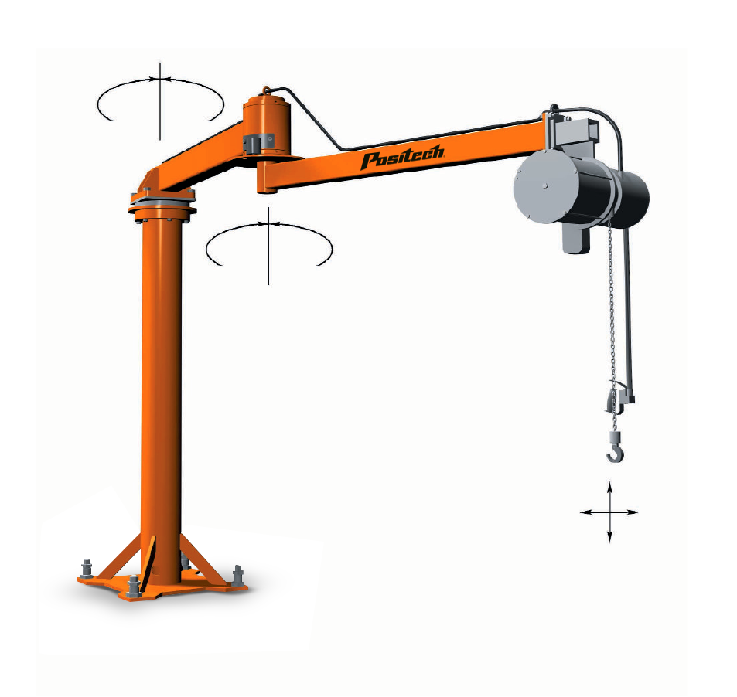
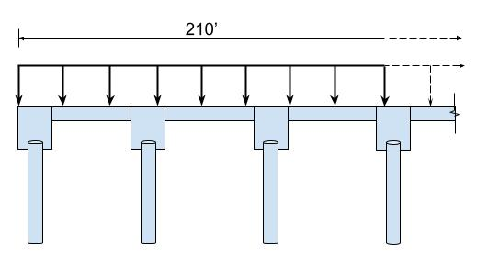
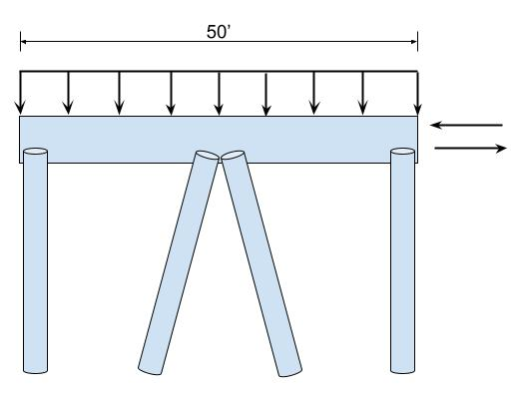
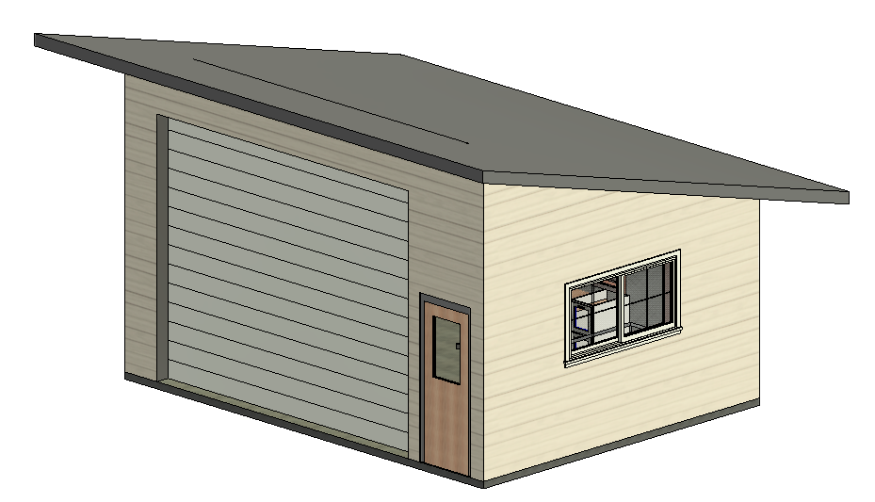
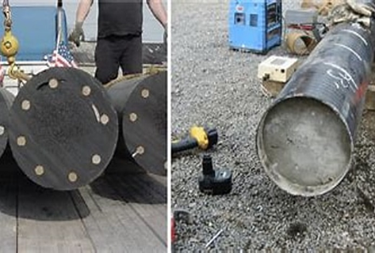
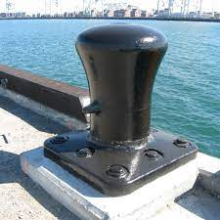
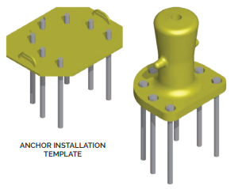
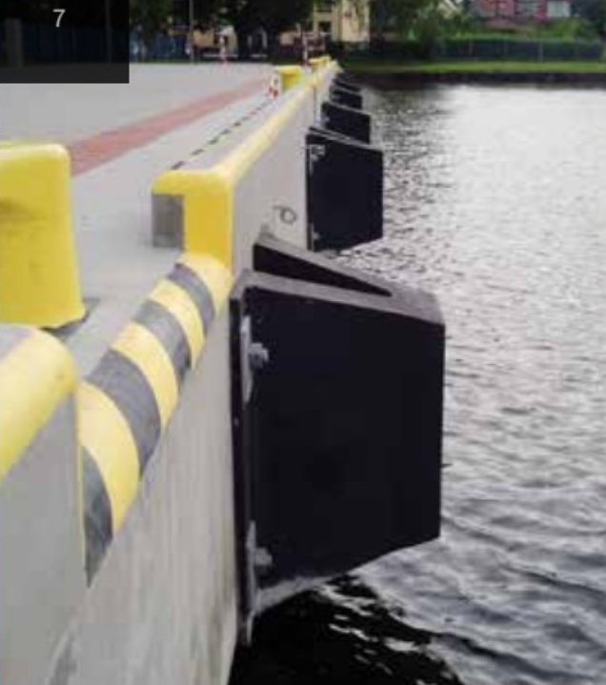
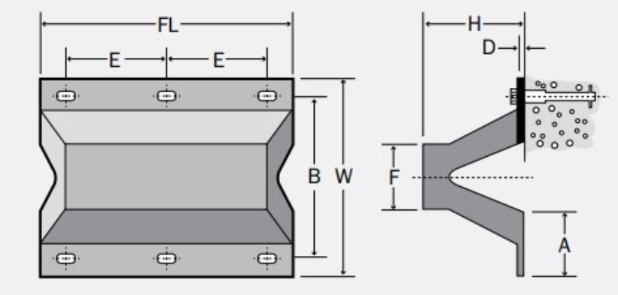
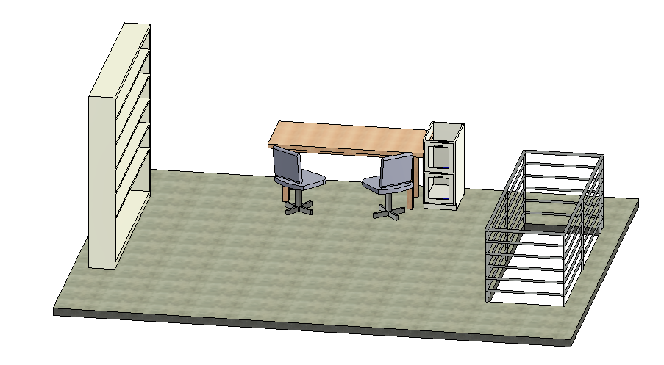
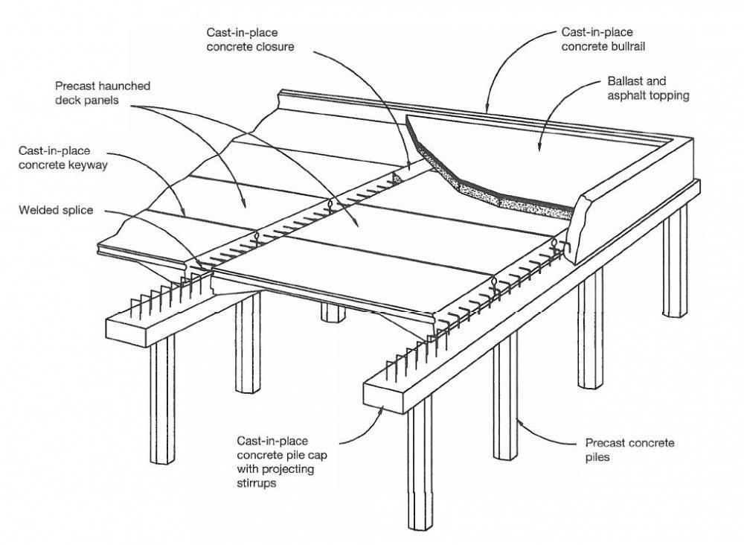
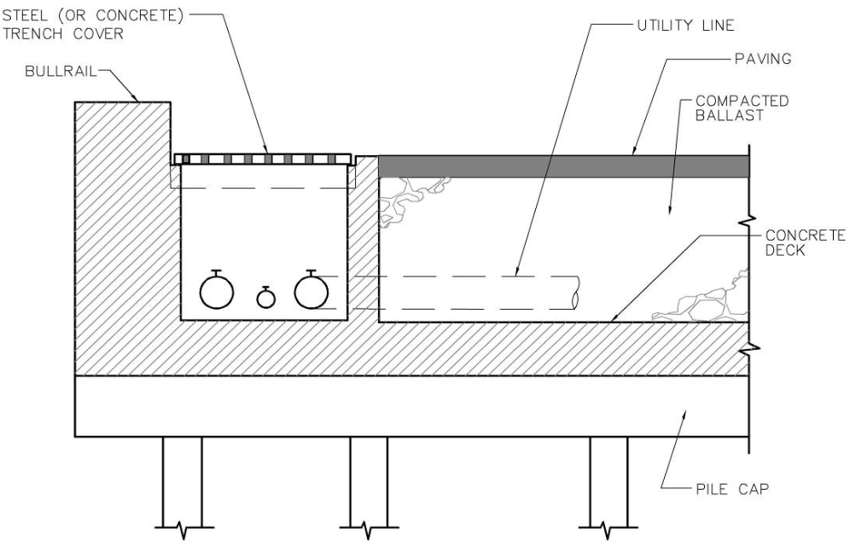
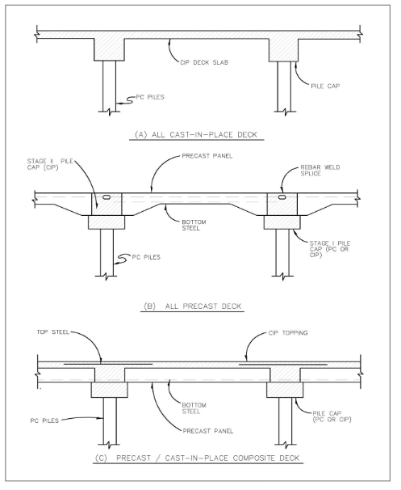
Narragansett Bay Campus (NBC) Pier Reconstruction
Michael Libby, Haley Brown, Dan Bukunt, Chris Piekarski, Sean Van Scoy
Civil and Environmental Engineering, University of New Hampshire, Durham, NH 03824
Introduction
Site Constraints
Loading
The University of Rhode Island has purchased a new 200-foot-long research vessel , the Resolution, which is set to replace their outdated research vessel, the Endeavor . To home this new ship a new pier must be designed and constructed in the Narragansett Bay. The existing pier is over 50 years old and is regularly flooded during high tide or storm events. The current size will not accommodate the new, larger vessel and the anticipated activity on the deck. A small research building and jib crane will be added as well.
Challenges:
Endangered eelgrass patches cannot be disturbed or shaded
The vessel must avoid the southern shoal when docking
A water depth of ~20’ is needed to accommodate large vessels
The sea level is predicted to rise over the pier’s 50-year design life
The current pier width of 36’ feels too small according to URI researchers
The vessel is ~200’ long
UFC LRFD Load Combinations
Gravity Loads
Dead Load
Live Load
Lateral Loads
Mooring Load
Berthing Load
Wind/Wave Load
Ice Load
Current Load
Methodology
Solutions:
Extend the new access trestle and rotate ~10 degrees from the current position. This orientation minimizes challenging winds while avoiding the eelgrass and shoal, and the water depth will be at least 20’.
The deck elevation is +12.5’ above MLLW, which accounts for future sea level rise, without creating problems accessing the vessel at low tide.
The pier deck dimensions will be 210’ by 50’ to provide room for the ship at berth and add more space for URI researchers to work on deck.
The approach to designing the new pier began with thorough research into the client's desired use. This includes the specifications of the vessel as well as their plans for equipment and materials that will be on the structure. Besides live loads, berthing, mooring, and environmental loads will result in larger forces that will need to be resolved through the pier. By determining the demand on the pier and where it acts, structural elements like piles, decking, and mooring fittings can be selected. The capacity of the members is determined and compared to their respective demands to determine a DCR. Keeping the DCR in a target range ensures an efficient and safe design. The layout and cross-section of the pier were determined with constructability and geometric strength in mind.
Elements
Structural Design Calculations
Articulated JIB Crane
5,000 Ibs capacity
20' span
360 ° rotation
Placement: NE Corner
Deck Planks
Flexural capacity
Pile Caps
Flexural capacity
Axial tension capacity
Shear capacity
Materials
Research Station
Single Story
(Dimensions)
14' bay door
Floor cut for water sampling
Placement: SW Corner
Piles
CIP concrete-filled steel
Zinc-galvanized plating
20” dia. Friction piles
Mooring Equipment
Fender System
50T Cast Iron Single Bitt Bollard
Trelleborg SANP 400 E1.2 Arch Fender
Cement | 505 lb/yd³
Fly Ash | 149 lb/yd³
Silica Fume | 42 lb/yd³
W/C Ratio | 0.4
Air Content | 6.5%
Slump | 3-4 in
Water | 202 lb/yd³
28-Day Strength | 5000 psi
Deck
Precast Concrete
High Alumina content
Construction Methods
Acknowledgements
Precast deck panels
Cast-in-place pile caps (poured in 2 stages)
Utility Trench
Above deck
Water, Wastewater, Electricity, Fuel lines
Project Sponsor: Michael Moser, PE
Appledore Marine Engineering, LLC
Project Advisor: Majid Ghayoomi, PhD, PE
University of New Hampshire
References
UFC (Unified Facilities Criteria), Design: Piers and Wharves
AISC (American Institute of Steel Construction) Steel Construction Manual, 15th Edition
ACI (American Concrete Institute). (2019). “Building Code Requirements for Structural Concrete.”
ASCE. 2018. Minimum Design Loads for Buildings and Other Structures. ASCE/SEI Standard 7-10.
Placement: Deck Perimeter

