Slide 1
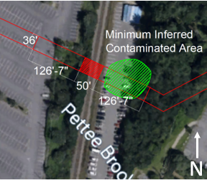
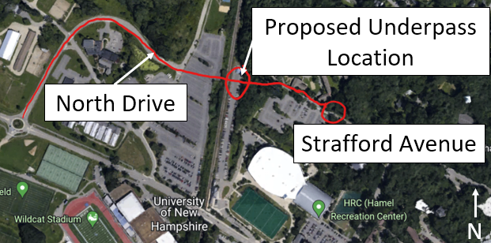
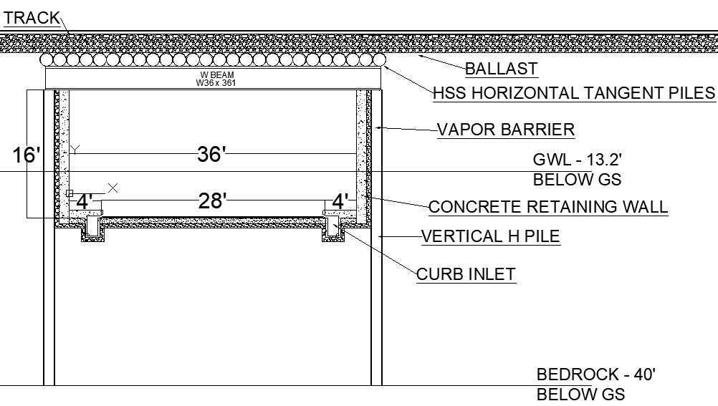
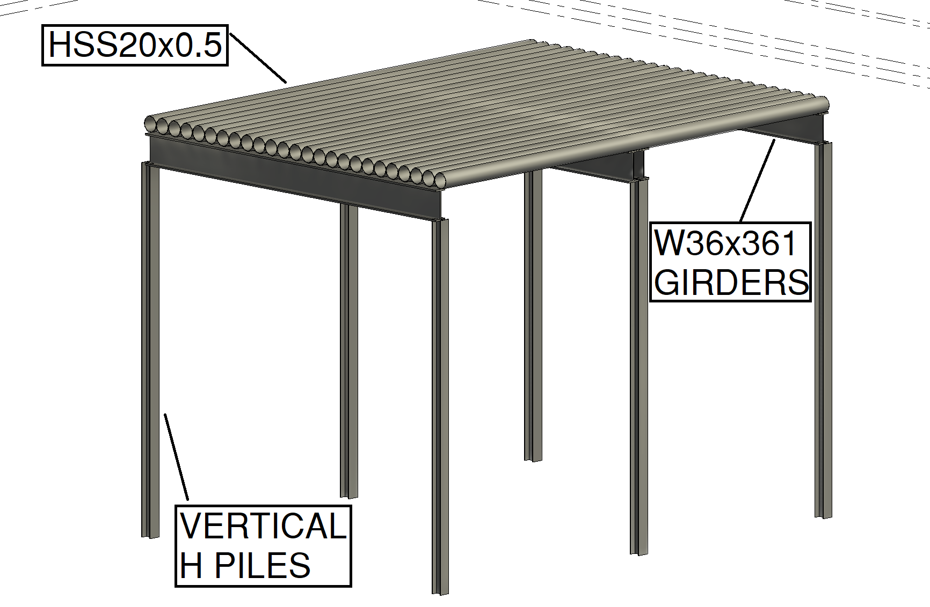
UNH North Drive Underpass
Jack Callinan • Joshua Taranto • Max Regan • Jack Regan, Department of Civil Engineering
James Wieck, P.G., Erik Dyrness, Project Advisors • Dr. Kyle Kwiatkowski, Faculty Advisor
Project Sponsor: GZA GeoEnvironmental Inc.
Project Description
PCE and Soil Management
Stakeholder Outreach
Project Location:
Durham, New Hampshire connecting North Drive and Strafford Avenue, Travelling under the Boston-Maine Railway.
Project Goals:
Alleviate heavy traffic on Main street in Durham.
Allow for pedestrian traffic between UNH’s Gables and Woodsides.
Maintain continuous railway service.
Management of prior brownfield site contaminants under the build site, primarily Tetrachloroethylene (PCE).
Allow for future growth of the B&M railway by building a second railway beside the first.
Project Challenges:
On-site PCE contamination during and after construction.
No track diversion, requiring a live railway during construction.
Strict tolerances on soil displacement required by the railway company.
Shallow bedrock and ground-water level.
Large number of Stakeholders.
PCE Contamination Management:
6,000 cubic yards of soil will be excavated for the underpass and transported offsite via 588 15-ton truck loads.
The high groundwater level also means dewatering will have to occur on-site, which will be pumped and managed on-site.
Continued Management:
Will use a vapor barrier comprising of 6" of gravel and a 6mm polyethylene wrap to prevent PCE infiltration into the underpass.
Stakeholders:
University of New Hampshire
Town of Durham.
Eversource.
PanAm Inc.
Amtrak.
Communications Plan:
Information such as work schedules or vibration monitoring will be sent out on given intervals or continuously to each stakeholder. All hands meetings between stakeholders will take place at specific project milestones.
Figure 1: Project Locus View
Figure 2: Inferred Soil Contamination
Structural Specifications
Required Permits
Remediation General Permit (RGP).
As part of the RGP, a Best Management Practice Plan (BMPP) will be assembled and followed.
Alteration of Terrain Permit (AoT).
Applicable to construction in locations of greater than 25% grade or an open body of water.
Relevant Town of Durham permits.
Figure 3: Underpass Cross-section
Figure 4: Steel Frame View 3D
Cost Estimation
Project Cost:
Contamination management costs:
$6.85 million
Construction costs:
$2.78 million
Total: 9.63 million
Project Timeframe: ~174 Days
Figure 5: Underpass Elevation View
Steel Frame Specifications
2 Sets of 22 HSS20x0.50 horizontal Piles, each spliced together at 25' resting on W-shape girders.
4 W36x361 girders spanning 40'.
Lateral bracing for girders at 10'.
Trenchless Design Method:
The live railway on top of the build-site and presence of shallow bedrock requires a trenchless design method. For this project, a drilled horizontal tangent pile system will be utilized in order to support the railway during excavation.

