Slide 1

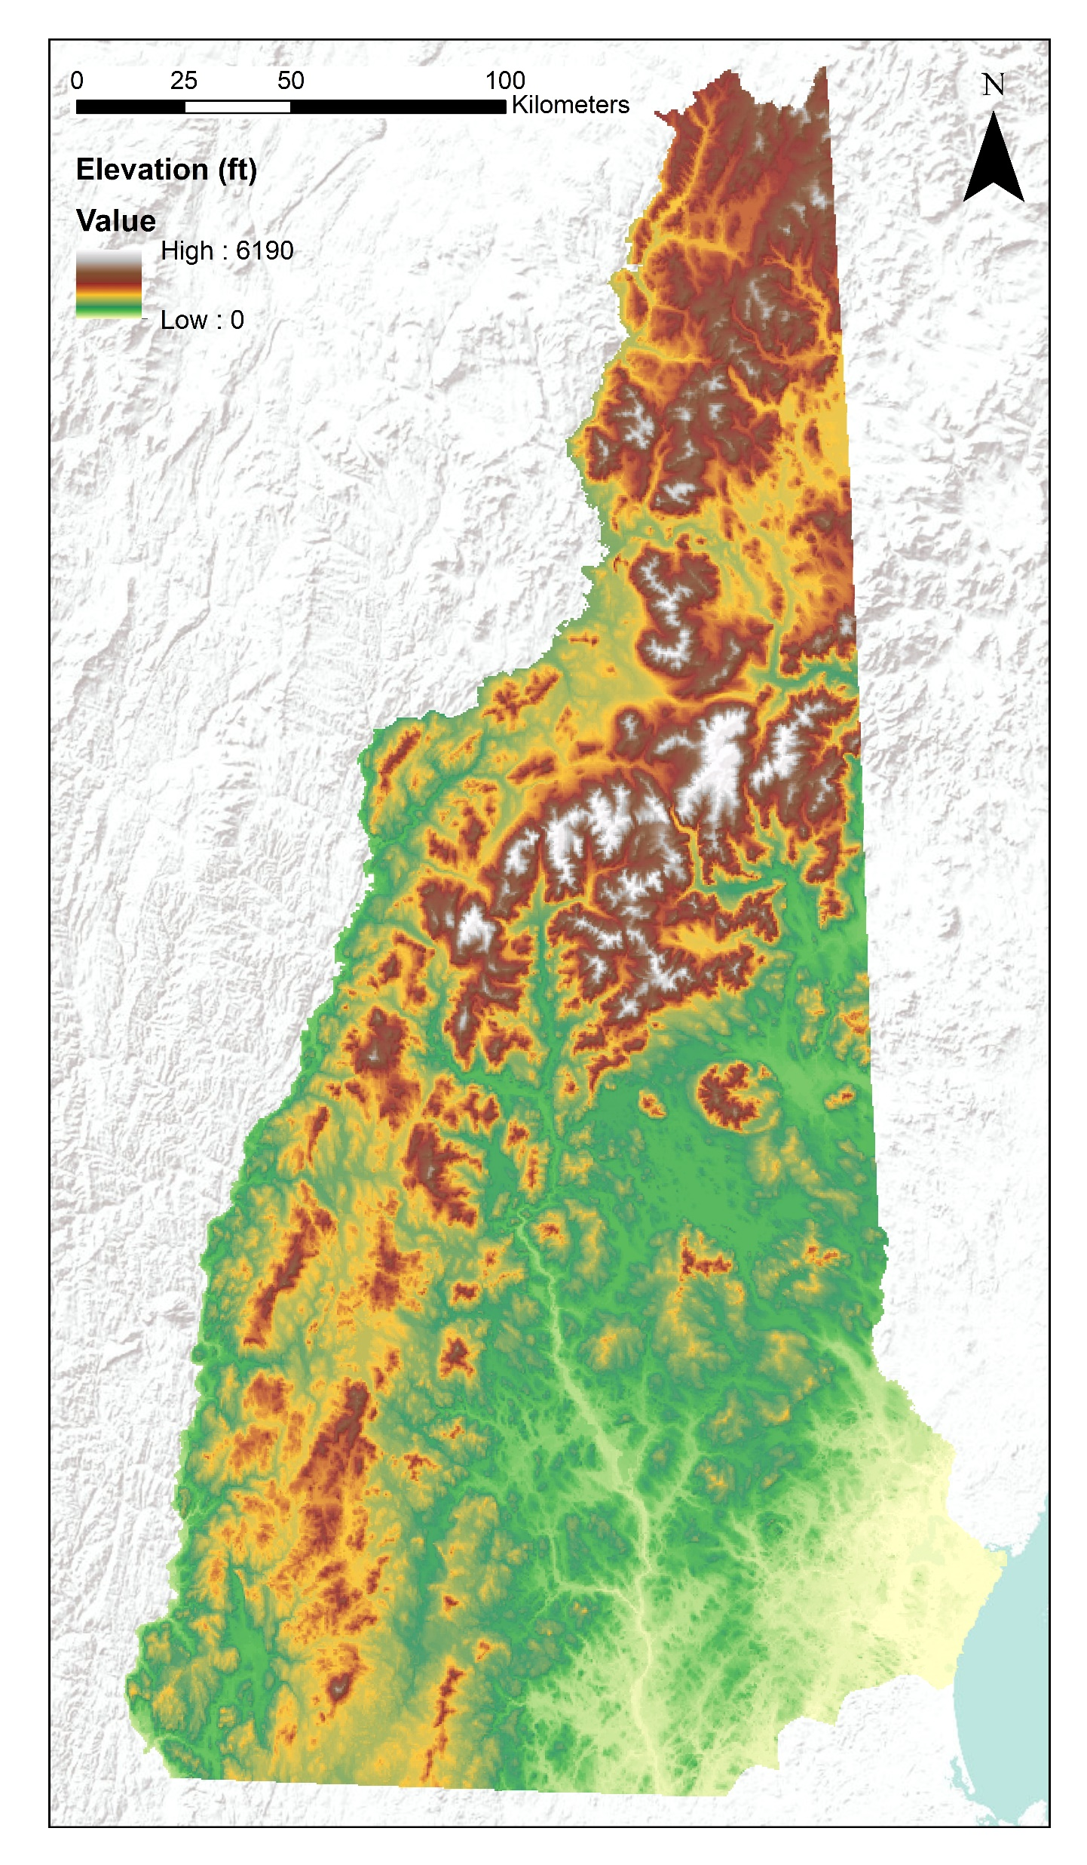

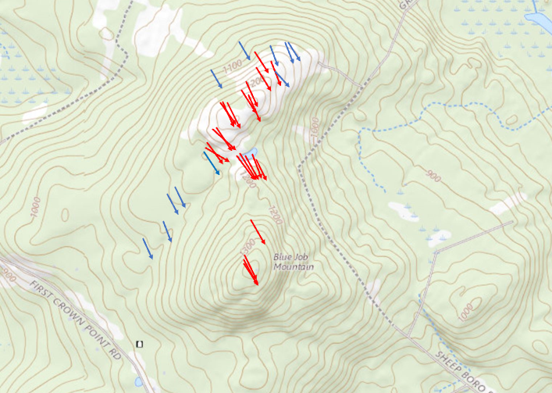
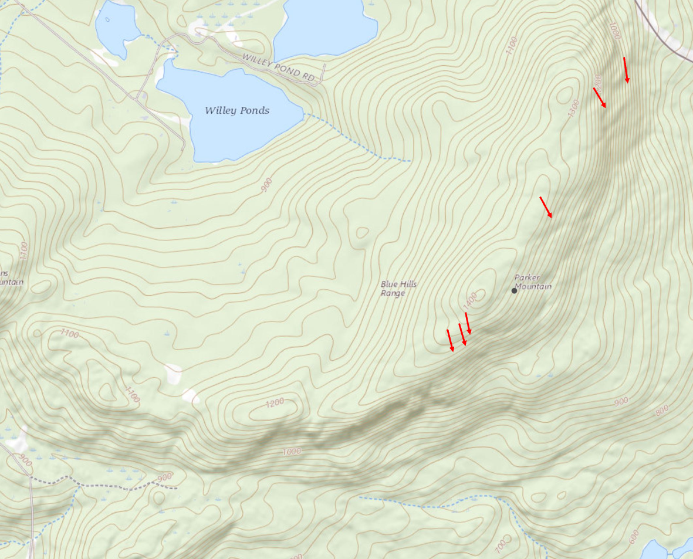
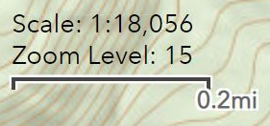
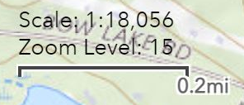
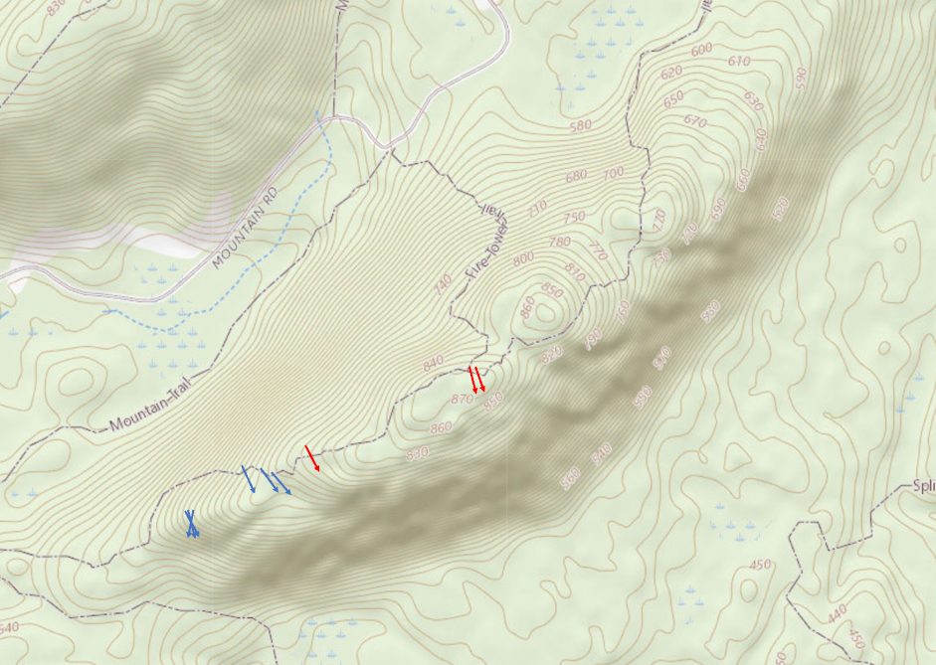
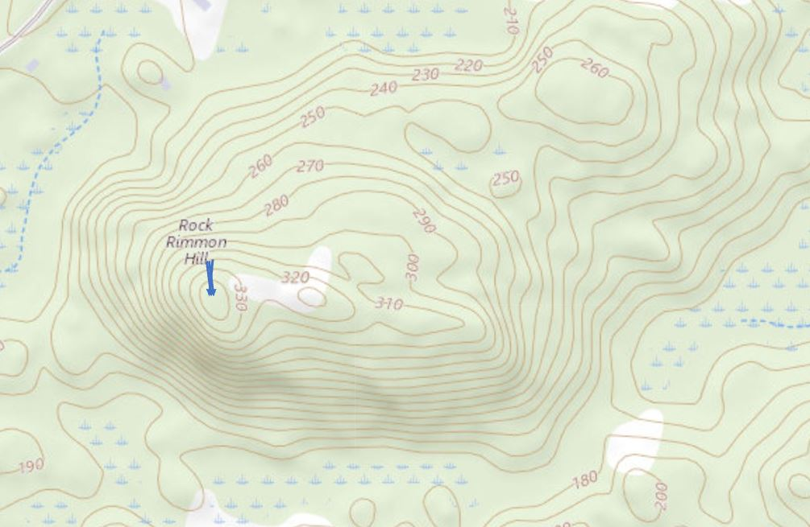

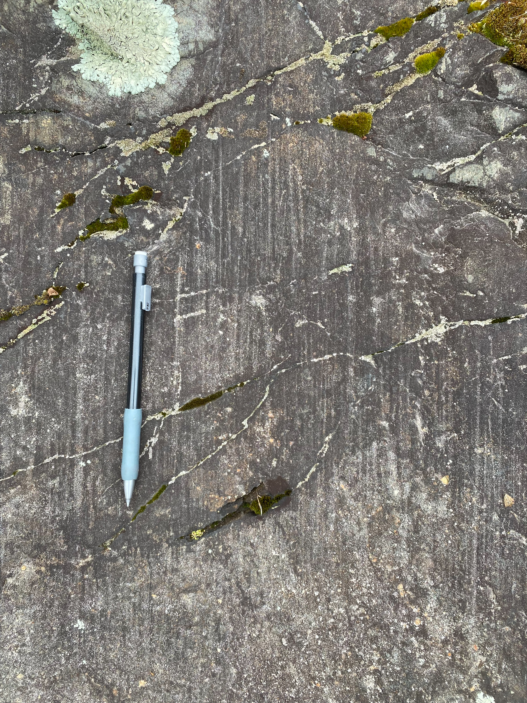
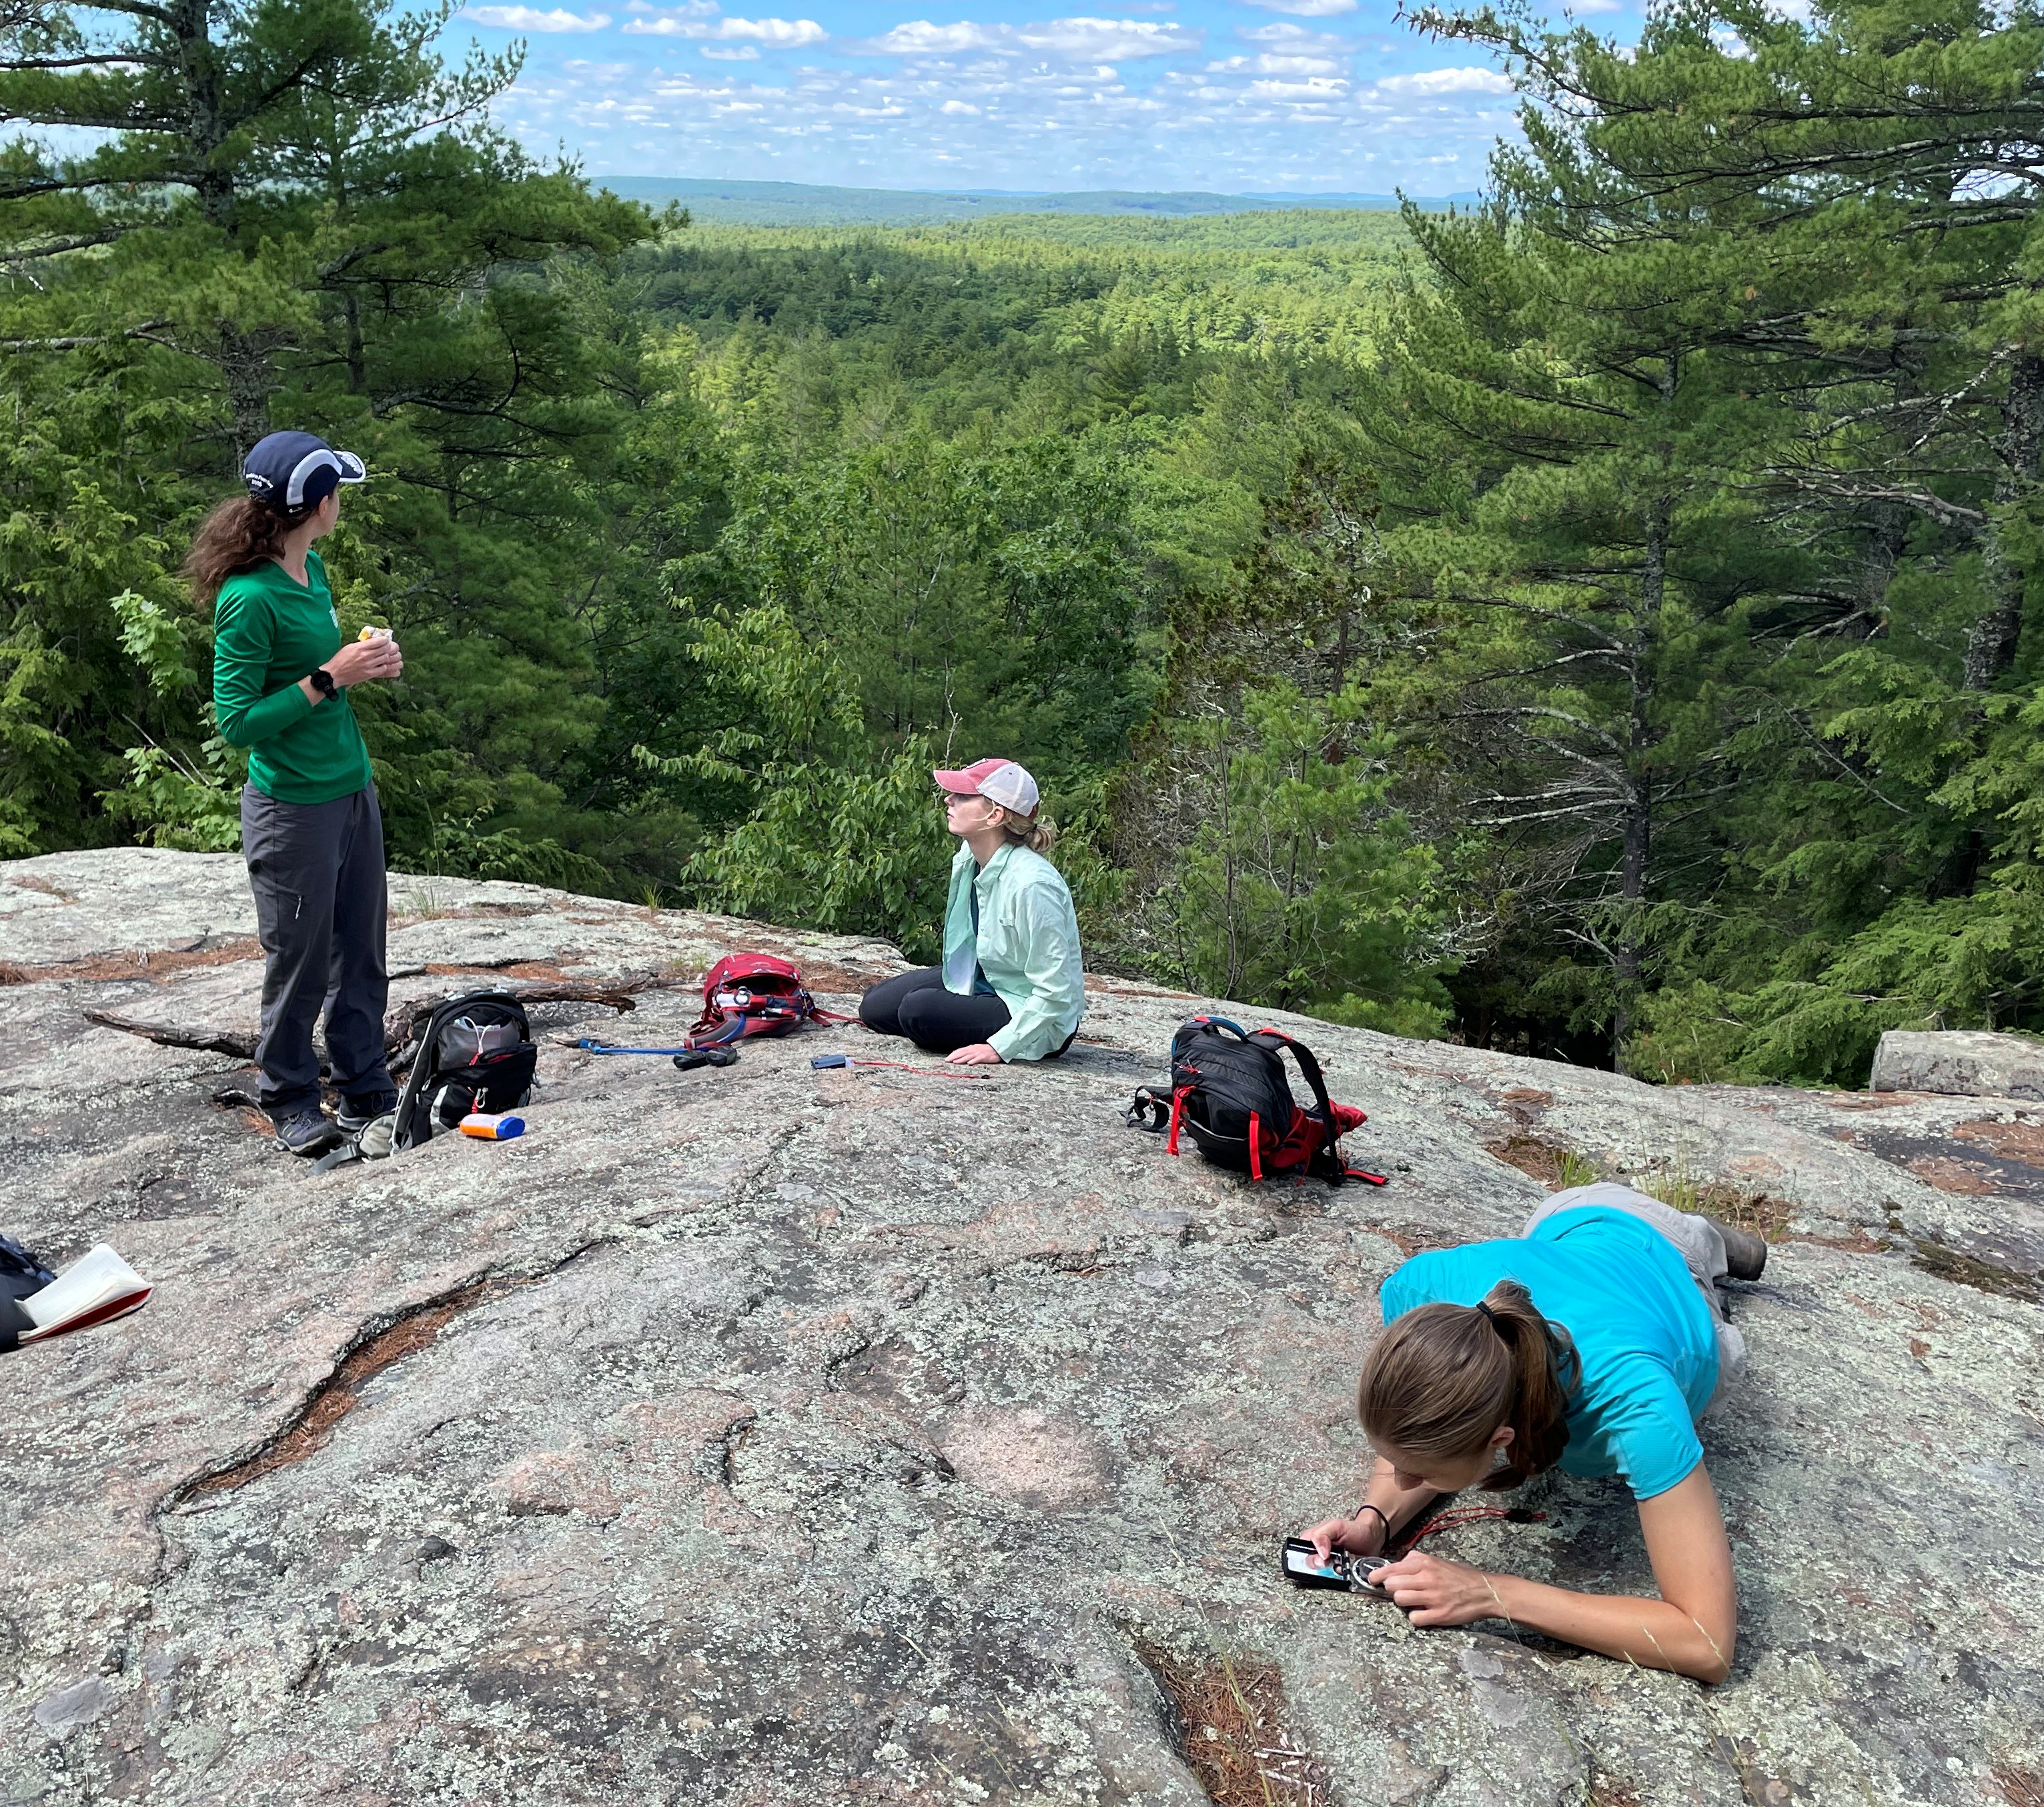

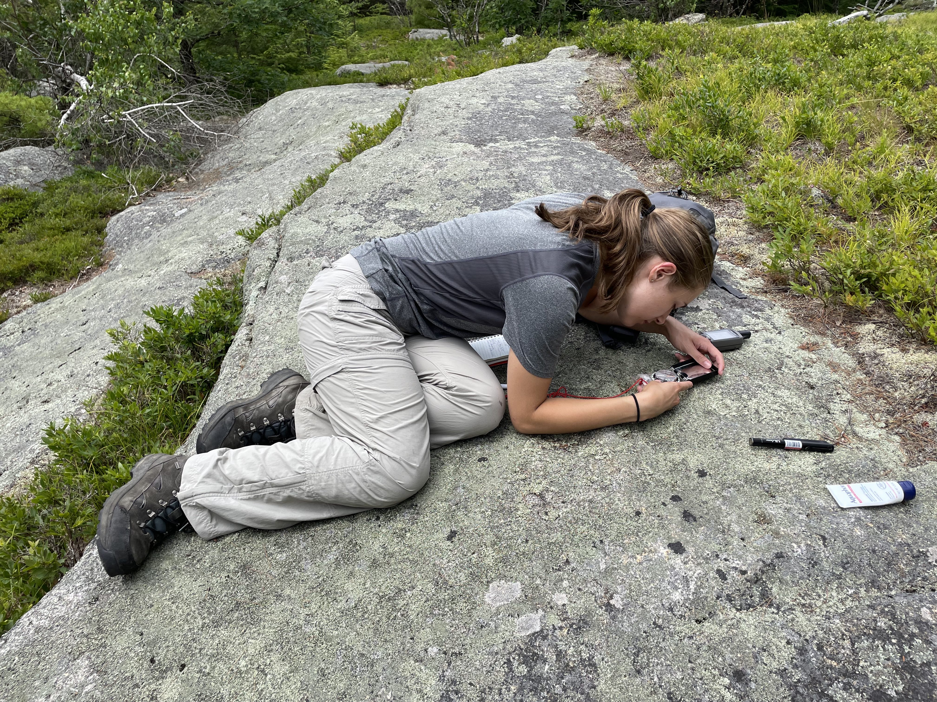
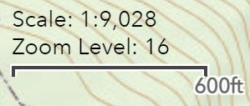
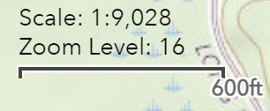
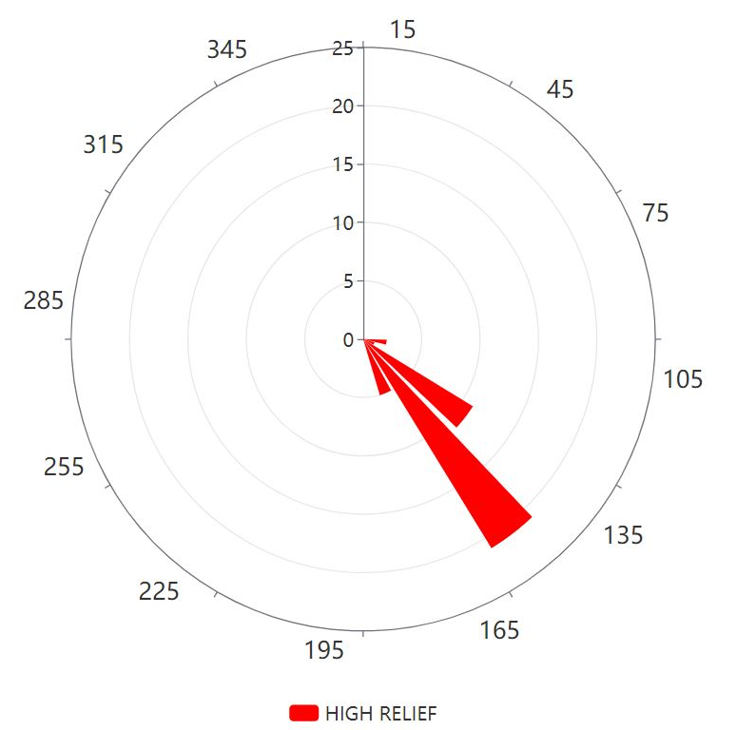
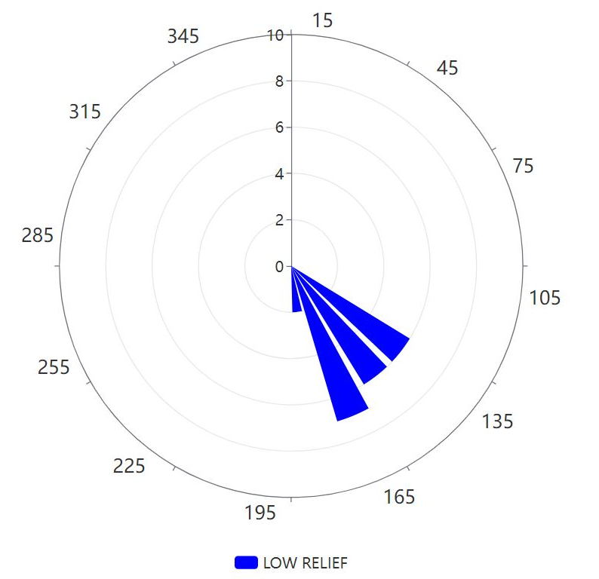
Using Glacial Striations on Bedrock to Determine Ice Flow Behavior During the Last Deglaciation in the New Hampshire Seacoast Region
Arielle A. Kotulak and Joseph M. Licciardi
University of New Hampshire, Department of Earth Sciences
1. Introduction
Approximately 15,000 years ago, southern New Hampshire became ice-free as the Laurentide Ice Sheet (LIS) margin retreated northward (Dalton et al., 2020). While the timing of glacial retreat is documented in regions both north and south of the New Hampshire Seacoast, detailed knowledge of ice recession in the Seacoast is limited. Here, we reconstruct former ice flow patterns by mapping glacial striations in bedrock at sites distributed across this region. We test the hypothesis that striation directions registered across a range of altitudes are indicative of ice thickness and activity during retreat; we consider two main schools of thought, which are highlighted in Section 2 (Conceptual Approach).
3. Site Locations
High Relief Striation
Low Relief Striation
Legend
6. Mapped Striations
A
A
Blue Job Mtn.
B
B
Parker Mtn.
A
Blue Job Mountain
Parker Mountain
B
C
Pawtuckaway South Mtn.
D
Rockrimmon Hill
C
2. Conceptual Approach
There are two predominant hypotheses regarding glacial erosion while the ice sheet was thin: (1) parallel striations at all elevations would suggest that glacial erosion in the Seacoast occurred only while the ice sheet was very thick (>1 km) and its flow was minimally affected by topographic irregularities, and that this may have been followed by ice stagnation and downwasting; (2) striation orientations that vary by elevation (with more divergence at lower elevations) would suggest that the ice sheet was flowing around topographic highs and that significant glacial erosion was still actively occurring after the glacier had thinned.
D
Fig. 1 Topographic map of New Hampshire.
Fig. 2 Distribution of field sites. White arrow represents general regional ice flow direction (Goldthwait et al., 1951). Smaller blue arrow represents an average ice flow measured by our group in Durham, NH.
C
Pawtuckaway South Mountain
D
Rockrimmon Hill
186 Degrees
4. Field Methods
173 Degrees
TIME: ~25 ka
Striations Created ~25 ka
Striations were typically measured on quartz veins due to their tendency to resist weathering and preserve striations. The compass is oriented directly above the striation and the azimuth direction is recorded. Additionally, a hand-held GPS is used at each location to record coordinates and elevation.
Ice Sheet (Thick, >1km)
High Relief Striation
Low Relief Striation
175 Degrees
Ice Flow Direction
~2 cm
Ice Flow Direction
Note: Rockrimmon Hill is a relatively small hill with only four measurements taken in one geographically limited location of low relief.
Fig. 3 A compass, a flashlight (used to help catch striations in the light, making them easier to see), and a handheld GPS (top left).
Figure 8. Arrows representing individual striation directions mapped at each site.
Fig. 4 Striations found on bedrock in Durham, NH.
A total of 63 striation measurements were recorded and plotted at their respective locations (a few striations that overlap and have the same general direction were omitted for clarity). Because this is a small-scale study, the quantity of measurements taken at each site is not sufficient to enable a comprehensive visual representation of ice flow across topographic features in this region. Nonetheless, our compiled striation data clearly show greater dispersion at lower relief sites (Figures 5, 6, 7), but more data are necessary for this to be visually evident on a site-by-site basis. For example, Blue Job, our most well-documented site, holds most of its low-relief measurements in the valley between the two peaks. In another example, all striations recorded at Rockrimmon Hill come from a small area near the summit and exhibit the most southerly orientations in our data set.
For future research, we could seek to record measurements surrounding entire topographic units, especially on the up-ice sides of hills as this is where ice flow would begin to diverge. A study conducted in Vermont displayed striation results in a similar fashion (though with considerably more data) and documented a clear trend toward topographic confinement of the LIS (Wright, 2015). As such, we predict that a more thorough evaluation of our sites would further confirm this same pattern in New Hampshire and allow us to gain a fuller picture of localized ice flow in the Seacoast region.
Glacial erosion when the ice sheet was thick. All striations are parallel, indicating the ice sheet was thick enough for its flow to be unaffected by topographic highs.
5. Results – Striation Distribution at High vs. Low Relief
(1) Ice Stagnation and Downwasting
TIME: ~15 ka
Expected Striation Evidence for Stagnation
High Relief Striation (made when ice was thick ~25ka)
Low Relief Striation (made when ice was thick ~25ka)
Ice Sheet (Thin, <1km)
Figure 7. Distribution of striation direction at all elevations (n=63).
7. Conclusions
Striation orientations vary more at lower relief levels than at higher relief levels, indicating topographic controls on ice flow when the ice sheet was thin.
Our data strongly suggest that the LIS was actively flowing and eroding the landscape as it thinned, rather than stagnating and downwasting.
More data are needed to provide a comprehensive picture of ice flow surrounding topography, especially in areas up-ice of topographic highs.
Melting
Striations were compiled into two categories: high relief and low relief, as defined by the range of relief within our data set (45m-175m). At left, these are plotted on azimuth rose diagrams displaying the distribution of orientation data. Note the difference in scales of the two plots. The average directions of ice flow at high and low relief are 154 degrees and 155 degrees, respectively. The nearly identical averages indicate generally consistent ice flow direction throughout the range of elevations. However, Figure 7 clearly displays a significantly higher dispersion at lower relief levels, which reflects that ice flow direction was impacted by topographic confinement while the ice sheet was thin. This implies the ice sheet was still actively eroding the landscape while it was thin enough to be affected by topography (see Section 2: Active Flow Conceptual Approach).
Figure 5. Distribution of striation directions at high relief (n=40)
(2) Active Flow
TIME: ~15 ka
Expected Striation Evidence for Active Flow
High Relief Striation (made when ice was thick ~25ka)
Low Relief Striation (made when ice was thin ~15ka)
Acknowledgements
We thank Alia Lesnek¹, Calen Rubin², and Julia Brazo² for assistance in field data collection and discussion.
¹Queens College, CUNY, Queens, NY. ²University of New Hampshire, Durham, NH.
Ice Sheet (Thin, <1km)
References
Dalton, A.S., et al., 2020. An updated radiocarbon-based ice margin chronology for the last deglaciation of the North American Ice Sheet Complex. Quaternary Science Reviews, Vol. 234, 15p. and map.
Goldthwait, J.W., Goldthwait, L. and Goldthwait, R.P., 1951. The geology of New Hampshire: Part 1 – surficial geology. New Hampshire State Planning and Development Commission, Concord, 81p. and map.
Wright, S.F., 2015. Late Wisconsinan ice sheet flow across northern and central Vermont, USA. Quaternary Science Reviews, Vol. 129.
Ice Flow Direction
Figure 6. Distribution of striation directions at low relief (n=23)

