Slide 1
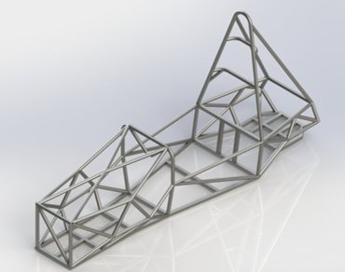
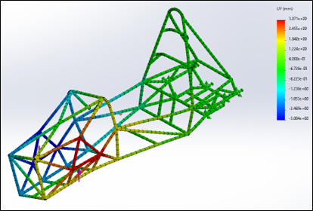
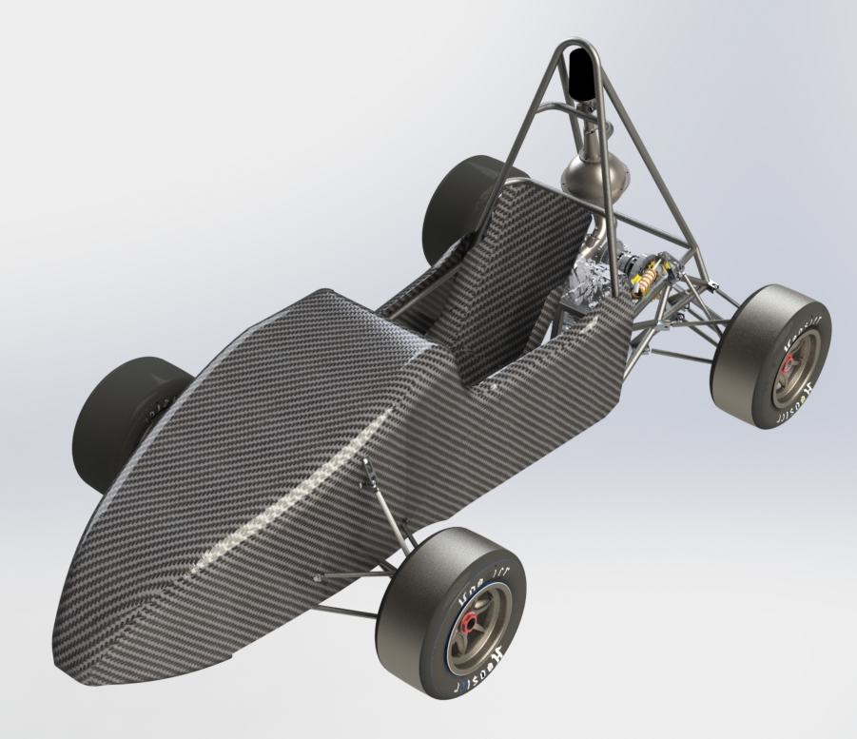
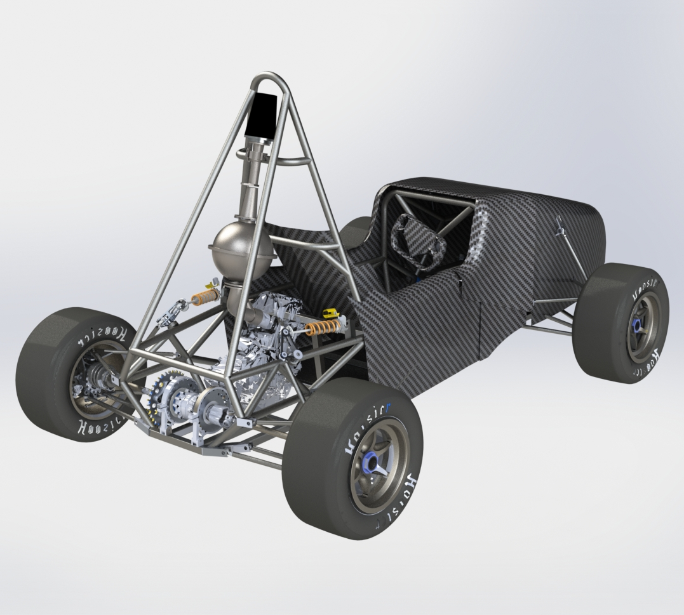
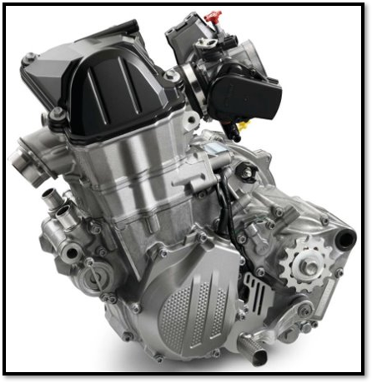
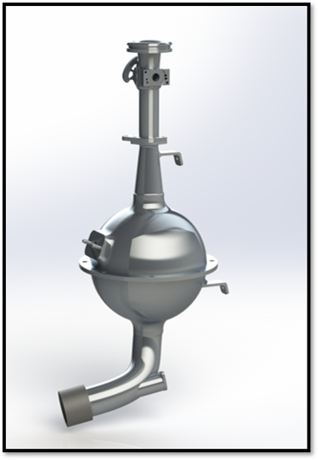
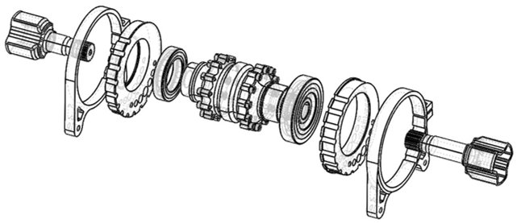
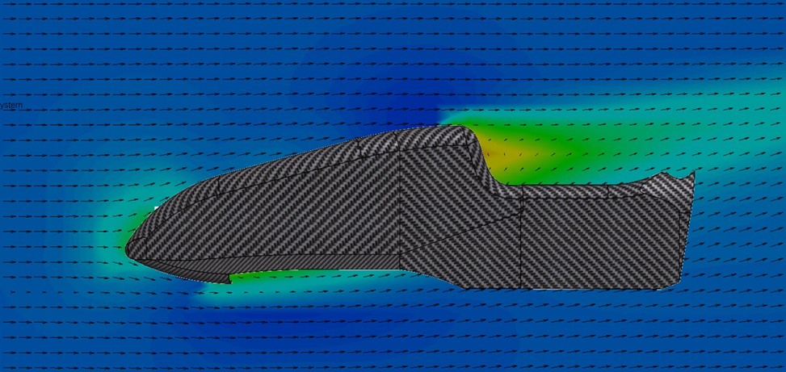
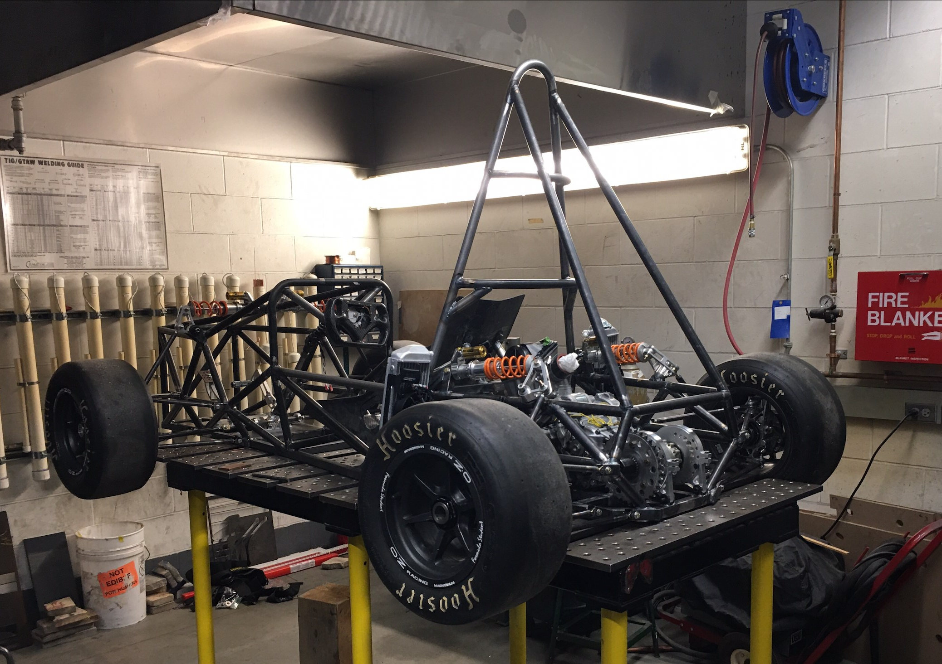
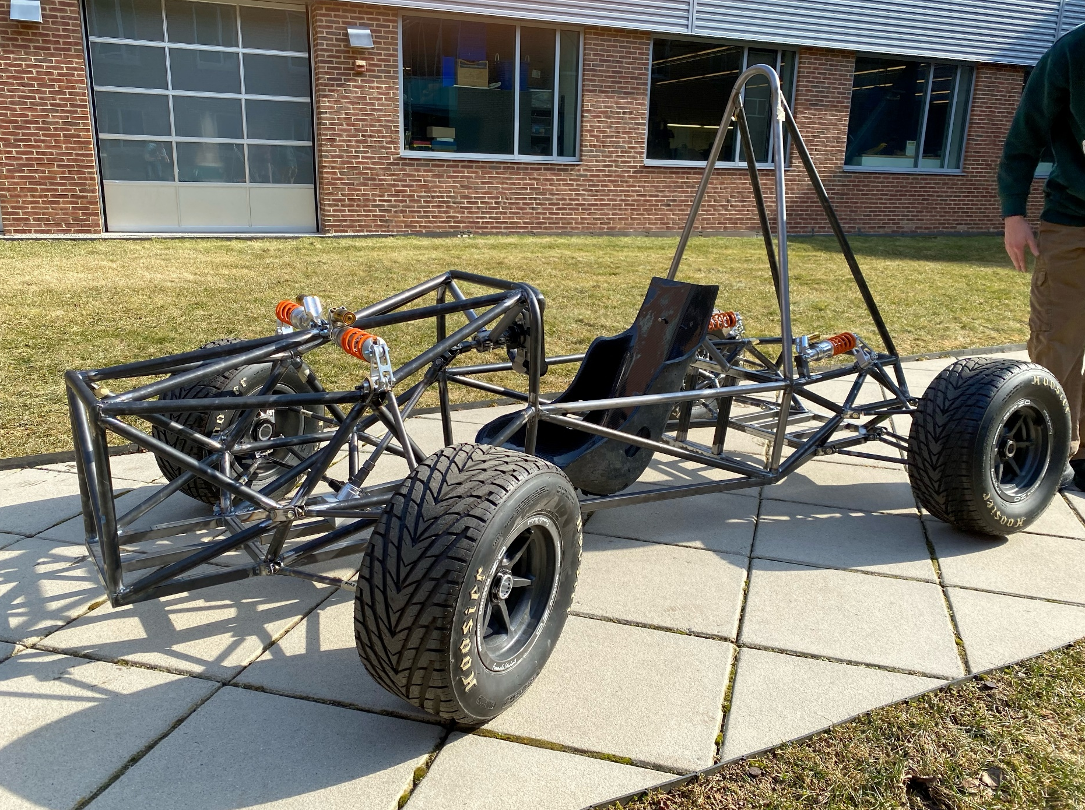
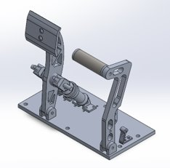
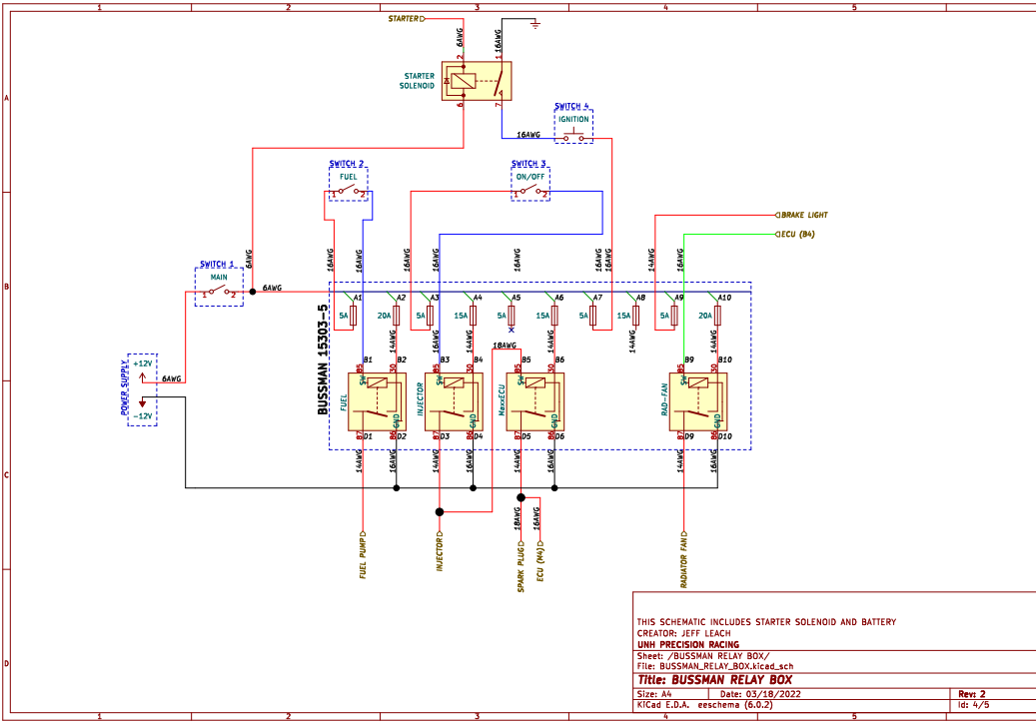
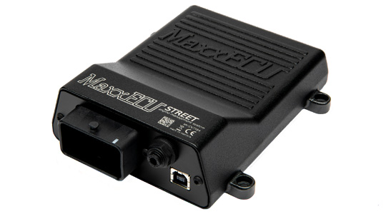
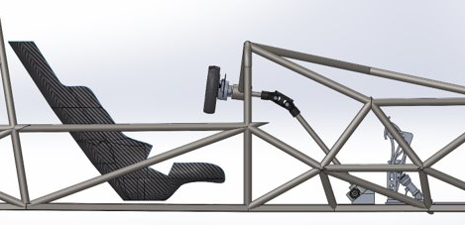
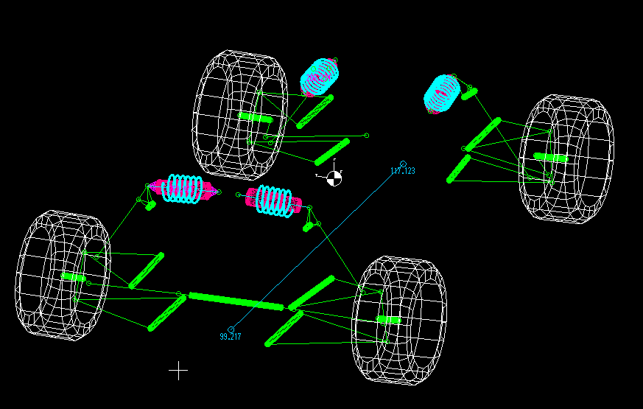
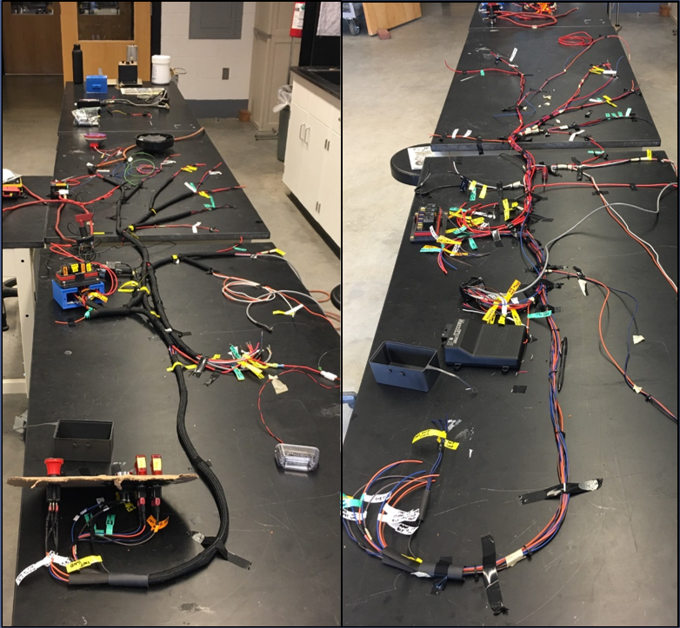
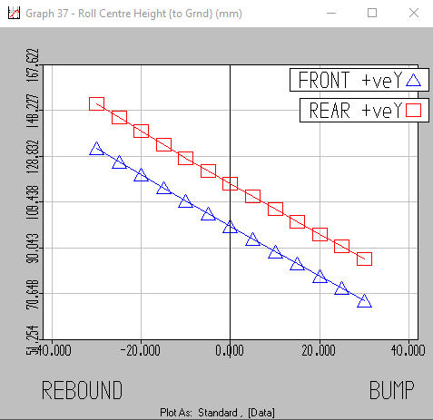
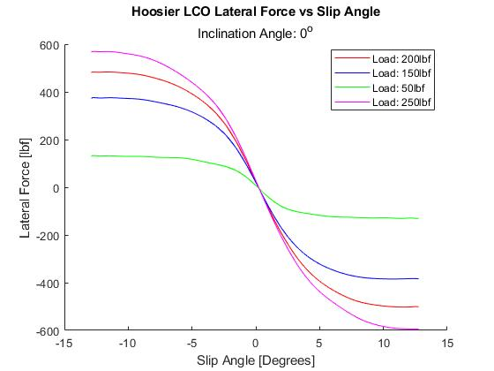
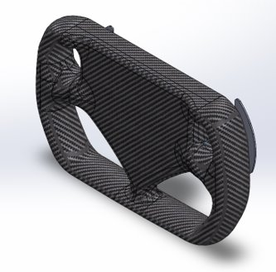
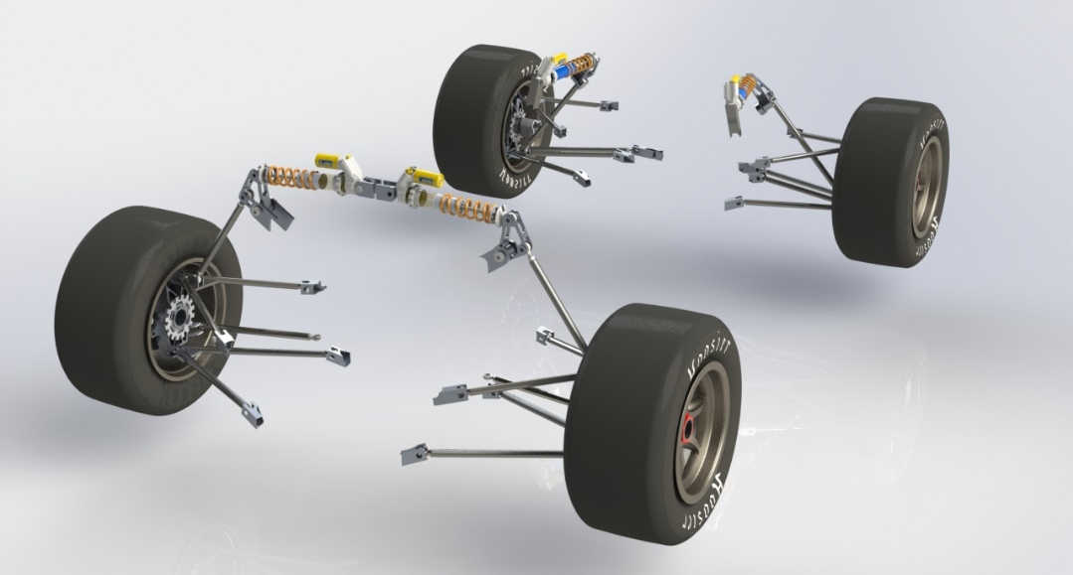
UNH Precision Racing Team 2021
Frame
College of Engineering and Physical Sciences
Mechanical Engineering Department
Powertrain
Design Goals
Torsional stiffness greater than 1500 [Nm/deg]
Maintain weight less than 100 lbs
Effectively maximize space for the driver, powertrain, suspension, and controls
Meet all structural qualifications outlined by the SAE structural equivalency survey
Manufactured design
TIG welded AISI 1020 steel tube members
Torsional stiffness equal to 1,831 [Nm/deg]
Weight of manufactured frame equal to 89lbs
Allows for optimal suspension attachment
Fits a driver of the 95th percentile
Adheres to SAE rules to ensure driver safety
Team Members
Project Managers: Brian Schwab, Gregory Keeler, Jeffrey Leach
Controls: Robbie Dowst, Anthony Ferraro
Frame: Brian Schwab, Gregory Keeler
Electronics: Jeffrey Leach
Powertrain: Jackson Perry, Edward McLellan
Suspension: Jeffrey Leach
Bodywork: Jaret Armstrong, Gregory Keeler
Faculty Advisor: Todd Gross
Engine
2016 KTM 450 SX-F
Max Torque : 34lb-ft @ 7000 RPM
Max Power: 53 HP @ 9500 RPM
Naturally aspirated, 100 Octane
High torque at low RPM's and linear power curve makes driving easier for inexperienced drivers
Drivetrain
Chain Drive
Drexler Limited Slip Differential
RCV Half-Shafts
Aluminum differential designed to allow tightening of the chain using an eccentric disk concept, various locking points.
Intake Manifold
3000 cc plenum
Utilize AT Power's FSAE throttle body with built in restriction diameter
Made from ABS printed plastic, experimenting with titanium printing.
Runner length of 264 mm with a single 42 lb./hr. injector firing directly at the intake valves.
Bodywork
Process breakdown
Design bodywork/nosecone in SOLIDWORKS around chassis & suspension
Create mold for bodywork panels and nose cone out of foam
Carbon fiber wet layup with vacuum bagging
Attach bodywork to chassis using quick release quarter-turn fasteners
Mold construction and materials
XPS Insulation Foam
Bondo Body Filler
Hexcel Fiberglass Plain Weave 2.1oz/71gsm
Carbon fiber layup with vacuum bagging:
Carbon Fiber Fabric - 4x4 twill 3k 8.3oz/281gsm Toray T300
Thin- 2:1 two-part thin epoxy resin system
Suspension
4.9 µm surface roughness @ STP, 40 mph, observed area of 0.3838 $m^{2}$, Cd = 0.3770
Purpose
Resist chassis roll – maximize tire contact patch with road
Roll center placement prioritizing responsiveness
Minimize roll center migration, increase stability/predictability
Select coilover to achieve desired ride frequency and roll rate
Adjustability: static camber, ride height, toe angle
Geometry Selection
Double wishbone, Short-Long Arm (SLA), pushrod actuated
Rear bell-crank repositioned out-of-plane to improve packaging
Component Modeling & FEA
SolidWorks 3D modeling - FEA and kinematics in MSC Marc Mentat, MATLAB, & LOTUS Shark
Calspan tire data used to predict dynamic forces
Manufacturing
Waterjet in Olson Center, finish machining in CEPS machine shop, TIG welding
Controls
Electronics
Pedal Assembly
6061-T6 Aluminum components withstand 2000N (450 lb-f) force from the driver.
Vertically mounted master cylinders optimize packaging, braking force, and pedal travel.
Safety Considerations
6-point harness holds driver securely in place.
No part of the driver can contact the ground.
Impact attenuator on the front of the car absorbs impact forces.
Steering Column
Utilizes double universal joint designed for automotive steering shafts
Rack mounted behind the front axle to improve Ackermann Steering.
Cooling
Dual radiators on sides of car increase cooling.
Brakes
Racing quality rotors, calipers, lines, and pads increase braking capabilities.
Engine Management
MaxxECU STREET standalone Engine control unit
Single injection for better trigger sensing and atomization
Variable Reluctance crankshaft position sensor
Ignition cut for launch control and shifting
Wiring Harness
Schematics created in KiCad
Breaker protected circuits for easy reset and short protection
Bussman relay/fuse box for improved organization and trouble shooting
Deutsch connectors for IP67 protection and high cycle life
Crimped wire connections for greater strength than solder
Roll Center Height to Ground (mm)

