Slide 1



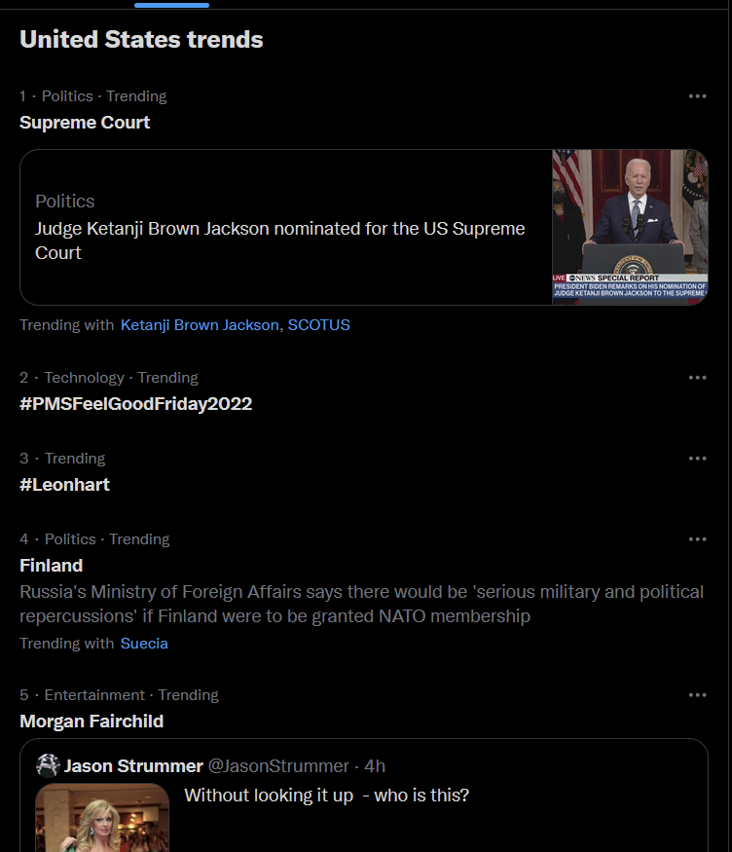
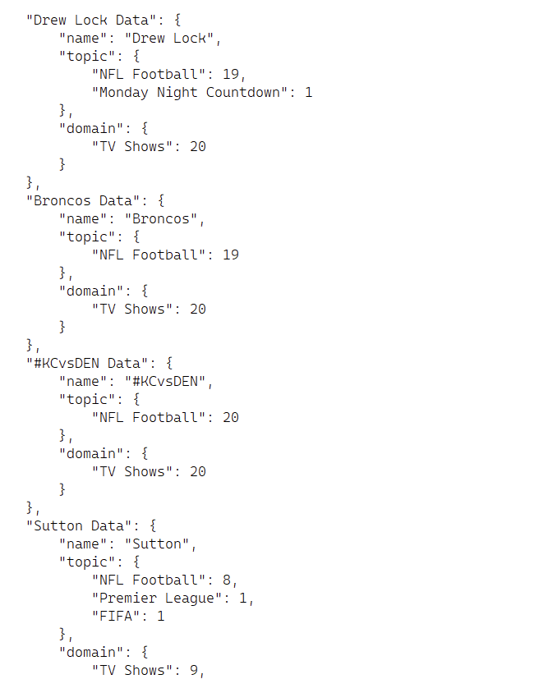
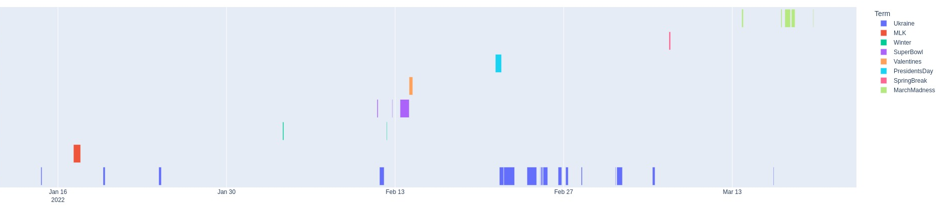
TWITTER FOR YOU: CORRELATION MAJOR EVENTS AND THEIR TRENDING DATES
BY: ALANA BURCH &
MEGAN SORETTE
INTRODUCTION
RESEARCH QUESTION/HYPOTHESIS
RESULTS
Twitter is a social networking service, created by Jack Dorsey, Biz Stone, Evan Williams, and Noah Glass in 2006. In 2008, the trending tab was created, showing users current events and news.
Topics “trend” based on the concentration of tweets in a short amount of time. Their rank on the trending tab is also determined by this method.
Holidays/big events trend as well. But how long do they trend for? Do they trend before the event happens or even after the event is over?
Our Research Question:
    ◌ What does the Twitter trending tab denote as
    major events/times of year?
Our Hypothesis:
    ◌ More global events (e.g., Ukraine) will trend for longer, as opposed to
    more national events (e.g., Presidents’ Day).
The goal is to collect currently trending topics, categories/related topics
to the event, and the date of collection.
The graph shows that these events trend:
Ukraine › January 14 – March 17
Martin Luther King Jr. Day › January 17 – January 18
The Winter Olympics › February 4 – February 12
The Superbowl › February 11 – February 14
Valentine’s Day › February 14 – February 15
Presidents’ Day › February 21 – February 22
Spring Break › March 8
March Madness › March 13 – March 20
CONCLUSION
METHODOLOGY
SCRIPTS
Our hypothesis, which states that global events will trend for longer, as opposed to national events, has proven to be false.
Regardless of how global the events were, they all trended for a shorter amount of time than their official allotted time.
One-day events, like Valentine’s Day and Presidents’ Day, started trending at their official allotted time and ended a day after, presumably because of the time difference between Twitter users.
Multiple-day events, like the Winter Olympics and March Madness, however, started trending past their official start date and ended before their official end date.
The times of year/events that will be studied are:
- Ukraine (February 24 – present)
- Martin Luther King Jr. Day (January 17)
- The Winter Olympics (February 4 – February 20)
- The Superbowl (February 13)
- Valentine’s Day (February 14)
- Presidents’ Day (February 21)
- Spring Break (last March – early April)
- March Madness (March 13 – April 4)
Data is collected using Twitter’s Standard API to access raw trending information. Python scripts were created to parse and format the data collected from Twitter (Figure 1). The scripts currently run every hour on a Virtual Machine, fully automating the process.
(Figure 1) Twitter trending data that will be parsed through Python scripts.
REFERENCES
Twitter API Standard v1.1 : (https://developer.twitter.com/en/docs/twitterapi/v1)
Twitter API v2 :
(https://developer.twitter.com/en/docs/twitter-api)
GRAPH

